Slide 1



SMART INDIA HACKATHON 2025
Digital Twin for CO₂ Capture in Urban Settings
Problem Statement ID - SIH25222
Problem Statement Title - Digital Twin for
CO₂ Capture in Urban Settings
Theme - Clean & Green Technology
PS Category - Software
Team ID - 67595
Team Name (Registered on portal) - MindSpire
Notes:
Click to add Notes

Slide 2

What This System Does
Shows live environmental data on a map.
Fetches pollution data from Open-Meteo & Open Weather Map.
Allows users to simulate positive/negative interventions on the city map.
Projected Pollutant reduction.
Provides secure login with Google + Firebase authentication.
Stores simulation data securely in Firebase.

Slide 3
Technology Stack
Frontend - HTML, CSS, JavaScript
Map Engine - MapLibre GL
Fonts - Google Fonts (Roboto)
Database + Auth - Firebase
APIs - Open-Meteo, OpenWeatherMap

Slide 4
Application UI Structure
Left Panel (Analytics):
Search location
Select pollutant layer
Current pollutant level
Projected pollutant level
AQI breakdown
CO₂ reduction card
Login status
Right Panel (Interventions):
Positive interventions
Negative interventions
Sliders + drag-and-drop

Slide 5
API Architecture
Primary API – Open-Meteo
PM2.5
PM10
CO
NO₂
Secondary API – OpenWeatherMap (With API Key)
Used only when primary API fails.
Why Dual APIs?
Ensures real time and uninterrupted data
Improves accuracy
Reduces dependency on one provider

Slide 6
API Keys Required
1. OpenWeatherMap API Key
Used for fallback real-time air pollution data.
2. Firebase Web App Keys
APIKey
AuthDomain
projectId
databaseURL
storageBucket
messagingSenderId
appId
These keys are required to initialize the secure Firebase backend.

Slide 7
API services being used to get access to real-time data and map.
Feature | API / Tool
Map Rendering | MapLibre GL JS
Base Map Tiles | OpenFreeMap (OSM)
Location Search | Open Street Map Nominatim API
AQI / Pollution Data | Open-Meteo (Primary)
Backup AQI Data | OpenWeatherMap (Fallback)

Slide 8
Firebase Authentication
How Login Works
  The system uses Firebase Authentication.
  Users authenticate using Google Sign-In.
  Firebase receives a secure token, verifies identity.
  No manual password is handled by the app → secure & encrypted.
Password Protection
  The account is still password-protected, but the password is handled by Google securely.
  The login panel requires:
  Identity verification
  Google password (indirectly)
  Multi-factor authentication (if enabled)
  No credentials are stored in your application → high security.

Slide 9
Firebase Authentication
Benefits
Prevents unauthorized access
Only verified users can save simulations
Avoids risk of storing plaintext passwords

Slide 10
Security Features
Database rules allow only authenticated users
All writes require valid Firebase Auth token
Prevents unauthorized or external data tampering
  We don’t blindly trust the API
    Even though Open-Meteo is a reliable source, we treat every API response as untrusted.
  Type checking – stopping “name instead of number”
    Each pollution value must be a number.
    Range checking – stopping unrealistic values(EPA-Enviromental Protection Agency)
    Anomaly detection – catching sudden spikes
    Integrity is ensured by hashing.

Slide 11
Interventions Engine
Positive Interventions
Timber construction
Green cement
Retrofitting
Public transport
EV adoption
Urban greening
Industrial CCS
Negative Interventions
Parali burning
Each intervention includes:
Max CO₂ reduction
Max pollution reduction
Slider input
Drag-and-drop placement

Slide 12
Drag & Drop Impact Simulation
Features
Drag intervention → drop on map
Shows visual “impact radius”
Slider changes update calculations in real-time
Multiple interventions can be placed
Result
System recalculates:
New AQI
New pollutant level
New CO₂ reduction

Slide 13
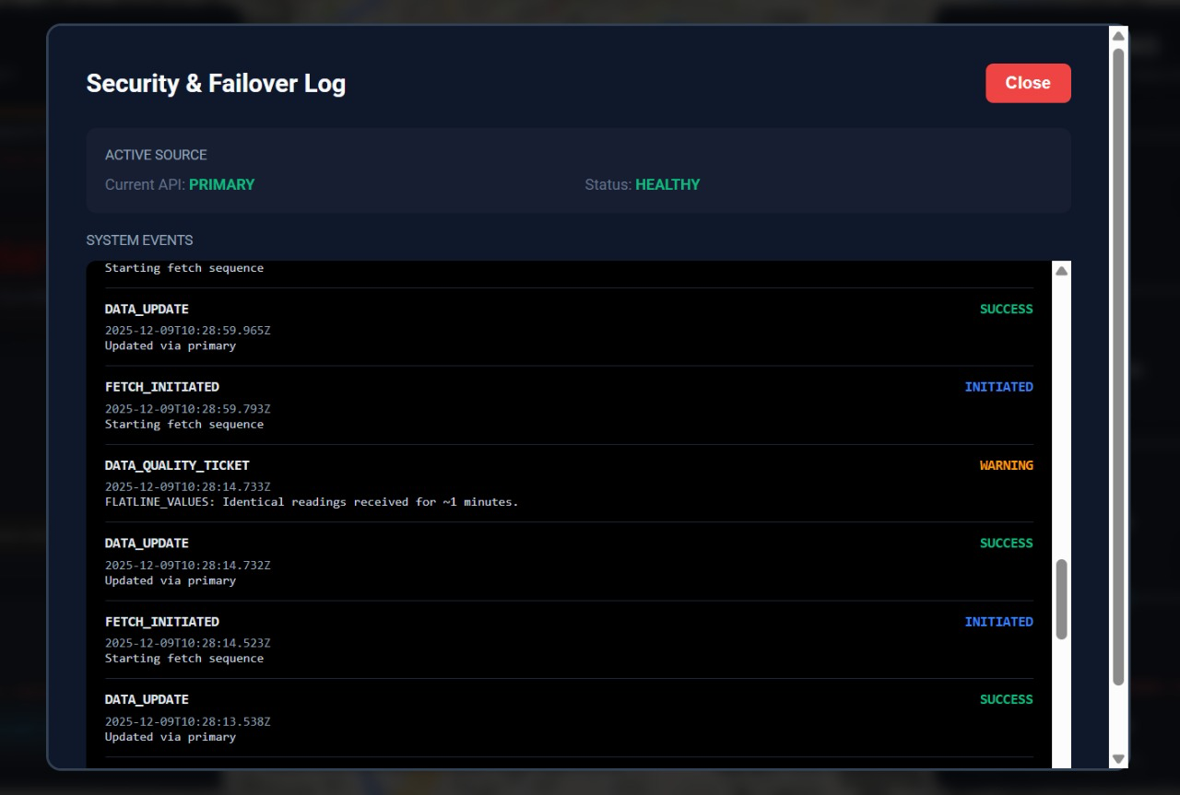
Data Status Panel
Status | Color | Message | What It Means
Fetching | 🔵 Blue | "Fetching live data from API..." | Request in progress
Success | 🟢 Green | "Live data verified" | All validations passed
Warning | 🟡 Yellow | "Live data (verification warning)" | Anomaly detected but data accepted
Error | 🔴 Red | "API timeout (attempt 1/3)" | Validation failed, retrying
Fallback | 🟣 Purple | "Using fallback data (API unavailable)" | Using baseline values

Slide 14
Security Features
1. Password Protection (Google Login)
  User must sign in using Google
  Google password protection + MFA
  App does not store passwords → secure by design
2. Database Security
  Firebase authentication required
  Unauthorized users cannot access simulation DB
3. API Security
  API keys stored in config, not exposed directly
  Requests made over TLS
  Full data encryption end-to-end

Slide 15
Why Our Digital Twin Is Unique
Dual API fallback system
Real-time AQI & CO₂ simulation
Drag-and-drop intervention engine
Policy modelling in seconds
Firebase-secured login
Cloud history storage
Strong password-protected authentication

Slide 16
Unique Innovations
• Intervention sandbox drag-and-drop system
• Visual cause-and-effect particle engine
• CO₂ impact logic with simple meaning + impact + source
• Plug-in intervention architecture
Unique Solutions
• Drag-and-drop intervention deployment
• Real-time pollution reduction particle feedback
• Solution cards with meaning + impact + source
• Pollution-type–specific interventions
• Before/After intervention comparison mode

Slide 17
Conclusion
Supports scientific, real-time monitoring of urban air pollutants for evidence-based policy decisions.
Helps the ministry evaluate the impact of new technologies and interventions on CO₂ and pollutant reduction.
Provides a digital testing environment to model future scenarios without real-world risk or cost.
Strengthens national goals in Clean & Green Technology, smart cities, and climate-resilient planning.
Enables standardized, secure, and accurate data that can guide national research, innovation, and environmental programs.

Slide 18
