Slide 1
Micro-algae-based Air Purifier
“Clean Air, Naturally Powered by Microalgae”
Air purifier
Algae like chlorella, sprullina etc.

Slide 2

The Urban Air Crisis
Air Pollution: A Global Crisis:-
Over 90% of the global population breathes polluted air.
This pollution causes millions of premature deaths each year.
Urban areas have high levels of CO₂, particulate matter, and harmful gases.
Main pollution sources: traffic, industry, and deforestation.
Current air purifiers:
Use a lot of energy.
Rely on traditional filters.
Create chemical byproducts and physical waste.
Worsen environmental issues.

Slide 3
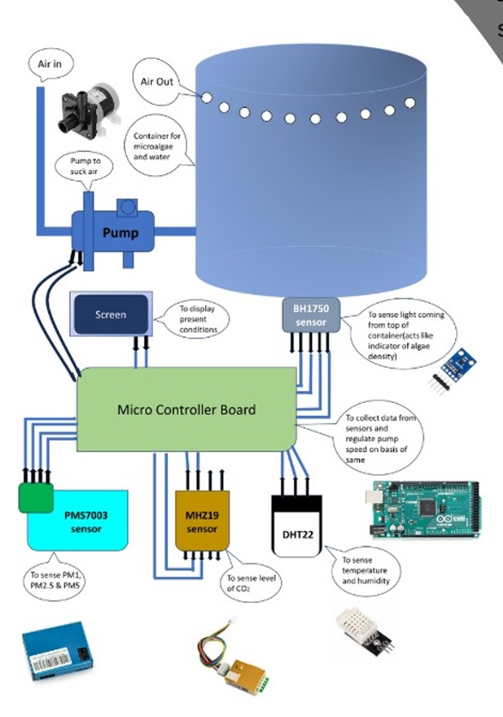
Microalgae: Nature’s Solution to Clean Air
Microalgae like Chlorella and Spirulina absorb CO₂ and pollutants, and release oxygen via photosynthesis.
In air purifiers, microalgae are grown in bioreactors or panels where polluted air is bubbled through.
This setup enables efficient gas exchange and air purification.
The technology is:
Self-regenerating
Continuously operational
Suitable for indoor and outdoor use
A sustainable and scalable air-cleaning solution

Slide 4
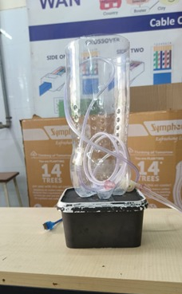
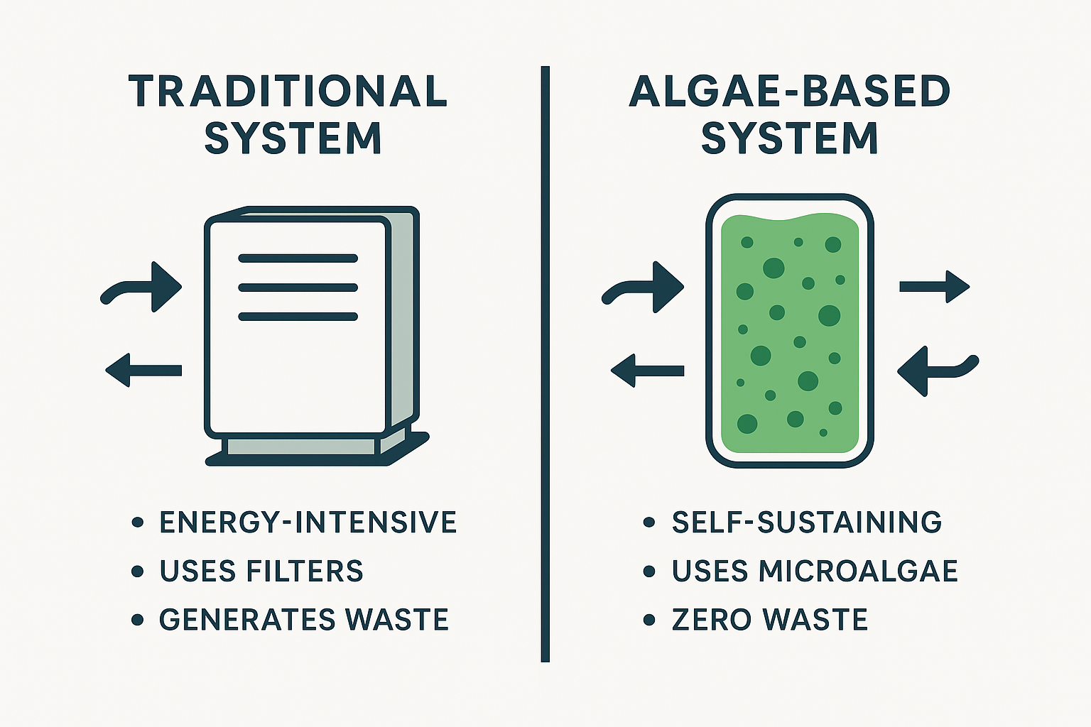
Benefits and Real-World Impact
Eco-Friendly & Sustainable:-
Algae purifiers (e.g., Chlorella, Spirulina) use photosynthesis to absorb CO₂.
Consume low energy and produce minimal waste.
Ideal green solution for urban air purification.
High Efficiency & Low Maintenance:-
Chlorella absorbs up to 2 kg CO₂/m² annually.
Bioreactors need only basic maintenance and minimal intervention.
Proven Real-World Impact:-
Successful pilots in Mexico City and Bangalore.
Notable CO₂ and particulate matter reductions.
Shows strong potential for urban-scale deployment.

Slide 5
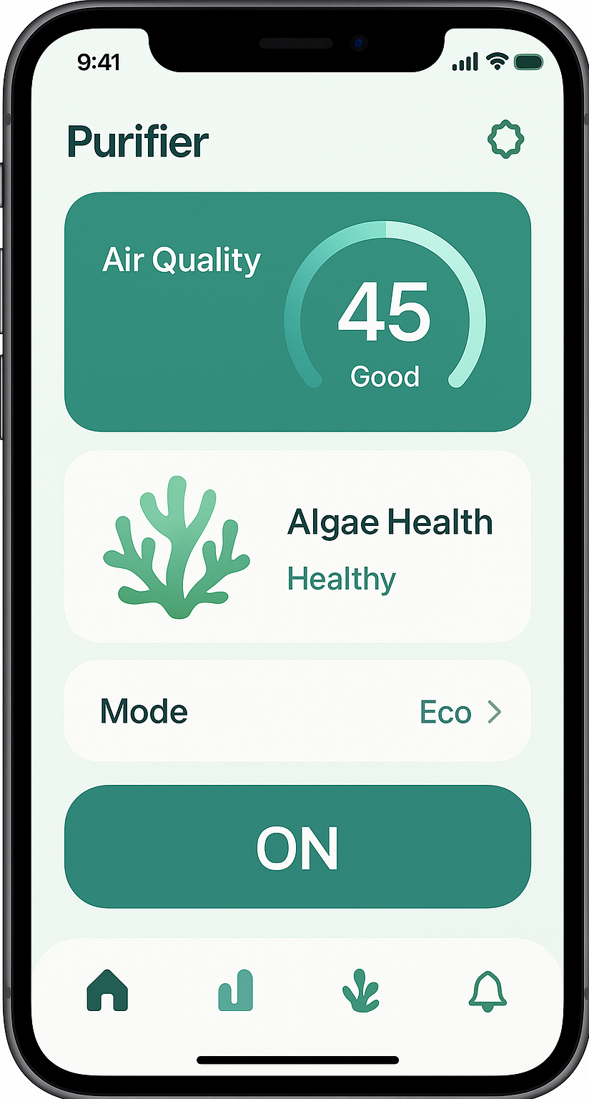
Mobile App Development — Smart Control for Clean Air
Real-time air quality wheel on the home screen
Fan speed control and scheduled day/night purifying modes
Alerts for low water levels and algae growth monitoring
Display of CO₂ removed and O₂ produced, with monthly tree-equivalent savings
Built-in Eco Store for purchasing algae cultures, nutrients, etc.
Notifications like: "You saved the work of 10 trees this month!“
Educational videos about how algae purification works

Slide 6

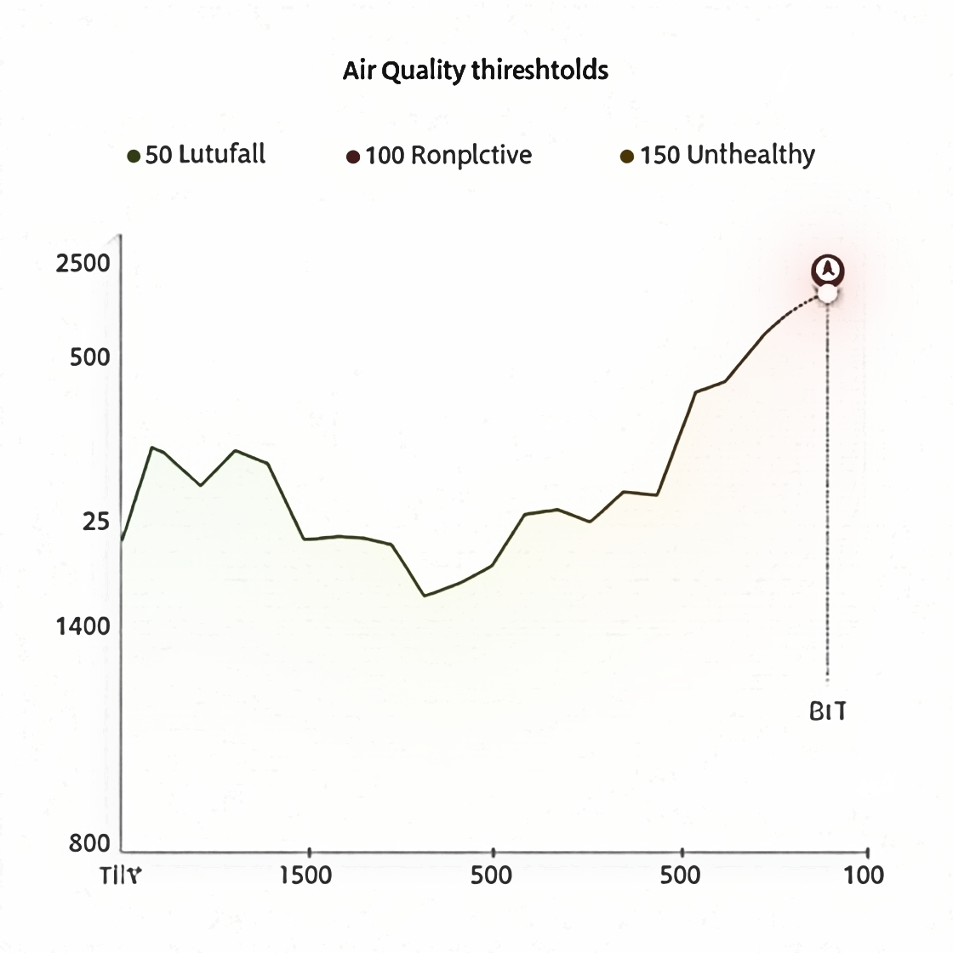
AI Integration — Automation & Accessibility
Voice assistant integration with Alexa, Google Assistant
Automatic purification triggers (e.g., start purifier when PM2.5 > 50)
Support for voice commands and screen-reader compatibility
Simple, intuitive UI design for elderly users and children
Adaptive AI that learns user preferences and automates usage

Slide 7
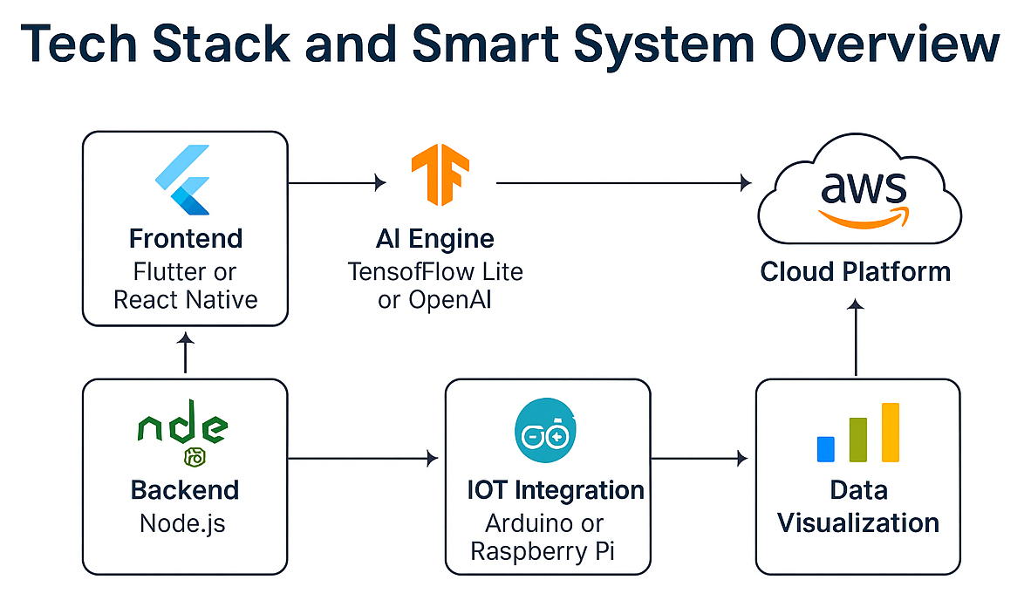
Tech Stack & Smart System
Frontend: Flutter or React Native for cross-platform app
Backend: Node.js with Firebase or AWS Lambda
Cloud Platform: AWS IoT Core for real-time sync
AI Engine: TensorFlow Lite or OpenAI API for voice automation
IoT Integration: Arduino or Raspberry Pi with PM2.5, CO₂, humidity sensors
Data Visualization: Charts and dashboards for user insights

Slide 8
Thank you !!

