Slide 1
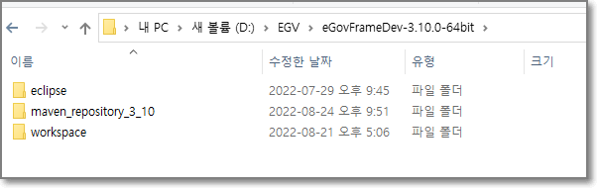
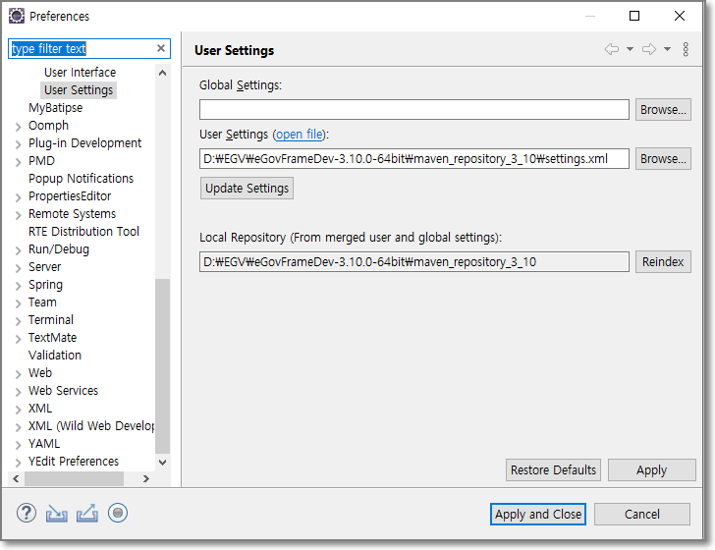
설치가이드
https://www.egovframe.go.kr/wiki/doku.php?id=egovframework:dev3.10:gettingstarted

Slide 2
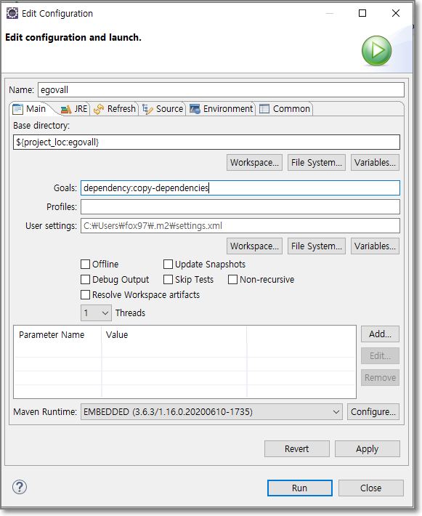
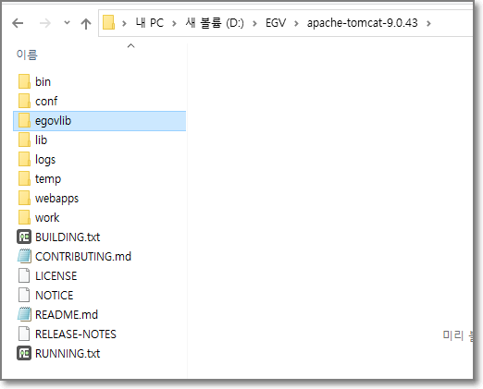
https://m.blog.naver.com/PostView.naver?isHttpsRedirect=true&blogId=mering_k&logNo=221389319037
이클립스 Maven Dependency lib export 추출방법
프로젝트 우클릭 - Run As - Maven Build Goals에 dependency:copy-dependencies 작성 Run 실행하면 !
D:\EGV\apache-tomcat-9.0.43\egovlib
프로젝트가 있는 local 폴더 project-target-dependency 폴더에 jar파일 떨궈짐

Slide 3
기업회원관리
권한관리
권한그룹관리
일반회원관리
그룹관리
ROLE_SYM | 시스템 업무 담당자
ROLE_COP | 협업 담당자
ROLE_USS | 사용자지원 담당자
ROLE_USER_MANAGER | 업무사용자 관리자
ROLE_SEC | 보안 업무 담당자
ROLE_MBER_MANAGER | 일반회원 관리자
ROLE_ENTRPRSMBER_MANAGER | 기업회원 관리자
ROLE_USER | 일반 사용자
ROLE_ANONYMOUS | 익명 사용자
ROLE_ADMIN | 관리자
업무사용자관리
부서관리
(기본조직)
롤관리
메뉴관리
프로그램관리
function

Slide 4
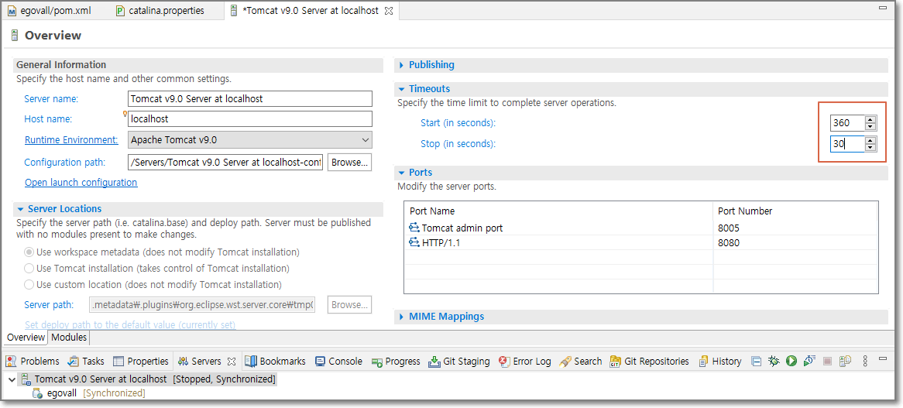
시간늘림

Slide 5
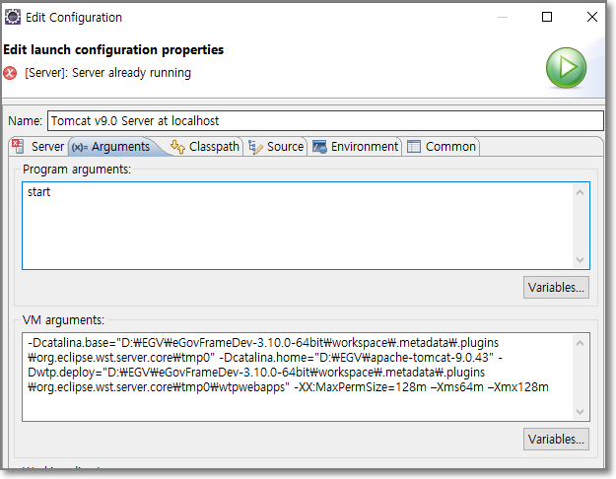
이클립스 톰캣 메모리 설정하기 Tomcat Memory
이클립스 톰캣 메모리 설정하기 Tomcat Memory
https://devmg.tistory.com/57
-XX:MaxPermSize=64m –Xms64m –Xmx128m
Tomcat8 이상부터 PermSize 없어짐
-Xms128m –Xmx256m 성공 (tomcat 단독일때
-Xms128m –Xmx256m 성공 (egovall 추가)
https://docs.oracle.com/cd/E40520_01/integrator.311/integrator_install/src/cli_ldi_server_config.html

Slide 6
D:\EGV\apache-tomcat-9.0.43\egovlib\ajaxtags-1.5.7.jar
D:\EGV\apache-tomcat-9.0.43\egovlib\ajaxtags-resources-1.5.7.jar
D:\EGV\apache-tomcat-9.0.43\egovlib\batik-ext-1.7.jar
D:\EGV\apache-tomcat-9.0.43\egovlib\c3p0-0.9.5.4.jar
D:\EGV\apache-tomcat-9.0.43\egovlib\ckeditor-java-core-3.5.3.jar
D:\EGV\apache-tomcat-9.0.43\egovlib\com.ibm.jbatch-tck-spi-1.0.jar
D:\EGV\apache-tomcat-9.0.43\egovlib\commons-email-1.5.jar
D:\EGV\apache-tomcat-9.0.43\egovlib\commons-fileupload-1.3.3.jar
D:\EGV\apache-tomcat-9.0.43\egovlib\commons-io-2.6.jar
D:\EGV\apache-tomcat-9.0.43\egovlib\commons-net-3.6.jar
D:\EGV\apache-tomcat-9.0.43\egovlib\disruptor-3.2.1.jar
D:\EGV\apache-tomcat-9.0.43\egovlib\egovframework.rte.bat.core-3.10.0.jar
D:\EGV\apache-tomcat-9.0.43\egovlib\egovframework.rte.fdl.access-3.10.0.jar
D:\EGV\apache-tomcat-9.0.43\egovlib\egovframework.rte.fdl.cmmn-3.10.0.jar
D:\EGV\apache-tomcat-9.0.43\egovlib\egovframework.rte.fdl.crypto-3.10.0.jar
D:\EGV\apache-tomcat-9.0.43\egovlib\egovframework.rte.fdl.excel-3.10.0.jar
D:\EGV\apache-tomcat-9.0.43\egovlib\egovframework.rte.fdl.filehandling-3.10.0.jar
D:\EGV\apache-tomcat-9.0.43\egovlib\egovframework.rte.fdl.idgnr-3.10.0.jar
D:\EGV\apache-tomcat-9.0.43\egovlib\egovframework.rte.fdl.property-3.10.0.jar
D:\EGV\apache-tomcat-9.0.43\egovlib\egovframework.rte.fdl.security-3.10.0.jar
D:\EGV\apache-tomcat-9.0.43\egovlib\egovframework.rte.fdl.string-3.10.0.jar
D:\EGV\apache-tomcat-9.0.43\egovlib\egovframework.rte.psl.dataaccess-3.10.0.jar
D:\EGV\apache-tomcat-9.0.43\egovlib\egovframework.rte.ptl.mvc-3.10.0.jar
D:\EGV\apache-tomcat-9.0.43\egovlib\gpkisecureweb-1.0.4.9.jar
D:\EGV\apache-tomcat-9.0.43\egovlib\gs-collections-5.1.0.jar
D:\EGV\apache-tomcat-9.0.43\egovlib\gs-collections-api-5.1.0.jar
D:\EGV\apache-tomcat-9.0.43\egovlib\h2-1.4.180.jar
D:\EGV\apache-tomcat-9.0.43\egovlib\hamcrest-core-1.3.jar
D:\EGV\apache-tomcat-9.0.43\egovlib\hamcrest-library-1.3.jar
D:\EGV\apache-tomcat-9.0.43\egovlib\HikariCP-java7-2.4.13.jar
D:\EGV\apache-tomcat-9.0.43\egovlib\httpclient-4.3.6.jar
D:\EGV\apache-tomcat-9.0.43\egovlib\httpcore-4.3.3.jar
D:\EGV\apache-tomcat-9.0.43\egovlib\jackson-annotations-2.6.1.jar
D:\EGV\apache-tomcat-9.0.43\egovlib\jackson-core-2.6.1.jar
D:\EGV\apache-tomcat-9.0.43\egovlib\jackson-core-asl-1.9.13.jar
D:\EGV\apache-tomcat-9.0.43\egovlib\jackson-databind-2.6.1.jar
D:\EGV\apache-tomcat-9.0.43\egovlib\jackson-mapper-asl-1.9.13.jar
D:\EGV\apache-tomcat-9.0.43\egovlib\jasypt-1.9.3.jar
D:\EGV\apache-tomcat-9.0.43\egovlib\javax.batch-api-1.0.jar
D:\EGV\apache-tomcat-9.0.43\egovlib\javax.inject-1.jar
D:\EGV\apache-tomcat-9.0.43\egovlib\javax.json-1.0.4.jar
D:\EGV\apache-tomcat-9.0.43\egovlib\javax.mail-1.5.6.jar
D:\EGV\apache-tomcat-9.0.43\egovlib\javax.mail-1.5.6.jar
D:\EGV\apache-tomcat-9.0.43\egovlib\javax.servlet.jsp-api-2.3.3.jar
D:\EGV\apache-tomcat-9.0.43\egovlib\javax.servlet-api-3.1.0.jar
D:\EGV\apache-tomcat-9.0.43\egovlib\javax.websocket-api-1.0.jar
D:\EGV\apache-tomcat-9.0.43\egovlib\jettison-1.2.jar
D:\EGV\apache-tomcat-9.0.43\egovlib\jodconverter-2.2.1.jar
D:\EGV\apache-tomcat-9.0.43\egovlib\jsr166e-1.0.jar
D:\EGV\apache-tomcat-9.0.43\egovlib\juh-2.3.0.jar
D:\EGV\apache-tomcat-9.0.43\egovlib\jurt-2.3.0.jar
D:\EGV\apache-tomcat-9.0.43\egovlib\ldapsdk-4.1.jar
D:\EGV\apache-tomcat-9.0.43\egovlib\libgpkiapi_jni-1.4.0.0.jar
D:\EGV\apache-tomcat-9.0.43\egovlib\mariadb-java-client-2.2.5.jar
D:\EGV\apache-tomcat-9.0.43\egovlib\mchange-commons-java-0.2.15.jar
D:\EGV\apache-tomcat-9.0.43\egovlib\postgresql-9.4.1208.jar
D:\EGV\apache-tomcat-9.0.43\egovlib\quartz-2.3.2.jar
D:\EGV\apache-tomcat-9.0.43\egovlib\quartz-jobs-2.3.2.jar
D:\EGV\apache-tomcat-9.0.43\egovlib\reactor-core-1.1.4.RELEASE.jar
D:\EGV\apache-tomcat-9.0.43\egovlib\ridl-2.3.0.jar
D:\EGV\apache-tomcat-9.0.43\egovlib\scribejava-apis-5.6.0.jar
D:\EGV\apache-tomcat-9.0.43\egovlib\scribejava-core-5.6.0.jar
D:\EGV\apache-tomcat-9.0.43\egovlib\smeapi-2.7.jar
D:\EGV\apache-tomcat-9.0.43\egovlib\sndng-mail-1.0.jar
D:\EGV\apache-tomcat-9.0.43\egovlib\spring-batch-core-3.0.10.RELEASE.jar
D:\EGV\apache-tomcat-9.0.43\egovlib\spring-batch-infrastructure-3.0.10.RELEASE.jar
D:\EGV\apache-tomcat-9.0.43\egovlib\spring-batch-integration-3.0.10.RELEASE.jar
D:\EGV\apache-tomcat-9.0.43\egovlib\spring-batch-test-3.0.10.RELEASE.jar
D:\EGV\apache-tomcat-9.0.43\egovlib\spring-data-commons-1.6.1.RELEASE.jar
D:\EGV\apache-tomcat-9.0.43\egovlib\spring-integration-core-4.1.9.RELEASE.jar
D:\EGV\apache-tomcat-9.0.43\egovlib\spring-ldap-core-2.0.2.RELEASE.jar
D:\EGV\apache-tomcat-9.0.43\egovlib\spring-messaging-4.3.25.RELEASE.jar
D:\EGV\apache-tomcat-9.0.43\egovlib\spring-retry-1.2.2.RELEASE.jar
D:\EGV\apache-tomcat-9.0.43\egovlib\spring-social-config-1.1.4.RELEASE.jar
D:\EGV\apache-tomcat-9.0.43\egovlib\spring-social-core-1.1.4.RELEASE.jar
D:\EGV\apache-tomcat-9.0.43\egovlib\spring-social-facebook-2.0.3.RELEASE.jar
D:\EGV\apache-tomcat-9.0.43\egovlib\spring-social-web-1.1.4.RELEASE.jar
D:\EGV\apache-tomcat-9.0.43\egovlib\twitter4j-core-4.0.7.jar
D:\EGV\apache-tomcat-9.0.43\egovlib\unoil-2.3.0.jar
D:\EGV\apache-tomcat-9.0.43\egovlib\xercesImpl-2.12.0.jar
D:\EGV\apache-tomcat-9.0.43\egovlib\xml-apis-1.4.01.jar
D:\EGV\apache-tomcat-9.0.43\egovlib\xmlpull-1.1.3.1.jar
D:\EGV\apache-tomcat-9.0.43\egovlib\xpp3_min-1.1.4c.jar
D:\EGV\apache-tomcat-9.0.43\egovlib\xstream-1.4.11.1.jar

