Slide 1

eventr
Web Based Management Service
Life is an event. Make it memorable.

Slide 2
University of Calcutta
CC13 Project Presentation
A Project on E-Learning System
Submitted by:
Pritam Sarkar
Deep Das
Biswajit Biswas
Mritunjoy Mahanta
Sayaraj Kundu
Under Guidance Of:
Prof. Amitav Biswas
Lecturer., [Computer Science Dept.]
of Vivekananda College(Thakurpukur)
2

Slide 3


Domain Description
Online event management allows you to manage your event using technology solutions. Online event management software helps enhance event-goers' experience, but it also makes the event planner's life easier by making the event planning process more seamless.

Slide 4

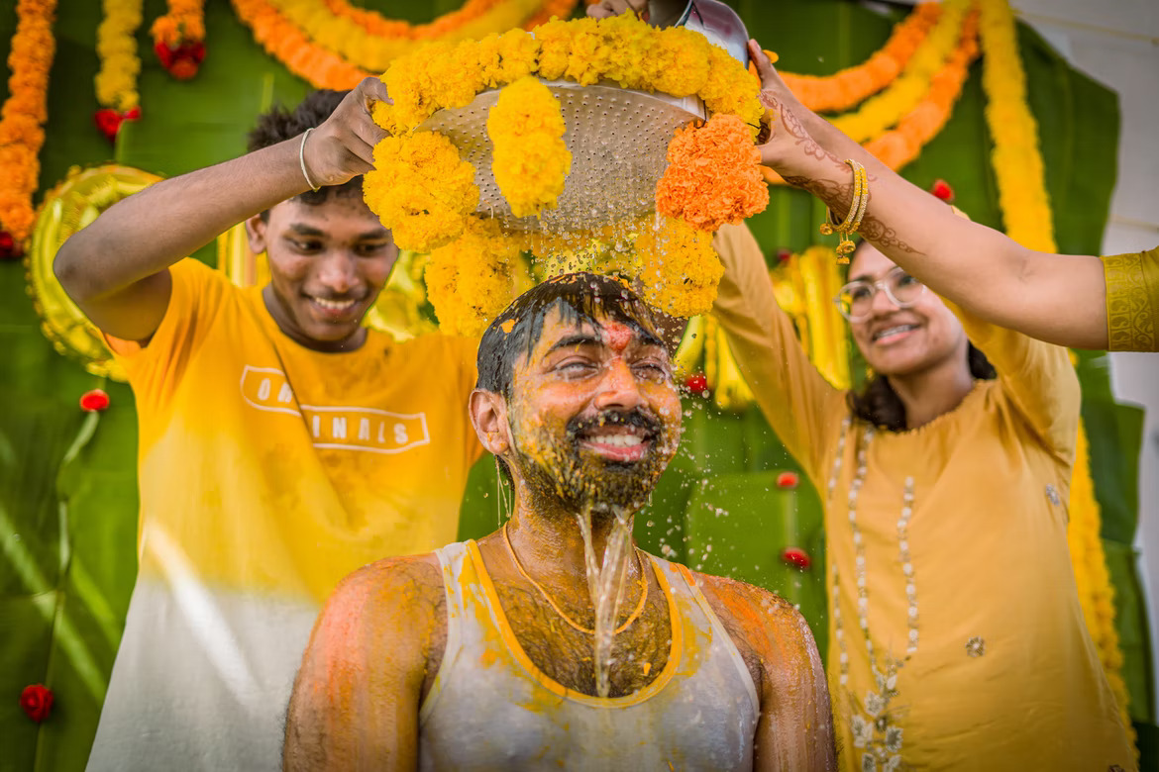


Introduction To Event Management

Slide 5
Introduction
Since India has been historically a society where people share strong bonds and socialize frequently, gatherings and get-togethers hold a special place in our hearts as events create opportunities for people to connect with an area, spend time together, celebrate and experience the diversity of cultures and foster creativity and innovation.
Since organizing an event usually includes quite a large sum of money to be spent, people want the best possible experience for the money they will be spending. So, they look for the services that offer the best service and this usually includes contacting all the services that are referred to them by their acquaintances if they don’t get any leads from the people they know, they straight up search for them on Google. To make things easier as well as to keep track of all the details of the event being planned, we propose to build an Event Planning and Management system. This would allow the user to find all the businesses offering the services in his/her area for a specific aspect of the event, and also to view all the aspects he needs to plan for (like decoration, catering, etc.) serially to make the plan more manageable.

