Slide 1
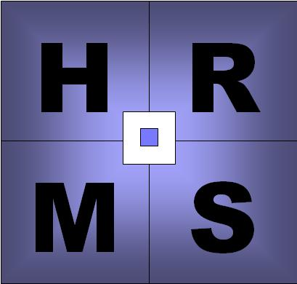
HUMAN RESOURCE MANAGEMENT SYSTEM

Slide 2

NETAJI SUBHASH ENGINEERING COLLEGE
MAJOR PROJECT
ON
HUMAN RESOURCE MANAGEMENT SYSTEM
Project submitted by:
Sougata Mondal
Debraj Roy
Mriganka De
Under the guidance of:
Mr. Anupam Bera Mr. Sushovan Das
Dept. of MCA Project Instructor
NESC CMC

Slide 3

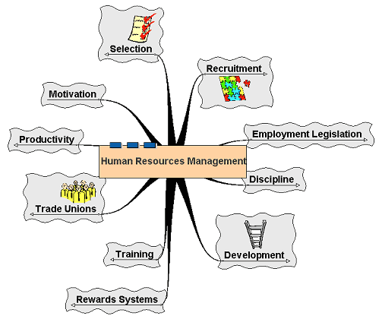
What is HRM???
HUMAN
RESOURCES
MANAGEMENT

Slide 4
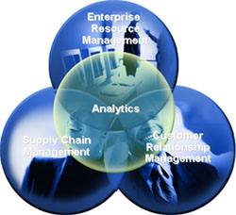
Introduction

Slide 5

Introduction To Project
A Human Resource Management System (HRMS), refers to the systems and processes at the intersection between human resource management (HRM) and information technology. It merges HRM as a discipline and in particular its basic HR activities and processes with the information technology field, whereas the programming of data processing systems evolved into standardized routines. The function of Human Resource departments is generally administrative and common to all organizations. Organizations may have formalized selection, evaluation, and payroll processes. Efficient and effective management of "Human Capital" has progressed to an increasingly imperative and complex process.

Slide 6

Abstract

Slide 7

Abstract
This project is an application developed to handle the human resource in various organizations especially in software industry. Our aim is to develop a complete application package that deals with every aspect related to employee profile, employee recruitment, leave, time and payroll management of them. It enables effectively to handle the huge amount of human resources their personal and professional data, recruitment procedure ,leave data and salary . It presents an effective combination of ASP.NET and C#.NET with database like MS-Access. In short, through this software a Human Resource Manager can easily monitor, analyze, assess the complete details of all the employees of the organization from their recruitments to payroll.

Slide 8

Entity – Relationship Diagram

Slide 9

Entities:
Administrator
Department
Designation
Employee
Client
Project
Project assigned
Daily time sheet
Candidate
Appointment
Post interview

Slide 10
Attributes:
Entity | Attributes
Administrator | adminid, firstname, lastname, username, adminpwd ,addeddate
Department | DepartmentID, DepartmentCode, DepartmentName, CurrentStrength, MaxNoEmp, MinSal, MaxSal, MinAge, MaxAge
Designation | DesignationID, DesignationCode, DesignationName
Employee | EmployeeID, DepartmentID, DesignationID, EmployeeCode, FirstName, LastName, Sex, DateOfBirth, UserName, Pwd, Address, EmailID, PhoneNo, EmployeeImage, Nationality
Client | ClientID, ClientCode, ClientName, EmailID,Country, AddedDate
Project | ProjectID, ProjectCode, ProjectName, ClientID, ProjectHour, StartDate, EndDate, AddedDate, Status
Project assigned | AssignmentID, EmployeeID, ProjectID
Daily time sheet | DailyTimeSheetID, EmployeeID, ProjectID, EntryDate, Hours, Minutes
Candidate | CandidateID, CandidateCode, ResumeDate, FirstName, LastName, DOB, Sex, Address, PhoneNo, EmailID, Department, Designation, College, Stream, Percentage, Location, Nationality, Hobby, Skill, Experience, Achivements
Appointment | AppointmentID, CandidateID, AppointmentNo, IssueDate, Authority, InterviewDate, ProbationPeriod, JoiningDate, Salary
Post interview | PostInterviewID, CandidateID, PostInterviewCode, InterviewLevel, Description, PostAppFor, OfferedSalary, Negotiated, SelectionStatus, InterviewerCode, InterviewerName, InterviewerDesignation

Slide 11

Relationships:
Administrator controls Departments
Administrator controls Employee
Administrator deals with Clients
Administrator selects Candidate
Employee has Designation
Employee works on Department
Employee assigned Project
Client deals with Project
Project deals with Project assigned
Project deals with Daily time sheet
Candidate face interview in Post Interview
In Post Interview if a candidate selected then Appointed

Slide 12
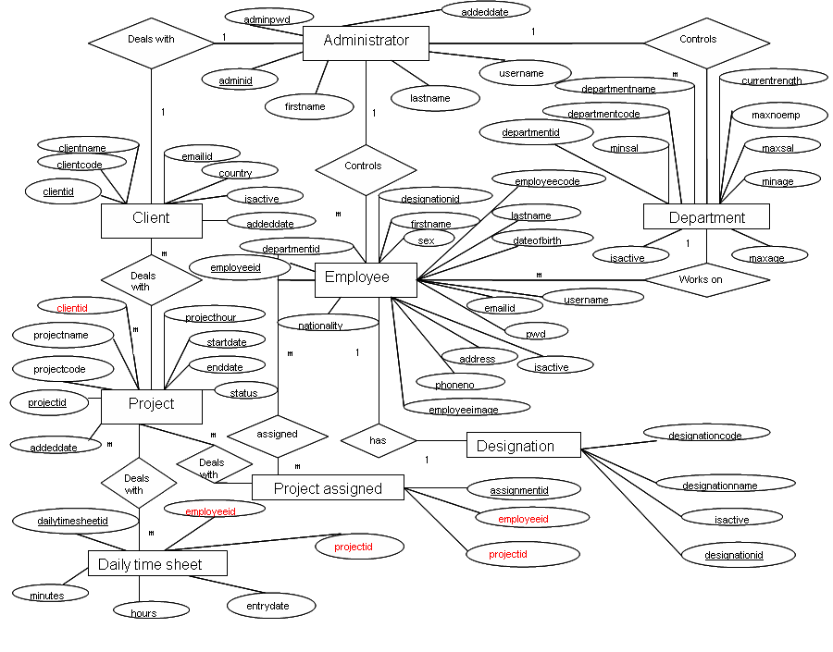

Slide 13
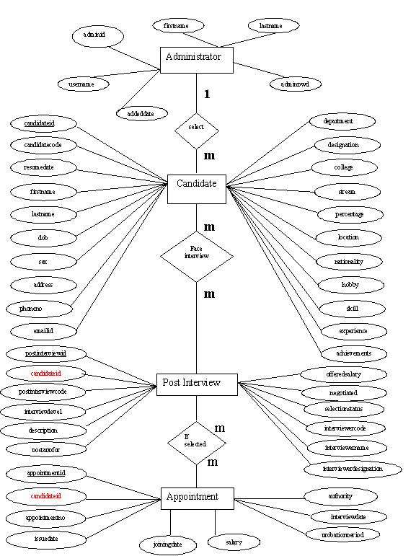

Slide 14

Data - Flow Diagram

Slide 15

Data Flow Diagrams:
A graphic tool used to describe and analyze the moment of data through a system – manual or automated – including the processes, stores of data, and delays in the system. Data flow diagrams are the central tools and the basis from which other components are developed. The transformation of data from input to output, through processes, may be described logically and independently of the physical components associated with the system.

Slide 16
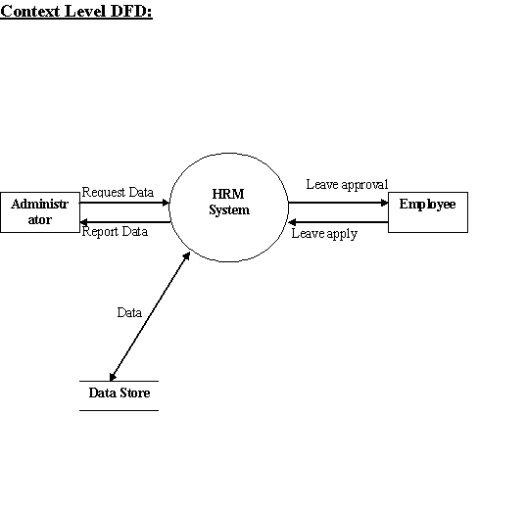

Slide 17
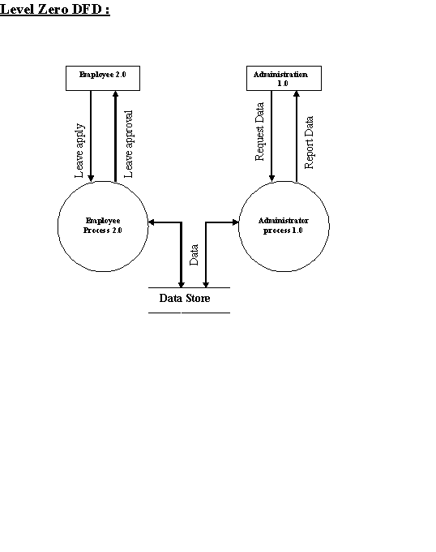

Slide 18
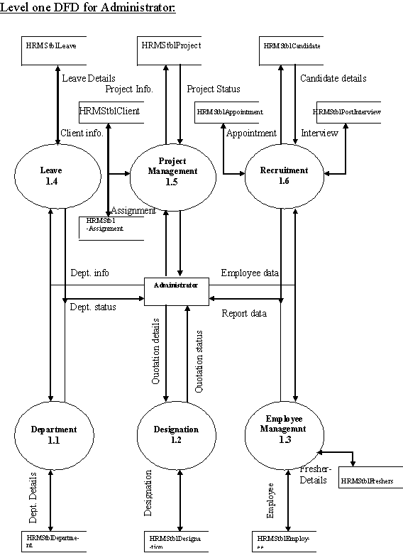

Slide 19
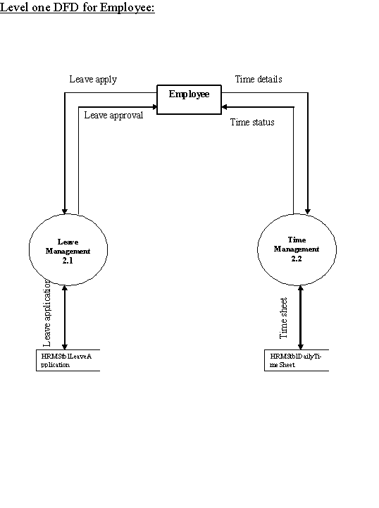

Slide 20

Snap - Shots

Slide 21

ADMINISTRATOR
&
EMPLOYEE
LOGIN PAGE

Slide 22
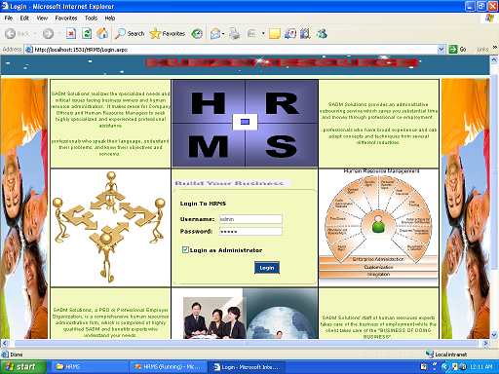

Slide 23

ADMINISTRATOR
HOME PAGE

Slide 24
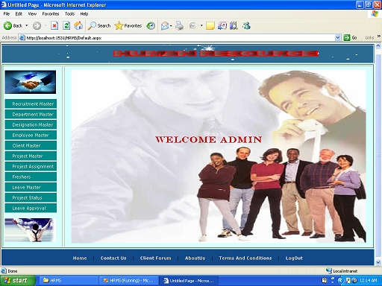

Slide 25
Administrator is able…
To perform Insert , Update and Delete
operations in all the Database Items.
To enter the new Employee details.
To Assign projects to the employees,
control their leave applications etc.
Maintain the informations of the clients

Slide 26

VIEWS AS AN
ADMINISTRATOR

Slide 27
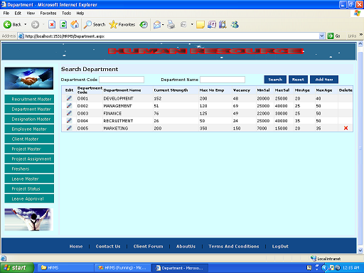
Department Page

Slide 28
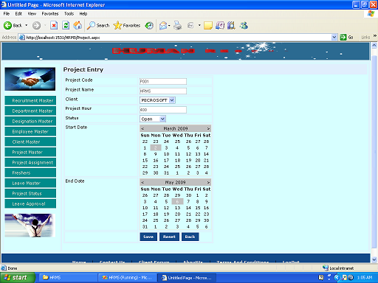
Project Page

Slide 29
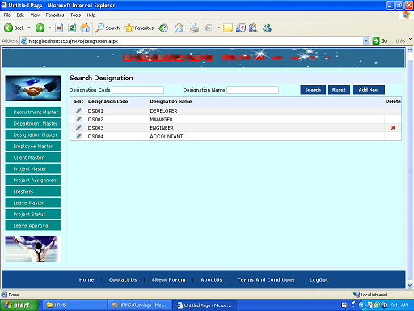
Designation Page

Slide 30
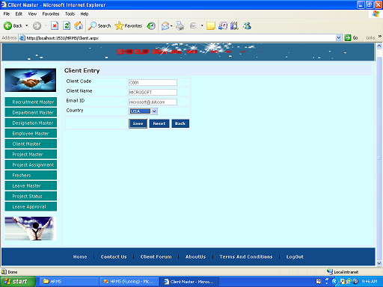
Client Page

Slide 31
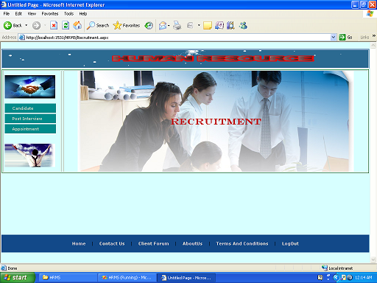
Recruitment Page

Slide 32
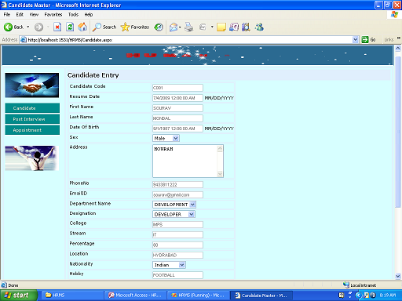
Candidate Page

Slide 33
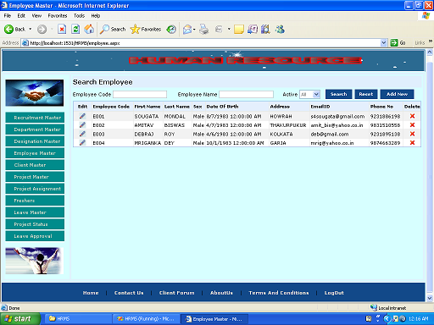
Employee Page

Slide 34
EMPLOYEE
HOME PAGE

Slide 35
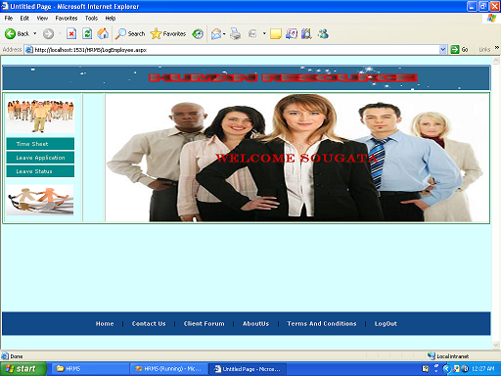

Slide 36
Employee is able…
To enter the working time of the
projects assigned to him/her.
To apply for a leave and can see the status of his application
To view the status of the ongoing
projects.

Slide 37

VIEWS AS AN
EMPLOYEE

Slide 38
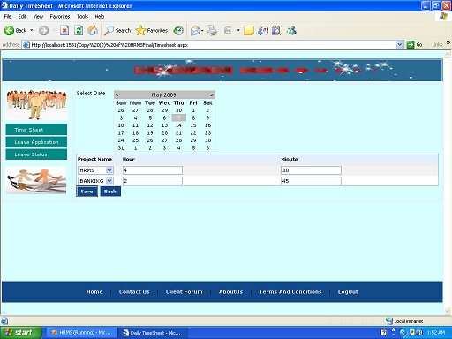
Daily Time Sheet

Slide 39
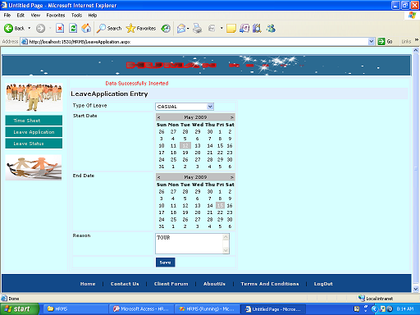
Leave Application Page

Slide 40

OTHER PAGES

Slide 41
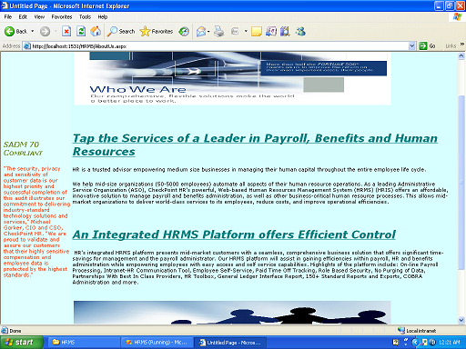
About Us

Slide 42
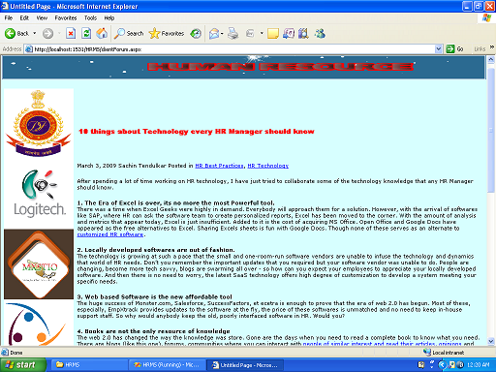
Client Forum

Slide 43
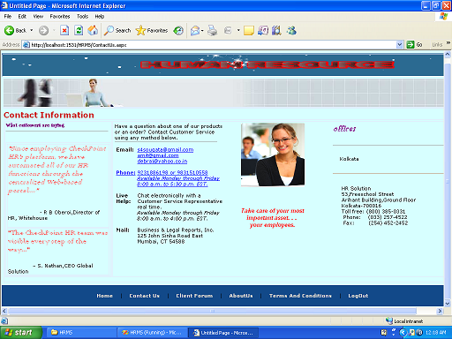
Contact Us

Slide 44
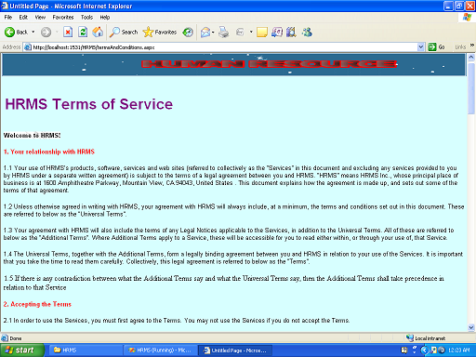
Terms & Conditions

Slide 45

Problem Solving
Methodology

Slide 46

      Hardware & Software Requirements
  Category:
  Web Application
  Software used :
  Platform : Windows NT
  Web Server : Asp. Net Development server
  Presentation : HTML 4.0
  Client Side Validation : JavaScript
  Server Side Validation : Asp. net framework 2.0 using C#
  Database Connectivity : ODBC
  RDBMS : MS SQL Server 2005
  And also a dedicated server to run all the above software.
  Hardware used :
  Processor : Pentium D 2.6GHz.
  RAM : 256 MB
  Hard Disk Drive : 80 GB
  CD Drive : LG
  Floppy Disk Drive : Samsung 1.44
  Keyboard : Samsung Multimedia
  Mouse : Pleomax Optical

Slide 47

Modules

Slide 48

Modules
Well-structured designs improve the maintainability of a system. A structured system is one that is developed from the top down and modular, that is, broken down into manageable components. In this project we modularized the system so that they have minimal effect on each other.
  Administrative Module deals with department ,employee, client and almost all the purposes related of that company such as leave management ,payroll management and even to manage the project. It is the main part of this software.
  Profile Management deals with creation of profiles for new employees along with updating existing profiles. An employee can be searched on the basis of their id and names.
  Employee Recruitment deals with registration of new applicants, short listing of applicants for technical rounds then to HR rounds and at last it produces the final list of selected candidates.
  Leave Management deals with allocation of leaves to employees, considering various factors Leave apply and Leave approval.
  Time Management deals with daily attendance of employees in the organization with enter and update attendance
  Payroll Management is our final module which deals with Employee agreement and calculation of salary.

Slide 49
Human Resource
management
system
Administrator
employee

Slide 50
Administrator
Department
Designation
Employee
Managemment
Recruitment
Leave
Management
Project
Management

Slide 51
Employee
Management
Employee
Fresher
Recruitment
Candidates
Post Interview
Appointment

Slide 52
Leave
Management
Leave Status
Leave
Application
Project
Management
Project
Project
Assignment

Slide 53
Employee
Time
Management
Leave
Management

Slide 54
Use – Case Diagram

Slide 55
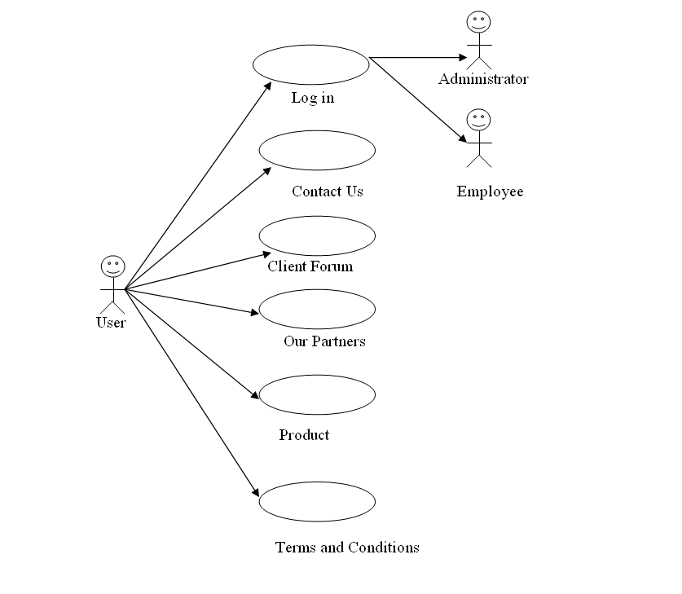

Slide 56
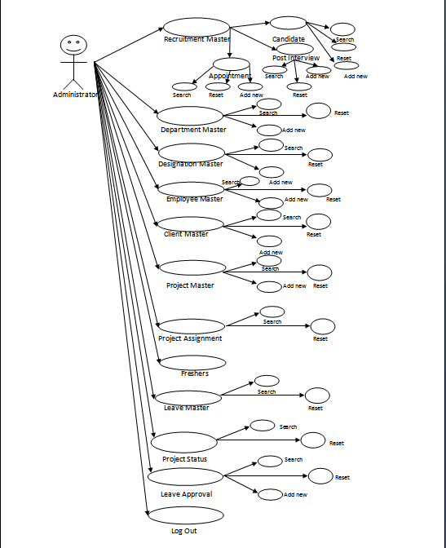

Slide 57
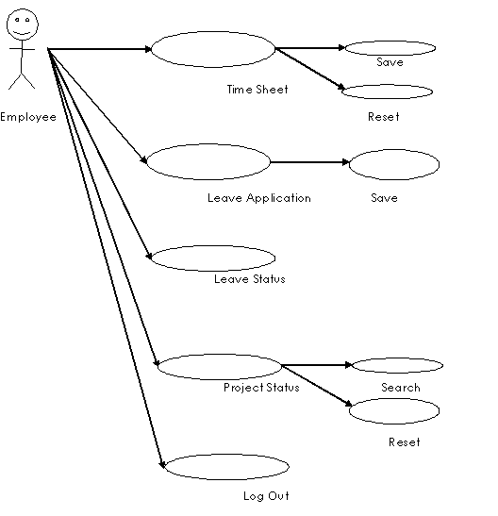

Slide 58
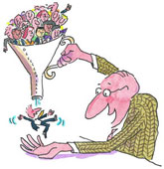
Testing

Slide 59

Testing
The testing phase involves the testing of development system using various data. Preparation of the test data plays a vital role in system testing. After preparing the test data, the system under study was tested using those data. While testing the system, by using the test data, errors were found and corrected by using the following testing steps and corrections were also noted for future use. Thus, a series of testing is performed on the proposed system before the system is ready for implementation.
The various types of testing done on the system are:
Unit Testing: Unit testing focuses on verification effort on the smallest unit of software design module. Using the unit test plans prepared in the design phase of the system development as a guide, important control paths are tested to uncover errors with in the boundary of the modules. The interfaces of the modules are tested to ensure proper flow of information into and out of the modules under consideration boundary conditions were checked. All independent paths were exercised to ensure that all statements in the module have been executed at least once and all error-handling paths were tested.
Each unit is thoroughly tested to check if it might fail in any possible situation. This testing is carried during the programming state itself. At the end of this testing phase each module is found to be have an adverse effect working satisfactorily, as regard to the expected output from the module.
Integration Testing: Data can be lost across an interface, one module can on another; sub-functions when combined may not produce the desired major function: global data structures can present problems. Integration testing is a systematic technique for the program structure while at the same time concluding tests to uncover errors associated with interface. All modules are combined in this testing step. Then the entire program is tested as a whole. Each of the module is integrated and tested separately and later all modules are tested together for sometime to ensure the system as a whole works well without any errors.

Slide 60

Future Scope

Slide 61

Future Scope
There are no physical boundaries to this project, since it is internet based project. However, there are some limitations such
as the administrator can not change the password himself, the Payroll system and Recruitment system are still remain to design. Moreover Contact us ,Client forum, products ,Terms and conditions and Our partners pages are also have to design. So our future scope is to design those parts in order to make the software more efficient.

Slide 62

Conclusion

Slide 63

Conclusion
This project presents an overview of implementation of Asp.Net with C# and access. This can be a good examples of secure web application. It has a great scope in industry which is dependent major on those.
The all modules included are very handy and efficient in handling every major aspect of HR Management in software industry. This project is very scalable and is 100% secure. So it has a great chances to perform for which we have developed this. Hence after developing this project we feel that deep the technology implemented and the web application developed from it is one of the better project to developed as final year project. At last we are thankful to our teachers and CMC Academy for their kind cooperation.

Slide 64

Thank You

