Slide 1
ADVANCED MACHINE LEARNING · PROJECT 7 · PHASE 2
Learning engine health from sensor sequences
RUL = 125 while healthy, then counting down to failure
LSTM, temporal CNN and Transformer models on NASA C-MAPSS, and a hybrid that fuses them with our Phase 1 degradation features
Kushal Tyagi · Nishant Sharma · Anant Lalwani · Dev Tyagi · Vansh Khod
Newton School of Technology, Rishihood University
Notes:
Presenter: Kushal. Introduce the team. Phase 1 predicted remaining useful life from engineered features. Phase 2 asks whether deep models that read the raw sensor history can do better, and whether combining both helps. The orange line is our target: flat while the engine is healthy, then counting down to failure.

Slide 2
Where Phase 1 left us
PRESENTER · KUSHAL
Its error analysis found three weak spots
10.75
1
Fast-degrading engines
predicted about 10 cycles too late
test RMSE in cycles: XGBoost on 88 engineered degradation features, the model to beat
2
Onset of degradation
error peaks at RUL 70–110, where the drift is still small
3
Short histories
engines with < 60 observed cycles are harder
Phase 2 question All three depend on the timing of the whole trajectory. Can models that learn directly from sensor sequences do better?
Notes:
Presenter: Kushal. Phase 1's best model, XGBoost on engineered features, reached 10.75 cycles RMSE on the official test set. Its error analysis showed three weak spots: fast degraders, the onset of degradation, and short histories. All three depend on the shape and timing of the trajectory, which fixed rolling features summarise poorly. That is exactly the gap the project brief describes, and it motivates Phase 2.

Slide 3
Five parts, one per team member
PRESENTER · KUSHAL
06
07
08
09
10
Sequence data & regularisation
LSTM, TCN, Transformer
Hybrid fusion model
Ablation studies
Test validation
Kushal
Anant
Nishant
Dev
Vansh
Same data, same five engine-level folds and same official test set as Phase 1, so every number is directly comparable. The test set is used once, at the end.
Notes:
Presenter: Kushal. Phase 2 has five notebooks, numbered 06 to 10, and each team member owns one. The hybrid in the middle is the main contribution. Everything uses the same folds and the same test protocol as Phase 1, so the comparison is fair.

Slide 4
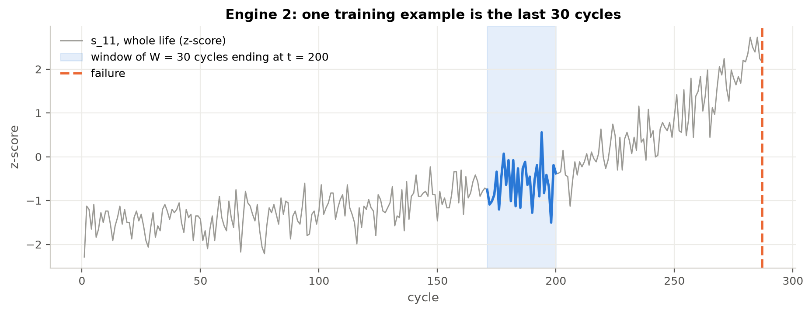
Every cycle becomes a 30-cycle window
PRESENTER · KUSHAL
30 × 15 input
14 normalised sensors plus a mask channel; 20,631 windows, the same rows as Phase 1
Short histories kept
padded with the engine's first reading; the mask marks padding (0) and real cycles (1)
No leakage
no window crosses an engine; deleting future cycles changes nothing (max difference 0)
One training example = the last 30 cycles of one engine, ending at the cycle we predict
Fair splits
Phase 1's five folds; early stopping on separate inner-validation engines
Notes:
Presenter: Kushal. A sequence model needs history, so every cycle becomes a window of its last 30 cycles. Early cycles with less history are padded with the engine's first reading, and a mask channel tells the model which steps are real. We tested two leakage rules automatically: windows never mix engines, and deleting the future leaves every window unchanged. The folds are identical to Phase 1.

Slide 5
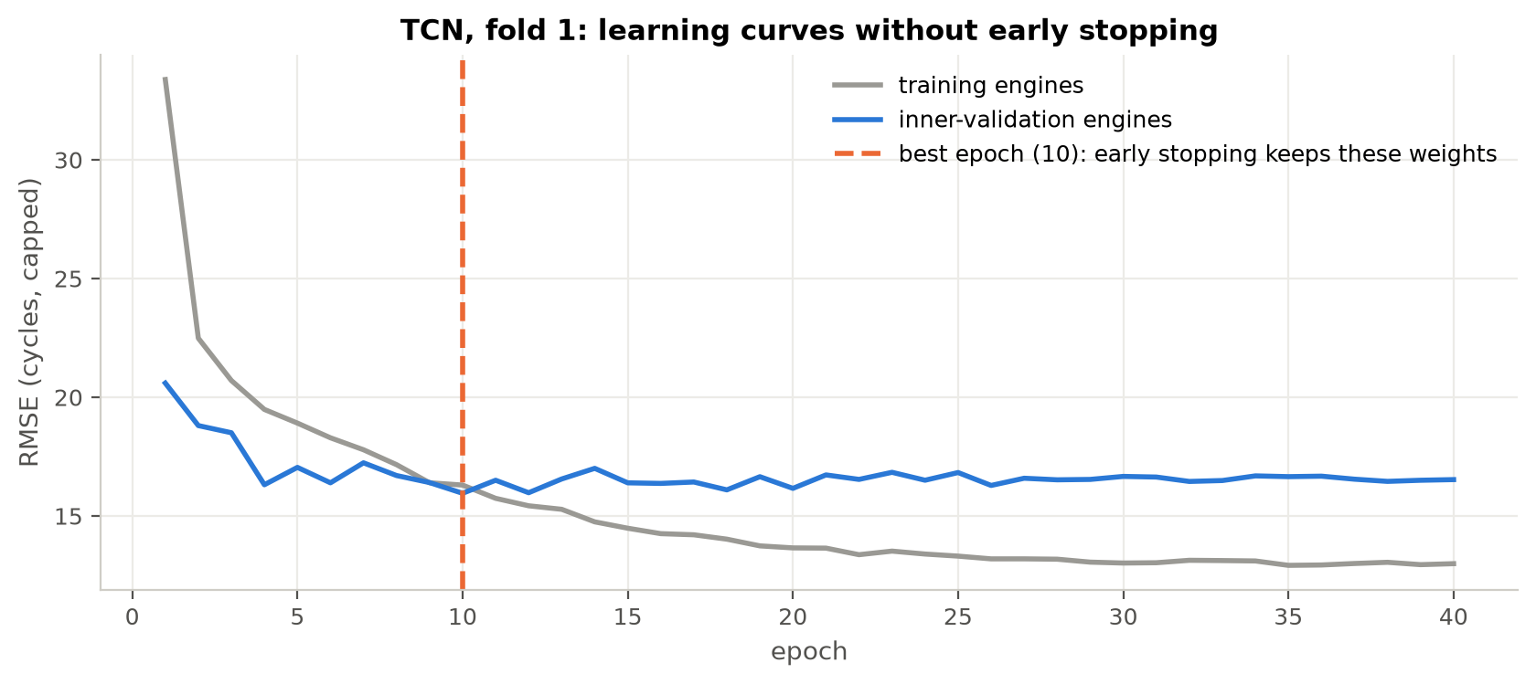
100 engines overfit fast, so we regularise
PRESENTER · KUSHAL
Dropout
p = 0.2
Weight decay
λ = 1e-4 (AdamW)
Early stopping
patience 8, best weights kept
LR schedule
halve on plateau
TCN, fold 1: validation error is lowest at epoch 10, then rises while training error keeps falling
Gradient clipping
max norm 1.0
Input noise
σ = 0.05 (tested)
Each one's effect is measured in the ablations (notebook 09).
Notes:
Presenter: Kushal. Consecutive windows overlap in 29 cycles, so the real amount of independent data is small and networks memorise engines quickly. The plot shows it: training error keeps falling, but validation error is best at epoch 10. We use six regularisers. Dropout randomly switches off units, weight decay shrinks weights like Ridge regression, early stopping keeps the best epoch, the learning rate is halved when progress stalls, gradient clipping prevents exploding gradients, and input noise is a simple augmentation.

Slide 6
Three ways to read a sensor window
PRESENTER · ANANT
1
LSTM
2
Temporal CNN
3
Transformer
Reads the window cycle by cycle. A gated memory cell adds up slow wear and ignores noise.
Causal, dilated 1-D convolutions detect local shapes. Dilations 1, 2, 4, 8 cover 61 cycles.
Self-attention lets every cycle look at every other cycle; the mask hides padding.
c(t) = f(t)·c(t−1) + i(t)·c̃(t)
R = 1 + Σ 2(k−1)·d = 61
softmax(QKᵀ / √d) · V
2 layers × 64 units · 56k parameters
4 residual blocks · 93k parameters
2 layers, 4 heads · 70k parameters
Notes:
Presenter: Anant. The brief names three architectures, so we trained all three on identical windows. The LSTM reads one cycle at a time; its forget and input gates decide what the cell state keeps, and because that state is updated by addition, gradients do not vanish over the sequence. The TCN uses causal convolutions, which never look ahead, and dilations that double each layer, so four blocks see 61 cycles. The Transformer uses attention: every cycle computes how relevant every other cycle is. All three are kept small, 56 to 93 thousand parameters, because we only have 100 engines.

Slide 7
Sequences beat raw features, not engineered ones
PRESENTER · ANANT
3 to 5.5 cycles better
than XGBoost on raw single-cycle readings: learning from the history works, with no hand-made features
Transformer is best
13.05 ± 0.73, ahead of the LSTM (14.01) and the TCN (15.41)
But all trail the features
XGBoost on engineered features stays at 9.26
Notes:
Presenter: Anant. Same folds as Phase 1. All three networks beat XGBoost on raw single-cycle sensors by 3 to 5.5 cycles, so they genuinely learn from the sequence. The Transformer is best. But none reaches XGBoost on our 88 engineered features. The next slide explains why.

Slide 8
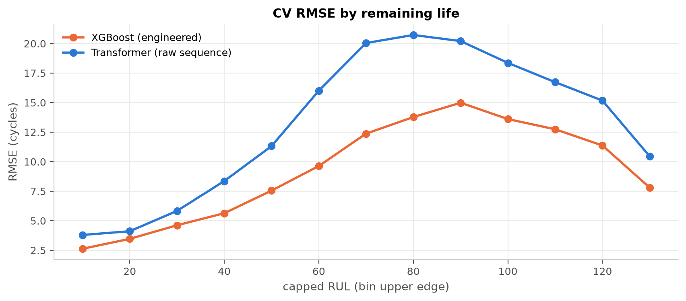
A window cannot see the engine's healthy baseline
PRESENTER · ANANT
Gap is largest at onset
RUL 60–100: about 20 cycles for the Transformer against 13–15 for XGBoost
The missing information
Phase 1's strongest signals were each engine's distance from its own first cycles, and its age. Both lie outside a 30-cycle window.
Too little data to learn it
100 engines cannot teach a network these long-range references from scratch
Notes:
Presenter: Anant. Broken down by remaining life, the network is worse everywhere, but most at the onset of degradation. Near failure the drift is strong and a 30-cycle window shows it. Early in degradation the change within 30 cycles is smaller than the noise, and only a comparison with the engine's own healthy level reveals it. That comparison is exactly our baseline-deviation feature from Phase 1, and the network cannot compute it because the first cycles are outside its window.

Slide 9
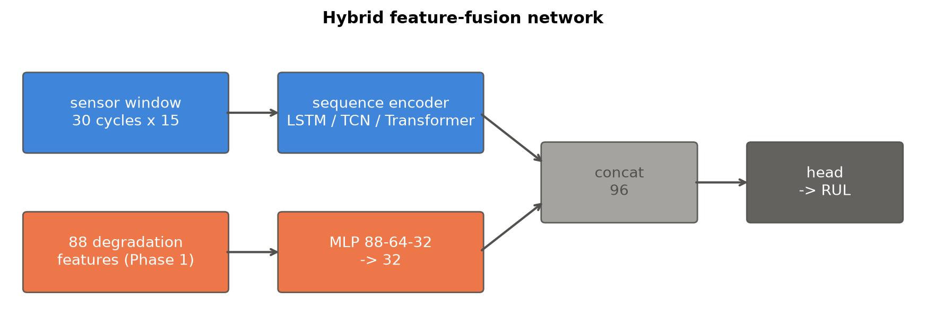
Hybrid: give the network both views
PRESENTER · NISHANT
Feature branch: long-range context
distance from the engine's own baseline, age, slopes, health index
Sequence branch: learned shapes
the raw 30-cycle trajectory, including patterns nobody hand-coded
Both branches are trained together with one loss, so the network learns what the features miss.
Notes:
Presenter: Nishant. The two approaches miss different things. The features carry long-range, engine-specific context that no window can see, like how far each sensor has moved from that engine's first cycles. The sequence encoder sees the raw shape of the recent trajectory, including patterns we did not anticipate. So the hybrid has two branches: an encoder over the window, and a small network over the 88 features. Their outputs are concatenated and a shared head predicts RUL. Because both are trained jointly, the encoder is pushed to learn what the features do not already explain. That is different from training two models and averaging them, which we test as a baseline.

Slide 10
The hybrid beats both of its parts
PRESENTER · NISHANT
4.14
RMSE in the last 50 cycles before failure, against 5.04 for XGBoost (−18%)
Each branch adds information
4.5 better than the sequence alone, 0.5 better than the features alone
Joint training matters
averaging two models (10.24) is worse than XGBoost alone; the hybrid beats it with all 3 encoders
Notes:
Presenter: Nishant. In cross-validation the hybrid beats its sequence branch by 4.5 cycles and its feature branch by half a cycle, so each branch contributes. Simply averaging XGBoost and the Transformer is worse than XGBoost alone, so joint training is what makes the combination work, and this holds for all three encoders. Over the whole life it is level with XGBoost, 9.55 against 9.26, within the fold spread. Where it gains is near failure: 4.14 against 5.04 in the last 50 cycles.

Slide 11
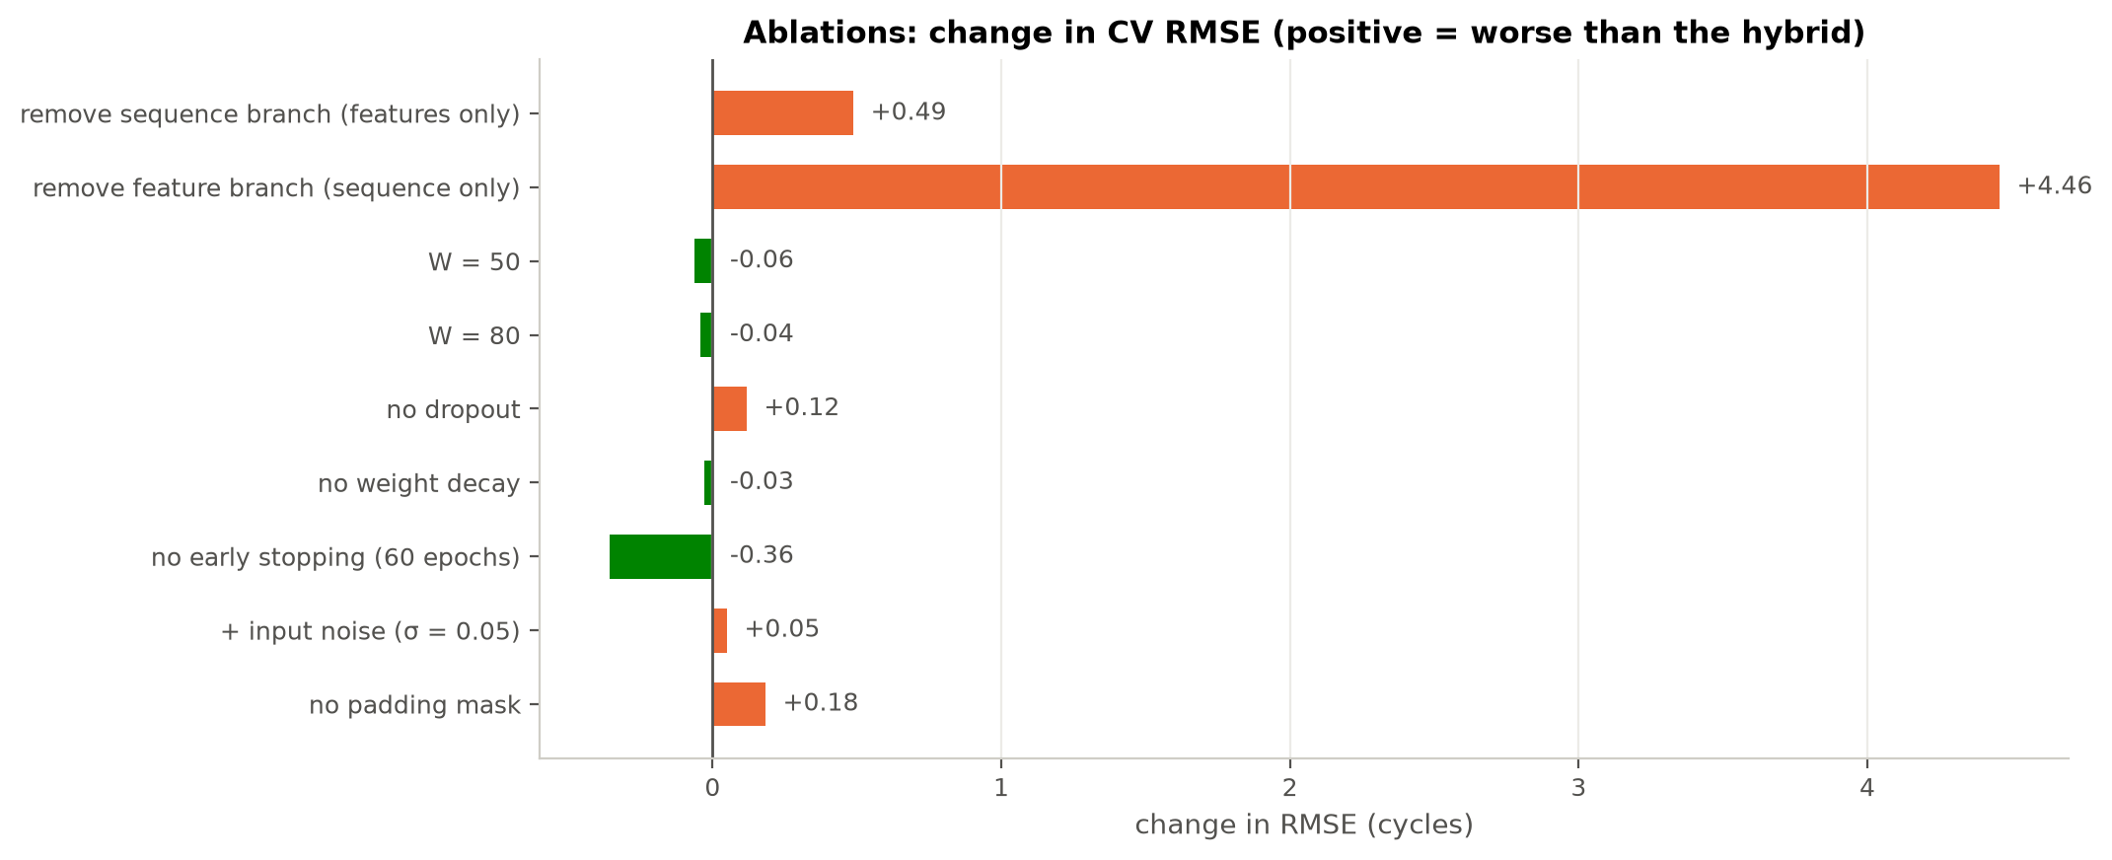
Ablations: the features are the backbone
PRESENTER · DEV
Remove the features: +4.46
worse on all 5 folds; the engineered features carry most of the information
Remove the sequence branch: +0.49
a smaller but consistent gain, worse on 4 of 5 folds
Early stopping stopped too early
it watched only 7–8 engines; a fixed 60 epochs is better over 3 seeds (9.73 vs 9.99)
Small effects are within noise
dropout, mask, weight decay, noise: all smaller than the seed noise of about ±0.7
Notes:
Presenter: Dev. An ablation removes one component at a time with everything else fixed. Removing the feature branch costs 4.46 cycles, so the features are the backbone. Removing the sequence branch costs half a cycle, a smaller but consistent gain. Early stopping surprised us: it watched only 7 or 8 validation engines, so its signal was noisy and it stopped too early. Training for a fixed 60 epochs was better, and stayed better when we repeated it with three seeds. Effects of a tenth or two of a cycle, like dropout or the mask, are within the run-to-run noise we measured, so we do not claim them.

Slide 12
Longer windows help sequences, not the hybrid
PRESENTER · DEV
Confirms the Phase 1 gap
the LSTM alone improves from 14.0 to 11.9 with 50 cycles of history
The hybrid does not need it
its features already carry the long-range context, so W = 30 is kept (44 minutes vs 3 at W = 80)
How big is noise?
the same setup retrained with 3 seeds: std up to 0.71 cycles, so only larger effects are trusted
Notes:
Presenter: Dev. This ablation tests the brief's hypothesis directly. With a longer history, the LSTM on its own improves a lot, from 14 to under 12, so fixed short windows really do miss part of the trajectory. The hybrid hardly changes, because its features already provide that context, so we keep the cheaper 30-cycle window. We also measured how much results vary when the same setup is retrained with different seeds: about 0.71 standard deviation, so only differences larger than that should be trusted.

Slide 13
Official test set: level with Phase 1
PRESENTER · VANSH
11.02
Model (100 test engines) | RMSE | 95% CI | MAE
XGBoost · raw sensors (Phase 1) | 18.19 | 14.9 – 21.2 | 12.93
LSTM · sensor windows | 15.52 | 13.0 – 18.0 | 11.63
Transformer · sensor windows | 15.03 | 12.7 – 17.3 | 11.17
TCN · sensor windows | 14.72 | 12.6 – 16.7 | 11.21
XGBoost · 88 features (Phase 1) | 10.75 | 9.1 – 12.4 | 8.09
Hybrid · LSTM + features | 11.02 | 9.3 – 12.7 | 8.02
test RMSE of the hybrid (95% CI 9.3–12.7), against 10.75 for XGBoost; MAE 8.02 vs 8.09
Three seeds per network, averaged. Same rows, same protocol as Phase 1.
Notes:
Presenter: Vansh. All models were retrained on the 100 training engines and scored once on the official test set, exactly like Phase 1. Each network was trained with three seeds and the predictions averaged. The sequence-only networks score around 15, better than raw features but well behind the engineered ones. The hybrid scores 11.02 against XGBoost's 10.75, with slightly lower MAE. The confidence intervals overlap almost completely, so the next slide tests whether there is any real difference.

Slide 14
No significant gap, and better in every stage
PRESENTER · VANSH
p = 0.90
Hybrid vs XGBoost, paired Wilcoxon test on per-engine errors: better on 51 of 100 engines. No significant difference.
p ≤ 0.0015
Each sequence-only network vs XGBoost: significantly worse, better on only 33–40 engines.
Notes:
Presenter: Vansh. Because both models are scored on the same engines, we use a paired test, the Wilcoxon signed-rank test, which does not assume normal errors. Hybrid against XGBoost: p equals 0.90, the hybrid is better on 51 engines and worse on 49, so there is no significant difference. Each sequence-only network is significantly worse than XGBoost. Scoring every test cycle by stage, the hybrid has a slightly lower error than XGBoost in the early, mid and late stages, 8.54 against 8.81 overall. Near failure it is also the best on the last observed cycle, MAE 2.93 against 3.38.

Slide 15
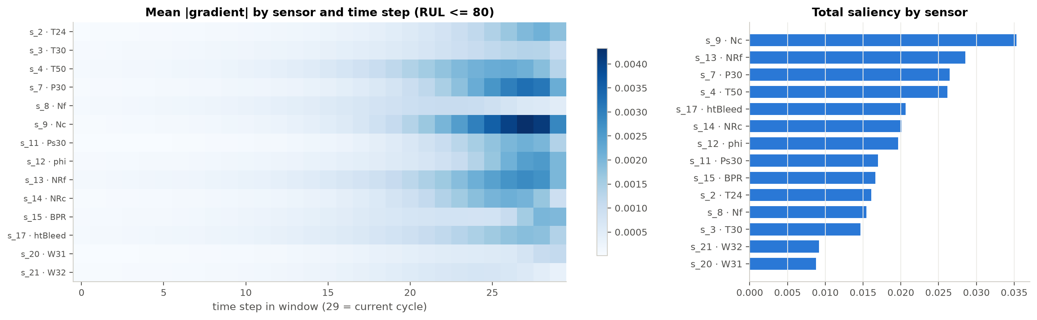
What the sequence branch looks at
PRESENTER · VANSH
The last ~10 cycles matter most
the oldest part of the window is barely used, consistent with the window ablation
Core speeds Nc and NRc lead
the sensors the hand-made features use least, so the branches complement each other
Notes:
Presenter: Vansh. Gradient saliency measures how much the prediction would change if each input value changed slightly. The network concentrates on the last ten or so cycles. The sensors it relies on most are the core speeds, s_9 and s_14, which were the weakest sensors in Phase 1's ranking and got little weight in the health index. So the sequence branch uses exactly the signal the engineered features use least. Saliency shows sensitivity, not causation.

Slide 16
What Phase 2 showed
PRESENTER · NISHANT
1
Sequence models learn real patterns
3 to 3.5 cycles better than raw features, but significantly behind engineered ones on 100 engines
Still open
Fast-degrading engines are about 10 cycles late for every model, because all of them use the engine's age. Next: rate-based features, and FD002–FD004.
2
The reason is identified
each engine's healthy baseline and age lie outside any fixed window
3
The hybrid closes the gap
level with the best Phase 1 model, lowest error in every stage over all test cycles
4
Features are the backbone
sequence learning works best as a complement, not a replacement
github.com/WhiteHacker000/Remaining-Useful-Life-Prediction-for-Industrial-Engines
Notes:
Presenter: Nishant. Four takeaways. Sequence models learn real degradation patterns but, on 100 engines, do not match engineered features. We identified why: the key information is outside the window. The hybrid fixes that and matches the best Phase 1 model, with a small edge across the stages. So domain features stay the backbone and deep learning complements them. One weak spot is still open: fast-degrading engines, which every model predicts late. Thank you, we are happy to take questions.

