Slide 1

Authentification
Architecture
11/10/2022

Slide 2

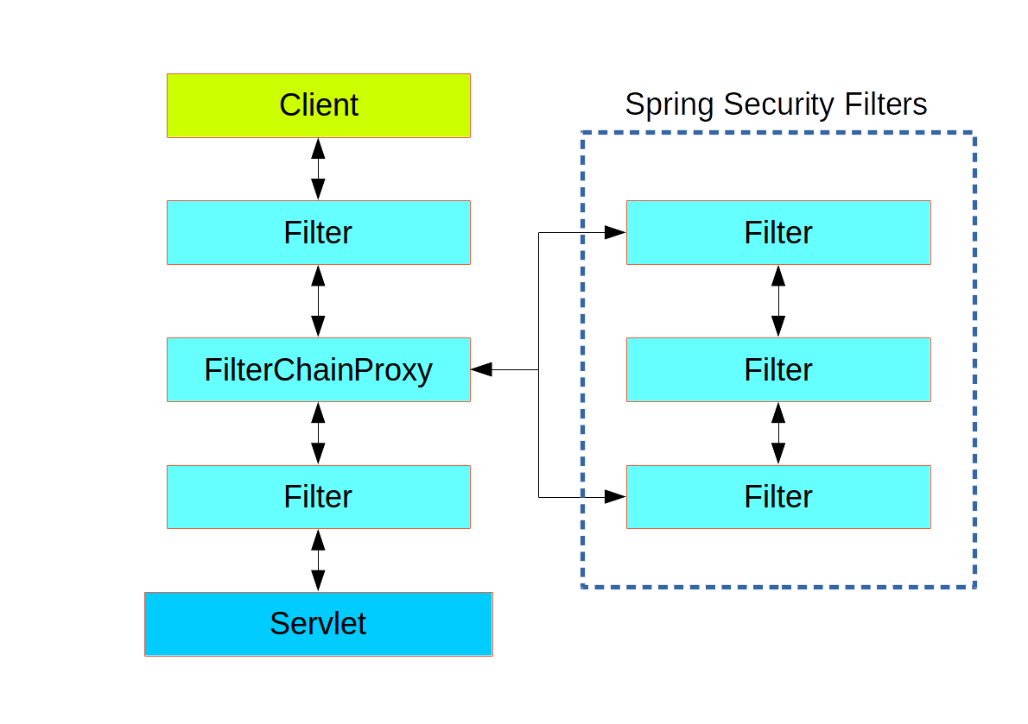
Authentication and Access Control
Application security boils down to 2 problems:
authentication (who are you?)
authorization (what are you allowed to do?). == access control
Spring Security has an architecture that is designed to separate authentication from authorization and has strategies and extension points for both.
Authentication
The main strategy interface for authentication is AuthenticationManager, which has only one method: authenticate()
public interface AuthenticationManager {
Authentication authenticate(Authentication authentication) throws AuthenticationException;
}
An AuthenticationManager can do one of 3 things in its authenticate() method:
Return an Authentication (normally with authenticated=true) if it can verify that the input represents a valid principal.
Throw an AuthenticationException if it believes that the input represents an invalid principal.
Return null if it cannot decide.
The most common used implementation of AuthenticationManager is to use AuthenticationProvider it’s a bit like Manger but has an extra method « supports » that return the supported authentication type in the AuthenticationProvider
Between the client and the servlet many filters and in the middle of the filter exists FilterChainProxy == Spring security filter is a single physical Filter but delegates processing to a chain of internal filters.
The client sends a request to the application, the container decides which filters and which servlet apply to it based on the request URI.
The filers are in a specific order, they form a chain of filter , each early filter can veto the rest of filters if it wants to handle the request itself.
Afilter can modify a request or response in the downstream filters.
There can be multiple filter chains all managed by spring security in the same top level all unknow to the container.
The spring security Filter can have a list of filter chains and dispatch a request to the first filter chain that match it.

Slide 3
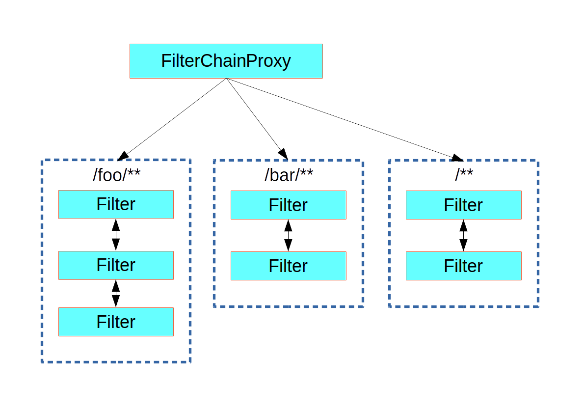
Authentication and Access Control
Spring security filter lay can have many filter that work internaly unkown to the container
Spring security filter layer can have many filter chains, each chain can have many filters

Slide 4
Modèle de base
Class AbstractAuthenticationToken
Interface Fields:
Collection<GrantedAuthority> authorities;
Object details;
Boolean authenticated = false;
Methods:
getName() → if getPrincipal() instanceOf UserDetails return username, if getPrincipal() instanceOf Principal return name, if null return « »
isAuthenticated() → default = false
setAuthenticated()
getDetails();
setDetails();
eraseCredentials() → eraseCreentials() + erasePrincipal() + eraseDetails()
Interface Authentification
Collection<? Enxtends GrantedAuth> getAuthorities()
Object getCredentials()
Object getDetails()
Object getPrincipal()
Boolean isAuthenticated()
Void setAuthenticated()
Interface CredentialsContainer
Indicates that the implementing object contains sensitive data, which can be erased
Void eraseCredentials()
Interface Principal
Equals()
toString()
hashCode()
getName() return the name of principal
Interface Serializable

Slide 5
Authentication Description
Collection<? Enxtends GrantedAuth> getAuthorities() →Set by an AuthenticationManager to indicate the authorities that the principal has been granted. Note that classes should not rely on this value as being valid unless it has been set by a trusted AuthenticationManager.Implementations should ensure that modifications to the returned collection array do not affect the state of the Authentication object, or use an unmodifiable instance.Returns:the authorities granted to the principal, or an empty collection if the token has not been authenticated. Never null.
Object getCredentials() -> proves the principal is correct , usually password but could be anything.
Object getDetails() -> store additional details about authentication request like ( ip, certif serial num … )
Object getPrincipal() -> identity of the principal being authenticated, in the case of username/pass →this would be username
Boolean isAuthenticated() →used to indicated to AbstractSecurityInterceptor whether it should present the authentication token to AuthenticationManager. Typically an AuthenticationManager (or, more often, one of its AuthenticationProviders) will return an immutable authentication token after successful authentication, in which case that token can safely return true to this method. Returning true will improve performance, as calling the AuthenticationManager for every request will no longer be necessary.
Void setAuthenticated() →Implementations should always allow this method to be called with a false parameter, as this is used by various classes to specify the authentication token should not be trusted. If an implementation wishes to reject an invocation with a true parameter (which would indicate the authentication token is trusted - a potential security risk) the implementation should throw an IllegalArgumentException.
Params:
isAuthenticated – true if the token should be trusted (which may result in an exception) or false if the token should not be trusted
Throws:
IllegalArgumentException – if an attempt to make the authentication token trusted (by passing true as the argument) is rejected due to the implementation being immutable or implementing its own alternative approach to isAuthenticated()

Slide 6
Important spring security Filters
UsernamePasswordAuthenticationFilter: process authentication, responds by default to “/login” URL
AnonymousAuthenticationFilter: when there's no authentication object in SecurityContextHolder, it creates an anonymous authentication object and put it there
FilterSecurityInterceptor: raise exceptions when access is denied
ExceptionTranslationFilter: catch Spring Security exceptions

Slide 7
Exceptions
AuthenticationException: Abstract superclass for all exceptions related to an Authentication object being invalid for whatever reason.

Slide 8
Authentication Description
AuthenticationProvider
Authenticate()
supports() → PWD
UserDetailsService
loadByUsername()
Identity DB
ExceptionTransaltionError
Filter
Authentication
Credentials
AuthenticationManager
Authenticate()
AuthenticationProvider
Authenticate()
supports() → ldap
Input
Output
Authentication
Principal
AuthenticationProvider
Authenticate()
supports() → Oauth2
Filter Layer

Slide 9
Fin

