Slide 1

第5.2节 常用统计分布
一、常见分布
二、概率分布的分位数
三、小结

Slide 2
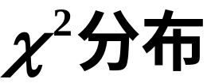
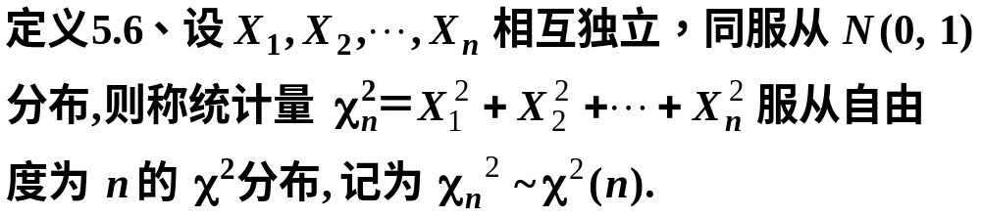

一、常见分布
1.
随机数演示
分布函数与密度函数演示

Slide 3
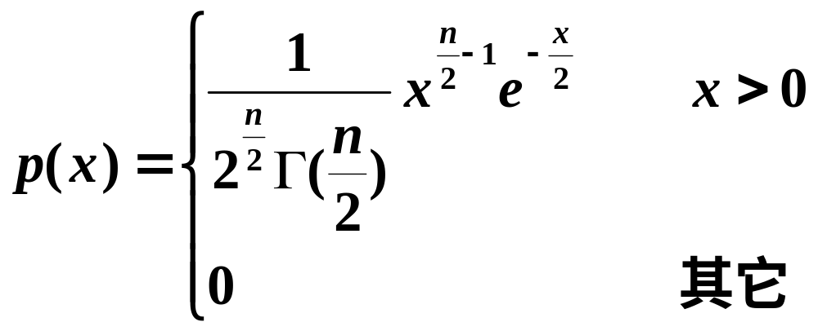


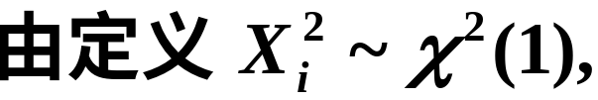
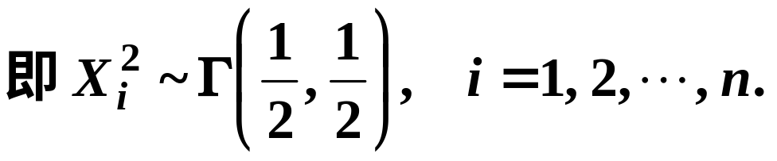
证明

Slide 4
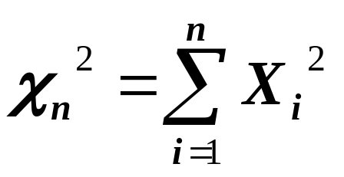
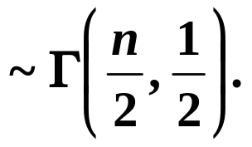

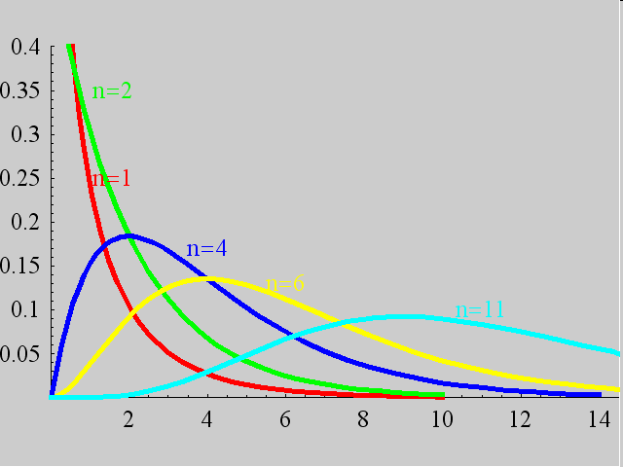

Slide 5

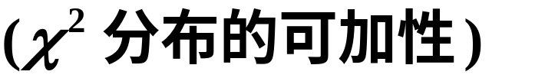


性质1
(此性质可以推广到多个随机变量的情形)

Slide 6



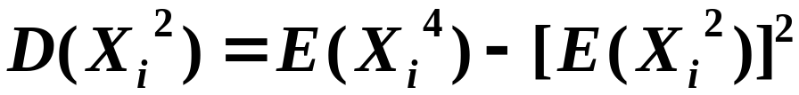
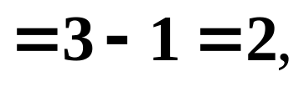

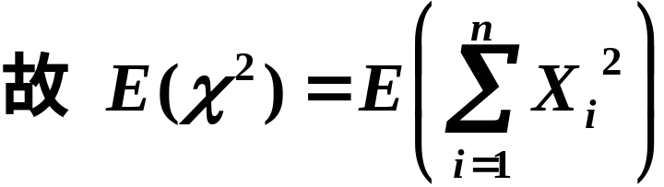
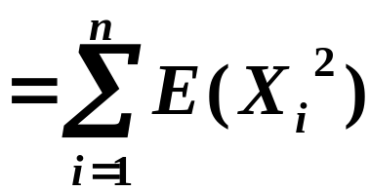

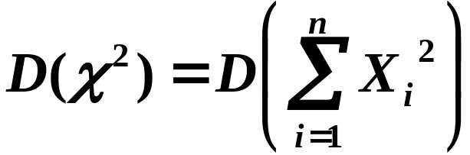
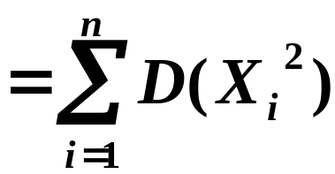

性质2
证明

Slide 7
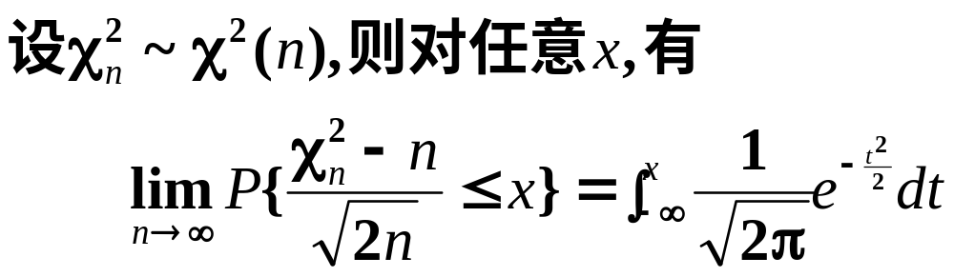

性质3

Slide 8
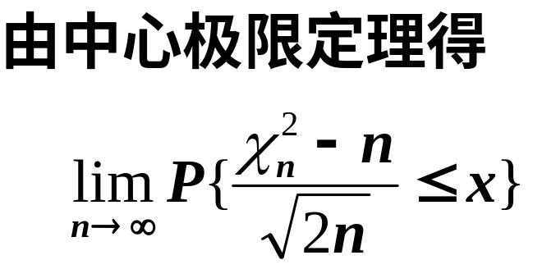
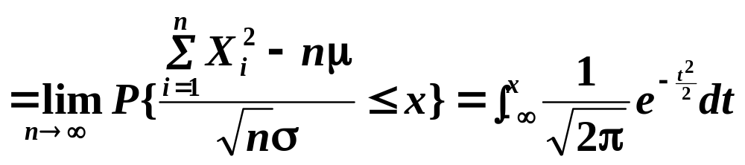
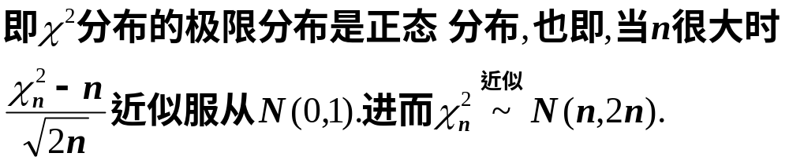

Slide 9
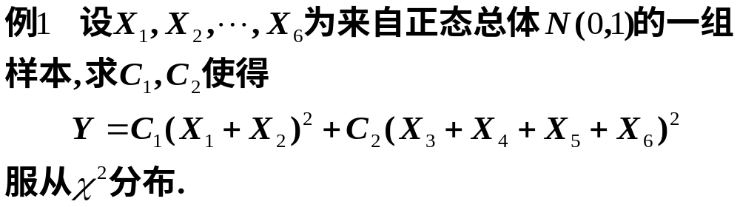
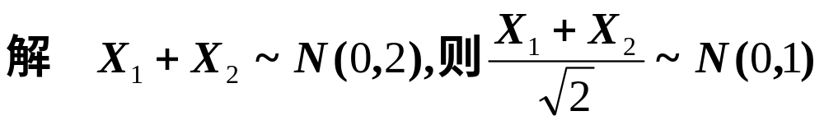
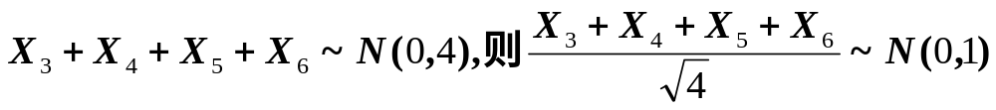
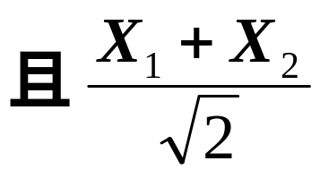
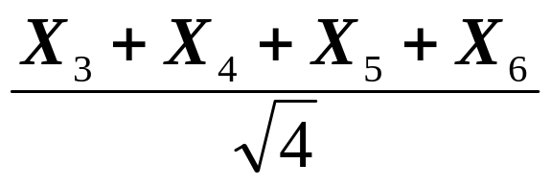
同理
与
相互独立

Slide 10
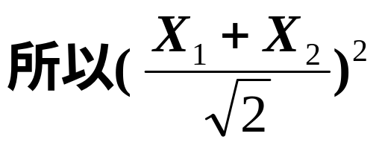
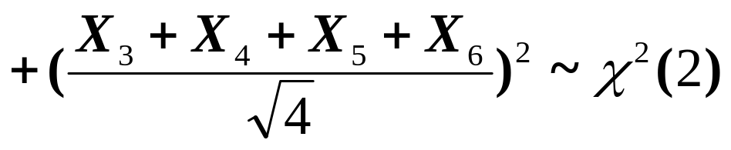


Slide 11

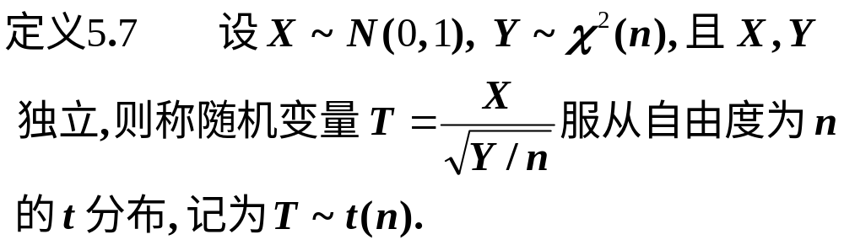
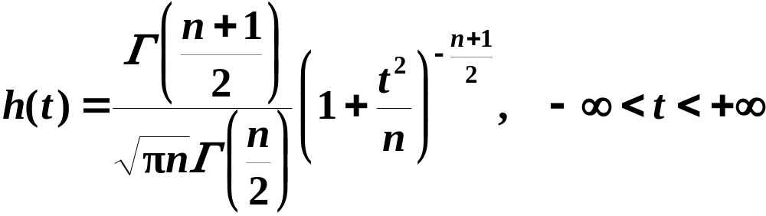
2.
学生氏资料
t 分布又称学生氏(Student)分布.
随机数演示
分布函数与密度函数演示

Slide 12


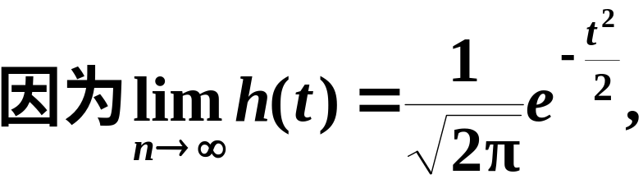
当n充分大时, 其图形类似于标准正态变量概率密度的图形.

Slide 13
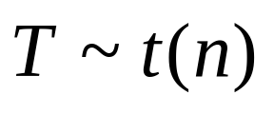

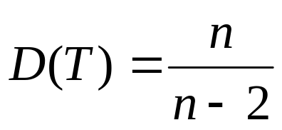
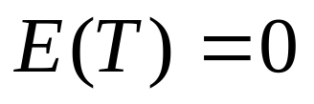

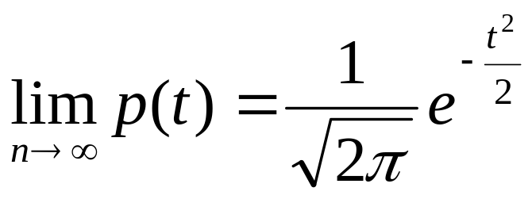

t 分布具有下列性质：
性质5.6 设 , 则当 时有
性质5.7 设 ， 是T的分布密度，
则
此性质说明，当 时，T分布的极限
分布是标准正态分布。

Slide 14
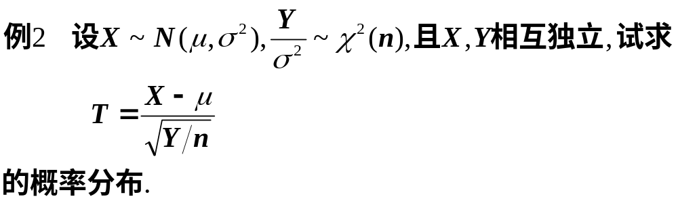
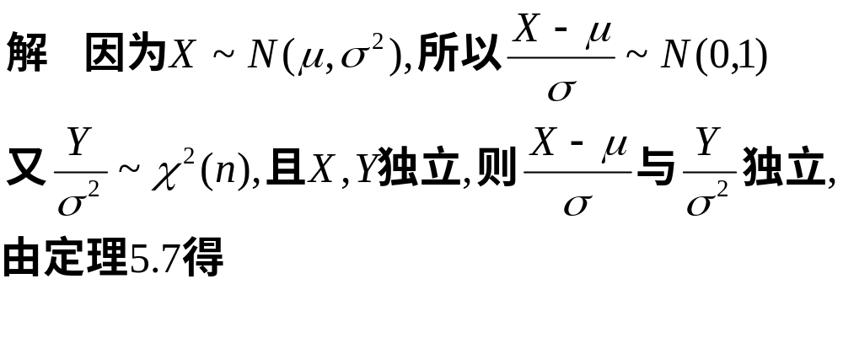
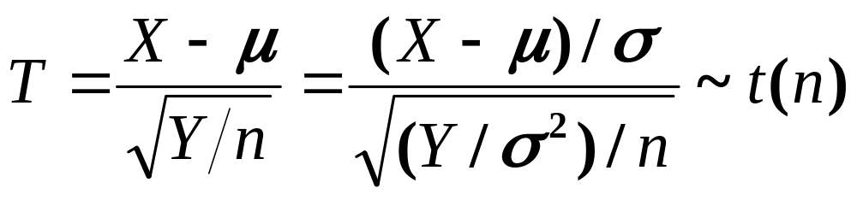

Slide 15

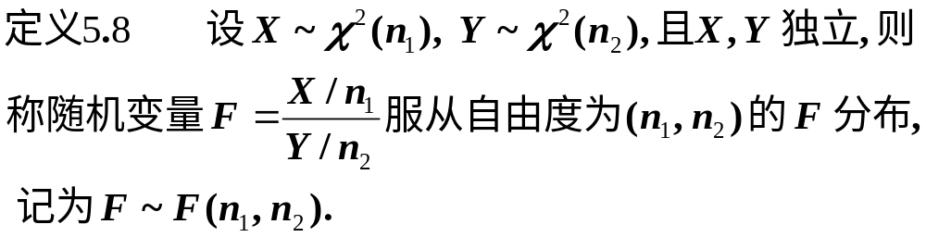
3.
随机数演示
分布函数与密度函数演示

Slide 16
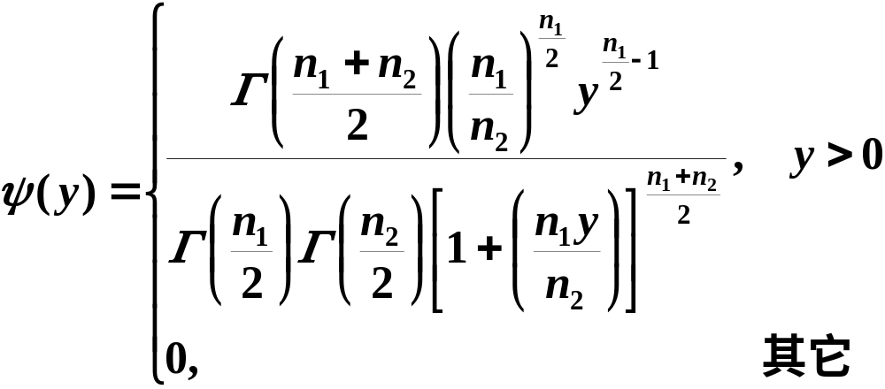

Slide 17
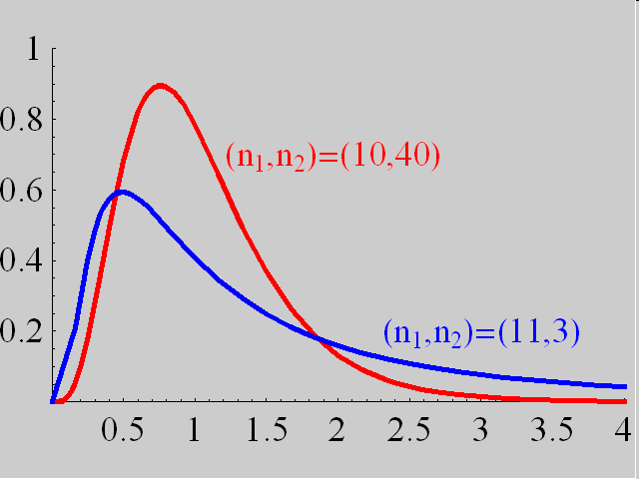

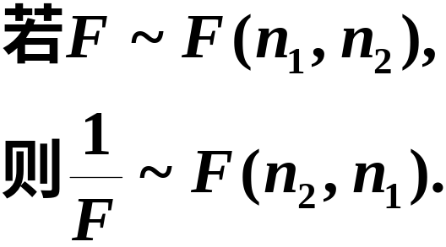
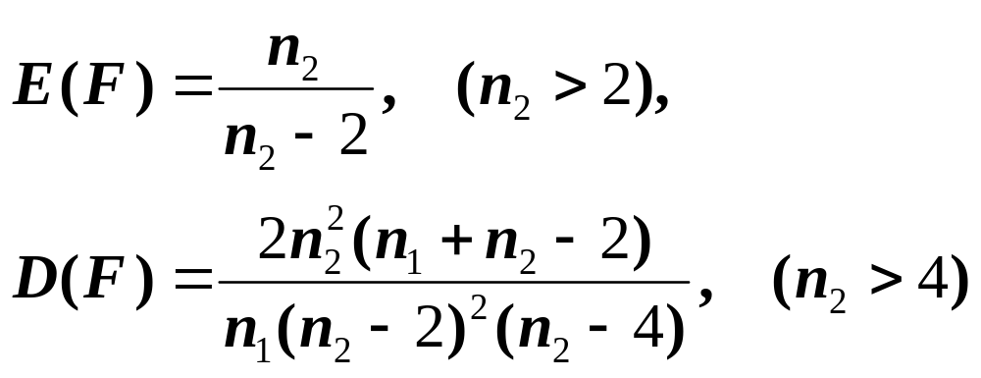
(1)
(2)

Slide 18
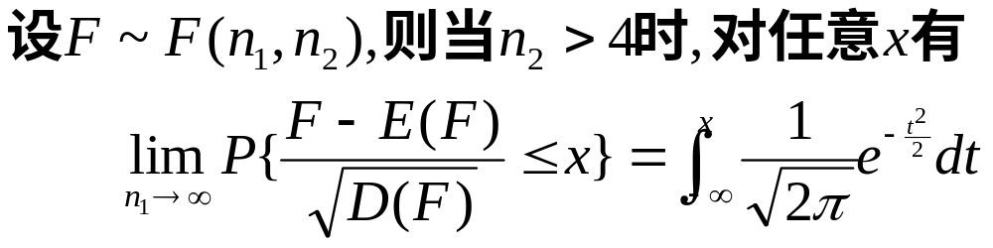
(3)
这说明F分布极限分布也是正态分布.

Slide 19
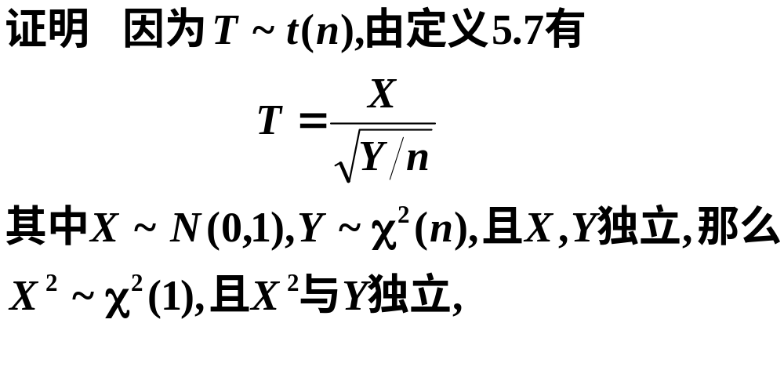
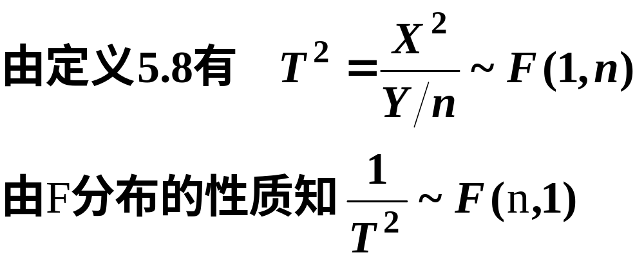

Slide 20
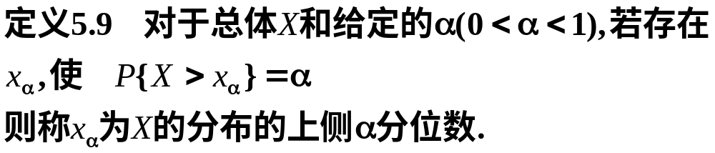
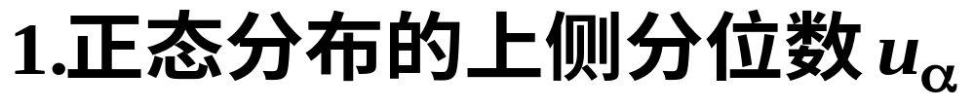
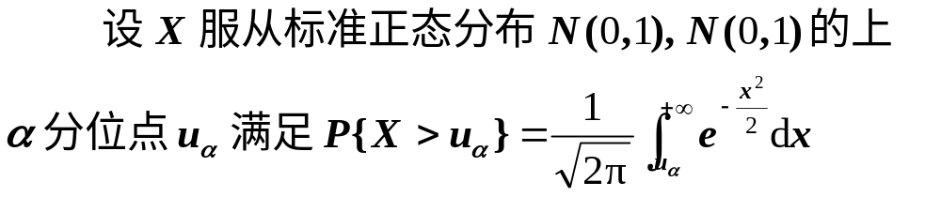
二、概率分布的分位数

Slide 21
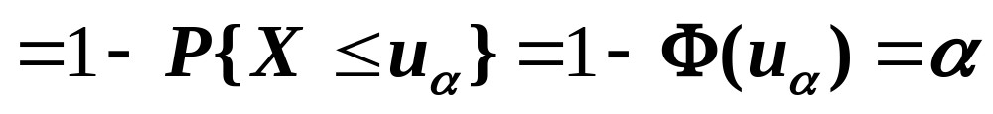
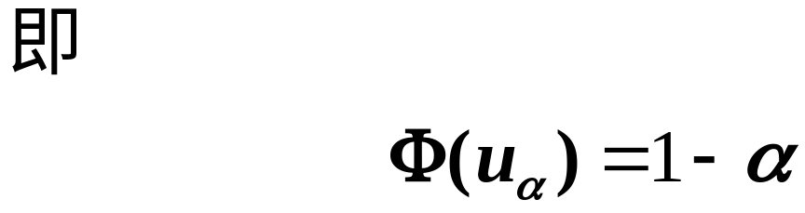

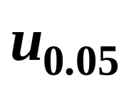





附表2-1
附表2-2
根据正态分布的对称性知

Slide 22






由分布的对称性知

Slide 23





附表3-1
附表3-2
在Matlab中求解

Slide 24





Slide 25







附表4-1
附表4-2
附表4-3
附表4只详列到 n=45 为止.
在Matlab中求解

Slide 26




费歇(R.A.Fisher)证明:
费歇资料
利用上公式,
例如
而查详表可得

Slide 27







附表5-1
附表5-2
在Matlab中求解

Slide 28






证明

Slide 29









Slide 30

三、小结
1.三个来自正态分布的抽样分布:
的定义,性质.
2.分位数的概念.

Slide 31


辛钦定理

Slide 32
附表2-1
标准正态分布表
z | 0.00 | 0.01 | 0.02 | 0.03 | 0.04 | 0.05 | 0.06 | 0.07 | 0.08 | 0.09
0.0 0.1 0.2 0.3 0.4 0.5 0.6 0.7 0.8 0.9 1.0 1.1 1.2 1.3 1.4 1.5 1.6 | 0.5000 0.5398 0.5793 0.6179 0.6554 0.6915 0.7257 0.7580 0.7881 0.8159 0.8413 0.8643 0.8849 0.9032 0.9192 0.9332 0.9452 | 0.5040 0.5438 0.5832 0.6217 0.6591 0.6950 0.7291 0.7611 0.7910 0.8186 0.8438 0.8665 0.8869 0.9049 0.9207 0.9345 0.9463 | 0.5080 0.5478 0.5871 0.6255 0.6628 0.6985 0.7324 0.7642 0.7939 0.8212 0.8461 0.8686 0.8888 0.9066 0.9222 0.9357 0.9474 | 0.5120 0.5517 0.5910 0.6293 0.6664 0.7019 0.7357 0.7673 0.7967 0.8238 0.8485 0.8708 0.8907 0.9082 0.9236 0.9370 0.9484 | 0.5160 0.5557 0.5948 0.6331 0.6700 0.7054 0.7389 0.7703 0.7995 0.8264 0.8508 0.8729 0.8925 0.9099 0.9251 0.9382 0.9495 | 0.5199 0.5596 0.5987 0.6368 0.6736 0.7088 0.7422 0.7734 0.8023 0.8289 0.8531 0.8749 0.8944 0.9115 0.9265 0.9394 0.9505 | 0.5239 0.5636 0.6026 0.6406 0.6772 0.7123 0.7454 0.7764 0.8051 0.8315 0.8554 0.8770 0.8962 0.9131 0.9278 0.9406 0.9515 | 0.5279 0.5675 0.6064 0.6443 0.6808 0.7157 0.7486 0.7794 0.8078 0.8340 0.8577 0.8790 0.8980 0.9147 0.9292 0.9418 0.9525 | 0.5319 0.5714 0.6103 0.6480 0.6844 0.7190 0.7517 0.7823 0.8106 0.8365 0.8599 0.8810 0.8997 0.9162 0.9306 0.9430 0.9535 | 0.5359 0.5753 0.6141 0.6517 0.6879 0.7224 0.7549 0.7852 0.8133 0.8389 0.8621 0.8830 0.9015 0.9177 0.9319 0.9441 0.9545
1.645

Slide 33
附表2-2
标准正态分布表
z | 0.00 | 0.01 | 0.02 | 0.03 | 0.04 | 0.05 | 0.06 | 0.07 | 0.08 | 0.09
1.6 1.7 1.8 1.9 2.0 2.1 2.2 2.3 2.4 2.5 2.6 2.7 2.8 2.9 3.0 | 0.9452 0.9554 0.9641 0.9713 0.9772 0.9821 0.9861 0.9893 0.9918 0.9938 0.9953 0.9965 0.9974 0.9981 0.9987 | 0.9463 0.9564 0.9648 0.9719 0.9778 0.9826 0.9864 0.9896 0.9920 0.9940 0.9955 0.9966 0.9975 0.9982 0.9990 | 0.9474 0.9573 0.9656 0.9726 0.9783 0.9830 0.9868 0.9898 0.9922 0.9941 0.9956 0.9967 0.9976 0.9982 0.9993 | 0.9484 0.9582 0.9664 0.9732 0.9788 0.9834 0.9871 0.9901 0.9925 0.9943 0.9957 0.9968 0.9977 0.9983 0.9995 | 0.9495 0.9591 0.9671 0.9738 0.9793 0.9838 0.9871 0.9904 0.9927 0.9945 0.9959 0.9969 0.9977 0.9984 0.9997 | 0.9505 0.9599 0.9678 0.9744 0.9798 0.9842 0.9878 0.9906 0.9929 0.9946 0.9960 0.9970 0.9978 0.9984 0.9698 | 0.9515 0.9608 0.9686 0.9750 0.9803 0.9846 0.9881 0.9909 0.9931 0.9948 0.9961 0.9971 0.9979 0.9985 0.9998 | 0.9525 0.9616 0.9693 0.9756 0.9808 0.9850 0.9884 0.9911 0.9932 0.9949 0.9962 0.9972 0.9979 0.9985 0.9999 | 0.9535 0.9625 0.9700 0.9762 0.9812 0.9854 0.9887 0.9913 0.9934 0.9951 0.9963 0.9973 0.9980 0.9986 0.9999 | 0.9545 0.9633 0.9706 0.9767 0.9817 0.9853 0.9890 0.9916 0.9936 0.9952 0.9964 0.9974 0.9981 0.9986 1.0000
1.96

Slide 34



附表4-1
分布表
 | = 0.25 | 0.10 | 0.05 | 0.025 | 0.01 | 0.005
1 2 3 4 5 6 7 8 9 10 11 12 13 14 15 16 | 1.323 2.773 4.108 5.385 6.626 7.841 9.037 10.219 11.389 12.549 13.701 14.845 15.984 17.117 18.245 19.369 | 2.706 4.605 6.251 7.779 9.236 10.645 12.017 13.362 14.684 15.987 17.275 18.549 19.812 20.064 22.307 23.542 | 3.841 5.991 7.815 9.488 11.071 12.592 14.067 15.507 16.919 18.307 19.675 21.026 22.362 23.685 24.996 26.296 | 5.024 7.378 9.348 11.143 12.833 14.449 16.013 17.535 19.023 20.483 21.920 23.337 24.736 26.119 27.488 28.845 | 6.635 9.210 11.345 13.277 15.086 16.812 18.475 20.090 21.666 23.209 24.725 26.217 27.688 29.141 30.578 32.000 | 7.879 10.597 12.838 14.860 16.750 18.548 20.278 21.955 23.589 25.188 26.757 28.299 29.891 31.319 32.801 34.267
17.535

Slide 35
附表4-2
分布表
 | =0.995 | 0.99 | 0.975 | 0.95 | 0.90 | 0.75
1 2 3 4 5 6 7 8 9 10 11 12 13 14 15 16 | 0.010 0.072 0.207 0.412 0.676 0.989 1.344 1.735 2.156 2.603 3.074 3.565 4.075 4.601 5.142 | 0.020 0.115 0.297 0.554 0.872 1.239 1.646 2.088 2.558 3.053 3.571 4.107 4.660 5.229 5.812 | 0.001 0.051 0.216 0.484 0.831 1.237 1.690 2.180 2.700 3.247 3.816 4.404 5.009 5.629 6.262 6.908 | 0.004 0.103 0.352 0.711 1.145 1.635 2.167 2.733 3.325 3.940 4.575 5.226 5.892 6.571 7.261 7.962 | 0.016 0.211 0.584 1.064 1.610 2.204 2.833 3.490 4.168 4.865 5.578 6.304 7.042 7.790 8.547 9.312 | 0.102 0.575 1.213 1.923 2.675 3.455 4.255 5.071 5.899 6.737 7.584 8.438 9.299 10.165 11.037 11.912
3.247

Slide 36
附表4-3
分布表
 | =0.25 | 0.10 | 0.05 | 0.025 | 0.01 | 0.005
17 18 19 20 21 22 23 24 25 26 27 28 29 30 31 32 | 20.489 21.605 22.718 23.828 24.935 26.039 27.141 28.241 29.339 30.435 31.528 32.620 33.711 34.800 35.887 36.973 | 24.769 25.989 27.204 28.412 29.615 30.813 32.007 33.196 34.382 35.563 36.741 37.916 39.087 40.256 41.422 42.585 | 27.587 28.869 30.144 31.410 32.671 33.924 35.172 36.415 37.652 38.885 40.113 41.337 42.557 43.773 44.985 46.194 | 30.191 31.526 32.852 34.170 35.479 36.781 38.076 39.364 40.646 41.923 43.194 44.461 45.712 46.979 48.232 49.480 | 33.409 34.805 36.191 37.566 38.932 40.289 41.638 42.980 44.314 45.642 46.963 48.278 49.588 50.892 52.191 53.486 | 35.718 37.156 38.582 39.997 41.401 42.796 44.181 45.559 46.928 48.290 49.645 50.993 52.336 53.672 55.003 56.328
34.382

Slide 37

附表3-1
分布表
 | =0.25 | 0.10 | 0.05 | 0.025 | 0.01 | 0.005
1 2 3 4 5 6 7 8 9 10 11 12 13 14 15 16 | 1.0000 0.8165 0.7649 0.7407 0.7267 0.7176 0.7111 0.7064 0.7027 0.6998 0.6974 0.6955 0.6938 0.6924 0.6912 0.6901 | 3.0777 1.8856 1.6377 1.5332 1.4759 1.4398 1.4149 1.3968 1.3830 1.3722 1.3634 1.3562 1.3502 1.3450 1.3406 1.3368 | 6.3138 2.9200 2.3534 2.1318 2.0150 1.9432 1.8946 1.8595 1.8331 1.8125 1.7959 1.7823 1.7709 1.7613 1.7531 1.7459 | 12.7062 4.3027 3.1824 2.7764 2.5706 2.4469 2.3646 2.3060 2.2622 2.2281 2.2010 2.1788 2.1604 2.1448 2.1315 2.1199 | 31.8207 6.9646 4.5407 3.7469 3.3649 3.1427 2.9980 2.8965 2.8214 2.7638 2.7181 2.6810 2.6503 2.6245 2.6025 2.5835 | 63.6574 9.9248 5.8409 4.6041 4.0322 3.7074 3.4995 3.3554 3.2498 3.1693 3.1058 3.0545 3.0123 2.9768 2.9467 2.9208
1.8125

Slide 38
附表3-2
分布表
 | =0.25 | 0.10 | 0.05 | 0.025 | 0.01 | 0.005
1 2 3 4 5 6 7 8 9 10 11 12 13 14 15 16 | 1.0000 0.8165 0.7649 0.7407 0.7267 0.7176 0.7111 0.7064 0.7027 0.6998 0.6974 0.6955 0.6938 0.6924 0.6912 0.6901 | 3.0777 1.8856 1.6377 1.5332 1.4759 1.4398 1.4149 1.3968 1.3830 1.3722 1.3634 1.3562 1.3502 1.3450 1.3406 1.3368 | 6.3138 2.9200 2.3534 2.1318 2.0150 1.9432 1.8946 1.8595 1.8331 1.8125 1.7959 1.7823 1.7709 1.7613 1.7531 1.7459 | 12.7062 4.3027 3.1824 2.7764 2.5706 2.4469 2.3646 2.3060 2.2622 2.2281 2.2010 2.1788 2.1604 2.1448 2.1315 2.1199 | 31.8207 6.9646 4.5407 3.7469 3.3649 3.1427 2.9980 2.8965 2.8214 2.7638 2.7181 2.6810 2.6503 2.6245 2.6025 2.5835 | 63.6574 9.9248 5.8409 4.6041 4.0322 3.7074 3.4995 3.3554 3.2498 3.1693 3.1058 3.0545 3.0123 2.9768 2.9467 2.9208
2.1315

Slide 39





附表5-1
分布表
 | 1 | 2 | 3 | 4 | 5 | 6 | 7 | 8 | 9 | 10 | 12 | 15 | 20 | 24 | 30 | 40 | 120
1 2 3 4 5 6 7 8 9 10 11 12 13 14 15 16 17 18 19 | 647.8 38.51 17.44 12.22 10.01 8.81 8.07 7.57 7.21 6.94 6.72 6.55 6.41 6.30 6.20 6.12 6.04 5.95 5.92 | 799.5 39.00 16.04 10.65 8.43 7.26 6.54 6.06 5.71 5.46 5.26 5.10 4.97 4.86 4.77 4.69 4.62 4.56 4.51 | 864.2 39.17 15.44 9.98 7.76 6.60 5.89 5.42 5.08 4.83 4.63 4.47 4.35 4.24 4.15 4.08 4.01 3.95 3.90 | 899.6 39.25 15.10 9.60 7.39 6.23 5.52 5.50 4.72 4.47 4.28 4.12 4.00 3.89 3.80 3.73 3.66 3.61 3.56 | 921.8 39.30 14.88 9.36 7.15 5.99 5.29 4.82 4.48 4.24 4.04 3.89 3.77 3.66 3.58 3.50 3.44 3.38 3.33 | 937.1 39.33 14.73 9.20 6.98 5.82 5.12 4.65 4.23 4.07 3.88 3.73 3.60 3.50 3.41 3.34 3.28 3.22 3.17 | 948.2 39.36 14.62 9.07 6.85 5.70 4.99 4.53 4.20 3.95 3.76 3.61 3.48 3.38 3.29 3.22 3.16 3.10 3.05 | 956.7 39.37 14.54 8.98 6.76 5.60 4.90 4.43 4.10 3.85 3.66 3.51 3.39 3.29 3.20 3.12 3.06 3.01 2.96 | 963.3 39.39 14.47 8.90 6.68 5.52 4.82 4.36 4.03 3.78 3.59 3.44 3.31 3.21 3.12 3.05 2.98 2.93 2.88 | 968.6 39.40 14.42 8.84 6.62 5.46 4.76 4.30 3.96 3.72 3.53 3.37 3.25 3.15 3.06 2.99 2.92 2.87 2.82 | 976.7 39.41 14.34 8.75 6.52 5.37 4.67 4.20 3.87 3.62 3.43 3.28 3.15 3.05 2.96 2.89 2.82 2.77 2.72 | 984.9 39.43 14.25 8.66 6.43 5.27 4.57 4.10 3.77 3.52 3.33 3.18 3.05 2.95 2.86 2.79 2.72 2.67 2.62 | 993.1 39.45 14.17 8.56 6.33 5.17 4.47 4.00 3.67 3.42 3.23 3.07 2.95 2.84 2.76 2.68 2.62 2.56 2.51 | 997.2 39.46 14.12 8.51 6.28 5.12 4.42 3.59 3.61 3.37 3.17 3.02 2.89 2.79 2.70 2.63 2.56 2.50 2.45 | 1001 39.46 14.08 8.46 6.23 5.07 4.36 3.89 3.56 3.31 3.12 2.96 2.84 2.73 2.64 2.57 2.50 2.44 2.39 | 1006 39.47 14.04 8.41 6.18 5.01 4.31 3.84 3.51 3.26 3.06 2.91 2.78 2.67 2.59 2.51 2.44 2.38 2.33 | 1014 39.49 13.95 8.31 6.07 4.90 4.20 3.73 3.39 3.14 2.94 2.79 2.66 2.55 2.46 2.38 2.32 2.26 2.20 | 1018 39.50 13.90 8.26 6.02 4.85 4.14 3.67 3.33 3.08 2.88 2.72 2.60 2.49 2.40 2.32 2.25 2.19 2.13
4.90

Slide 40

附表5-2
分布表
 | 1 | 2 | 3 | 4 | 5 | 6 | 7 | 8 | 9 | 10 | 15 | 20 | 24 | 30 | 40 | 60 | 120
1 2 3 4 5 6 7 8 9 10 11 12 13 14 15 16 17 18 19 | 161.4 18.51 10.13 7.71 6.61 5.99 5.59 5.32 3.12 4.96 4.84 4.75 4.67 4.60 4.54 4.49 4.45 4.41 4.38 | 199.5 19.00 9.55 6.94 5.79 5.14 4.74 4.46 4.26 4.10 3.98 3.89 3.81 3.74 3.68 3.63 3.59 5.55 3.52 | 215.7 19.16 9.28 6.59 5.41 4.76 4.35 4.07 3.81 3.71 3.59 3.49 3.41 3.34 3.29 3.24 3.20 3.16 3.13 | 224.6 19.25 9.12 6.39 5.19 4.53 4.12 3.84 3.63 3.48 3.36 3.26 3.18 3.11 3.06 3.01 2.96 2.93 2.90 | 230.2 19.30 9.01 6.26 5.05 4.39 3.97 3.69 3.48 3.33 3.20 3.11 3.03 2.96 2.90 2.85 2.81 2.77 2.74 | 234.0 19.33 8.94 6.16 4.95 4.28 3.87 3.58 3.37 3.22 3.09 3.00 2.92 2.85 2.79 2.74 2.70 2.66 2.63 | 236.8 19.35 8.89 6.09 4.88 4.21 3.79 3.50 3.29 3.14 3.01 2.91 2.83 2.76 2.71 2.66 2.61 2.58 2.54 | 238.9 19.37 8.85 6.04 4.82 4.15 3.73 3.44 3.23 3.07 2.95 2.85 2.77 2.70 2.64 2.59 2.55 2.51 2.48 | 24.05 19.38 8.81 6.00 4.77 4.10 3.68 3.39 3.18 3.02 2.90 2.80 2.71 2.65 2.59 2.54 2.49 2.46 2.42 | 241.9 19.40 8.79 5.96 4.74 4.06 3.64 3.35 3.14 2.98 2.85 2.75 2.67 2.60 2.54 2.49 2.45 2.41 2.38 | 245.9 19.43 8.70 5.86 4.62 3.94 2.51 3.22 3.01 2.85 2.72 2.62 2.53 2.46 2.40 2.35 2.31 2.27 2.23 | 248.0 19.45 8.66 5.80 4.56 3.87 3.44 3.15 2.94 2.77 2.65 2.54 2.46 2.39 2.33 2.28 2.23 2.19 2.16 | 249.1 19.45 8.64 5.77 4.53 3.84 3.41 3.12 2.90 2.74 2.61 2.51 2.42 2.35 2.29 2.24 2.19 2.15 2.11 | 250.1 19.46 8.62 5.75 4.50 3.81 3.38 3.08 2.86 2.70 2.57 5.47 2.38 2.31 2.25 2.19 2.15 2.11 2.07 | 151.1 19.47 8.59 5.72 4.46 3.77 3.34 3.04 2.83 2.66 2.53 2.43 2.34 2.27 2.20 2.15 2.10 2.06 2.03 | 252.2 19.48 8.57 5.69 4.43 3.74 3.30 3.01 2.79 2.62 2.49 2.38 2.30 2.22 2.16 2.11 2.06 2.02 1.98 | 253.3 19.49 8.55 5.66 4.40 3.70 3.27 2.97 2.75 2.58 2.45 2.34 2.25 2.18 2.11 2.06 2.01 1.97 1.93 | 254.3 19.50 8.53 5.63 4.36 3.67 3.23 2.93 2.71 2.54 2.40 2.30 2.21 2.13 2.07 2.01 1.96 1.92 1.88
2.31

Slide 41

费歇资料
Ronald Aylmer Fisher
Born: 17 Feb 1890 in London, England
Died: 29 July 1962 in Adelaide, Australia

Slide 42

学生氏资料
William Sealey Gosset
Born: 13 June 1876 in Canterbury, England
Died: 16 Oct 1937 in Beaconsfield, England

Slide 43

格里汶科资料
Boris Vladimirovich Gnedenko
Born: 1 Jan 1912 in Simbirsk (now Ulyanovskaya), Russia
Died: 27 Dec 1995 in Moscow, Russia

