Slide 1
第5.2节 常用统计分布
一、常见分布
二、概率分布的分位数
三、小结

Slide 2
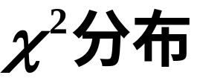
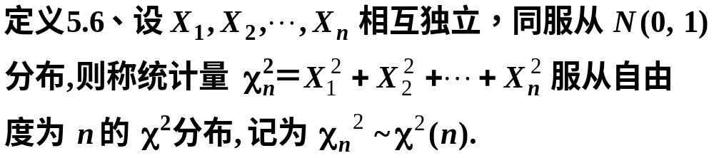

一、常见分布
1.
随机数演示
分布函数与密度函数演示

Slide 3
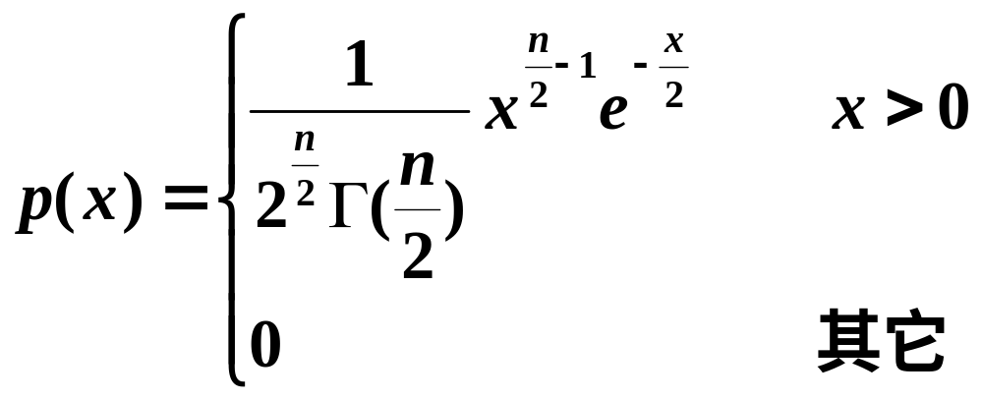


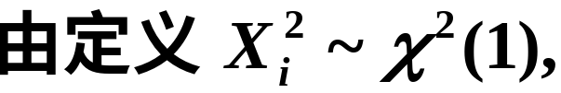
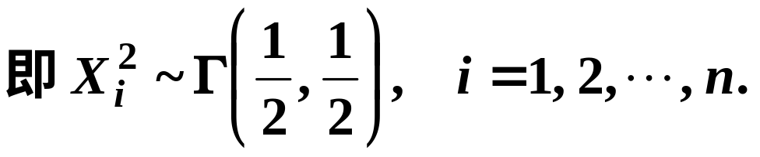
证明

Slide 4
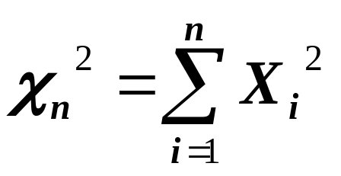
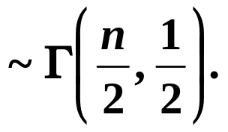

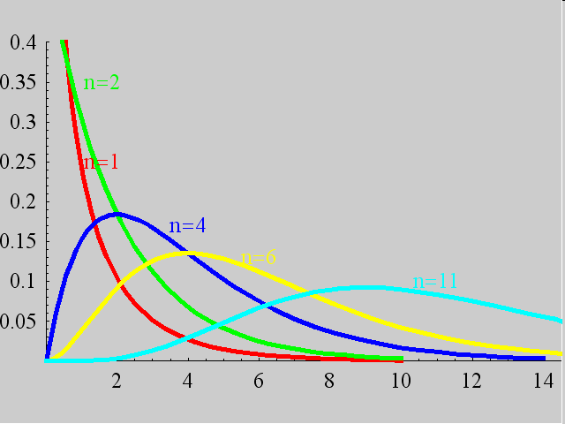

Slide 5

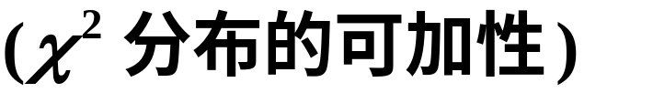

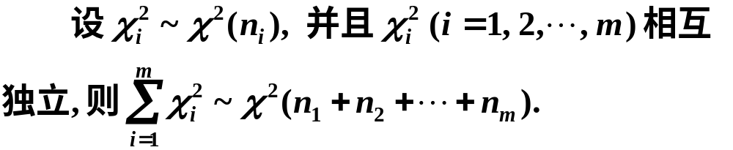
性质1
(此性质可以推广到多个随机变量的情形)

Slide 6



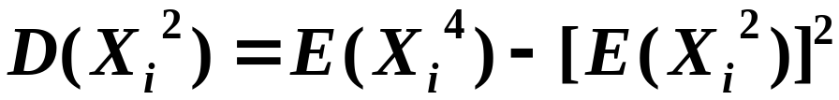
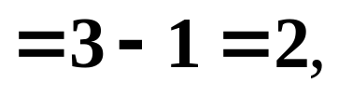

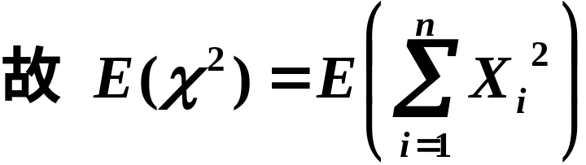
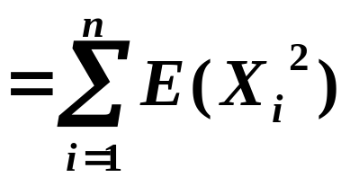

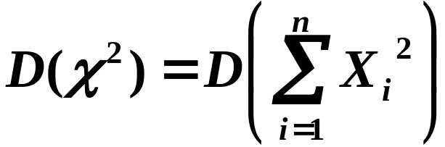
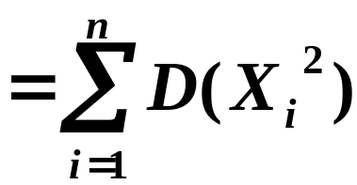

性质2
证明

Slide 7
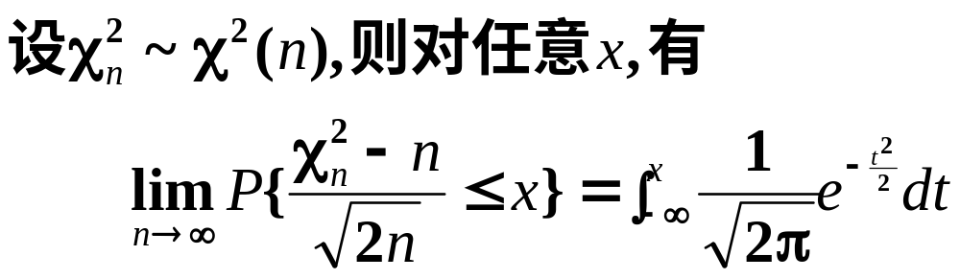

性质3

Slide 8
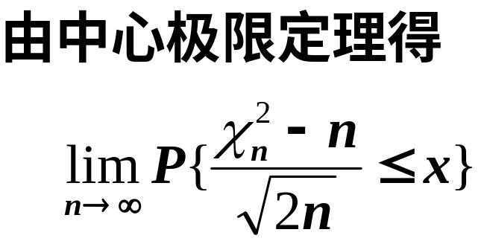
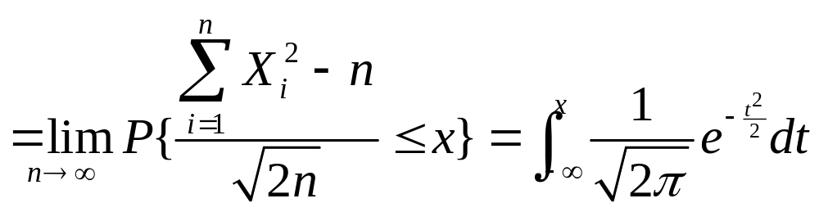
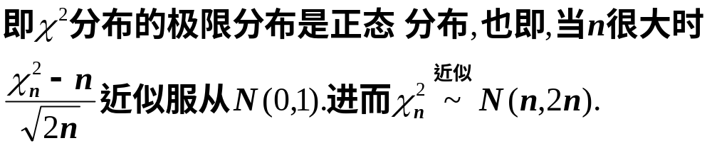

Slide 9
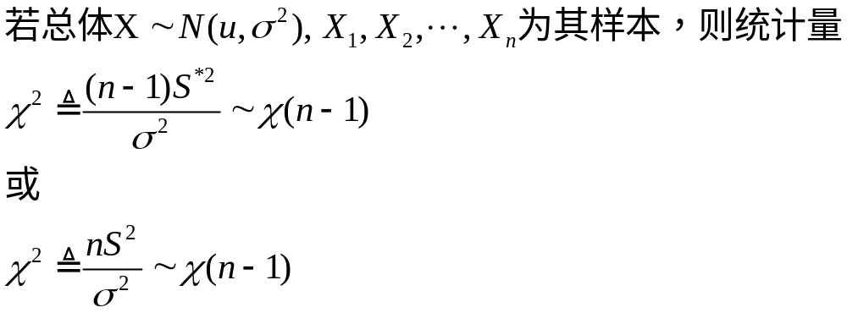
性质4

Slide 10

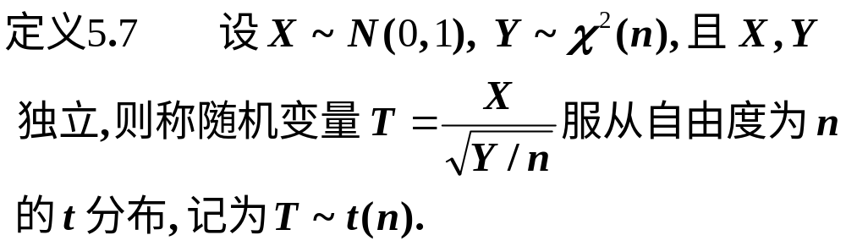
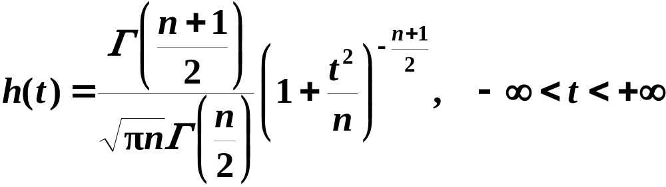
2.
学生氏资料
t 分布又称学生氏(Student)分布.
随机数演示
分布函数与密度函数演示

Slide 11


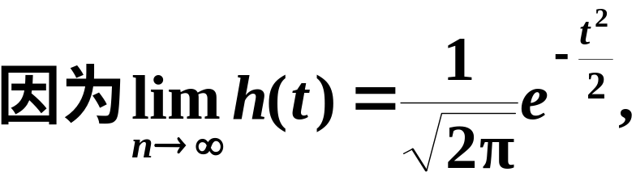
当n充分大时, 其图形类似于标准正态变量概率密度的图形.

Slide 12
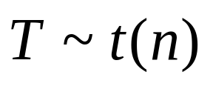

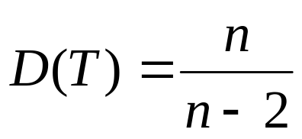
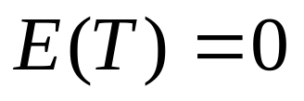

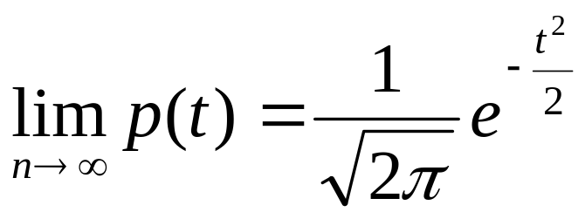

t 分布具有下列性质：
性质5.6 设 , 则当 时有
性质5.7 设 ， 是T的分布密度，
则
此性质说明，当 时，T分布的极限
分布是标准正态分布。

Slide 13
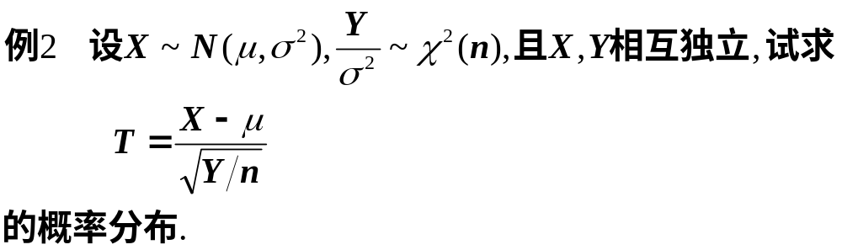
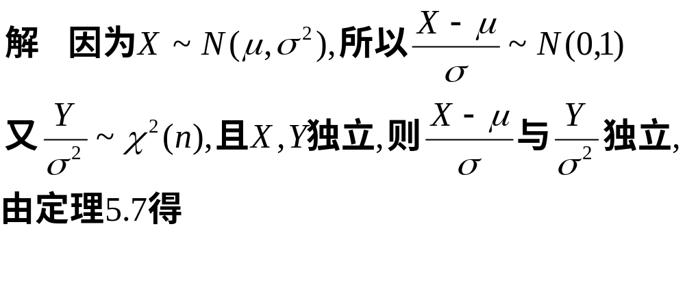
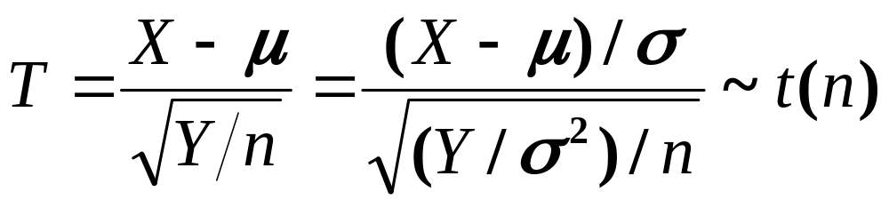

Slide 14
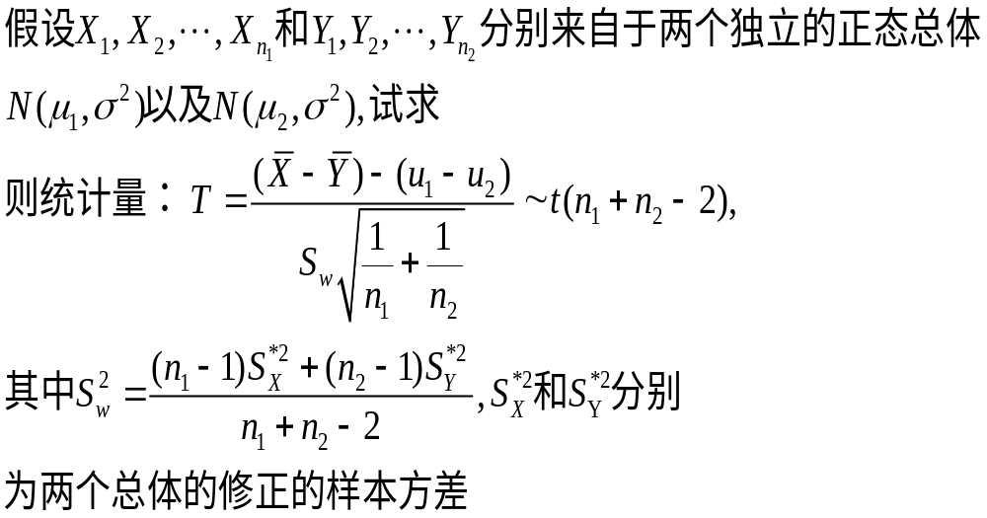
性质5.8

Slide 15

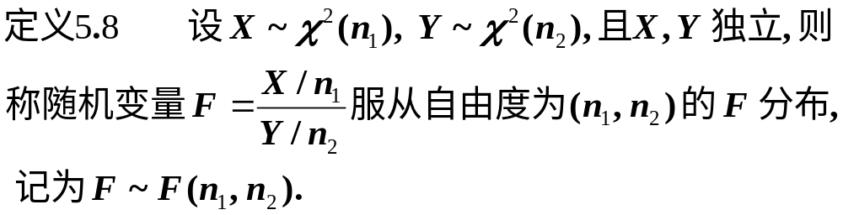
3.
随机数演示
分布函数与密度函数演示

Slide 16
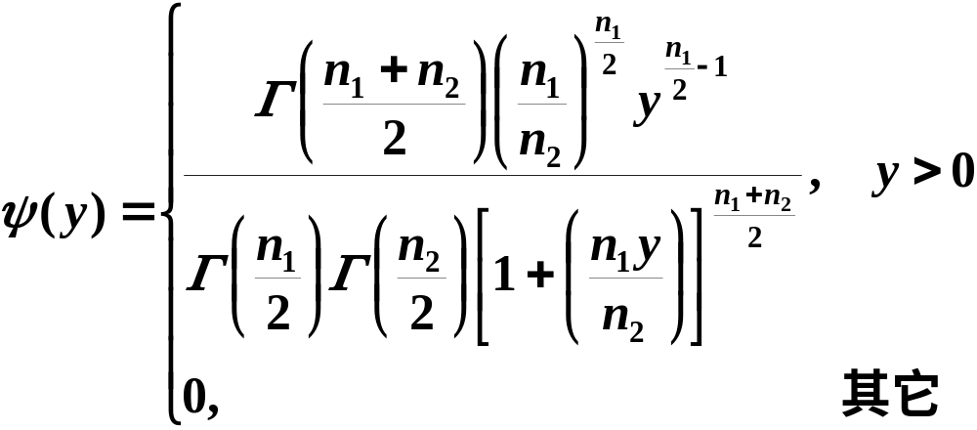

Slide 17
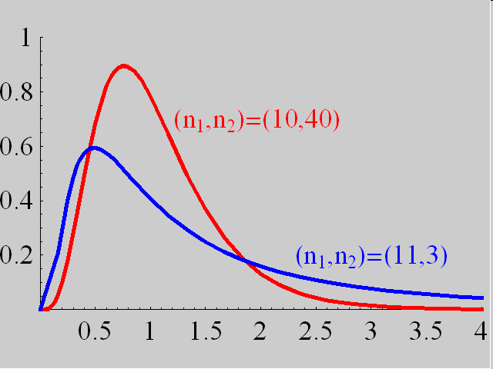

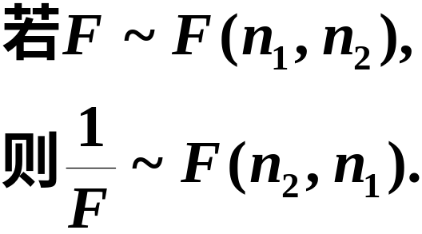
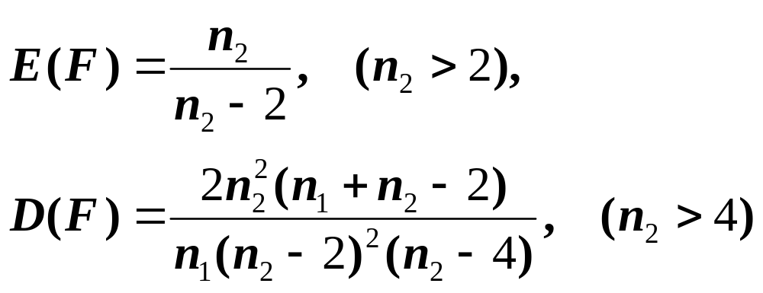
(1)
(2)

Slide 18
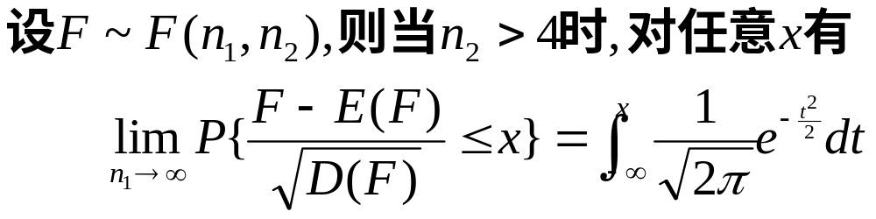
(3)
这说明F分布极限分布也是正态分布.

Slide 19
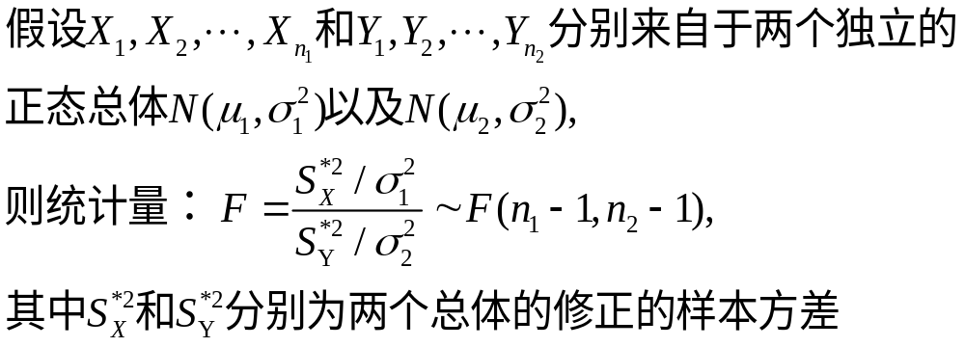
性质5.9

Slide 20
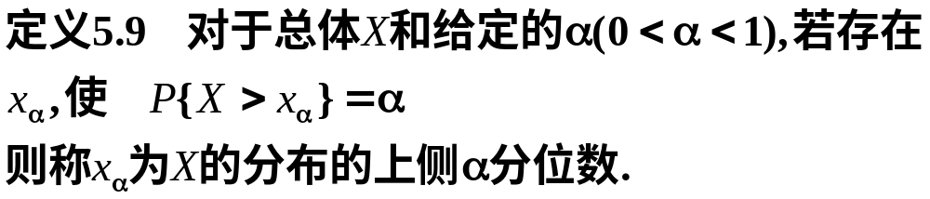
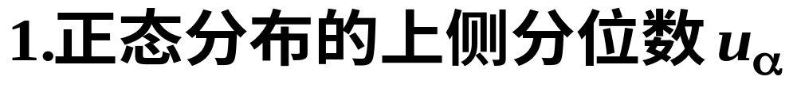
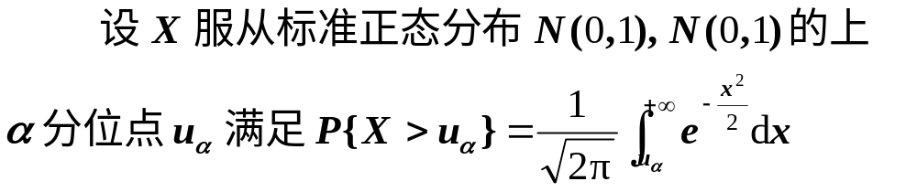
二、概率分布的分位数

Slide 21
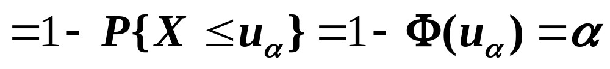
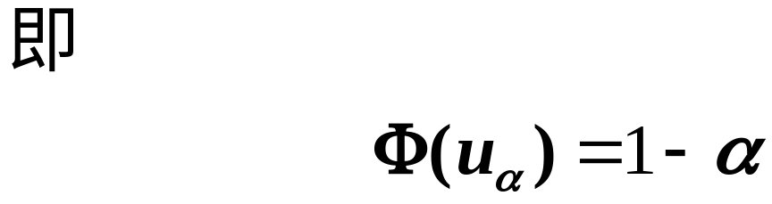

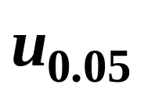

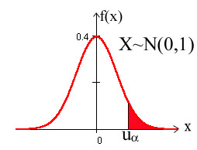
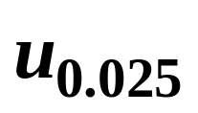

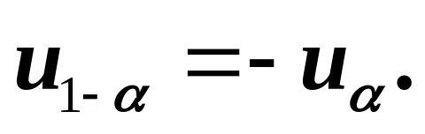
附表2-1
附表2-2
根据正态分布的对称性知

Slide 22
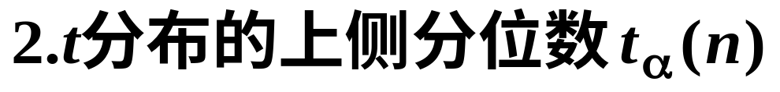


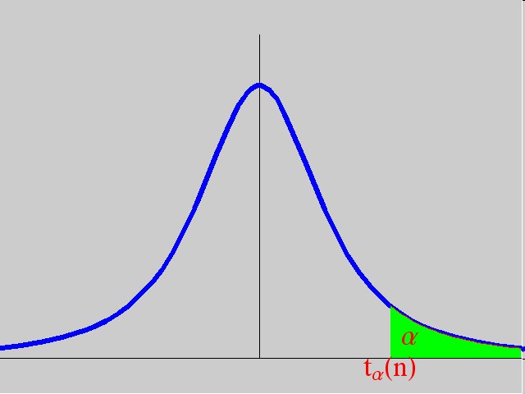


由分布的对称性知

Slide 23





附表3-1
附表3-2
在Matlab中求解

Slide 24





Slide 25







附表4-1
附表4-2
附表4-3
附表4只详列到 n=45 为止.
在Matlab中求解

Slide 26




费歇(R.A.Fisher)证明:
费歇资料
利用上公式,
例如
而查详表可得

Slide 27







附表5-1
附表5-2
在Matlab中求解

Slide 28






证明

Slide 29









Slide 30

三、小结
1.三个来自正态分布的抽样分布:
的定义,性质.
2.分位数的概念.

Slide 31


辛钦定理

Slide 32
附表2-1
标准正态分布表
z | 0.00 | 0.01 | 0.02 | 0.03 | 0.04 | 0.05 | 0.06 | 0.07 | 0.08 | 0.09
0.0 0.1 0.2 0.3 0.4 0.5 0.6 0.7 0.8 0.9 1.0 1.1 1.2 1.3 1.4 1.5 1.6 | 0.5000 0.5398 0.5793 0.6179 0.6554 0.6915 0.7257 0.7580 0.7881 0.8159 0.8413 0.8643 0.8849 0.9032 0.9192 0.9332 0.9452 | 0.5040 0.5438 0.5832 0.6217 0.6591 0.6950 0.7291 0.7611 0.7910 0.8186 0.8438 0.8665 0.8869 0.9049 0.9207 0.9345 0.9463 | 0.5080 0.5478 0.5871 0.6255 0.6628 0.6985 0.7324 0.7642 0.7939 0.8212 0.8461 0.8686 0.8888 0.9066 0.9222 0.9357 0.9474 | 0.5120 0.5517 0.5910 0.6293 0.6664 0.7019 0.7357 0.7673 0.7967 0.8238 0.8485 0.8708 0.8907 0.9082 0.9236 0.9370 0.9484 | 0.5160 0.5557 0.5948 0.6331 0.6700 0.7054 0.7389 0.7703 0.7995 0.8264 0.8508 0.8729 0.8925 0.9099 0.9251 0.9382 0.9495 | 0.5199 0.5596 0.5987 0.6368 0.6736 0.7088 0.7422 0.7734 0.8023 0.8289 0.8531 0.8749 0.8944 0.9115 0.9265 0.9394 0.9505 | 0.5239 0.5636 0.6026 0.6406 0.6772 0.7123 0.7454 0.7764 0.8051 0.8315 0.8554 0.8770 0.8962 0.9131 0.9278 0.9406 0.9515 | 0.5279 0.5675 0.6064 0.6443 0.6808 0.7157 0.7486 0.7794 0.8078 0.8340 0.8577 0.8790 0.8980 0.9147 0.9292 0.9418 0.9525 | 0.5319 0.5714 0.6103 0.6480 0.6844 0.7190 0.7517 0.7823 0.8106 0.8365 0.8599 0.8810 0.8997 0.9162 0.9306 0.9430 0.9535 | 0.5359 0.5753 0.6141 0.6517 0.6879 0.7224 0.7549 0.7852 0.8133 0.8389 0.8621 0.8830 0.9015 0.9177 0.9319 0.9441 0.9545
1.645

Slide 33
附表2-2
标准正态分布表
z | 0.00 | 0.01 | 0.02 | 0.03 | 0.04 | 0.05 | 0.06 | 0.07 | 0.08 | 0.09
1.6 1.7 1.8 1.9 2.0 2.1 2.2 2.3 2.4 2.5 2.6 2.7 2.8 2.9 3.0 | 0.9452 0.9554 0.9641 0.9713 0.9772 0.9821 0.9861 0.9893 0.9918 0.9938 0.9953 0.9965 0.9974 0.9981 0.9987 | 0.9463 0.9564 0.9648 0.9719 0.9778 0.9826 0.9864 0.9896 0.9920 0.9940 0.9955 0.9966 0.9975 0.9982 0.9990 | 0.9474 0.9573 0.9656 0.9726 0.9783 0.9830 0.9868 0.9898 0.9922 0.9941 0.9956 0.9967 0.9976 0.9982 0.9993 | 0.9484 0.9582 0.9664 0.9732 0.9788 0.9834 0.9871 0.9901 0.9925 0.9943 0.9957 0.9968 0.9977 0.9983 0.9995 | 0.9495 0.9591 0.9671 0.9738 0.9793 0.9838 0.9871 0.9904 0.9927 0.9945 0.9959 0.9969 0.9977 0.9984 0.9997 | 0.9505 0.9599 0.9678 0.9744 0.9798 0.9842 0.9878 0.9906 0.9929 0.9946 0.9960 0.9970 0.9978 0.9984 0.9698 | 0.9515 0.9608 0.9686 0.9750 0.9803 0.9846 0.9881 0.9909 0.9931 0.9948 0.9961 0.9971 0.9979 0.9985 0.9998 | 0.9525 0.9616 0.9693 0.9756 0.9808 0.9850 0.9884 0.9911 0.9932 0.9949 0.9962 0.9972 0.9979 0.9985 0.9999 | 0.9535 0.9625 0.9700 0.9762 0.9812 0.9854 0.9887 0.9913 0.9934 0.9951 0.9963 0.9973 0.9980 0.9986 0.9999 | 0.9545 0.9633 0.9706 0.9767 0.9817 0.9853 0.9890 0.9916 0.9936 0.9952 0.9964 0.9974 0.9981 0.9986 1.0000
1.96

Slide 34



附表4-1
分布表
 | = 0.25 | 0.10 | 0.05 | 0.025 | 0.01 | 0.005
1 2 3 4 5 6 7 8 9 10 11 12 13 14 15 16 | 1.323 2.773 4.108 5.385 6.626 7.841 9.037 10.219 11.389 12.549 13.701 14.845 15.984 17.117 18.245 19.369 | 2.706 4.605 6.251 7.779 9.236 10.645 12.017 13.362 14.684 15.987 17.275 18.549 19.812 20.064 22.307 23.542 | 3.841 5.991 7.815 9.488 11.071 12.592 14.067 15.507 16.919 18.307 19.675 21.026 22.362 23.685 24.996 26.296 | 5.024 7.378 9.348 11.143 12.833 14.449 16.013 17.535 19.023 20.483 21.920 23.337 24.736 26.119 27.488 28.845 | 6.635 9.210 11.345 13.277 15.086 16.812 18.475 20.090 21.666 23.209 24.725 26.217 27.688 29.141 30.578 32.000 | 7.879 10.597 12.838 14.860 16.750 18.548 20.278 21.955 23.589 25.188 26.757 28.299 29.891 31.319 32.801 34.267
17.535

Slide 35
附表4-2
分布表
 | =0.995 | 0.99 | 0.975 | 0.95 | 0.90 | 0.75
1 2 3 4 5 6 7 8 9 10 11 12 13 14 15 16 | 0.010 0.072 0.207 0.412 0.676 0.989 1.344 1.735 2.156 2.603 3.074 3.565 4.075 4.601 5.142 | 0.020 0.115 0.297 0.554 0.872 1.239 1.646 2.088 2.558 3.053 3.571 4.107 4.660 5.229 5.812 | 0.001 0.051 0.216 0.484 0.831 1.237 1.690 2.180 2.700 3.247 3.816 4.404 5.009 5.629 6.262 6.908 | 0.004 0.103 0.352 0.711 1.145 1.635 2.167 2.733 3.325 3.940 4.575 5.226 5.892 6.571 7.261 7.962 | 0.016 0.211 0.584 1.064 1.610 2.204 2.833 3.490 4.168 4.865 5.578 6.304 7.042 7.790 8.547 9.312 | 0.102 0.575 1.213 1.923 2.675 3.455 4.255 5.071 5.899 6.737 7.584 8.438 9.299 10.165 11.037 11.912
3.247

Slide 36
附表4-3
分布表
 | =0.25 | 0.10 | 0.05 | 0.025 | 0.01 | 0.005
17 18 19 20 21 22 23 24 25 26 27 28 29 30 31 32 | 20.489 21.605 22.718 23.828 24.935 26.039 27.141 28.241 29.339 30.435 31.528 32.620 33.711 34.800 35.887 36.973 | 24.769 25.989 27.204 28.412 29.615 30.813 32.007 33.196 34.382 35.563 36.741 37.916 39.087 40.256 41.422 42.585 | 27.587 28.869 30.144 31.410 32.671 33.924 35.172 36.415 37.652 38.885 40.113 41.337 42.557 43.773 44.985 46.194 | 30.191 31.526 32.852 34.170 35.479 36.781 38.076 39.364 40.646 41.923 43.194 44.461 45.712 46.979 48.232 49.480 | 33.409 34.805 36.191 37.566 38.932 40.289 41.638 42.980 44.314 45.642 46.963 48.278 49.588 50.892 52.191 53.486 | 35.718 37.156 38.582 39.997 41.401 42.796 44.181 45.559 46.928 48.290 49.645 50.993 52.336 53.672 55.003 56.328
34.382

Slide 37

附表3-1
分布表
 | =0.25 | 0.10 | 0.05 | 0.025 | 0.01 | 0.005
1 2 3 4 5 6 7 8 9 10 11 12 13 14 15 16 | 1.0000 0.8165 0.7649 0.7407 0.7267 0.7176 0.7111 0.7064 0.7027 0.6998 0.6974 0.6955 0.6938 0.6924 0.6912 0.6901 | 3.0777 1.8856 1.6377 1.5332 1.4759 1.4398 1.4149 1.3968 1.3830 1.3722 1.3634 1.3562 1.3502 1.3450 1.3406 1.3368 | 6.3138 2.9200 2.3534 2.1318 2.0150 1.9432 1.8946 1.8595 1.8331 1.8125 1.7959 1.7823 1.7709 1.7613 1.7531 1.7459 | 12.7062 4.3027 3.1824 2.7764 2.5706 2.4469 2.3646 2.3060 2.2622 2.2281 2.2010 2.1788 2.1604 2.1448 2.1315 2.1199 | 31.8207 6.9646 4.5407 3.7469 3.3649 3.1427 2.9980 2.8965 2.8214 2.7638 2.7181 2.6810 2.6503 2.6245 2.6025 2.5835 | 63.6574 9.9248 5.8409 4.6041 4.0322 3.7074 3.4995 3.3554 3.2498 3.1693 3.1058 3.0545 3.0123 2.9768 2.9467 2.9208
1.8125

Slide 38
附表3-2
分布表
 | =0.25 | 0.10 | 0.05 | 0.025 | 0.01 | 0.005
1 2 3 4 5 6 7 8 9 10 11 12 13 14 15 16 | 1.0000 0.8165 0.7649 0.7407 0.7267 0.7176 0.7111 0.7064 0.7027 0.6998 0.6974 0.6955 0.6938 0.6924 0.6912 0.6901 | 3.0777 1.8856 1.6377 1.5332 1.4759 1.4398 1.4149 1.3968 1.3830 1.3722 1.3634 1.3562 1.3502 1.3450 1.3406 1.3368 | 6.3138 2.9200 2.3534 2.1318 2.0150 1.9432 1.8946 1.8595 1.8331 1.8125 1.7959 1.7823 1.7709 1.7613 1.7531 1.7459 | 12.7062 4.3027 3.1824 2.7764 2.5706 2.4469 2.3646 2.3060 2.2622 2.2281 2.2010 2.1788 2.1604 2.1448 2.1315 2.1199 | 31.8207 6.9646 4.5407 3.7469 3.3649 3.1427 2.9980 2.8965 2.8214 2.7638 2.7181 2.6810 2.6503 2.6245 2.6025 2.5835 | 63.6574 9.9248 5.8409 4.6041 4.0322 3.7074 3.4995 3.3554 3.2498 3.1693 3.1058 3.0545 3.0123 2.9768 2.9467 2.9208
2.1315

Slide 39





附表5-1
分布表
 | 1 | 2 | 3 | 4 | 5 | 6 | 7 | 8 | 9 | 10 | 12 | 15 | 20 | 24 | 30 | 40 | 120
1 2 3 4 5 6 7 8 9 10 11 12 13 14 15 16 17 18 19 | 647.8 38.51 17.44 12.22 10.01 8.81 8.07 7.57 7.21 6.94 6.72 6.55 6.41 6.30 6.20 6.12 6.04 5.95 5.92 | 799.5 39.00 16.04 10.65 8.43 7.26 6.54 6.06 5.71 5.46 5.26 5.10 4.97 4.86 4.77 4.69 4.62 4.56 4.51 | 864.2 39.17 15.44 9.98 7.76 6.60 5.89 5.42 5.08 4.83 4.63 4.47 4.35 4.24 4.15 4.08 4.01 3.95 3.90 | 899.6 39.25 15.10 9.60 7.39 6.23 5.52 5.50 4.72 4.47 4.28 4.12 4.00 3.89 3.80 3.73 3.66 3.61 3.56 | 921.8 39.30 14.88 9.36 7.15 5.99 5.29 4.82 4.48 4.24 4.04 3.89 3.77 3.66 3.58 3.50 3.44 3.38 3.33 | 937.1 39.33 14.73 9.20 6.98 5.82 5.12 4.65 4.23 4.07 3.88 3.73 3.60 3.50 3.41 3.34 3.28 3.22 3.17 | 948.2 39.36 14.62 9.07 6.85 5.70 4.99 4.53 4.20 3.95 3.76 3.61 3.48 3.38 3.29 3.22 3.16 3.10 3.05 | 956.7 39.37 14.54 8.98 6.76 5.60 4.90 4.43 4.10 3.85 3.66 3.51 3.39 3.29 3.20 3.12 3.06 3.01 2.96 | 963.3 39.39 14.47 8.90 6.68 5.52 4.82 4.36 4.03 3.78 3.59 3.44 3.31 3.21 3.12 3.05 2.98 2.93 2.88 | 968.6 39.40 14.42 8.84 6.62 5.46 4.76 4.30 3.96 3.72 3.53 3.37 3.25 3.15 3.06 2.99 2.92 2.87 2.82 | 976.7 39.41 14.34 8.75 6.52 5.37 4.67 4.20 3.87 3.62 3.43 3.28 3.15 3.05 2.96 2.89 2.82 2.77 2.72 | 984.9 39.43 14.25 8.66 6.43 5.27 4.57 4.10 3.77 3.52 3.33 3.18 3.05 2.95 2.86 2.79 2.72 2.67 2.62 | 993.1 39.45 14.17 8.56 6.33 5.17 4.47 4.00 3.67 3.42 3.23 3.07 2.95 2.84 2.76 2.68 2.62 2.56 2.51 | 997.2 39.46 14.12 8.51 6.28 5.12 4.42 3.59 3.61 3.37 3.17 3.02 2.89 2.79 2.70 2.63 2.56 2.50 2.45 | 1001 39.46 14.08 8.46 6.23 5.07 4.36 3.89 3.56 3.31 3.12 2.96 2.84 2.73 2.64 2.57 2.50 2.44 2.39 | 1006 39.47 14.04 8.41 6.18 5.01 4.31 3.84 3.51 3.26 3.06 2.91 2.78 2.67 2.59 2.51 2.44 2.38 2.33 | 1014 39.49 13.95 8.31 6.07 4.90 4.20 3.73 3.39 3.14 2.94 2.79 2.66 2.55 2.46 2.38 2.32 2.26 2.20 | 1018 39.50 13.90 8.26 6.02 4.85 4.14 3.67 3.33 3.08 2.88 2.72 2.60 2.49 2.40 2.32 2.25 2.19 2.13
4.90

Slide 40

附表5-2
分布表
 | 1 | 2 | 3 | 4 | 5 | 6 | 7 | 8 | 9 | 10 | 15 | 20 | 24 | 30 | 40 | 60 | 120
1 2 3 4 5 6 7 8 9 10 11 12 13 14 15 16 17 18 19 | 161.4 18.51 10.13 7.71 6.61 5.99 5.59 5.32 3.12 4.96 4.84 4.75 4.67 4.60 4.54 4.49 4.45 4.41 4.38 | 199.5 19.00 9.55 6.94 5.79 5.14 4.74 4.46 4.26 4.10 3.98 3.89 3.81 3.74 3.68 3.63 3.59 5.55 3.52 | 215.7 19.16 9.28 6.59 5.41 4.76 4.35 4.07 3.81 3.71 3.59 3.49 3.41 3.34 3.29 3.24 3.20 3.16 3.13 | 224.6 19.25 9.12 6.39 5.19 4.53 4.12 3.84 3.63 3.48 3.36 3.26 3.18 3.11 3.06 3.01 2.96 2.93 2.90 | 230.2 19.30 9.01 6.26 5.05 4.39 3.97 3.69 3.48 3.33 3.20 3.11 3.03 2.96 2.90 2.85 2.81 2.77 2.74 | 234.0 19.33 8.94 6.16 4.95 4.28 3.87 3.58 3.37 3.22 3.09 3.00 2.92 2.85 2.79 2.74 2.70 2.66 2.63 | 236.8 19.35 8.89 6.09 4.88 4.21 3.79 3.50 3.29 3.14 3.01 2.91 2.83 2.76 2.71 2.66 2.61 2.58 2.54 | 238.9 19.37 8.85 6.04 4.82 4.15 3.73 3.44 3.23 3.07 2.95 2.85 2.77 2.70 2.64 2.59 2.55 2.51 2.48 | 24.05 19.38 8.81 6.00 4.77 4.10 3.68 3.39 3.18 3.02 2.90 2.80 2.71 2.65 2.59 2.54 2.49 2.46 2.42 | 241.9 19.40 8.79 5.96 4.74 4.06 3.64 3.35 3.14 2.98 2.85 2.75 2.67 2.60 2.54 2.49 2.45 2.41 2.38 | 245.9 19.43 8.70 5.86 4.62 3.94 2.51 3.22 3.01 2.85 2.72 2.62 2.53 2.46 2.40 2.35 2.31 2.27 2.23 | 248.0 19.45 8.66 5.80 4.56 3.87 3.44 3.15 2.94 2.77 2.65 2.54 2.46 2.39 2.33 2.28 2.23 2.19 2.16 | 249.1 19.45 8.64 5.77 4.53 3.84 3.41 3.12 2.90 2.74 2.61 2.51 2.42 2.35 2.29 2.24 2.19 2.15 2.11 | 250.1 19.46 8.62 5.75 4.50 3.81 3.38 3.08 2.86 2.70 2.57 5.47 2.38 2.31 2.25 2.19 2.15 2.11 2.07 | 151.1 19.47 8.59 5.72 4.46 3.77 3.34 3.04 2.83 2.66 2.53 2.43 2.34 2.27 2.20 2.15 2.10 2.06 2.03 | 252.2 19.48 8.57 5.69 4.43 3.74 3.30 3.01 2.79 2.62 2.49 2.38 2.30 2.22 2.16 2.11 2.06 2.02 1.98 | 253.3 19.49 8.55 5.66 4.40 3.70 3.27 2.97 2.75 2.58 2.45 2.34 2.25 2.18 2.11 2.06 2.01 1.97 1.93 | 254.3 19.50 8.53 5.63 4.36 3.67 3.23 2.93 2.71 2.54 2.40 2.30 2.21 2.13 2.07 2.01 1.96 1.92 1.88
2.31

Slide 41

费歇资料
Ronald Aylmer Fisher
Born: 17 Feb 1890 in London, England
Died: 29 July 1962 in Adelaide, Australia

Slide 42

学生氏资料
William Sealey Gosset
Born: 13 June 1876 in Canterbury, England
Died: 16 Oct 1937 in Beaconsfield, England

Slide 43

格里汶科资料
Boris Vladimirovich Gnedenko
Born: 1 Jan 1912 in Simbirsk (now Ulyanovskaya), Russia
Died: 27 Dec 1995 in Moscow, Russia

