Slide 1
Ambiguity Aversion
A Vignette Study Josh White & A/Prof Amy Perfors

Slide 2
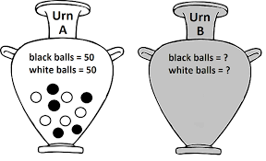
Ellsberg’s “Two-Urn Paradox” (1961)

Slide 3
Each urn contains 100 balls. Every ball is either white or black.
You are to randomly draw a ball from one of these urns. If the ball is white, you win $100. Which urn do you choose?

Slide 4
Some Distinctions
Risk:
A measurable lack of certainty represented by numerical probabilities
E.g., “there is a 50% chance that it will rain tomorrow”
Urn A
Uncertainty:
An unmeasurable lack of certainty
E.g., “there is an unknown probability that it will rain tomorrow”
Urn B
Ambiguity Aversion (AA):
The preference for “risk” over “uncertainty”, independent of utility.
E.g. the robust finding that people, on average, prefer urn A over urn B.

Slide 5
The Ambiguity Aversion Literature
Economists showing off thier math skills trying to model AA.
Successful, yet often narrow in focus.
More or less confined to:
Contrived economic games & bets (e.g., the urns)
Applications in financial decisions and markets.
Overtly quantitative domains.
But how does ambiguity affect other decisions that cant be easily quantified, when utility can’t be easily measured?

Slide 6
AA and Qualitative domains
Very sparse literature here, but AA has been found to arise in:
Medical contexts
Choices to undergo medical procedures (Curley et. al., 1984; Bier & Connell, 1994)
Choices to vaccinate (Ritov & Baron, 1990)
Decisions on where to live (Viscusi et al., 1991)
No systematic treatment of this (that I know of).
This is where we come in! We want to find out:
Does ambiguity aversion systematically arise in qualitative ‘real-world’ situations in a variety of different contexts and scenarios?
Is the degree of ambiguity aversion different for gains and losses?

Slide 7
Study Design
Participants (N = 1200, MTurk sample) presented with one qualitative vignette.
Then shown two different situations in relation to the vignette — one “ambiguous”, one “risky”.
Asked “which of these two situations you would rather be in”
Respond on 7-point Likert scale, coded so that 3 = Ambiguity Aversion, 0 = Neutrality, -3 = Ambiguity Seeking.
24 different vignettes, all of differing contexts: social, workplace, romantic, health, family etc.
12 “gain” vignettes, 12 “loss” vignettes.

Slide 8
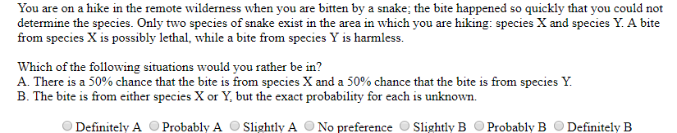
Examples

Slide 9
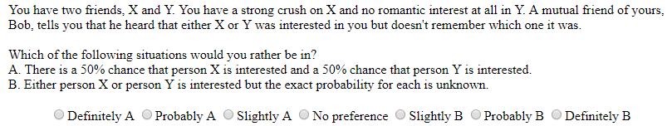

Slide 10
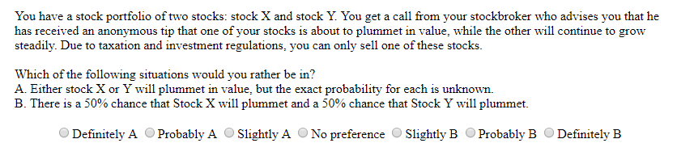

Slide 11
Results
## Warning: `fun.y` is deprecated. Use `fun` instead. ## Warning: `fun.y` is deprecated. Use `fun` instead.

Slide 12
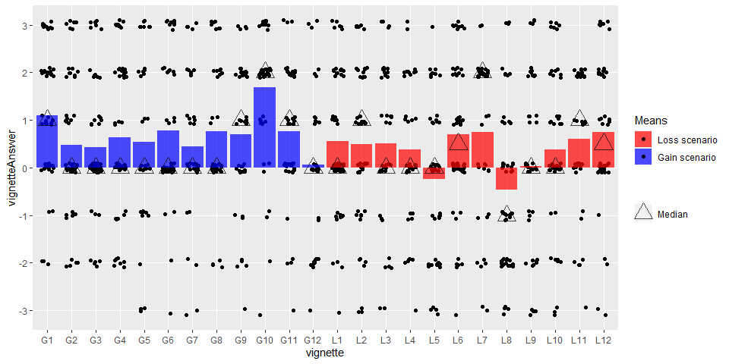

Slide 13
Statistical Analyses
We ran the following ordinal logistic regressions on this preference:
No predictors. (AA overall?)
Predictor including a main effect of condition, that is whether it is gain or loss. (AA modulated by gain or loss?)
Predictor including a main effect of order of the option. (Ensure answer order doesn’t affect responses)
Predictor including a main effect of condition plus a random intercept of question.(Does AA vary by situation?)
Post-hoc model with only a random effect for intercept by vignette, to see whether condition (gain or loss) predictor adds anything beyond random effect.
Compare AIC to select best model.
Ran both Bayesian and Frequentist versions of models.

Slide 14
Freq: No Predictors
olm.freq.nopred <-polr(vignetteAnswer.ordfac ~ 1, data = d_pass, method = "logistic", Hess = TRUE) summary(olm.freq.nopred)
## Call: ## polr(formula = vignetteAnswer.ordfac ~ 1, data = d_pass, Hess = TRUE, ## method = "logistic") ## ## No coefficients ## ## Intercepts: ## Value Std. Error t value ## -3|-2 -3.358 0.165 -20.348 ## -2|-1 -1.862 0.087 -21.352 ## -1|0 -1.332 0.073 -18.199 ## 0|1 0.142 0.060 2.378 ## 1|2 0.716 0.063 11.298 ## 2|3 2.058 0.094 21.921 ## ## Residual Deviance: 3961.75 ## AIC: 3973.75
#get probabilities logistic_cdf <- function(x) { return( 1/(1+exp(-x) )) } cdf <- logistic_cdf(olm.freq.nopred$zeta) pdf <- c(cdf[1], diff(cdf), 1 - cdf[6]) names(pdf) <- -3:3 barplot(pdf, xlab = "AmbAv Likert Categories", ylab = "Probability")

Slide 15
Freq: Gain or Loss Predictor
olm.freq.GLpred <- polr(vignetteAnswer.ordfac ~ vignetteType, data = d_pass, method = "logistic", Hess = TRUE) summary(olm.freq.GLpred)
## Call: ## polr(formula = vignetteAnswer.ordfac ~ vignetteType, data = d_pass, ## Hess = TRUE, method = "logistic") ## ## Coefficients: ## Value Std. Error t value ## vignetteTypeG 0.361 0.106 3.4 ## ## Intercepts: ## Value Std. Error t value ## -3|-2 -3.197 0.171 -18.668 ## -2|-1 -1.696 0.099 -17.051 ## -1|0 -1.162 0.088 -13.189 ## 0|1 0.319 0.080 4.013 ## 1|2 0.895 0.083 10.796 ## 2|3 2.242 0.109 20.530 ## ## Residual Deviance: 3950.19 ## AIC: 3964.19
ci <- confint(olm.freq.GLpred)
## Waiting for profiling to be done...
exp(cbind(OR = coef(olm.freq.GLpred), t(ci)))
## OR 2.5 % 97.5 % ## vignetteTypeG 1.4 1.2 1.8

Slide 16
Freq: Answer Order Predictor
olm.freq.ordpred <- polr(vignetteAnswer.ordfac ~ answerOrder, data = d_pass, method = "logistic", Hess = TRUE) summary(olm.freq.ordpred)
## Call: ## polr(formula = vignetteAnswer.ordfac ~ answerOrder, data = d_pass, ## Hess = TRUE, method = "logistic") ## ## Coefficients: ## Value Std. Error t value ## answerOrderB -0.076 0.106 -0.719 ## ## Intercepts: ## Value Std. Error t value ## -3|-2 -3.398 0.174 -19.512 ## -2|-1 -1.901 0.103 -18.389 ## -1|0 -1.371 0.092 -14.944 ## 0|1 0.103 0.081 1.270 ## 1|2 0.677 0.083 8.125 ## 2|3 2.019 0.108 18.716 ## ## Residual Deviance: 3961.24 ## AIC: 3975.24

Slide 17
Freq: Fixed Gain/Loss Effect and Random Intercept
olmm.freq <- clmm(vignetteAnswer.ordfac ~ vignetteType + (1|vignette), data = d_pass, link = "logit", nAGQ = 10) summary(olmm.freq)
## Cumulative Link Mixed Model fitted with the adaptive Gauss-Hermite ## quadrature approximation with 10 quadrature points ## ## formula: vignetteAnswer.ordfac ~ vignetteType + (1 | vignette) ## data: d_pass ## ## link threshold nobs logLik AIC niter max.grad cond.H ## logit flexible 1130 -1963.78 3943.56 633(1902) 3.24e-03 1.4e+02 ## ## Random effects: ## Groups Name Variance Std.Dev. ## vignette (Intercept) 0.143 0.378 ## Number of groups: vignette 24 ## ## Coefficients: ## Estimate Std. Error z value Pr(>|z|) ## vignetteTypeG 0.366 0.188 1.94 0.052 . ## --- ## Signif. codes: 0 '***' 0.001 '**' 0.01 '*' 0.05 '.' 0.1 ' ' 1 ## ## Threshold coefficients: ## Estimate Std. Error z value ## -3|-2 -3.270 0.204 -16.00 ## -2|-1 -1.749 0.149 -11.75 ## -1|0 -1.202 0.141 -8.50 ## 0|1 0.328 0.136 2.41 ## 1|2 0.923 0.138 6.70 ## 2|3 2.303 0.156 14.78
ci <- confint(olmm.freq) exp(cbind(OR = coef(olmm.freq), ci))
## OR 2.5 % 97.5 % ## -3|-2 0.038 0.025 0.057 ## -2|-1 0.174 0.130 0.233 ## -1|0 0.301 0.228 0.397 ## 0|1 1.388 1.063 1.811 ## 1|2 2.517 1.921 3.297 ## 2|3 10.006 7.373 13.581 ## vignetteTypeG 1.441 0.997 2.084

Slide 18
Freq: Only random intercept (post-hoc)
olm.freq.onlyrand <- clmm(vignetteAnswer.ordfac ~ 1 + (1|vignette), data = d_pass, link = "logit", nAGQ = 10) summary(olm.freq.onlyrand) #posthoc - does GL add to model?
## Cumulative Link Mixed Model fitted with the adaptive Gauss-Hermite ## quadrature approximation with 10 quadrature points ## ## formula: vignetteAnswer.ordfac ~ 1 + (1 | vignette) ## data: d_pass ## ## link threshold nobs logLik AIC niter max.grad cond.H ## logit flexible 1130 -1965.53 3945.06 492(1479) 4.68e-03 7.5e+01 ## ## Random effects: ## Groups Name Variance Std.Dev. ## vignette (Intercept) 0.177 0.421 ## Number of groups: vignette 24 ## ## No Coefficients ## ## Threshold coefficients: ## Estimate Std. Error z value ## -3|-2 -3.452 0.188 -18.39 ## -2|-1 -1.931 0.124 -15.56 ## -1|0 -1.384 0.114 -12.11 ## 0|1 0.146 0.105 1.39 ## 1|2 0.743 0.108 6.89 ## 2|3 2.124 0.129 16.48

Slide 19
Freq: Comparing the models
The AIC values for our different models are :
No Predictors: 3973.75
Gain or Loss Predictor: 3964.19
Answer order Predictor: 3975.24
Mixed model: 3943.56 (i.e. random intercept by vignette and fixed GL Predictor)
Only Random Intercept: 3945.06 (post-hoc)
Best model by AIC is the Mixed Model, according with the general findings in the Ambiguity Aversion literature.

Slide 20
Conclusions
Broadly confirms the conclusions of the present AA literature
Extends the findings to a variety of different qualitative contexts and situations
AA more prevalent in relation to gains than losses, although most of the variaition
The degree of AA present differs considerably in relation to the circumstances at hand.

Slide 21

Questions, Discussion, Ideas

Slide 22
References
Bier, V. M., & Connell, B. L. (1994). Ambiguity seeking in multi‐attribute decisions: Effects of optimism and message framing. Journal of Behavioral Decision Making, 7(3), 169-182.
Curley, S. P., Eraker, S. A., & Yates, J. F. (1984). An investigation of patient’s reactions to therapeutic uncertainty. Medical Decision Making, 4(4), 501-511.
Ellsberg, D. (1961). Risk, ambiguity, and the Savage axioms. The quarterly journal of economics, 643-669.
Ritov, I., & Baron, J. (1990). Reluctance to vaccinate: Omission bias and ambiguity. Journal of Behavioral Decision Making, 3(4), 263-277.
Viscusi, W. K., Magat, W. A., & Huber, J. (1991). Communication of ambiguous risk information. Theory and Decision, 31(2-3), 159173.
Wang, P. A. (2011). Online Phishing in the Eyes of Online Shoppers. IAENG International Journal of Computer Science, 38(4).

Slide 23
Bayesian versions
fit same models, but bayesian! using brms packge (implemented with stan)
results more or less the same.
The WAIC values for our different models are :
No Predictors: 3974.08
Gain or Loss Predictor: 3964.38
Answer order Predictor: 3975.28
Mixed model: 3929.4 (i.e. random intercept by vignette and fixed GL Predictor)
Only Random Intercept: 3929.94 (post-hoc)
Again — best model is Mixed model.

Slide 24
Urn vignette Analysis
Lastly, to ensure that our study replicates the existing effect with our new methodology, (using a likert response to show preference as opposed to pricing options or asking for a simple force choice preference), two of our vignettes (one for gain and one for loss) were direct replications of the urn phenomenon. For example:

Slide 25
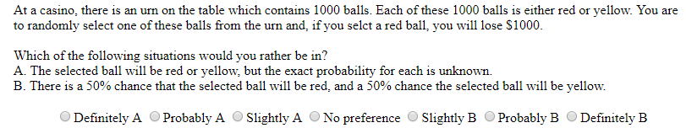

Slide 26
Urn Vignette results
## Warning: `fun.y` is deprecated. Use `fun` instead. ## Warning: `fun.y` is deprecated. Use `fun` instead.

Slide 27
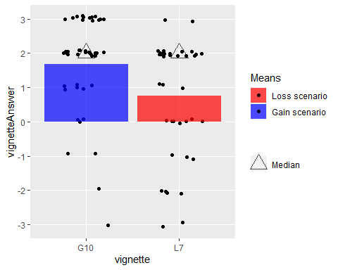

Slide 28
Urn vignette Analyses
We ran the following ordinal logistic regressions on this preference:
No predictors.
Predictor including a main effect of condition, that is whether it is gain or loss.
## Call: ## polr(formula = vignetteAnswer.ordfac ~ 1, data = d_pass_urns, ## Hess = TRUE, method = "logistic") ## ## No coefficients ## ## Intercepts: ## Value Std. Error t value ## -3|-2 -3.31 0.59 -5.63 ## -2|-1 -2.26 0.37 -6.10 ## -1|0 -1.71 0.30 -5.68 ## 0|1 -0.99 0.24 -4.06 ## 1|2 -0.50 0.22 -2.25 ## 2|3 1.54 0.28 5.41 ## ## Residual Deviance: 273.17 ## AIC: 285.17
## Call: ## polr(formula = vignetteAnswer.ordfac ~ vignetteType, data = d_pass_urns, ## Hess = TRUE, method = "logistic") ## ## Coefficients: ## Value Std. Error t value ## vignetteTypeG 1.2 0.417 2.87 ## ## Intercepts: ## Value Std. Error t value ## -3|-2 -2.839 0.607 -4.680 ## -2|-1 -1.775 0.404 -4.395 ## -1|0 -1.203 0.344 -3.491 ## 0|1 -0.440 0.307 -1.436 ## 1|2 0.075 0.299 0.249 ## 2|3 2.261 0.395 5.726 ## ## Residual Deviance: 264.55 ## AIC: 278.55

Slide 29
AIC values
The AIC values for our two different frequentist models are:
285.17 for the model with no predictors
278.55 for the model with Gain or Loss as a predictor
These values illustrate that the existing effect is replicated in our findings. Firstly, ambiguity aversion exists in both gains and loss variants of the classic urn task. Secondly, the degree of ambiguity aversion is affected by whether we are discussing domains of loss or gain — ambiguity aversion is stronger for gains than for losses.

Slide 30
Bayesian

Slide 31
WAIC values
The WAIC values for our four different Bayesian models are (I was not able to easily extract the AIC from these models):
No Predictor Model: 284.88
Gain/Loss Predictor Model: 278.45

