Slide 1



Mitigating Global Interpreter Lock (GIL) Bottlenecks in Edge AI Systems.
Author: Mridankan Mandal and Smit Sanjay Shende
Indian Institute of Information Technology, Allahabad.
Objective: Optimize Python based orchestration layers for AI agents on resource constrained edge hardware.
Context: Modern edge AI utilizes Python frameworks like LangChain or LlamaIndex to manage high performance C++ inference kernels.
Constraint: While inference is fast, the Python coordination logic often requires high thread counts to mask sensor and network I/O latency, leading to internal serialization.
DOORS (6th European Edge Computing Workshop) 2026

Slide 2
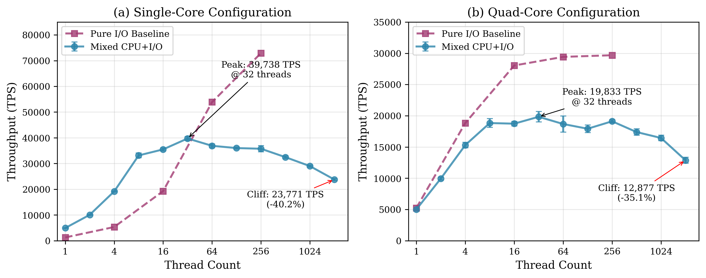
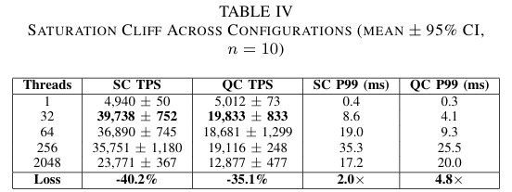
The Problem: The Saturation Cliff.
Definition: The "Saturation Cliff" is a performance degradation of ≥20% that occurs when the thread count exceeds a workload specific threshold.
Causation: The cliff is triggered by GIL contention and context switch overhead dominating useful computation.
Failure of Existing Solutions:
Multiprocessing: Bypasses the GIL but introduces approximately 8x memory overhead (20 to 30 MB per worker), causing OOM crashes on devices with 512 MB to 2 GB RAM.
Asyncio: Provides low overhead, but stalls the entire event loop during CPU bound data serialization or tokenization phases.
Static Threading: Naive scaling (like N ≥ 512) frequently results in 40.2% throughput loss on single core devices.

Slide 3
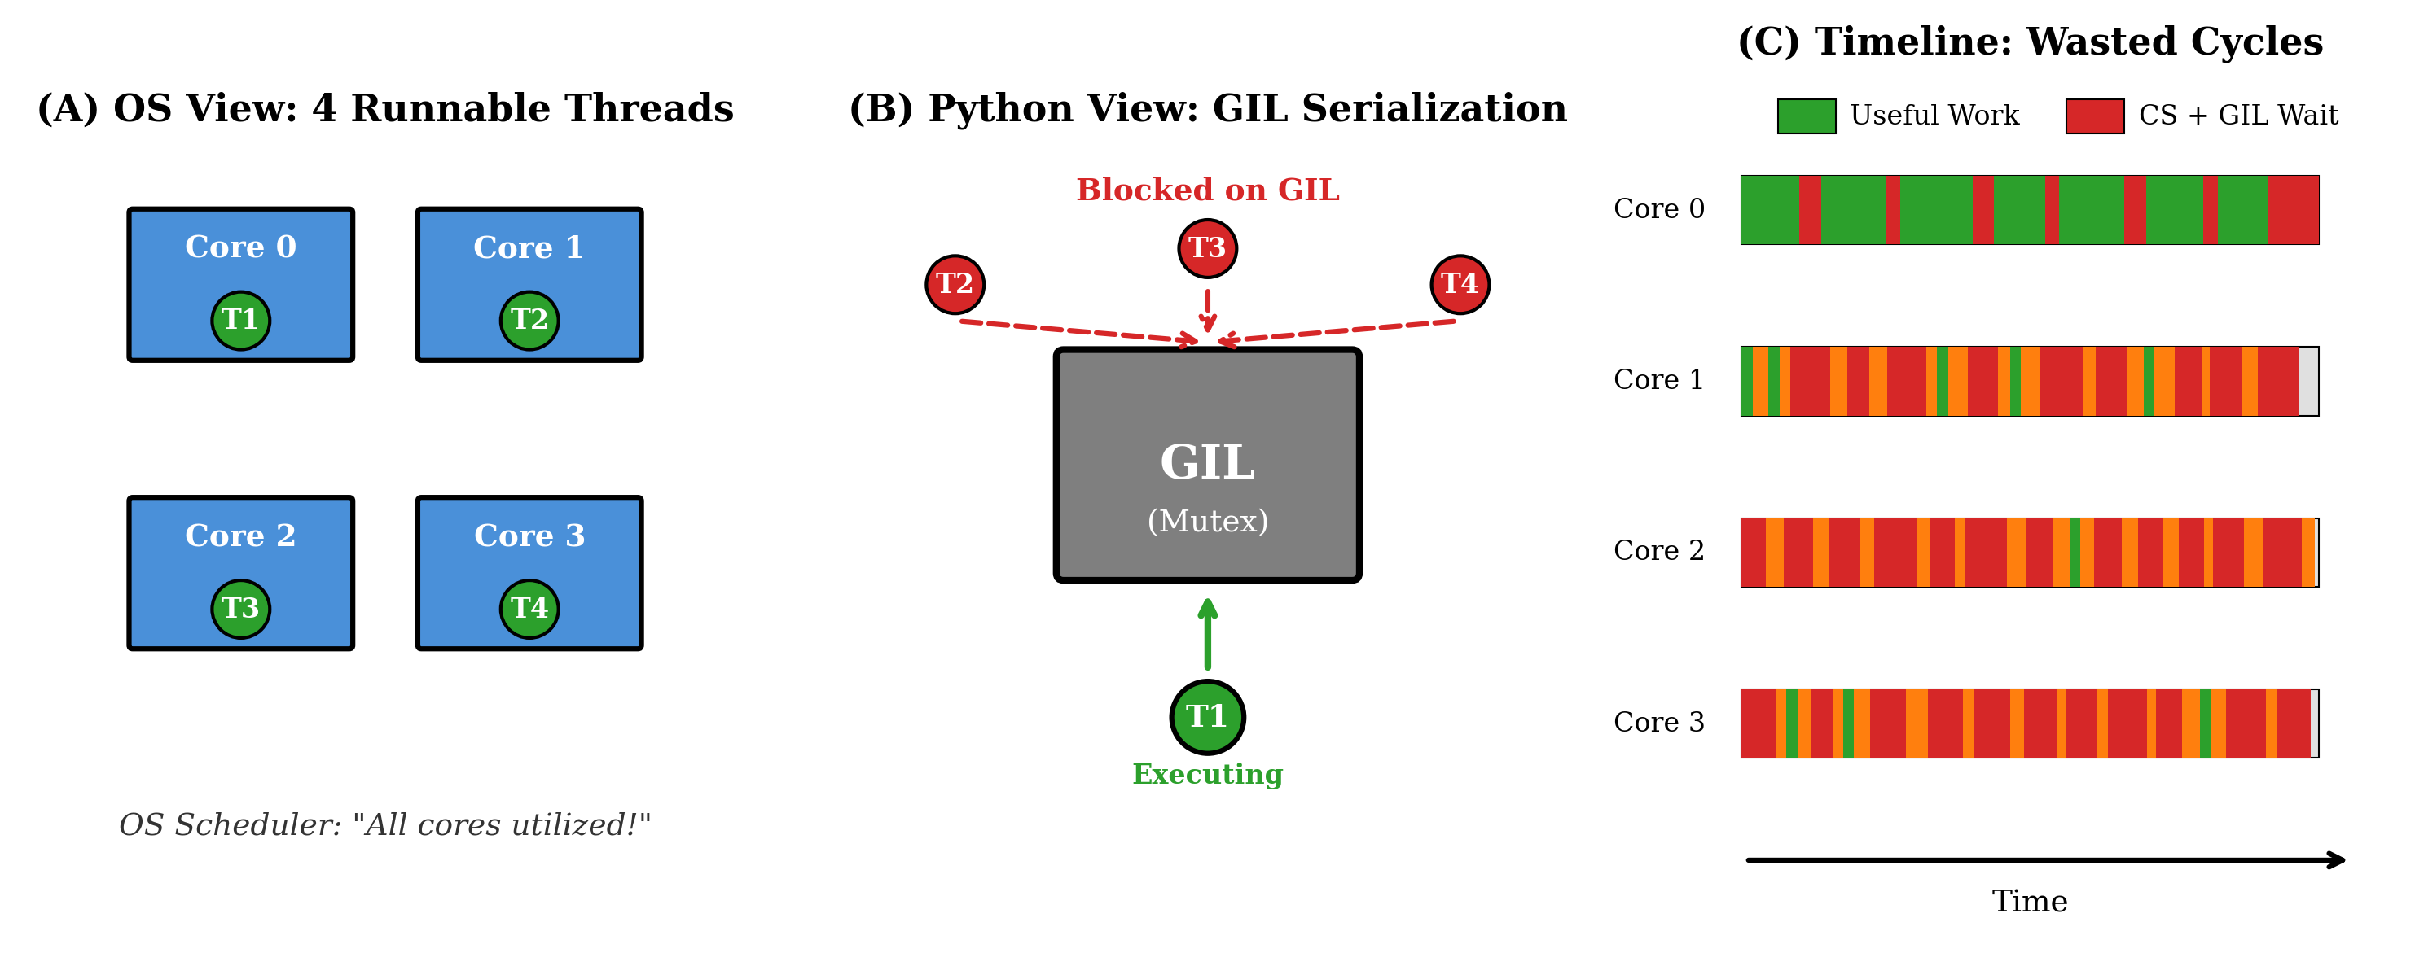
Mechanism: The OS-GIL Paradox.
The Paradox: A conflict between Operating System (OS) scheduling and Python interpreter semantics.
OS Perspective: The scheduler assumes all runnable threads can be distributed across available cores for parallel execution.
Python Perspective: The GIL ensures only one thread executes bytecode at any instant, effectively serializing the orchestration layer.
Consequence: This creates a contention cycle where threads rapidly wake, fail to acquire the lock, and sleep again, wasting CPU cycles on context switches instead of progress.

Slide 4
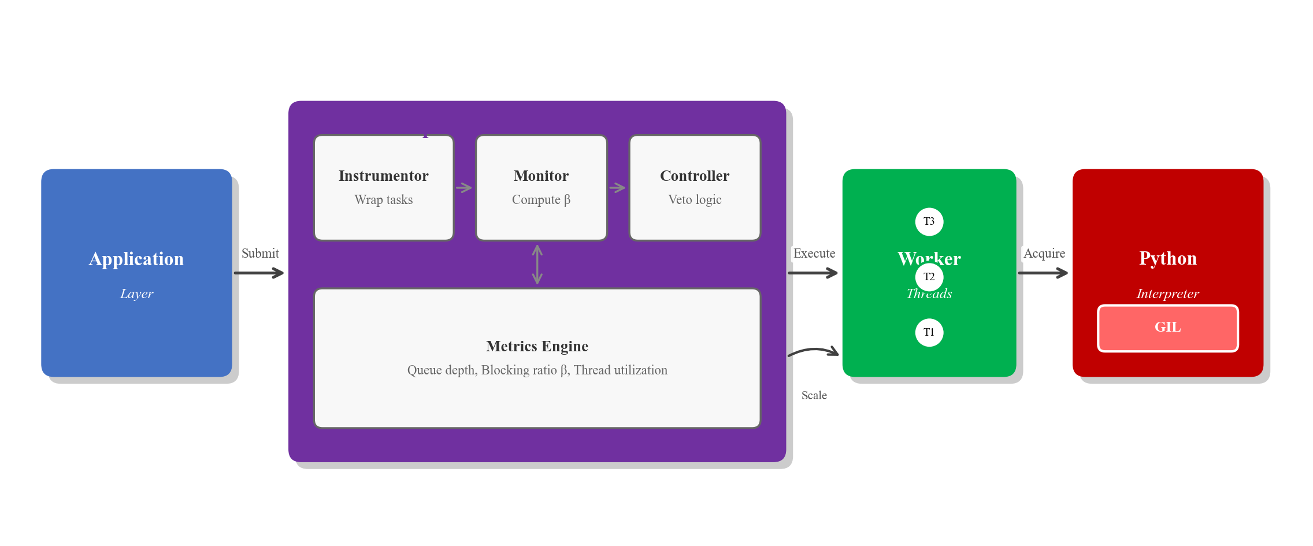


Technical Innovation: The Blocking Ratio (β).
Concept: A lightweight profiling metric (<0.3% overhead) to distinguish genuine I/O wait from GIL contention.
Mathematical Formulation:
Instantaneous Ratio: βᵢ = 1 − t_CPU,i / t_wall,i
Time-Weighted Average: β̄ = Σ t_wall,i ⋅ βᵢ / Σ t_wall,i
System Interpretation:
High β: Threads are waiting for I/O (network/sensors). It is safe to increase concurrency.
Low β: Threads are blocked by the GIL or CPU saturation. Adding threads will trigger the saturation cliff.

Slide 5
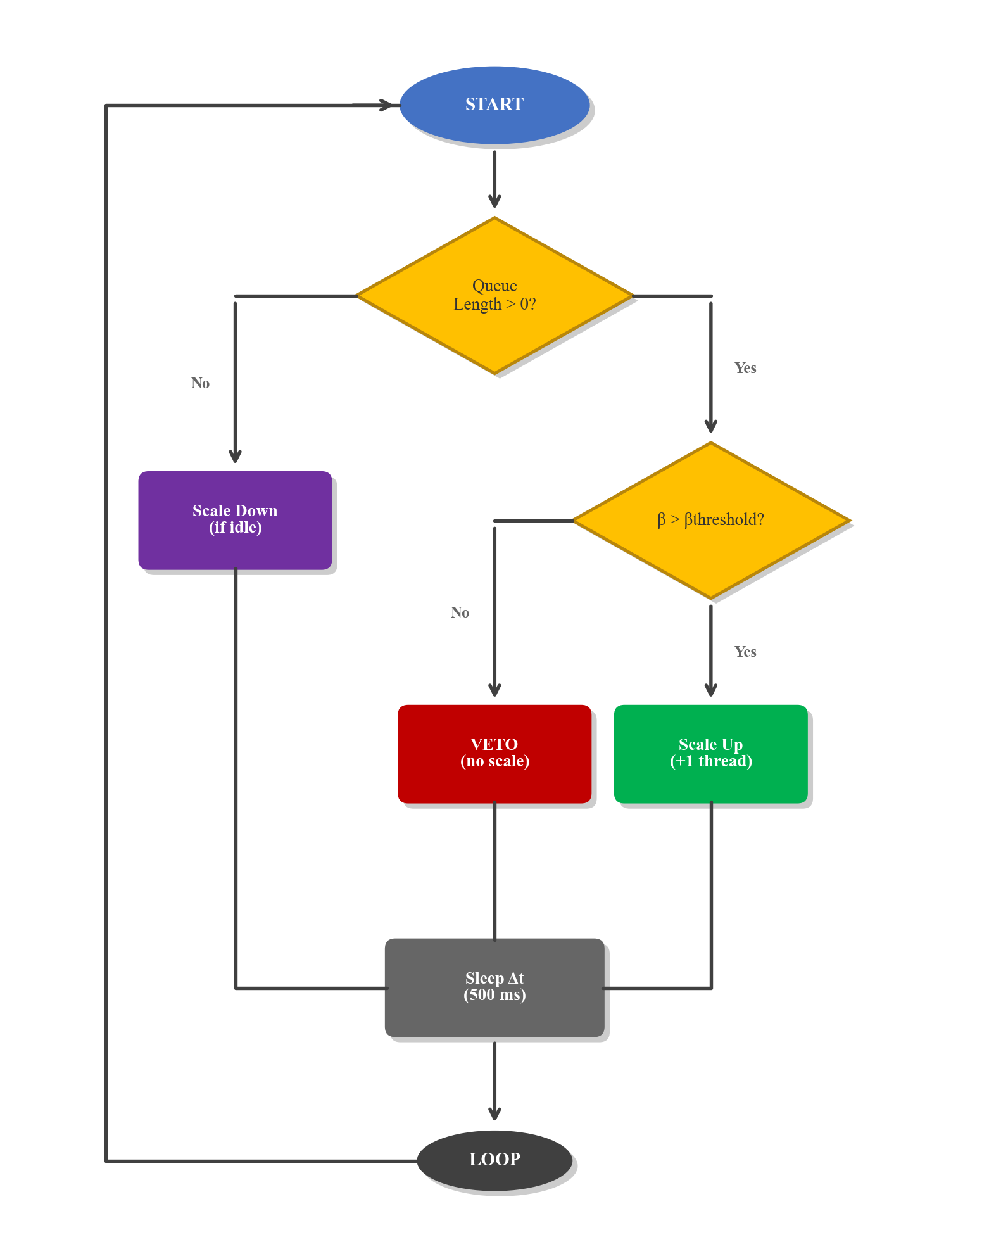

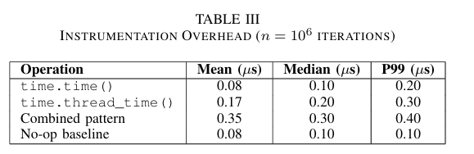
System Architecture: Adaptive Thread Pool.
The Controller: A feedback loop driven system consisting of three modules.
Instrumentor: Captures t_CPU and t_wall using high precision OS counters with 0.30 μs median overhead per task.
Monitor: Collects β samples every 500 ms and applies Exponentially Weighted Moving Average (EWMA) smoothing (α = 0.2) to filter transient noise.
Controller Logic:
Hysteresis: Requires 3 consecutive signals before scaling to ensure stability.
GIL Safety Veto: Preempts scale up attempts if β_ewma ≤ 0.3, effectively preventing the system from entering the saturation cliff.

Slide 6
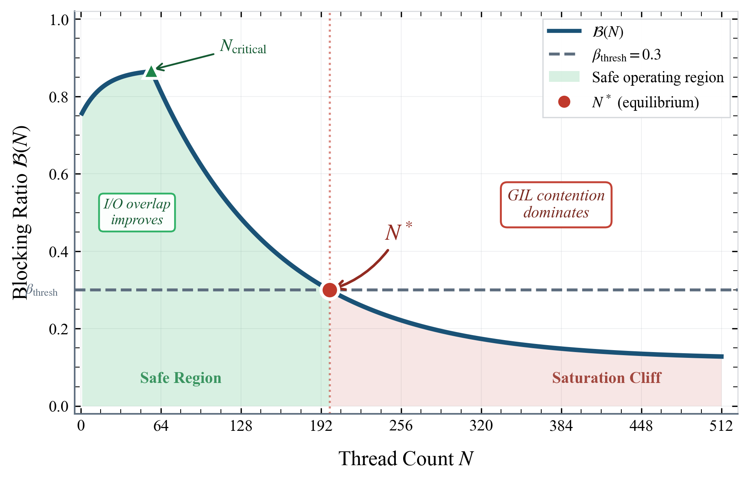
Theoretical Stability and Convergence.
Computational Complexity: The controller operates with O(1) time and O(1) space complexity per interval.
Theorem 2 (Monotonicity): Under sustained load, the sequence of thread counts is non decreasing until it reaches the safety boundary.
Theorem 3 (Convergence): The system converges to a stable operating point N* that maximizes throughput without violating the GIL safety threshold.
Visualization: The controller stabilizes at the intersection of the blocking characteristic curve ℬ(N) and the safety threshold β_thresh.

Slide 7
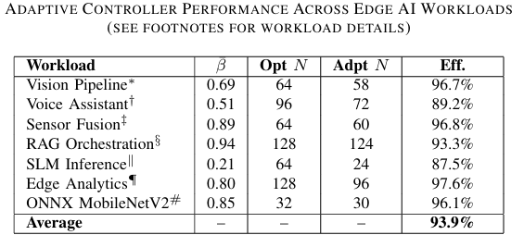
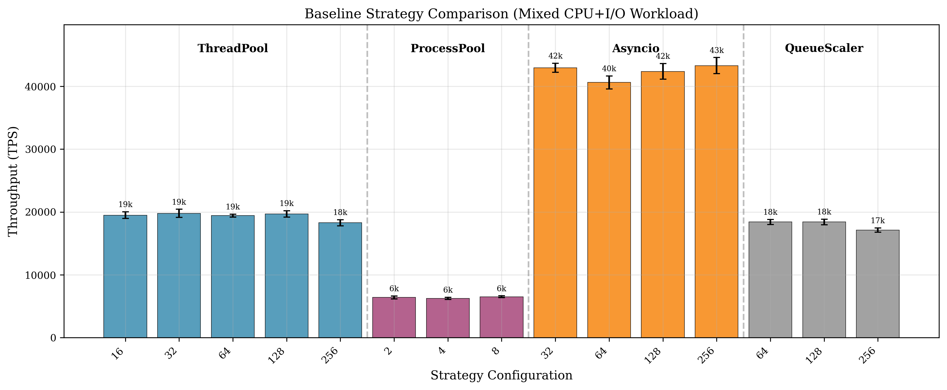
Evaluation and Results:
Performance: The adaptive system achieves 96.5% of optimal performance without expert manual tuning.
Efficiency: 93.9% average efficiency across seven edge AI profiles, including vision, RAG, and ONNX MobileNetV2.
Free Threading Analysis (Python 3.13t): On quad core devices, GIL removal enables ~4x throughput improvement.
On single core devices, the saturation cliff persists due to context switch overhead, validating the β metric for both GIL and no-GIL builds.
Conclusion: This library based approach is essential for memory constrained edge deployments where multiprocessing is infeasible.
https://github.com/WhiteMetagross/BetaPool

