Slide 1

SAM E-Commerce Store
DS&A Semester Project
Members:
1. Saif-ur-Rehman Awan 4778-FOC/BSSE/F23
2. Abdul Moiz 4819-FOC/BSSE/F23
3. Ahmed Khurseed 4796-FOC/BSSE/F23

Slide 2
Project Overview
Project Title: SAM E-Commerce Store
Purpose:
A terminal-based mini e-commerce system to simulate real-world shopping and admin functionalities using Data Structures & Algorithms.
This project was developed as part of our Data Structures & Algorithms course in 4th semester under the guidance of Mr. Shakeel Ahmed.

Slide 3
Features:
Admin:
Add/Edit/Delete/Search Products.
Sort by Price.
Customer:
Browse & Search Products.
Add to Cart.
Undo Last Cart Action.
Checkout Process
Log in/ Sign up.
File based Data Presistance.

Slide 4
Data Structures
Feature | Data Structure
Cart | Linked List
Undo Cart Action | Stack (Custom Class)
Product List | Array
User Accounts | Array
File I/O | Text Parsing (C-style)

Slide 5
Object-Oriented Concepts
Classes:
Cart, UndoStack, product_catalog, user_interface
Encapsulation:
Private/Public Members
Abstraction:
High Level methods like checkout(), main_menu()
Modularity:
Role-based interface split.
Code Reusablility:
File Read/Write Helper, structured input/output.

Slide 6
File Handling
Products.txt
Stores all product info (ID, Name, Price, Quantity)
Users.txt
Stores user credentials (ID, Username, Password, Role)
Data read at Startup, saved at exit

Slide 7
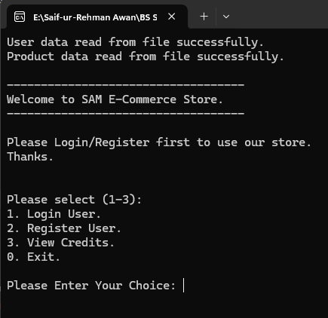
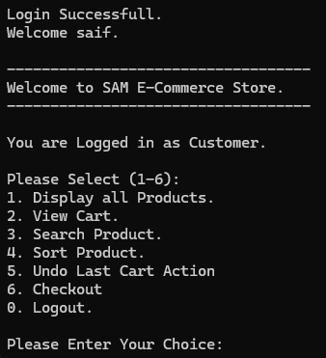
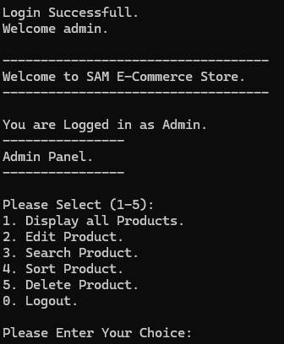
Live Demo - 01
Login / Sign Up Page
User Interface for Customer
User Interface for Admin

Slide 8
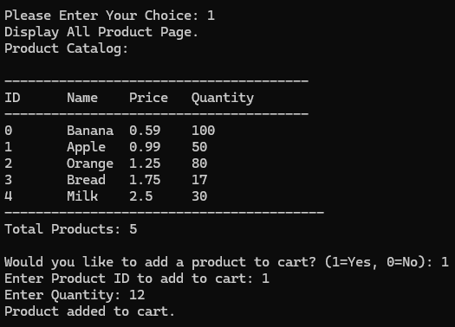
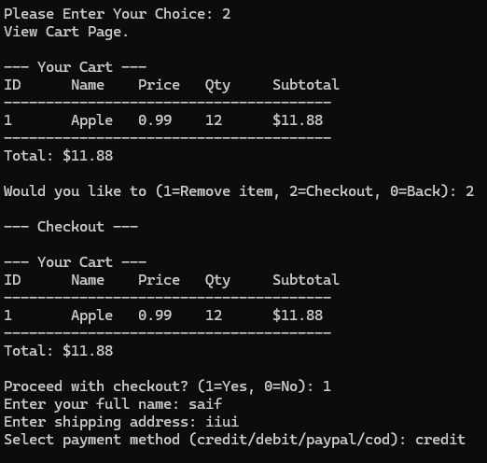
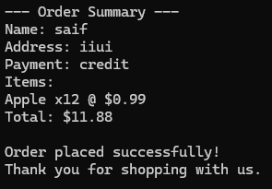
Live Demo - 02
Displaying all Products
Add to Cart & Checkout Process

Slide 9

Challenges Faced
Manual memory management (no vector, no STL)
Building undo stack for cart
Designing file format
Ensuring file read/write consistency
Avoiding memory leaks

Slide 10

Learning Outcomes:
Applied linked lists, stacks, arrays
Hands-on experience with file handling in C++
Practiced modular programming & OOP
Learned to manage user roles & logic separation
Understood trade-offs in terminal-based interfaces

Slide 11
Credits:
Members:
Saif-ur-Rehman Awan 4778-FOC/BSSE/F23
Abdul Moiz 4819-FOC/BSSE/F23
Ahmed Khurseed 4796-FOC/BSSE/F23
Supervisor:
Mr. Shakeel Ahmed, IIUI Lecturer

Slide 12

Thank You
Any Queries? Feel Free to Ask!

