Slide 1
Welcome to bosh2
Bye Bye bosh & bosh-init
Abhi alias 박웅철
㈜크로센트
2017. 12

Slide 2
Agenda
Introduction
Understanding Sample Manifest YAML file
Deployment Guide
Understanding Warden-CPI & CF Manifest YAML files
Live Demo
Q&A

Slide 3

1. Introduction (1/7) - Continuous Evolution
Continues Evolution

Slide 4

1. Introduction (2/7) - BOSH-2.0
WHAT ?
Why ?
How ?

Slide 5


1. Introduction (3/7) - What is BOSH-2.0 = ?
bosh-lite
bosh-init

Slide 6
1. Introduction (4/7) - Why is BOSH-2.0 = ?
Because it is a Dynamic Provisioning Tool
Generate strong passwords, certs, and keys
TLS/SSL features are enabled on every job
Cloud Config
Global Networking
Availability Zones
Links

Slide 7
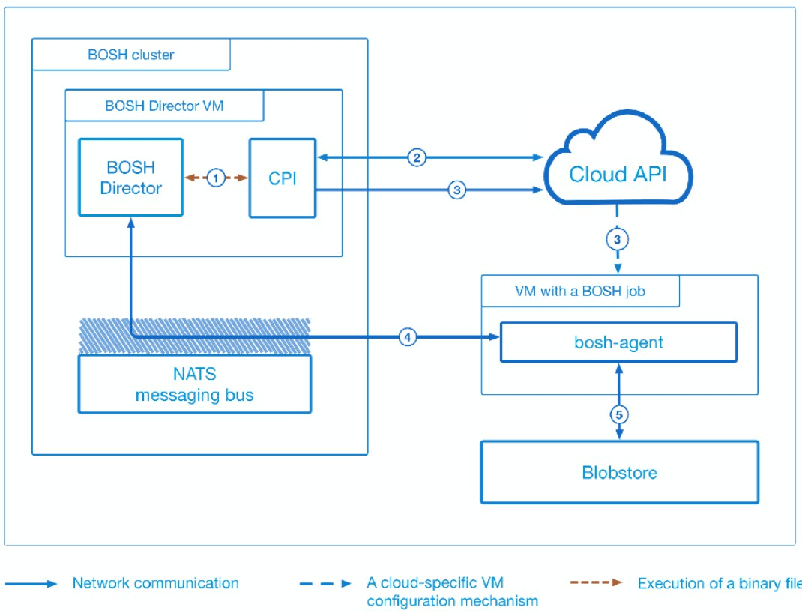
1. Introduction (5/7) - How BOSH-2.0 Works = ? (1/2)
Bosh CLI
PSQL
HM
Reg
PSQL
PostgreSQL
HM
Health Manager
Reg
Registry

Slide 8
1. Introduction (6/7) - How BOSH-2.0 Works = ? (2/2)
Building Multi-Datacenter

Slide 9
1. Introduction (7/7) - What else ?
Bosh and docker are friends
& more are coming

Slide 10
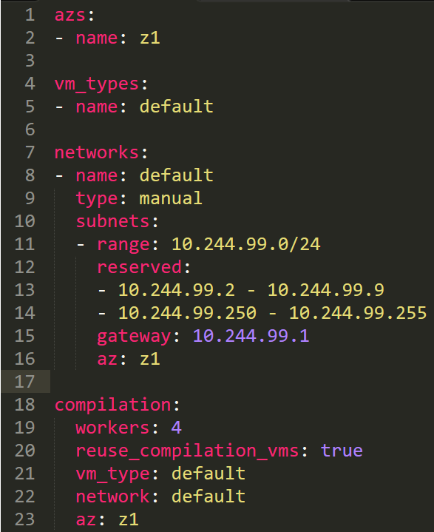
2. Understanding Sample Manifest YAML file (1/7) - Cloud-Config

Slide 11
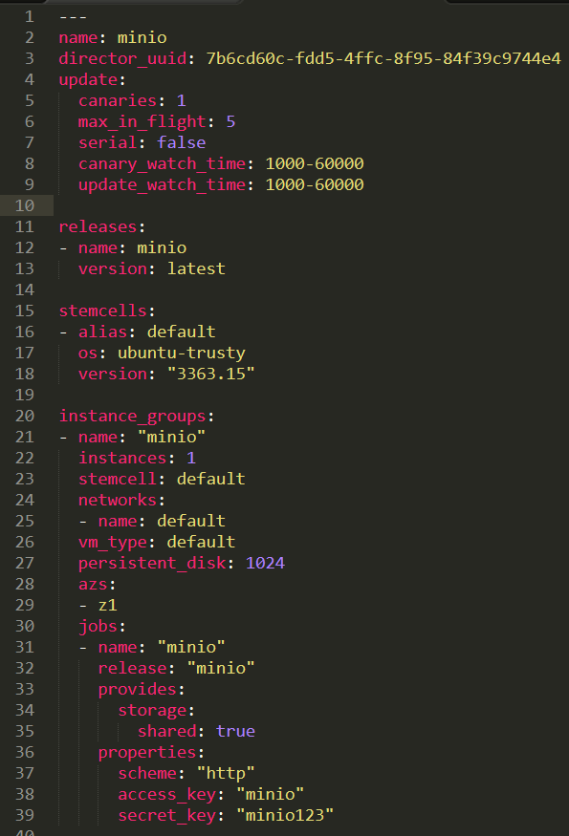
2. Understanding Sample Manifest YAML file (2/7) - Cloud-Config & Deployment-Manifest
Cloud-Config
Deployment-Manifest

Slide 12
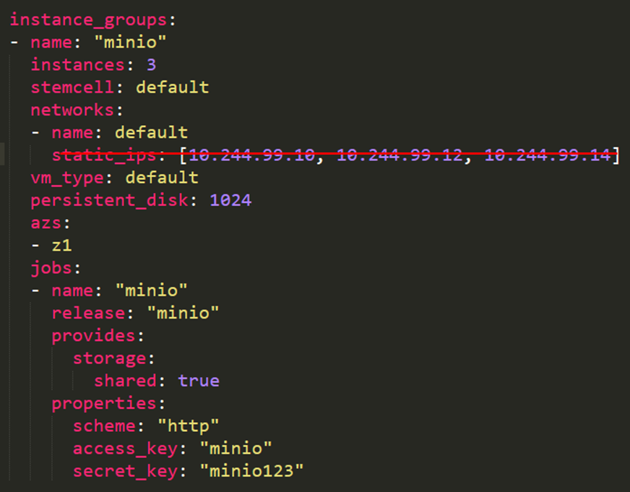
2. Understanding Sample Manifest YAML file (3/7) - Global Networking
No more static IPs
BOSH Director can automatically assign
IP addresses to jobs in all deployments
Using network configuration from Cloud-Config

Slide 13
2. Understanding Sample Manifest YAML file (4/7) - Availability Zones
Can deploy on
Multiple-availability-zones

Slide 14
2. Understanding Sample Manifest YAML file (5/7) - Links (1/2)

Slide 15
2. Understanding Sample Manifest YAML file (6/7) - Links (2/2)
Links-manifest

Slide 16
2. Understanding Sample Manifest YAML file (7/7) - Config-Server

Slide 17
3. Deployment Guide (1/8) - Install bosh-cli-2.0 (bosh alias bosh2)
Download bosh-cli-2.0 binary file for your platform
$ wget https://s3.amazonaws.com/bosh-cli-artifacts/bosh-cli-2.0.1-linux-amd64
Install bosh-cli-2.0 on your platform
$ chmod +x ~/Downloads/bosh-cli-*
$ sudo mv ~/Downloads/bosh-cli-* /usr/local/bin/bosh
Check the bosh version & its commands
$ bosh -v
$ bosh -h

Slide 18
3. Deployment Guide (2/8) - Install bosh 2.0 on Virtual-Box (1/4)
Your machine has at least 8GB RAM, and 100GB free disk space. Smaller configurations may work.
Make sure you are on VirtualBox 5.1+ since previous versions had a network connectivity bug.
$ http://download.virtualbox.org/virtualbox/5.1.20/virtualbox-5.1_5.1.20-114628~Ubuntu~xenial_amd64.deb
Install Director
$ git clone https://github.com/cloudfoundry/bosh-deployment ~/workspace/bosh-deployment
$ mkdir –p ~/deployments/vbox && cd ~/deployments/vbox

Slide 19
3. Deployment Guide (3/8) - Install bosh 2.0 on Virtual-Box (2/4)
Below command create bosh-init vm on virtualbox by means of bosh.yml as base manifest.
Yaml files with –o command set variables director_name, internal_ip, internal_gw, internal_cidr, outbound_network_name using –v command.
It also create state.json to record running state and creds.yml (for certs & credentails) in your ~/deployments/vbox directory
Following Command Creates Director’s vm and install it’s jobs
Note: we can increase default memory size of bosh director in ~/workspace/bosh-deployment/virtualbox/cpi.yml for example 4096 to 7168
Note: we can increase default disk size of bosh director in ~/workspace/bosh-deployment/bosh-lite.yml for example 65_536 to 100_536
$ bosh create-env ~/workspace/bosh-deployment/bosh.yml
--state state.json
-o ~/workspace/bosh-deployment/virtualbox/cpi.yml
-o ~/workspace/bosh-deployment/virtualbox/outbound-network.yml
-o ~/workspace/bosh-deployment/bosh-lite.yml
-o ~/workspace/bosh-deployment/bosh-lite-runc.yml
-o ~/workspace/bosh-deployment/jumpbox-user.yml
--vars-store ./creds.yml
-v director_name="Bosh Lite Director"
-v internal_ip=192.168.50.6
-v internal_gw=192.168.50.1
-v internal_cidr=192.168.50.0/24
-v outbound_network_name=NatNetwork

Slide 20
3. Deployment Guide (4/8) - Install bosh 2.0 on Virtual-Box (3/4)
Log into director with your alias name.
$ export BOSH_CLIENT=admin
$ export BOSH_CLIENT_SECRET=`bosh int ./creds.yml --path /admin_password`
$ bosh alias-env vbox -e 192.168.50.6 --ca-cert <(bosh int ./creds.yml --path /director_ssl/ca)
Download Upload BOSH Lite Stemcell
$ wget https://s3.amazonaws.com/bosh-core-stemcells/warden/bosh-stemcell-3468.1-warden-boshlite-ubuntu-trusty-go_agent.tgz
$ bosh -e vbox upload-stemcell bosh-stemcell-3468.1-warden-boshlite-ubuntu-trusty-go_agent.tgz wget
Update cloud config & set-up local route for bosh ssh
$ bosh -e vbox update-cloud-config ~/workspace/bosh-deployment/warden/cloud-config.yml
$ sudo route add –net 10.244.0.0/16 gw 192.168.50.6 # Linux
$ sudo route add –net 10.244.0.0/16 192.168.50.6 # Mac OS X

Slide 21
3. Deployment Guide (5/8) - Install bosh 2.0 on Virtual-Box (4/4)
SSH to the Director as jumpbox User
$ bosh int ./creds.yml --path /jumpbox_ssh/private_key > ~/.ssh/bosh-virtualbox.key
$ chmod 600 ~/.ssh/bosh-virtualbox.key
$ ssh -i ~/.ssh/bosh-virtualbox.key jumpbox@192.168.50.6
Useful Command Lines
BOSH TARGET
$ bosh alias-env name –e vbox
BOSH LOGIN
$ bosh -e vbox log-in
CHECK STEMCELL VERION AND DELETING COMMANDS
$ bosh -e vbox stemcells
$ bosh -e vbox delete-stemcell name/version

Slide 22
3. Deployment Guide (6/8) - Deploying CF using BOSH 2.0 (1/2)
Note: If you open new terminal to deploy SBP you have to initialize bosh director credentials again
$ cd ~/deployments/vbox
$ cd export BOSH_CLIENT_SECRET=`bosh int ./creds.yml --path /admin_password`
Clone your cf-deployment repository
$ git clone https://github.com/cloudfoundry/cf-deployment ~/workspace
$ cd ~/workspace/cf-deployment
Configure your VirtualBox BOSH with appropriate networking/vm type information (called "cloud-config")
$ bosh -e vbox update-cloud-config bosh-lite/cloud-config.yml
Following Command run’s cf job vm’s on VirtualBox using BOSH-2.0
$ bosh -e vbox -d cf deploy cf-deployment.yml
-o operations/bosh-lite.yml
--vars-store deployment-vars.yml
-v system_domain=bosh-lite.com

Slide 23
3. Deployment Guide (7/8) - Deploying CF using BOSH 2.0 (2/2)
Useful Command Lines
BOSH RELEASES
$ bosh -e vbox releases
BOSH DEPLOYMENTS
$ bosh -e vbox deployments
BOSH VMS & INSTANCES
$ bosh -e vbox vms (or) bosh -e vbox instances
BOSH SSH
$ bosh –e vbox ssh –d cf(deployment-name) nats(job-name)
BOSH TASKS
$ bosh –e vbox tasks
BOSH LOCKS
$ bosh -e vbox locks

Slide 24
3. Deployment Guide (8/8) - CF PUSH
Set-Up CF api and login as admin:
CF TARGET
$ cf api https://api.bosh-lite.com --skip-ssl-validation
SET PASSWORD FOR CF ADMIN
$ cd ~/workspace/cf-deployment
$ export CF_ADMIN_PASSWORD=$(bosh int ./deployment-vars.yml --path /cf_admin_password)
AUTHENTICATE YOUR CF USER WITH DESIRED PASSWORD
$ cf auth admin $CF_ADMIN_PASSWORD
CREATE SPACE
$ cf create-space woongcheol -o system -q Innovation
$ cf push

Slide 25
4. Understanding Warden-CPI & CF Manifest YAML files
BOSH-WARDEN-CPI:
$ https://github.com/cloudfoundry/bosh-deployment
CF-DEPLOYMENT:
$ https://github.com/cloudfoundry/cf-deployment

Slide 26
5. LIVE DEMO
DEPLOYING BOSH-WARDEN-CPI
DEPLOYING CF
DEPLOYING MY PERSONAL RELEASE

Slide 27
6. Q&A
THANK YOU

Slide 28


