Slide 1
Lossy Compression of Comic Strips
Presenter: Xuran ZHOU Supervisor: Prof. Szymon Grabowski

Slide 2
Motivation
Why existing methods are not suitable for comic strips:
JPEG
Causes ringing artifacts around hard edges and text — very visible in comics
PNG
Lossless but poor compression ratio for comic images
General-purpose methods
Not designed for comic-specific features
Comic strips have distinct features:
Large flat-color regions, contour lines, speech bubble text, color gradients, low number of distinct colors

Slide 3
Approach
① One-Color Regions [Today's focus]
Based on 4C(Chain Code Cartoon Compression) framework [1]
Innovation: automatic parameter selection (ctol-color tolerance, msz-minimum size, ptol-palette tolerance) based on image features
② Tonal Transition Regions
Based on CGV(Color Gradient Vectorization) method [2][3]
Innovation: integrate gradient-color regions handling into 4C framework
③ Text Regions (Speech Bubbles)
Detection: SickZil-Machine[4]
Compression: MRC-inspired approach[5]
Innovation: MRC-inspired compression to avoid ringing artifacts on text edges
Divide comic image into three region types, each compressed separately:
[1] Jeromel & Žalik (2020) — "An efficient lossy cartoon image compression method"
[2] Taylor (2011) — "Compression of Cartoon Images"
[3] Chang & Su (2015) — "Color Gradient Vectorization for SVG Compression of Comic Image"
[4] Ko & Cho (2020) — "SickZil-Machine: A Deep Learning Based Script Text Isolation System for Comics Translation"
[5] Haneda & Bouman (2011) — "Text Segmentation for MRC Document Compression"

Slide 4
One-Color Region Pipeline
Input image → Region Detection → Region Reduction → Palette Generation → Chain Code Encoding → Output
Step 1 — Region Detection
BFS scan from each unassigned pixel. Pixels within ctol color distance are grouped into the same region.
Step 2 — Region Reduction
Regions smaller than msz pixels are merged into neighboring regions. Contour regions (Y < 100) merged to most similar neighbor; normal regions (Y > 100) merged to largest similar neighbor.
(Y represents the luminance value (Luma), derived from the YCbCr color space)
Step 3 — Palette Generation
Similar region colors (within ptol distance) are unified into a shared palette color using weighted averaging.
Step 4 — Chain Code Encoding (VCC)
Each region's contour is encoded using Vertex Chain Code — only 3 symbols (1=straight, 2=left, 3=right). More compressible than standard 4/8-direction chain codes.

Slide 5
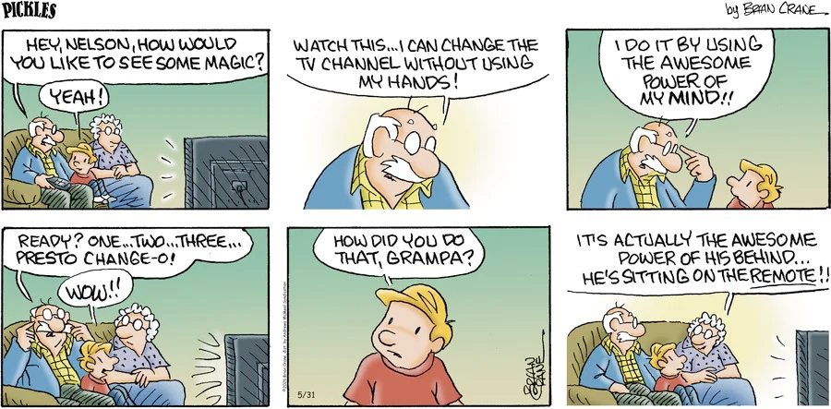
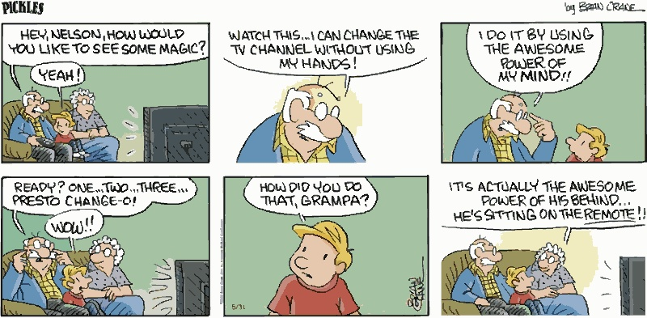
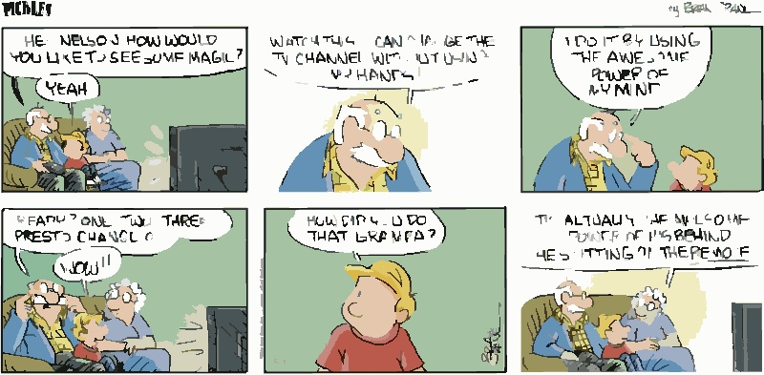
Experimental Results
Parameters: ctol = 50 | msz = 3 | ptol = 25
Parameters: ctol = 50 | msz = 20 | ptol = 25
reconstructed
original

Slide 6
Data Summary
Parameters: ctol = 50 | msz = 3 | ptol = 25
Initial regions detected: 24705
Regions after reduction: 7448
Palette colors: 79
Chain code symbols (total): 133245
Effect of msz on region count:
msz=3: regions=7448
msz=5: regions=4768
msz=10: regions=2810
msz=20: regions=2402
msz=30: regions=2808
msz=50: regions=3220

Slide 7
Parameter Analysis
4C parameters (ctol, msz, ptol) must be tuned manually for each image. Different comics require different settings.
Our Solution — Automatic parameter selection based on image features:
ctol → computed from color standard deviation of the image
High std (many color variations) → small ctol
Low std (uniform colors) → large ctol
msz → computed from edge density (Canny edge detection)
Dense edges (detailed image) → small msz
Sparse edges (large color blocks) → large msz
ptol → computed from number of unique colors in image
Many colors → small ptol | Few colors → large ptol
No machine learning required — direct image analysis formulas only.

Slide 8
Limitations & Future Improvements
Current Limitation:
Contour lines (black outlines) may be merged and lost during Region Reduction.
Current solution: lower msz — simple but reduces compression ratio.
Potential Improvement — Separate contour line handling:
1. Detect contour lines first using Canny edge detection
2. Store contours separately, excluding them from Region Reduction
3. Compress contour layer independently
4. Merge layers during reconstruction
Benefit: preserve contour detail without sacrificing compression ratio.

