Slide 1
Patient Table
Studies Table
Modality Table
idPatient
Name
CreatedDate
idPatient
idStudy
StudyName
CreatedDate
idModality
Name
idPatient
idStudy
idSeries
idModality
SeriesName
CreatedDate
Series Table
idPatient
idStudy
idSeries
idFile
FilePath
CreatedDate
Files Table

Slide 2
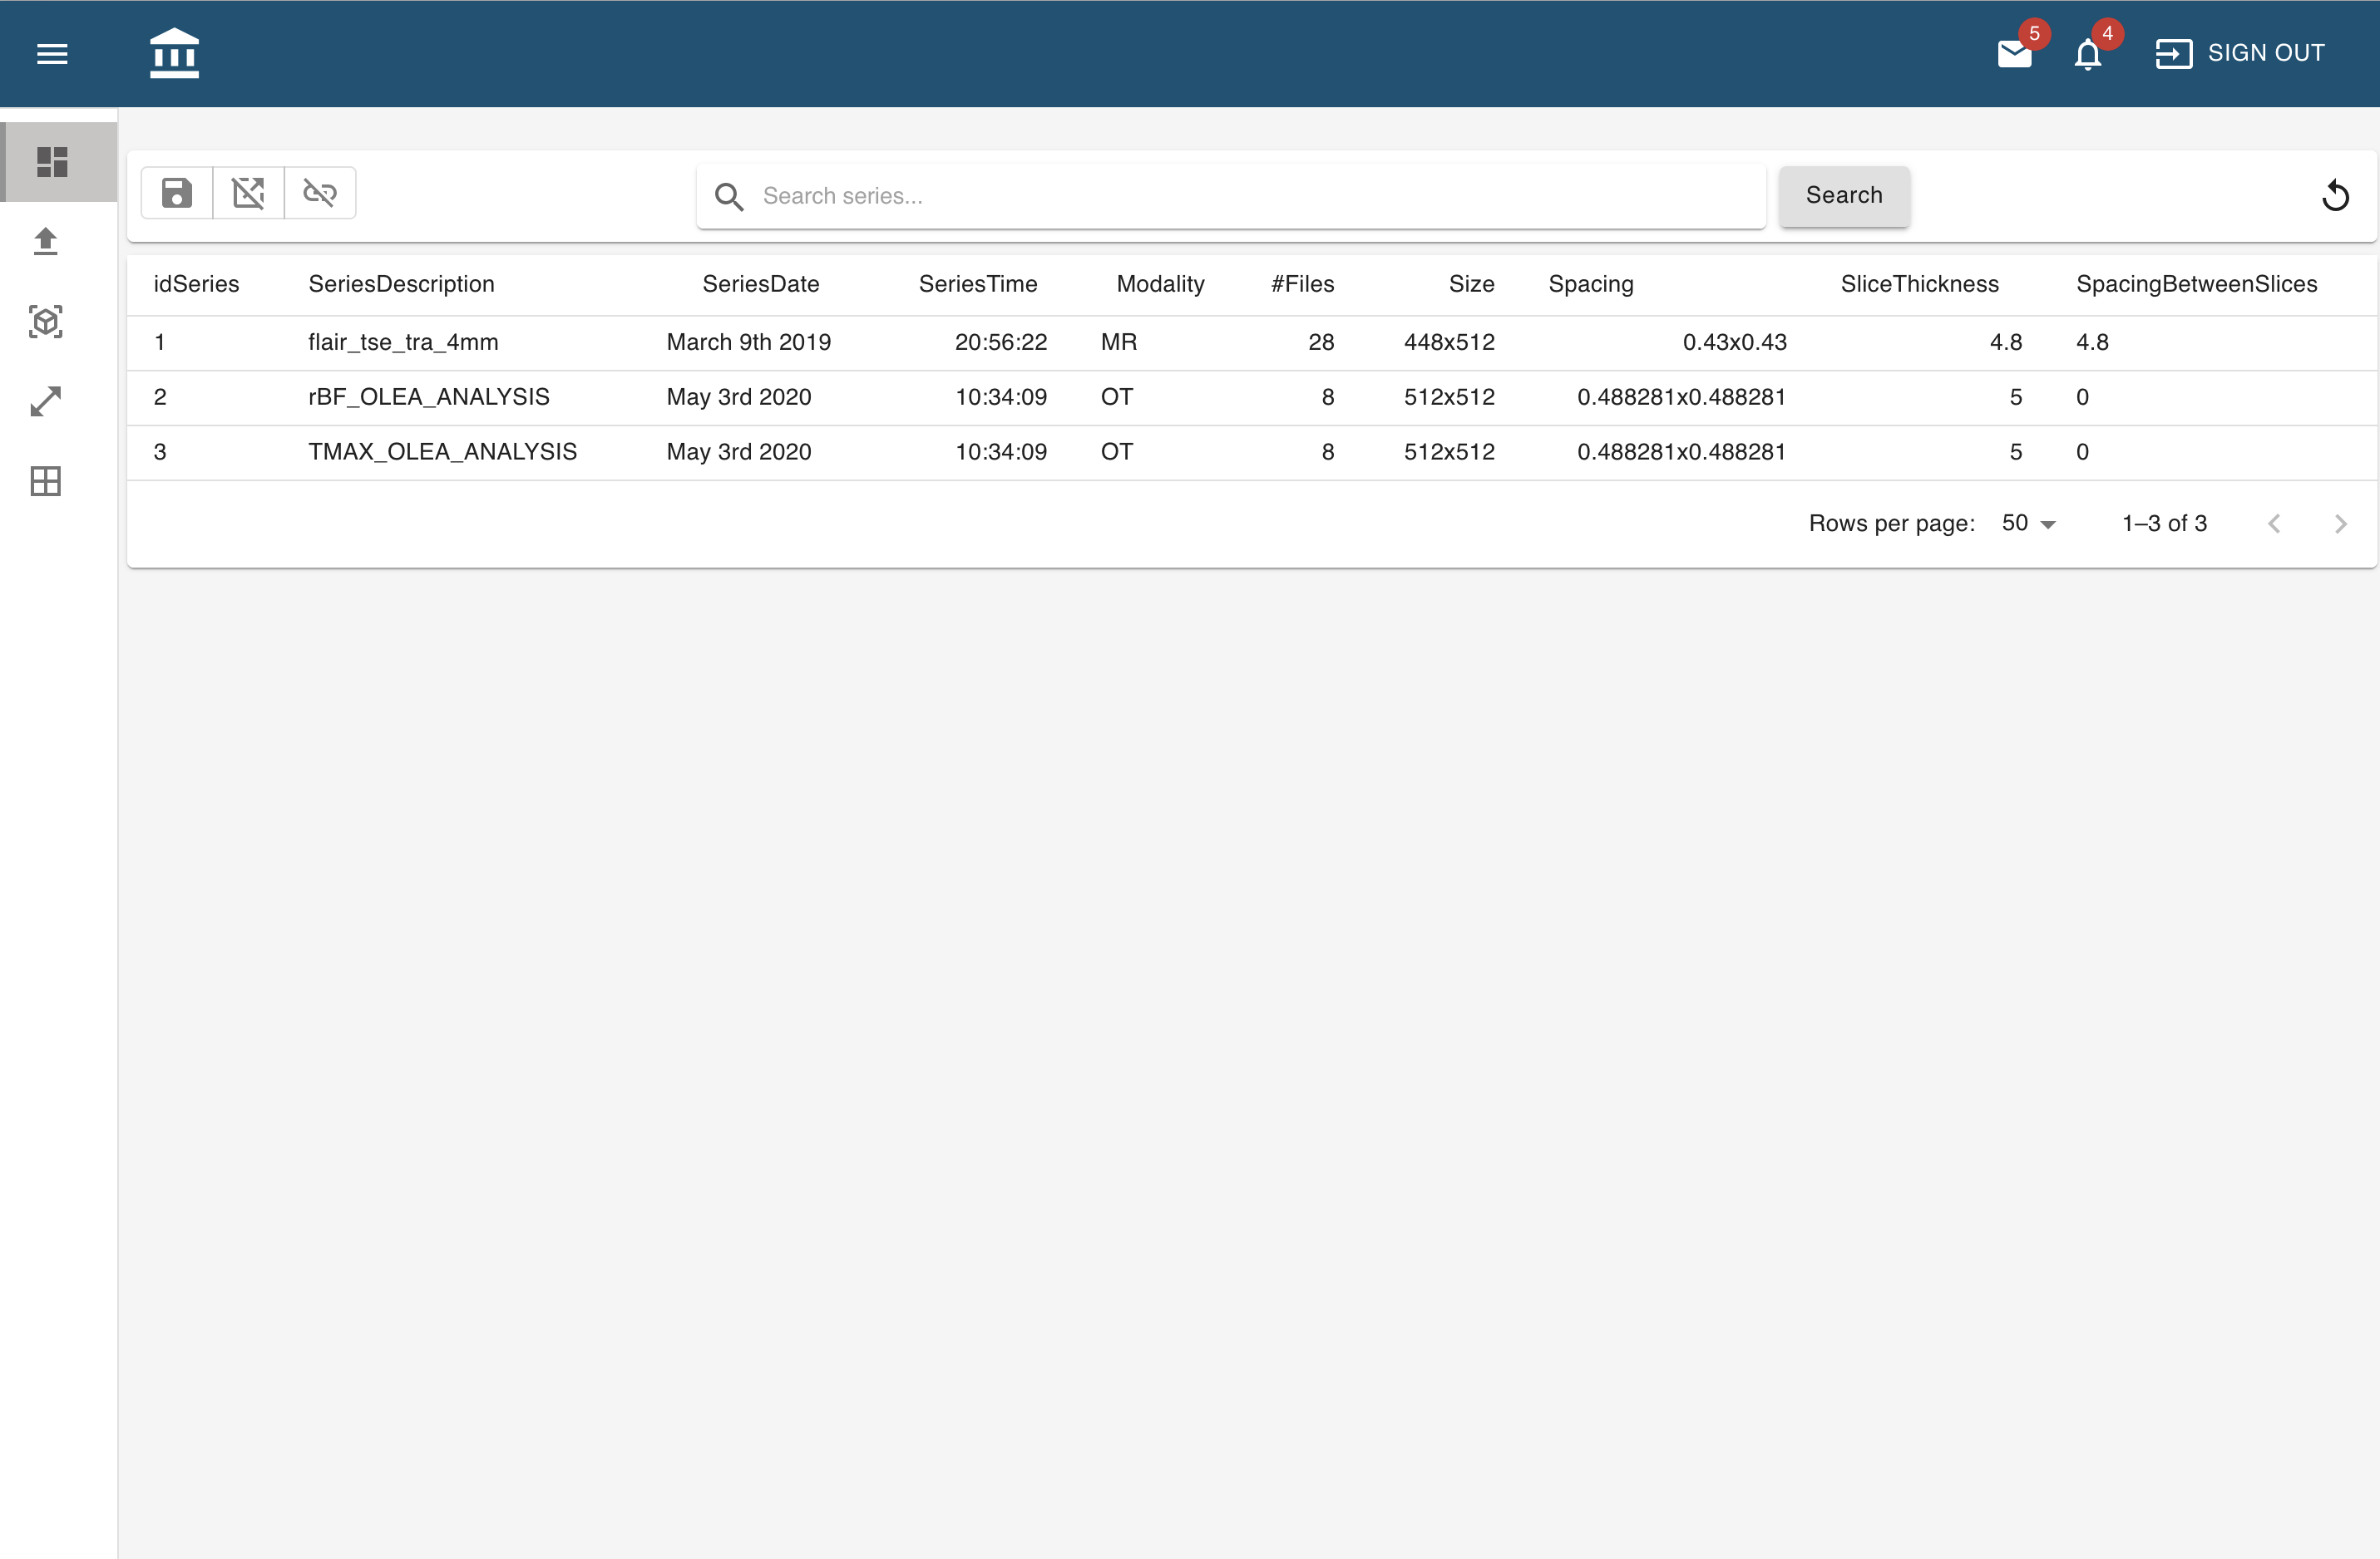
Download Page

Slide 3
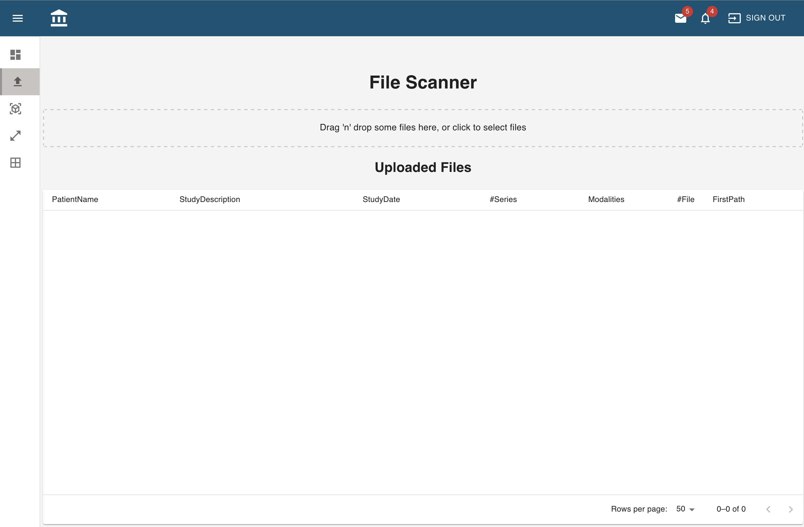
Upload Page

Slide 4
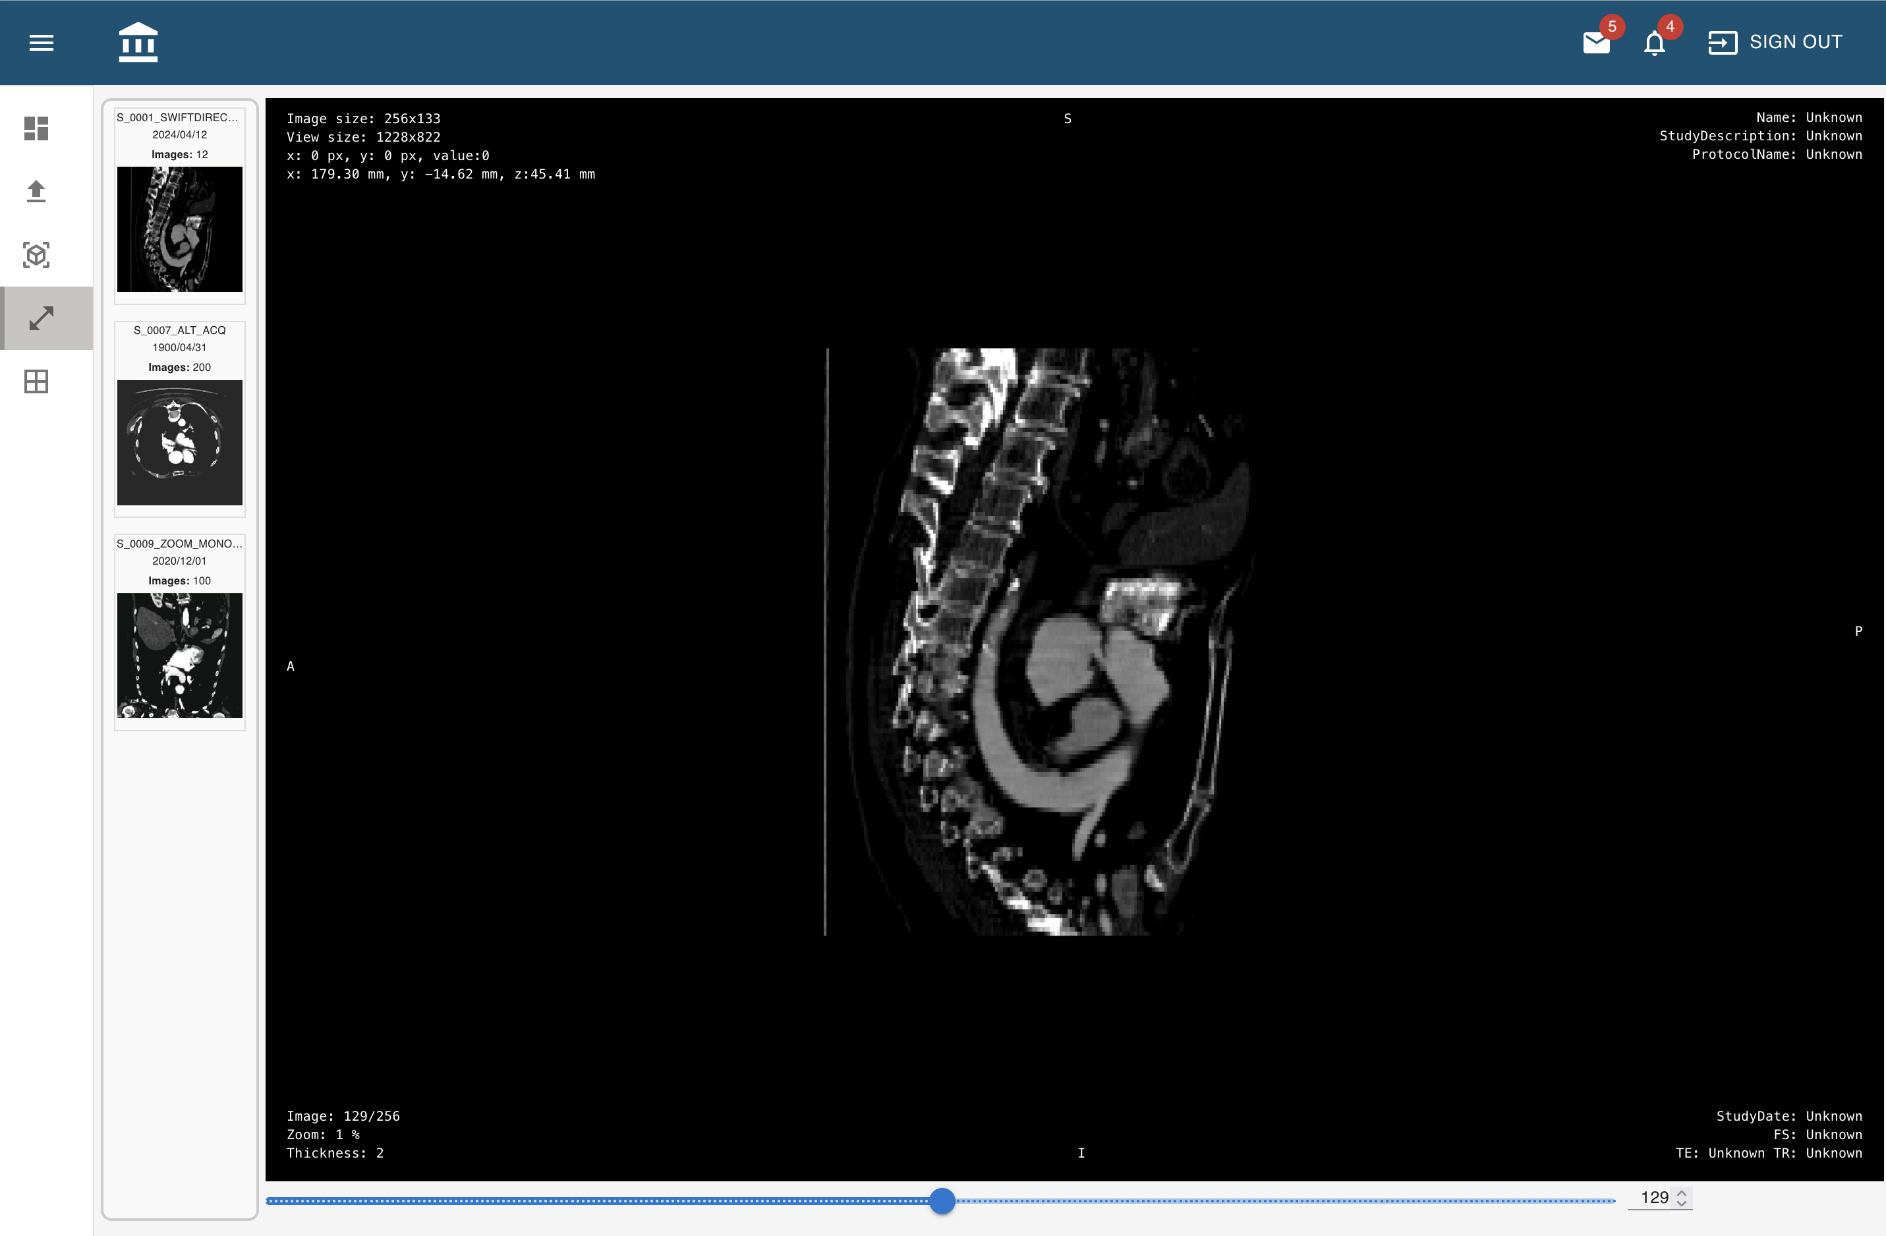
Viewer Page

Slide 5
Python Code To Read a DICOM file
import numpy as np
from PIL import Image
from numpy import maximum, ndarray
from pydicom import dcmread, FileDataset
from pydicom.multival import MultiValue
from pydicom.valuerep import PersonName
def getDicomValue(ds,name):
value = ds.get(name)
if value is None:
return ''
if isinstance(value, MultiValue):
array = np.array(value)
# Convert NumPy array to list
return array.tolist()
if isinstance(value, PersonName):
return value.formatted('format_str') # Adjust as needed
if isinstance(value, np.ndarray):
return value.tolist() # Convert NumPy arrays to lists
if isinstance(value, (np.floating, np.integer)):
return value.item() # Convert NumPy scalar to native Python type
return value

Slide 6
def convert_dicom(filepath, output_type="json", with_metadata=False):
# https://pydicom.github.io/pydicom/stable/tutorials/dataset_basics.html
# Extract dataset from dcm file
# https://pydicom.github.io/pydicom/stable/reference/dataset.html
ds = dcmread(filepath)
# Extract the pixel data from dataset
pixel_data = ds.pixel_array
try:
rescale_intercept = ds.RescaleIntercept
except:
rescale_intercept = 0
# Convert to float to avoid overflow or underflow losses.
pixel_data_float = pixel_data.astype(float)
pixel_data_float += rescale_intercept
maximum = np.amax(pixel_data_float)
minimum = np.amin(pixel_data_float)
# Rescaling grey scale between 0-255
pixel_data_float_scaled = np.maximum(pixel_data_float, 0) / pixel_data_float.max(initial=0) * 255.0
# Convert to uint8 ndarray
pixel_data_uint8_scaled = np.uintc(pixel_data_float_scaled)
SliceLocation = getDicomValue(ds,'SliceLocation')
ImageOrientationPatient = getDicomValue(ds,'ImageOrientationPatient')
ImagePositionPatient = getDicomValue(ds,'ImagePositionPatient')
InstanceNumber = getDicomValue(ds,'InstanceNumber')
if output_type == "json":

Slide 7
# Convert array to list
PixelSpacing = getDicomValue(ds,'PixelSpacing')
Modality = getDicomValue(ds,'Modality')
SeriesDescription = getDicomValue(ds,'SeriesDescription')
ProtocolName = getDicomValue(ds,'ProtocolName')
PatientName = getDicomValue(ds,'PatientName')
StudyDate = getDicomValue(ds,'StudyDate')
StudyTime = getDicomValue(ds,'StudyTime')
SliceThickness = getDicomValue(ds,'SliceThickness')
SpacingBetweenSlices = getDicomValue(ds,'SpacingBetweenSlices')
RepetitionTime = getDicomValue(ds,'RepetitionTime')
EchoTime = getDicomValue(ds,'EchoTime')
ImageType = getDicomValue(ds,'ImageType')
MagneticFieldStrength = getDicomValue(ds,'MagneticFieldStrength')
SeriesNumber = getDicomValue(ds,'SeriesNumber')
NumberOfFrames = getDicomValue(ds,'NumberOfFrames')
StudyDescription = getDicomValue(ds,'StudyDescription')
output_json = {
"slices":[{
"image": pixel_data_uint8_scaled.tolist(),
"InstanceNumber": InstanceNumber,
"SliceLocation": SliceLocation,
"ImageOrientationPatient": ImageOrientationPatient,
"ImagePositionPatient": ImagePositionPatient,
"filepath": filepath,
}],
"width": ds.Columns,
"height": ds.Rows,
"minimum": float(minimum),
"maximum": float(maximum),
"Modality":Modality,
"SeriesDescription":SeriesDescription,
"PatientName":PatientName,
"StudyDate":StudyDate,
"StudyTime":StudyTime,
"SliceThickness":SliceThickness,
"SpacingBetweenSlices":SpacingBetweenSlices,
"ProtocolName":ProtocolName,
"RepetitionTime": RepetitionTime,
"EchoTime": EchoTime,
"MagneticFieldStrength": MagneticFieldStrength,
"SeriesNumber": SeriesNumber,
"NumberOfFrames": NumberOfFrames,
"PixelSpacing": PixelSpacing,
"ImageType": ImageType,
"StudyDescription":StudyDescription
}
if with_metadata:
output_json["metadata"] = ds.to_json_dict()
return output_json
return {
"image": pixel_data_uint8_scaled.tolist(),
"InstanceNumber": InstanceNumber,
"SliceLocation": SliceLocation,
"ImageOrientationPatient": ImageOrientationPatient,
"ImagePositionPatient": ImagePositionPatient,
"filepath": filepath,
}

