Slide 1
CCNA Routing & Switching and MPLS at RailTel
By
Name : Mridul Baweja
Roll No. : 41011502817
Class : ECE-2

Slide 2
Packettracer
Packet Tracer is a cross-platform visual simulation tool designed by Cisco Systems that allows users to create network topologies and imitate modern computer networks. The software allows users to simulate the configuration of Cisco routers and switches using a simulated command line interface.
The following simulation and labs were performed using Packettracer :-
1. VLAN in a single and multiple networks
2. Subnetting using switches and routers
3. Providing static routes to a system
4. Dynamic Routing protocols:
a. RIP
b. IGRP
c. OSPF
5. Creating autonomous systems
6. Implementing NAT and PAT
7. Using access lists to limit access to systems in a network
8. Setting a remote connection on a switch/router using telnet

Slide 3
Open Systems Interconnection Model (OSI model)
Sno. | Layer | Purpose
1. | Application Layer | - Provides user interface - Consistes of protocols like HTTP,HTTPS,SMTP,POP3 etc.
2. | Presentation Layer | - Presents data - Handles encryptions
3. | Session Layer | - Keeps different applications’ data seperate
4. | Transport Layer | - Provides reliable or unreliable delivery - Performs error correction before retransmit
5. | Network Layer | - Provides logical addressing, which routers use for path determination
6. | Data-Link Layer | - Combines packets into bytes and bytes into frames - Provides access to media using MAC address - Performs error detection not correction
7. | Physical Layer | - Moves bits between devices - Specifies voltage, wire speed, and pinout of cables

Slide 4
Topics Covered
IP Addressing
Subnetting
VLANs
Router to Router Configuration
Access Lists
NAT and PAT
Remote Connection
DHCP
MPLS

Slide 5
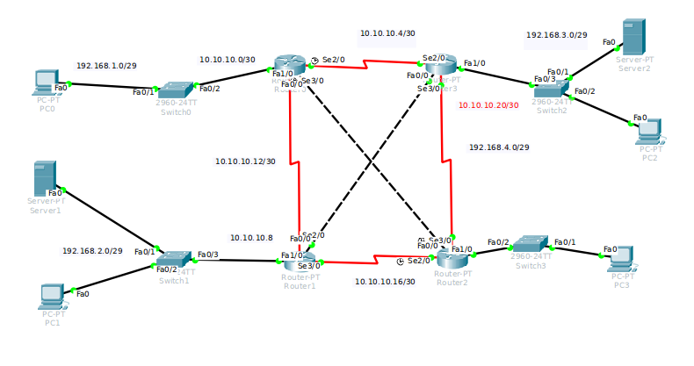
A lab in Packettracer

