Slide 1


HIV/AIDS Among African-Americans in California: Epidemiologic Data and Research Overview
Christopher Krawczyk, Ph.D.
Chief – HIV Prevention Research and
Evaluation Section
Office of AIDS
California Department of Public Health

Slide 2
General Population Statistics
 | California | USA
Female (%) | 50.1 | 50.7
White/non-Hispanic (%) | 43.8 | 66.9
Black/non-Hispanic (%) | 6.7 | 12.8
Hispanic/Latino (%) | 35.2 | 14.4
Amer. Indian/AK Native (%) | 1.2 | 1.0
Asian (%) | 12.2 | 4.3
Native Hawaiian/ Pac. Isl. (%) | 0.4 | 0.2
U.S. Census Bureau. State & County QuickFacts

Slide 3
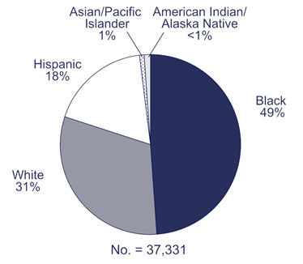
New HIV Diagnoses, 2005 – All Cases
California
CDC – 33 States
Asian/Pacific Islander 3%
American Indian/ Alaska Native <1%
Hispanic 35%
Black 20%
White 39%
No. = 3,312
CDPH, Office of AIDS. HIV/AIDS Case Registry.
CDC, HIV/AIDS Among African-Americans. www.cdc.gov

Slide 4
HIV/AIDS Among African-Americans in California:
Rate Disparity
Office of AIDS
California Department of Public Health

Slide 5
California New HIV Diagnoses, 2005 - Males
HIV Number
HIV Rate
Asian/Pacific Islander 3%
American Indian/ Alaska Native <1%
American Indian/ Alaska Native 19.8
Asian/Pacific Islander 5.3
Black 18%
Hispanic 36%
Hispanic 21.0
Black 55.9
White 42%
White 17.0
No. = 2842
Total = 19.2
CDPH, Office of AIDS. HIV/AIDS Case Registry.

Slide 6
California New HIV Diagnoses, 2005 - Females
HIV Number
HIV Rate
Asian/Pacific Islander 3%
American Indian/ Alaska Native 1%
Asian/Pacific Islander 0.6
American Indian/ Alaska Native 7.4
White 1.6
Hispanic 3.4
Hispanic 33%
Black 36%
Black 17.9
White 25%
No. = 470
Total = 3.1
CDPH, Office of AIDS. HIV/AIDS Case Registry.

Slide 7
HIV and AIDS rates, California (2005)
Men
Women
Data sources: California Department of Public Health, Office of AIDS, HIV/AIDS Case Registry; data as of March 31, 2006; State of California, Department of Finance, Race/Ethnic Population with Age and Sex Detail 2000-2050, Sacramento, California, July 2007.
Notes:
New cases of HIV and AIDS diagnosed in 2005 among California adults age 13 and over at diagnosis.
Note: Counts for California cases in this period exclude AIDS cases diagnosed, but not yet reported and deaths that have not yet been reported as of March 31,2006 and may underestimate the actual number of diagnoses and deaths in most recent years. The ‘Other’ category includes individuals in the following population groups: Asians, Native Hawaiians and Pacific Islanders, American Indians and Alaska Natives, persons of more than one race and persons of unknown/unreported race. Rates not calculated for individuals whose sex at birth is unknown.
Source: California Department of Public Health, HIV/AIDS Case Registry, cases reported through March 31, 2006
California Department of Finance, Race/ethnic population with age and sex detail, 2000-2050, Sacramento, California July, 2007

Slide 8
California New HIV/AIDS Diagnoses, 2005. Aged 13 to 19 Years of Age
HIV Number
HIV Rate
American Indian/ Alaska Native 0%
Asian/Pacific Islander 1%
Unknown 8%
American Indian/ Alaska Native 0.0
Asian/Pacific Islander 0.2
Black 27%
Black 10.8
Hispanic 3.1
Hispanic 45%
White 19%
White 1.5
No. = 116
Total = 2.7
CDPH, Office of AIDS. HIV/AIDS Case Registry.

Slide 9
HIV/AIDS Among African-Americans in California:
Risk Factors
Office of AIDS
California Department of Public Health

Slide 10
African American Risks Reported in State Funded Test Sites
19,339 African American tests (2006) | % HIV Positive | % of AA Tests
HIV-infected sex partner | 5.4% | 4.4%
Men who have sex with men | 4.3% | 12.7%
MSM and inject drugs | 3.1% | 1.3%
Sex for drugs or money | 2.0% | 12.8%
Hepatitis C diagnosis | 2.0% | 4.7%
Injection drug user (non-MSM) | 1.9% | 8.1%
Sexually transmitted infection | 1.8% | 17.8%

Slide 11
African American Risks Reported in State Funded Test Sites
2006: 19,339 African American tests | % HIV Positive | % of AA Tests
IDU sex partner | 1.7% | 12.2%
Transgender sex partner | 1.6% | 2.2%
Stimulant drug use | 1.6% | 32.7%
Transfusion, job related | 1.6% | 3.2%
Use drugs with sex | 1.4% | 57.7%
Sex worker sex partner | 1.3% | 11.4%
No identifiable risk or unknown | 0.9% | 23.2%

Slide 12
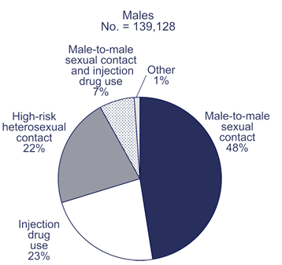
Mode of Exposure, 2005 African-American Males
HIV California
HIV/AIDS CDC – 33 States
No. = 2842
MSM-IDU 3%
Heterosexual 9%
Other/NIR 27%
IDU 8%
MSM 54%
CDPH, Office of AIDS. HIV/AIDS Case Registry.
CDC. Fact Sheet: HIV/AIDS among African Americans. June 2007
Notes:
The percent positive among men with NIR in C&T sites is very low; however this percentage among HARS data is very high. This seems to indicate that men testing in other facilities have a high rate of reporting no NIR.

Slide 13
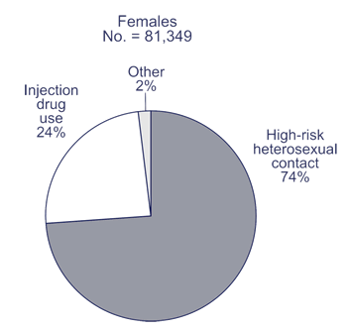
Mode of Exposure, 2005 African-American Females
HIV California
HIV/AIDS CDC – 33 States
No. = 470
Other/NIR 26%
IDU 18%
Heterosexual 56%
CDPH, Office of AIDS. HIV/AIDS Case Registry.
CDC. Fact Sheet: HIV/AIDS among African Americans. June 2007
Notes:
The percent positive among men with NIR in C&T sites is very low; however this percentage among HARS data is very high. This seems to indicate that men testing in other facilities have a high rate of reporting no NIR.

Slide 14
Female HIV Positivity by Risk Groups
Hierarchical Risk Groups | White | African American | Latina
HIV+ partner* | 3.57 | 8.09 | 5.01
IDU | 0.80 | 3.58 | 0.65
Sex with IDU* | 0.30 | 1.81 | 0.71
Sex for drugs/$ | 0.78 | 1.87 | 0.80
MSM partner* | 0.40 | 1.29 | 0.78
Multiple partners | 0.21 | 0.66 | 0.34
Monogamous partnership | 0.20 | 0.72 | 0.33
No risk reported | 0.58 | 2.21 | 1.21
Unknown risk (missing/declined) | 1.01 | 2.96 | 1.07
HIV+
*does not include oral sex
Prepared by: Prevention Research and Evaluation Section, California DPH, Office of AIDS.

Slide 15
HIV/AIDS Among African-Americans in California:
Transgender People
Office of AIDS
California Department of Public Health

Slide 16
Transgender People
2003 HIV Counseling & Testing Data:
1203 tests among self-identified transgenders
36 of 126 AA transgender tests were positive
Positivity: 28.6%

Slide 17
HIV/AIDS Among African-Americans in California:
Geographic Influence
Office of AIDS
California Department of Public Health

Slide 18
African-American MSM at OA Funded C&T Sites – Geographic Role
Tested
Tier 1 |  | Tier 2
Alameda |  | Berkeley
Contra Costa |  | Fresno
Long Beach |  | Kern
Los Angeles |  | Orange
Riverside |  | Pasadena
Sacramento |  | San Joaquin
San Bernardino |  | San Mateo
San Diego |  | Santa Clara
San Francisco
Solano
No. = 8307
Tier 1
87%
Tier 2 10%
Tier 3 3%
Prepared by: Prevention Research and Evaluation Section, California DPH, Office of AIDS.
Notes:
The percent positive among men with NIR in C&T sites is very low; however this percentage among HARS data is very high. This seems to indicate that men testing in other facilities have a high rate of reporting no NIR.

Slide 19
African-American MSM at OA Funded C&T Sites – Geographic Role
Tested
Positive
No. = 8307
No. = 621
Tier 1
87%
Tier 1
90.5%
Tier 1
90.5%
Tier 2 7.9%
Tier 2 10%
Tier 2 7.9%
Tier 3 3%
Tier 3 3%
Tier 3 1.6%
Prepared by: Prevention Research and Evaluation Section, California DPH, Office of AIDS.
Notes:
The percent positive among men with NIR in C&T sites is very low; however this percentage among HARS data is very high. This seems to indicate that men testing in other facilities have a high rate of reporting no NIR.

Slide 20
Proportion of HIV+ Females Concentrated in Urban Areas
African American
Latina
White
81%
72%
56%
Prepared by: Prevention Research and Evaluation Section, California DPH, Office of AIDS.
Notes:
<number>
<footer>
<header>
<date/time>
More positives in urban areas

Slide 21
Female HIV-positivity: Urban vs. Non-urban
P<.01
Prepared by: Prevention Research and Evaluation Section, California DPH, Office of AIDS.
Notes:
<number>
<footer>
<header>
<date/time>
Higher positivity in urban areas

Slide 22
HIV/AIDS Among African-Americans in California:
Delayed HIV Diagnosis
Office of AIDS
California Department of Public Health

Slide 23
Time to AIDS diagnosis (in months) from first HIV diagnosis in 2005
 | Men |  |  |  | Women
 | n | Median | 75th Percentile |  | n | Median | 75th Percentile
Black | 444 | 3 | 59 |  | 170 | 1 | 37
Asian | 69 | 0 | 20 |  | Excluded – small n
Hispanic | 922 | 0 | 12 |  | 156 | 1.5 | 40
White | 959 | 4 | 63 |  | 119 | 30 | 84
Total |  | 1 | 36 |  |  | 2 | 52.5
Source: California Department of Public Health, Office of AIDS, HIV/AIDS Case Registry; data as of March 31, 2006.
* Averaged over all race/ethnicities.
Notes:
*Excluded interquartile ranges for racial/ethnic categories with fewer than 20 AIDS cases. Time to diagnosis was measured in months between the first reported HIV diagnosis and the AIDS diagnosis, based on either a CD4 T lymphocyte count or diagnosis with an opportunistic infection.
I highlighted the Third Quartile column. This is probably the more interesting column.

Slide 24
Time to AIDS diagnosis (in months) from first HIV diagnosis in 2005
 | Men |  |  |  | Women
 | n | Median | 75th Percentile |  | n | Median | 75th Percentile
Black | 444 | 3 | 59 |  | 170 | 1 | 37
Asian | 69 | 0 | 20 |  | Excluded – small n
Hispanic | 922 | 0 | 12 |  | 156 | 1.5 | 40
White | 959 | 4 | 63 |  | 119 | 30 | 84
Total |  | 1 | 36 |  |  | 2 | 52.5
Source: California Department of Public Health, Office of AIDS, HIV/AIDS Case Registry; data as of March 31, 2006.
* Averaged over all race/ethnicities.
Notes:
*Excluded interquartile ranges for racial/ethnic categories with fewer than 20 AIDS cases. Time to diagnosis was measured in months between the first reported HIV diagnosis and the AIDS diagnosis, based on either a CD4 T lymphocyte count or diagnosis with an opportunistic infection.
I highlighted the Third Quartile column. This is probably the more interesting column.

Slide 25
HIV/AIDS Among African-Americans in California:
HIV/AIDS Care
Office of AIDS
California Department of Public Health

Slide 26
Care Program Client Statistics
Program | Year | Total (n) | Total AA (n) | AA (%) | AA Aged 15-25 (%) | AA AIDS non-HIV (%) | AA MSM (%) | AA Female (%)
ADAP | FY 06/07 | 31,221 | 4,392 | 14.1 | 3.4 | 40.3 | n/a | 15.0
CMP | FY 05/06 | 1,760 | 339 | 19.3 | 2.9 | n/a | n/a | 30.0
EIP | FY 05/06 | 8,655 | 1,714 | 19.8 | 4.3 | n/a | 14.8 | 32.6
CSP/CADR | CY 2006 | 41,191 | 9,037 | 21.9 | n/a | n/a | n/a | n/a
CARE/HIPP | FY 06/07 | 337 | 36 | 10.7 | 0.0 | n/a | n/a | 25.0
- CMP age range is 13-24
- CSP numbers include duplicated clients

Slide 27
HIV/AIDS Among African-Americans in California:
Office of AIDS Research
Office of AIDS
California Department of Public Health

Slide 28
Office of AIDS Research - Males
National HIV Behavioral Surveillance (NHBS) Project
Partners Project
Health Evaluation of Young Men (HEY Man) Study
Interpersonal/Social HIV Risk Among African American and White Male Inmates
Developing a Tailored Case Management Intervention for MSM (HOLLA)
HIV Prevention for African American Down Low Men (BRUTHAS)
HIV Prevention for African-American MSM Who Do Not Identify as Gay (MAALES)
Community Collaborative award for African-American MSM or African-American MSM who do not identify as gay

Slide 29
Office of AIDS Research - Females
National HIV Behavioral Surveillance (NHBS) Project
Partners Project
Females of African American Legacy Empowering Self (FemAALES) Project: Reducing HIV Risk Behaviors and Increasing Sexual Communication Skills in African American Women with At-Risk Male Partners

Slide 30
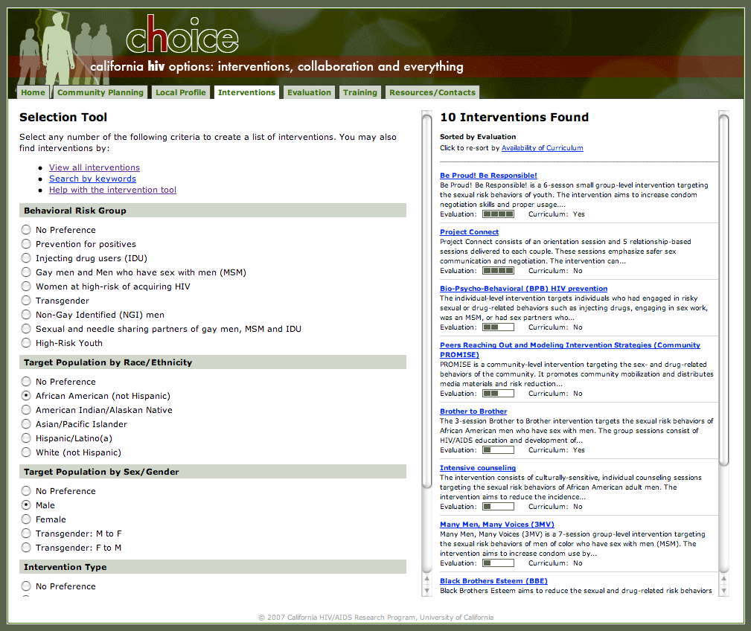
CHOICE Website – Intervention Dissemination

Slide 31
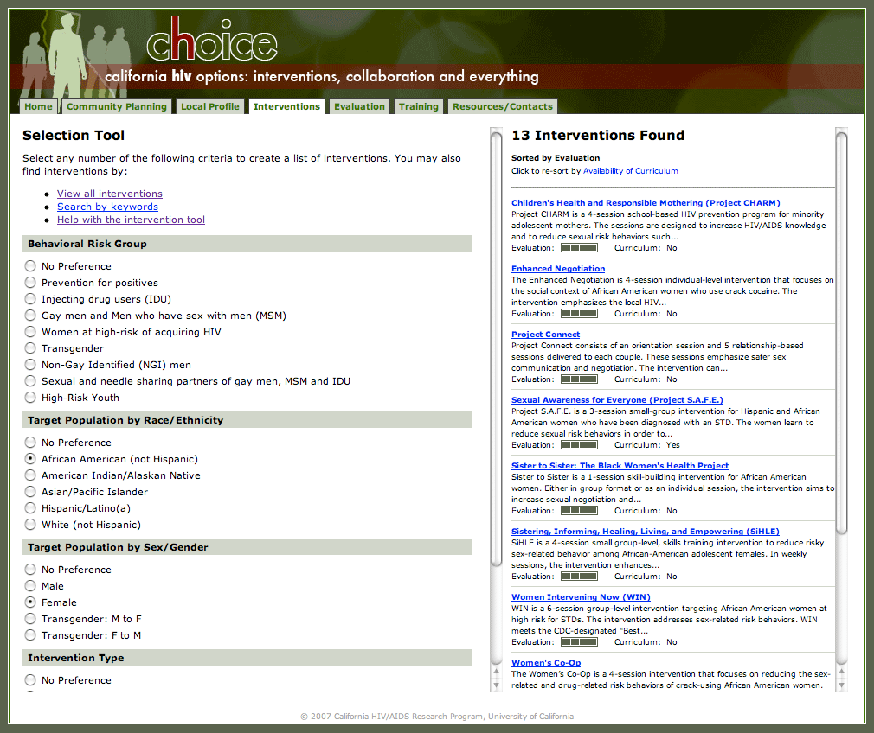
CHOICE Website – Intervention Dissemination

Slide 32
HIV/AIDS Among African-Americans in California:
Thank You
Office of AIDS
California Department of Public Health

