Slide 1
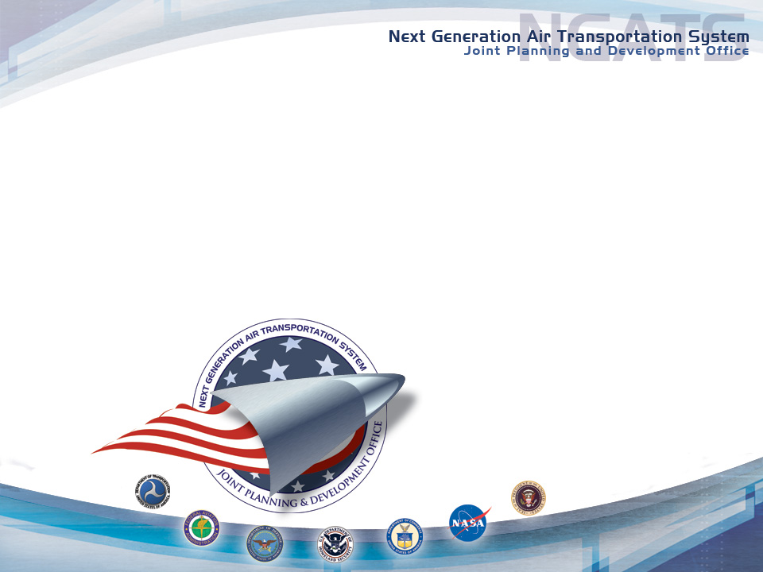
NGATS Weather Concept of Operations
JPDO Weather IPT

Slide 2

JPDO Recent Publications
Concept of Operations for
the Next Generation Air Transportation System
Draft Version 0.2; July 24, 2006
Next Generation Air Transportation System Weather Concept of Operations
Version 1.0; May 13, 2006
Both documents available for download and comment:
[http://techhangar.jpdo.aero/]

Slide 3
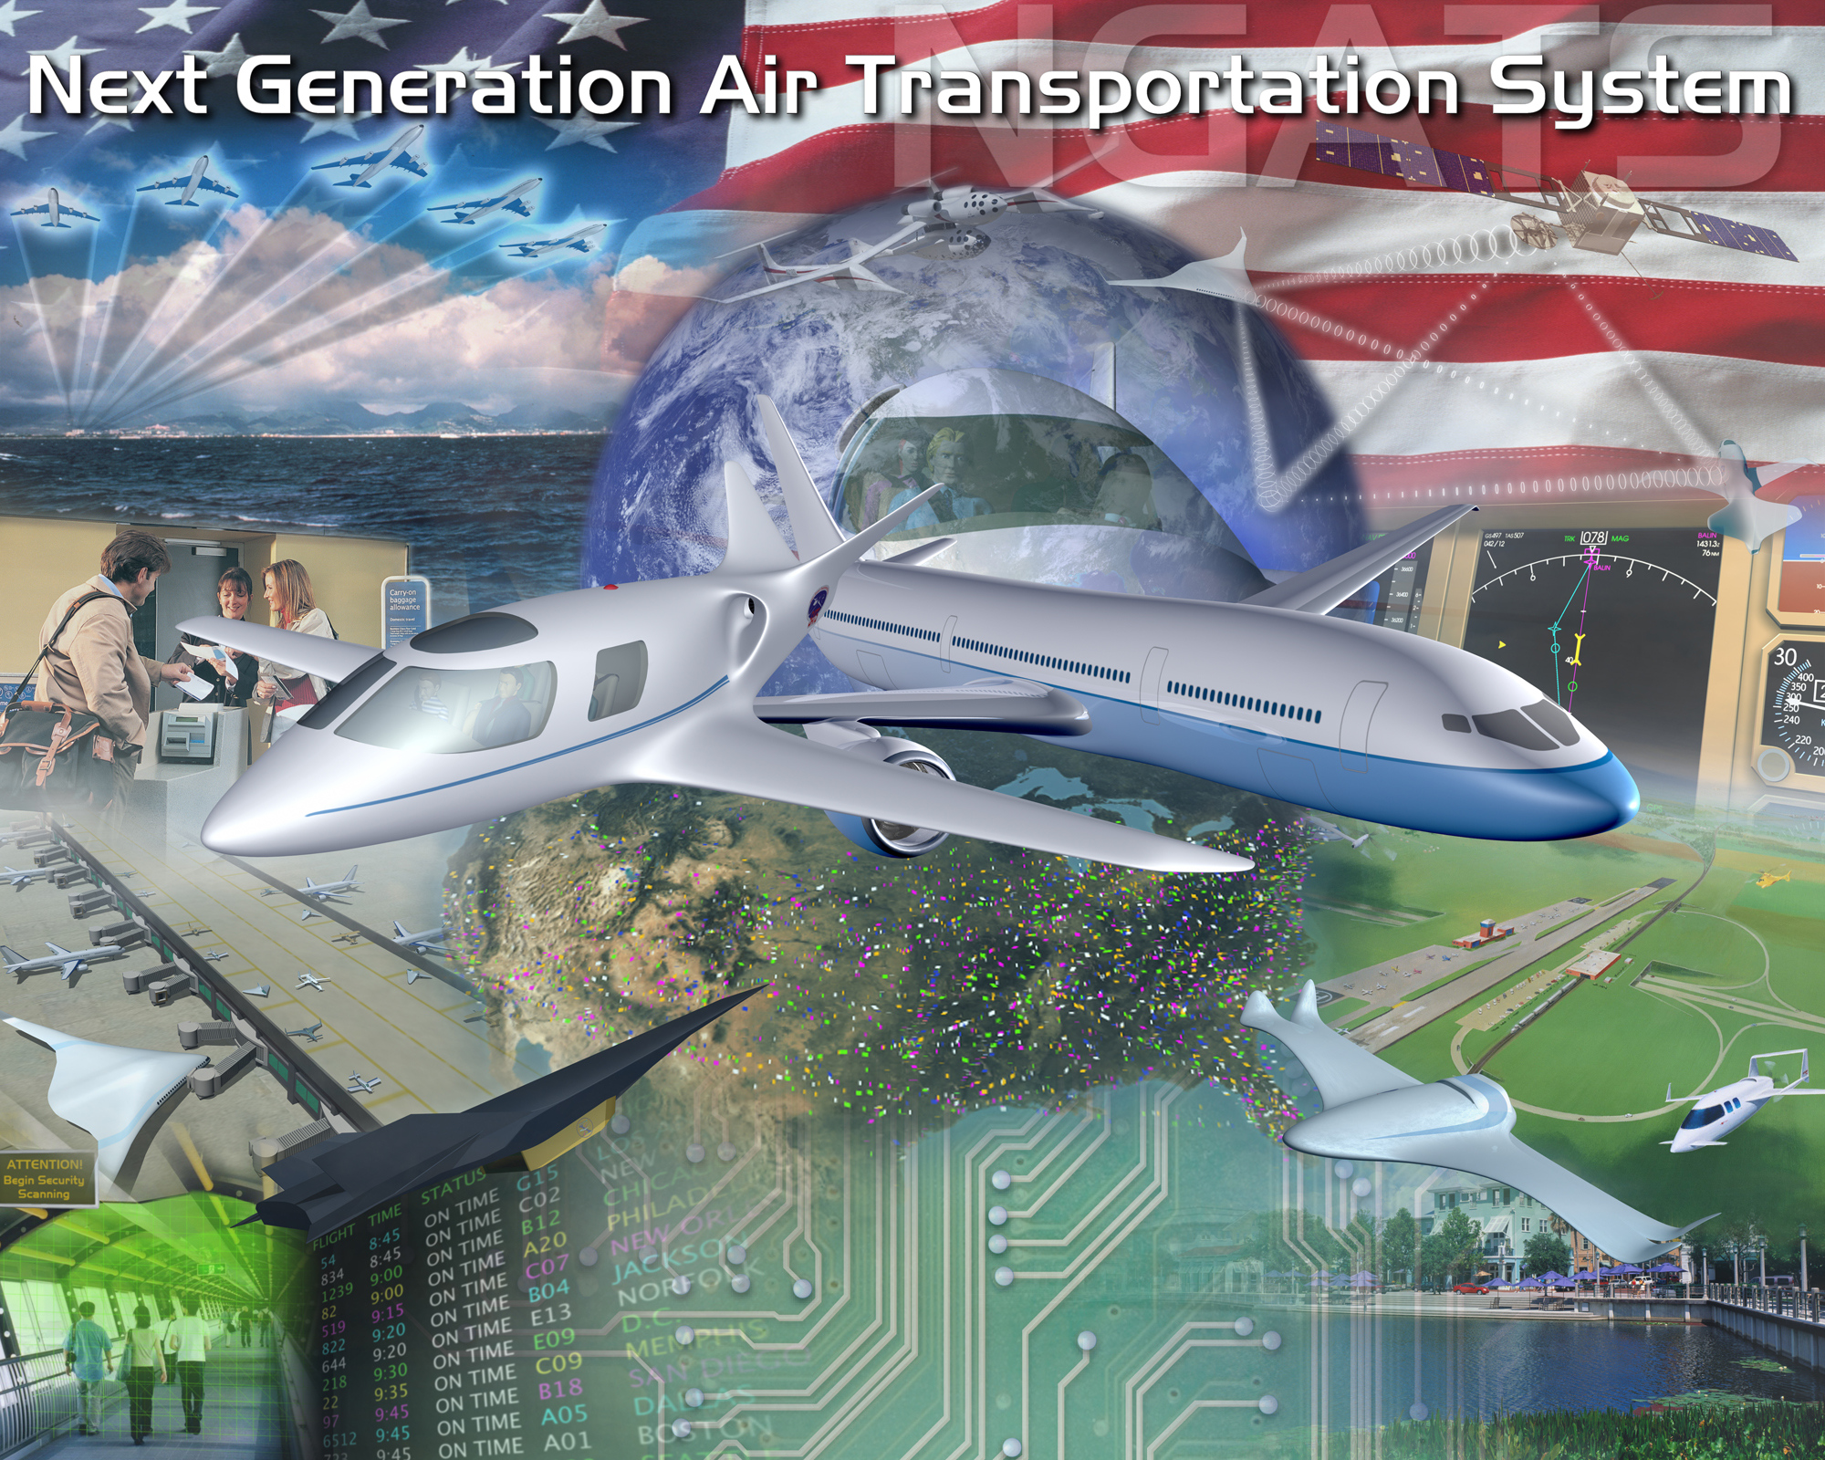
2025 NGATS Concept
Operating Principles
“It’s about the users…”
System-wide transformation
Prognostic approach to safety
assessment
Globally harmonized
Environmentally compatible to
enable continued growth
Key Capabilities
Net-Enabled Information Access
Performance-Based Ops & Services
Weather-Assimilated Decision Making
Layered, Adaptive Security
Broad-Area Precision Navigation
Trajectory-Based Aircraft Operations
“Equivalent Visual” Operations
“Super Density” Operations

Slide 4
Weather Concept Philosophy
Our charge is NOT about the weather …
Rather, it is about the
Identification and effective use
of weather information
(and supporting capabilities)
to mitigate weather impacts on NGATS operations

Slide 5
Weather Concept Scope/Approach
Scope
2025 concepts for Weather Support (future vision)
Starting point for inter-IPT discussions
First step in NGATS weather functional analysis
Approach
Analyzed NGATS 2025 Operating Principles and Key Capabilities
Identified Weather Implications/Impacts
Established resulting Operating Principles for NGATS Weather Support Concepts
Developed Weather Concept Details
To Follow…
Transition “Road Map”
Transition plan for Weather Support - current NAS to 2025 Concept
Complementary products:
Weather System Requirements
Supporting R&D Requirements

Slide 6
Weather Implications/Impacts AMDAR Data Access
Section 2.3 (Performance-Based Services)
“… enables a definition of service tiers and allows the government to move from equipment-based regulations to performance-based regulations.”
2.3.1: Aircraft are capable of receiving and transmitting weather information
2.3.2: Weather sensors included in Performance-Based Services
“… At a minimum, in addition to accurately providing its 4-D geospatial position, aircraft provide in situ winds, temperature, relative humidity, turbulence and icing information. Aircraft may also measure non-weather phenomena (e.g., volcanic ash), utilize forward or down looking remote weather sensors, and carry dosimeters to measure the radiation environment which is affected by space weather activity.”

Slide 7
Weather Concept Operating Principles AMDAR Data Access
Operating principles
Derived from the analysis of the implications/impacts of weather from the NGATS 2025 Concept
Grouped into five (5) categories:
Policy and Organization
Data Collection and Access
Products and Decision Oriented Tools
Integration and Procedures
Enhanced Aircraft Capabilities

Slide 8
Data Collection and Access AMDAR Data Access
Section 3.2.d: Aircraft “Performance-Based Service” includes data link capability for:
Accessing and processing in-flight updates to NGATS weather products
Transmitting and receiving aircraft weather data generated through on-board automation such as the Meteorological Data collection and Reporting System (MDCRS) or Tropospheric Airborne Meteorological Data Reporting (TAMDAR) type systems.
Note: UAS platforms are used to gather such in-flight data.

Slide 9
Summary
Under NGATS (Section 2.3.2):
“Fully capable aircraft have a standardized set of weather sensors/algorithms to provide weather data to other users directly and via the [NGATS] 4-D Weather. Weather data from aircraft are valuable inputs to the [NGATS] 4-D Weather for providing advice and warning to nearby aircraft, and for providing input and verification for weather forecast products. …”

Slide 10
BACK-Up Slides

Slide 11
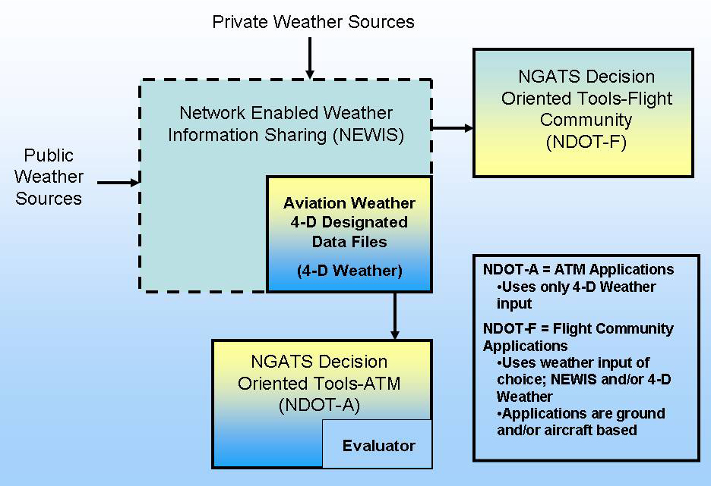
Weather CONOPS: Aviation Weather Information Access
Constantly Updated
Includes Probability
Forecasts

Slide 12
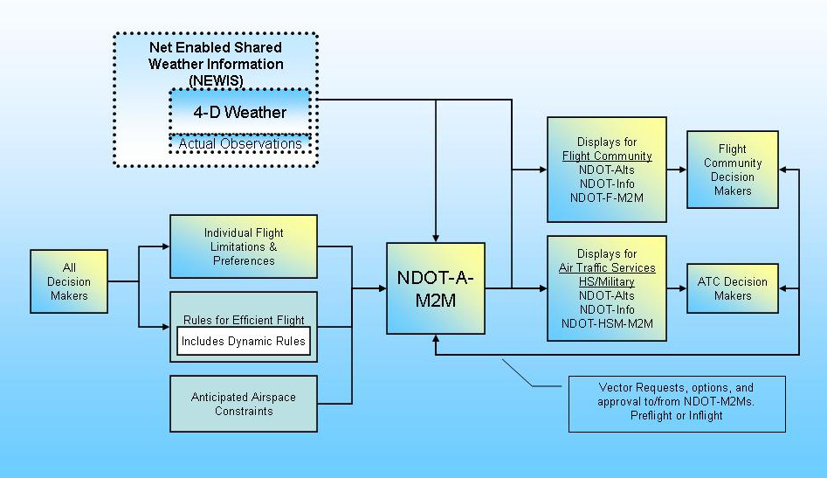
Weather CONOPS: Air Traffic Support

