Slide 1

Eric Prebys, FNAL
Selection Committee Chair
6/11/2010

Slide 2
Joint Argonne/Fermilab Venture
Patterned after existing internships, but focused on accelerator physics
Under auspices of virtual “Illinois Accelerator Institute” (also new)
~5 students at each lab
Joint selection process, after which program administered separately at the two labs
Nominally June 7-August 13, to match SULI/IPM
June 14-June 25 spent at the USPAS (MIT, Boston)
Student works closely with a mentor on a predetermined project involving accelerator physics or related technology
Eligible
Physics, Math, Engineering, or Computer Science majors at U.S. Universities (not necessarily U.S. citizens)
Juniors or outstanding Sophomores
E. Prebys – Lee Teng Welcome
6/11/2010
<number>

Slide 3
 | 2008 | 2009 | 2010
Argonne | 6 | 6 | 5
FNAL | 5 | 5 | 6
Total offers | 13 | 14 | 14
Rejections | 2 | 3 | 3
Males | 10 | 9 | 9
Females | 1 | 2 | 3
non-US | 3 | 2 | 4
Illinois schools | 5 | 2 | 0
Sophomores | 1 | 3 | 2
Juniors | 10 | 8 | 9
 | FNAL
 | ANL
E. Prebys – Lee Teng Welcome
6/11/2010
<number>

Slide 4
Accelerator science is a very exciting and growing field
High energy and nuclear physics
Light sources (materials, biophysics, etc)
Spallation neutron sources
Medical applications
Hadron therapy
Isotope production
Power production (sub-critical reactors)
Security
Industrial applications (food sterilization, welding)
Art (see T. Johnson’s work, 2nd floor)
This program is an excellent opportunity
Real world experience
USPAS!
Good step toward graduate school
E. Prebys – Lee Teng Welcome
6/11/2010
<number>

Slide 5
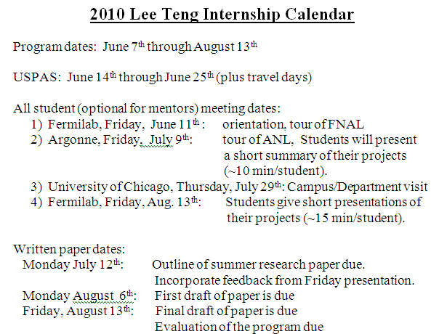
E. Prebys – Lee Teng Welcome
6/11/2010
<number>

Slide 6
Make the most of it
Lots of opportunities to talk to scientists, graduate students and fellow undergrads
Don’t be shy! (accelerator students can be a bit isolated)
Lots of opportunities for fun (but keep it legal)
Let us know how it goes
This is still a pretty new program and we’re looking for ways to improve things!
Stay in touch!
Let us know how you’re doing, particularly if you’re considering accelerator physics as a career.
E. Prebys – Lee Teng Welcome
6/11/2010
<number>

