Slide 1

DOI Climate Change Response
“Addressing climate change impacts will require a monumental effort by DOI”
“The data piece is probably the most important component of all of this”
David Hayes, Deputy Secretary of the Interior
Key Points from DOI Data Management/Integration Subcommittee:
Data and information sharing and integration are the key to collaboration among DOI bureaus and their many partners in addressing the significant climate change challenges.
We need a significant DOI response to develop effective and efficient means of finding, retrieving, using, and sharing the best available data and information. This will require both a top-down and bottom-up approach to addressing Department-wide data management issues.
The key to data sharing and integration is modernization of data systems using reusable and sharable building blocks (“web services”) based on DOI and industry standards to allow data exchange across multiple data systems.
Notes:
<number>
<number>

Slide 2
Challenges for Data Sharing, Integration, Dissemination to Address Climate Change
Major Challenge #1:
Need to discover, share, have access to large holdings of data and information to address rapid climate change
e. g., geospatial data, imagery, water quantity & quality, soils, vegetation, invasive species, land cover and use, status and trends of plant and animal populations, to name a few
Multiple scientific and resource management disciplines
Multiple scales, multiple agencies
Data are stored at thousands of locations in a variety of formats; many methods needed to access them
Notes:
<number>
<number>

Slide 3
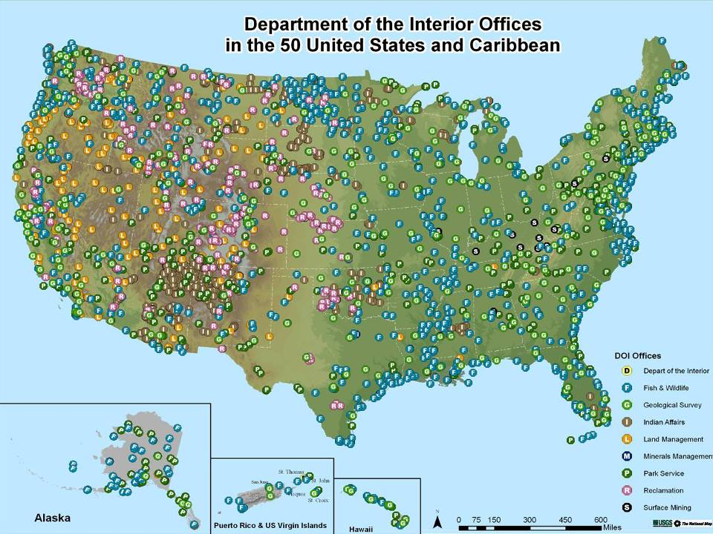

Slide 4
Challenges for Data Sharing, Integration, Dissemination
Major Challenge #2:
Most of the data and information we need exists or will exist in databases and sources outside of the DOI.
e.g., NOAA, NASA, EPA, Forest Service, universities, NEON, State agencies, NatureServe, NGOs, Data.gov
Notes:
<number>
<number>

Slide 5

Key User Communities have different needs
Land managers
Planners
Resource professionals “ologists”
LCC scientists, data managers
Researchers from CESUs, USGS, academia, NOAA, NEON, USDA
Educators (interpreters, teachers)
Partner/constituency groups staff
General public
Data.gov
Stakeholder
Notes:
<number>
<number>

Slide 6
Examples of Data and Information Products that Need to be Shared
Briefing statements for busy managers and the technologically disinclined
Metadata catalog to allow discovery and access to DOI data sets
Data sets - tables, spreadsheets, relational databases in various formats
GIS products (maps, vector and raster data)
Aerial Photography and Satellite Imagery
Technical reports (e.g., “gray literature”)
Journal publications that can be shared without violating copyright restrictions
Data synthesis reports - statistical and geospatial analyses
Resource Assessments (involve simplification and translation of complex data)
Environmental Assessments (EA) and Environmental Impact Assessments (EIAs)
Management plans
Trend reports
Standards – standard operating procedures, protocols, and content standards
Tools – models, scripts and templates
Downscaled (fine-scaled) climate models
Environmental models (e.g., hydrologic models, ecosystem models)
Training materials
Graphics – suitable for inclusion in presentations or reports
Multimedia
Data.gov
Notes:
<number>
<number>

Slide 7
But there is hope . . .
Technology and standards are available that make it possible to integrate and share data amongst legacy data systems and new systems yet to be built through a loosely-coupled, distributed system based on web services and segment architecture.
The approach is flexible and modular and is phased in over time. We don’t have to figure it all out in advance, or get all of the funding and people in place in advance.
The approach is based on industry standards. Microsoft, Oracle, Java, Google, IBM, etc. do the heavy lifting. Approach is widely used in the online travel, shopping, banking industries.
The approach is also OMB and DOI’s standard. This is what they’re promoting for all federal agencies; re-usable, sharable components. http://www.fsam.gov
Notes:
<number>
<number>

Slide 8


Internal Data
Shared Data
User Communities
NPS
NPS
Land Managers & Planners
FWS
Researchers
FWS
Bureau “Ologists”
USGS
USGS
LCC or other Portals
NASA
NASA
NOAA
NOAA
NOAA
General Public
States, Tribes
Data.gov
Conceptual approach showing a few agencies: Each agency maintains their data systems, yet make portions of their data available for sharing by using a common set of standards and processes.

Slide 9
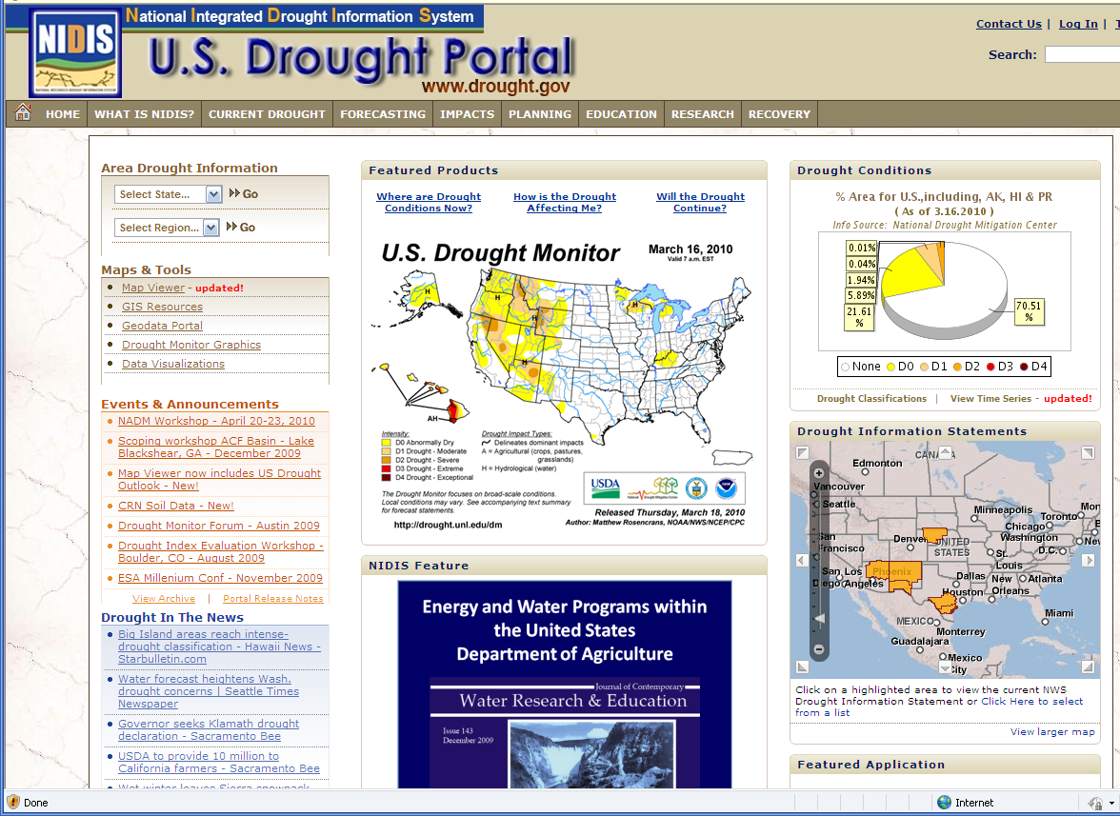

Slide 10


IRMA
The NPS is Doing its Part:
Integration of Resource Management Applications
Service-oriented Architecture (SOA): build once, use many times services that can be re-used by many applications
Using DOI and industry standards to allow data exchange and integration among data systems
DOI award for “Best Agency SOA Application”

Slide 11
DOI Climate Change Response
“The Department of Interior has committed to a unified monitoring and data management effort that will promote state of the art data integration procedures to facilitate data sharing.”
- Interior’s Plan for a Coordinated, Science-based Response to Climate Change Impacts on our Land, Water, and Wildlife Resources
The technology exists
We know how to do this – several DOI efforts already underway
Lots of other agencies, universities, NGOs, industry contributing
Congress and OMB want to eliminate redundancy and see true interagency collaboration … the DOI could be a national leader if we got our data integration act together
Notes:
<number>
<number>

Slide 12
What it will take to make this happen
Top-down Responsibilities of DOI:
Establish roles, policies, and accountabilities (i.e., governance)
Promote interagency coordination and provide leadership, incentives, and funding for segment architecture modernization by each bureau.
Provide strong leadership and incentives to accelerate agreement on metadata and data exchange standards.
Support funding initiatives to implement DOI data integration efforts
Bottom-up Responsibilities of each Bureau and Partner:
Define bureau business and user requirements.
Develop and modernize data systems using federal segment architecture.
Implement recommended metadata, data exchange, and taxonomic standards that come out of the Framework and Blueprint activities.
Provide training and enforce use of data and metadata standards.
Develop budget initiatives to implement the above.
Notes:
<number>
<number>

Slide 13
What the NPS and others are doing now
IRMA system has already integrated 6 separate applications; eventually will integrate 19 applications; serious about data integr.
Natural Resource Database Template
Consistent core data structure in MS Access
Hundreds of successful NRDT databases nationwide
Long-term datasets will be available through IRMA or data.gov – can be discovered and accessed by others
FWS I&M Program co-locating with us in Fort Collins
We have offered to share same contractor company and give them our modules and code if they want to “join at the hip”
USGS – talking about 7-10 regional data centers where researchers would submit their data; working on web services and metadata and data structure standards.
States – Western Governor’s Assn. 17 states serious about this
Notes:
<number>
<number>

