Slide 1
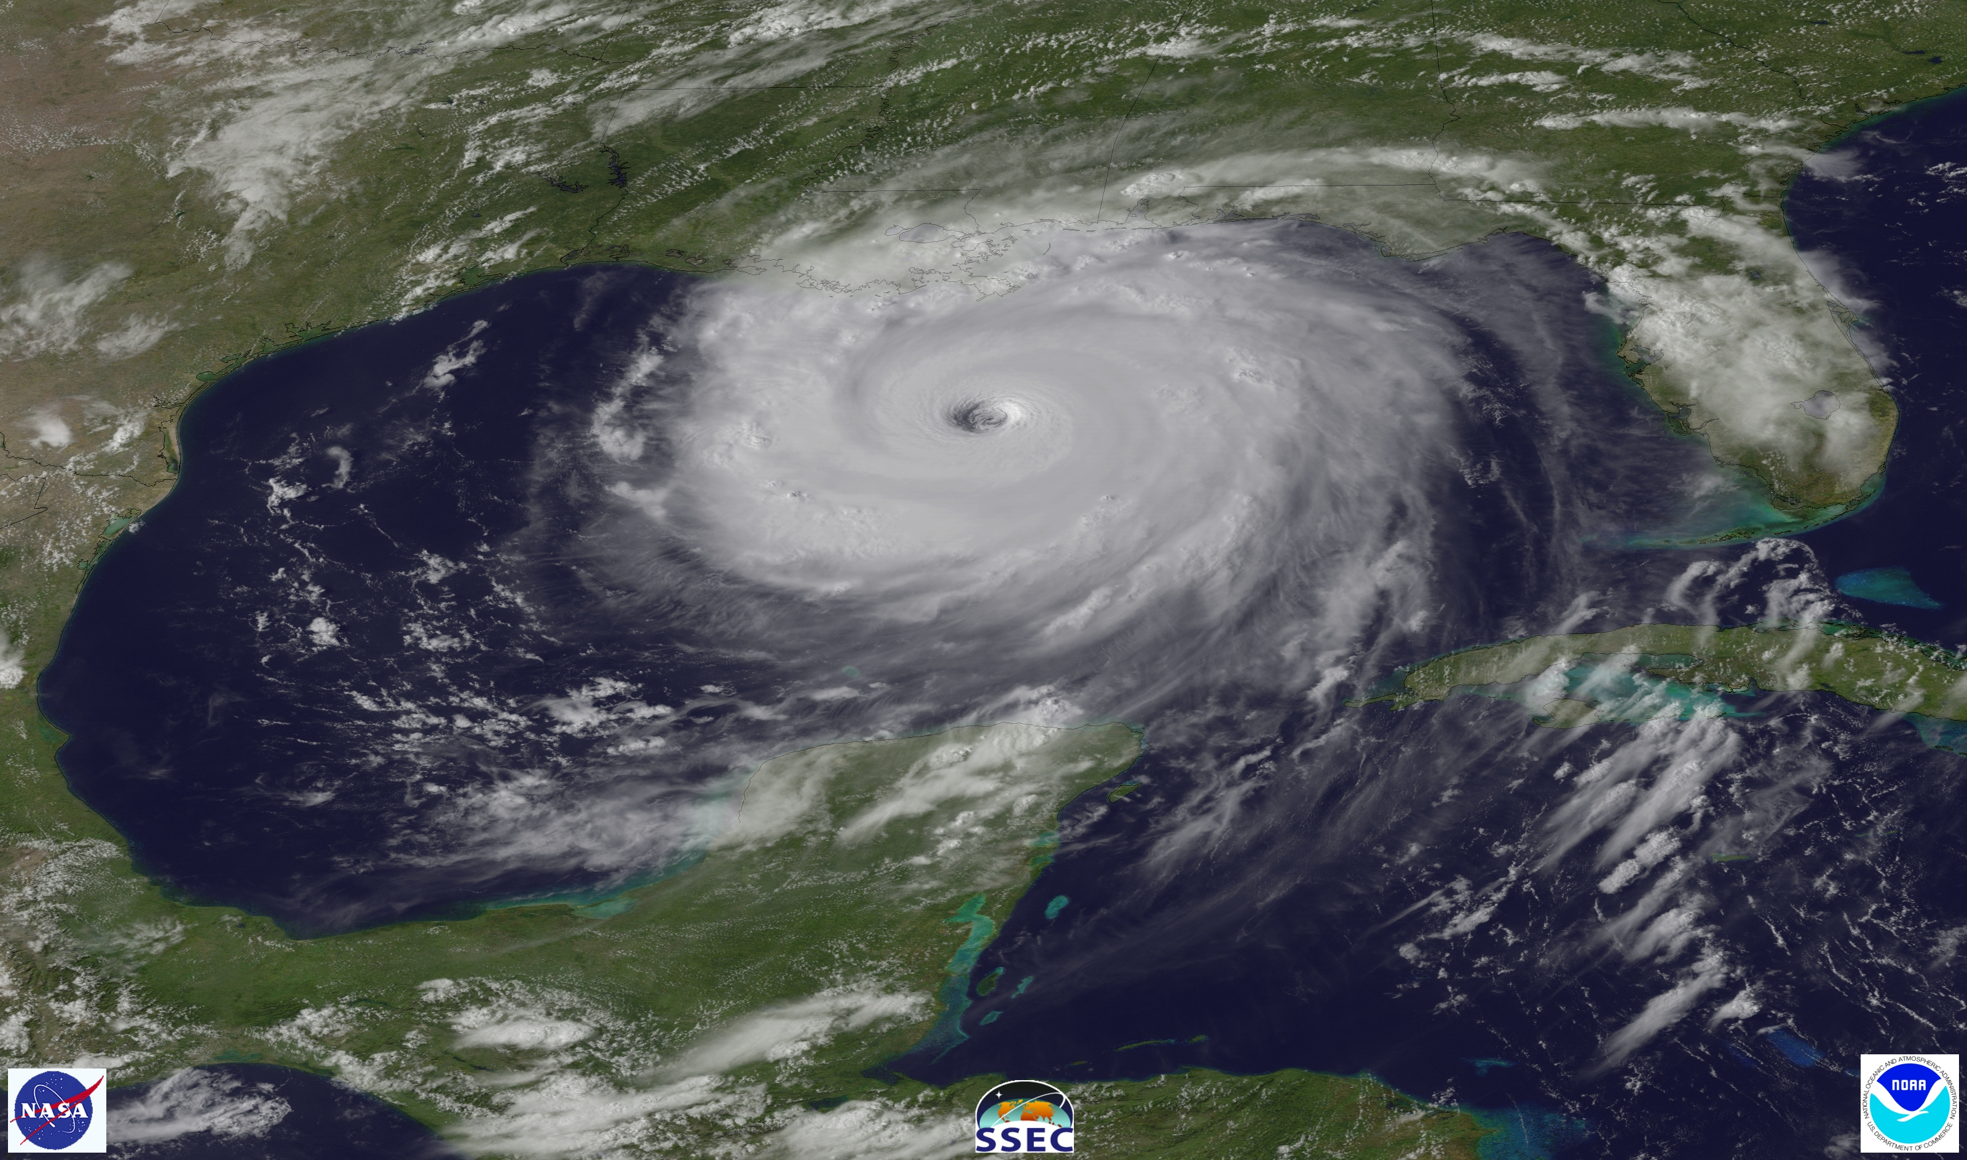
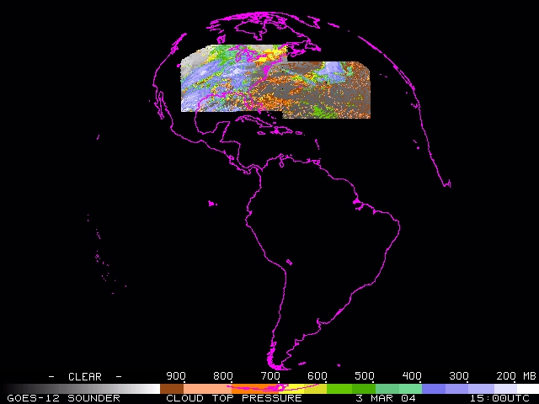
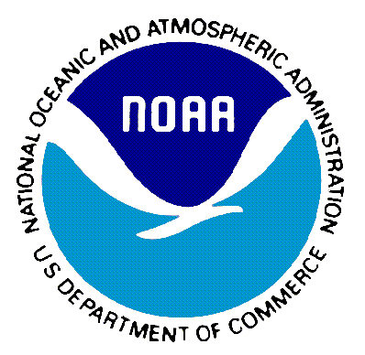
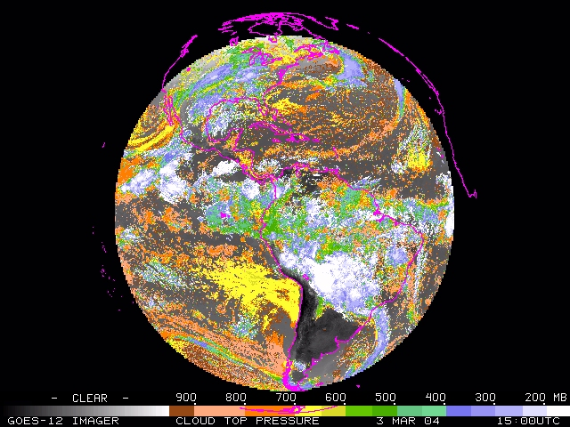
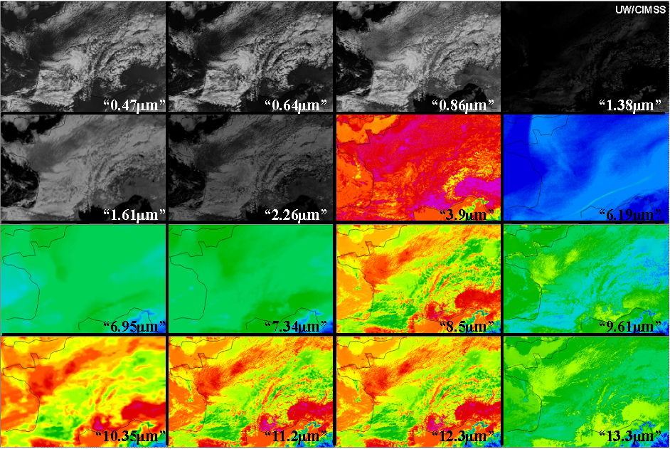
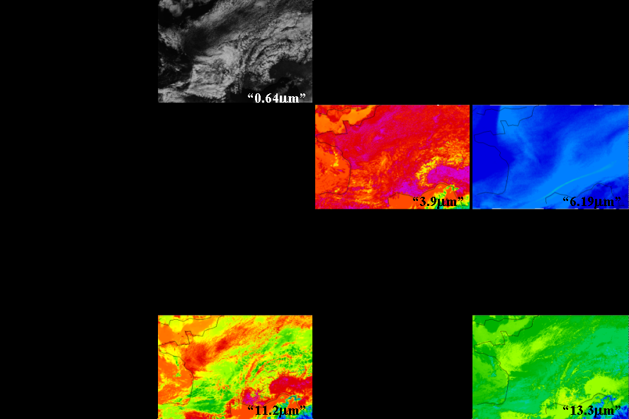
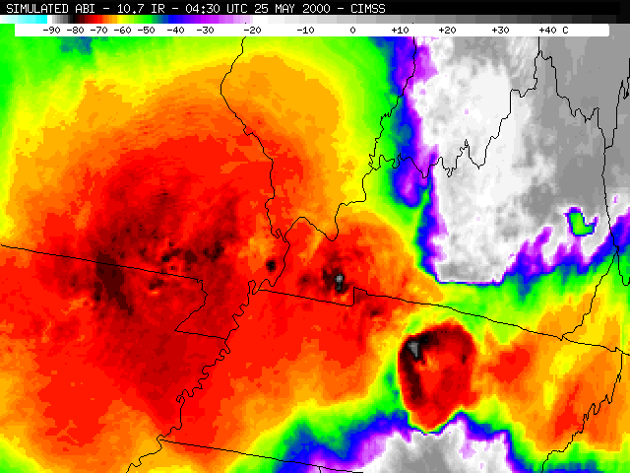
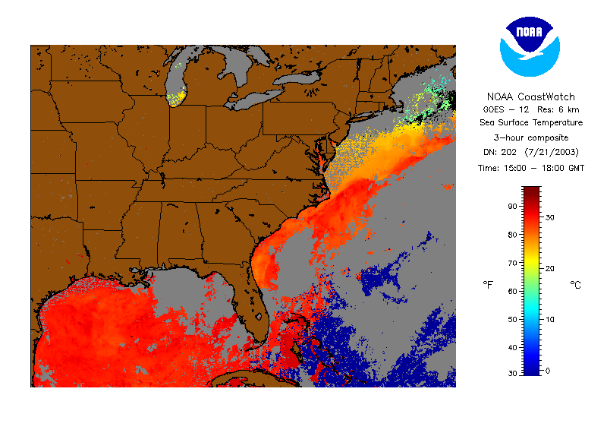
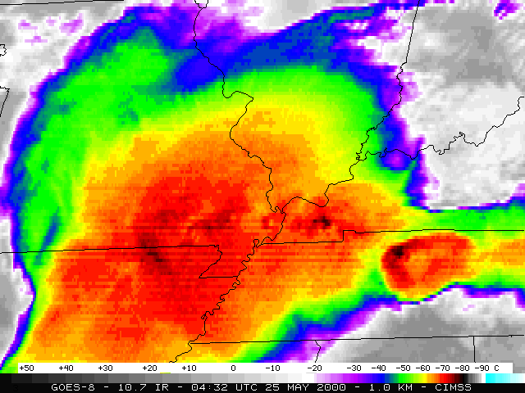
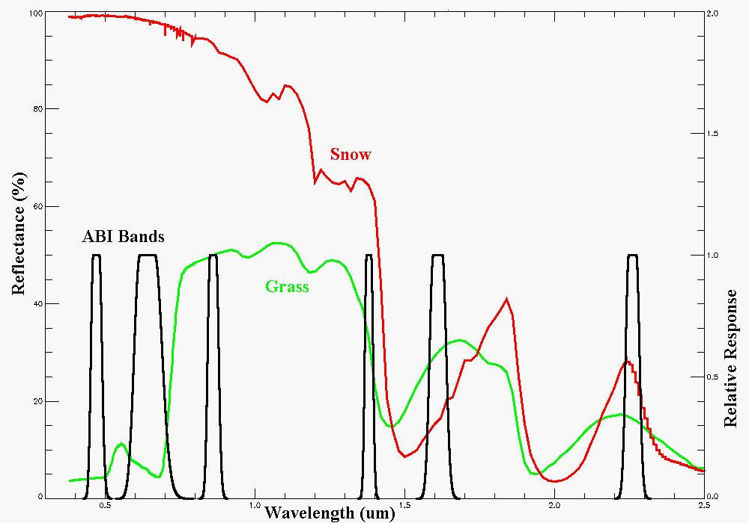
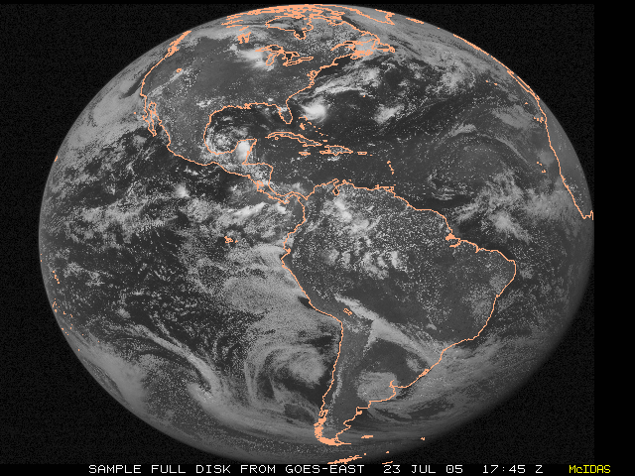
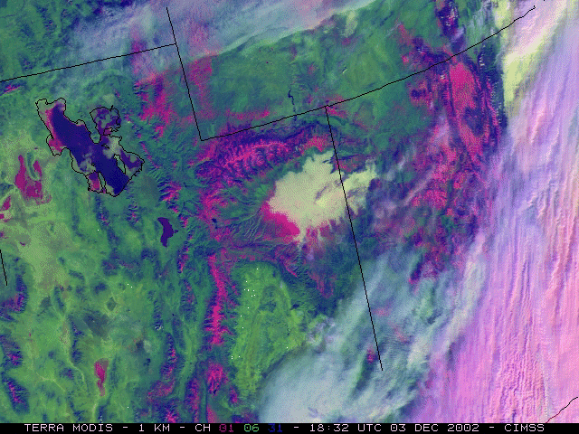
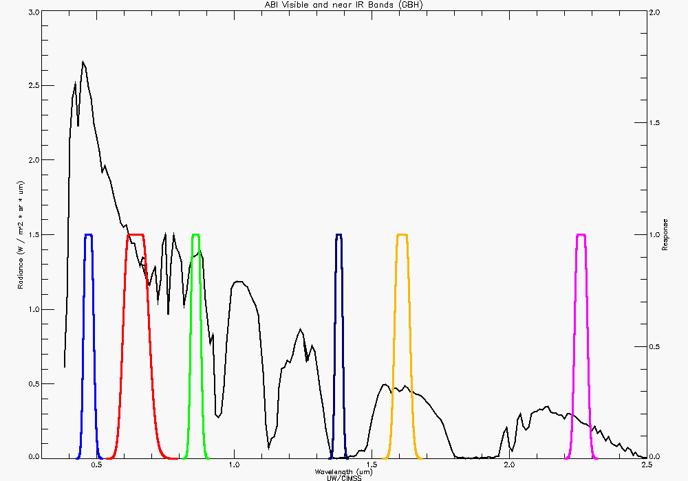
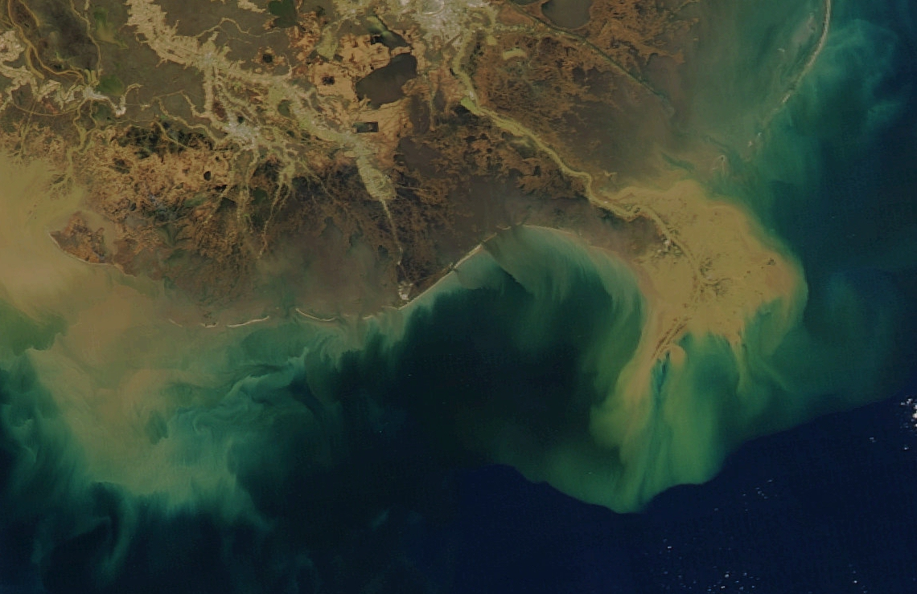
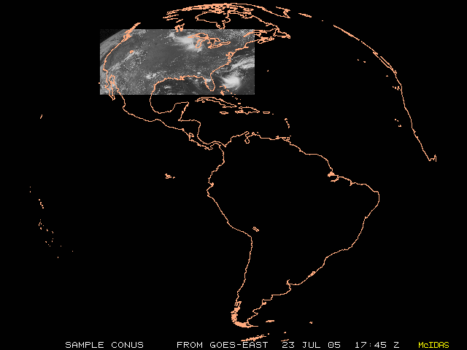
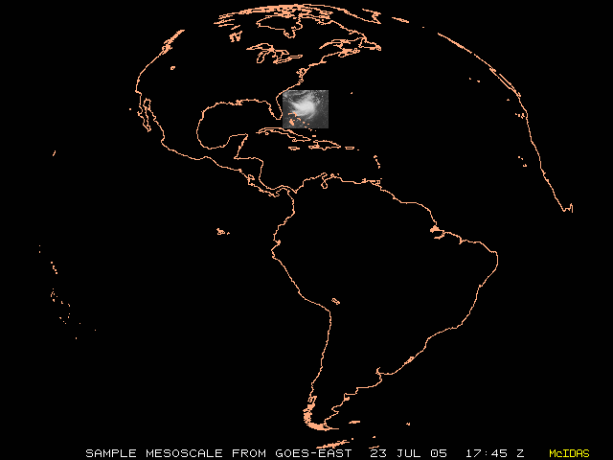
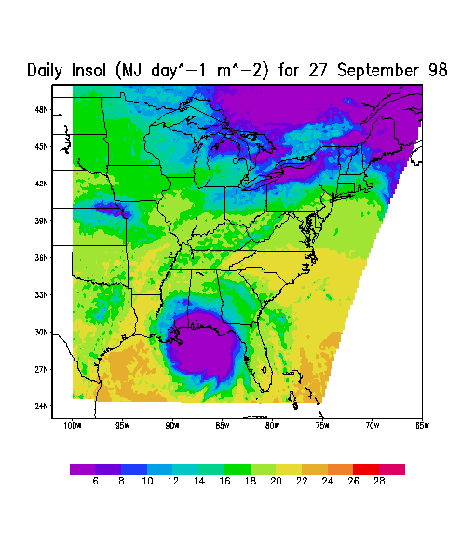
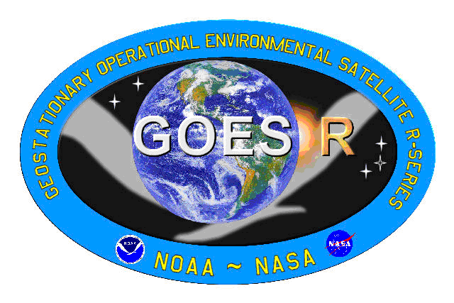
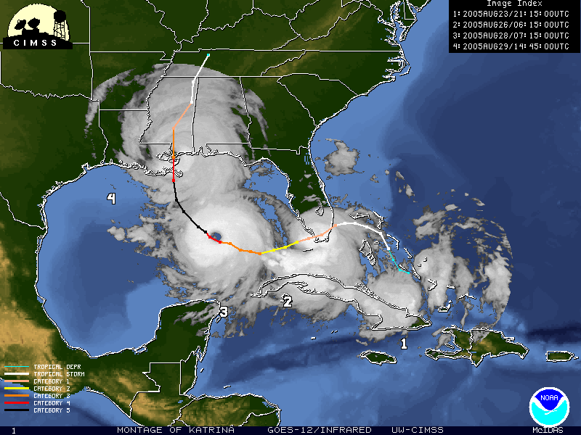
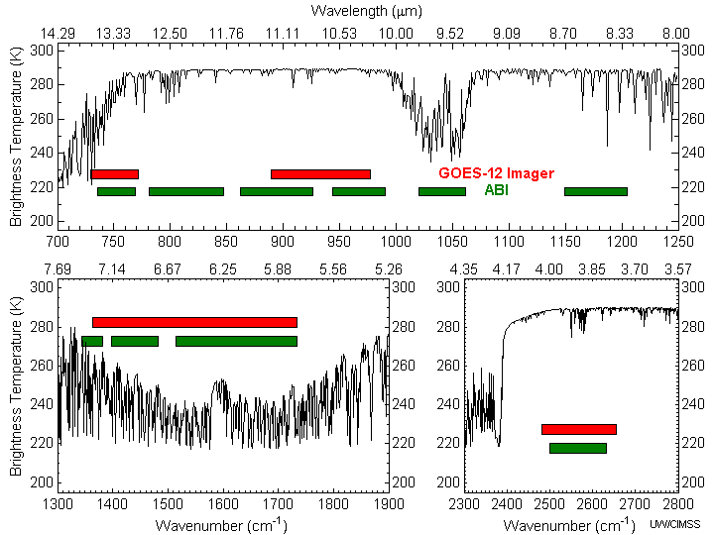
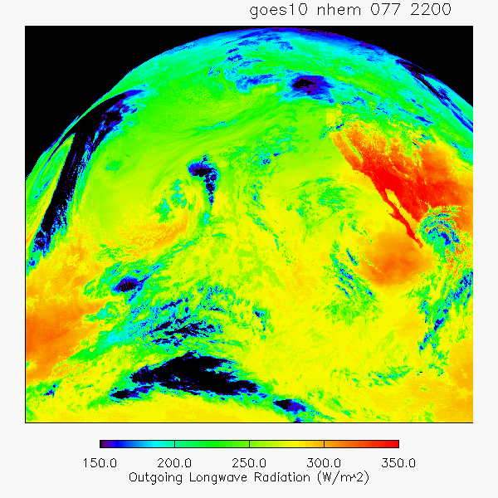
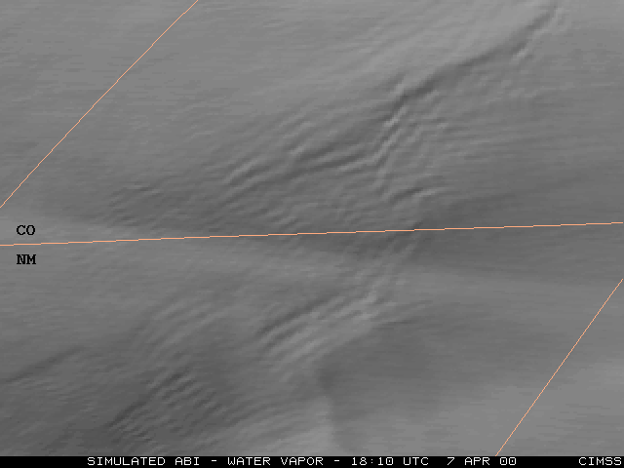
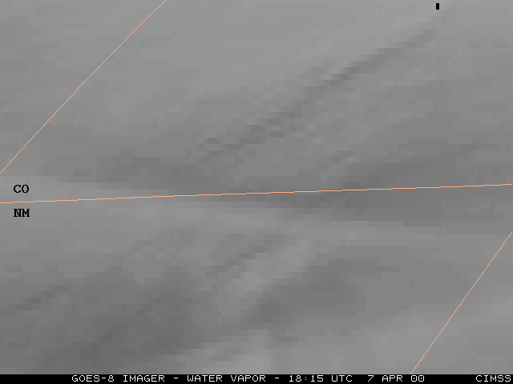
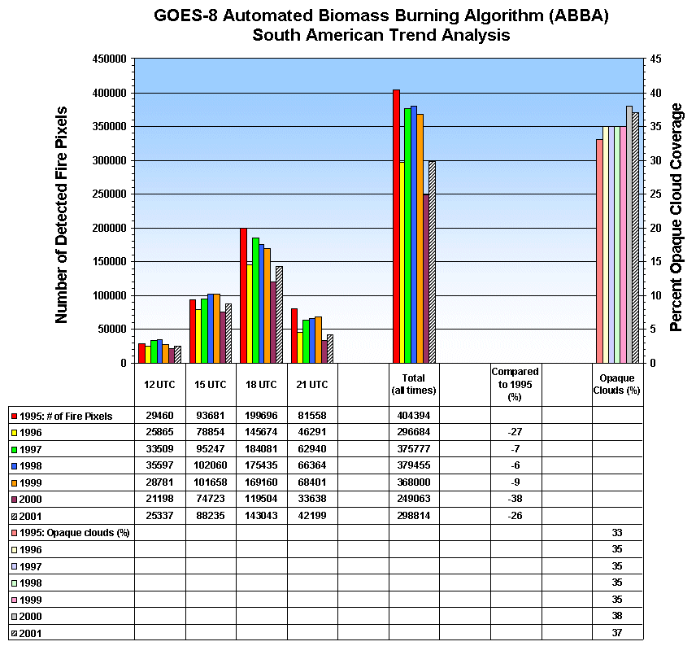
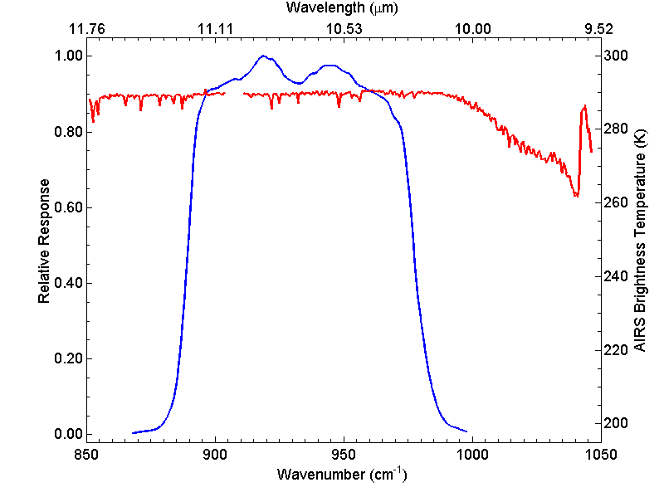
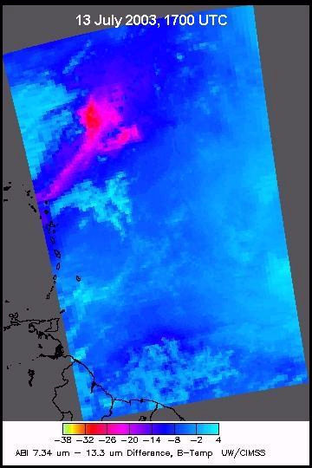
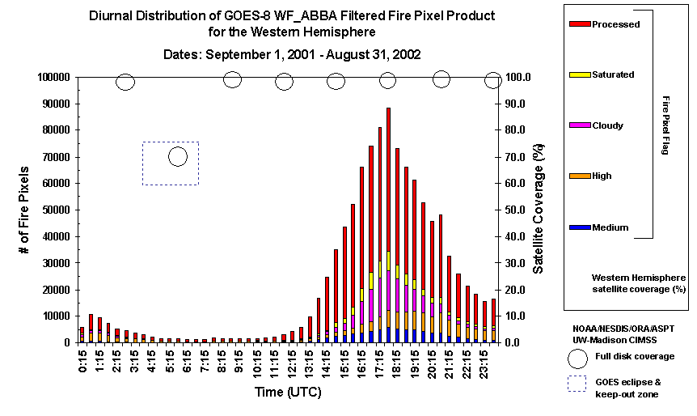
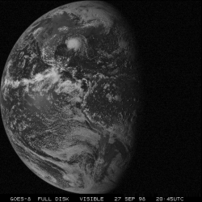
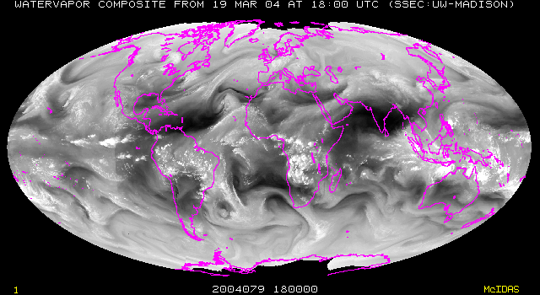
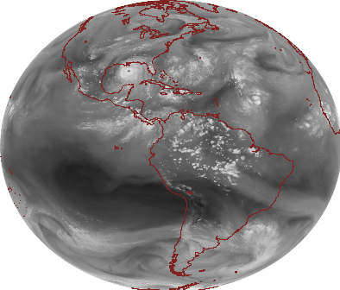
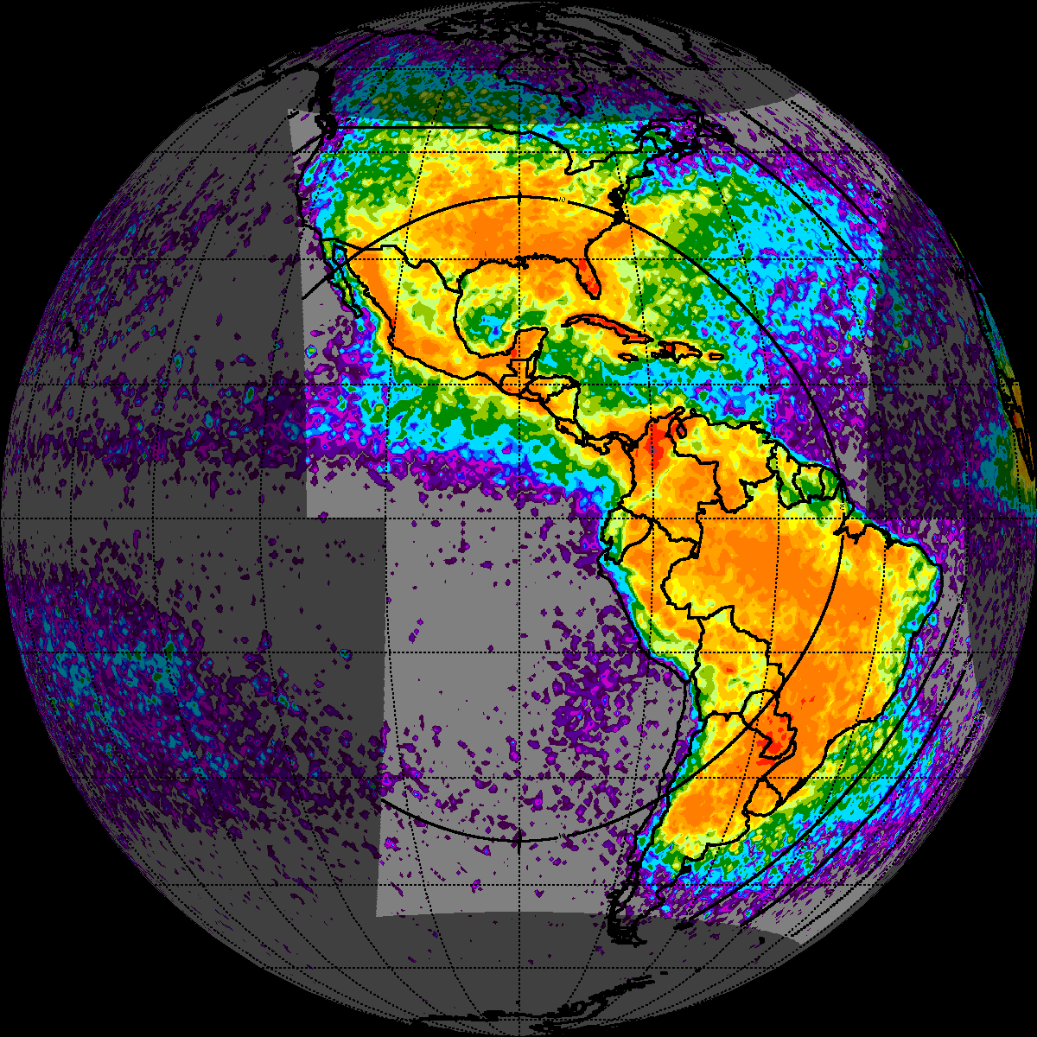
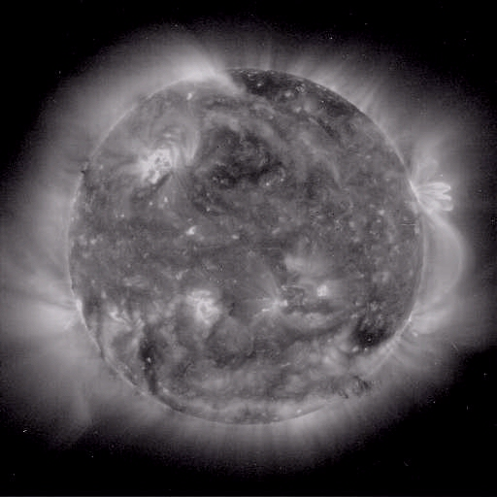
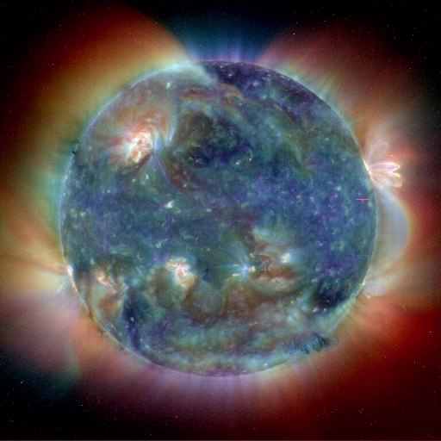
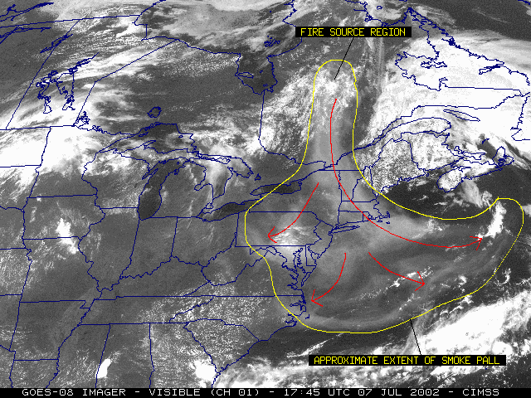
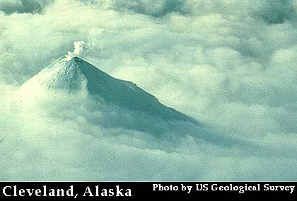
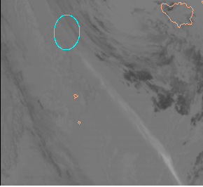
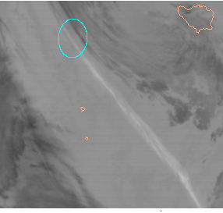
Using GOES-R to help fulfill NOAA’s Mission Goals
(Ecosystems, Weather/Water, Climate, and Commerce)
Much improved spatial coverage with the HES Sounder
Current GOES Sounder coverage in one hour
Timothy J. Schmit, NOAA/NESDIS/STAR (Satellite Applications and Research)
W. P. Menzel, NOAA/NESDIS/STAR (Satellite Applications and Research)
James J. Gurka, NOAA/NESDIS/OSD (Office of Systems Development)
Jun Li, Mat Gunshor CIMSS (Cooperative Institute for Meteorological Satellite Studies)
Steven Hill, NOAA/NWS/NCEP Space Environment Center (SEC), Boulder, CO
Simulated “ABI” Spectral Bands:
Corresponding Simulated GOES Imager Spectral Bands:
GOES-R HES Sounder coverage in one hour
Cloud Top Pressure
CIMSS
Higher Spatial Resolution Channels
concentric anvil-layer waves
Simulated ABI
(from MODIS)
“The planet’s daily pulse is observed from the geostationary perspective”
The cloud information is from GOES
Enhanced “V”:
IR windows
May 25, 2000
Payload:
ABI
HES-SNDR
GLM
HES-CW
SIS
SEISS
MAG
AUX
SST
Payload:
HES-CW
ABI
AUX
Ecosystems
Weather/Water
Enhanced “V”
Protect, restore, and manage the use of coastal and ocean resources through ecosystem-based management
GOES
Huge increase in measurements beneficial to ecosystem management and coastal & ocean resource utilization.
First time ever, characterization of diurnal ocean color as a function of tidal conditions and observation of phytoplankton blooms (e.g. red tides) as they occur.
Improved coastal environment monitoring of a) response of marine ecosystems to short-term physical events, such as passage of storms and tidal mixing; b) biotic and abiotic material in transient surface features, such as river plumes and tidal fronts; and c) location of hazardous materials, such as some oil spills, and noxious algal blooms
Monitoring of chlorophyll, turbidity and sediment transport
Auxiliary services used for Reservoir Management, water quality, etc.
Monitoring of sea surface temperature near corals in the Western hemisphere
Monitoring of the surface vegetation, burn scars
Serve society’s needs for weather and water information
http://cimss.ssec.wisc.edu/goes/misc/000525.html
Current
Imager
Future
Imager
Improved disaster mitigation for hurricane trajectory forecasts from better definition of mass and motion fields, along with better knowledge of the sea surface temperatures.
Improved knowledge of moisture/thermal fields provide better data for agricultural forecasting.
Better general weather announcements affecting public health from improved forecasting and monitoring of surface temperatures in urban and metropolitan areas during heat stress (and sub-zero conditions).
Better monitoring of the sun and near-Earth space environment
Auxiliary services data collection (river monitoring, etc).
Improved data for environmental modeling
Better hot spot detection and characterization
Improved data for air quality forecasts
Better weather forecasts
Better fog detection
Better thunderstorm monitoring
Better cloud, precipitation monitoring
Better hurricane monitoring
30 min
ABI Bands allow for several Land Products
AVIRIS spectra
Snow
Low
cloud
Snow, Phase
Northern
Hemisphere (1X)
Full Disk (2X)
The Weather/Water NOAA goal includes:
Local Forecasts and Warnings Tropical Storm Program Space Weather
Air Quality Environmental Modeling Hydrology – Rivers, Lakes, and Floods Weather and Water Science and Technology Infusion Program
The Ecosystems NOAA goal includes:
Corals Ecosystem Research Habitat Restoration Coastal Resource Management Invasive Species Undersea Research and Exploration Protected Species Management Protected Areas
Fisheries Management Aquaculture Enforcement
Cirrus
Part. size
CONUS (6X)
CONUS (3X)
Mesoscale (60X)
Three-color composite (0.64, 1.6 and 11 µm) shows the low cloud over the snow and the water versus ice clouds.
Veg.
GOES-R Imager reduces scan conflicts
Clouds
http://www.ssec.wisc.edu/~gumley/modis_gallery/
Haze
OLR
Hydrology/
Land Surface
Mountain Waves in WV channel (6.7 µm)
7 April 2000, 1815 UTC
A. Heidinger, NOAA/NESDIS/ORA
Simulated ABI
Actual GOES-8
Climate
Commerce
Support the Nation’s commerce with information for safe, efficient, and environmentally sound transportation
UW
Understand climate variability and change to enhance society’s ability to plan and respond
Better information regarding conditions leading to fog, icing, head or tail winds, and development of severe weather including microbursts en route makes air traffic more economical and safer.
Better depiction of ocean currents, low level winds and calm areas, major storms, and hurricanes (locations, intensities, and motions) benefits ocean transportation. Information regarding storms, fog, flooding, snowfall, blowing snow, and blowing sand assists surface transportation.
Power consumption can be regulated more effectively with real-time assessment of regional and local insolation and temperatures.
Geostationary Lightning Mapper for nowcasts and aviation forecasts
Monitoring SST eddies in the Gulf of Mexico can be useful for oil and gas operations.
Better monitoring of solar disturbances that can interfere with GPS use, interrupt communications, and cause disruptions of electric power grids.
Solar/energetic particle observations leading to improved forecasts and specification of radiation and communication impacts for aviation interests
Auxiliary services used for search and rescue activities
As of a May 2000 report, 138 insured satellites in geosynchronous orbit valued at $20.1 B. “Space weather suggested as cause or contributor to over $500 M in insurance claims in past 4 years.“ U.S. Aviation Underwriters, Inc
A Cost Benefit Analysis (CBA) from eight cases combined for an annual marginal economic benefits from ABI and HES of approximately $638 M annually (2002 dollars) and a discounted (present value) sum-of-direct benefits of approximately $3.1B across a 13-year effective benefit lifecycle.
Payload:
ABI
HES-CW
HES-SNDR
GLM
SIS
AUX
Satellite-to-satellite cross-calibration of the full operational satellite system
Hourly high spectral resolution infrared radiances facilitate radiance calibration, calibration-monitoring
Provide measurements that resolve climate-relevant (diurnal, seasonal, and long-term inter-annual) changes in atmosphere, ocean, land and cryosphere.
Solar irradiance inputs measured by SIS
Diurnal signature for fires in the Western hemisphere
Diurnal signature of clouds in the Western hemisphere
Diurnal signature for Land/Sea temperatures in clear skies
Diurnal signature of lightning (both cloud-to-ground and intra-cloud discharges) over both land and ocean in the western hemisphere
Improved measurements of Outgoing Longwave Radiation (OLR), O₃ and SO₂
Continuing the geostationary radiance database
Annual lightning strikes
Simulated ABI Band Differences
convolved from AIRS data
(SO₂ plume from
Montserrat Island, West Indies)
Payload key:
ABI – Advanced Baseline Imager
HES – Hyperspectral Environmental Suite
Sounder (SNDR) and Coastal Waters (CW)
GLM – Geostationary Lightning Mapper
SIS – Solar Imaging Suite
SEISS – Space Environment In-Situ Suite
MAG – Magnetometer
AUX – Auxiliary Services
LRIT-- Low Rate Information transmission
EMWIN-- Emergency Managers Wx Information Network
DCS-- Data Collection System
SAR-- Search and Rescue
Volcanic Ash Plume:
11-12 and 8.5-11 μm images
WV:
Payload:
GLM
ABI
HES-CW
HES-SNDR
SIS
SEISS
MAG
AUX
One day after the Mt. Cleveland eruption
20 February 2001, 0845 UTC
The Commerce NOAA goal includes:
Aviation Weather Marine Weather Marine Transportation Services
NOAA Emergency Response Geodesy
Commercial and Remote Sensing Licensing Commerce and Transportation Science and Technology Infusion Program
http://www.ssec.wisc.edu/data/composites.html
The Climate NOAA goal includes:
Climate Observations and Analysis
Climate and Ecosystems Climate Forcing Climate Predictions and Projections Climate Information for Decisions
“GOES-N/P”
“GOES-R”
Natural Hazards
Simulated
GOES
(11-12 μm)
Simulated
ABI
(8.5-11 μm)
Simulated SXI (Solar X-ray Imager) images: GOES R will produce multi-band "color" images at the same rate as GOES N/P produces single band images. (Images courtesy of SOHO EIT, a joint NASA/ESA program; and Steve Hill/NOAA SEC).
GOES-R data and products will support all of NOAA’s mission goals!
UW/CIMSS

