Slide 1



New England Common Assessment Program
Using the 2007 NECAP Reports
February, 2008

Slide 2
Welcome and Introductions
Mary Ann Snider
Director of Assessment & Accountability
RI Department of Education

Slide 3
Welcome and Introductions
NECAP Service Center: 1-877-632-7774
Tim Crockett Assistant Vice-President 1-800-431-8901 x2106 tcrockett@measuredprogress.org | Harold Stephens NECAP Program Director 1-800-431-8901 x2235 hstephens@measuredprogress.org
Amanda Smith NECAP Program Manager 1-800-431-8901 x2259 asmith@measuredprogress.org | Elliot Scharff NECAP Program Manager – Science 1-800-431-8901 x2126 escharff@measuredprogress.org
Josh Evans NECAP Program Manager 1-800-431-8901 x2244 jmevans@measuredprogress.org | Tina Haley NECAP Program Assistant 1-800-431-8901 x2427 chaley@measuredprogress.org
Jennifer Varney NECAP Program Assistant 1-800-431-8901 x2115 jvarney@measuredprogress.org | Mellicent Friddell NECAP Program Assistant 1-800-431-8901 x2355 mfriddell@measuredprogress.org

Slide 4

Guide to Using the 2007 NECAP Reports

Slide 5
Purpose of the Workshop
Review the different types of NECAP reports
Discuss effective ways to analyze and interpret results data
Provide schools and districts an opportunity to share how they have analyzed results data

Slide 6
Involvement of Local Educators
Development of Grade Level Expectations
Test item review committees
Bias and sensitivity review committees
Classroom teacher judgment data
Standard setting panelists
Technical Advisory Committee

Slide 7
FERPA
The Family Educational Rights and Privacy Act (FERPA)
Access to individual student results is restricted to:
the student
the student’s parents/guardians
authorized school personnel
Superintendents and principals are responsible for maintaining the privacy and security of all student records.
Authorized school personnel shall have access to the records of students to whom they are providing services when such access is required in the performance of their official duties.
FERPA website: http://www.ed.gov/policy/gen/guid/fpco/ferpa/index.html

Slide 8
Types of NECAP Reports
Student Report
Item Analysis Report
Results Report
Summary Report
Student Level Data Files

Slide 9
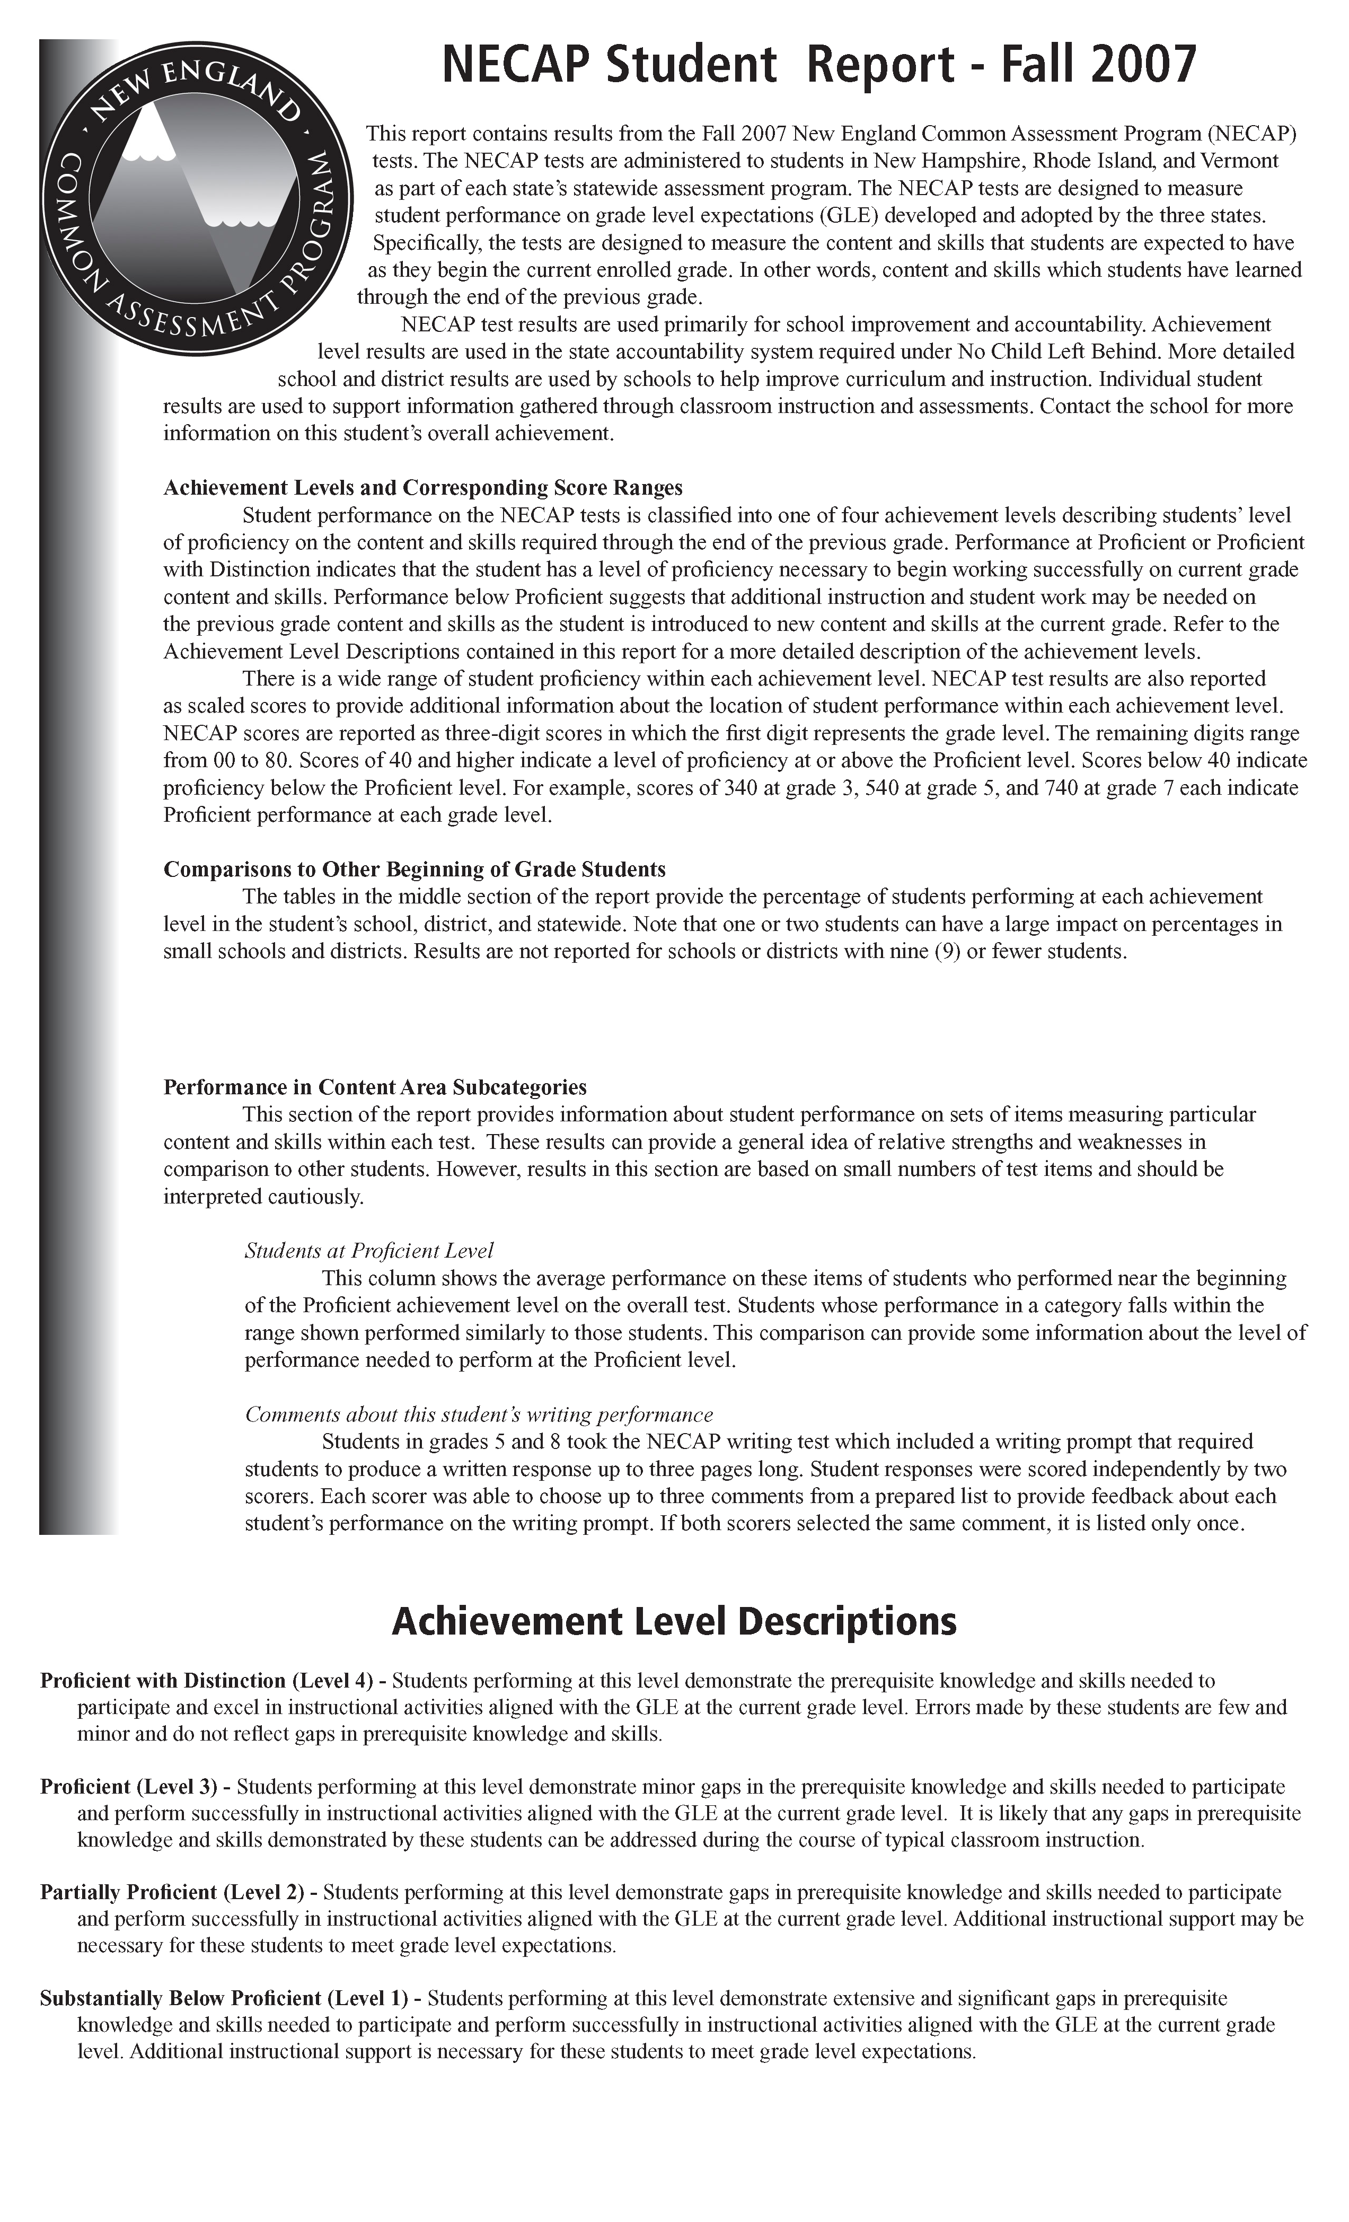
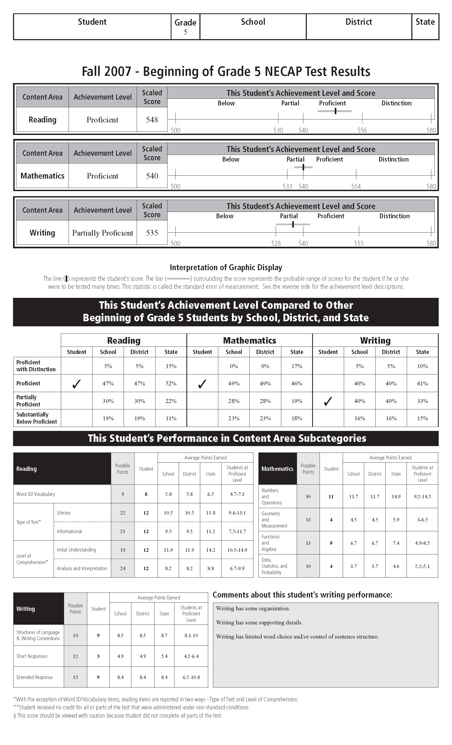
Student Report

Slide 10
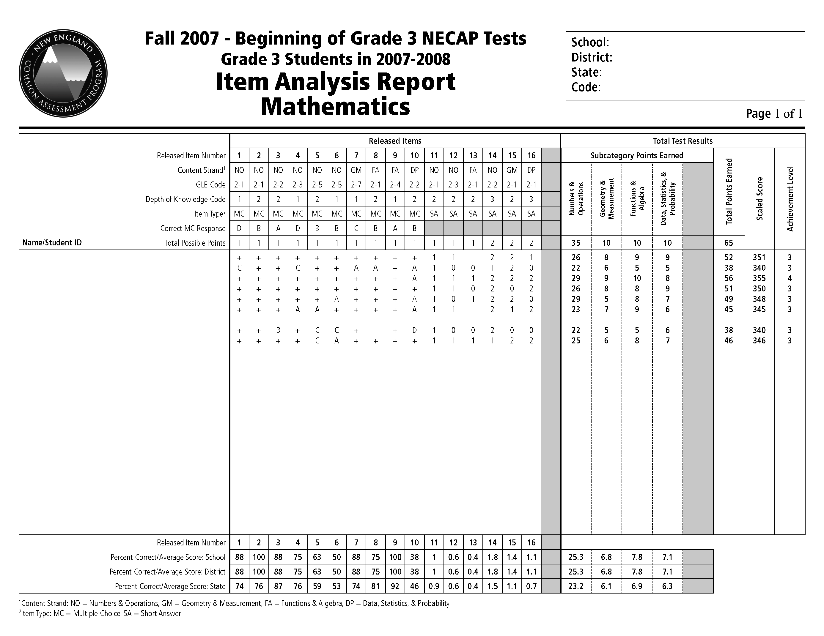
Item Analysis Report

Slide 11

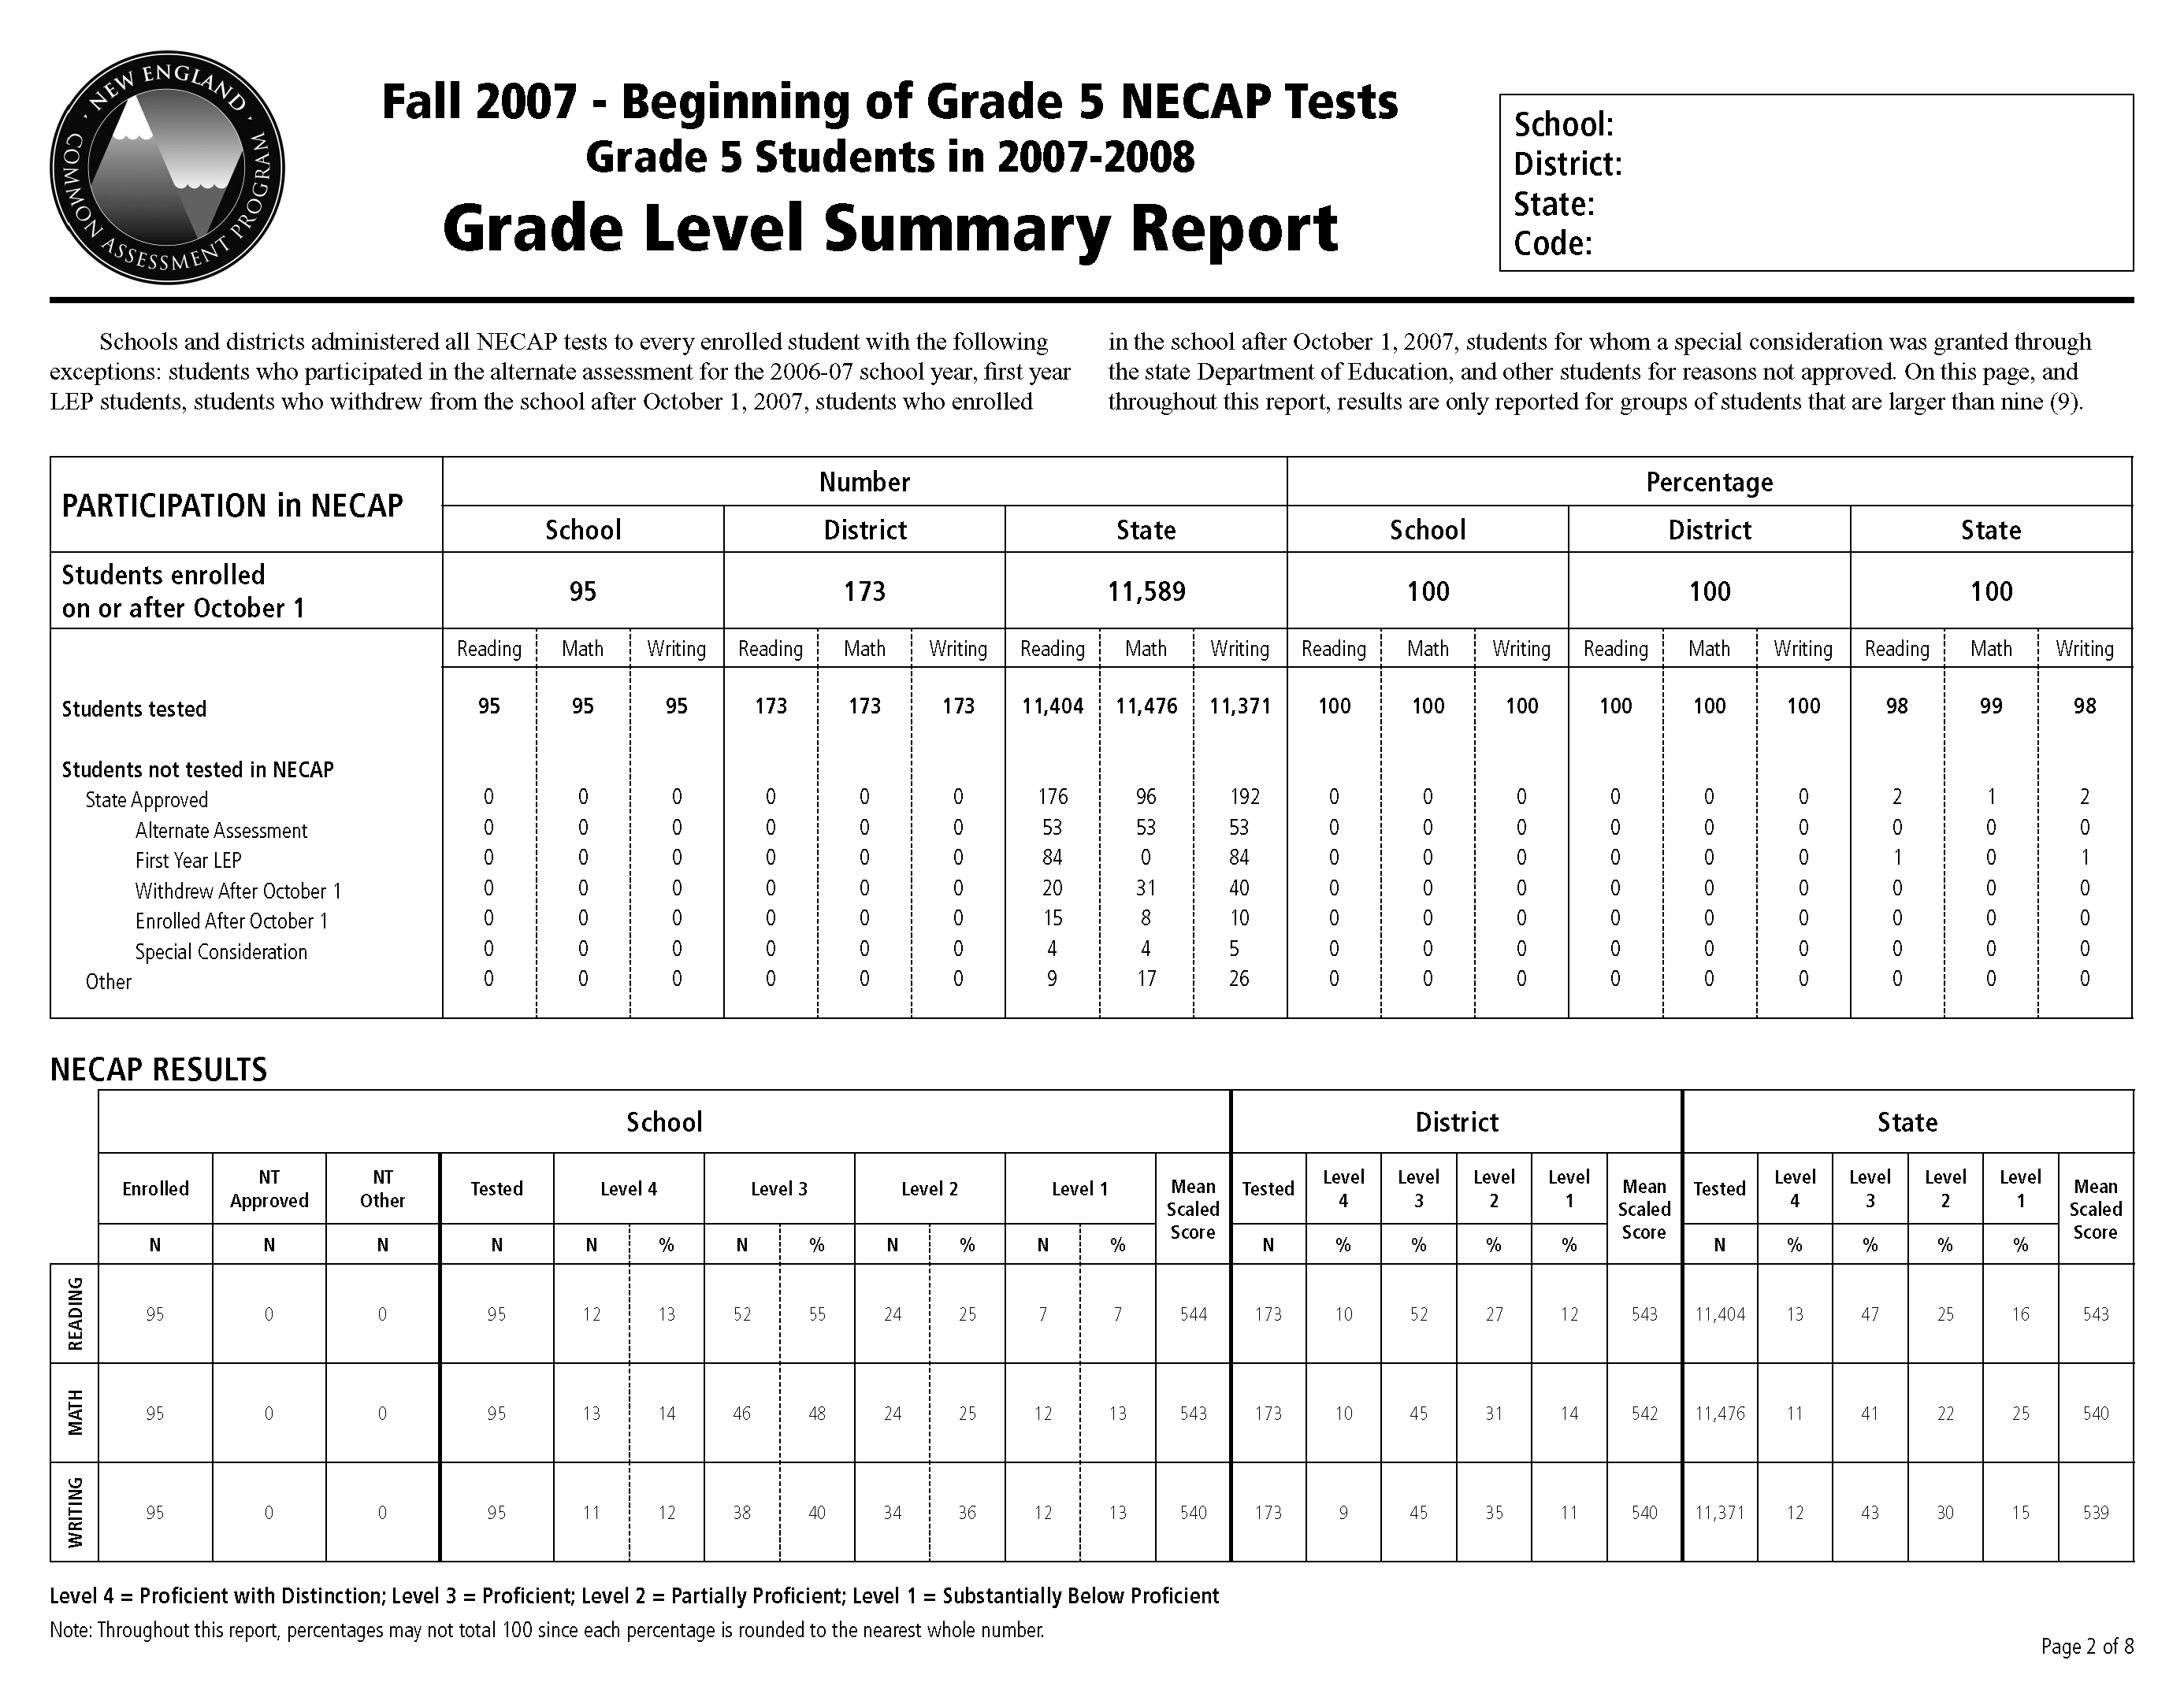
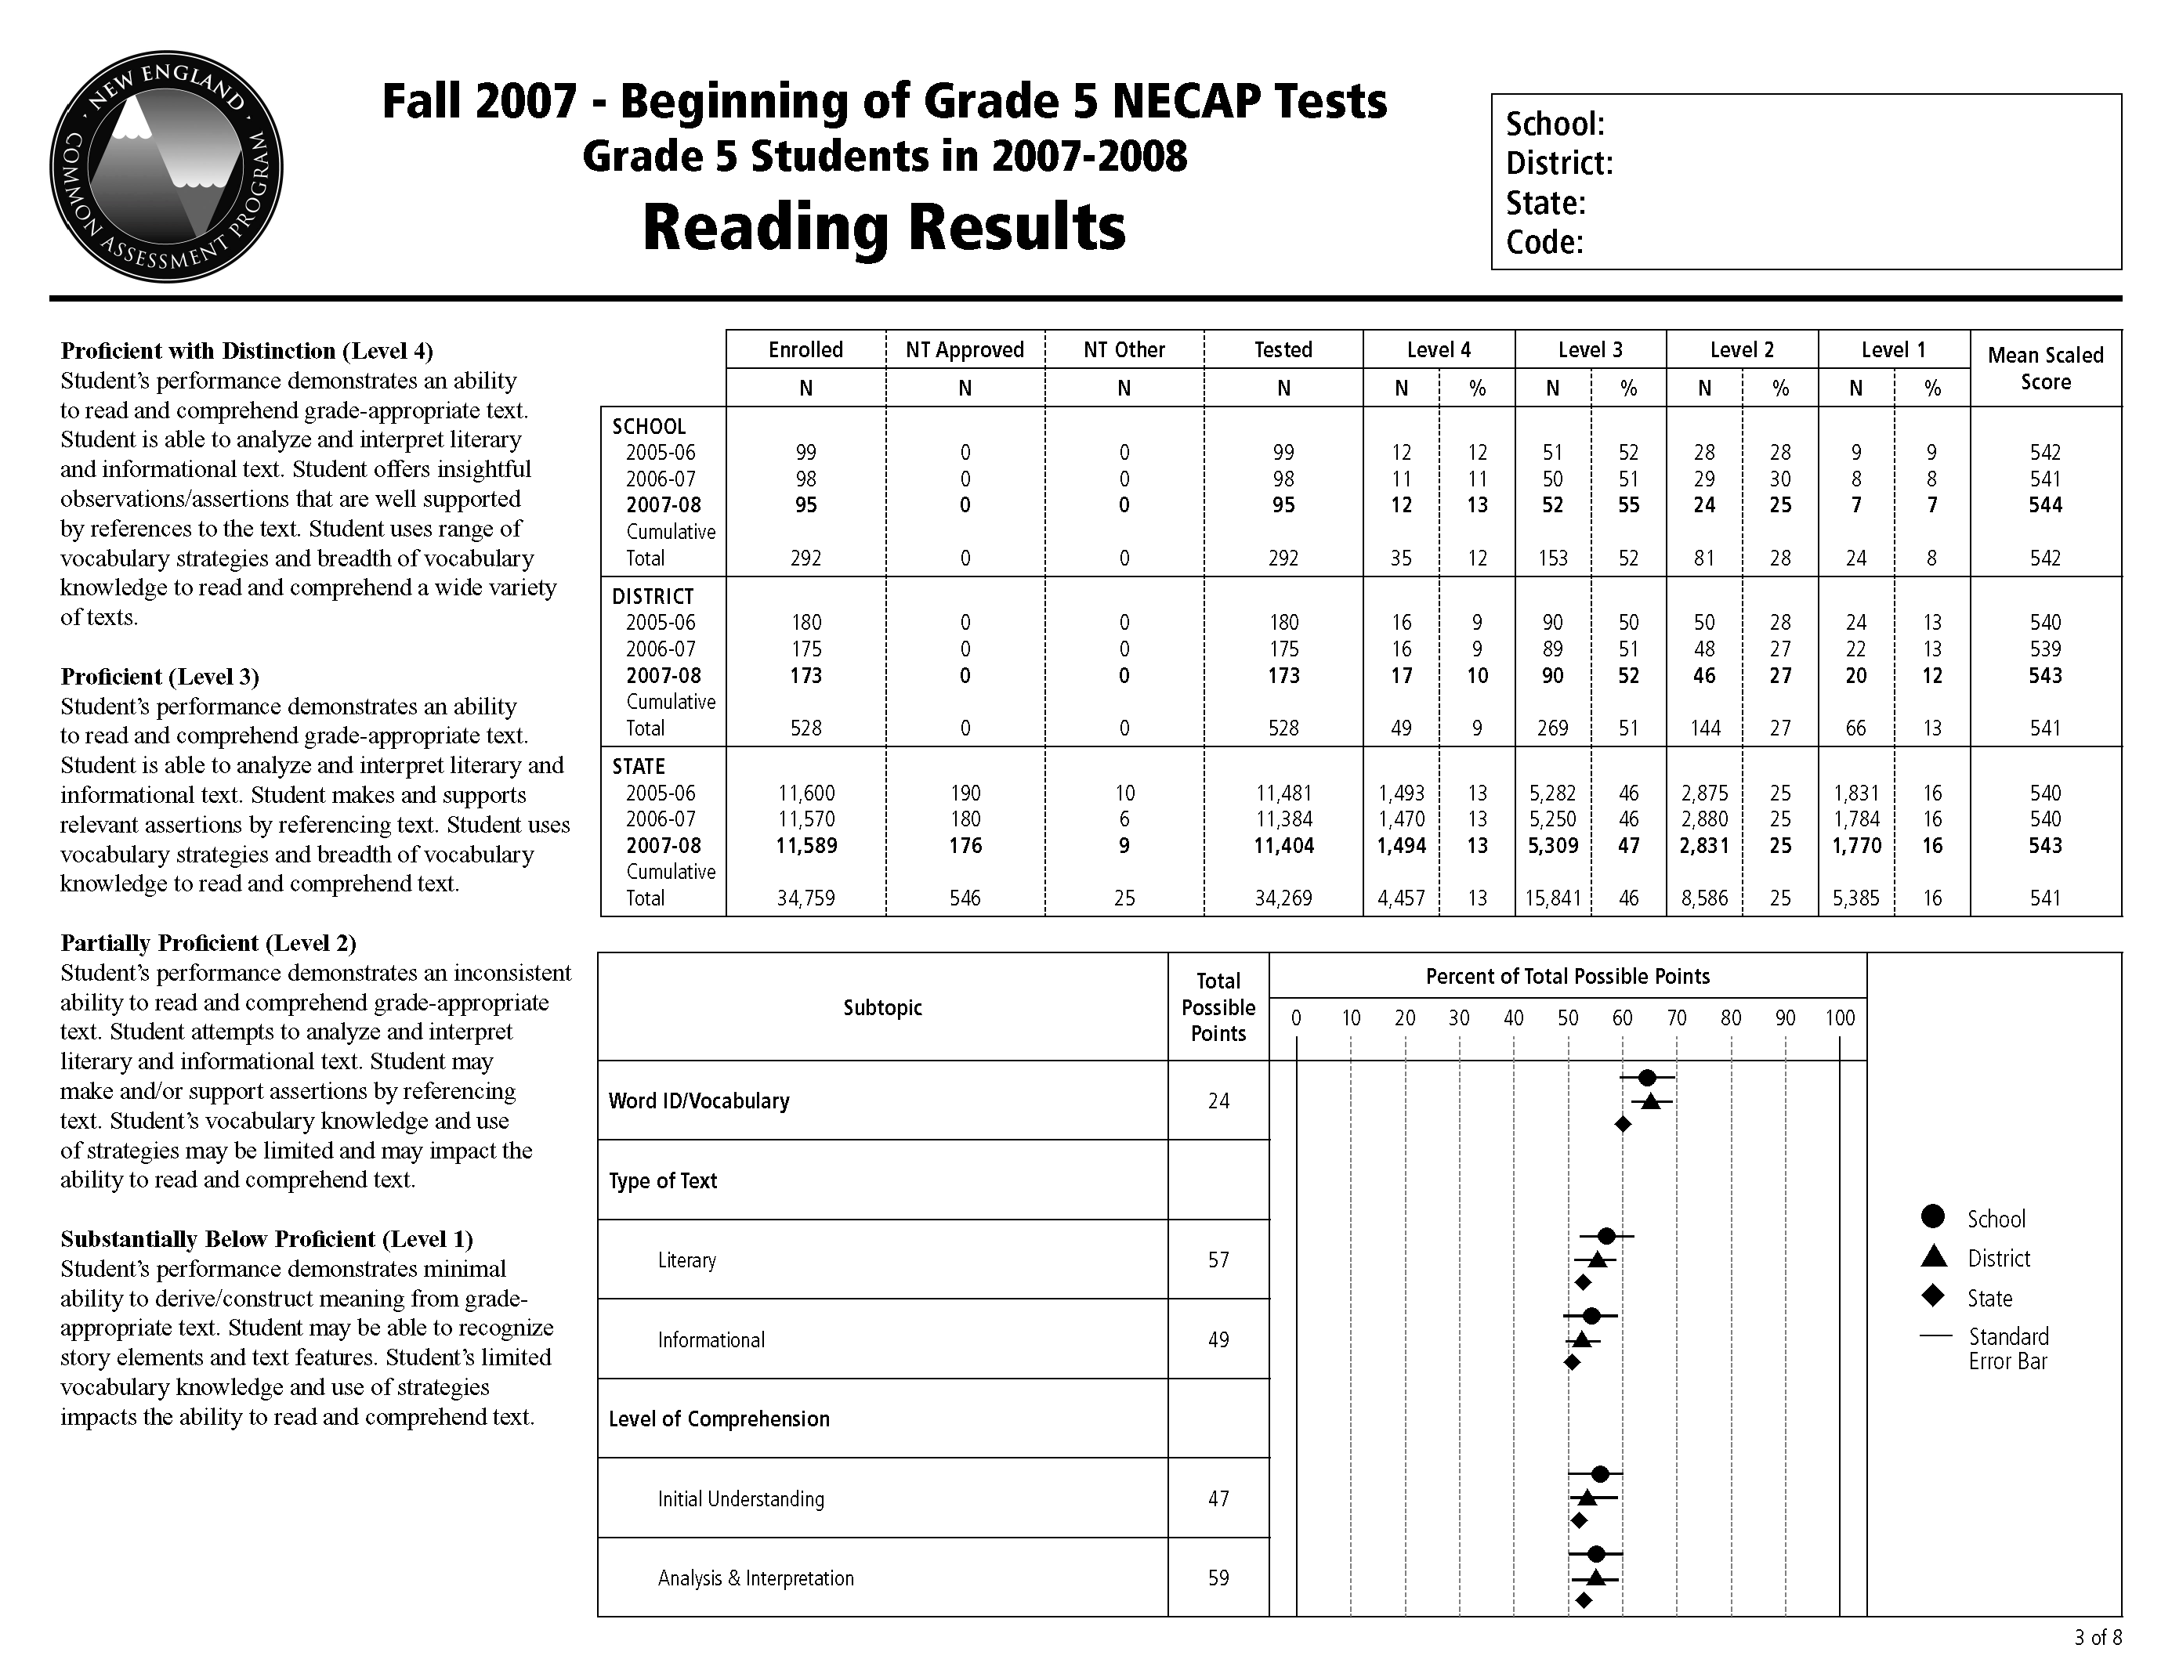
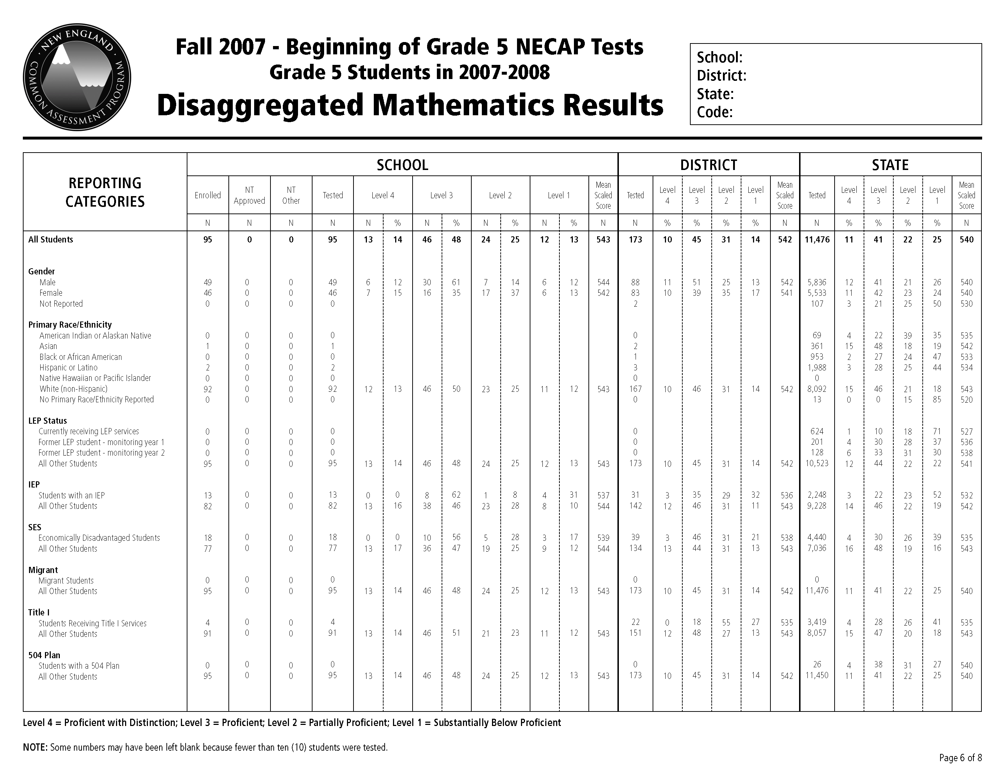
Results Report

Slide 12
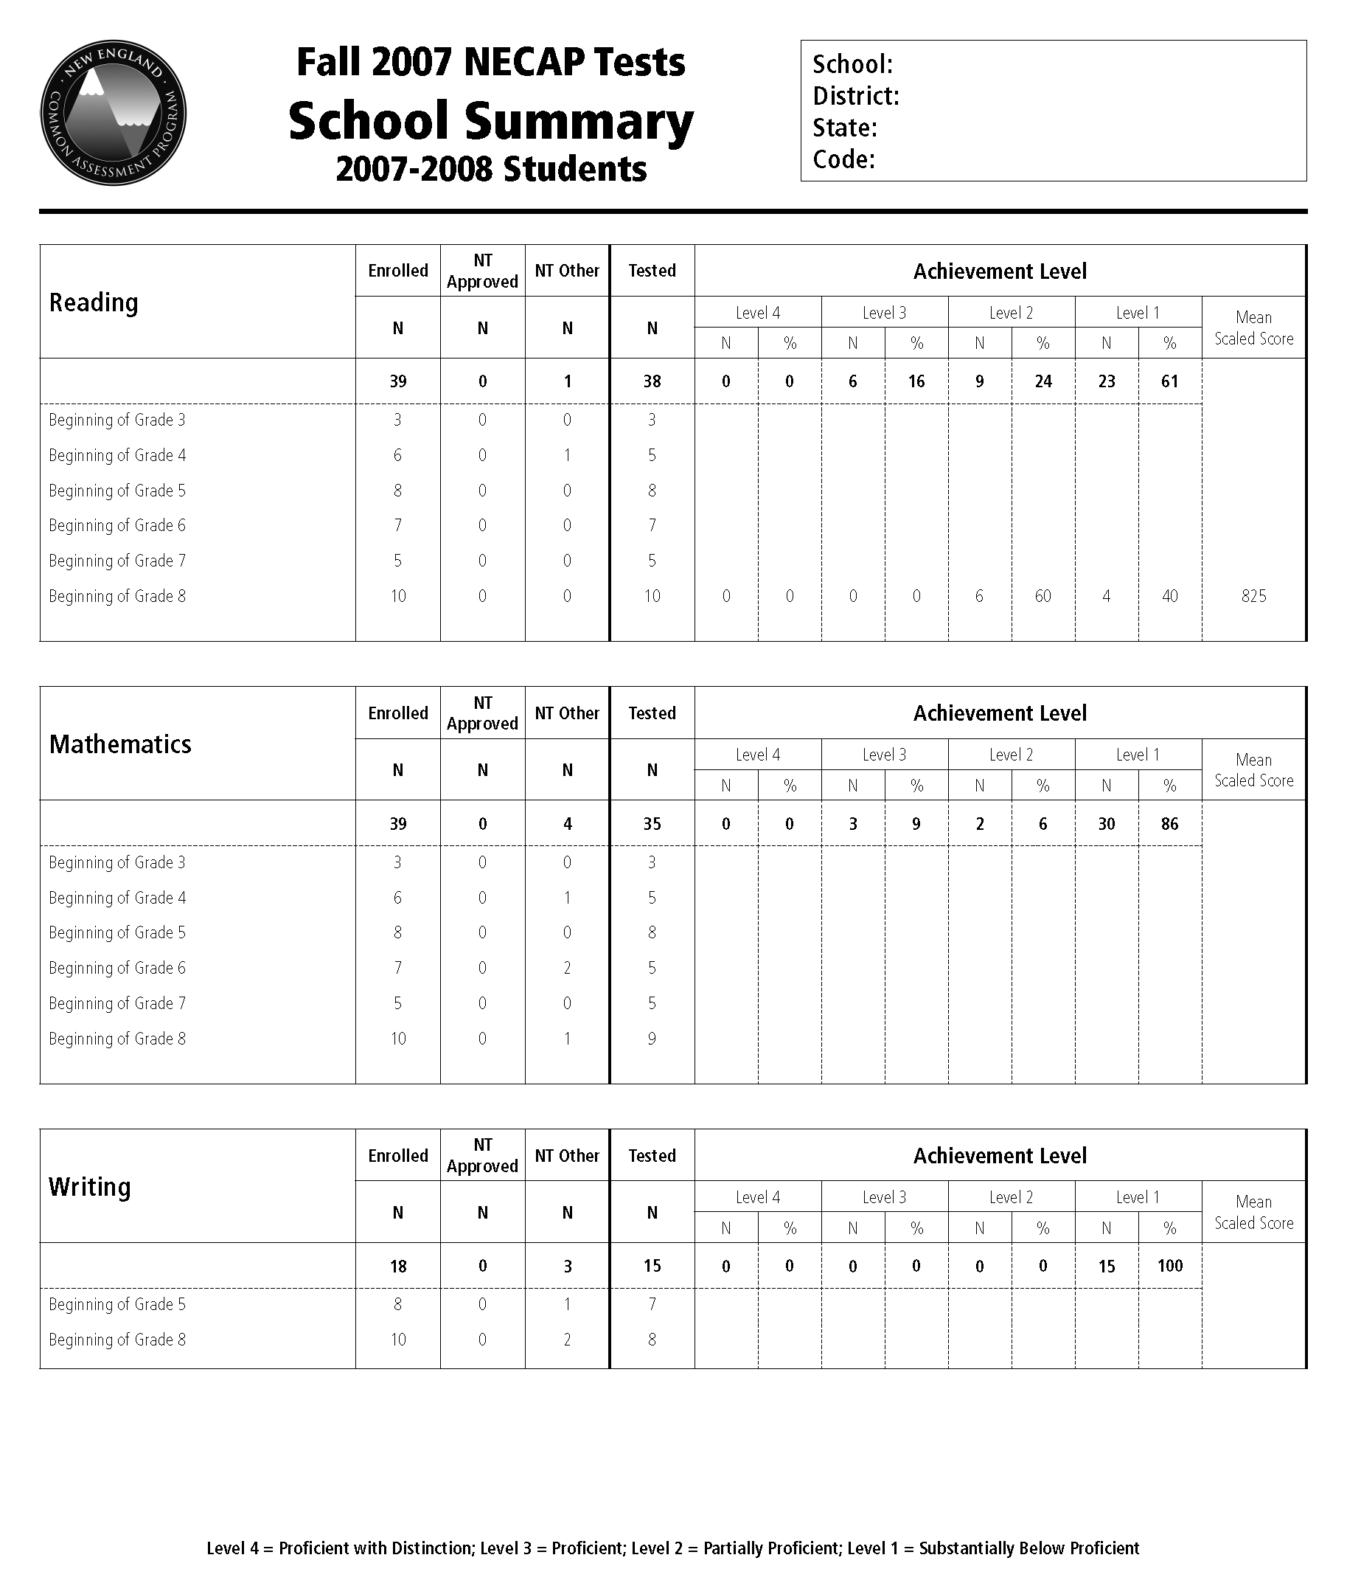
Summary Report

Slide 13
Student Level Data Files
Contain:
All demographic information for each student that was provided by the state
The scaled score, achievement level, and subscores earned by each student in all content areas tested
Also contain:
Performance on released items
Student questionnaire responses
Optional reports data

Slide 14

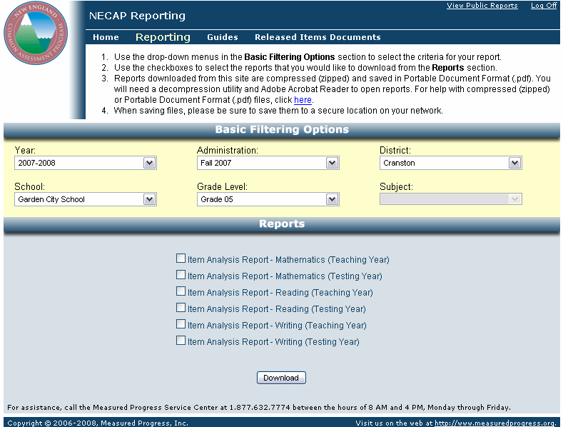
Accessing Your Reports
http://iservices.measuredprogress.org
Schools and Districts can download multiple reports at once.

Slide 15
Using Your Data
Three essential questions…
How did we do?
What do the data tell us about parts of our program?
What do the data tell us about parts of our population?
We will begin exploring these questions today by…
Looking at the different school-level reports (group data)
Looking at the Item Analysis Report (primarily individual student data)

Slide 16
Essential Question #1 for Interpreting School Status
How did we do?
Question #1
…compared to the district
…compared to the state
…compared to our own history (both total school and grade/cohort group)
…compared to what we would have predicted knowing our school’s programs and students

Slide 17
Essential Question #2 for Interpreting School Status
What do the data tell us about parts of our program
Question #2
How did we perform across the content areas? How did we perform in the various sub-content areas? What does the Item Analysis Report tell us about sub-content areas? How did our sub-content area and item-level performance compare to the district and state?

Slide 18
Essential Question #3 for Interpreting School Status
What do the data tell us about parts of our population?
Question #3
How did the various sub-groups perform relative to: a. the district?
b. the state?
c. the same sub-groups last year?
d. what we would have predicted knowing the population? How do the percentages of students in the various sub-groups compare to the district and state? What does the questionnaire data tell us about the sub-populations?

Slide 19
Before You Go Any Further…
What questions will you answer and for what audiences?
Based on what you know about your school’s programs and students, and how they have changed, what do you expect to see? (For example, how would a specific year’s 5th graders perform relative to 5th graders from previous years?)
What processes will you use to look at your reports?
Will you look at teaching year or testing year reports?
Who should participate in the discussions?
How should you group the participants?

Slide 20
Looking at the data
There are many ways to look at reports…
In order to simplify this presentation, we will only show one of the processes you might use.

Slide 21
Looking at the School-Level Reports
Schools can view reports for Testing Year (2007-08)

Slide 22

Looking at the School-Level Reports
Or for Teaching Year (2006-07)

Slide 23

Looking at the School-Level Reports
1A and 1B: How did we do compared to the district and the state?

Slide 24
Looking at the School-Level Reports
2A: How did we perform across the content areas?

Slide 25
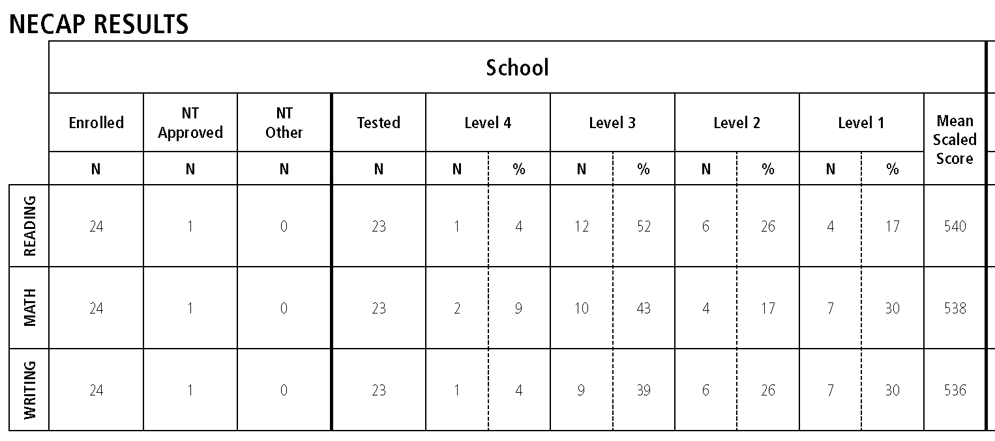
Looking at the Results Report – Grade Level Summary
2A: How did we perform across the content areas?
56% of the students in this school scored proficient or above on the grade 5 reading test.
52% of the students in this school scored proficient or above on the grade 5 mathematics test.
43% of the students in this school scored proficient or above on the grade 5 writing test.
Does this data match what we know about the school’s program?

Slide 26
Looking at the Results Report – Grade Level Summary
2A: How did we perform across a content area (compared to the district and the state)?
Does this data match what we know about the school’s program?
52% of the students in this school scored proficient or above on the grade 5 mathematics test.
48% of the students in this district scored proficient or above on the grade 5 mathematics test.
64% of the students in the state scored proficient or above on the grade 5 mathematics test.

Slide 27
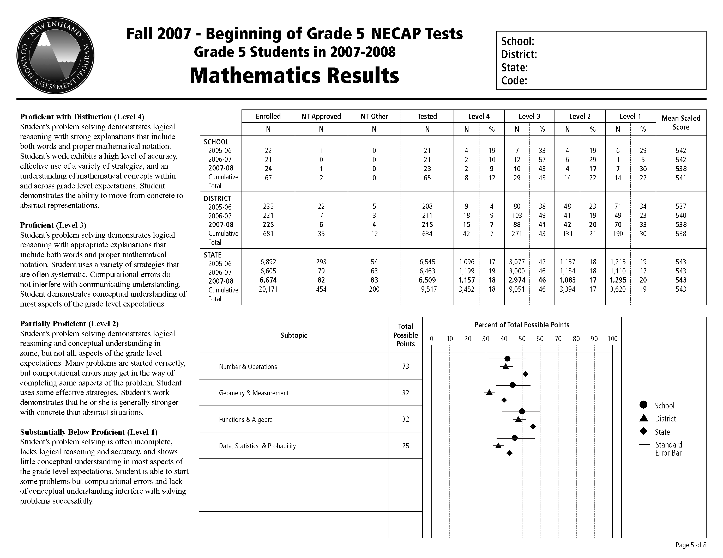
Looking at the Results Report – Content Area Results
1C: How did we do compared to our own history?

Slide 28
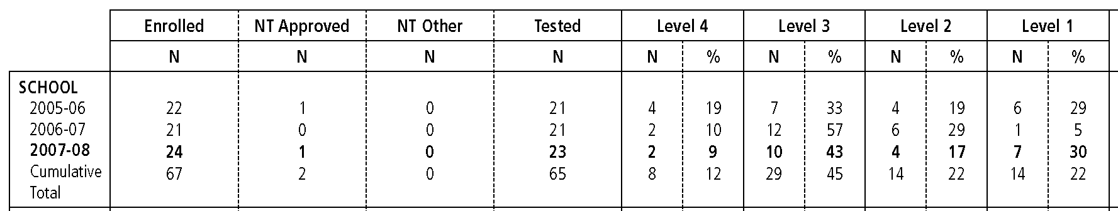
Looking at the Results Report – Content Area Results
1C: How did we do compared to our own history?
67% of last year’s fifth grade students scored proficient or above on the mathematics test.
Does this confirm what we know about this year’s cohort of fifth grade students compared with last year’s cohort?
52% of this year’s fifth grade students scored proficient or above on the mathematics test.
The big difference could be due to a cohort effect (stronger group vs. weaker group).

Slide 29
Looking at the Results Report – Content Area Results
1C: How did we do compared to our own history?
This is the better indicator of how we’re doing.
Cumulative Totals… provide information on multiple cohorts of students exposed to the program of instruction at a specific grade. Caution should be used if the program of instruction has changed significantly.

Slide 30
Looking at the Results Report – Content Area Results
2B: How did we perform in the various sub-content areas?

Slide 31
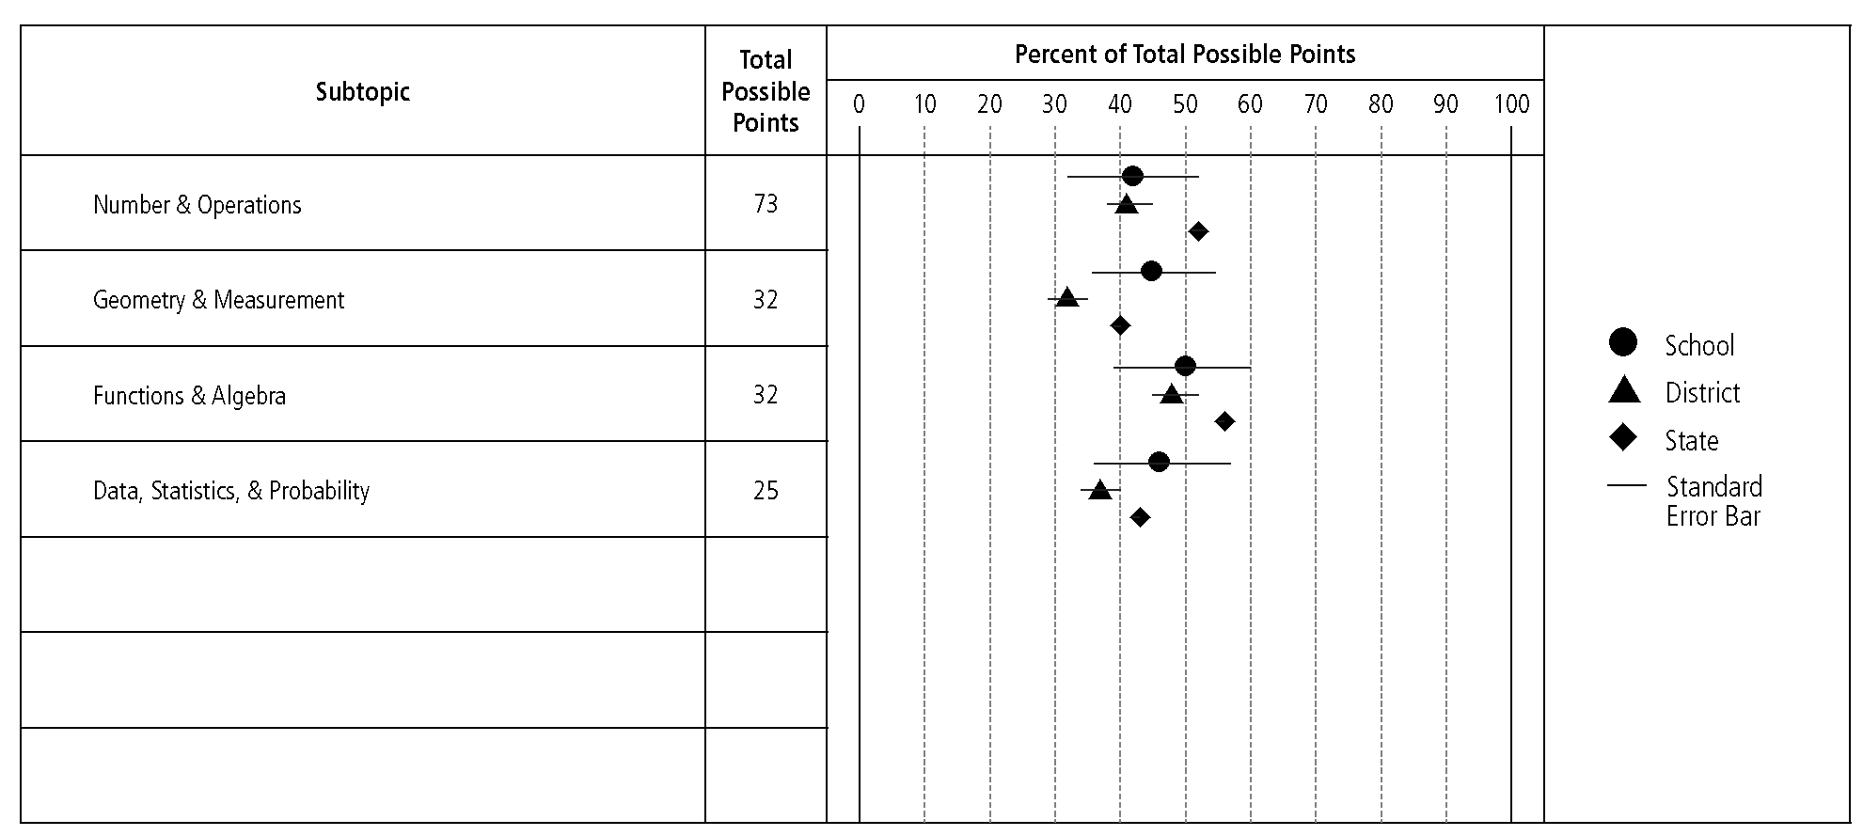
Looking at the Results Report – Content Area Results
2B: How did we perform in the various sub-content areas?
Total Possible Points includes both common and matrix items (not field-test).
Total Possible Points also represents the test’s balance of representation.

Slide 32
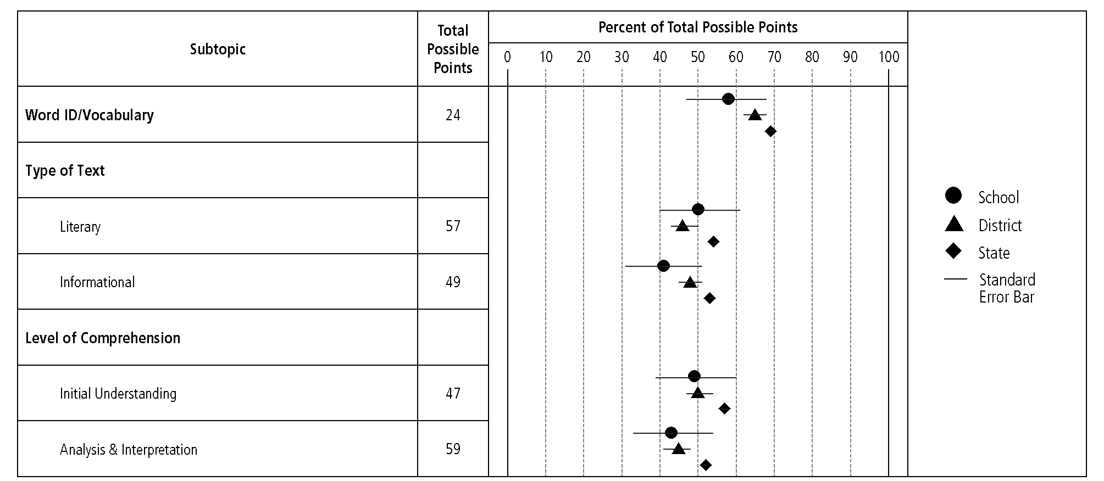
Looking at the Results Report – Content Area Results
Please note: The Total Possible Points column is organized differently on the Reading Results Report
106 possible points are represented here – they are sorted by “Type of Text”
The same 106 possible points are represented here – they are sorted by “Level of Comprehension”

Slide 33
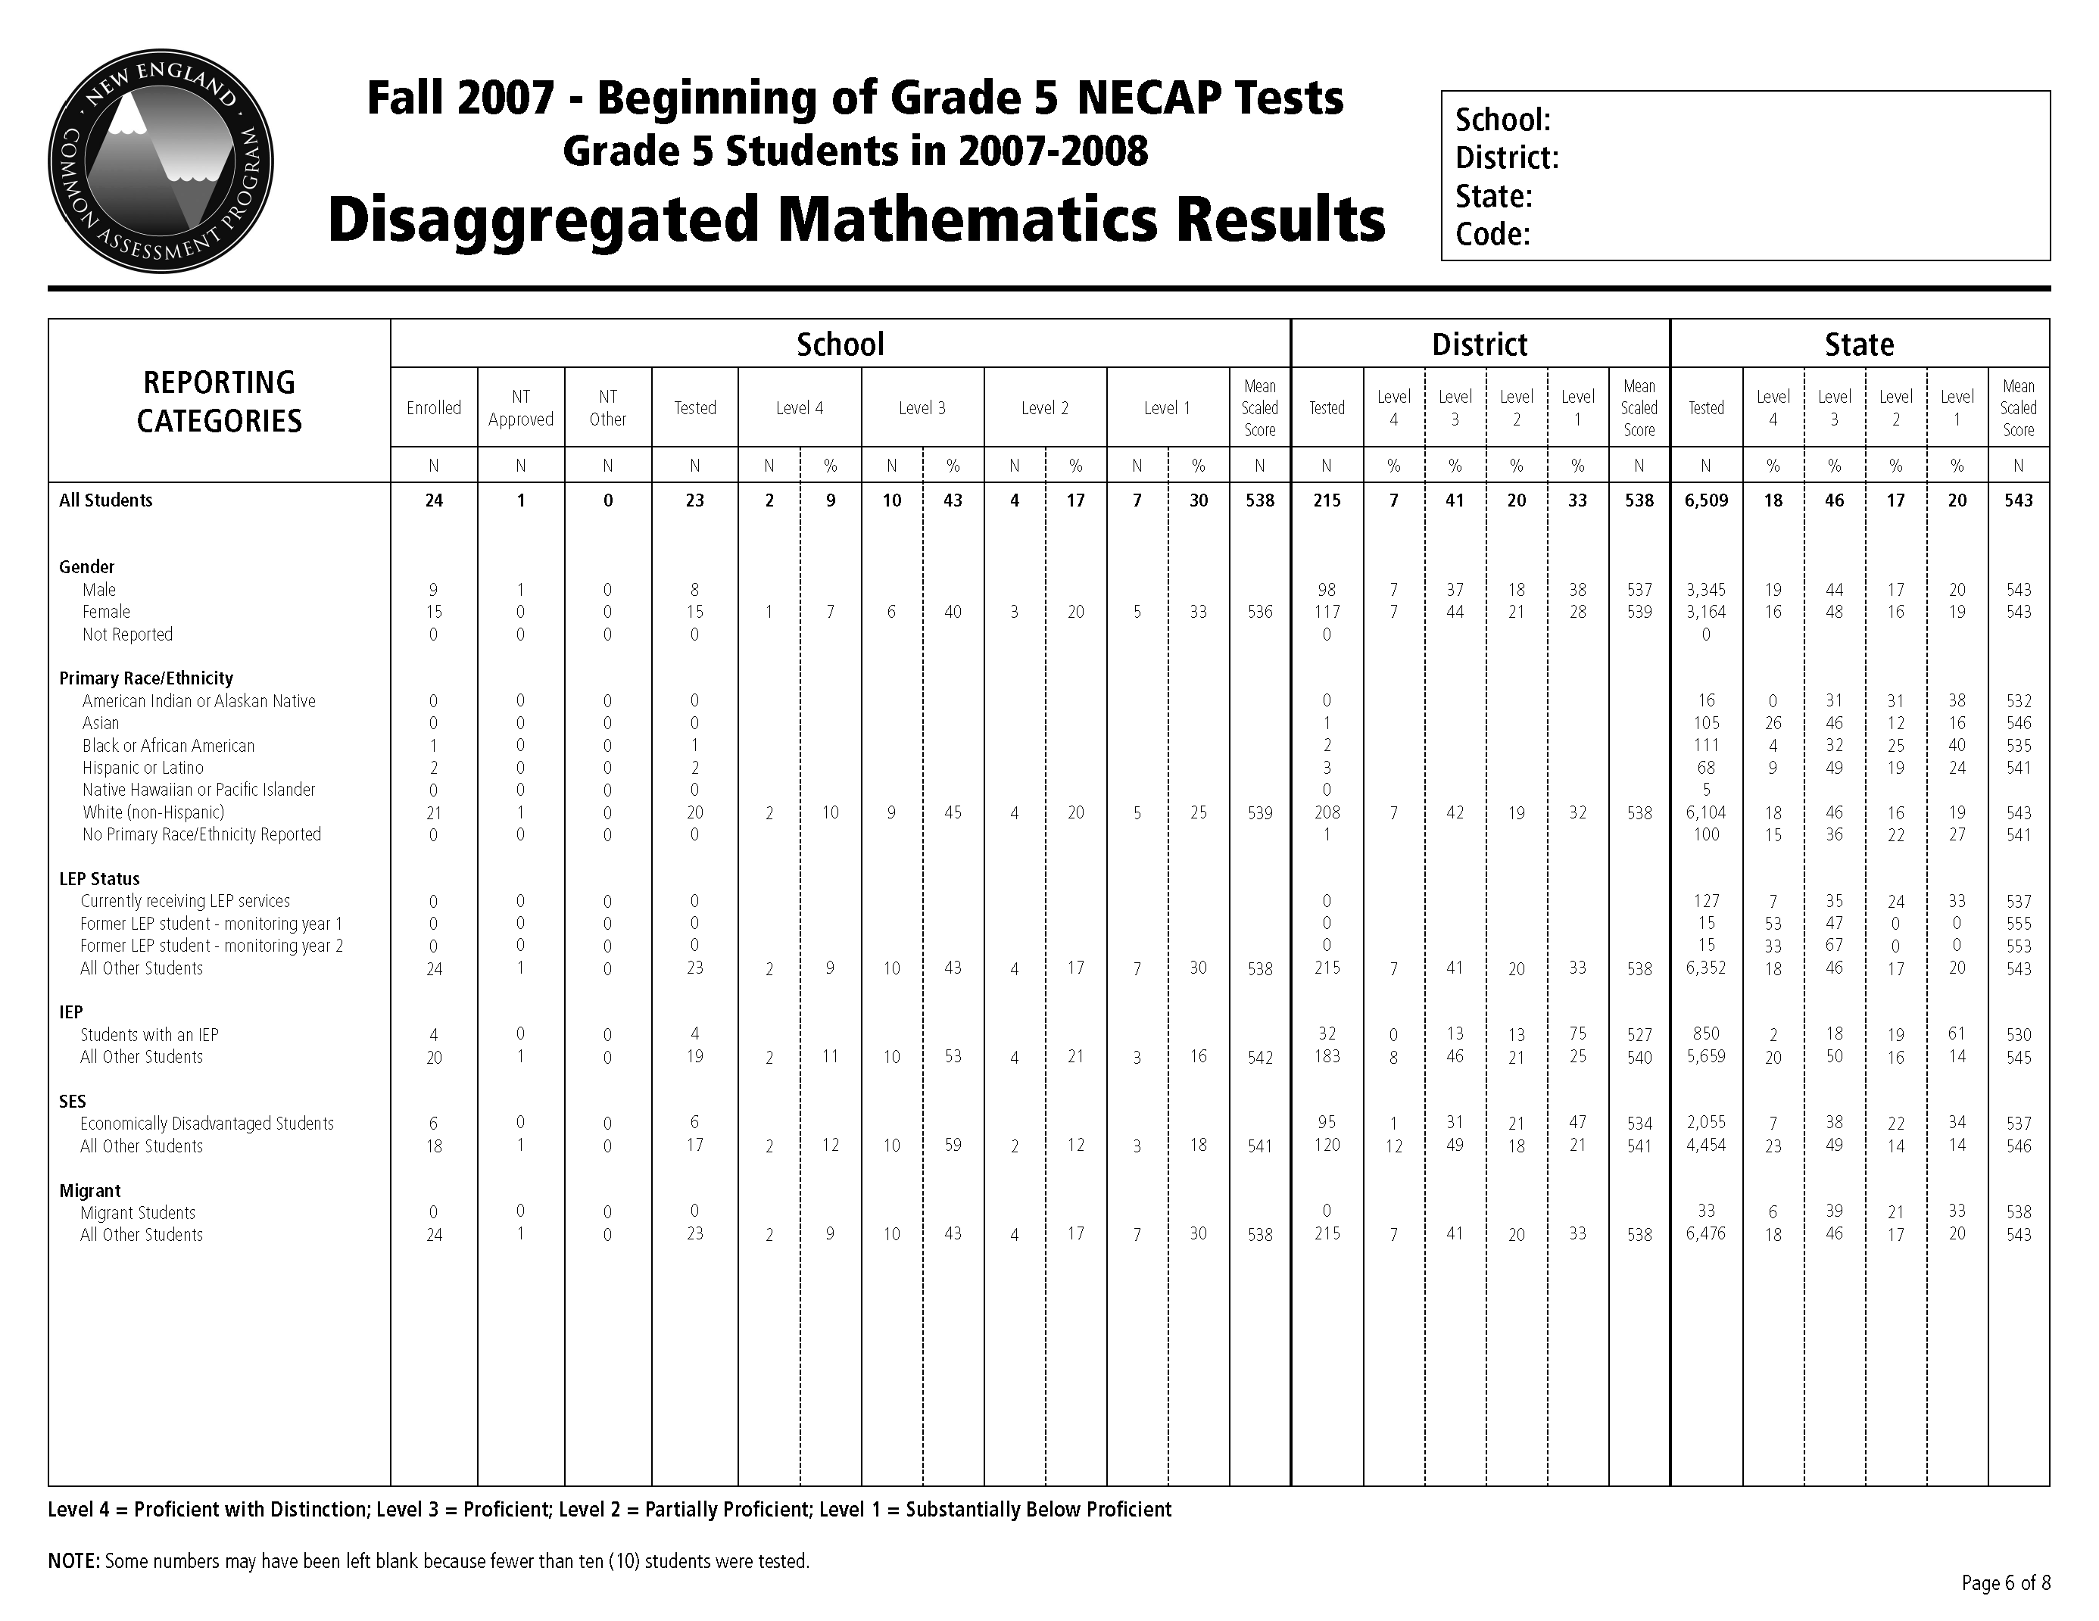
Looking at the School-Level Report
3B: How did the various sub-groups compare to the district and state?

Slide 34
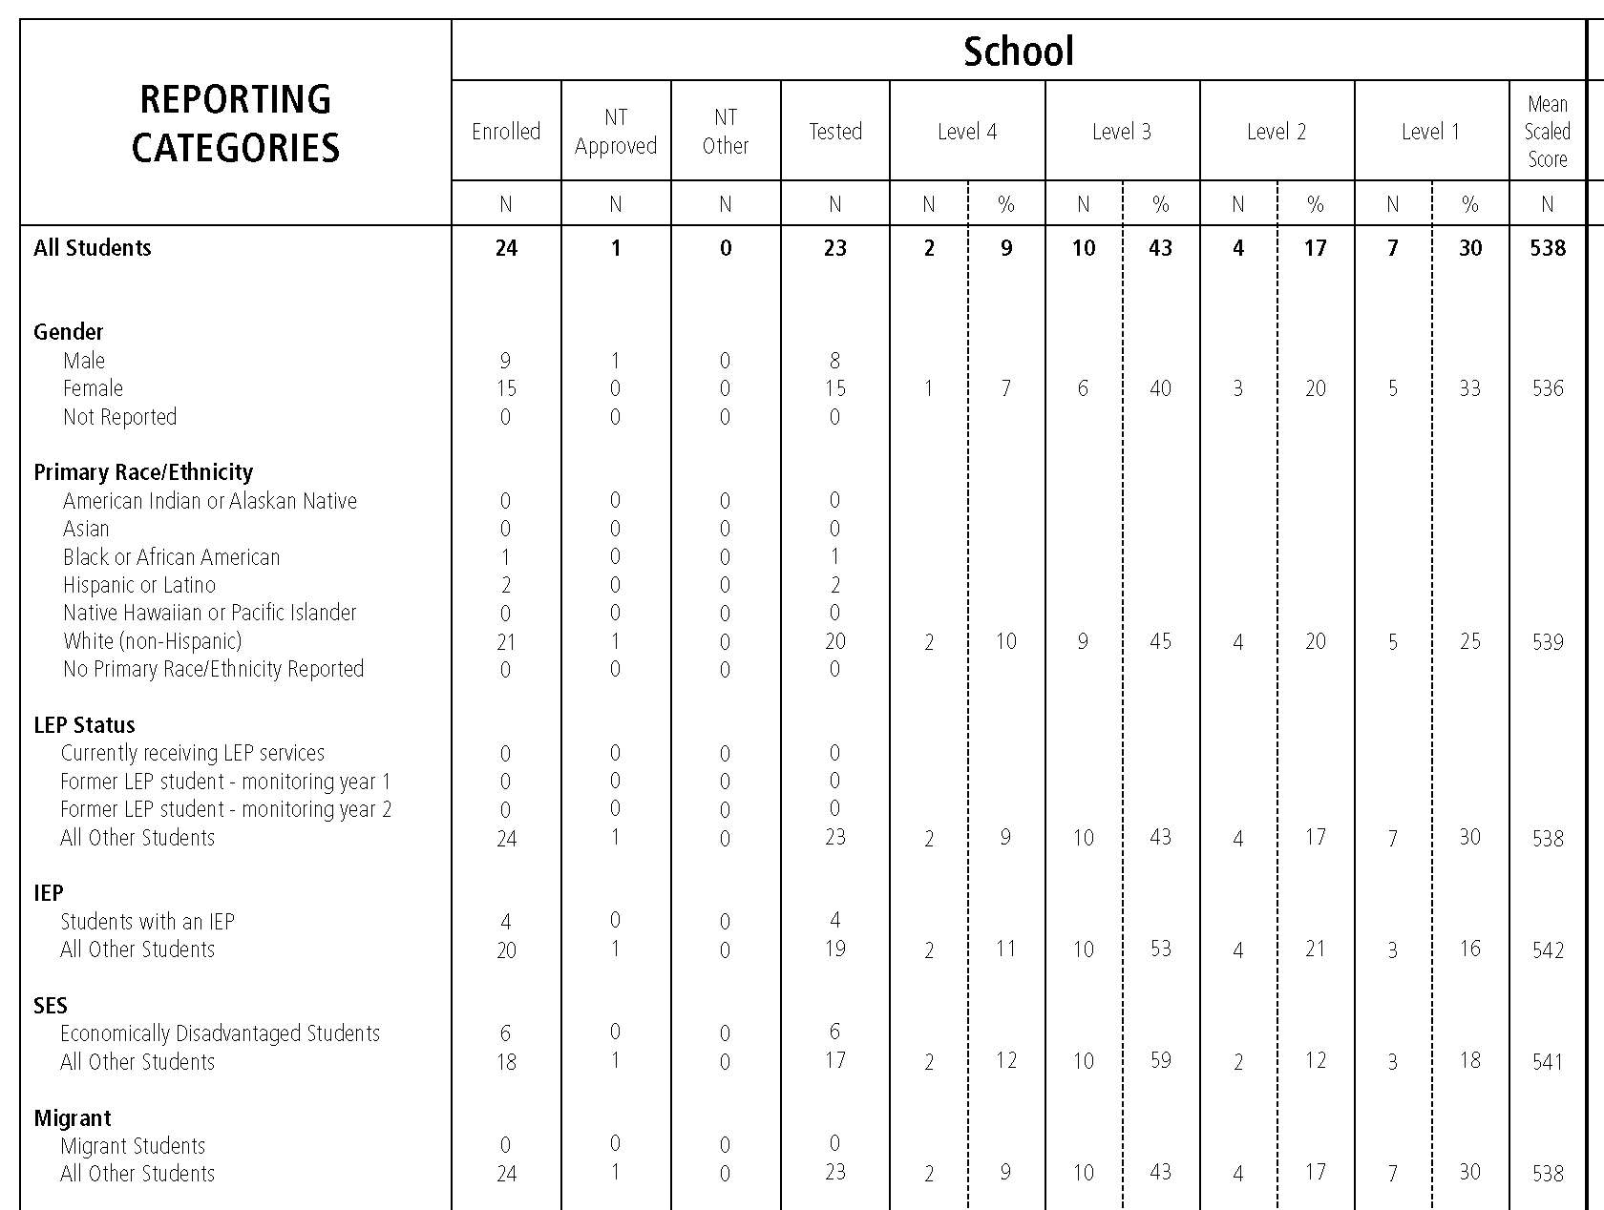
Looking at the School-Level Report
3A: How did the various sub-groups perform?
Important Note: Disaggregated results are not reported for sub-groups of less than 10

Slide 35
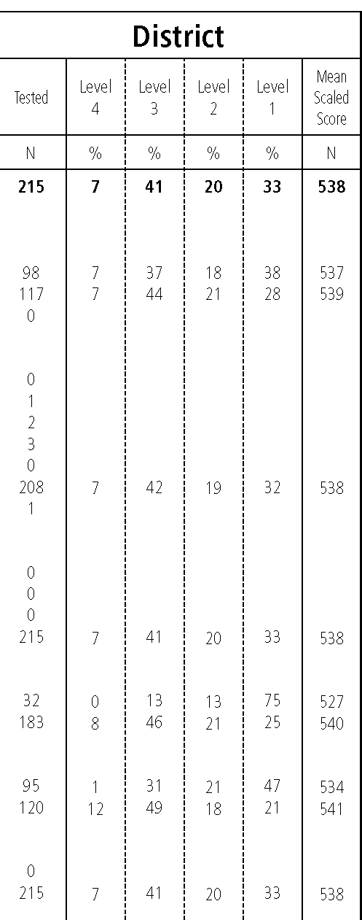
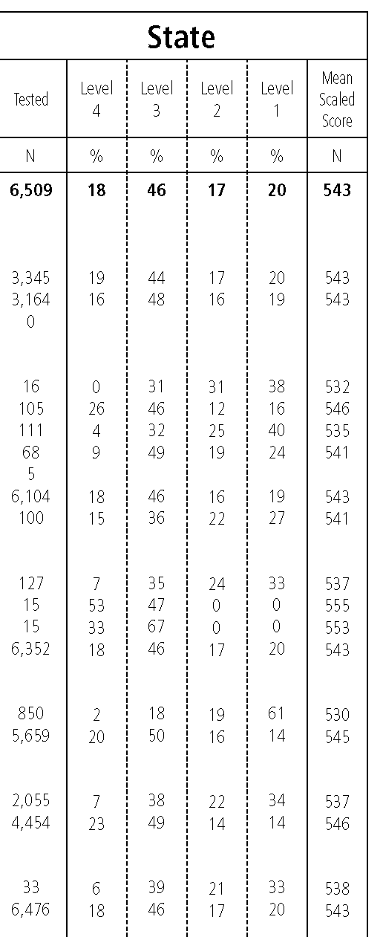
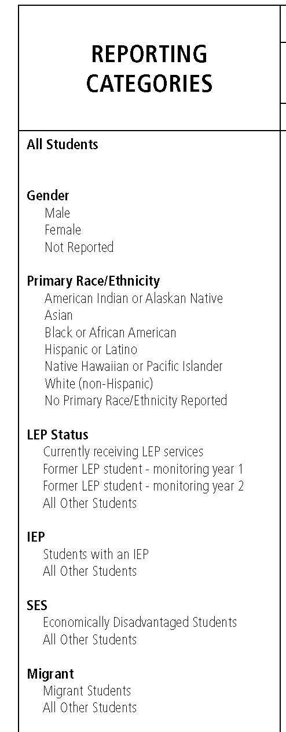
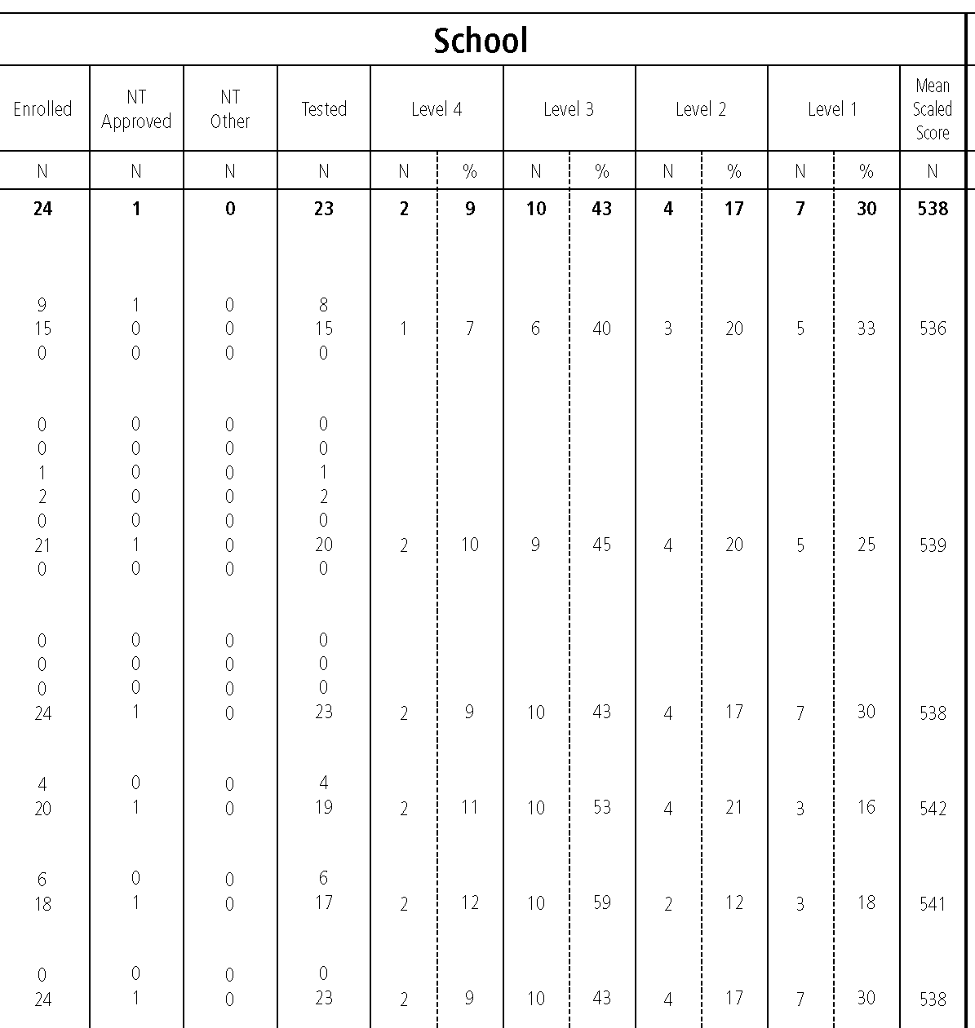
Looking at the School-Level Report
3A: How did the various sub-groups perform?
Because this is a small school, and so many of the sub-groups are smaller than 10, this part of the report is not as useful.
13% of the students with an IEP in this district scored proficient or above
20% of the students with an IEP in the state scored proficient or above
Does this data match what we know about the district’s program?
But we can still look at district and state disaggregated results.

Slide 36
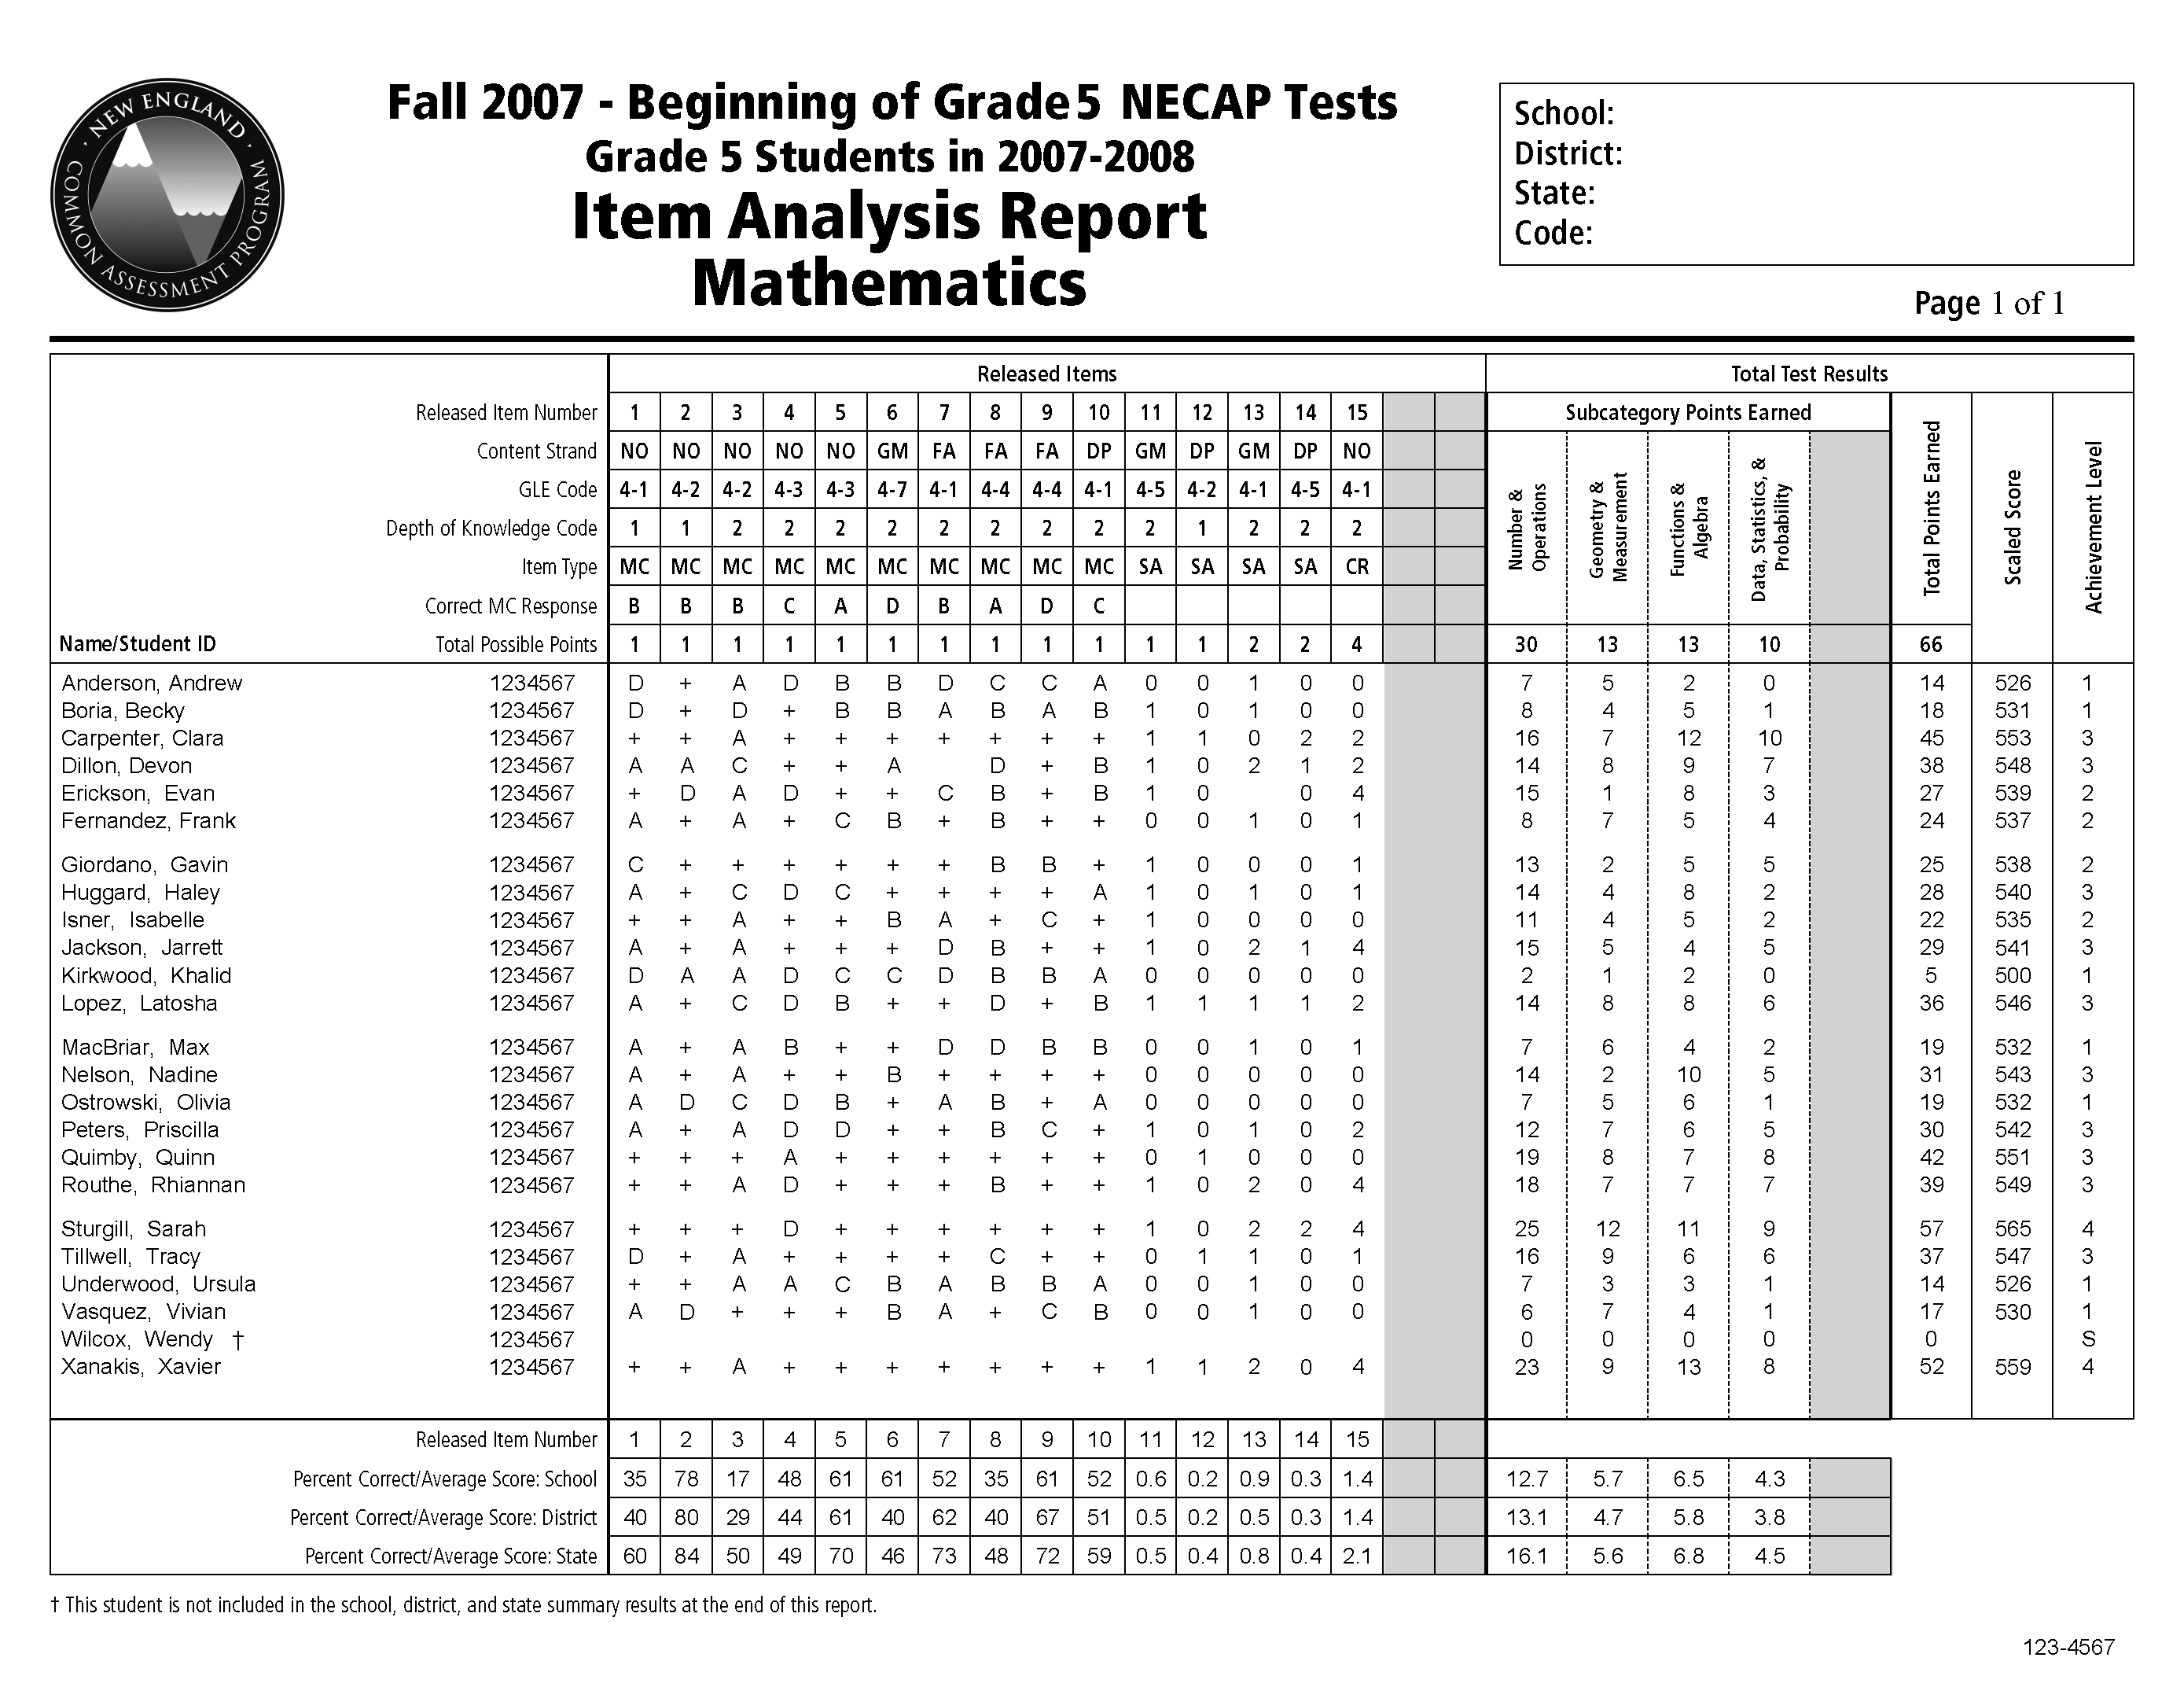
Looking at the Item Analysis Report
This part of the report gives specific information about the released items

Slide 37
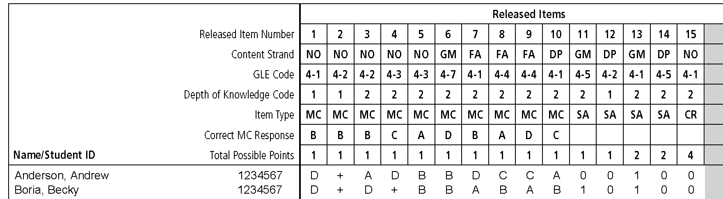
Looking at the Item Analysis Report

Slide 38
Looking at the Item Analysis Report
This part of the report represents all of the items used to compute student scores

Slide 39
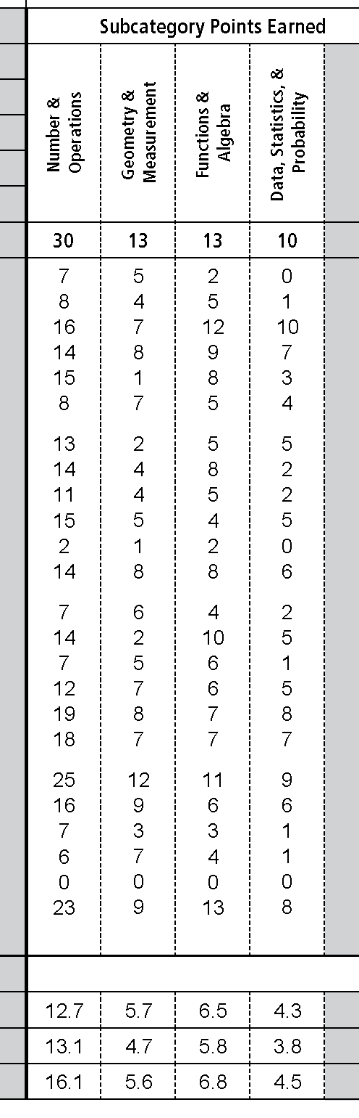
Looking at the Item Analysis Report

Slide 40
Looking at the Item Analysis Report
This part of the report does not represent all of the items used to compute student scores

Slide 41
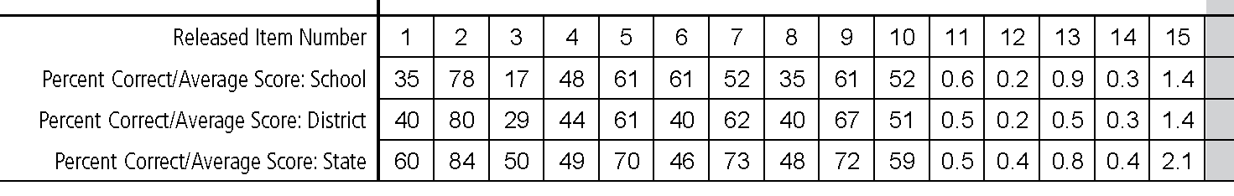
Looking at the Item Analysis Report
2D: How did our item-level performance compare to the district and state?
This school scored 33 percent lower than the state on item 3 – that’s probably significant and certainly worth a closer look.

Slide 42
Looking at the Item Analysis Report
2D: How did our item-level performance compare to the district and state?
Over 80% of the students who answered item 3 wrong chose option A.

Slide 43
Looking at the Item Analysis Report
2D: How did our item-level performance compare to the district and state?
What do we know about this item?
This information will help us use the Released Items Support Materials

Slide 44


Released Items Documents

Slide 45
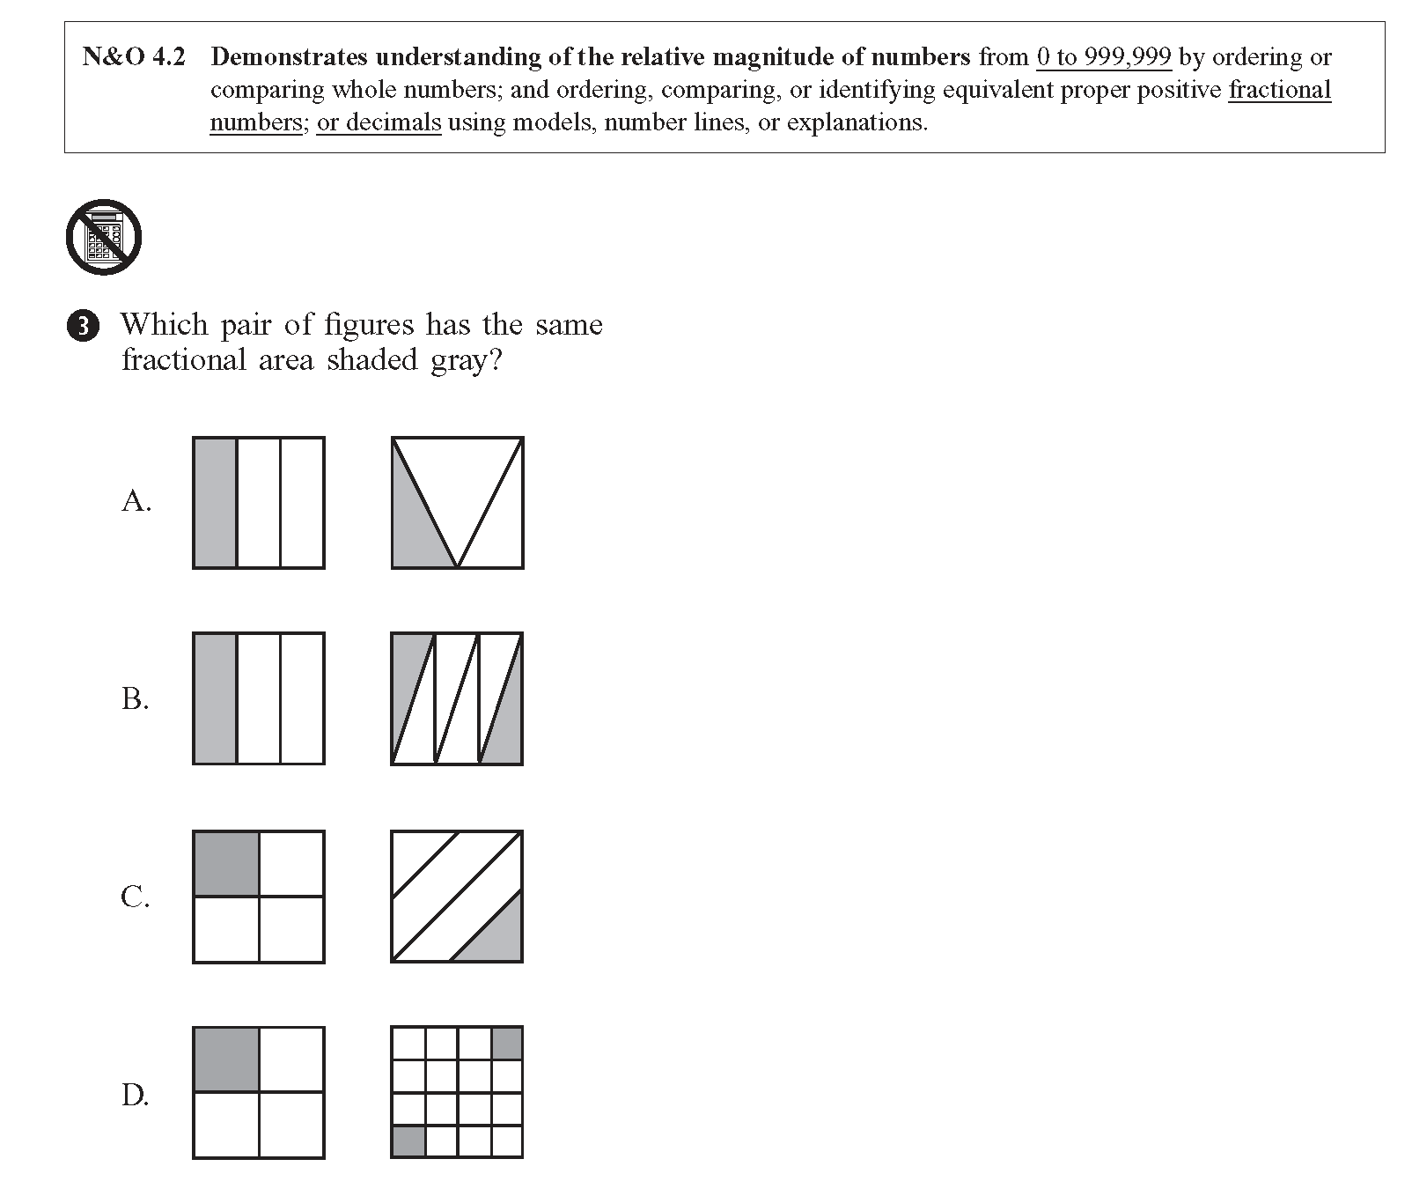
Using the Released Items Support Materials
Consider how the school’s curriculum and instructional practices address this GLE.
Consider why so many students might have incorrectly selected option A.

Slide 46
Looking at the Item Analysis Report
2C: What does the Item Analysis Report tell us about sub-content areas?

Slide 47
Looking at the Item Analysis Report
2C: What does the Item Analysis Report tell us about sub-content areas?
We can see that this school performed better than the district or the state on the “Geometry and Measurement” items throughout the test.

Slide 48
Looking at the Item Analysis Report
2C: What does the Item Analysis Report tell us about sub-content areas?
Items 6, 11, and 13 all focus on the “Geometry and Measurement” content strand.

Slide 49
Looking at the Item Analysis Report
2C: What does the Item Analysis Report tell us about sub-content areas?
This school scored higher than the district and the state on “Geometry and Measurement” items 6, 11, and 13.

Slide 50
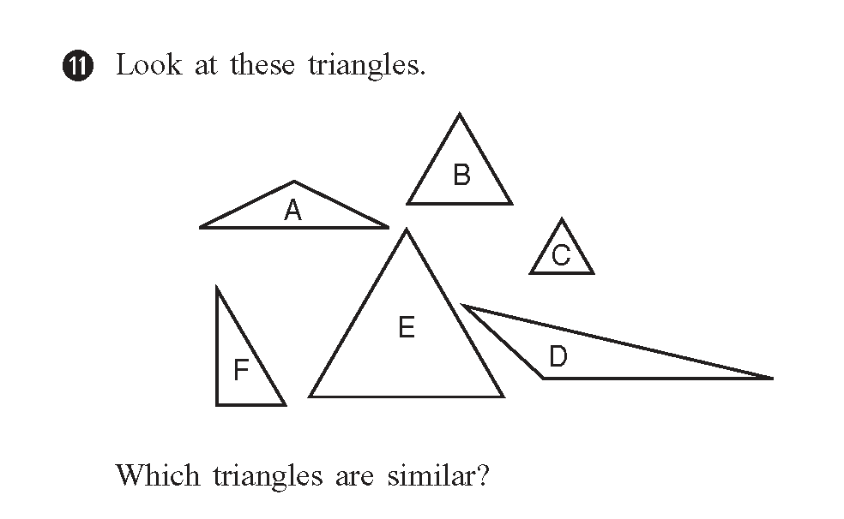
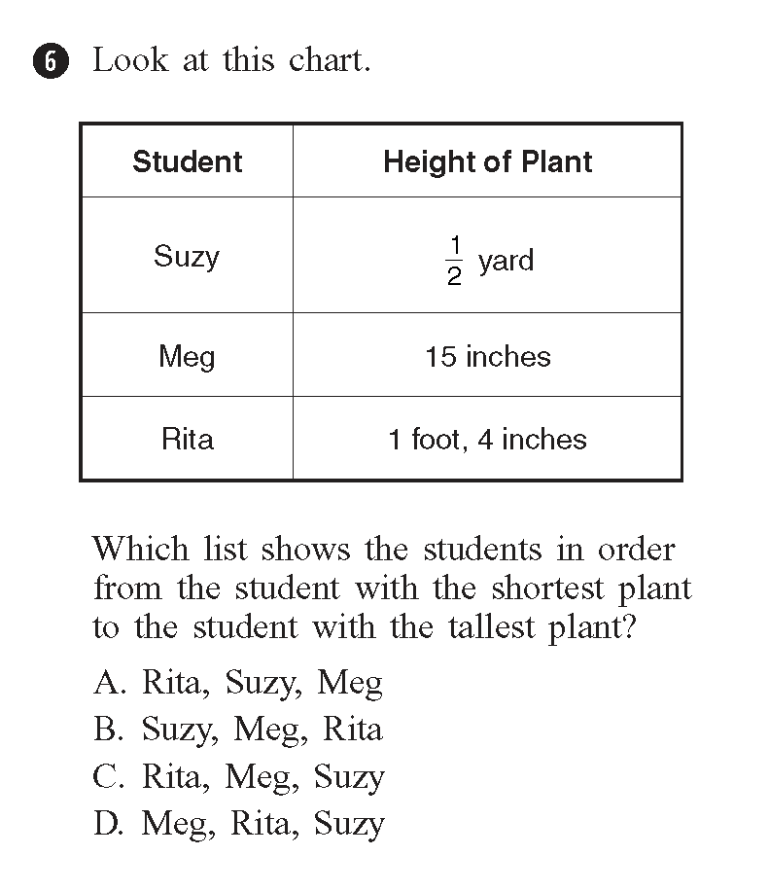
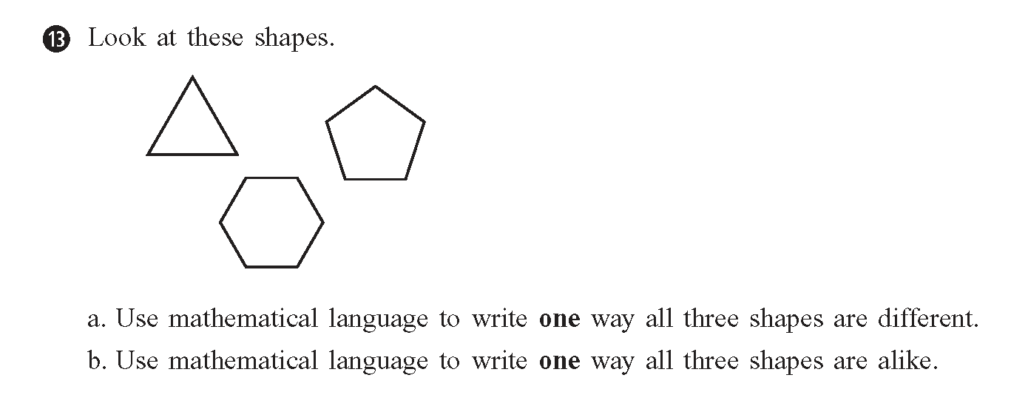
Using the Released Items Documents
Consider why the students were more successful in answering questions related to the “Geometry and Measurement” content strand.
What is different about the way “Geometry and Measurement” is taught?
Can this information apply to areas of mathematics where students are not doing as well?
What curriculum and instructional practices might have contributed to this success?

Slide 51
Looking at the Item Analysis Report
2D: How did our item-level performance compare to the district and state?
Over one-third of the students received only partial credit for answering item 15

Slide 52
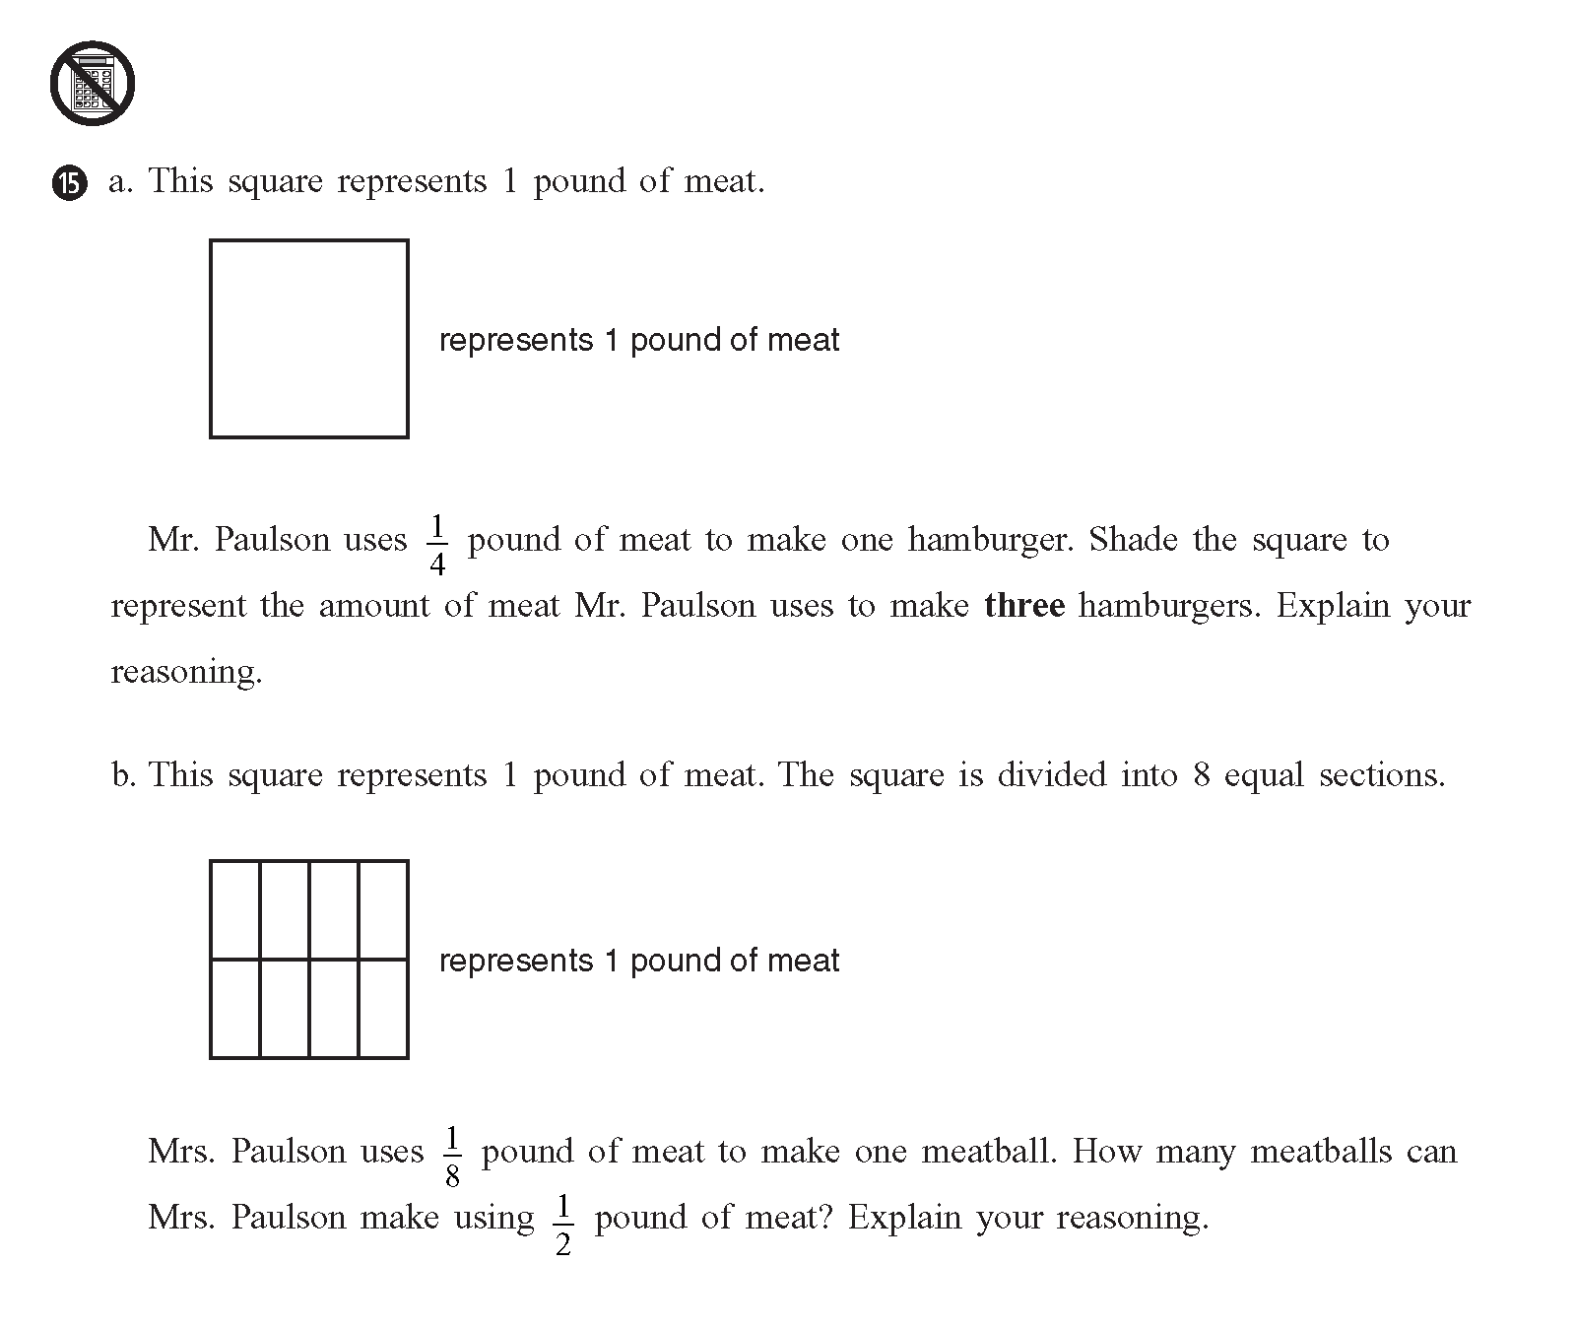
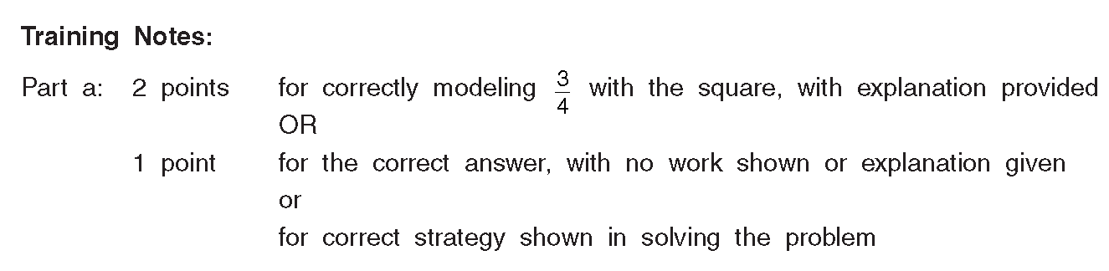
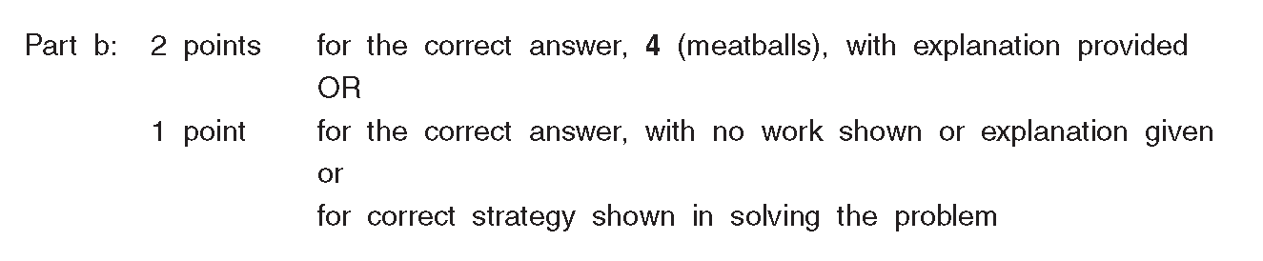
Using the Released Items Support Materials

Slide 53
Three Essential Questions Handout
1D: How did we do compared to what we would have predicted knowing our school’s students?

Slide 54
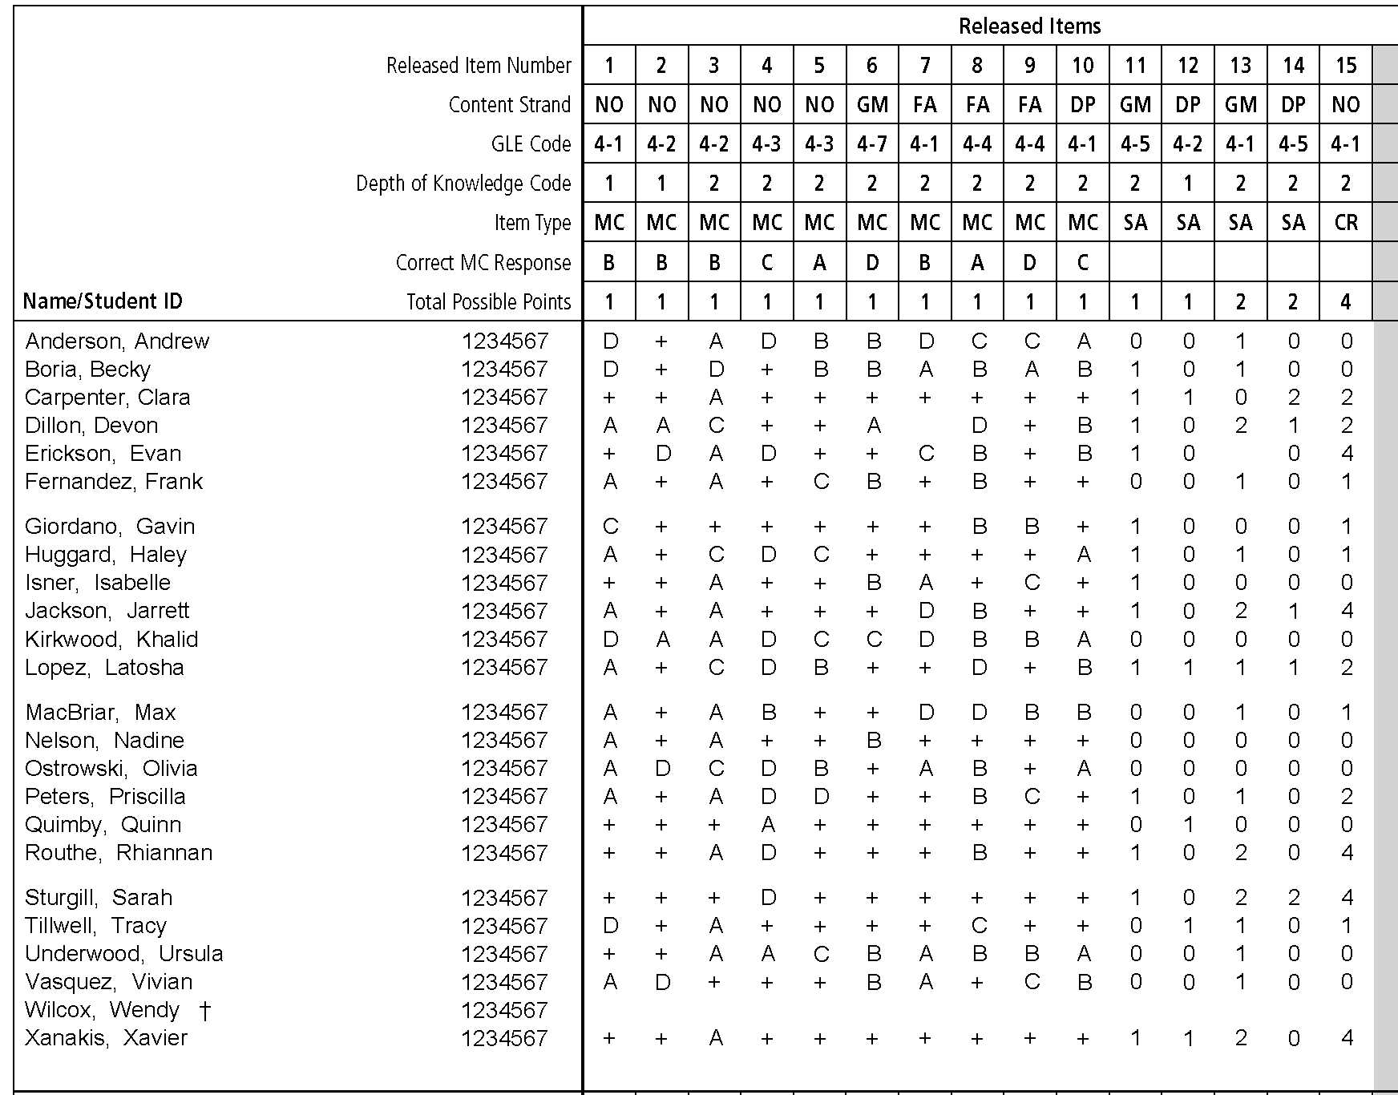
Looking at the Item Analysis Report
1D: How did we do compared to what we would have predicted knowing our school’s students?

Slide 55
Small Group Activity
Select at least one of the three essential questions
Select your target audience
Begin to answer the question by examining your data
Note key findings or conclusions
Begin to discuss strategies for improvement
Be prepared to share your findings with the large group

Slide 56
Supporting Materials
Guide to Using the 2007 NECAP Reports
Companion PowerPoint presentation
Three Essential Questions handout
Grade Level Expectations
Test Specifications documents
Released Items documents
Preparing Students for NECAP: Tips for Teachers to Share with Students
Technical Report

Slide 57

Conclusion
“Not everything that can be counted counts, and not everything that counts can be counted.”
~ Albert Einstein

