Slide 1

SPoRT ADAS: A Meso-Surface Analysis
Science Sharing Session for NWS May 2008
<number>

Slide 2
Overview
What is the SPoRT ADAS*?
What are its uses?
Accessing product in AWIPS
Comparison with existing analysis
Missing product expectations and actions
*Advanced Regional Prediction System (ARPS) Data Analysis System (CAPS/OU)
<number>

Slide 3
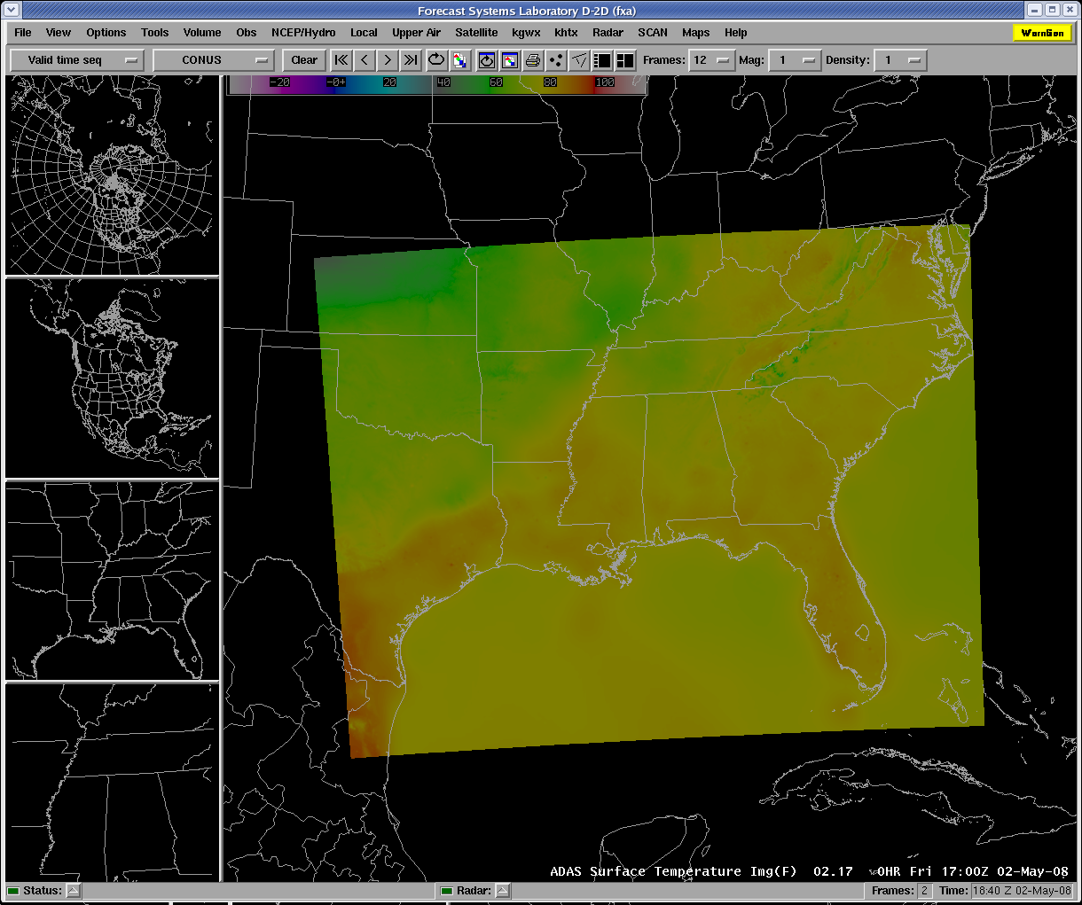
What is the SPoRT ADAS?
Blends surface data into a coherent analysis using ADAS:
Strength in analyzing asynoptic data sets
13-km, 2-h RUC forecast as first-guess
METAR, buoy, Mesonet, SAO
An observation is rejected if it is:
significantly different than neighbors
greatly different than first-guess
blacklisted (user-defined)
2-km resolution captures mesoscale features
Assimilates observations from ±15 minutes from the top of every hour
Available in AWIPS at 40-45 minutes past every hour
<number>

Slide 4
SPoRT ADAS Uses
Provides an additional high-resolution surface analysis for:
real-time meso-analysis
initializing grids within gridded forecasts
verification of gridded forecasts
Similar to:
LAPS*: quality control issues at times
MSAS†: smooth appearance
RTMA‡: quality control issues and smooth appearance
SPoRT ADAS has been most useful in forecasting nighttime temperatures in the elevated regions of NE AL
*Local Analysis and Prediction System (NOAA/GSD)
†Mesoscale Analysis and Prediction System (MAPS) Surface Assimilation System (NOAA/ESRL)
‡Real-Time Mesoscale Analysis (NCEP)
<number>

Slide 5
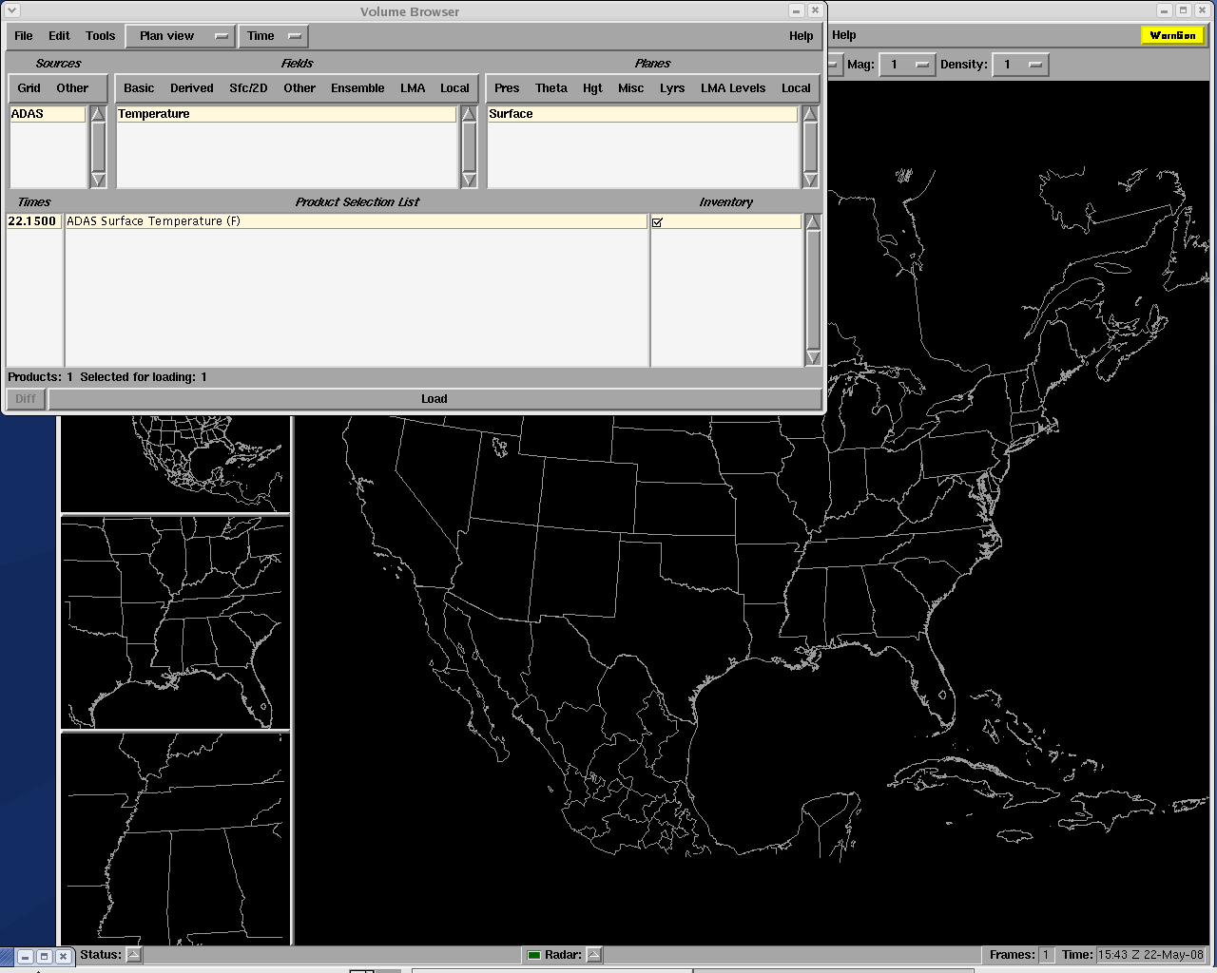
Accessing the SPoRT ADAS in AWIPS
Located under the “Volume” tab on the menu
Click on “Browser”
Product appears as “ADAS”
Variables available:
2-m temperature
2-m relative humidity
10-m winds
other variables derived from T and RH
<number>

Slide 6
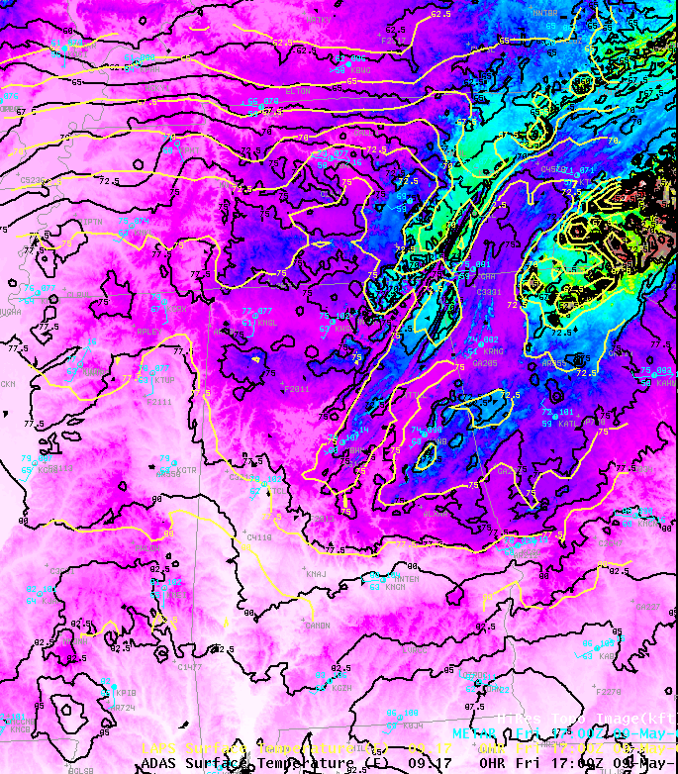
Surface Temperature Comparison
May 9, 2008 1700 UTC
Neither analysis shows obvious bulls eyes due to quality control issues
One case—may have been no questionable observations
Better resolution of SPoRT ADAS allows it to pick up sharper gradients
Especially evident in the higher terrain of eastern Alabama and western Georgia
LAPS
SPoRT ADAS
<number>

Slide 7
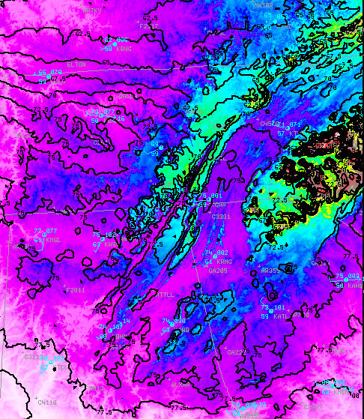
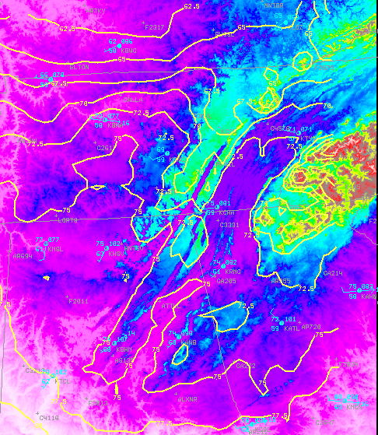
Surface Temperature in High Terrain
SPoRT ADAS depicts tight gradients associated with terrain features much better than LAPS
<number>

Slide 8
Errors and Error Reporting
If the file has not arrived by 50 past the hour, there has either been an error in the analysis process or in the transfer of the data from NASA to NWS
Analyses may occasionally be missing due to unavailable RUC files, missing observation files, or corrupted observation files
Outages due to errors in the analysis process may last for several consecutive hours
Contact SPoRT Liaisons Geoffrey Stano and/or Kevin Fuell if a data outage occurs for more than a half day
<number>

Slide 9
Summary
SPoRT ADAS uses good quality control and 2-km resolution to pick up fine-scale features not seen in other surface analyses available in AWIPS
SPoRT ADAS has proven most useful for nighttime temperature over elevated terrain in eastern edge of HUN forecast region
Let’s work together to analyze this product: feedback on where/when SPoRT ADAS provides better analysis than other available analyses
Science Point of Contact: Brad Zavodsky (Brad.Zavodsky@nasa.gov), 961-7914
<number>

Slide 10
For more information on the ARPS Data Analysis System (ADAS)
For more information on the MAPS Surface Assimilation System (MSAS)
For more information on the Real-Time Mesoscale Analysis (RTMA)
<number>

