Slide 1

Small Works Contracting
Mission
GA helps its customers succeed
Vision
Customers seek and value our services and expertise
Others recognize our innovation and efficiency.
People want to work here.
John Lynch and Roland Orr
State of Washington
Division of Engineering and Architectural Services

Slide 2
Division of Engineering and Architectural Services
Design and Construction Project Management
Energy Performance Contracting
We serve a number of major state agencies
Community Colleges - 33 campuses
Department of Corrections
Department of Social and Health Services
Department of Veterans Affairs
Washington State Patrol
Department of General Administration
Approximately 20 additional small agencies

Slide 3
Objectives for Today
Demonstrate examples showing when to follow a public works procurement process vs. a purchasing process
Outline the general differences in the public works process depending on the size and nature of the project
Discuss the “Limited Public Works” process used by the Department of General Administration for small public works projects

Slide 4
Characteristics of Public Works
Work is performed on public property
Work is more than “ordinary maintenance”
Work tends to require a building permit
Cost of labor is a significant portion of the total cost of the work
The level of the project cost and the source of project funding are not factors that determine public works

Slide 5
State Statute References
RCW 39.04 Public Works
RCW 39.06 Licensed Contractors Required
RCW 39.10 Alternative Public Works
RCW 39.12 Prevailing Wages
RCW 39.80 Architect/Engineering Contracts
RCW 43.19 General Administration
RCW 60.28 Liens for labor, taxes, etc.
RCW 39.34 Inter-local Cooperation Act
RCW 28A School Districts
RCW 35 Counties
RCW 36 Cities

Slide 6

Example Project #1

Slide 7
Example Projects
Number 1
Convert an existing classroom into four individual private offices. Build framed walls, provide new lighting & receptacles, modify existing HVAC, modify fire alarm system, and carpet etc.
Which procurement process should be used?
◻ Public Works process
◻ Purchasing process

Slide 8
Example Projects
Number 1
Convert an existing classroom into four individual private offices. Build framed walls, provide new lighting & receptacles, modify existing HVAC, modify fire alarm system, and carpet etc.
Which procurement process should be used?
☑ Public Works process
◻ Purchasing process

Slide 9
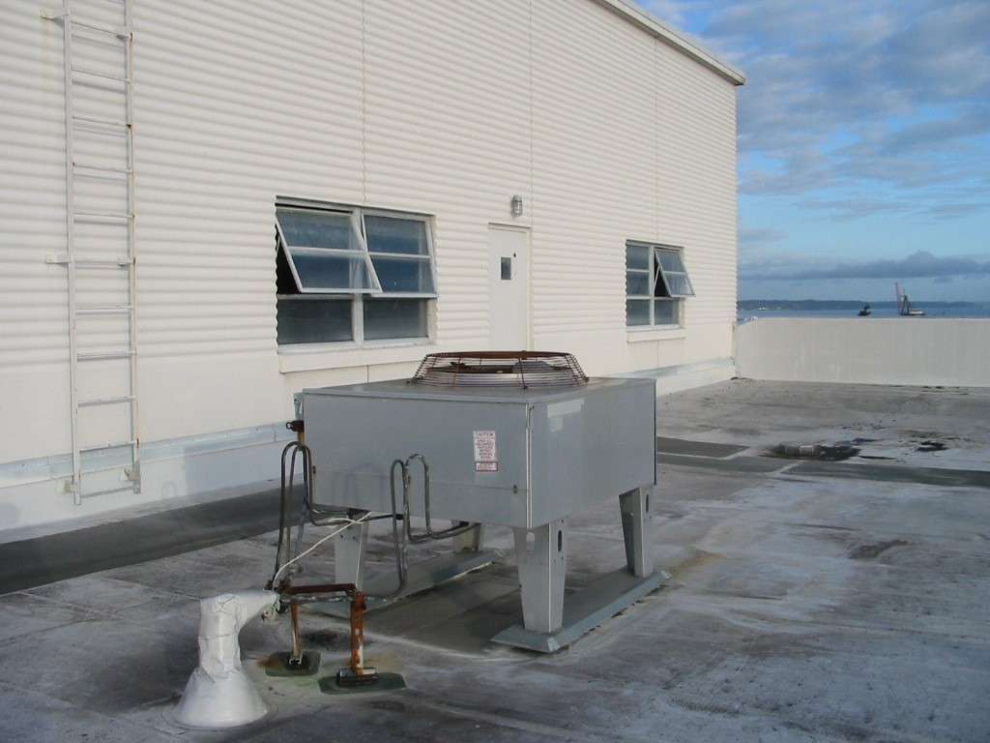
Example Project #2

Slide 10
Example Projects
Number 2
Replace an existing rooftop HVAC unit. The existing electrical wiring can be re-used and the existing ductwork should match with only minor modifications.
Which procurement process should be used?
◻ Public Works process
◻ Purchasing process

Slide 11
Example Projects
Number 2
Replace an existing rooftop HVAC unit. The existing electrical wiring can be re-used and the existing ductwork should match with only minor modifications.
Which procurement process should be used?
◻ Public Works process
☑ Purchasing process

Slide 12
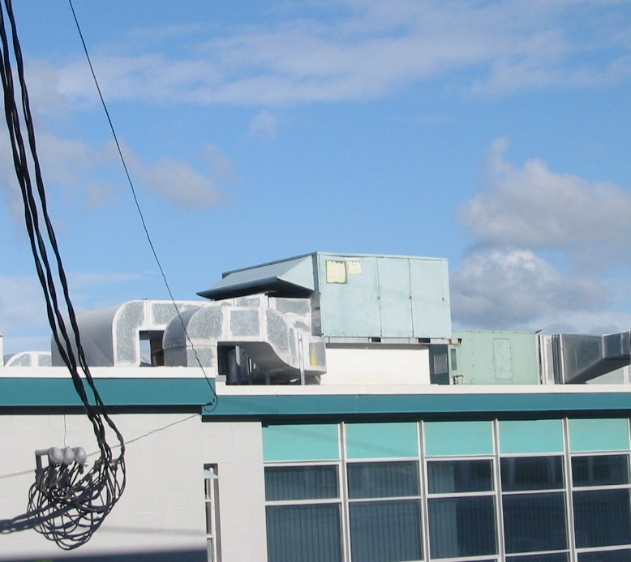
Example Project #3

Slide 13
Example Projects
Number 3
Replace an large existing rooftop HVAC unit. New electrical wiring may be needed and the existing ductwork will need modifications. The new unit may be heavier.
Which procurement process should be used?
◻ Public Works process
◻ Purchasing process

Slide 14
Example Projects
Number 3
Replace an large existing rooftop HVAC unit. New electrical wiring may be needed and the existing ductwork will need modifications. The new unit may be heavier.
Which procurement process should be used?
☑ Public Works process
◻ Purchasing process

Slide 15
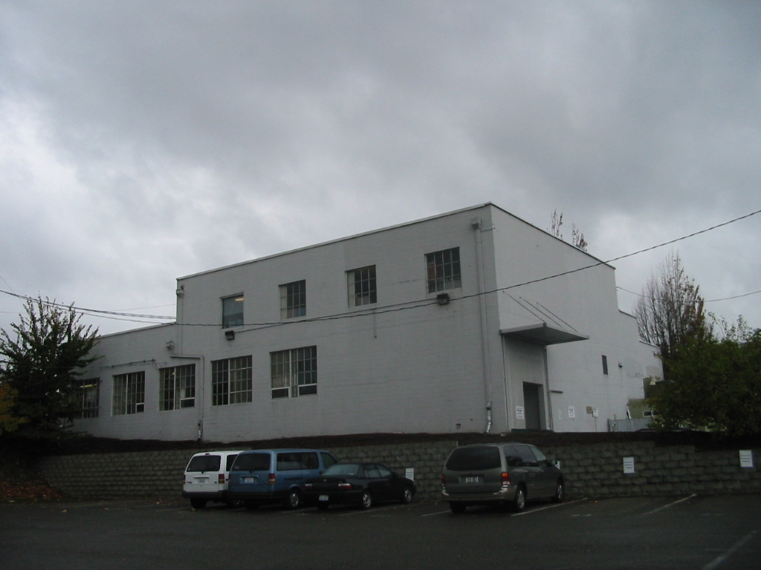
Example #4

Slide 16
Example Projects
Number 4
Repaint a two story building.
Which procurement process should be used?
◻ Public Works process
◻ Purchasing process

Slide 17
Example Projects
Number 4
Repaint a two story building.
Which procurement process should be used?
☑ Public Works process
◻ Purchasing process

Slide 18
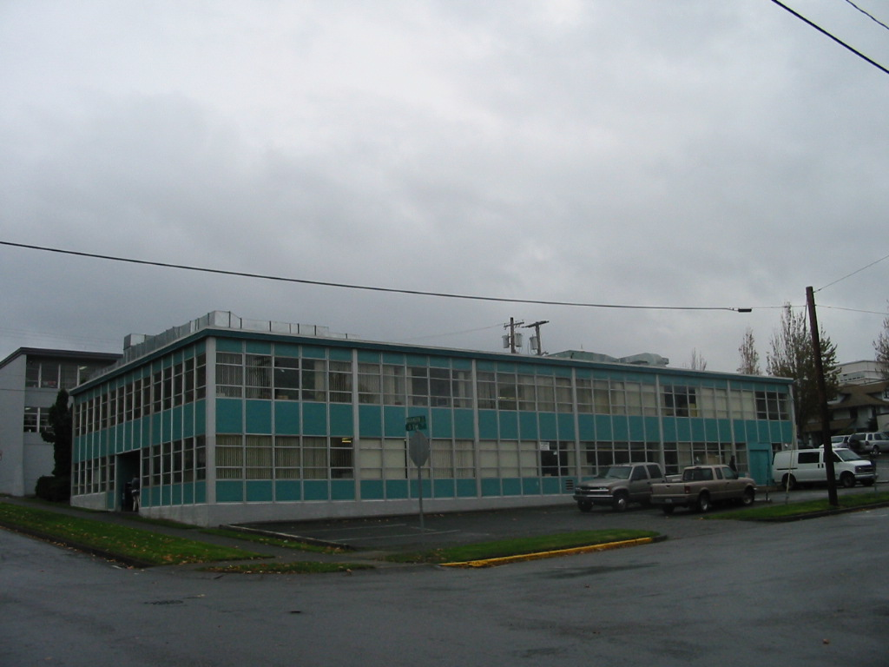
Example #5

Slide 19
Example Projects
Number 5
Provide new carpet in a 20,000 sq. foot office building.
Which procurement process should be used?
◻ Public Works process
◻ Purchasing process

Slide 20
Example Projects
Number 5
Provide new carpet in a 20,000 sq. foot office building.
Which procurement process should be used?
◻ Public Works process
☑ Purchasing process

Slide 21
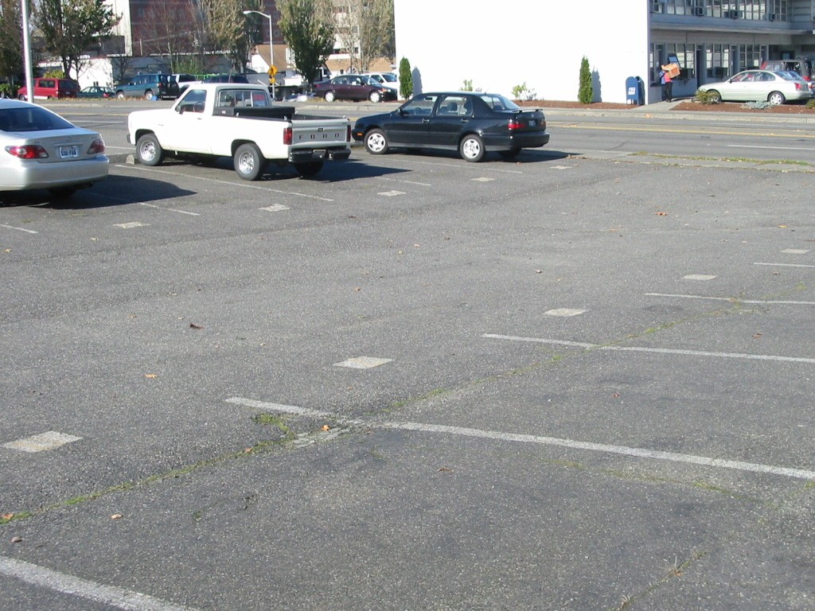
Example Project #6

Slide 22
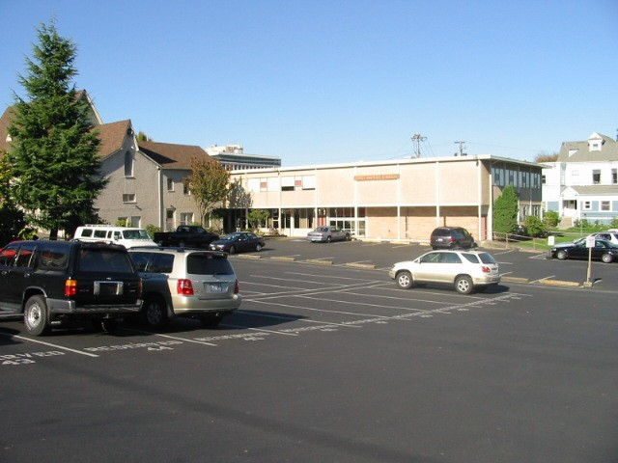
Example Project #6

Slide 23
Example Projects
Number 6
Provide a thin sealer coat and new paint striping for an asphalt parking lot.
Which procurement process should be used?
◻ Public Works process
◻ Purchasing process

Slide 24
Example Projects
Number 6
Provide a thin sealer coat for an asphalt parking lot.
Which procurement process should be used?
◻ Public Works process
☑ Purchasing process

Slide 25
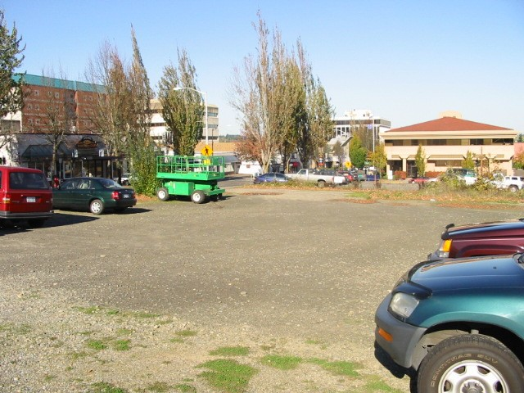
Example Project #7

Slide 26
Example Projects
Number 7
Provide new asphalt paving for a parking lot.
Which procurement process should be used?
◻ Public Works process
◻ Purchasing process

Slide 27
Example Projects
Number 7
Provide new asphalt paving for a parking lot.
Which procurement process should be used?
☑ Public Works process
◻ Purchasing process

Slide 28
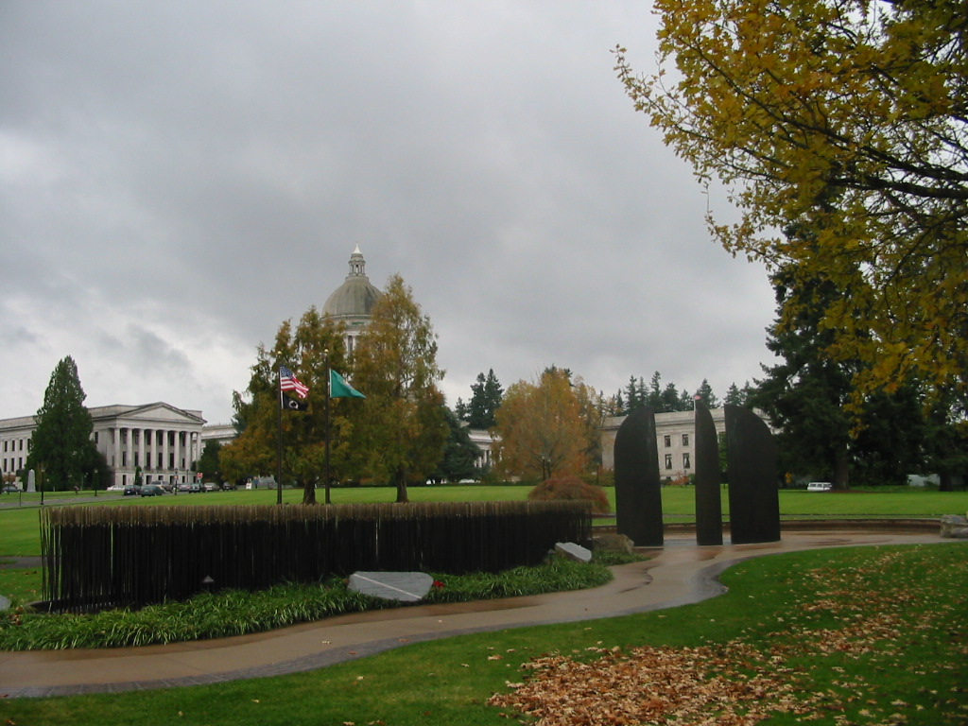
Example #8

Slide 29
Example Projects
Number 8
A civic organization has offered build a commemorative memorial with landscaping at a state facility campus.
Which procurement process should be used?
◻ Public Works process
◻ Purchasing process
◻ Neither

Slide 30
Example Projects
Number 8
A civic organization has offered build a commemorative memorial with landscaping at a state facility campus.
Which procurement process should be used?
☑ Public Works process
◻ Purchasing process
◻ Neither

Slide 31
Example Projects
RCW 39.04.010 Definitions
The term public work shall include all work, construction, alteration, repair, or improvement other than ordinary maintenance, executed at the cost of the state or of any municipality, …...

Slide 32
The Ideal World
Purchasing Process | Public Works Process

Slide 33
The Real World
Purchasing Process | Gray Area | Public Works Process

Slide 34
Purchasing Process
State agencies typically have delegated purchasing authority up to $10,000
Higher Ed has independent authority
Refer to the Washington Purchasing Manual:
http://www.ga.wa.gov/PCA/Manual.htm

Slide 35
Public Works Process
Limited Public Works
Small Works Roster
Job Order Contracts
Advertised Projects
Other Alternative Processes for >$10 M
General Contractor/ Construction Manger
Design - Build

Slide 36
Small Works Roster
RCW 39.04.155
Small Works Roster - - Procedure for securing quotations:
Construction, repair, or alteration projects estimated to cost less than two hundred thousand dollars are exempt from the requirement that the contracts be awarded after advertisement and competitive bid as defined by RCW 39.04.010.

Slide 37
Limited Public Works
A Manual describing the Limited Public Works Process is available on line:
http://www.ga.wa.gov/eas/doc-form.htm
Forms referenced in the manual are available at the same site.

Slide 38
Limited Public Works
Limited Public Works is a process used for projects less than $35,000. RCW 39.04.155 allows us to solicit contractors through the Small Works Roster without a public advertisement since the cost is less than $35,000.

Slide 39
Limited Public Works
Architect/Engineer Contract Services
A/E is selected based on qualifications per RCW 39.80
E&AS maintains on-call A/E contracts that are available for state agencies to use
Some LPW projects will not require an A/E contract for the design

Slide 40
Limited Public Works
Assemble Bid Package Including:
Cover Sheet w/project number, title and location
Table of Contents
Request for Bids
General Conditions (May be referenced in the specification if available for Contractor review)
Bid Proposal Form
Technical Specification w/ Detailed Project Scope of Work
Applicable Drawings

Slide 41
Limited Public Works
Compile a list of capable, licensed, contractors utilizing the Small Works Roster
Notify contractors located within your region with the applicable specialty
Consider MBE and WBE contractors
Send Bid Packages to interested contractors with notice of pre-bid meeting time and date
Hold a Pre-Bid meeting

Slide 42
Limited Public Works
Compile contractors Q&A into an addendum to the contract documents
Distribute the addendum to all contractors who received a bid package
Receive and open bids
Record date, time, and initials on bid envelopes
Open bids with at least two staff
Record bids on bid summary sheet

Slide 43
Limited Public Works
Notify all bidders of the bid results
Prepare LPW Contract
Check Contractor is licensed (call L & I Contractor Registration (360) 902-5202)
Contract w/Bond Waiver/Bond Form/Insurance Certificate and/or Retainage Bond Form
Letter of Transmittal
Retainage Investment Form
Transmittal to Insurance Agent attach Certificate of Ins. Form, Insurance Req., and Bond Form

Slide 44
Limited Public Works
Send contract to contractor
Receive contract back from contractor
Verify that contract requirements have been met
No changes to document have been made by contractor
Contract is signed
Insurance coverage is on State Certificate
Insurance certificate shows required coverage

Slide 45
Limited Public Works
Verify contract req. (cont.)
Insurance Effective Dates cover contract period
Insurance Company is recognized by the Office of the Insurance Commissioner (phone (360) 753-7307)
Payment & Performance Bond Waiver is signed/or Payment & Performance Bond is provided/ and Retainage Bond Form if desired

Slide 46
Limited Public Works
Contracting Officer signs contract
Issue the Notice to Proceed
Send contractor NTP transmittal
Send invoice voucher forms
Send L&I the Notice of Award
If a Change Order is needed, follow the contract requirements

Slide 47
Limited Public Works
Process Contractors invoice
A copy of the L&I Intent to Pay Prevailing Wages form to be received with first invoice
Verify/approve the percent complete on the contractors schedule of values
Approve the invoice and arrange for payment

Slide 48
Limited Public Works
Conduct final walk-thru of project
Create punch list if necessary
Verify that punch list items are corrected
Establish the contract acceptance date
Issue acceptance letter
Send Notice of Completion Form
For contracts less than $20,000, send directly to Employment Security
For contracts over $20,000, send to Dept. of Revenue

Slide 49
Limited Public Works
Final Payment
Lien period has expired (45 days from the Acceptance Date)
Receive Affidavit of Wages Paid from Contractor
Receive release from L & I
Receive release from Employment Security
Receive release from Dept. of Revenue for contracts over $20,000
Release the contract retainage

Slide 50
Limited Public Works
QUESTIONS ?

Slide 51
Limited Public Works
Important Telephone Numbers
E&AS Contracts Section (360) 902-7272
L&I Contractor Registration (360) 902-5202
L&I Contracts Release (360) 902-4764
Employment Security (360) 902-9626
Dept. of Revenue (360) 753-3830

Slide 52
Division of Engineering and Architectural Services
Please contact us if you have additional questions or want copies of our standard documents
jlynch@ga.wa.gov
rorr@ga.wa.gov

