Slide 1


FOODBORNE ILLNESS
A microbiology review
Notes:
This module provides a basic review of simple microbiology as it relates to the prevention of foodborne illness.

Slide 2

FOODBORNE ILLNESS
Challenges to control
Poor consumer handling of food
Emerging pathogens have increased resistance
Food supply is global
More food is eaten outside of home
New modes of transmission
Notes:
Some challenges to controlling FBI

Slide 3
FOODBORNE ILLNESS
Types of Contamination
Physical
Metal shavings, broken glass, wood splinters, bandages
Chemical
Cleansers, metal leaching (copper, lead, cadmium), pesticides
Biological
Bacteria, fungi, viruses, parasites

Slide 4
FOODBORNE ILLNESS
Food infection
Bacteria are consumed
Body reacts by raising temperature- fever
Longer incubation
Food intoxication
Toxin contaminated food is eaten
Shorter incubation
Notes:
Other consideration in food borne illness:
INFECTION-MEDIATED INTOXICATION- bacteria are consumed and produce toxins during colonization.
FOOD POISONING- bacteria have contaminated food to a very high level rapidly (Staph aureus)
PLANT TOXINS- natural plant toxins (i.e. wild mushrooms, or consumed accidentally).
BIOACCUMULATION- {i.e. consumption of mussels/clams from waters in Red Tide} (PSP)

Slide 5
FOODBORNE ILLNESS
Limiting factors of microbial growth
Time
Temperature
Moisture (A_{w}>0.85)
pH
Nutrients
Competition

Slide 6
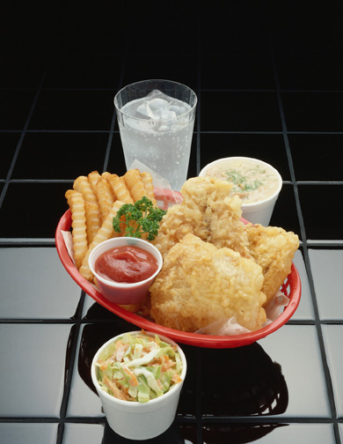
FOODBORNE ILLNESS
PATHWAYS OF CONTAMINATION
FOOD HANDLERS
FOOD CONTACT
SURFACES
WATER
VERMIN
PACKAGING
SOIL
INGREDIENTS
AIR

Slide 7
FOODBORNE ILLNESS
Centers for Disease Control
Top 4 emerging pathogens
E.coli 0157:H7
Salmonella enteriditis
Listeria monocytogenes
Campylobacter jejuni

Slide 8
FOODBORNE ILLNESS
CDC estimates:
6.5-33 million FBI cases each year
Highly under-reported
E.coli causes about 21,000 cases each year
Salmonella causes 2-4 million illnesses/yr.
Campylobacter cause 1-6 million cases/yr.

Slide 9
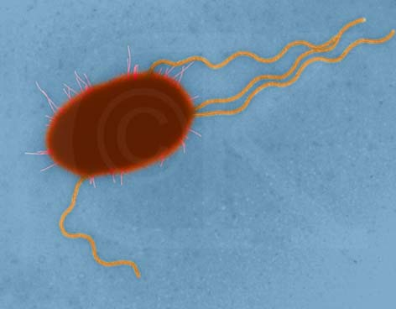
BACTERIA
Escherichia coli
Infection
Incubation: 3-4 days
Symptoms: diarrhea, vomiting, mild fever
Foods: undercooked ground beef, unpasteurized cider
Source: Human and bovine
intestinal tract

Slide 10
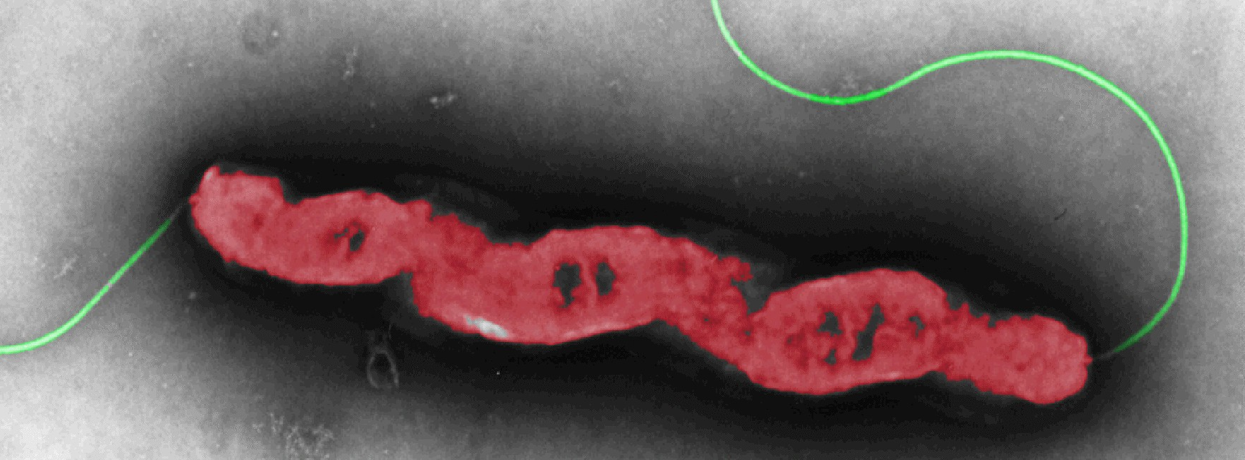
BACTERIA
Campylobacter jejuni
Infection
Incubation: 2-5 days
Symptoms: diarrhea, vomiting, headache, fever, muscle pain
Foods: poultry, dairy products, water
Sources: intestinal tracts of wild/ domestic animals

Slide 11
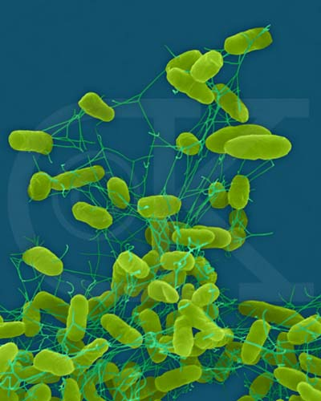
BACTERIA
Salmonella enteriditis
Infection
Incubation: 12- 36 hours
Symptoms: abdominal cramps, headache, fever, nausea, diarrhea
Foods: poultry, meat, eggs and egg products, sliced melons
Sources: water, soil, insects, animals, and humans
Notes:
1. Particularly dangerous in pooled eggs. Often spread through cross- contamination.

Slide 12
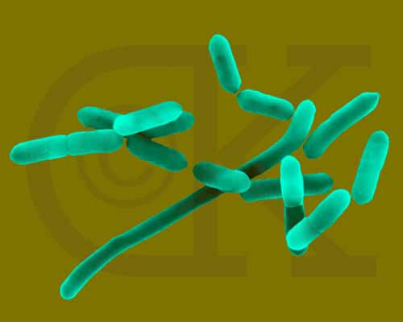
BACTERIA
Listeria monocytogenes
Infection
Incubation: 3 to 70 days
Symptoms: flu-like, meningitis, encephalitis, spontaneous abortion
Fetuses, infants, and pregnant women
Foods: unpasteurized milk, ice cream, ready-to-eat, lunchmeats
Sources: soil, water, damp environments, domestic/ wild animals (esp. fowl)
Notes:
Lysteria is found in refrigerators and walk –in condensate plumbing.
Recent outbreak in a deli over turkey meat.

Slide 13
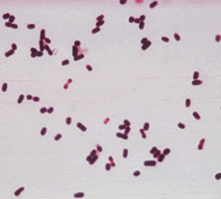
BACTERIA
Clostridium perfringens
Infection
Forms spores in adverse conditions
Incubation: 10- 12 hours
Symptoms: abdominal pain, nausea, diarrhea
Fever, headache, vomiting usually absent
Foods: Stews, gravies, beans
Sources: soil, animal and human intestinal tracts

Slide 14
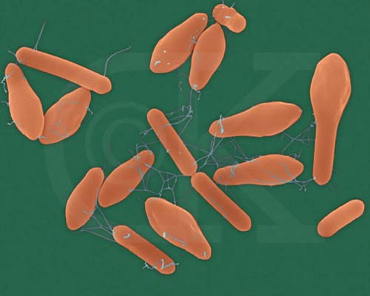
BACTERIA
Clostridium botulinum
Intoxication
Incubation: 4 hours to 8 days
Symptoms: vomiting; constipation; difficulty with vision, swallowing, speaking; paralysis, death
Foods: baked potatoes, sous vide, garlic/ oil mixtures, low-acid canned foods
Sources: present on almost all foods, soil, water

Slide 15
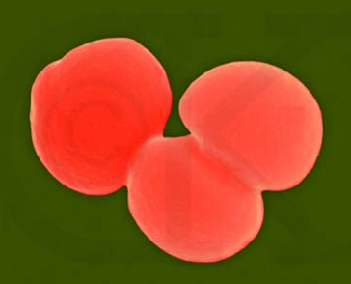
BACTERIA
Staphylococcus aureus
Intoxication
Incubation: 1 to 7 hours
Symptoms: nausea, retching, abdominal cramps, diarrhea
Foods: ready-to-eat, reheated foods, dairy products, protein foods
Source: skin, hair, nose, throat, infected sores, animals
Notes:
1. Very commonly food workers are the source.

Slide 16
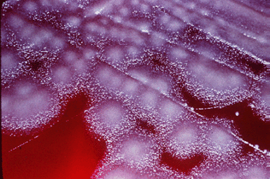
BACTERIA
Bacillus cereus
Intoxication
Incubation: 30 min. to 6 hours (emetic) and 6 to 15 hours (diarrheal)
Symptoms: nausea, vomiting, watery diarrhea
Foods: rice products, starchy foods, casseroles, puddings, soups
Source: soil and dust, cereal crops

Slide 17
VIRUSES
Basic characteristics
Need living cell to propagate
Do not reproduce in food
Do not need PHF
Smallest microbial contaminant
Spread usually result of poor hygiene

Slide 18
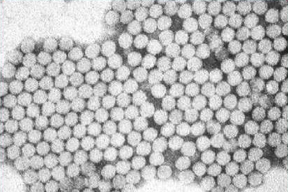
VIRUSES
Hepatitis A
Infection
Incubation: 10-50 days
Symptoms: sudden fever, vomiting, jaundice
Foods: water (ice), shellfish, ready-to-eat, fruit juices, vegetables
Source: human intestinal/ urinary tracts

Slide 19
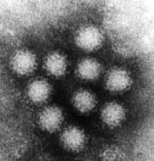
VIRUSES
Norwalk virus
Infection
Incubation: 10-50 hours
Symptoms: nausea, diarrhea, headache, mild fever
Foods: water, shellfish, raw vegetables and fruits
Source: human intestinal tract, water

Slide 20
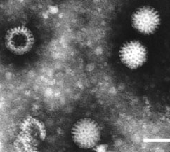
VIRUSES
Rotavirus
Infection
Incubation: 1-3 days
Symptoms: vomiting, diarrhea, mild fever
Foods: ready-to-eat, water and ice
Sources: human intestinal tract, water

Slide 21

FUNGI
Molds
Usually spoil foods, sometimes illness
Sweet, acidic, low A_{w} foods
Some produce aflatoxins (peanuts)
Gorgonzola, bleu, Brie, Camembert cheeses, mushrooms
Notes:
1. Fungi and bacteria require different nutrients and environments so therefore do not have to compete.

Slide 22
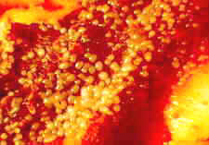
FUNGI
Yeasts
Spoil food
Produce CO₂ and alcohol
Prefer sweet, acidic, A_{w} foods
Jams, jellies, syrup, honey, fruit juice
Yeast colony growing on pizza
Notes:
1. Alcohol produced is source of characteristic smell (example- bread dough).

Slide 23
PARASITES
Basic characteristics
Living organisms
Require a host
Usually killed by freezing (and cooking)
Normal fauna in many animals
Hogs, cats, rodents, fish, etc.
Notes:
Freezing kills by physical destruction of cell walls as ice crystals form.
Host provides nourishment and protection during a particular stage of the life- cycle.

Slide 24
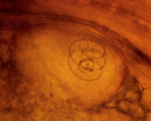
PARASITES
Trichinella spiralis
Roundworm
Incubation: 2-28 days
Symptoms: flu-like, swelling around eyes, extreme sweating, hemorrhaging
Foods: undercooked pork, game
Source: domestic pigs, bear, walrus
Notes:
1. Picture shows a Trichinella Cyst in muscle tissue.

Slide 25
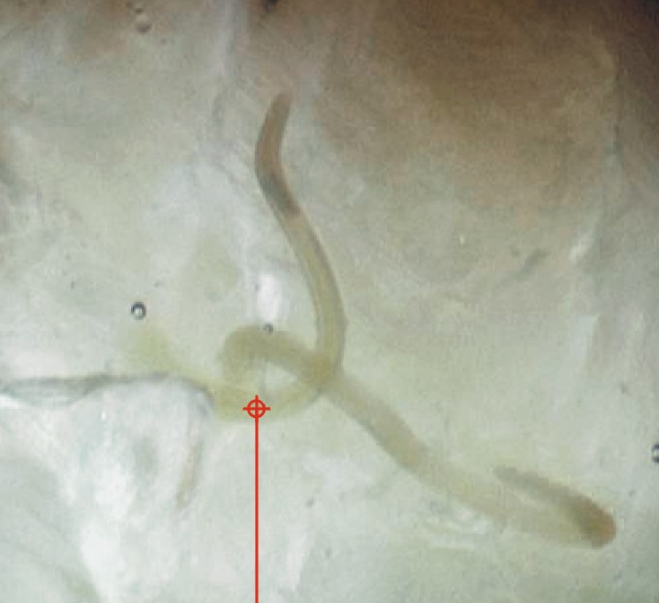
PARASITES
Anisakis simplex
Roundworm
Incubation: hours to 2 weeks
Symptoms: tickle in throat, coughing up worms
Foods: undercooked, improperly frozen seafood
Source: marine fish- bottom feeders
Notes:
Also known as the “Herring worm”. Picture shows nematode in muscle tissue of herring.
Eggs laid by the adult develop in the host’s gut. New adults are expelled.

Slide 26
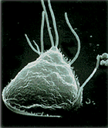
PARASITES
Giardia lamblia
Protozoan
Incubation: 3-25 days
Symptoms: fatigue, nausea, gas, weight loss, abdominal cramps
Foods: water, ice, raw vegetables
Source: beavers, bears, dogs, cats, humans
Notes:
1. Unprotected water sources and under chlorinated pools are conducive to transfer of Giardia.

Slide 27
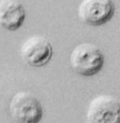
PARASITES
Cryptosporidium parvum
Protozoan
Incubation: 1-12 days
Symptoms: severe diarrhea, may have no symptoms
Foods: water, raw foods, unpasteurized cider, ready-to-eat
Source: humans, cattle, barn-wash
Notes:
1. Isolated in outbreak concerning apple cider.

Slide 28
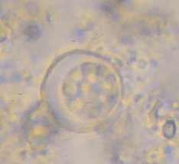
PARASITES
Cyclospora cayetanensis
Protozoan
Incubation: days to weeks
Symptoms: watery diarrhea, weight loss, bloating, cramps, vomiting, muscle aches
Foods: water, marine fish, raw milk, raw produce
Source: humans, water
Notes:
1. Implicated in outbreaks related to raspberries and strawberries. Concern it may be propagated in agricultural fields, by workers, as a result of poor hygiene.

