Slide 1
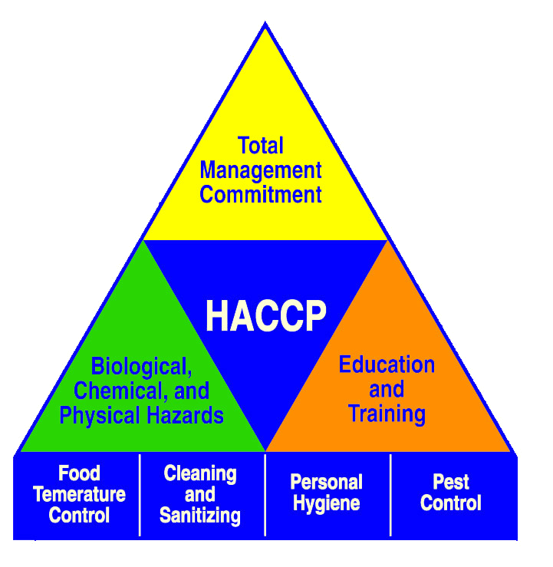
Chapter 6
PRINCIPLE #3
ESTABLISH CRITICAL LIMITS

Slide 2
What’s Your Knowledge? (T or F)
A critical limit is a measurable but simple and clearly written direction to take specific action.
A critical limit need not be established for each identified CCP.
Critical limits most used in child nutrition programs are related to time/ temperature.
Critical limits are based on scientific data, regulations and other information.
Critical limits must be appropriate for the food and equipment in your operation.

Slide 3
Objectives
Be able to:
Define Critical Limits
State the difference between a CCP and a critical limit
State 4 characteristics that make critical limits effective
Identify good sources for critical limits
Write critical limits for the CCPs in your operation

Slide 4
Critical Limits
Typically, minimum and/or maximum times and temperatures that must be met to keep food safe at the CCPs
Boundaries of safety

Slide 5
Effective Critical Limits
Measurable
Based on scientific data, food regulations, and expert advice
Appropriate for the food and equipment in your operation
Clear and easy to follow

Slide 6
Critical Limits Ex: A. Hamburger Patties
Type of Kitchen | Product | CCPs | Critical Limits | Source
Satellite | Hamburger patties, delivered cooked | Receiving | Receive at 140ºF or above | 1999 FDA Food Code
 |  | Holding | Hold food at 140ºF or above | 1999 FDA Food Code

Slide 7
Critical Limits Ex: A. Hamburger Patties
Type of Kitchen | Product | CCPs | Critical Limits | Source
Satellite | Hamburger patties, delivered raw, frozen | Cooking | Cook to an internal product temperature of 155ºF or above for at least 15 seconds | 1999 FDA Food Code
 |  | Holding | Hold food at 140ºF or above | 1999 FDA Food Code

Slide 8
Critical Limits Ex: A. Hamburger Patties
Type of Kitchen | Product | CCPs | Critical Limits | Source
Full-Service Kitchen | Hamburger patties, raw, frozen | Cooking | Cook to an internal product temperature of 155ºF or above for at least 15 seconds | 1999 FDA Food Code
 |  | Holding | Hold food at 140ºF or above | 1999 FDA Food Code

Slide 9
Critical Limits Ex: A. Hamburger Patties
Type of Kitchen | Product | CCPs | Critical Limits | Source
Central Kitchen | Hamburger patties, raw, frozen | Cooking | Cook to an internal product temperature of 155ºF or above for at least 15 seconds | 1999 FDA Food Code
 |  | Holding | Hold food at 140ºF or above | 1999 FDA Food Code
 |  | Transport-ing | Hold food at 140ºF or above during transporting period | 1999 FDA Food Code

Slide 10
Critical Limits Ex: B. Ground Beef Chili
Type of Kitchen | Product | CCPs | Critical Limits | Source
Central Kitchen | Ground Beef Chili, made from scratch | Cooking | Cook to an internal product temperature of 155ºF or above for at least 15 seconds. | 1999 FDA Food Code
 |  | Cooling | Product temperature should be lowered from 140º-70ºF within 2 hours and from 70º-41ºF or below within 4 hours for a total of 6 hours or less. | 1999 FDA Food Code

Slide 11
Critical Limits Ex: B. Ground Beef Chili
Type of Kitchen | Product | CCPs | Critical Limits | Source
Satellite | Ground Beef Chili | Reheat-ing | Reheat, within 2 hours, to an internal product temperature of 165ºF or above for at least 15 seconds | 1999 FDA Food Code
 |  | Holding | Hold food at 140ºF or above after reheating | 1999 FDA Food Code

Slide 12
Critical Limits Form
Date: 7/31/00 |  | Person Deciding on CL: Maria Hernandez
Product: Ground Beef Chili
CCP | Critical Limits |  | Source
Reheating | Reheat, within 2 hours, to an internal product temperature of 165ºF or above for at least 15 seconds |  | 1999 FDA Food Code
Holding | Hold food at 140ºF or above after reheating |  | 1999 FDA Food Code

Slide 13
Activity
Discussion Questions
Review Questions
Case Study (FSD) (See next slide)
Activity: Establishing Critical Limits (FSD) Tuna Salad Sandwich
Activity: Establishing Critical Limits (FSD) Beef Taco Filling
Homework: Establishing Critical Limits (FSD)

Slide 14
Case Study (FSD)
Monroe Middle School has a satellite kitchen with cooking facilities. It receives tuna casseroles cold from a central kitchen. The cook follows the instructions in the recipe: “Cook 45 minutes at 350ºF.” When the cook receives the casseroles, she puts them in a preheated oven. What is wrong with this? What are your suggestions?

