Slide 1
Madden-Julian Oscillation: Recent Evolution, Current Status and Predictions
Update prepared by
Climate Prediction Center / NCEP
March 30, 2009
Notes:
<number>

Slide 2
Outline
Overview
Recent Evolution and Current Conditions
MJO Index Information
MJO Index Forecasts
MJO Composites

Slide 3
Overview
The MJO strengthened during the past week with the enhanced convective phase located in the Western Hemisphere.
The MJO is expected to continue during the next 1-2 weeks with the enhanced convective phase shifting to the Indian Ocean by the end of the period.
The MJO is anticipated to decrease rainfall across much of the Maritime Continent and increase rainfall for the Gulf of Guinea region of Africa during Week 1 and later central Africa and the Indian Ocean in Week 2.
For the US, the southern branch of the jet stream is expected to be very active with a southward shifted storm track across the central and eastern US.
Additional potential impacts across the global tropics are available at: http://www.cpc.ncep.noaa.gov/products/precip/CWlink/ghazards/ghaz.shtml
Notes:
<number>

Slide 4
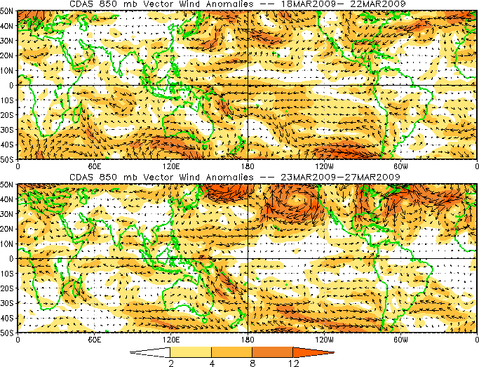
850-hPa Vector Wind Anomalies (m s⁻¹)
Note that shading denotes the magnitude of anomalous wind vectors
Easterly anomalies stretch from Africa to western Indonesia.
Westerly anomalies persist in the far western Pacific Ocean.
Easterly anomalies have decreased during the last five days across the equatorial central Pacific.
Notes:
<number>

Slide 5
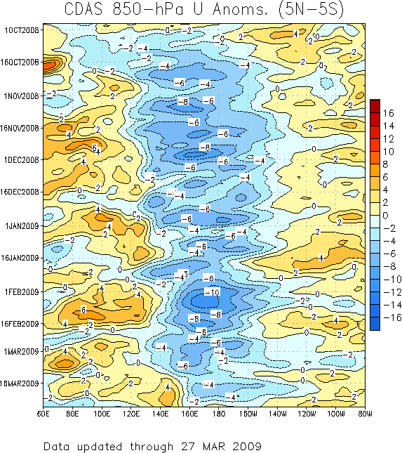
850-hPa Zonal Wind Anomalies (m s⁻¹)
Westerly anomalies (orange/red shading) represent anomalous west-to-east flow
Easterly anomalies (blue shading) represent anomalous east-to-west flow
A persistent pattern of westerly (easterly) anomalies stretching from the Indian Ocean to the central Pacific Ocean has been in place since October with a few breaks in late December and mid-January.
The decrease in westerly anomalies across the Indian ocean in mid-January was associated with MJO activity.
During the second portion of March, westerly anomalies have shifted eastward and winds near the Date Line are close to average.
Time
Longitude
Notes:
<number>

Slide 6
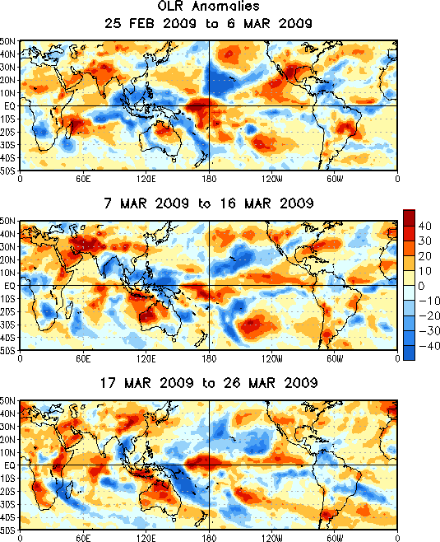
OLR Anomalies: Last 30 days
Drier-than-normal conditions, positive OLR anomalies (yellow/red shading)
Wetter-than-normal conditions, negative OLR anomalies (blue shading)
During late February and early March convection was enhanced across the Maritime Continent while dry conditions are evident for parts of Brazil.
During mid March, convection was enhanced near Papua New Guinea while dry conditions dominated northwest Australia.
Convection shifted eastward during late March to parts of the South Pacific Convergence Zone (SPCZ) while dry conditions continued over Australia and developed over the Indian Ocean.
Notes:
<number>

Slide 7
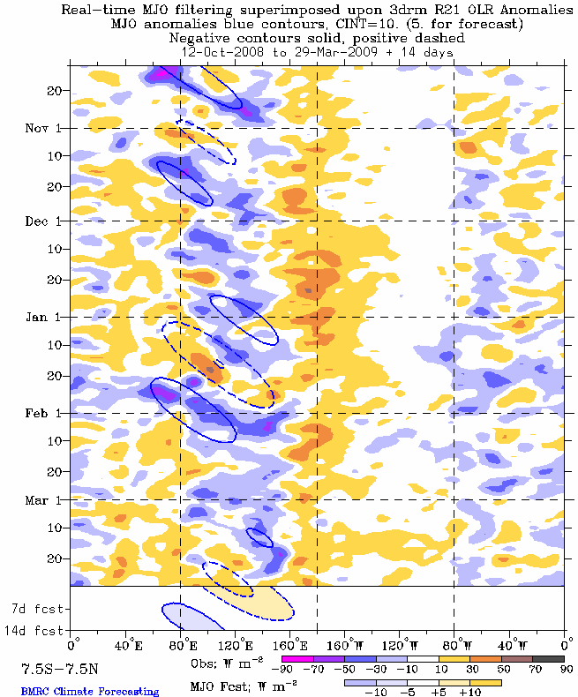
>
Outgoing Longwave Radiation (OLR)
Anomalies (7.5°S-7.5°N)
Drier-than-normal conditions, positive OLR anomalies (yellow/red shading)
Wetter-than-normal conditions, negative OLR anomalies (blue shading)
(Courtesy of the Bureau of Meteorology - Australia)
Moderate MJO activity was evident during October and November as enhanced (suppressed) convection developed across the Indian Ocean and shifted eastward during the period.
During December, anomalous convection was generally stationary and consistent with La Nina conditions.
From mid-January to mid-February, eastward movement of suppressed (enhanced) convection is observed from the Indian Ocean to portions of Indonesia and the western Pacific.
Recently, suppressed convection has developed over the Indian Ocean and Maritime Continent.
Time
Longitude
Notes:
<number>

Slide 8
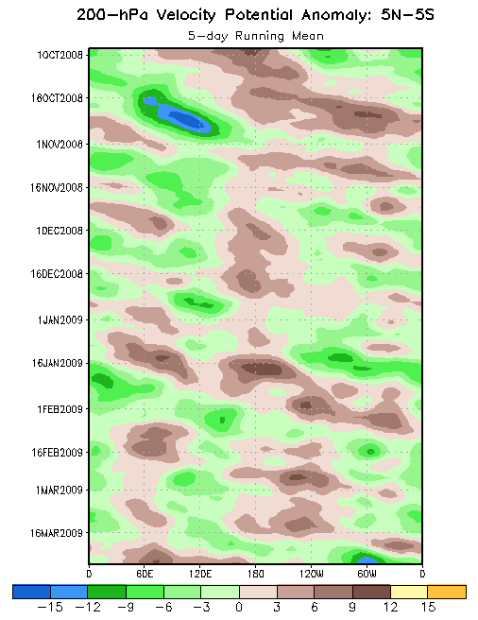
200-hPa Velocity Potential
Anomalies (5°S-5°N)
Positive anomalies (brown shading) indicate unfavorable conditions for precipitation
Negative anomalies (green shading) indicate favorable conditions for precipitation
The MJO strengthened in early September and eastward propagation was observed from September through October.
From mid-November to mid-January, the subseasonal activity organized on a faster time scale and the MJO was weak or incoherent.
Velocity potential anomalies increased as the MJO strengthened and shifted eastward during January to mid-February.
The velocity potential anomalies were weak late February and early March.
In late March, anomalies have increased indicating the MJO has strengthened once again.
Time
Longitude
Notes:
<number>

Slide 9
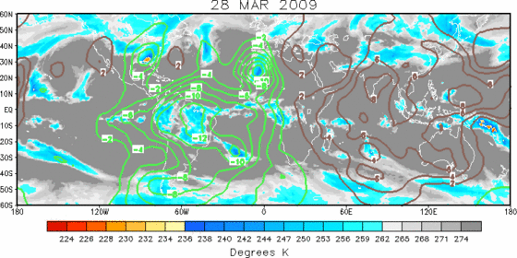
IR Temperatures (K) / 200-hPa Velocity Potential Anomalies
Positive anomalies (brown contours) indicate unfavorable conditions for precipitation
Negative anomalies (green contours) indicate favorable conditions for precipitation
A coherent velocity potential spatial pattern is evident with large-scale anomalous upper-level divergence (convergence) evident over South America/Atlantic Ocean (Indian Ocean/Indonesia).

Slide 10
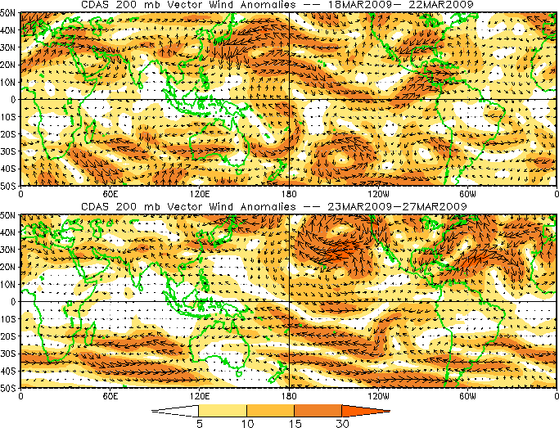
200-hPa Vector Wind Anomalies (m s⁻¹)
Note that shading denotes the magnitude of anomalous wind vectors
Westerly anomalies continued over the equatorial central Pacific Ocean and relaxed over Central and South America during the last five days.
Notes:
<number>

Slide 11
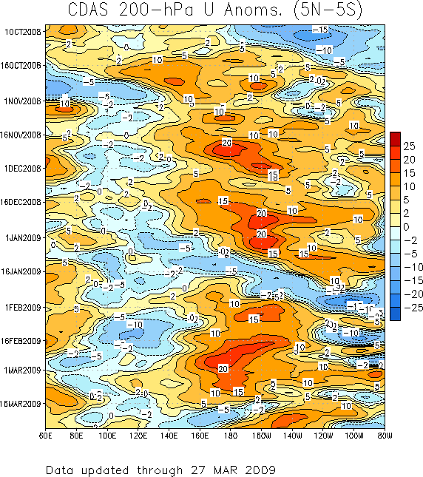
200-hPa Zonal Wind Anomalies (m s⁻¹)
Westerly anomalies (orange/red shading) represent anomalous west-to-east flow
Easterly anomalies (blue shading) represent anomalous east-to-west flow
Westerly and easterly anomalies associated with the MJO activity shifted eastward during October.
Westerly anomalies strengthened markedly in mid-November near the Date Line and persisted through December. These anomalies are consistent with La Nina conditions.
Eastward propagation is evident during January associated with MJO activity.
More recently, easterly anomalies have replaced westerly anomalies just west of the Date Line.
Time
Longitude

Slide 12
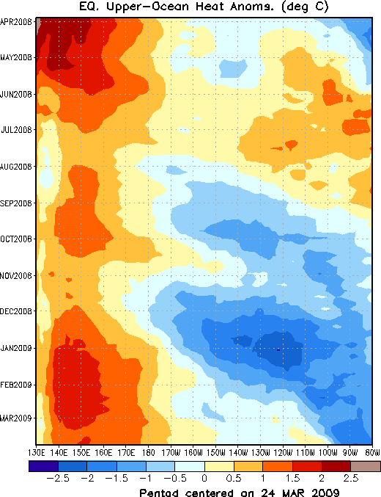
Weekly Heat Content Evolution in the Equatorial Pacific
During June and July 2008, positive heat content anomalies encompassed much of the Pacific basin.
During August 2008, negative anomalies started to develop east of the Date Line and have increased and expanded eastward. There was a pause in this increase during October as a Kelvin wave shifted eastward.
During November 2008 – January 2009, negative anomalies increased across the Pacific but became less negative during February.
Time
Longitude
Notes:
<number>

Slide 13
MJO Index -- Information
The MJO index illustrated on the next several slides is the CPC version of the Wheeler and Hendon index (2004, hereafter WH2004).
Wheeler M. and H. Hendon, 2004: An All-Season Real-Time Multivariate MJO Index: Development of an Index for Monitoring and Prediction, Monthly Weather Review, 132, 1917-1932.
The methodology is nearly identical to that described in WH2004 but small deviations from the BMRC figure are possible at times due to differences in input data and methodology. These typically occur during weak MJO periods.
The index is based on a combined Empirical Orthogonal Function (EOF) analysis using fields of near-equatorially-averaged 850-hPa and 200-hPa zonal wind and outgoing longwave radiation (OLR).

Slide 14
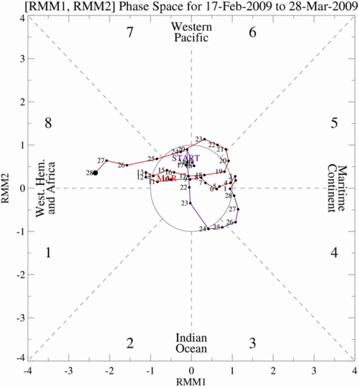
MJO Index -- Recent Evolution
The axes (RMM1 and RMM2) represent daily values of the principal components from the two leading modes
The triangular areas indicate the location of the enhanced phase of the MJO
Counter-clockwise motion is indicative of eastward propagation. Large dot most recent observation.
Distance from the origin is proportional to MJO strength
Line colors distinguish different months
The MJO index shows moderate activity that has shifted from phase 5 to phase 8 during the past week.

Slide 15
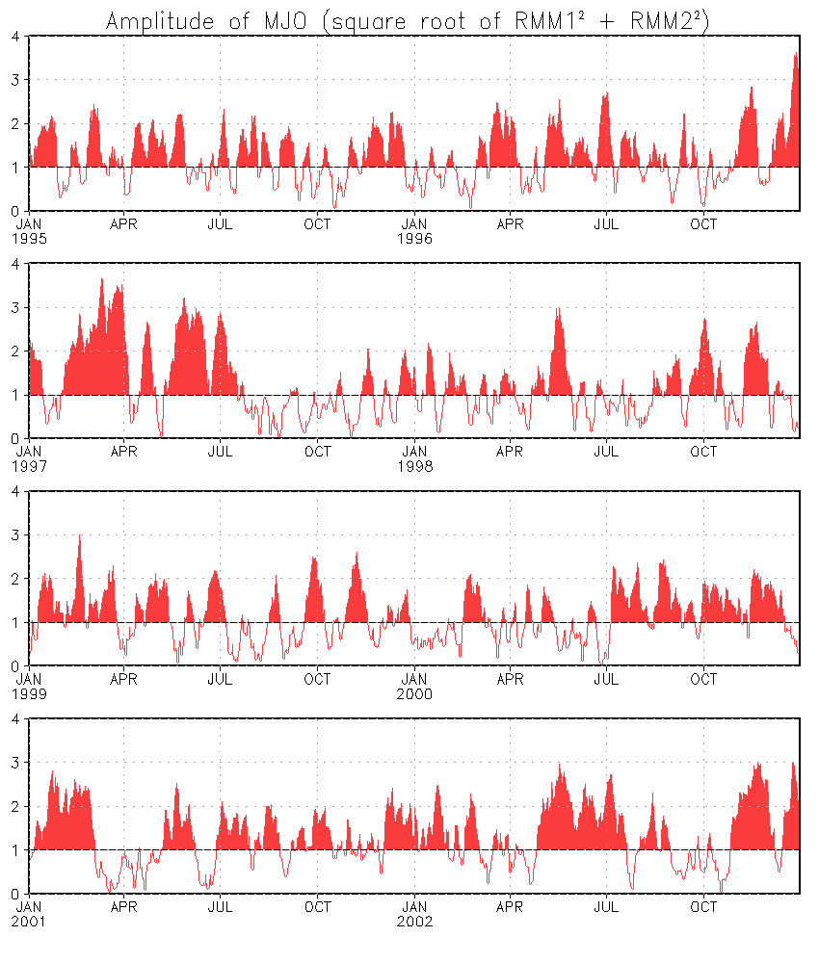
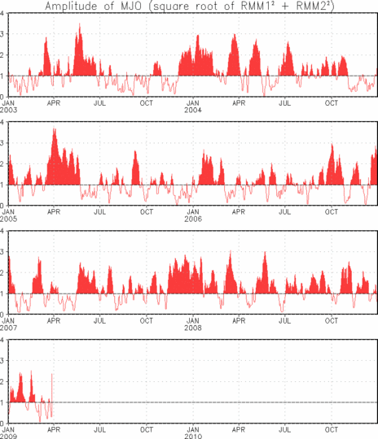
MJO Index – Historical Daily Time Series
Time series of daily MJO index amplitude from 1995 to present. Plots put current MJO activity in historical context.

Slide 16
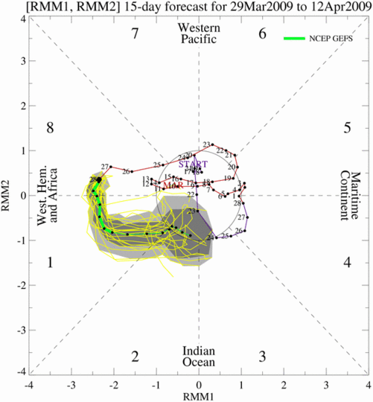
Ensemble GFS (GEFS) MJO Forecast
Yellow Lines – 20 Individual Members Green Line – Ensemble Mean
RMM1 and RMM2 values for the most recent 40 days and forecasts from the ensemble Global Forecast System (GEFS) for the next 15 days
light gray shading: 90% of forecasts dark gray shading: 50% of forecasts
The GEFS forecasts predict the MJO signal to continue at current strength during Week 1 and then weaken as it shifts to the Indian Ocean in Week 2.

Slide 17
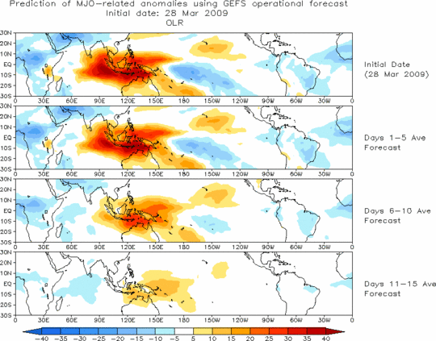
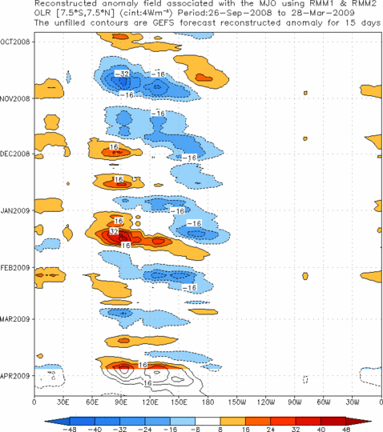
Ensemble Mean GFS MJO Forecast
Figures below show MJO associated OLR anomalies only (reconstructed from RMM1 and RMM2) and do not include contributions from other modes (i.e., ENSO, monsoons)
Spatial map of OLR anomalies for the next 15 days
Time-longitude section of (7.5°S-7.5°N) OLR anomalies for the last 180 days and for the next 15 days
Suppressed convection is expected for the Maritime Continent during much of the period while enhanced convection is forecast for much of the Atlantic and Africa.

Slide 18
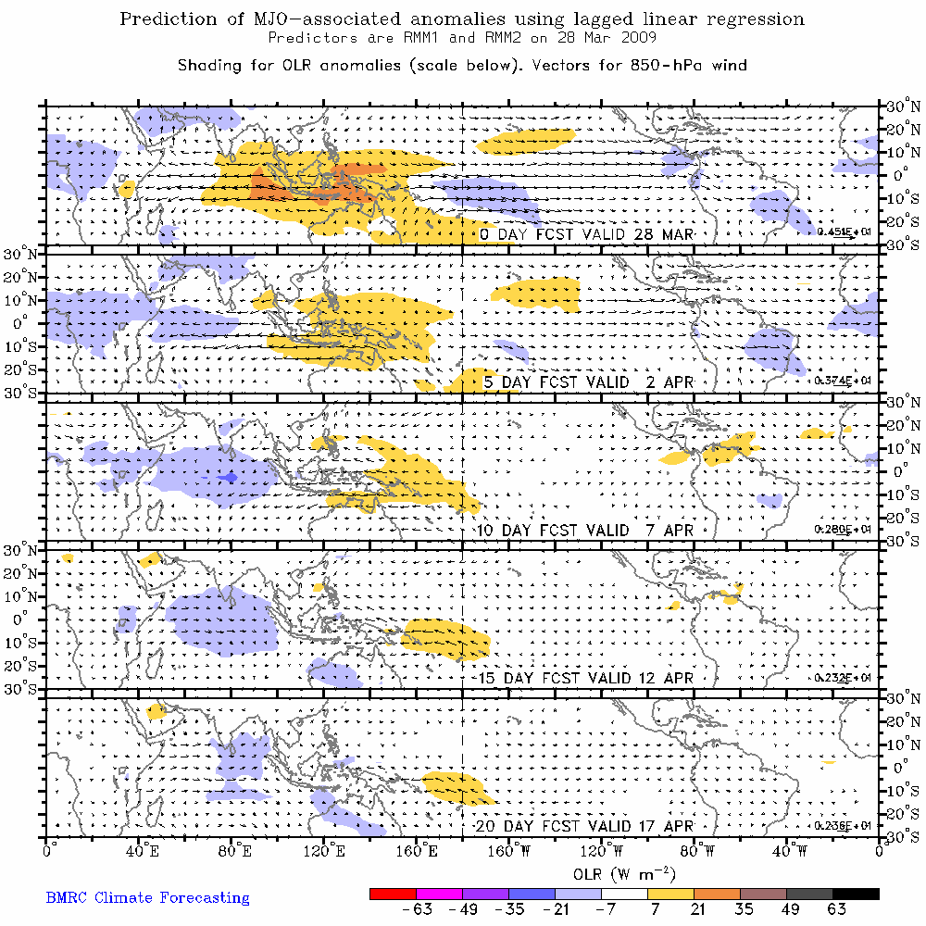
Statistical MJO Forecast
Figure below shows MJO associated OLR anomalies only (reconstructed from RMM1 and RMM2) and do not include contributions from other modes (i.e., ENSO, monsoons)
Spatial map of OLR anomalies and 850-hPa wind vectors for the next 20 days
(Courtesy of the Bureau of Meteorology Research Centre - Australia)
A statistical MJO forecast indicates suppressed convection shifting across the Maritime Continent during the period with enhanced convection entering the Indian Ocean during Week 2.

Slide 19
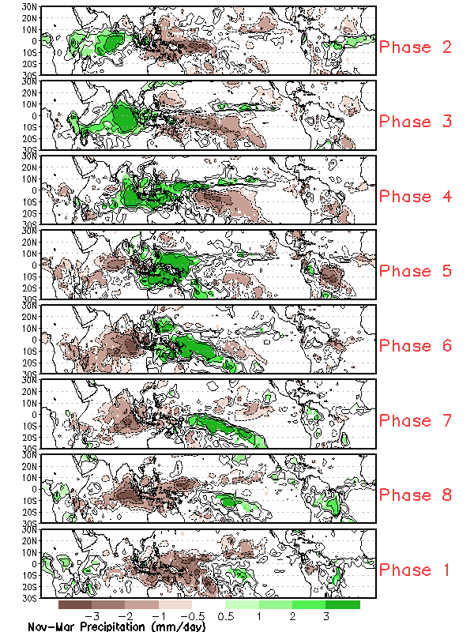
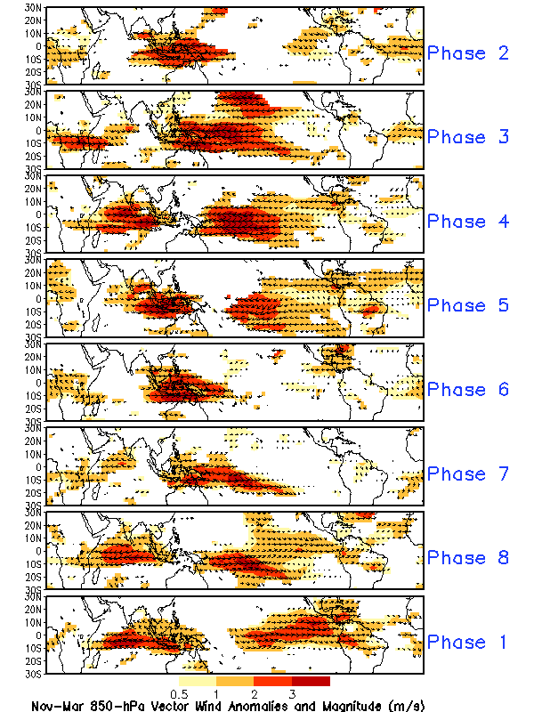
MJO Composites – Global Tropics
Precipitation Anomalies (Nov-Mar)
850-hPa Wind Anomalies (Nov-Mar)

