Slide 1
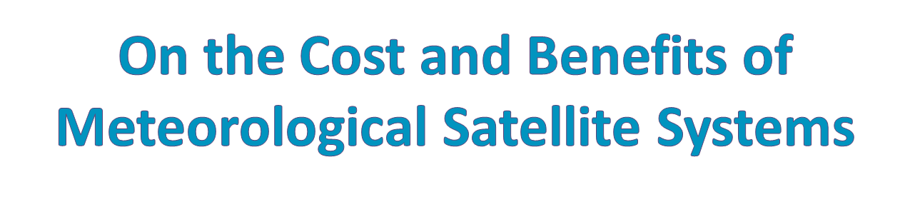
Lars Peter Riishojgaard
WIGOS Project Manager, WMO
Chair, OPAG-IOS
WMO Commission for Basic Systems
10th Symposium on Environmental Satellites
<number>
Notes:
<number>

Slide 2

A quick look at money and weather forecasting
Anecdotally: A tale of two hurricanes
Macroscopically: weather, weather forecasting and the US economy
Enabling capabilities for weather prediction
Role of NWP and NWP diagnostics
Impact of satellite data
A dollar value on observations?
10th Symposium on Environmental Satellites
<number>
Notes:
<number>

Slide 3

Galveston Hurricane
Landfall in Texas at 5 PM 09/08/1900
> $500M (2008 dollars) in property damage
~10,000 fatalities (out of a population of ~40,000)
No satellite data, no upper air network, no NWP
Estimated Category 4 at landfall
Katrina
Landfall (2nd) in Louisiana at 6 AM 08/29 2005
> $90B in property damage (2008 dollars)
> 1800 fatalities (out of a population of ~1.5M)
Extensive satellite and conventional observations, good forecast
Category 3 at Landfall
10th Symposium on Environmental Satellites
<number>
Notes:
<number>

Slide 4

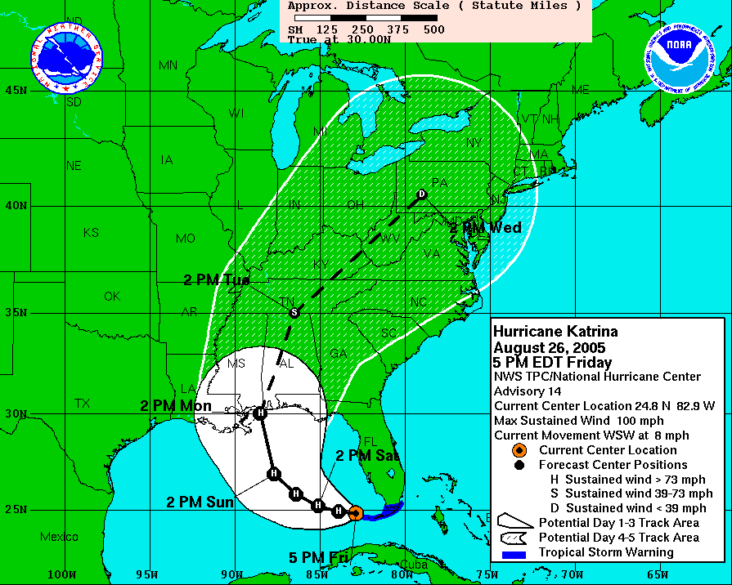
<number>
10th Symposium on Environmental Satellites
Notes:
<number>

Slide 5

Department of Commerce: “20% of overall US economy is weather sensitive”: ~$3 trillion/year
Impact to air and surface transportation, agriculture, construction, energy production and distribution, etc.
Assume that half of this is “forecast sensitive”: $1.5 trillion/year
Assume that the potential savings due to weather forecasting amount to 5% of the “forecast sensitive total”: ~$75B/year
10th Symposium on Environmental Satellites
<number>
Notes:
<number>

Slide 6

Assume that the savings are distributed linearly over the achieved forecast range for the global NWP system:
0 h useful forecast range => $0 in savings
336 h useful forecast (two weeks maximum predictability) range => $75B in savings
This implies that the value to the United States economy of weather observations, dissemination, forecast products and services is >200M per hour of forecast range per year !
10th Symposium on Environmental Satellites
<number>
Notes:
<number>

Slide 7

The amount of $75B/year is one estimate of the magnitude of the total potential socioeconomic benefit of weather prediction activities to the US economy
Scaling exercise, using World Bank (2011) numbers:
Annual GDP of United States: ~$15T
Annual GDP of all nations combined: ~$70T
Assuming on average (i) equal sensitivity to weather, and (ii) equal potential benefits from ability to predict across all nations, we get an estimated
$75B *($15T/$70T) = $350B as the total global potential benefit of weather prediction activities (indicating a likely range of $100B to $1T
10th Symposium on Environmental Satellites
<number>
Notes:
<number>

Slide 8

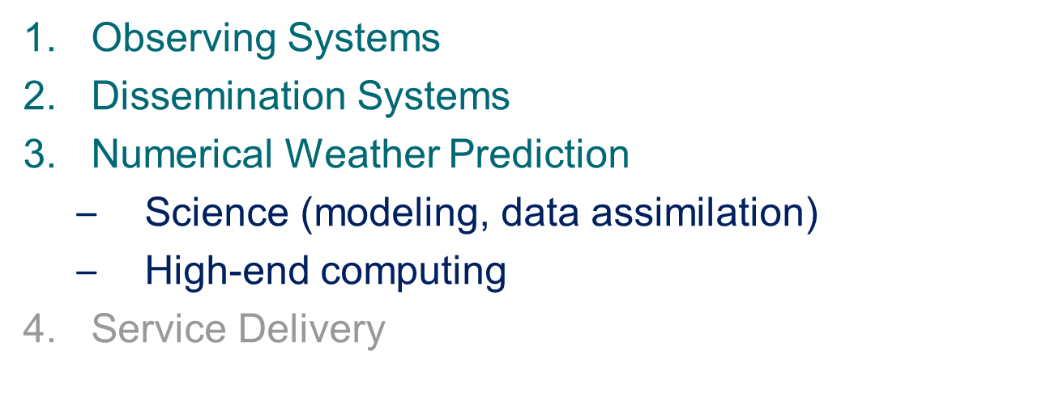
1, 2 and 3 are of a foundational nature, with 1 representing the single largest expenditure, and 3 providing a powerful diagnostics capability
10th Symposium on Environmental Satellites
<number>
Notes:
<number>

Slide 9
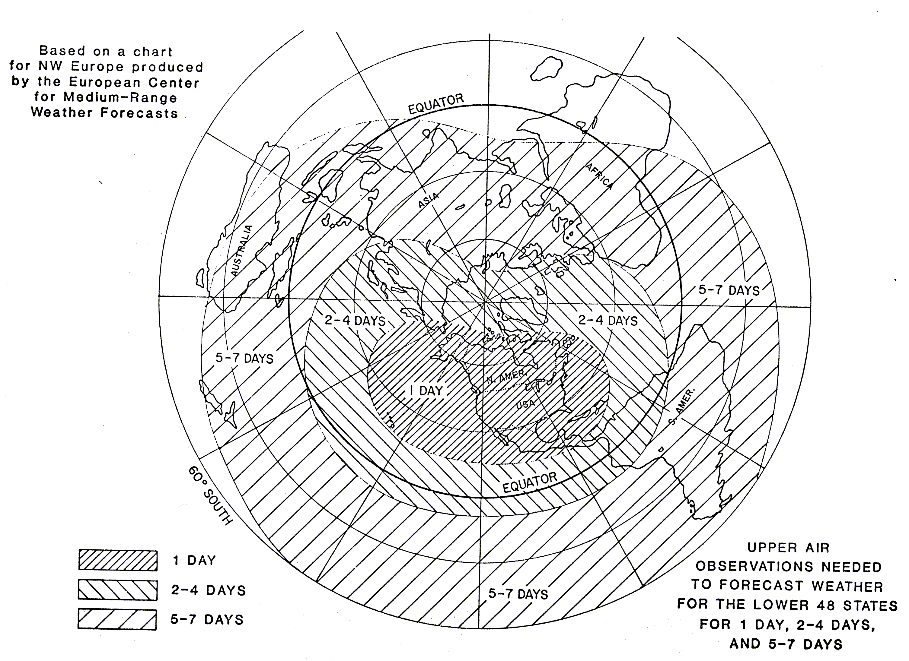
NWP requirements for upper-air data coverage
Hence the need for a global observing system, irrespective of target location of forecast!
10th Symposium on Environmental Satellites
<number>
Notes:
<number>

Slide 10
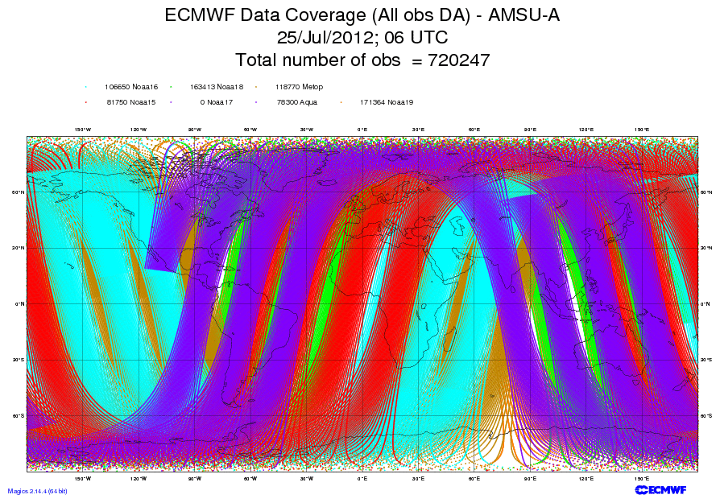
10th Symposium on Environmental Satellites
<number>
Notes:
<number>

Slide 11
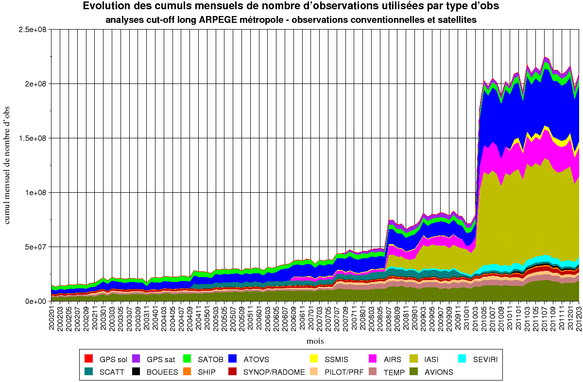
Monthly Mean of No. Of Observations Daily in Global Model
<number>
IASI
SSMI/S
SEVIRI
GPS-RO
AIRS
SCAT
SSMI
ATOVS
2002
2004
2006
2007
2008
2010
2011
Notes:
<number>
03/06/25
Utilisation accrue des donnees depuis les annees 2000
En plus des sondeurs et imageurs (ATOVS, AIRS, SEVIRI, IASI), donnees de diffusiometres (vents a la surface de la mer) et GPS spatial.
Les nouvelles generations d’instruments (IASI) font augmenter considerablement le nombre de donnees observees utilisees.
Ici, seulement le nombre de points d’observations, pas le nombre de donnees, qui a encore plus augmente: 1.5 million par reseau, dont plus d’1 million pour les satellites.

Slide 12
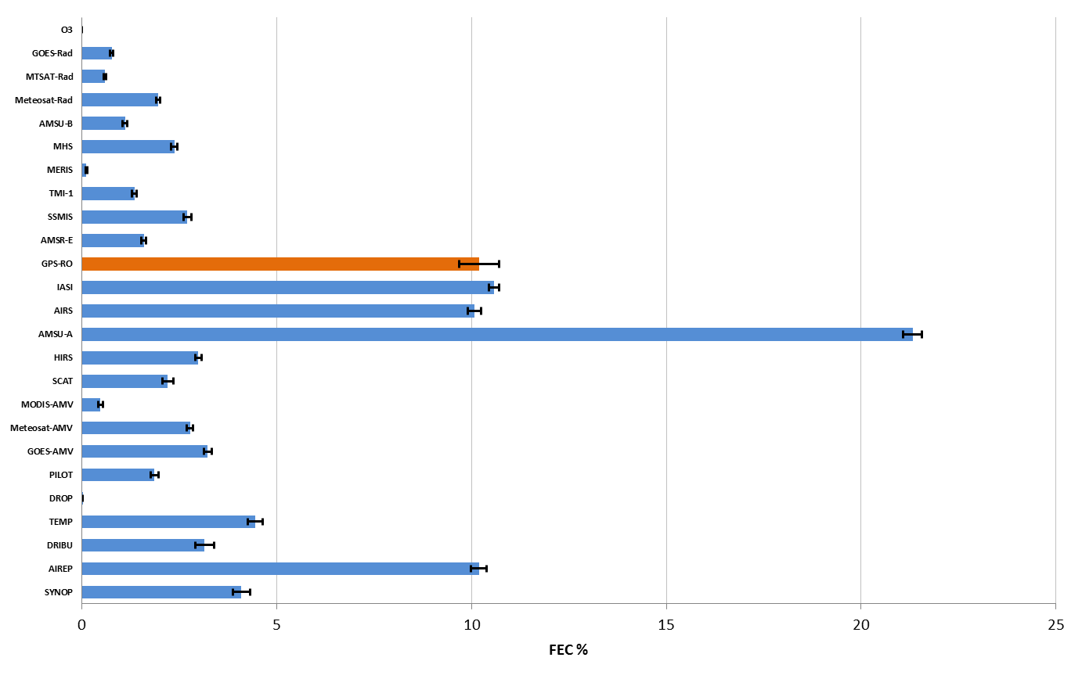
From Healy et al. Sedona 2012
GNSS-RO
IASI
AMSU-A
AIRS

Slide 13
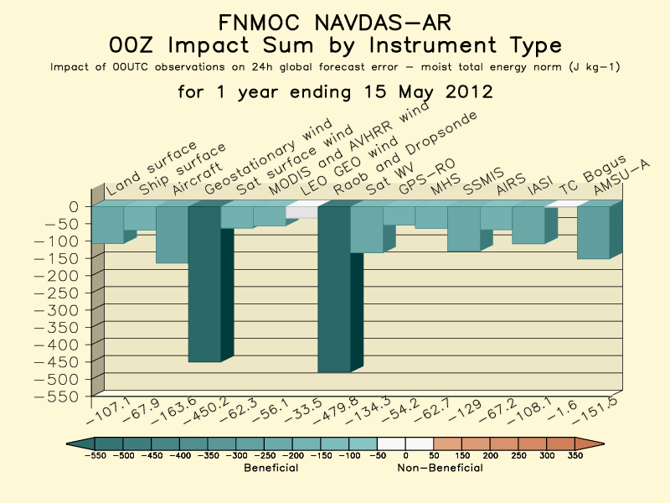
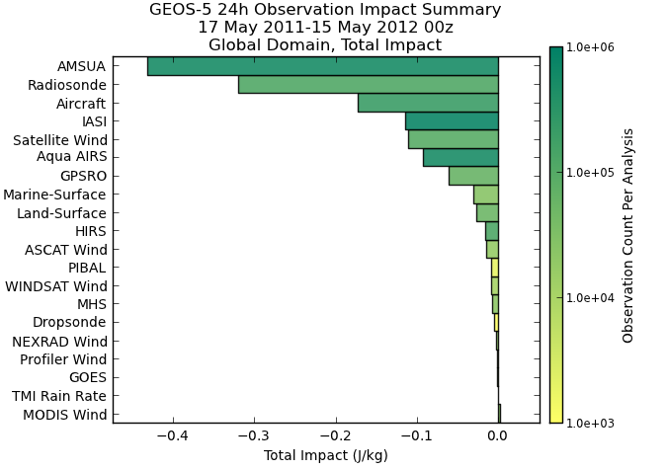

FNMOC and GMAO Observation Impact Monitoring
Current Operations
Gelaro et al. , Sedona May 2012
http://www.nrlmry.navy.mil/obsens/fnmoc/obsens_main_od.html
http://gmao.gsfc.nasa.gov/products/forecasts/systems/fp/obs_impact/

Slide 14

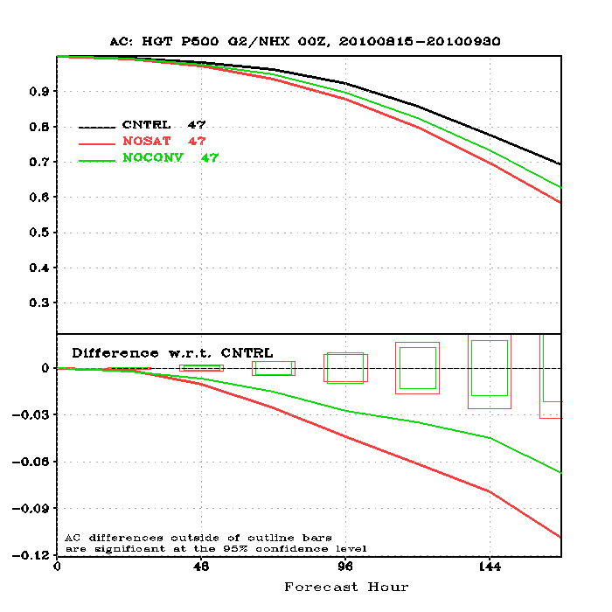
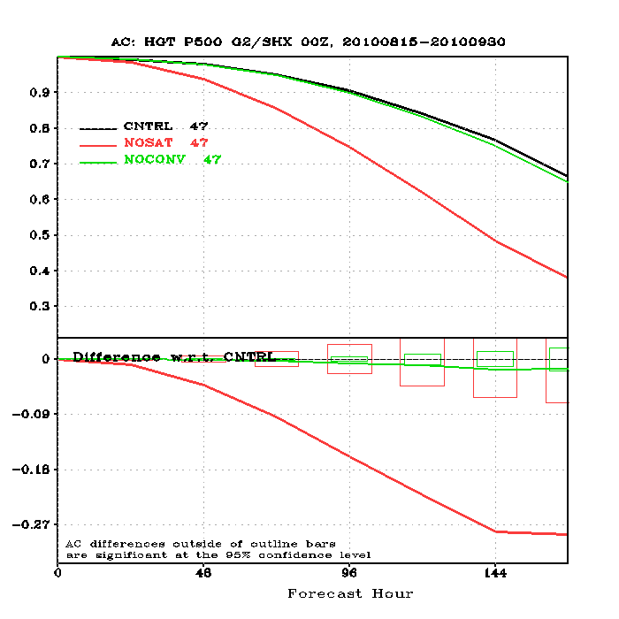
No SAT: > 24 h loss of skill
No SAT: >60 h loss of skill
Northern Hemisphere
Southern Hemisphere
Jung, 5th WMO Impact Workshop, Sedona 2012)
10th Symposium on Environmental Satellites
14

Slide 15

The economic impact of weather is at least somewhat recognized and understood
In contrast, the economic impact of weather prediction is generally not well studied and documented
The cost of obtaining meteorological observations is generally understood only at the national level; no reliable cost estimates available at the global level
Assessment of the monetary value of meteorological observations is even less developed
By a rough estimate, the value to US economy likely in the range of $5B/year or more for NWP alone; this does not measure the value of direct forecast applications, of climate, ocean, land surface, atmospheric composition measurements, or of improved scientific understanding
10th Symposium on Environmental Satellites
<number>
Notes:
<number>

