Slide 1
Satellite Products Inter-Comparison Using the NOAA Products Validation System (NPROVS) and Plans for NPP Cal/Val
Tony Reale
NOAA
Center for Satellite Applications and Research (STAR)
Bomin Sun, Michael Pettey, Frank Tilley, and Charles Brown
(IM Systems Group)
Acknowledgements …. Murty Divikarla (IMSG), Nick Nalli (IMSG), Chris Barnet (STAR) …
(funding under JPSS/NPP cal/val program)
18th Conference on Satellite Meteorology
Oceanography and Climate
New Orleans, January 22-26, 2012

Slide 2
Outline
What is NPROVS
What’s new
IASI vs ATOVS vs GFS vs Sonde Profiles
QC
Terrain
Cloud
Bringing in NPP
IDPS (NGAS), NUCAPS (NOAA), MiRS
Revised guidelines for validation
Meeting spec
GCOS Reference Upper Air Network (GRUAN)
Site Atmospheric State Best Estimate (SASBE)
at NPP overpass ?

Slide 3
MetOp-B
ATOVS, MIRS,
IASI, IASI (EU)
GRAS
JPSS-NPP
CrIMSS (2)
MIRS
NASA-EOS-Aqua
AIRS
NOAA-18
ATOVS, MIRS
RADIOSONDE
DROPSONDE
NWP
FORMOSAT-3,4
COSMIC (UCAR)
NOAA-19
ATOVS, MIRS
DMSP F-16,17,18
MIRS
GOES-11,13,12
IR Soundings
MetOp-A
ATOVS, MIRS,
IASI, IASI (EU)
GRAS
Yes
Plan
No
NOAA Products Validation System (NPROVS) Schematic
Notes:
<number>
ALL
Current systems and plans (yellow) to integrate CrIMSS (2 … IDPS and NDE) and MIRS (2 … NPP and metop-B) as available

Slide 4
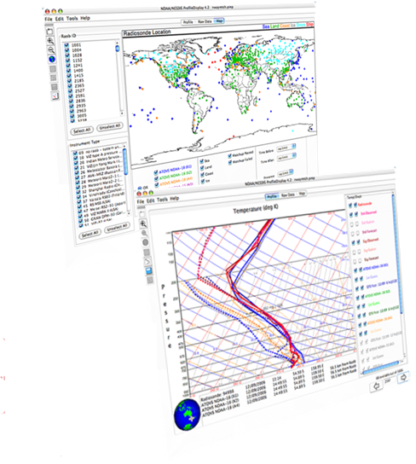
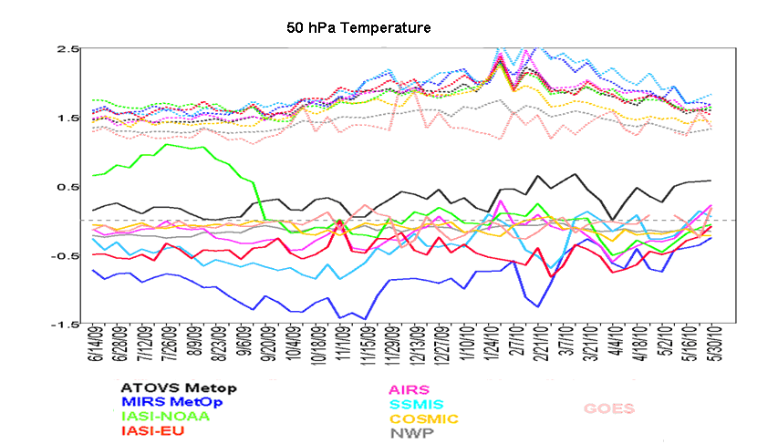
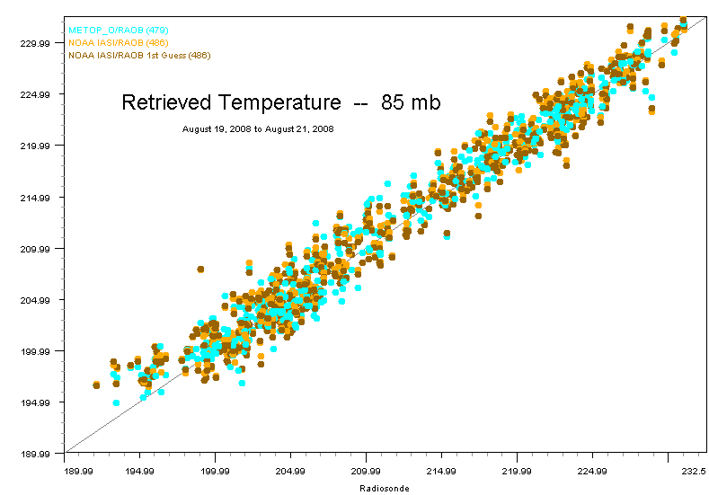
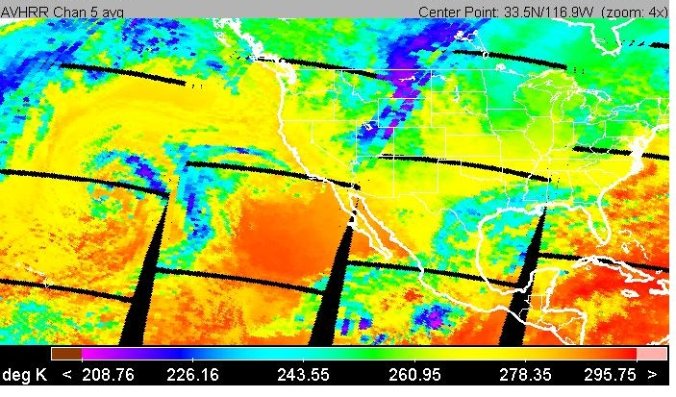
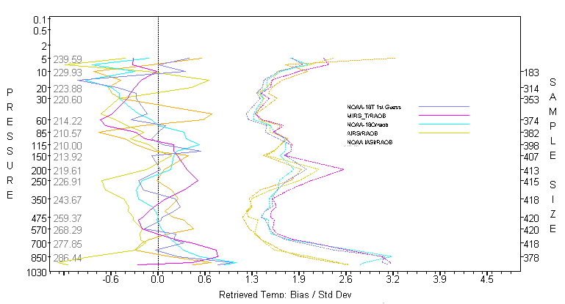
NPROVS- Environmental Data Graphical Evaluation
(EDGE) Analytical Interface
NARCS
PDISP
ODS
Notes:
<number>
<number>
<number>
NPROVS runs every day
Latest achievement is the inclusion of COSMIC (NCAR) product suite
Plan is to designate COSMIC as ground truth, incorporate respective center products (including guess) and maybe derive a product of our own that is NWP independent,
EDGE includes tropopause validation option, but currently not exercised
We also plan back processing for past COSMIC and CHAMP eras (I’m sure Ben can significantly reduce our work effort in this area … )
What about MetOp GRAS?

Slide 5
NPROVS Web Site
Pre-computed monthly performance statistics for selected product combinations
Pre-computed performance trends since April 2008
Download PDISP and NARCS graphical display applets and datasets
http://www.star.nesdis.noaa.gov/smcd/opdb/poes/NPROVS.php

Slide 6
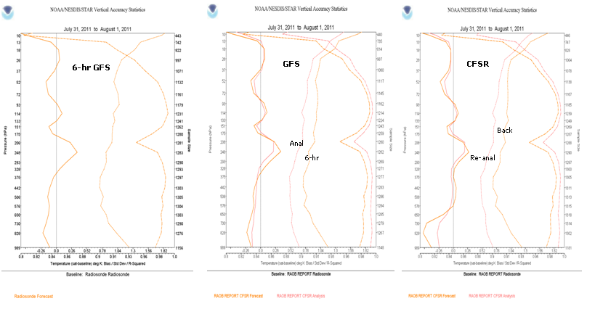
What’s New !
GFS and CFSR Analysis and Background interpolated to sonde
(courtesy Bradley Ballish, NWS)
(courtesy jack Wollen, NWS)
… vertical profiles of Mean, St. Dev from Sonde and “R^{2”}

Slide 7
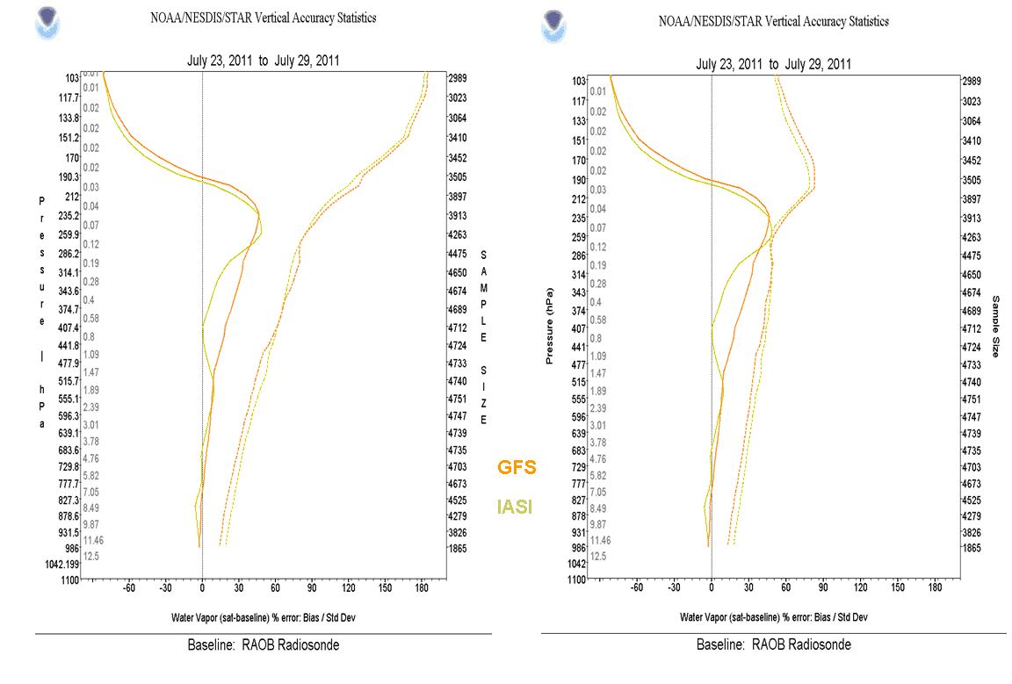
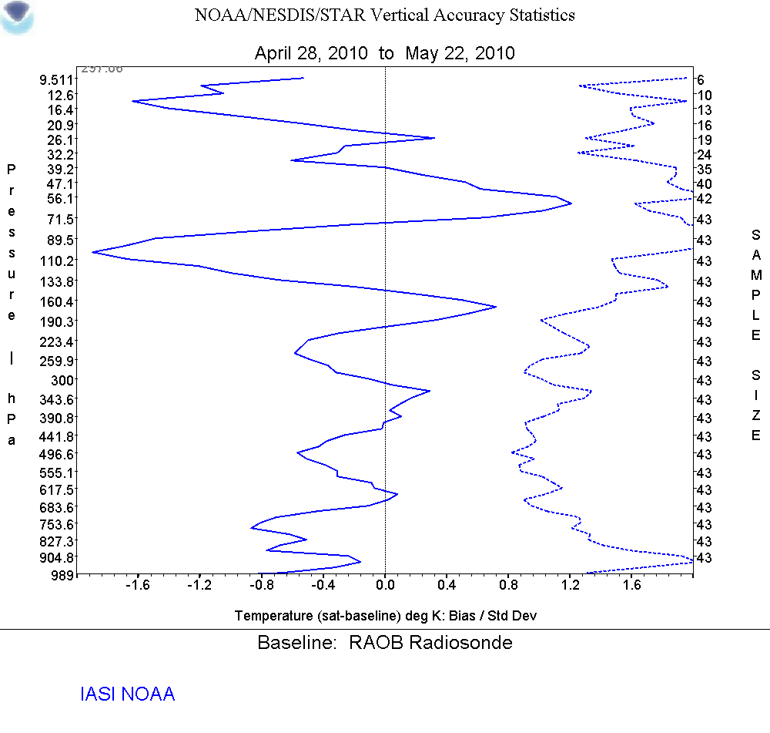
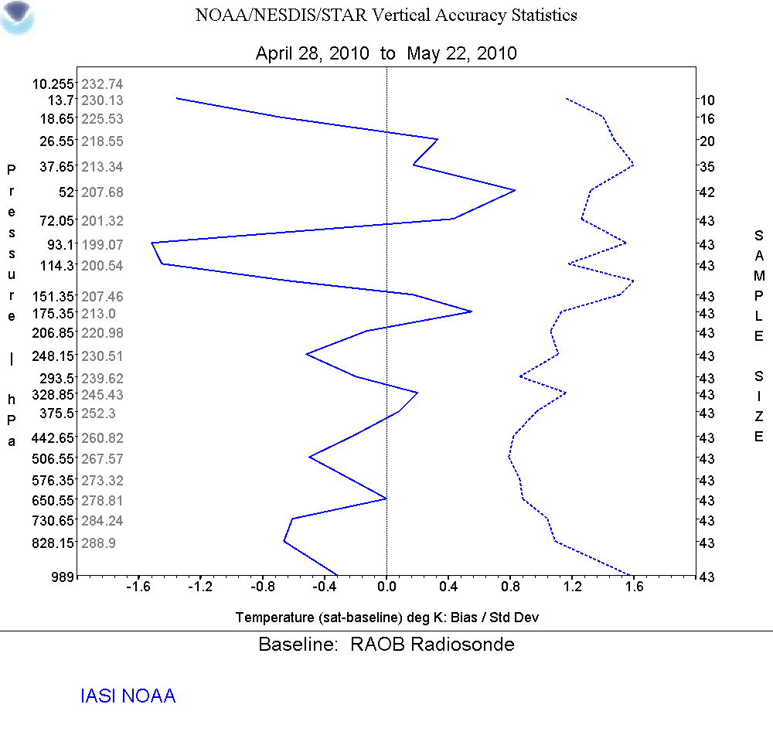
What’s New !
Weighting the moisture % differences…
100 levels vs 1km layer averaging
… vertical profiles of differences from Sonde

Slide 8
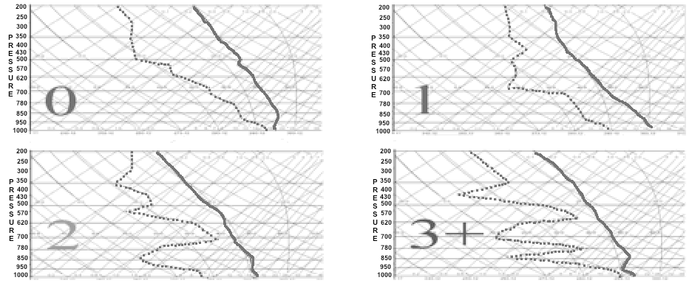
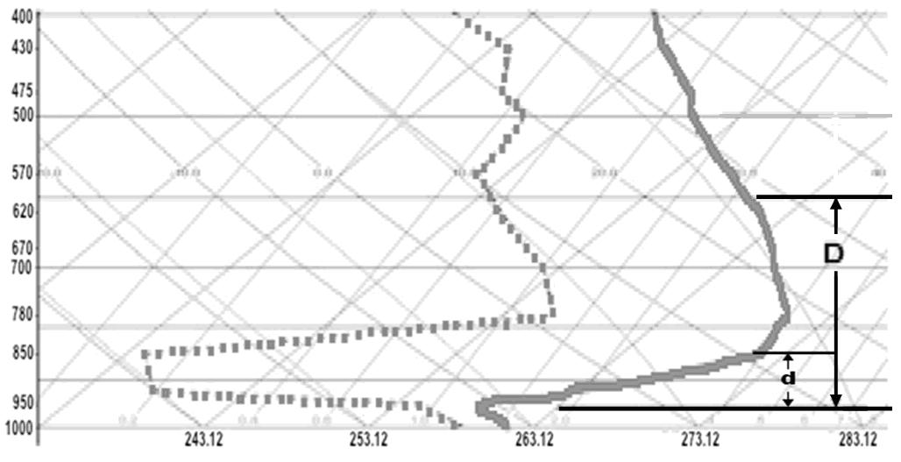
What’s New !
Radiosonde Profile Characterizations
Moisture Structure
Temperature Inversions

Slide 9
Radiosonde Profile Characterization Parameters
Terrain (land, coast, ship, island)
Cloud
Day/nite
Superadiabatic
Moisture profile shape
TPW Increment
UT / LS … suspicious moisture
T inversions (surface, aloft)
Rad Correction (site, NCEP)
Instrument type

Slide 10
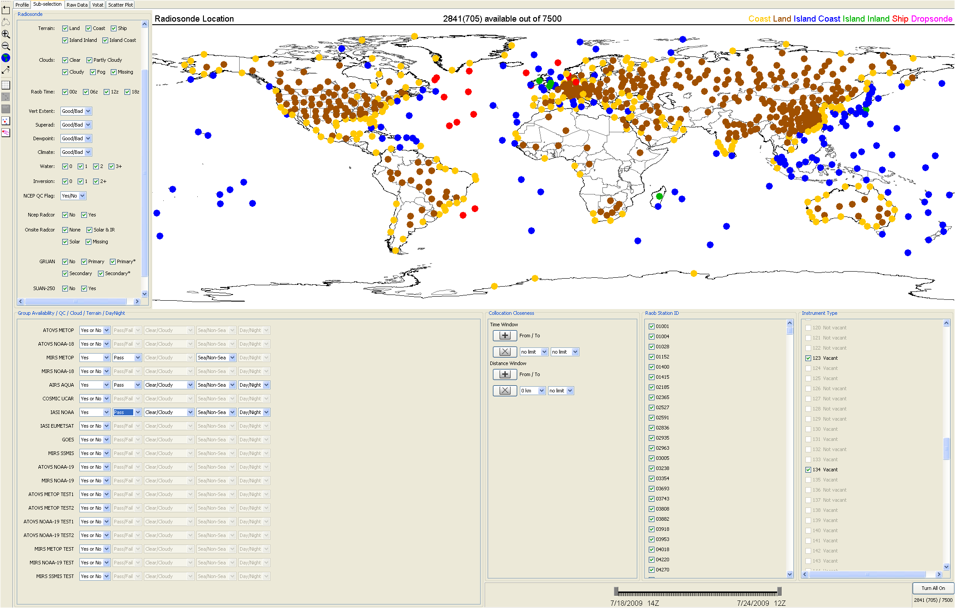
NOAA Products Validation System (NPROVS)
PDISP user interface for display and analysis of collocated data
Raob
SAT
Space
Time
Site id
Inst
… 7500 radiosondes over 7 days

Slide 11
IASI vs ATOVS vs GFS vs Sonde QC, Terrain, Cloud Yield !

Slide 12
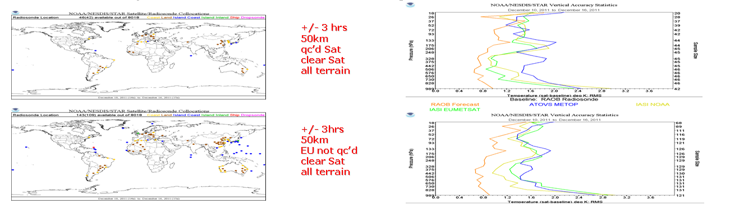
Common Sample

Slide 13
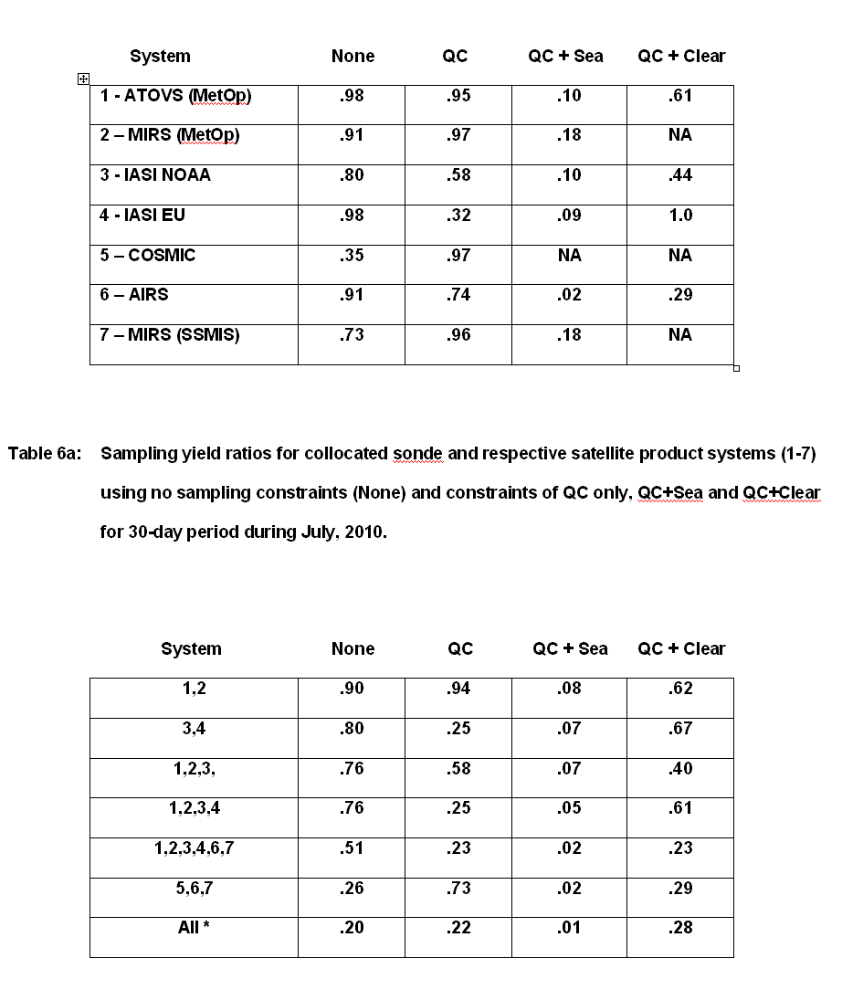
Common Sample Yield Analysis
(51)
(10)
(66)

Slide 14
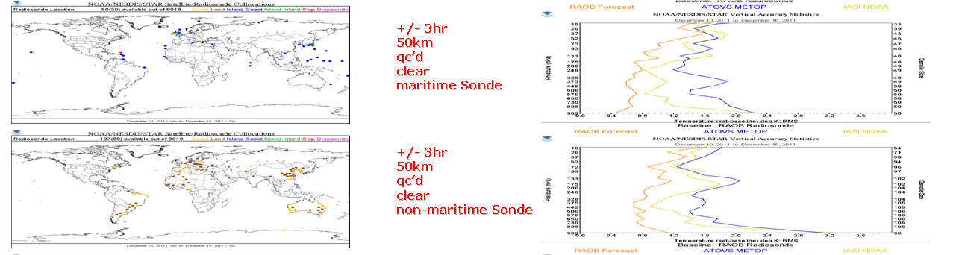
Common Sampling

Slide 15
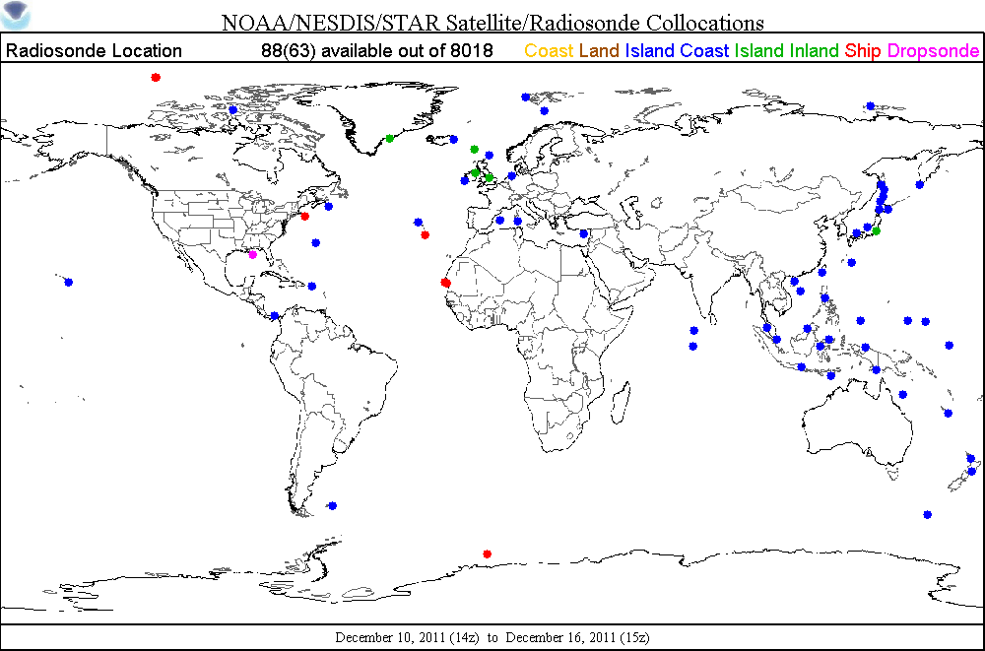
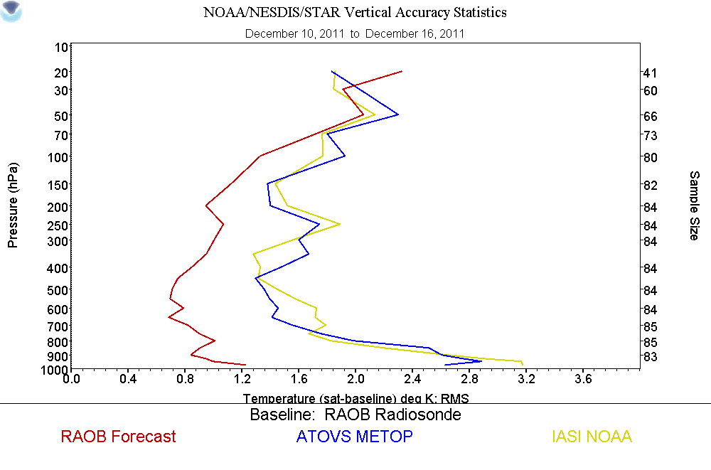
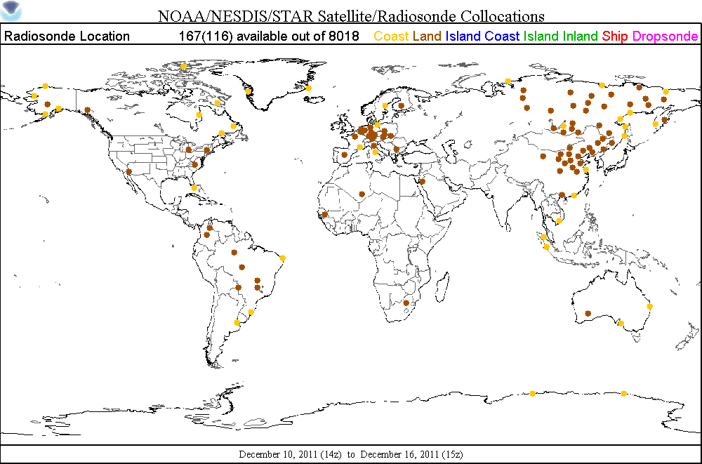
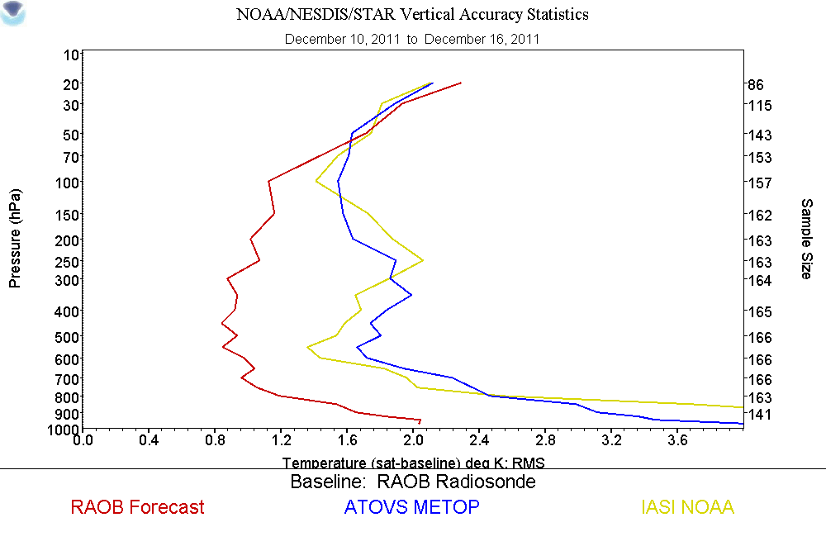
+/- 3hr
50km
qc’d
Cloudy
maritime
+/- 3hr
50km
qc’d
Cloudy
Non-maritime
Common Sampling

Slide 16
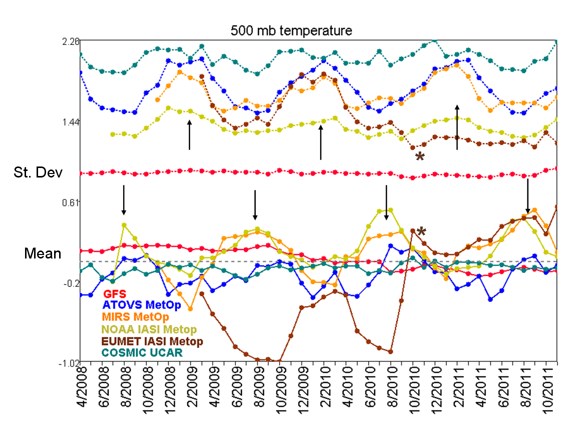
Independent Samples

Slide 17
Bringing in NPP

Slide 18
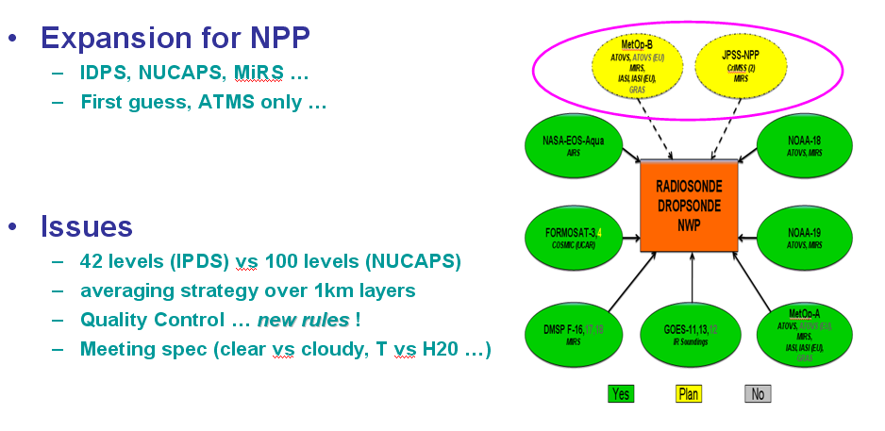

Slide 19
CriMSS Performance Specification
Atmospheric Vertical Temperature Profile (AVTP) Measurement Uncertainty – Layer Average Temperature Error
PARAMETER | THRESHOLD
AVTP Clear, surface to 300 mb | 1.6 K / 1-km layer
AVTP Clear, 300 to 30 mb | 1.5 K / 3-km layer
AVTP Clear, 30 mb to 1 mb | 1.5 K / 5-km layer
AVTP Clear, 1 mb to 0.5 mb | 3.5 K / 5-km layer
AVTP Cloudy , surface to 700 mb | 2.5 K / 1-km layer
AVTP Cloudy, 700 mb to 300 mb | 1.5 K / 1-km layer
AVTP Cloudy, 300 mb to 30 mb | 1.5 K / 3-km layer
AVTP Cloudy, 30 mb to 1 mb | 1.5 K / 5-km layer
AVTP Cloudy, 1 mb to 0.5 mb | 3.5 K/ 5-km layer
Atmospheric Vertical Moisture Profile (AVMP) Measurement Uncertainty – 2-km Layer Average Mixing Ratio % Error
PARAMETER | THRESHOLD
AVMP Clear, surface to 600 mb | Greater of 20% or 0.2 g/kg / 2-km layer
AVMP Clear, 600 to 300 mb | Greater of 35% or 0.1 g/kg / 2-km layer
AVMP Clear, 300 to 100 mb | Greater of 35% or 0.1 g/kg / 2-km layer
AVMP Cloudy, surface to 600 mb | Greater of 20% of 0.2 g/kg / 2-km layer
AVMP Cloudy, 600 mb to 400 mb | Greater of 40% or 0.1 g/kg / 2-km layer
AVMP Cloudy, 400 mb to 100 mb | Greater of 40% or 0.1 g/kg / 2-km layer
Nalli, Barnet, et al. - AMS Jan-12
<number>
(courtesy Nick Nalli)
Notes:
KPPs in boldface
Old NPOESS Requirements:
IORD – Integrated Operational Requirements Document
NGAS – Northrop Grumman Aerospace Systems
“Partly Cloudy” – ≤50% cloudiness
“Cloudy” – >50% cloudiness
Clear – the CrIMSS EDR retrieval algorithm detected no cloud within a FOR;
Cloudy – the CrIMSS EDR algorithm detected overcast cloud or more than three layers of clouds within a FOR;
Partly Cloudy – the CrIMSS algorithm detected one to three layers of clouds.
<number>

Slide 20
CrIMSS Validation Issues
Levels: “42 (T), 22(MR)” vs 100 (T) 30 (MR)
IDPS vs NUCAPS
Layers for validation (1km)
T vs (MR vs PW …)
Averaging of layers for meeting spec
T, MR (clear vs cloudy), (altitude)
Weighting (MR)
Quality Flag …
Can only reject precipitating scenes in IDPS

Slide 21
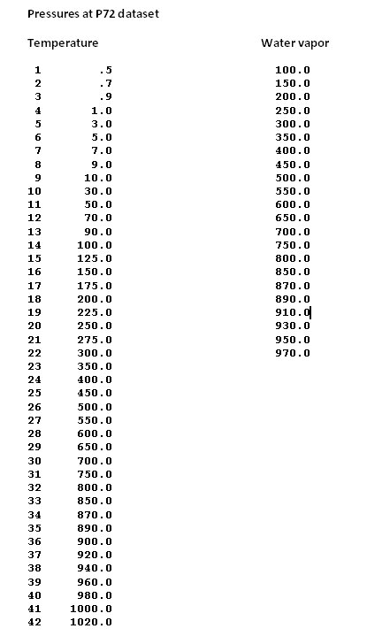

Slide 22
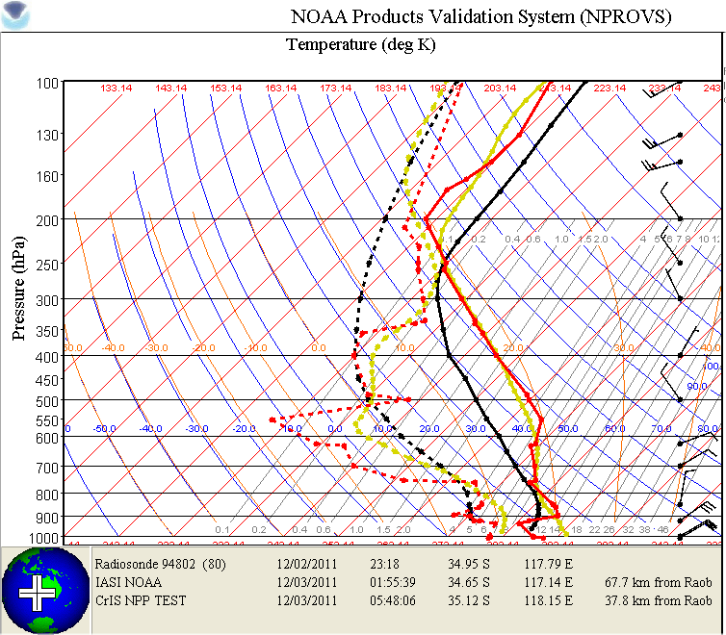
IASI
CrIMSS
Raob
P72 Proxy CrIMSS moved to 12/03/11

Slide 23
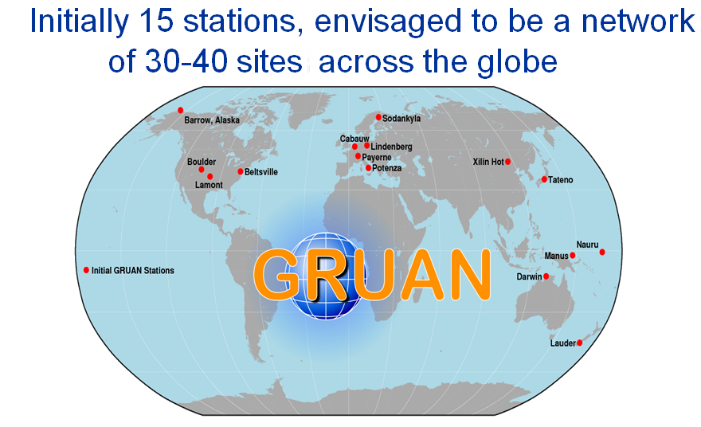
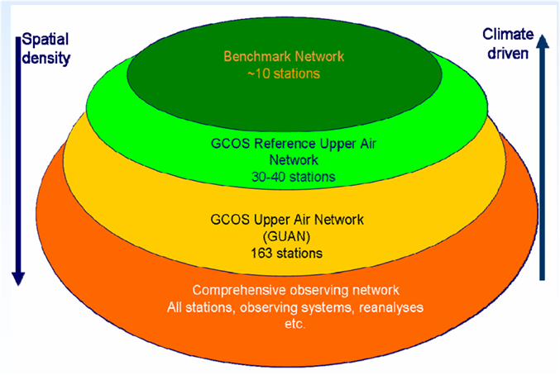
NPROVS Facilitates NPP Validation within
GCOS Reference Upper Air Network (GRUAN)
Fully characterize the site atmospheric column (sonde + ancillary)
at NPP overpass
ARM site atmospheric state best estimate (SASBE) for AIRS temperature and water vapor retrieval validation …Tobin et al., 2006, J. Geophys. Res., 111, D09S14 …
Uncertainty analysis for estimating atmospheric temperature for remote sensing applications … Dykema et al., International Temperature Symposium, March 2012, Los Angeles, Ca.
ICM-4 in Japan, March 2012
Notes:
<number>
Chris and antonia

Slide 24
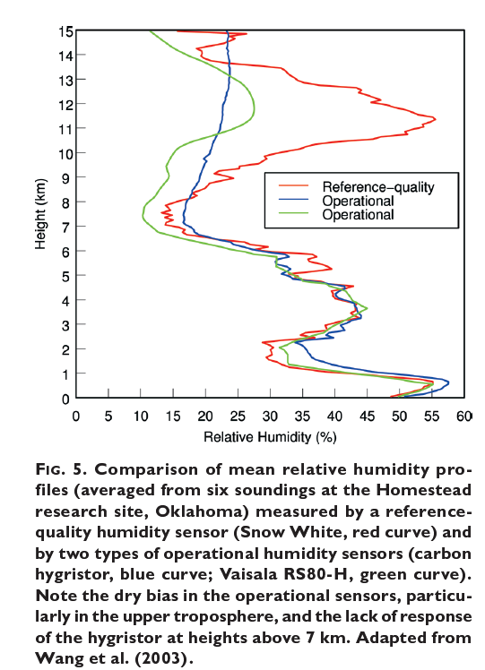
Reference for Moisture
dry bias
(courtesy Dian Seidel, NOAA Air Resources Lab)

Slide 25
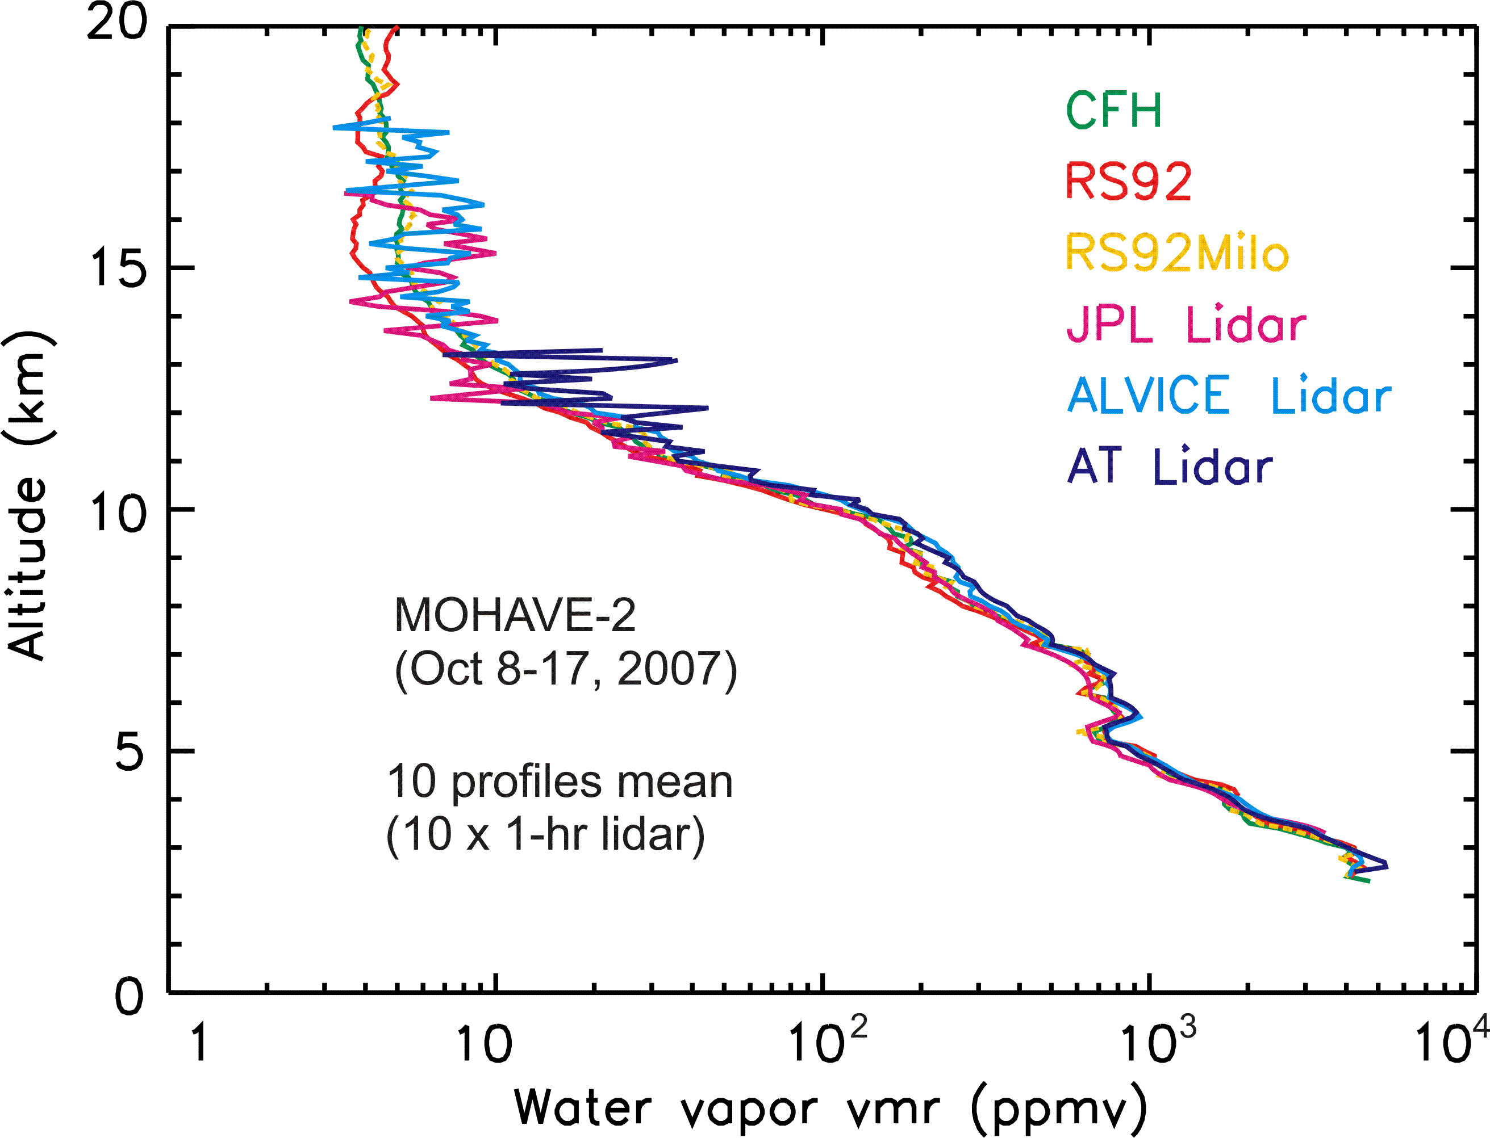
Courtesy Thierry LeBlanc (NASA)

Slide 26
SUMMARY
NPROVS will provide routine and specialized CrIMMS sounding product validation versus legacy satellite product systems and forecasts
Terrain and Clouds have >1.0 increased RMS impact on perceived impacts using “qc’d” legacy IASI
Provide a gateway to routine validation at emerging GCOS Reference Upper Air Network Sites

