Slide 1
Return of Title IV Funds (R2T4) – Programs of Study Taught in Modules
Session # 22
Dan Klock | Dec. 2013
U.S. Department of Education
2013 FSA Training Conference for Financial Aid Professionals
Notes:
<number>

Slide 2
TOPICS covered today
Recent regulations – prior to the Program Integrity rules
Program Integrity rules
Questions and Answers
Contact information
<number>
Notes:
<number>

Slide 3
Theory Behind the Calculation
Student earns Title IV aid through attendance
Percentage of aid earned is equal to the percentage of the payment period or period of enrollment completed (or in the case of a clock- hour program – the percentage of the scheduled clock hours completed)
<number>

Slide 4
34 CFR 668.22
When a recipient ceases attendance before the scheduled end of the program for which s/he received Title IV, HEA aid
The institution is required to determine the amount of aid that the student earned
The institution also determines the unearned portion
<number>
Notes:
<number>

Slide 5
Rules prior to 7/1/11
R2T4 prior to 7/1/11 did not specifically deal with term-based programs with courses that are less than the length of the term
GEN-00-24 – (December 2000) – we said when a student is in a modular program within a standard term and the student completes at least one of the modules, then R2T4 does not apply
Completing one compressed course is the equivalent of completing a single course that spans the entire PP or POE
<number>
Notes:
<number>

Slide 6
GEN - 00-24 (December 2000)
Session 1
Session 2
Session 3
WD
Withdrawal after completing Session 1 and two weeks into Session 2 and 3
<number>

Slide 7
Program Integrity – Final Regulations (75 FR 66832) 10/29/10
Return of Title IV Funds topics:
Definitions
When a student is considered a withdrawal
Written Confirmation
Institution that is required to take attendance
Total # of days in a PP or POE
Programs offered in modules
Academically-related activities
<number>
Notes:
<number>

Slide 8
R2T4 – Current Definitions
Standard Terms
Semesters, trimesters – generally 14 – 17 weeks long
Quarters – generally 10 – 12 weeks long
Non-standard terms – where all coursework is expected to begin and end within a set period of time that is not a semester, trimester or quarter terms
Non-terms – all clock-hour programs and credit-hour programs that do not begin and end within a set time (self-paced), where courses overlap, where sequential courses do not begin and end within a term
<number>
Notes:
<number>

Slide 9
R2T4 – Current Definitions
“Week of instructional time”
Any seven consecutive day period with at least one day in which scheduled instruction or examination occurs
Does not include homework time, vacation time, orientation or counseling
<number>
Notes:
<number>

Slide 10
R2T4 – Definitions
“Offered in modules”
When a course does not span the entire payment period (PP) or period of enrollment (POE)
<number>
Notes:
<number>

Slide 11
“Offered in modules”
If the student ceases attendance before the period for which aid was awarded, it is a withdrawal
The denominator of the Return calculation includes the full # of days used to determine the aid award, absent any institutionally scheduled breaks of 5 or more consecutive days or periods of time that the student was on an approved LOA
<number>

Slide 12
Written confirmation
For courses offered in modules
A student is NOT considered to have withdrawn if
For standard term programs, the institution obtains written confirmation that the student will return to complete a later module within the same PP or POE
For non-term and non-standard terms – the institution obtains written confirmation that module begins no later than 45 calendar days after the end of the module the student ceased attendance
<number>
Notes:
<number>

Slide 13
Written confirmation
Student can revise the date of return to a later module, if
For standard term programs, the student does so in writing, between the time of the withdrawal, but prior to the return date
For non-term and non-standard term programs, the module cannot begin later than 45 calendar days after the end of the module the student ceased attendance
<number>
Notes:
<number>

Slide 14
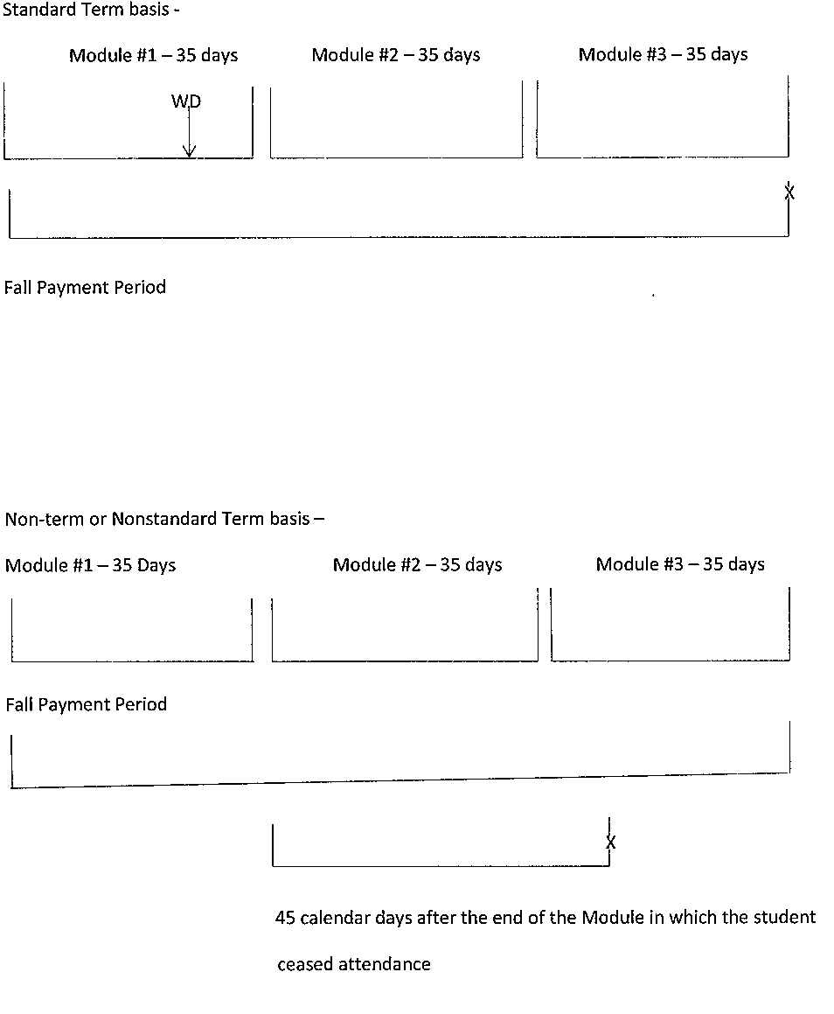
Graphic of Written Conf. timeframe
<number>

Slide 15
“Offered in modules” - Example A
Institution A:
Fall and Spring = standard terms
Never considered to be “offered in modules”
Summer = three 5-week sessions (combined to be a standard term)
Students can enroll in any of the Summer Sessions or all of them
Students enrolled in the 5-week Sessions are considered in programs “offered in modules” since none of the Sessions span the entire length of the term
<number>

Slide 16
“Offered in modules” – Example A
Student #1 – Enrolls in all three Summer Sessions
and ceases enrollment on Day 5 in the
1st 5-week Session
<number>

Slide 17
“Offered in modules” - Example A
THE RESULTS:
Step 1 – Recalculate Pell & Campus-based
Step 2 – Determine earned & unearned amounts of Title IV aid (TIV)
Numerator = # of days attended in Course 1 (assume no breaks) of 5 or more days
Denominator = Start date of Course 1 thru end date of Course 3 (less any scheduled break of 5 or more consecutive days or approved LOAs) 105 days or .048 or 4.8%
<number>

Slide 18
“Offered in modules” - Example A
Module 1
5 weeks
Module 2
5 weeks
Module 3
5 weeks
35 days
35 days
35 days
Withdrawal Day 5
<number>

Slide 19
“Offered in modules” - Example A
Session 1
5 weeks
Session 2
5 weeks
Session 3
5 weeks
35 days
35 days
35 days
Withdrawal Day 5 student also drops remaining Sessions.
At an Inst Required to Take Attendance: WD = Day 5. Denominator = 105 days. Per GEN 04-12, the inst. must have a process to make this determination no later than 14 days after the LDA
Inst. NOT Required to Take Attendance: WD = 668.22(c). Denominator = 105 days.
<number>

Slide 20
“Offered in modules” - Example A
Student #2: Enrolls in all three Summer Sessions
Day 4 of Session 1, drops Session 2
Day 8 of Session 1, withdraws during the 1st 5-wk Session
Student does not provide written confirmation of return within the payment period
<number>

Slide 21
“Offered in modules” – Example A
THE RESULTS:
Step 1 – Recalculate Pell & Campus-based
Step 2 – Determine earned & unearned amounts of TIV
Numerator = # of days attended (assume no breaks) 8 days
Denominator = 35 days each in Sessions 1 & 3, less any scheduled breaks or approved LOAs 70 days or .114 or 11.4%
<number>

Slide 22
“Offered in modules” – Example A
Session 1
5 weeks
Session 2
5 weeks
Session 3
5 weeks
35 days
35 days
35 days
Day 4 – drops Session 2
Day 8 - Withdraws
<number>

Slide 23
“Offered in modules” – Example B
Summer Sessions include three 5-week Sessions and 15-week Sessions
<number>

Slide 24
“Offered in modules” – Example B
Session
5- week
Session
5-week
Session
5-week
Session 15- week
Student C enrolls in two 15-week courses – this student is not
considered to be enrolled in a program offered in modules
Student D enrolls in the first 5-week module and one 15-week course – this student is considered to be enrolled in a program offered in modules
<number>

Slide 25
When a student is considered a withdrawal
In a program measured in credit-hours
Student does not complete all the days scheduled to complete in the PP or POE
In a program measured in clock-hours
Student does not complete all the clock-hours & weeks of instructional time scheduled to complete in the PP or POE
<number>
Notes:
<number>

Slide 26
When a student is considered a withdrawal
In a non-term or non-standard term
Student is not scheduled to begin another course within the PP or POE for more than 45 calendar days after the end of the module the student ceased attending
(Unless the student is on an approved LOA)
<number>
Notes:
<number>

Slide 27
“Offered in modules” – Example C
Session 1
5 weeks
Session 2
5 weeks
Session 3
5 weeks
35 days
1 wk
break
35 days
1 wk
break
35 days
Claire begins Session 1 in a non-term program, but withdraws on Day 5. She indicates that she wants to return at the beginning of Session 3 to resolve some health issues in the interim. What is her withdrawal date?
<number>

Slide 28
“Offered in modules” - Example C
Session 1
5 weeks
Session 2
5 weeks
Session 3
5 weeks
35 days
1 wk
break
35 days
1 wk
break
35 days
What is Claire’s withdrawal date?
Day 5 – it will be 72 days before Session 3 begins, however for the purpose of determining whether written confirmation is required, we consider the number of days from the end of the module the student ceased attending
It will be 49 days before Session 3 begins
<number>

Slide 29
“Offered in modules” - Example C
Session 1
5 weeks
Session 2
5 weeks
Session 3
5 weeks
35 days
1 wk
break
35 days
1 wk
break
35 days
Claire’s other option would be to seek a Leave of Absence beginning on Day 6 of Module 1 and ending the day before Session 3 begins.
<number>

Slide 30
Written Confirmation
Student #3 – Enrolls in all three Summer Sessions and drops Session 2 on Day 3, then ceases enrollment on Day 5 in the 1st
5-week Session, but provides written confirmation of future return
<number>

Slide 31
“Offered in modules” - Example D
THE RESULTS:
Step 1 – Recalculation of Pell & Campus-based
Step 2 – No Return calculation due to the fact that the student provides written confirmation of her/his planned return between the time of the withdrawal and before the start of the 3rd module
<number>

Slide 32
“Offered in modules” - Example D
Session 1
5 weeks
Session 2
5 weeks
Session 3
5 weeks
35 days
35 days
35 days
Day 5 – withdraws from Session 1 and provides written confirmation that student will return to Session 3
<number>

Slide 33
Written confirmation
What happens when the student doesn’t return for the future module?
The withdrawal date (WD) is -
At an institution required to take attendance = the last date of attendance (LDA)
At an institution not required to take attendance
= 34 CFR 668.22(c)(1)(i) – (vi)
<number>
Notes:
<number>

Slide 34
Written confirmation
Session 1
5 weeks
Session 2
5 weeks
Session 3
5 weeks
35 days
35 days
35 days
Day 4 – Withdraws from Session 1 and drops Session 2, but provides written confirmation of return to Session 3
Day 71 – Student does not return. WD = Day 4 at Institution Required to Take Attendance;
34 CFR 668.22(c)(1)(i) – (vi) at an Institution NOT Required to Take Attendance
<number>

Slide 35
Written confirmation
What happens when a student DOES return to a later module within the same PP or POE?
If this is a non-term program, the student reenters the same program – student is eligible for the same amt. of Title IV, HEA funds (TIV) prior to WD
As long as the student returns within 180 days TIV is restored
(see 668.4(f))
<number>
Notes:
<number>

Slide 36
Institution required to take attendance
An outside entity (accreditor, State) has a requirement to take attendance
(No change this is the current rule)
If the outside entity has a requirement for attendance taking for a sub-group of students, then that sub-group are bound by the “Institution required to take attendance” rules in 668.22(b)
If the outside entity has a requirement that attendance taking must occur for a limited time
<number>
Notes:
Or in the final bullet, let’s say that an outside entity that is providing a scholarship requires attendance taking for the initial 4 weeks of instruction, then during that limited period if any of the students with the scholarship withdrew, those students would be subject to the “Inst . Required to take Attendance” rules for that period and the LDA would be the Withdrawal date.
<number>

Slide 37
Institution required to take attendance
The institution has a requirement that attendance be taken
The Program Integrity Final Regulations do NOT require institutions to take attendance
If an institution requires its faculty to take attendance at the program, departmental, or institutional level
If there is no institutional requirement, but an individual faculty member chooses to take attendance, those records could, but would not be required to be used (Therefore, the institution is not required to take attendance – 668.22(c))
<number>
Notes:
READ SLIDE:
Even when not required, the Department is encouraging institutions to use its records of attendance as the best information available to make the determination of the withdrawal date.
<number>

Slide 38
Institution required to take attendance
Institution or an outside entity has a requirement that can only be met by taking attendance for the program or a portion of the program
<number>
Notes:
Here’s an example: The State licensing agency for professionals in the career that this program prepares students to be employed has a requirement that the institution provide 900 clock hours of training in X,Y, and Z before any student is qualified to sit for the State licensing examination.
<number>

Slide 39
Institution required to take attendance
If the institution is required to take attendance or requires attendance for only some students
The attendance records must be used to determine the withdrawal date for that cohort of students
<number>
Notes:
Institution B offers a variety of training programs, one of which is a certified helicopter repair technician program. The Federal Aviation Administration requires to become certified, the applicant must have 1,500 hours of supervised training. So every student in this program would be required to have their attendance taken. When a student withdraws from this program, the institution must calculate the Return of Title IV Funds consistent with the provisions of 668.22(b) an institution required to take attendance. Withdrawing students in all the other programs at institution B would be calculated on the basis of 668.22(c) an institution that is not required to take attendance.
<number>

Slide 40
Institution required to take attendance
If the institution is required to take attendance or requires attendance for a limited period of time
The attendance records must be used to determine the withdrawal date for that limited period of time
A student in attendance on the last day of the limited period, who continues attendance, but subsequently WDs – will be treated as a student at an inst. not req’d to take attendance
<number>
Notes:
READ SLIDE
Must be able to document attendance after the period of limited attendance taking. Either the last date of Academically related activity during the limited period is used unless, the institution can demonstrate that the student attended past the limited period of attendance. See 75 FR 66900 – Oct 29, 2010 Final Regulation also see TA-Q3 in the Program Integrity Q’s and A’s for the R2T4 heading. One example could be evidence that a student took a test, submitted a paper or project after the limited period of attendance taking.
<number>

Slide 41
Institution required to take attendance
Term I – 16 weeks
2 wks
Program A – Daily attendance taking is required for the 1st 2-week period
All students who withdraw during the 1st 2 wks = Institution Required to take attendance
All students who withdraw after the 2-wk period = Institution not required to take attendance
<number>

Slide 42
Institution required to take attendance
Only required to take attendance for a single day
“Census” snap-shot
Not considered “An institution required to take attendance”
Follow the rules in 668.22(c)
<number>
Notes:
<number>

Slide 43
Institution required to take attendance
Q – If an institution monitors whether its online students log into classes, is this an institution “required to take attendance?”
A – No, monitoring by itself does not meet the definition, however, if there is tracking academic engagement then the institution is considered to be an institution that is required to take attendance.”
<number>
Notes:
<number>

Slide 44
Total number of days in a Payment Period or Period of Enrollment
Includes all the calendar days within the period that the student was scheduled to complete, except
The number of institutionally scheduled breaks of 5 consecutive days or more are not included in the total calendar days used in the Return calculation, or
The days in which the student was on an approved LOA (that complies with668.22(d)).
<number>
Notes:
<number>

Slide 45
Program “offered in modules”
Module 1
Module 2
Module 3
Student enrolls for 3 modules within a term each 35 days in length and with a weekend in between modules 1 & 2 and 2 & 3.
Cheryl begins and completes Module 1 and doesn’t return for Modules 2 & 3 and doesn’t contact the institution.
Institution Required to Take Attendance – WD = LDA- last day she took a final exam. The denominator = 109 days (35 x3, plus 4 days between Modules).
Institution NOT Required to Take Attendance – WD = 34 CFR 668.22(c)(1)(i) – (vi). The denominator = 109 days (35 x 3, plus 4 days between Modules).
<number>

Slide 46
Program “offered in modules”
Student enrolls for 3 modules within a standard term each 35 days in length and with a week in between modules 1 & 2 and 2 & 3.
Anthony begins and completes Module 1 and doesn’t return for Modules 2 & 3 and doesn’t contact the institution.
Institution Required to Take Attendance – WD = LDA- last day he took a final exam. The denominator =105 days (35 x 3). The time between the Modules are more than 5 consecutive days and therefore excluded .
Institution NOT Required to Take Attendance – WD = 34 CFR 668.22(c)(1)(i) – (vi). The denominator =105 days (35 x3).
<number>

Slide 47
Academically-related activity – what’s included
Examples of an academically-related activity
Physically attending a class with direct interaction bet the instructor and students
Submitting an academic assignment
Taking an exam, an interactive tutorial, or computer-assisted instruction
<number>
Notes:
.
<number>

Slide 48
Academically-related activity – what’s included
Examples of an academically-related activity – (con’t)
Attending a study group that is assigned by the institution
Participating in an online discussion about academic matters
Initiating contact with a faculty member to ask a question about the academic subject studied in the course
<number>
Notes:
<number>

Slide 49
Academically-related activity – what’s NOT included
Effective 7/1/11 – you can no longer consider the following an academically-related activity for R2T4 purposes -
Living in institutional housing
Participating in the institution’s meal plan
Logging into an online class without active participation
Participating in academic counseling or advisement
<number>
Notes:
<number>

Slide 50
Academically-related activity
PLEASE REMEMBER !
These academically-related activities must be documented and retained by the institution in accordance with the recordkeeping requirements in 34 CFR 668.24
Student self-documentation of an academically-related activity will not meet the requirement
<number>
Notes:
<number>

Slide 51
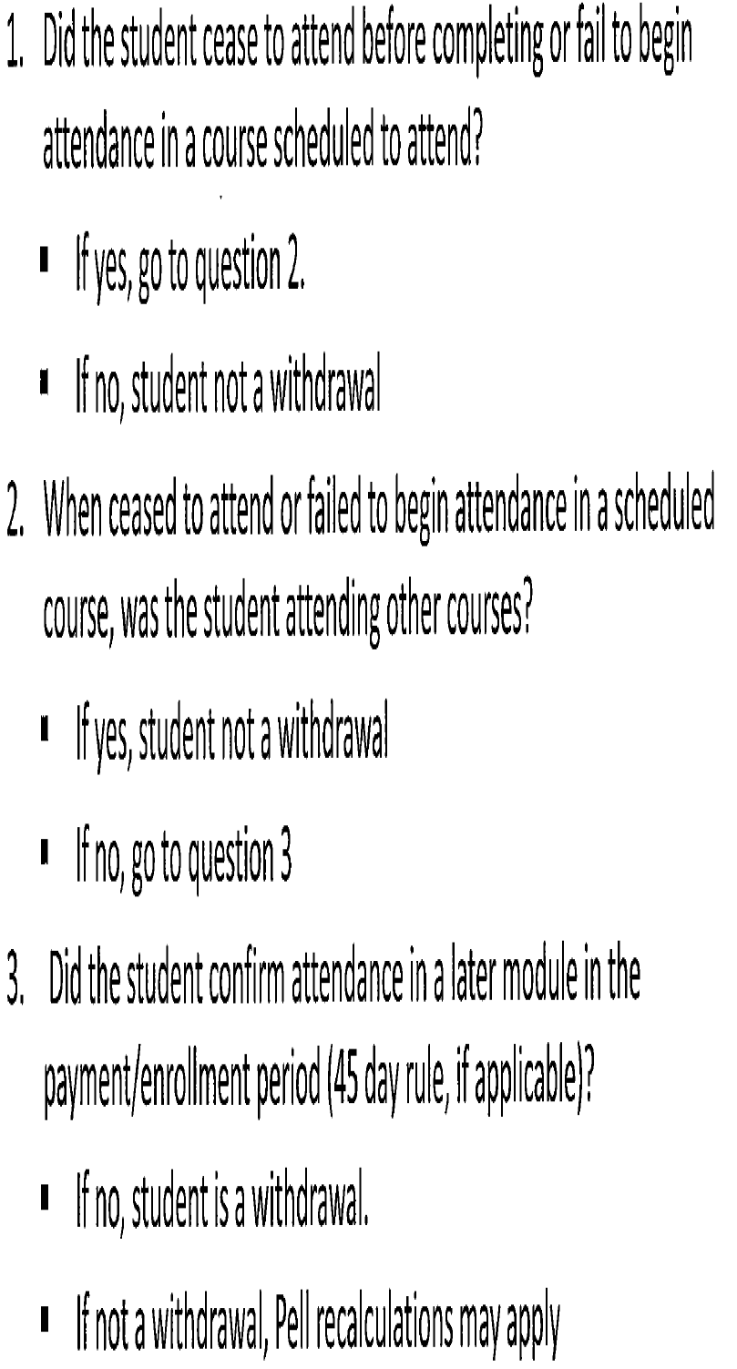
3 Questions to determine a withdrawal?
<number>

Slide 52

QUESTIONS?
<number>
Notes:
<number>

Slide 53
Contact Information
Dan Klock
dan.klock@ed.gov
202-377-4026 – phone
202-275-5000 - fax
<number>
Notes:
<number>

