Slide 1

NMFS FIS ER E-signature Project
Project Summary Brief
February 2009
Notes:
<number>
Thanks for the opportunity to talk about the progress of the e-signature group
Make sure to have your phone on mute with potentially 40 folks on the phone
Desired outcomes
understanding of a model for an e-signature project approval consistent with Procedural Directive
understanding of the issues involved in e-signature projects
understanding of a model for distributed team coordination and communication
Other outcomes for you?
Open to questions along the way. Might try use the tool to post questions or observations on chat and we can queue them up for the end of our presentation. We plan to present for about 30 minutes to leave time for conversation.

Slide 2
Table of Contents
Charter and Team
Roadmap
Timeline
Stakeholder Management
E-signature Alternatives Analysis
Summary of Risk Assessment of E-signature Pilots
Highlights of Illustrative Biz Plan for Hawaii Long Line Logbook
Challenge and Responses for the e-Signature Team
Roadmap and Model Artifacts for future e-signature projects
Next Steps/Recommendations
Notes:
Anything else you are interested in

Slide 3
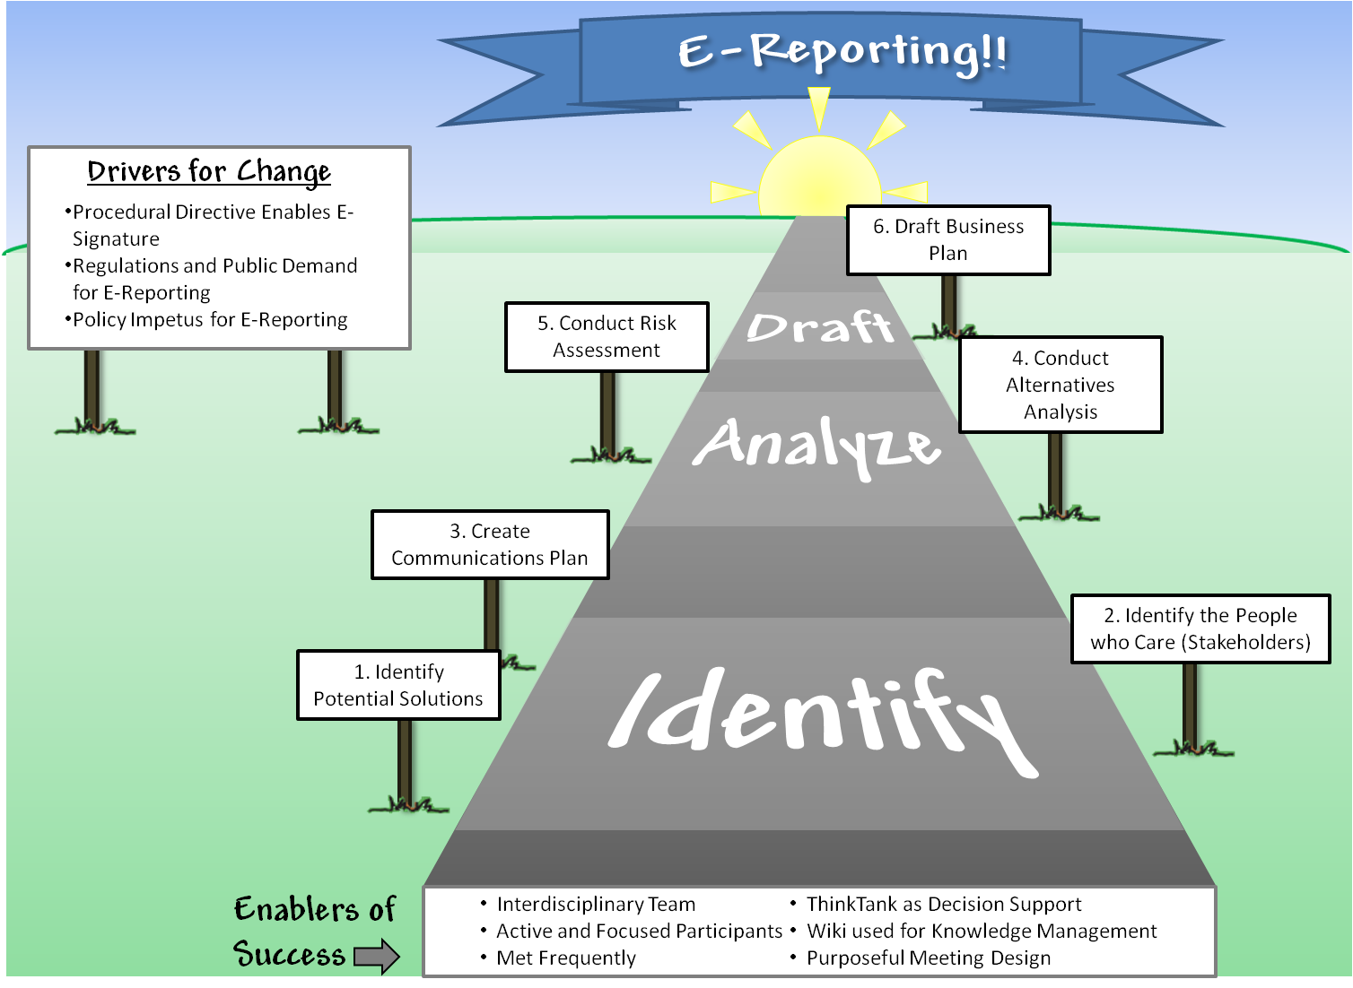
E-signature Team Procedural Directive Roadmap
Notes:
Highlight drivers for change
Policy
Regulations—timeliness and quality of data for managing fisheries.
Public demand
These drivers compel us to take a journey. Our presentation will give you an overview of how we traversed this terrain.
Enablers of success we will discuss “along the road”

Slide 4
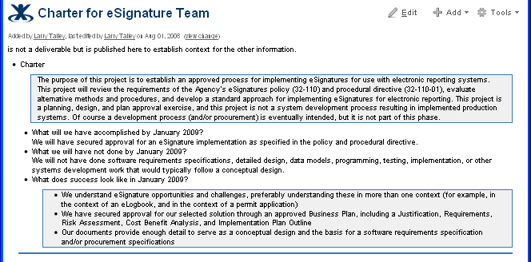
E-signature Team Charter
.../esig/Charter+for+eSignature+Team
Notes:
In initial project meetings we extracted charter statements from the ERPSG project proposal, and expanded that with some “what will success look like” detail to give us operational guidance
Understand e-signature risks, opportunities, and design tradeoffs, in more than one context (similarities and differences will be instructive)
One or more approved business plans
With sufficient detail to serve as basis for a software requirements specification

Slide 5
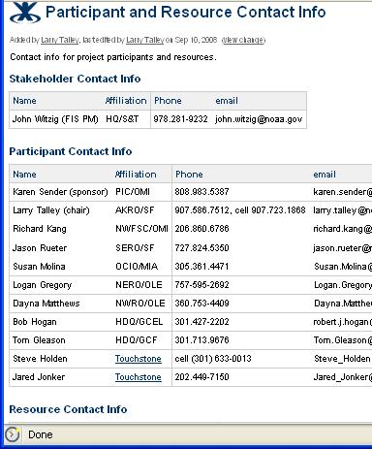
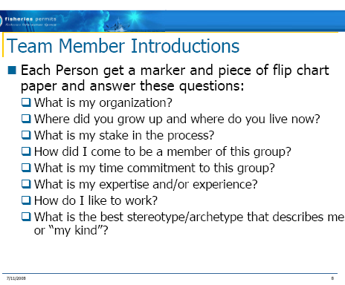
E-signature Team Composition
.../esig/Participant+and+Resource+Contact+Info
Notes:
On the left is the only page of the e-signature wiki that was static enough to print and tape up on my wall!
Fisheries people from multiple regions and centers
IT
Enforcement
GCEL and GCF
E-signature and organizational change subject-matter experts
Steve will speak to our team-building exercise on the right

Slide 6
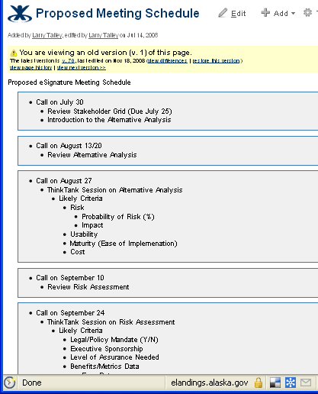
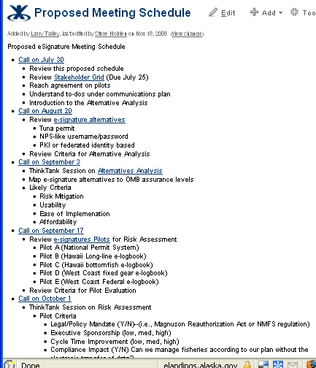
NMFS E-signature Project Timeline
.../esig/Proposed+Meeting+Schedule
<number>
Notes:
<number>
On the left is the original meeting schedule posted July 14
We stuck pretty close to schedule, eventually falling behind a few weeks, but keeping our established meeting dates and times
After some initial “prep work” we settled into meetings every-other-week
This consistency and predictability made it easier for participants to schedule this work, and we maintained a very good attendance record
Note wiki idiom -- a schedule page turns into a chronological record of meetings and deliverables

Slide 7
NMFS E-signature stakeholders
High
Keep
Satisfied
Manage
Closely
Regional
Offices
OMB
GCLE
OLE
NOAA
GCF
FIS
PMT
POWER
Monitor
(Minimum Effort)
Keep
Informed
Fisheries
Management
Councils
Office of
Policy
Software
Vendors
CIO
IT
Experts
End Users
Low
Low
INTEREST
High
Notes:
Realized that e-signatures are as much an organizational change effort as a technology and policy issue
Making the transition from paper-based to electronic processes is hard. Very tradition bound.
More detailed analysis supporting this, but wanted you to see a summary of the analysis
Wiki was a big part of keeping interested parties informed.
Group composition was a part of that.
Larry also created “in the loop” messages to highlight certain work to a group of folks who asked to be kept “in the loop.”

Slide 8
Five Step Process for Determining Desired Assurance Level (OMB Policy)
First two steps are the primary focus for the process the NMFS e-signature team used
Conduct risk assessment
Map identified risks to assurance level
Select technology based on NIST technical guidance
Validate that implemented system has achieved desired assurance level
Periodically reassess system to assure solution produces desired assurance.
Notes:
For most agencies, including ITC, the focus right now is on steps 1 and 2 since NIST technical guidance is out in draft. Public comment period just closed.

Slide 9

Alternatives Analysis for E-signature Choices
Think Tank screen shot
06/03/25
DRAFTNMFS eSignature Group
<number>
Notes:
One of the first steps in the OMB and NMFS procedural directive process is to understand the e-signature solutions
Note that e-signature solutions involve a trade-off between risk mitigation and usability
HMS (no-proofing, credit card)
NPS (user name password, long-standing, multi-faceted relationships)
USDA (face to face proofing at USDA service centers, with multiple IDs with trained employees)
Worth noting that we did this work on-line using ThinkTank as a decision support tool. Facilitation by Jared helped the team to reach consensus on our analysis and also resulted in this artifact to document the process and the results

Slide 10
Results--Risk Assessments for each NMFS E-signature pilot
The team ran five pilots through the risk assessment process required by the procedural directive:
Hawaii Longline Logbook (example to follow)
Hawaii Non-Commercial Bottomfish Logbook
National Permit System
West Coast Federal Fixed Gear eLogbook
West Coast E-fishticket
The team piloted the implementation of the procedural directive in two ways
Validated the approach by running the National Permit System (NPS) business plan through the risk assessment framework
Built on the NPS validation of the framework to create a template for business plans using the Hawaii Longline Logbook as a pilot
06/03/25
DRAFTNMFS eSignature Group
<number>

Slide 11
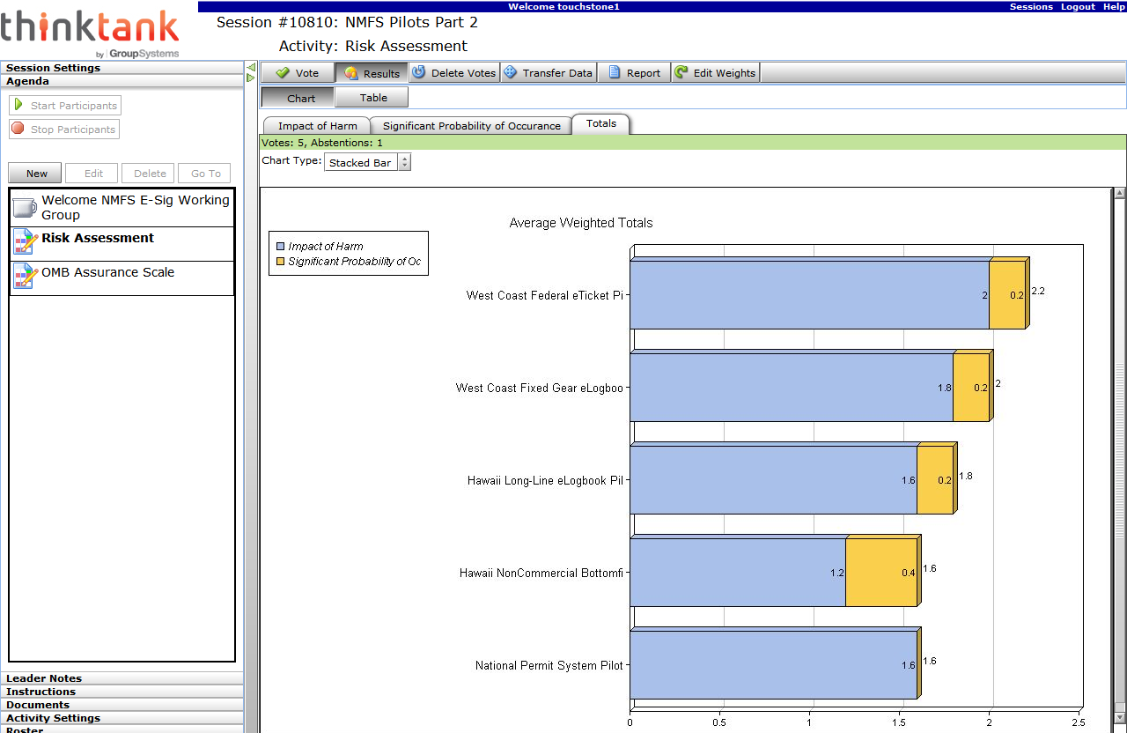
Risk Analysis Results in Thinktank
Notes:
Primary analytical step in policy framework from OMB and NMFS
Risk-based standard. No all impacts are realized.
Impersonation in e-logbook transactions Common criminal/identity thief Impersonation using stolen identity credentials, with fraudulent reporting of false data to incriminate or defame victim Inconvenience, distress or damage to standing or reputation Low: opportunity will be limited because the e-logbook is onboard the vessel at sea and protected by two layers of security controls (access controls on the vessel's computer, and access controls on the e-logbook software); also common criminals are unlikely to have subject-area expertise to discover an incrimination or defamation opportunity and there are probably easier attacks Low: impersonated parties or agency staff would be likely to notice during dockside interview process and/or subsequent data review, and when detected, the impact could be effectively mitigated No net cost or benefit: e-reporting and e-signature provide two layers of security controls (access controls on the vessel's computer, and access controls on the e-logbook software); the traditional paper logbook may have been laying about on the bridge with no security control. However, this may be balanced by the fact that it is easy to understand and mitigate the risk with the traditional paper logbook (the skipper will understand the risk and the potential solutions), while the risks associated with electronic solutions won't be well understood.

Slide 12
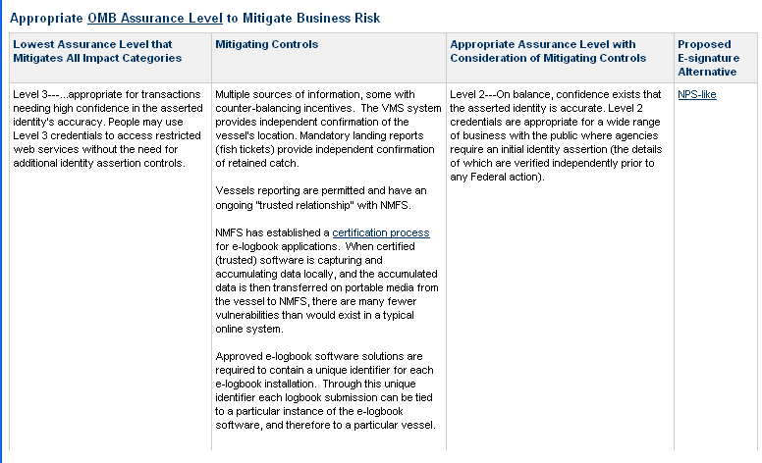
NIST Special Publication 800-63: Electronic Authentication Guideline
Mapping of assurance level to technology – Hawaii Longline Logbook result:
Notes:
NIST, OMB, and NMFS policy and procedure proscribe a specific approach
OMB has established four assurance levels ranging from level 1, “John Doe” (no assurance of identity) to level 4, “DNA evidence” (only a slight exaggeration)
OMB specifies what is essentially a formula, where you input your risk assessment, and the output is an assurance level
But the OMB process has some flexibility
So in practice the formula produces an initial assurance level, and then human judgment is applied to the total system, including mitigating controls, to arrive at an “appropriate” assurance level
For the Hawaii Longline Logbook situation the formula generated level 3, a level which requires a complex technical token (much more than a complex password)
However, given the mitigating controls, the team’s judgment was that level 2 would appropriately address the risks
Note that the proposed e-signature alternative is specified as “NPS-like”. Hawaii may or may not decide to use NPS software components, but, this category allowed the team an efficient way to describe a general constellation of e-signature features, which include:
Identity proofing with shared secrets from historical relationship
Username and password as an identity credential
E-signature validated by password, stored in encrypted PDF
Implemented with due diligence but with ordinary technology

Slide 13
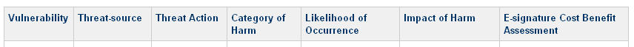
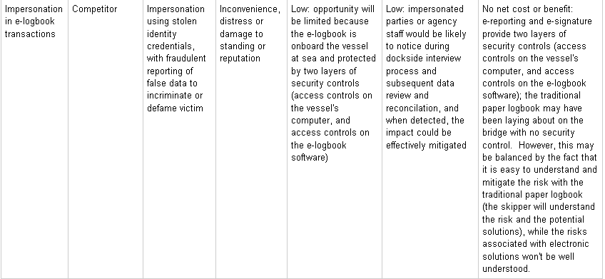
Hawaii Longline Logbook: Risk Assessment
.../esig/HLL+Risk+Assessment
Notes:
In the proscribed process the risk assessment is an early step, to identify losers early so you can cut your losses
I won’t dwell on the risk assessment, but I wanted to give a brief glimpse
This happens to be one of 17 vulnerability/threat combinations that we considered for Hawaii Longline Logbook
The columns in the table and the category definitions come from NIST, OMB, and NMFS policy and procedure

Slide 14
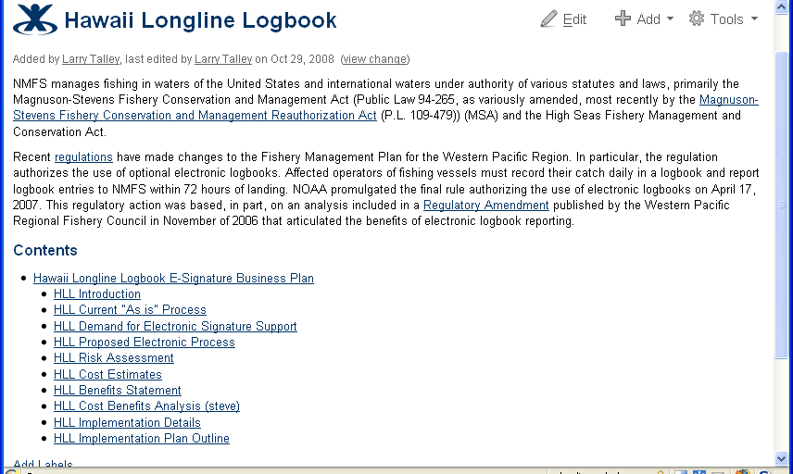
Hawaii Longline Logbook: Business Plan
.../esig/Hawaii+Longline+Logbook+E-Signature+Business+Plan
Notes:
If the project still appears to be feasible after the risk assessment, it is time to draft other parts of the business plan.
The sections of the business plan are specified in the procedure document. We have already looked at the risk assessment, and I want to drill into just one more section.
Being a programmer myself, I want to talk about the implementation details

Slide 15
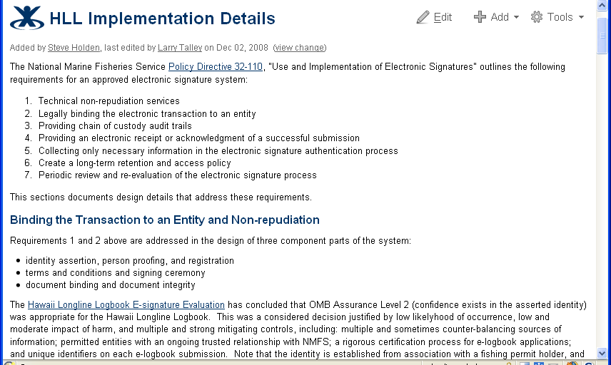
Hawaii Longline Logbook: Implementation Details
.../esig/HLL+Implementation+Details
Notes:
Luckily for you I won’t have time today to really get into this
I want to point out that again, there are specific requirements from the policy directive to address at this level
The policy directive doesn’t mandate a particular level of detail
Since this team was chaired by a programmer I would guess that the model documents coming out of our process probably have as much emphasis on implementation details as anyone could expect
My target for this section was to provide enough detail to enable planning of a software requirements specification effort

Slide 16
NMFS E-signature Challenges
Problem domain challenges: e-signature is a broad cross-cutting issue
technical concerns
legal concerns
business process concerns
customer service (usability) concerns
organizational change concerns
NMFS formed a cross-disciplinary and geographically dispersed team, which introduced another set of challenges
achieving commitment to the team, "buy-in"
scheduling across six time zones and different "day job" demands
communication and coordination among team members
joint authorship and decision-making with a distributed team
version control for collaborative work products
communication to a diverse set of stakeholders
06/03/25
DRAFTNMFS eSignature Group
<number>
<number>
Notes:
<number>

Slide 17
Response to Challenges
Held a face-to-face kickoff with explicit focus on achieving buy-in and building trust.
Used email and a consistent and predictable meeting schedule to address the scheduling challenge.
Leveraged a wiki for communication and coordination, version control, and communication to stakeholders.
Also used a decision support application, ThinkTank, with the wiki to address joint authorship and decision-making and to create a repository of actions and outputs.
The wiki was particularly helpful for stakeholder communication by providing a transparent venue for the broad cross-cutting set of stakeholders to see what was going on.
Contractor support
Domain expertise with e-signatures
Domain expertise with facilitating change
Decision support using Thinktank
Purposeful Meeting Design (face to face and remote design and facilitation)
06/03/25
DRAFTNMFS eSignature Group
<number>
<number>
Notes:
<number>
Some of you know that prior to this project I had developed an e-signature system for the State of Alaska. When I volunteered to chair this team, I was aware of some of the challenges, and I knew from the beginning that I wanted to engage a consultant. As I was doing some initial research on Google, I read a couple of Steve’s publications on e-signature in government, and I sent him an email asking for clarification of one of his slides. Imagine my delight when he responded that he was no longer a professor in academia but was now a consultant!
It got even better when I found that his consulting firm specializes in facilitating organizational change.
I should also point out that using Thinktank for decision support can be so easy and natural that it can be taken for granted, but, while it is simple to use, I think there are some big benefits. Obviously it is nice to have pretty documentation of how the decisions were made; but in our case Thinktank, or perhaps our Thinktank consultant, also helped by forcing us to structure and organize some of our decisions.
Finally, Steve and Jared’s attention to “purposeful meetings” contributed strongly to team success and satisfaction

Slide 18
E-signature Team Procedural Directive Roadmap
Notes:
This brings us back to the graphic of the journey to e-reporting.
Having traveled this road, we to know that we believe we have left if better than we found it by creating the model artifacts shown in the sign posts.
We were very fortunate that Susan Molina’s NPS team blazed this trail (tired of this metaphor yet?) and were able to abstract from the specifics to a more general model that others in NMFS can follow to comply with the procedural directive.
We would like to think that Karen Sender and the folks in Hawaii have benefited by us creating a relatively polished business plan for Hawaii Longline Logbook in a relatively short amount of time using the NPS business plan as a shell and dropping in substance from the wiki from the group’s analysis.

Slide 19
Next Steps for NMFS Implementation
Pilot e-signature draft business plans are close to approval per policy and procedural directives
Wiki needs to be transitioned from a working collaboration tool to a reference site for future e-signature initiatives
Projects that follow the process described should be compliant with:
the OMB e-auth policy
NIST technical guidance
NMFS policy
NMFS procedural guidance
Per current understanding of policy and procedure e-signature projects should go through this analysis individually
With some real-world experience it may be feasible to have a “logbook” business plan and a “fish ticket” business plan, and realize economies of scale in the analysis and conceptual design phases
While policy and procedure mandates specific risk and cost/benefit assessments, it seems likely that generic software components could be developed and shared (“NPS-like” e-signature web service?)
06/03/25
DRAFTNMFS eSignature Group
<number>
Notes:
Business plans are still in draft and need to be finished
We need to flesh out the wiki with the roadmap, signposts, and model documents to make it a better resource for future e-signature projects
New e-signature projects still have to do the work to go through this process, but, it should be easier with this guide
I suggest that as soon as we have two e-logbook projects with e-signature requirements, or two fish ticket projects, we then attempt to achieve economies of scale in this analysis and conceptual design phase
But we may already have two or more projects that are ready to use “NPS-like” e-signature implementations, and it may make sense to develop shared software services soon

