Slide 1
Fluorescence Measurements at ANL and the Auger Experiment
Motivation for Fluorescence Calibrations
AIRFLY Fluorescence Experiment at ANL
Auger Experiment Update

Slide 2
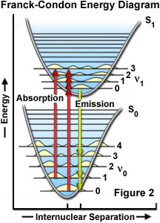
N₂ Molecule Vibrational Energy Levels
337nm transition

Slide 3
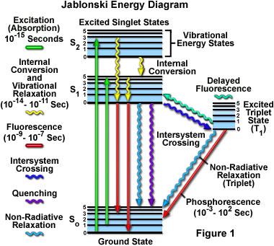
Main transitions are fast, nanoseconds

Slide 4
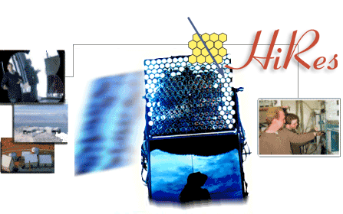
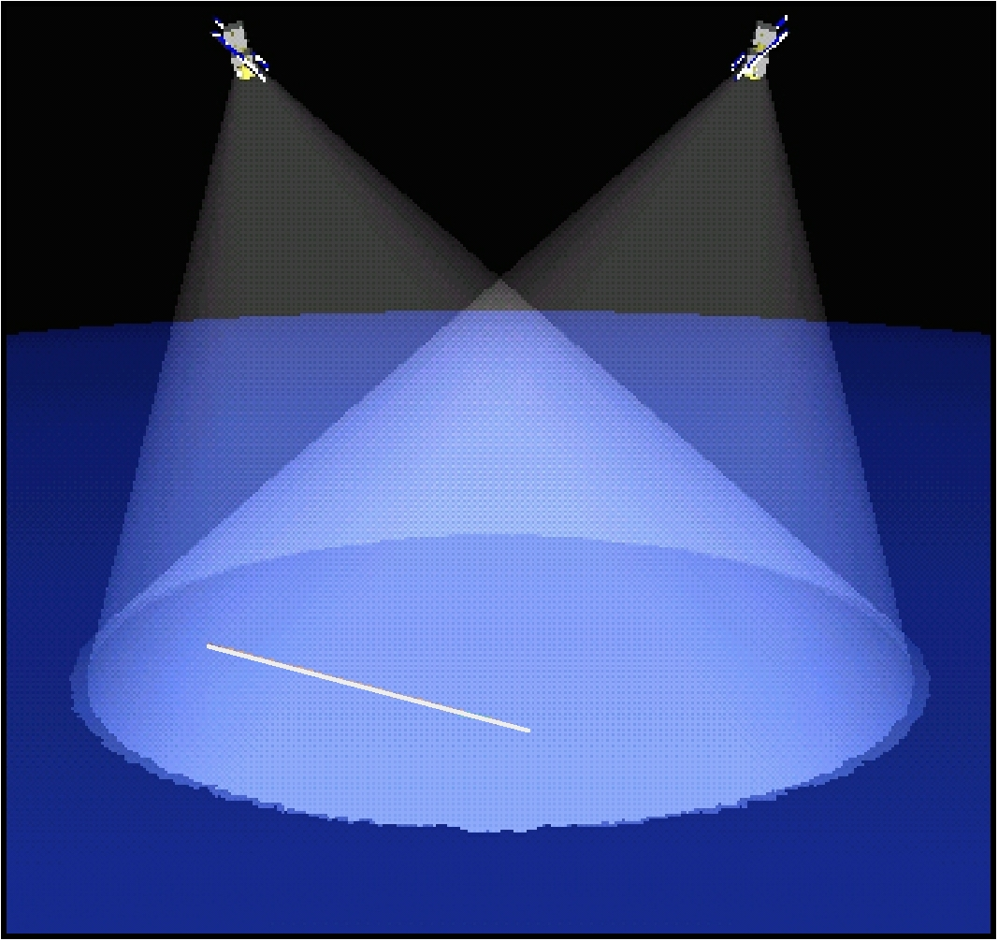
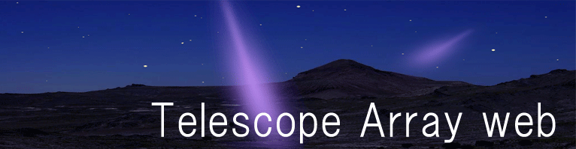
Auger
Many experiments use or will use Nitrogen Fluorescence
OWL and EUSO space- based experiments

Slide 5
Scintillator
Fluorescence

Slide 6
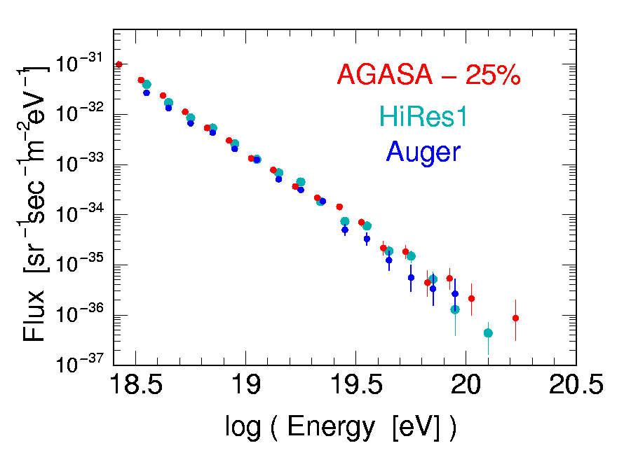
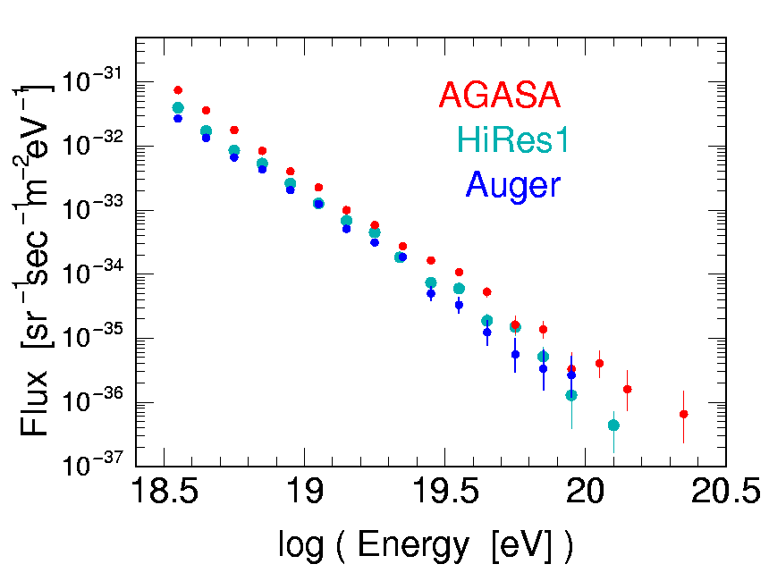
Due to smaller model dependence, Auger normalizes to its fluorescence detectors. Looks like HiRes. Only a 1σ discrepancy (25% in energy scale). Need to reduce σ…
0.22 Auger- years of data

Slide 7
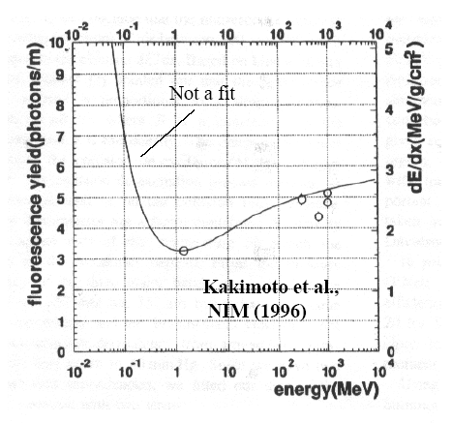
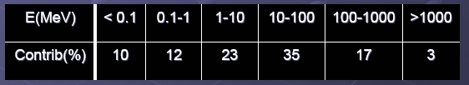
One example measurement of electron-induced fluorescence
Not an absolute measurement
Agrees with curve?
45% of Fluorescence Due to Electrons and Positrons < 10 MeV in 10¹⁹ eV Shower

Slide 8
Much more information needed…
Pressure, Temperature, Humidity dependence
Oxygen quenching
More complete energy scan
Absolute measurement to 5%

Slide 9
Much more information needed…
Complete Spectrum from 300-400 nm (Rayleigh scattering 1/Λ⁴)
Spectrum has been measured before but only piece-by-piece with 14 filters, each with different inefficiencies and acceptance from wrong wavelengths

Slide 10
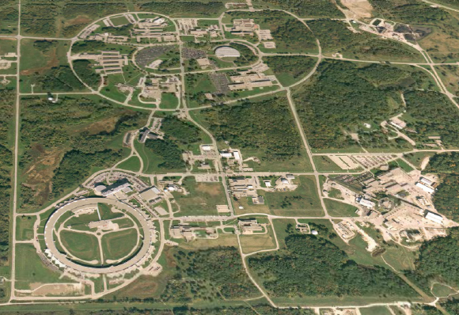
Fluorescence Calibration at Argonne
Chemistry Division Van de Graaff
HEP Division Advanced Wakefield Accelerator
Advanced Photon Source
Complementary machines: AWA only accelerator with enough energy to do absolute calibration with Cerenkov gas. Van de Graaff only machine with enough charge to measure spectrum.

Slide 11
Heroes…
AWA group notably Manoel Conde, Felipe Franchini, Zikri Yusof
Chemistry staff notably Sergey Chemerisov and Bob Lowers

Slide 12
APS
AWA
Chemistry
45% of Fluorescence Due to Electrons and Positrons < 10 MeV in 10¹⁹ eV Shower

Slide 13
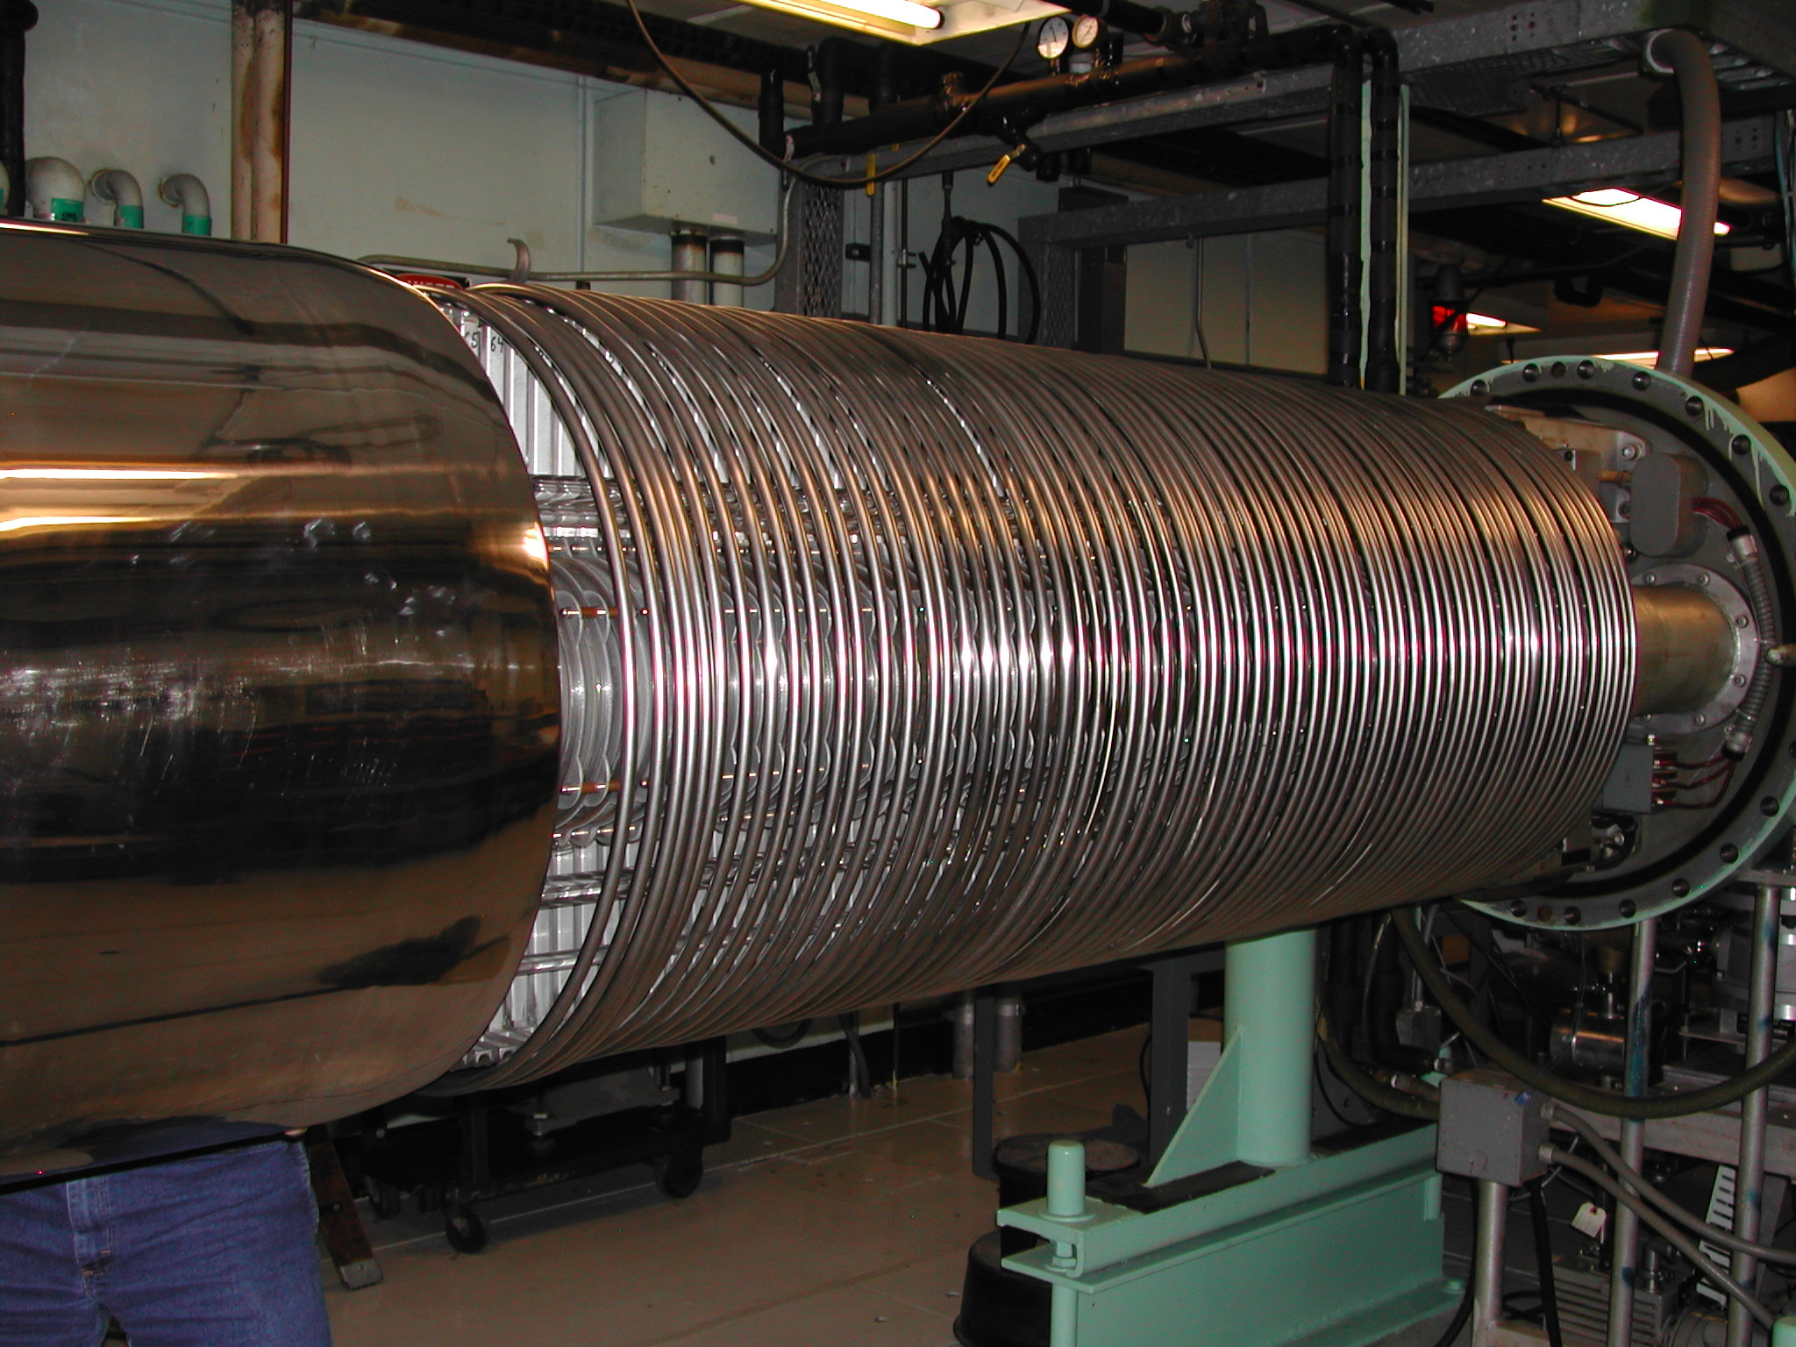
Van de Graaff with cover removed
Resistor plates step V down to zero
Charged to 3 million volts
Beam

Slide 14
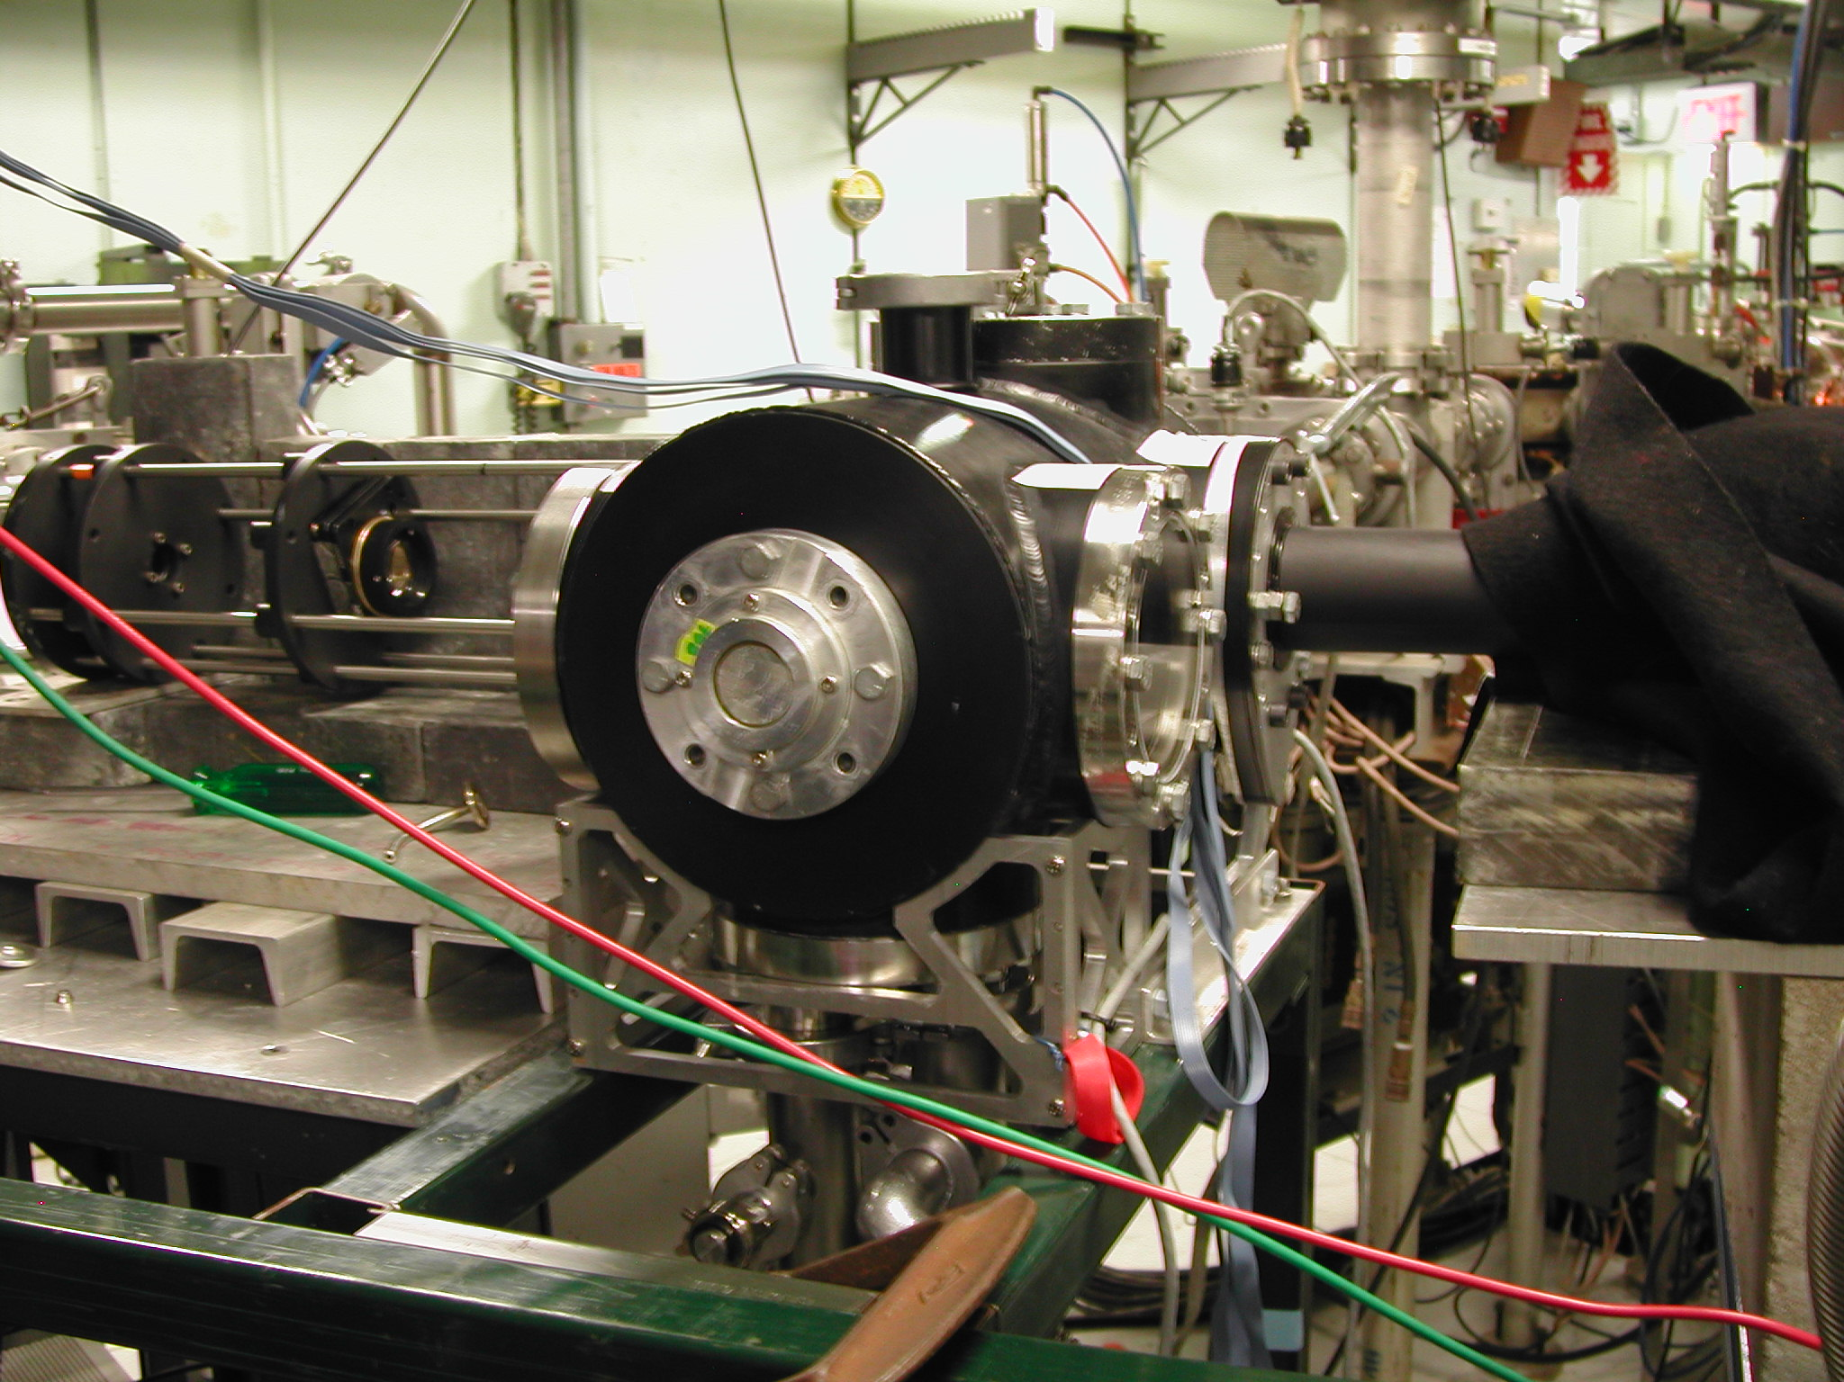
AIRFLY Experiment, led by Paolo Privitera from INFN

Slide 15
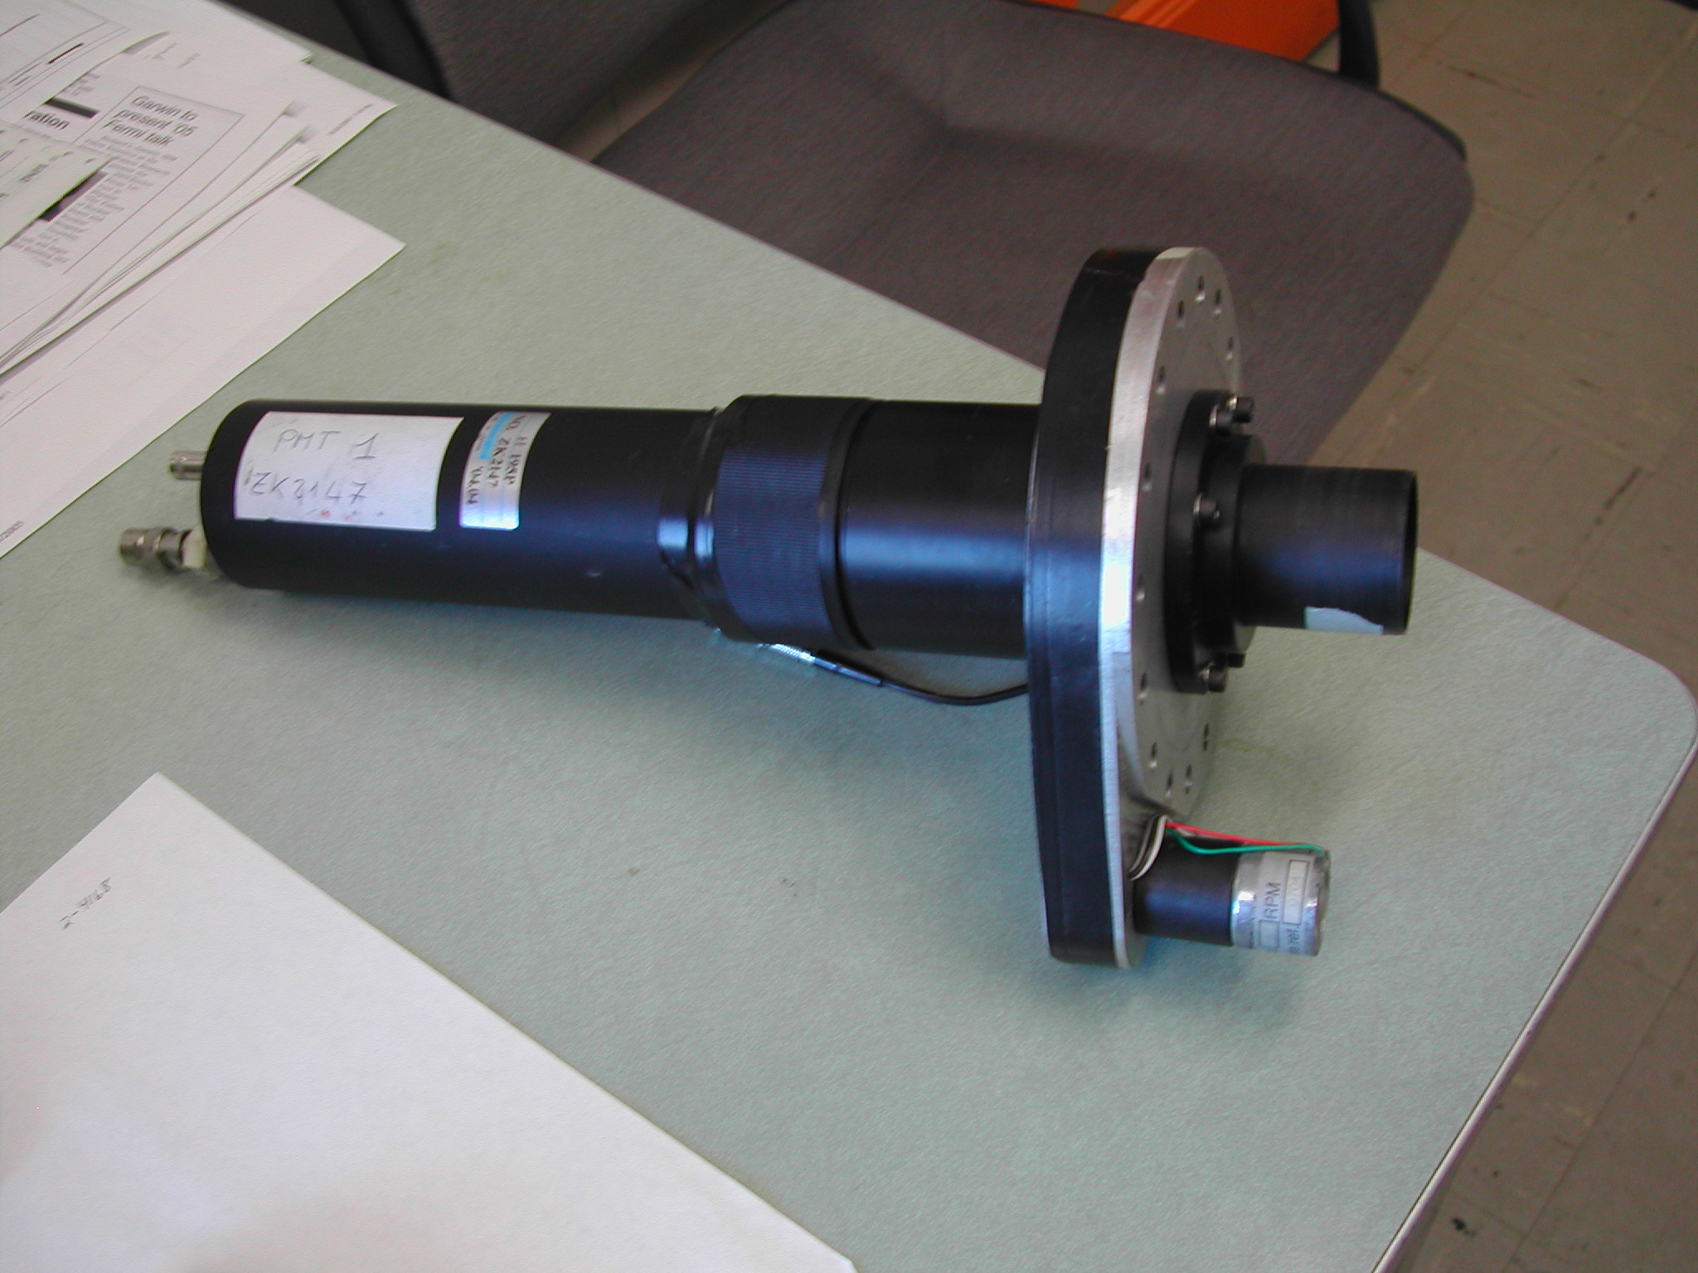
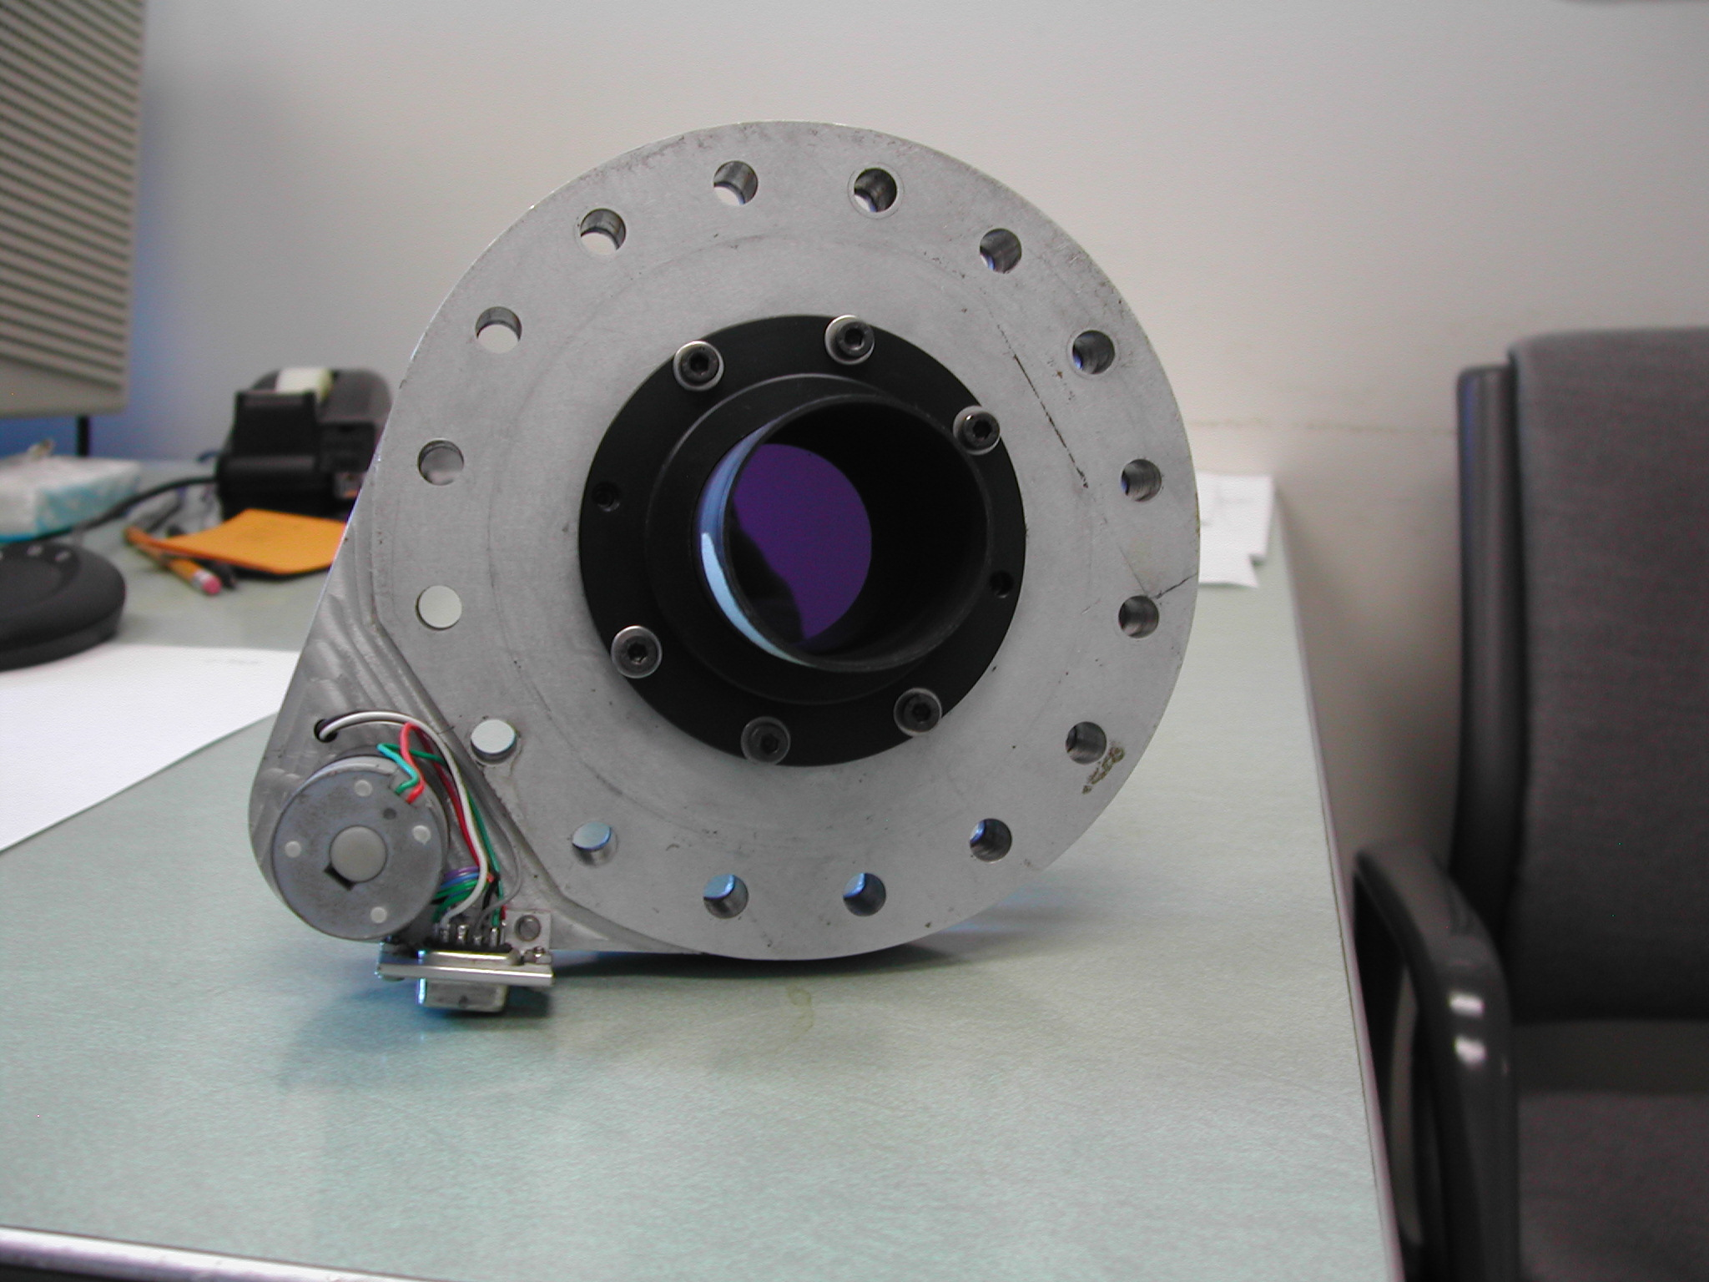
AIRFLY Experiment, led by Paolo Privitera from INFN

Slide 16
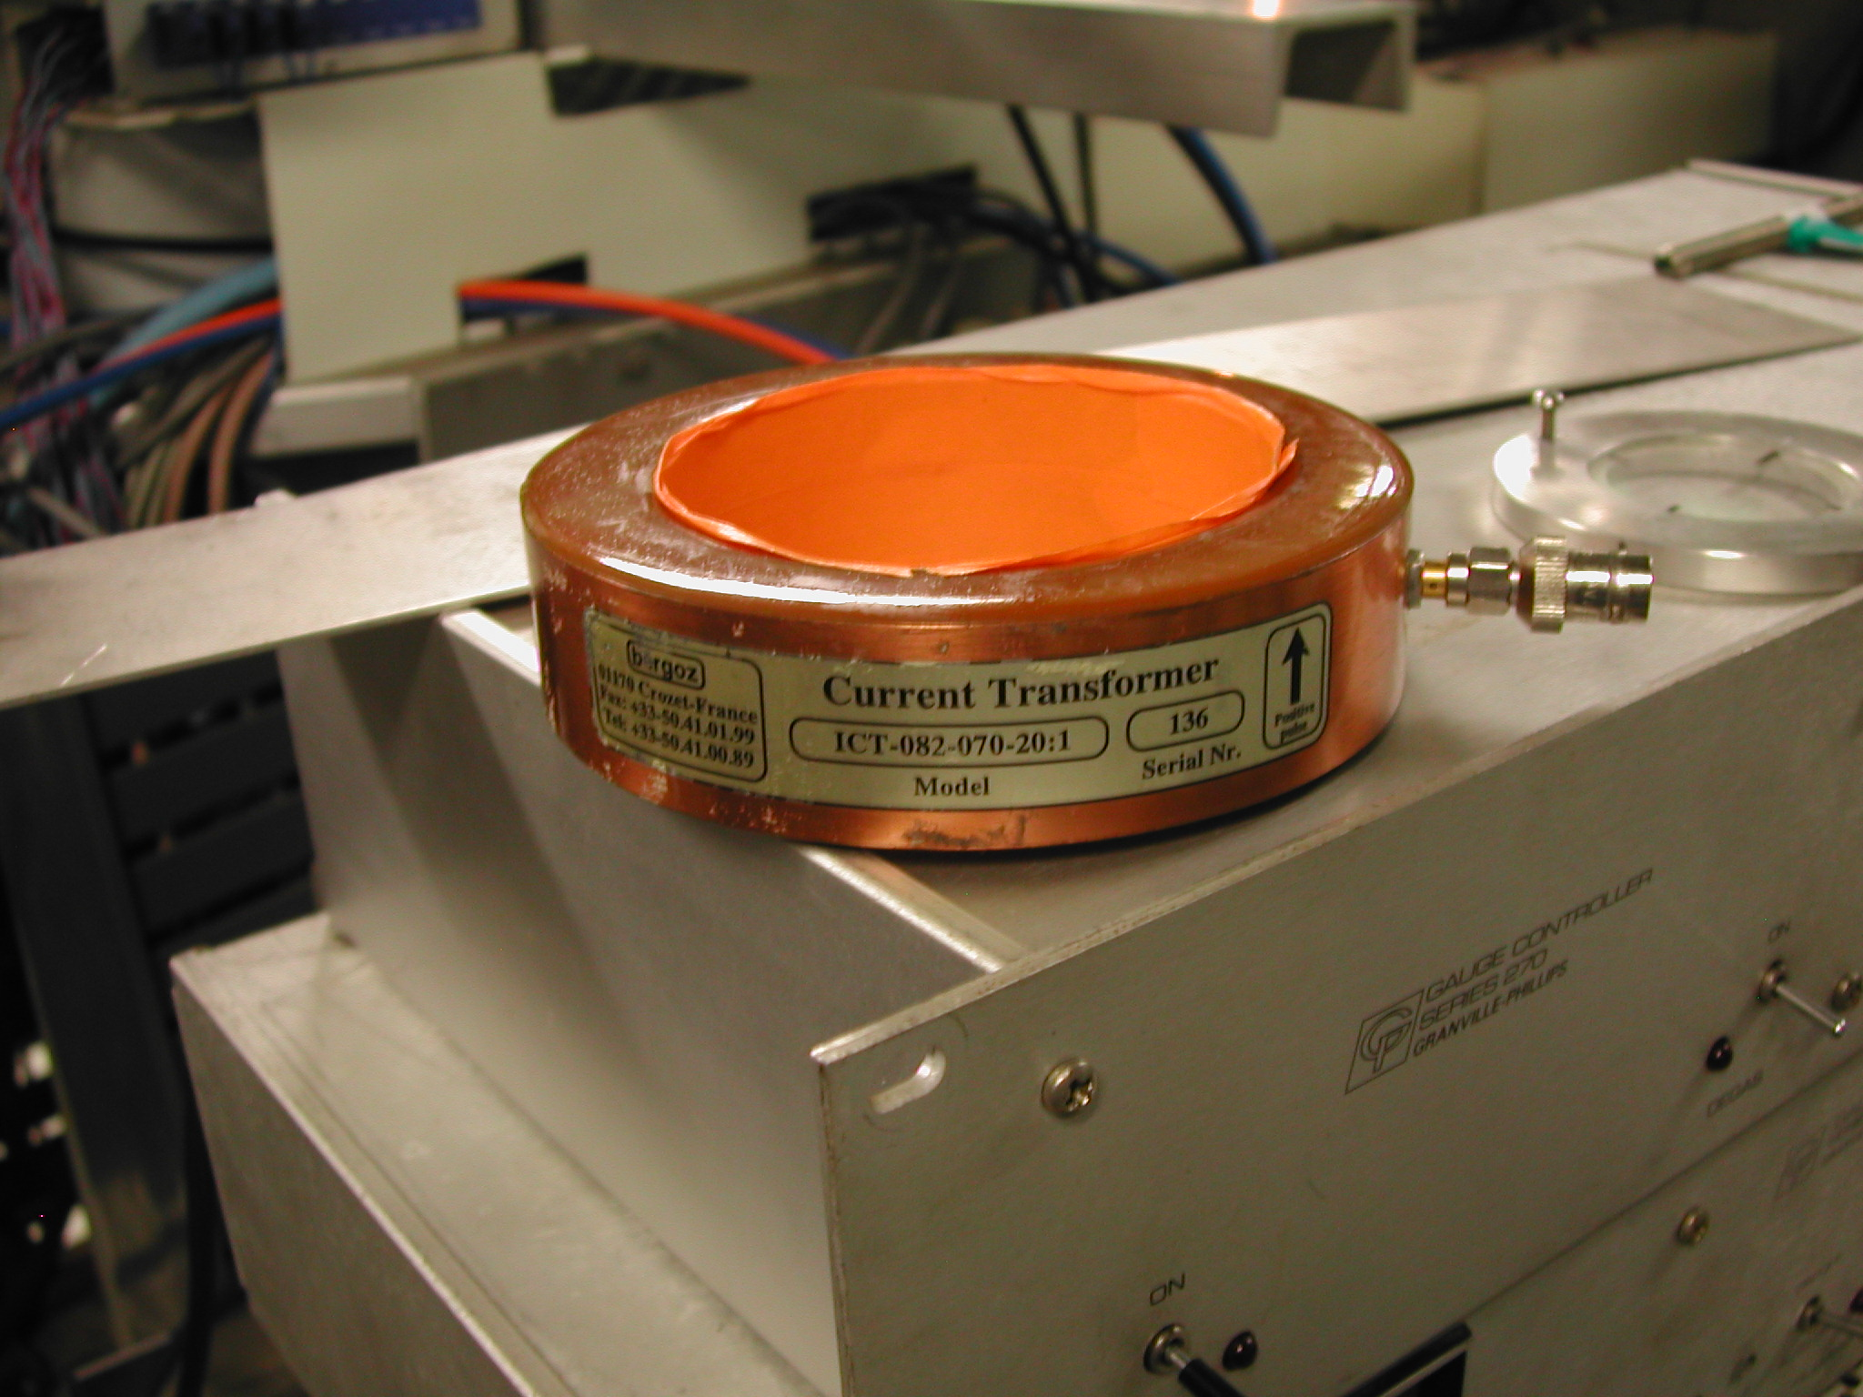
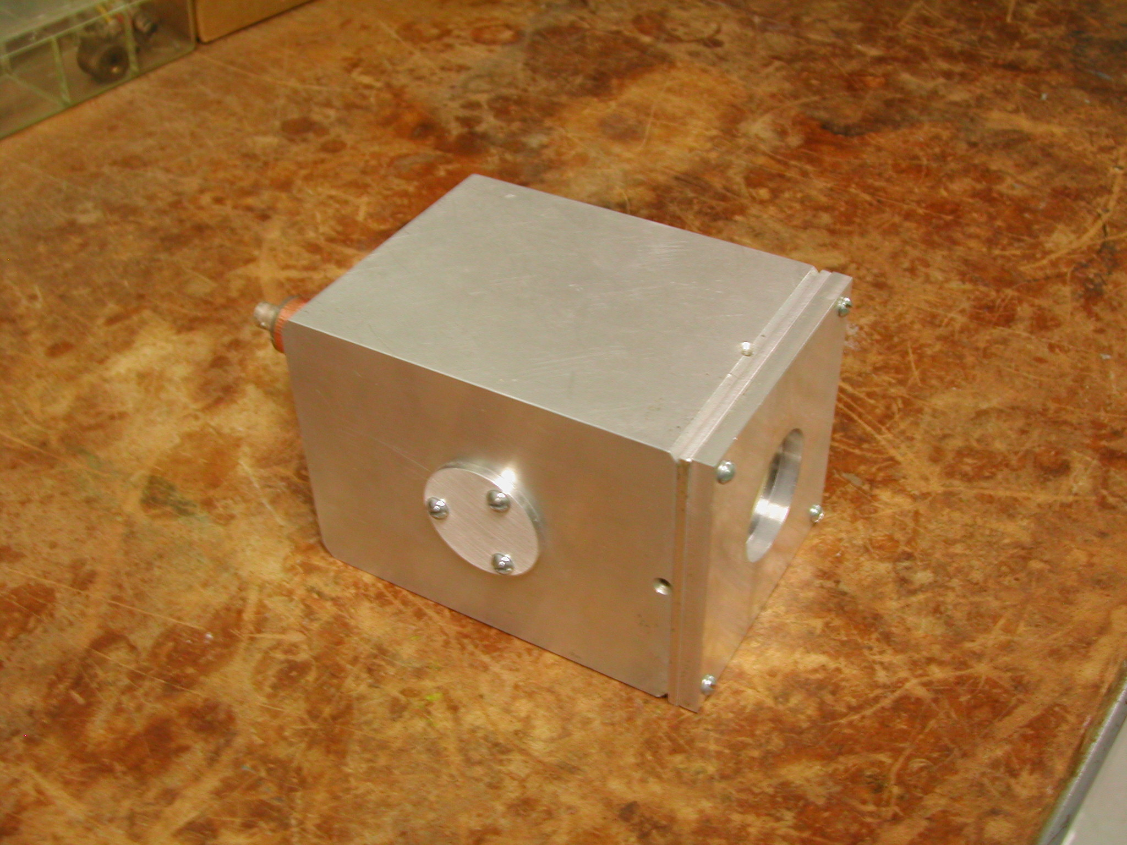
Beam Pickup, used for all the PMT measurements
Faraday Cup, mainly used to check Pickup
Will fit slopes from PMT vs Pickup, an experiment with 2 electronics channels!

Slide 17
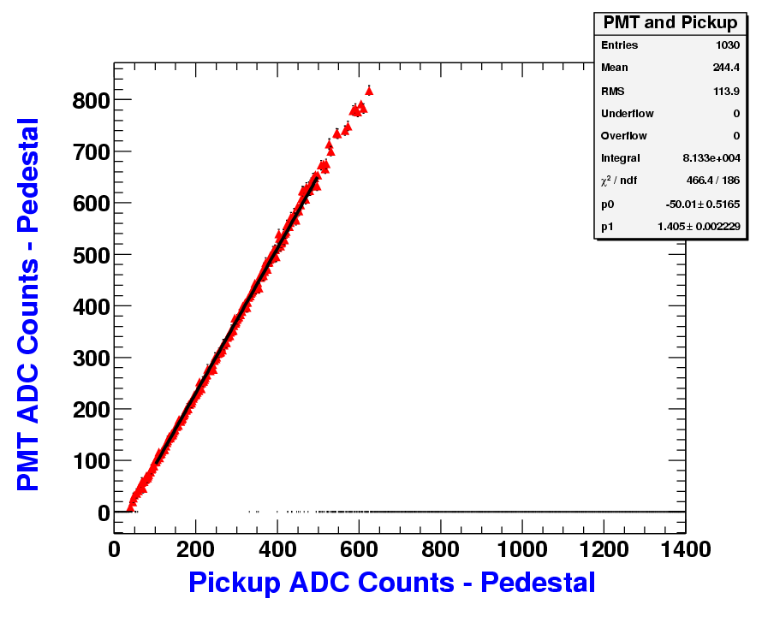
AWA PMT Fluorescence Data, 14 MeV electrons

Slide 18
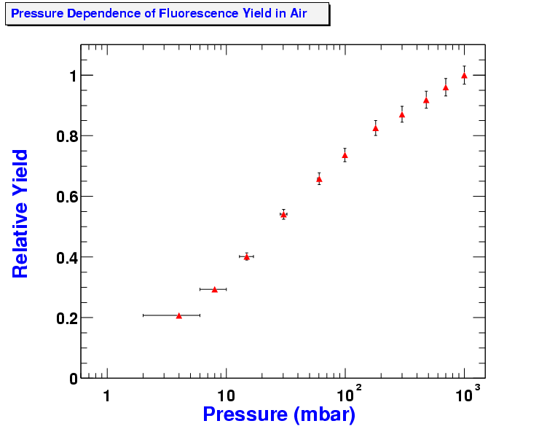
AWA PMT Fluorescence Data, 14 MeV electrons

Slide 19
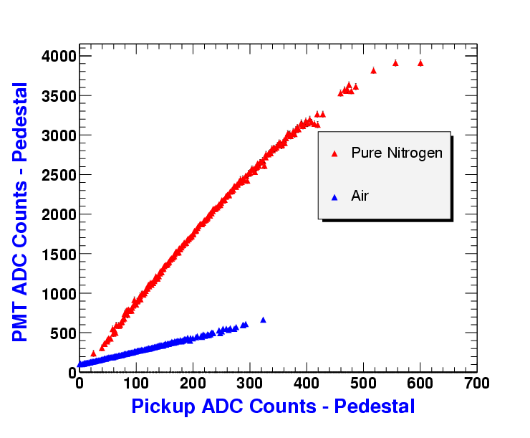
AWA PMT Fluorescence Data, 14 MeV electrons
Oxygen quenching due to molecule collisions with N₂*

Slide 20
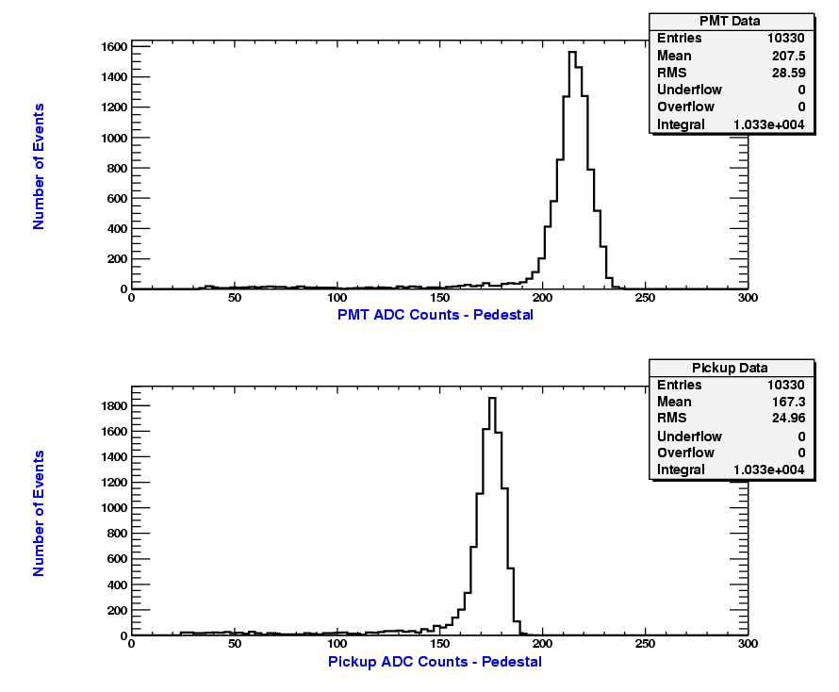
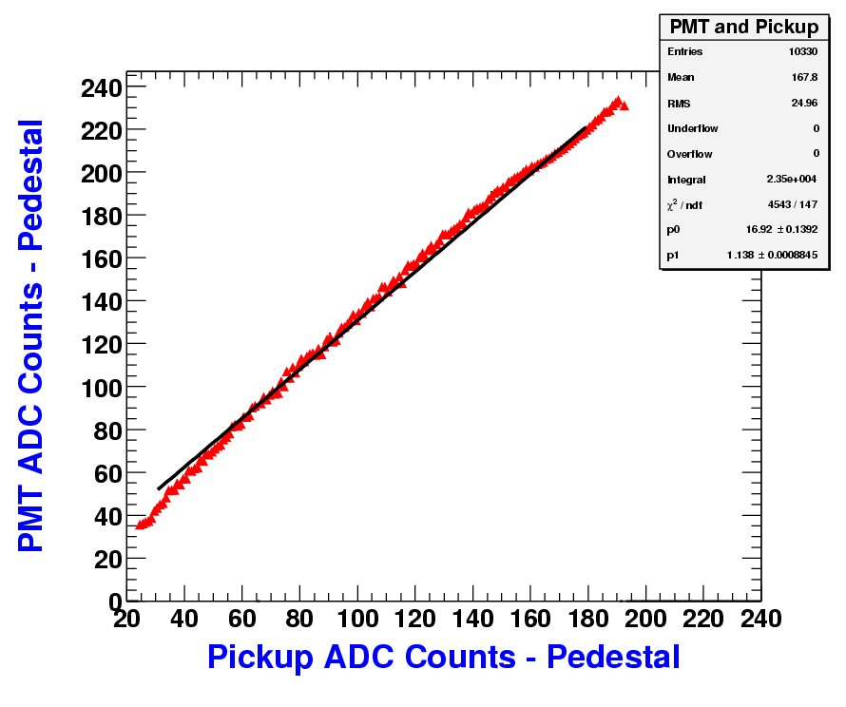
0.5 MeV Run at Van de Graaff with beam halo

Slide 21
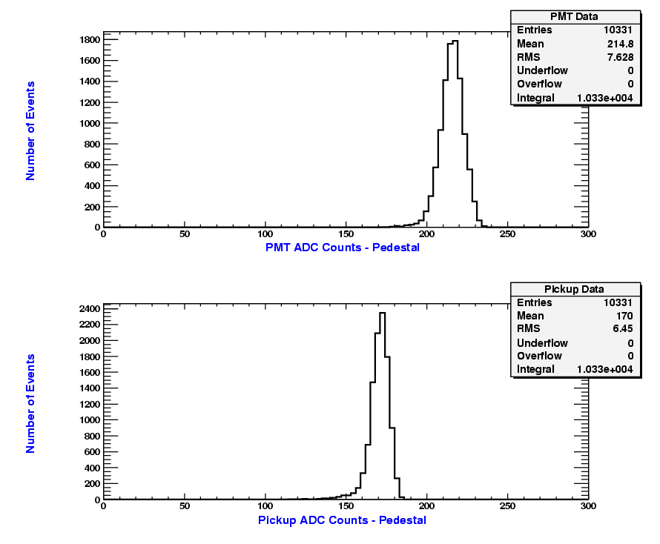
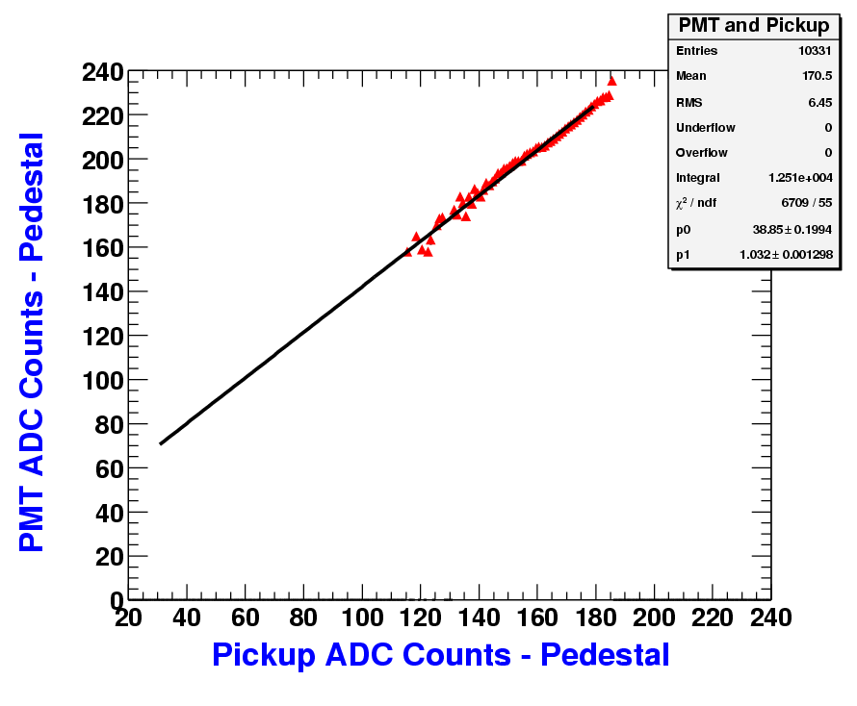
5 minutes later, beam halo is gone
Cut ±2 sigma around main beam pickup peak for both AWA and Van de Graaff

Slide 22
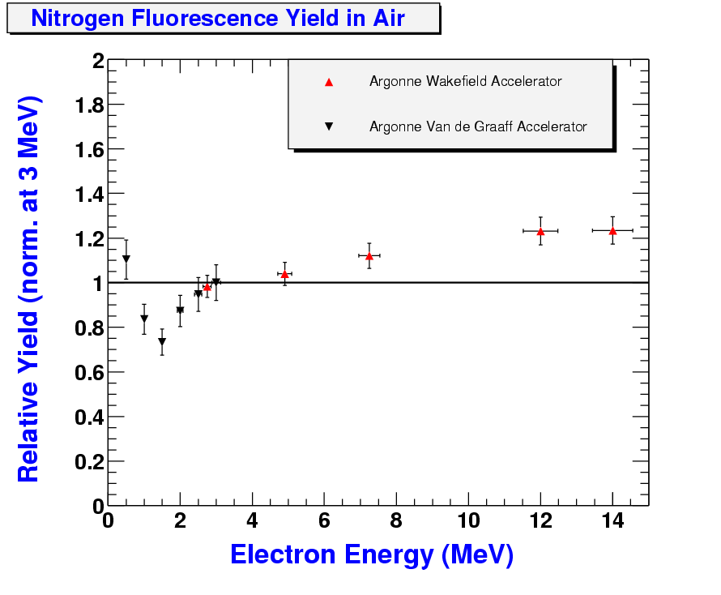

Slide 23
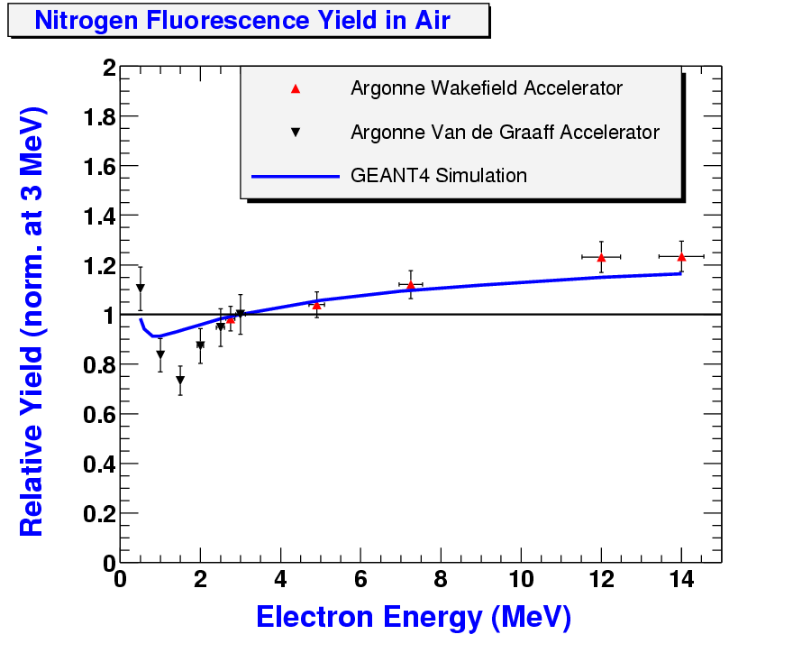
Don’t take too seriously yet, different low energy input gives different curves.

Slide 24
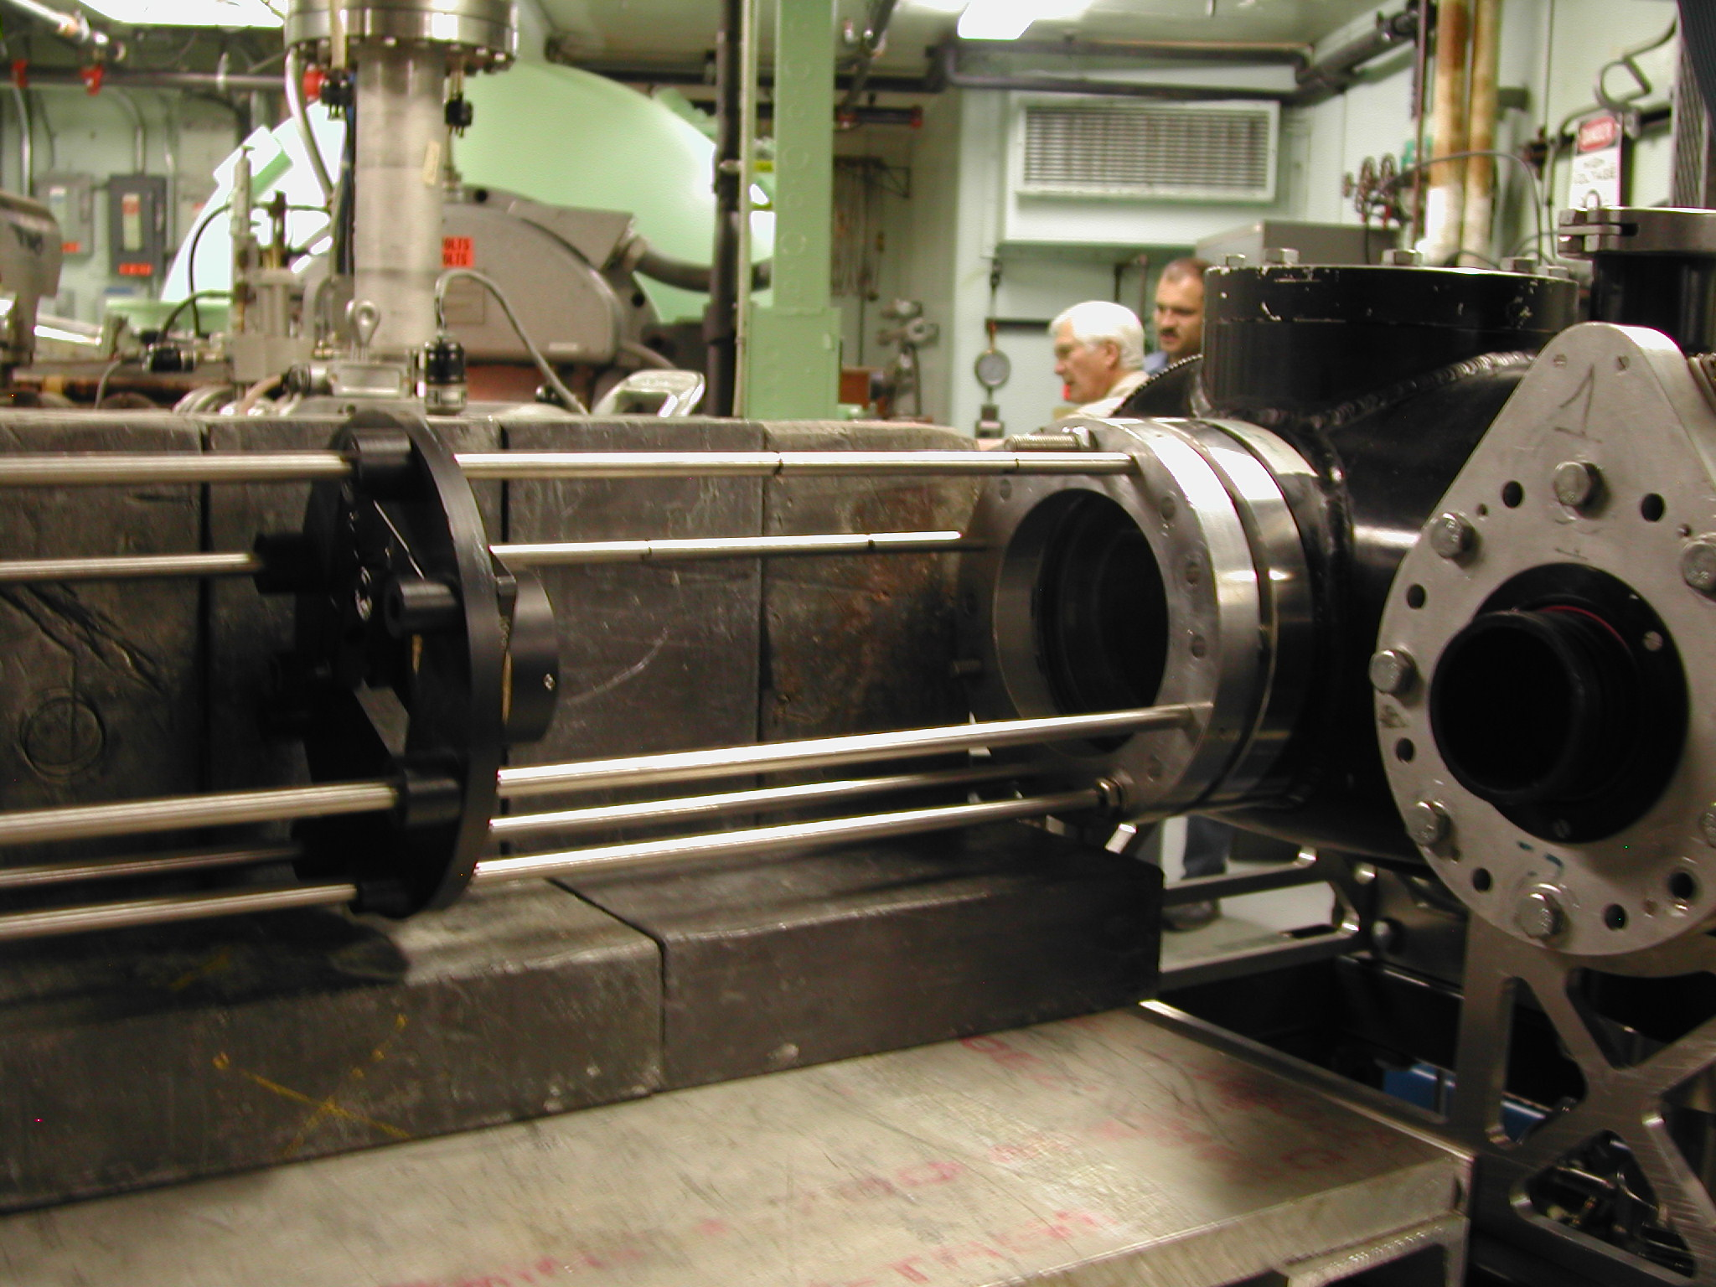

Slide 25
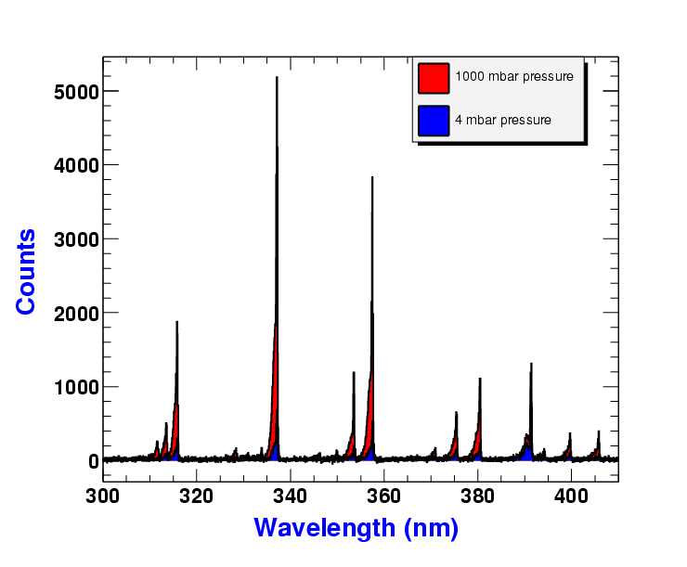
5 minutes of raw data!

Slide 26
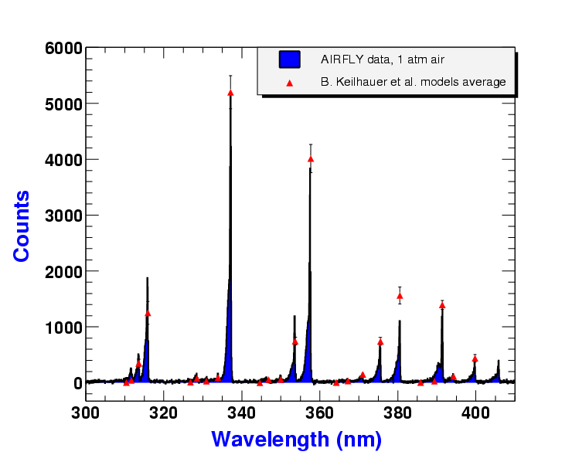
Model normalized at 337nm

Slide 27

Model normalized at 337nm

Slide 28

Model normalized at 337nm

Slide 29
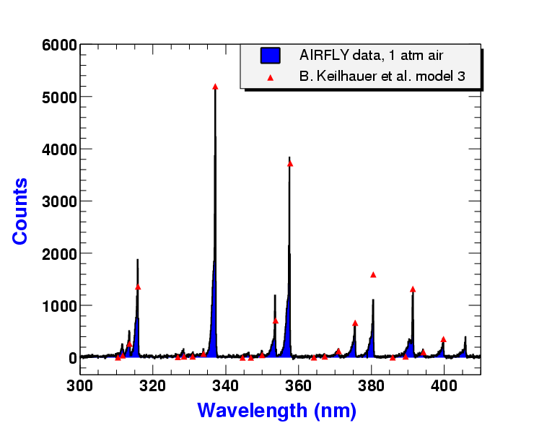
Model normalized at 337nm

Slide 30
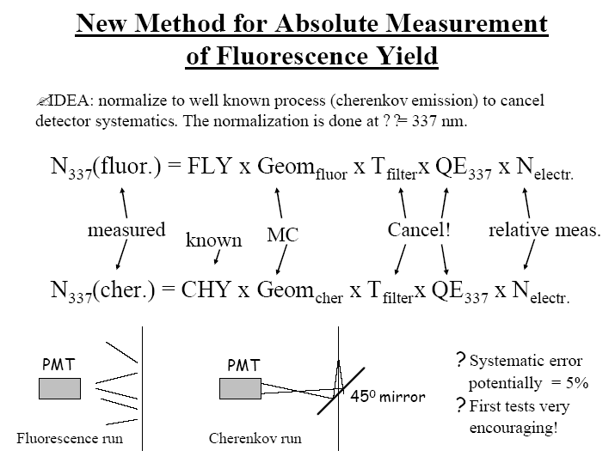
Main goal for December running at AWA

Slide 31
The End

