Slide 1
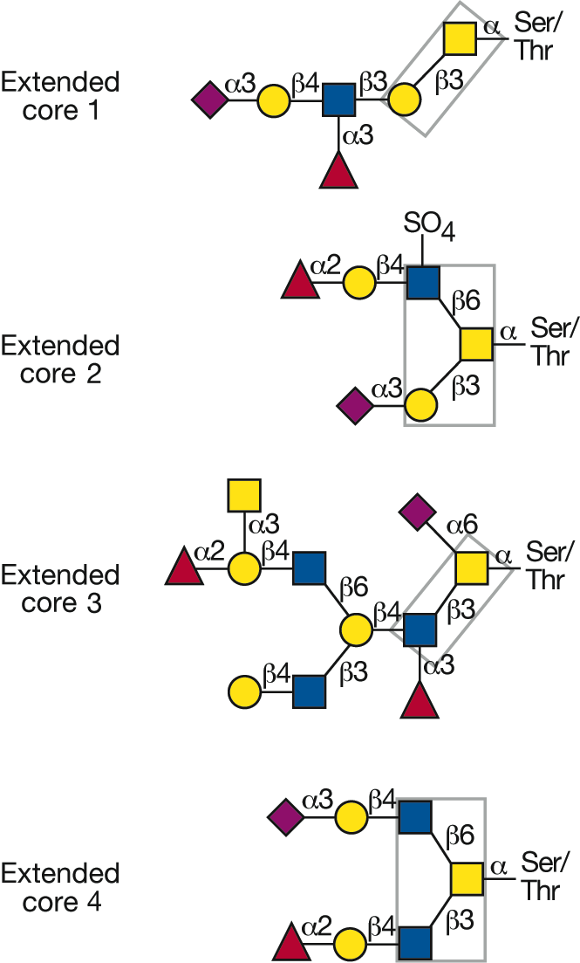


Complex O-GalNAc glycans with different core structures
Essentials of Glycobiology
Chapter 9, Figure 2
Second Edition
Notes:
<number>
FIGURE 9.2. Complex O-GalNAc glycans with different core structures. Representative examples of complex O-GalNAc glycans with extended core 1, 2, or 4 structures from human respiratory mucins and an O-GalNAc glycan with an extended core 3 structure from human colonic mucins. All four core structures (in boxes) can be extended, branched, and terminated by fucose in various linkages, sialic acid in α2-3 linkage, or blood group antigenic determinants (Table 9.1). Core structures 1 and 3 may also carry sialic acid α2-6-linked to the core N-acetylgalactosamine.

