Slide 1
Water Quality Trading & EPA
Ginny Kibler
April 30, 2007
EPA Office of Water

Slide 2
TOPICS
CLEAN WATER ACT FROM A TRADING PERSPECTIVE
EPA NATIONAL WATER QUALITY TRADING POLICY
WQT NATIONAL PICTURE

Slide 3
Clean Water Act Components
Water Quality Standards
Total Maximum Daily Loads (TMDL)
NPDES Permit

Slide 4
WQS water body specific
Where Trading fits within the CWA
Secondary Treatment Standards or Effluent Limitations Guidelines (ELGs)
Designated
Uses
WQC
Anti-degradation
TMDLs
WLA
WQBELS
TBELs
LA
Permit

Slide 5
EPA’s 2003 National WQ Trading Policy

Slide 6
PS Baseline & Discharge Limits
Minimum Control Level for Buyer
Credits to be Bought
Baseline for Buyer & Seller
Credits available
for sale
Trading Limit for Seller

Slide 7
NPS Seller Baseline
TMDL – must first meet load allocation
Means NPS must 1st meet its portion of LA before it can generate credits
PreTMDL/no TMDL
State and local regulations

Slide 8
What pollutants are “tradable”?
National Policy allows trades for:
Total Nitrogen
Total Phosphorus
Sediment
Cross-pollutant trading
Other pollutants?
National Policy does not support trades for:
Persistent bioaccumulative toxics (PBTs)
Except on a pilot basis

Slide 9
When can trading occur?
Trading in unimpaired waters
Trading in Impaired Waters with TMDL
Trading in Impaired Waters without TMDL
Pretreatment
Intra-plant

Slide 10
When can trading NOT occur?
Trading cannot be used to meet technology-based effluent limitations
Trades cannot result in nonattainment of an applicable water quality standard.
Trading may not adversely affect water quality at an intake for drinking water supply
Trading cannot allow a discharger to exceed a cap established under a TMDL

Slide 11
Anti-backsliding
CWA prohibits the relaxation of permit effluent limits
Trading Policy:
Anti-backsliding will be satisfied when a PS increases its discharge through trading:
In accordance with an NPDES permit
Consistent with TMDL

Slide 12
Antidegradation
CWA requires that once a designated use is achieved it will be maintained
EPA DOES NOT SUPPORT ANY TRADING ACTIVITY THAT WOULD CAUSE IMPAIRMENT TO AN EXISTING OR DESIGNATED USE

Slide 13
Common Elements of a Credible Trading Program
Legal Authority
Unit of trade
Timing of Credits
Managing Uncertainty
Compliance and Enforcement
Record-keeping
Certifications
Monitoring
Reporting
Inspections

Slide 14
Common Elements of a Credible Trading Program
Public Notice
TMDL process
Permits process
Public website
Program Evaluations
“However beautiful the strategy, you should occasionally look at the results.”
Winston Churchill, 1874-1965

Slide 15

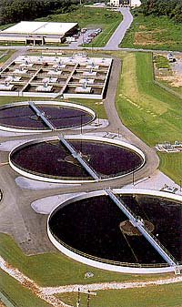
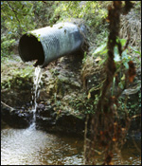
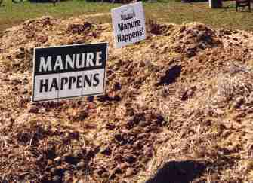
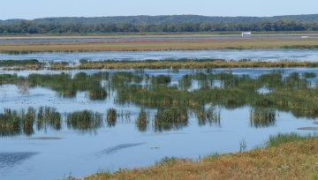
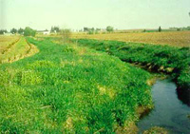
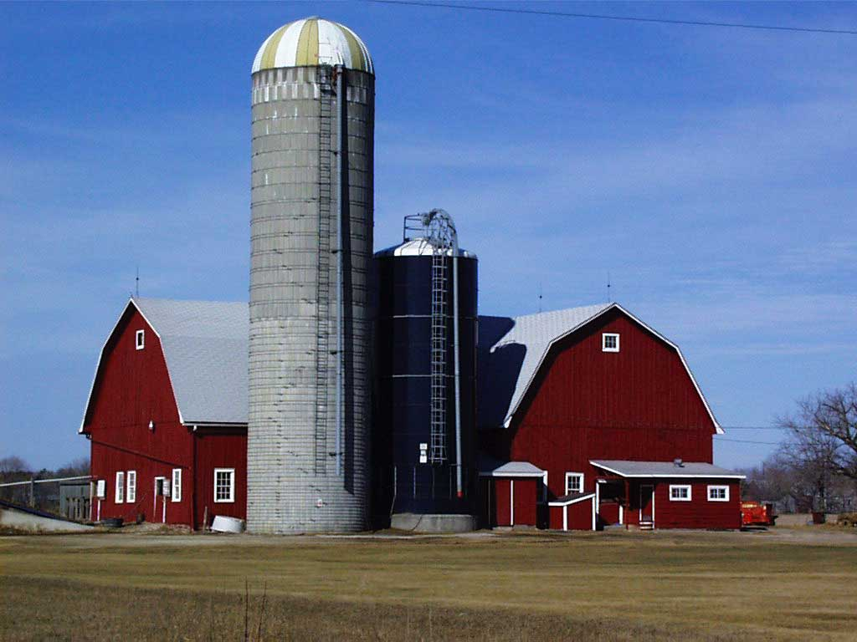
Trading Scenarios:

Slide 16
Formula for Water Quality Trading:
Trading is:
DRIVEN by regulation
MOTIVATED by economics
GOVERNED by local trading rules
BUILT on trust
TRADING WILL NOT BE
VIABLE EVERYWHERE

Slide 17
Keys to Success WQT programs should strive to be:
Transparent
Keep the public informed at every step of the process
Real
Show pollutant reductions and water quality improvement
Accountable
Manage the program effectively
Defensible
Base the program on sound science and protocol
Enforceable
Establish responsibility for meeting water
quality standards

Slide 18
National Picture: State WQT Regs & Programs

Slide 19
Timeline
2002
2003
2004
2005
2006
Connecticut legislation and rules
Michigan rules
EPA policy
Idaho guidance
Colorado policy
Oregon policy
Virginia legislation
Ohio rules
Virginia rules
Florida report
Pennsylvania policy

Slide 20
Who can trade?
Point sources can buy and sell in all programs
8 out of 9 state programs include trades involving NPS
NPS as buyer & seller
NPS as last resort
NPS as seller
PS only
Connecticut
Virginia
Florida
Idaho
Michigan
Ohio
Oregon
Pennsylvania
Colorado

Slide 21
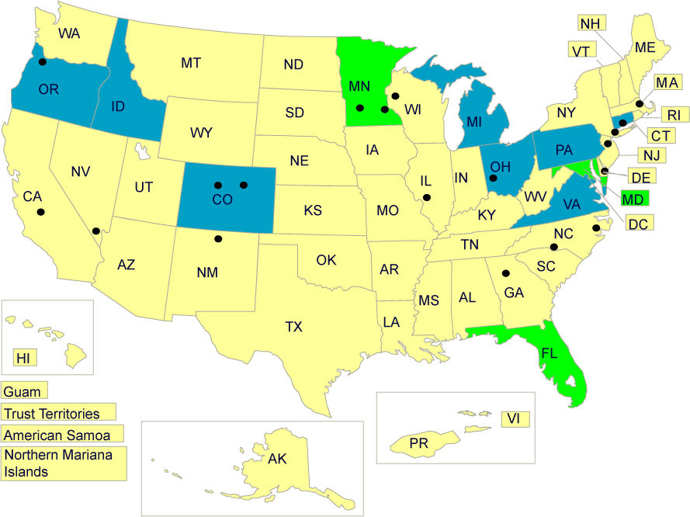
Status of WQT in US

Slide 22
Contact
Ginny Kibler
Office of Wastewater
Management
USEPA
Kibler.virginia@epa.gov
202-564-0596

