Slide 1
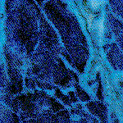
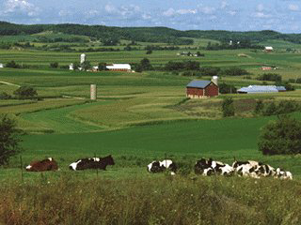
Bovine Spongiform Encephalopathy: An Update
Linda A.Detwiler
Senior Staff Veterinarian
USDA, APHIS, VS

Slide 2
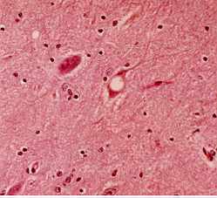
Transmissible Spongiform Encephalopathies
prolonged incubation period
progressive debilitating neurological illness
pathological changes confined to CNS
fatal

Slide 3
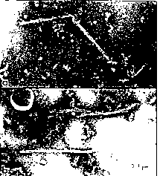
Transmissible Spongiform Encephalopathies
Scrapie Associated Fibrils (SAF) - negative stain EM
Transmissibility

Slide 4
Transmissible Spongiform Encephalopathies: Etiology
agent not fully characterized
smaller than smallest known virus
ellicits no detectable immune or inflammatory response in the host
resistant to most disinfectants and treatments which normally destroy nucleic acids

Slide 5
Transmissible Spongiform Encephalopathies: Agent Theories
VIRUS - unconventional, unusual biochemical and biopysical properties
VIRINO - host-derived protein coat coupled to a small noncoding regulatory nucleic acid
PRION - host-coded normal cellular protein becomes partially protease resistant through post tranlational conformation change

Slide 6
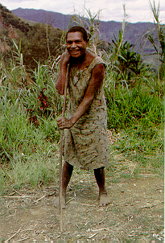
Transmissible Spongiform Encephalopathies: Human
Creutzfeldt-Jakob Disease (CJD)
Gerstmann-Straussler-Scheinker syndrome (GSS)
fatal familial insomnia (FFI)
Kuru
variant CJD (vCJD)

Slide 7
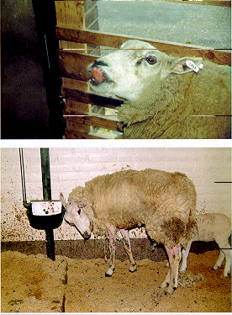
Transmissible Spongiform Encephalopathies: Scrapie
Reported most sheep producing regions
Known over 250 years
Sheep, goats, moufflon

Slide 8
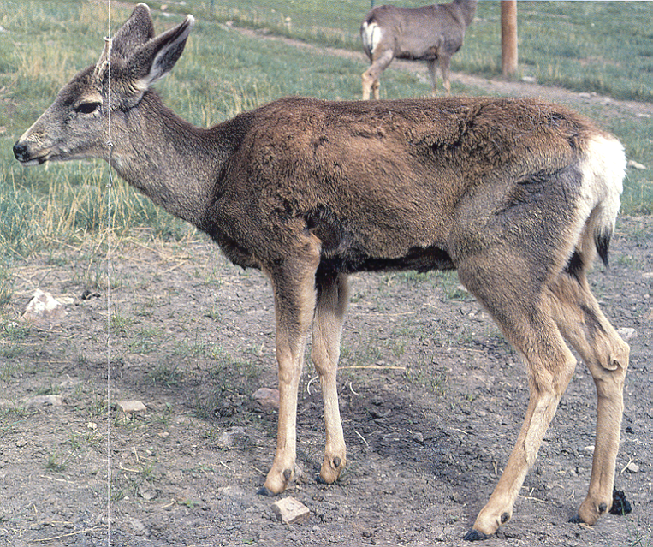
Transmissible Spongiform Encephalopathies: Chronic Wasting Disease
First recognized as disease syndrome - 1967
Colorado, Wyoming - endemic areas
Farm raised elk

Slide 9
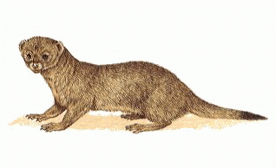
Transmissible Spongiform Encephalopathies: Transmissible Mink Encephalopathy
Affects ranch raised mink
First recognized in 1947
Detected and documented in Canada, Finland, (East) Germany, Russia
Associated with feed

Slide 10
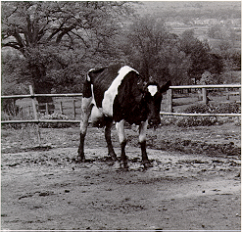
Transmissible Spongiform Encephalopathies: Animal
Bovine Spongiform Encephalopathy
Feline Spongiform Encephalopathy
TSE of Exotic Ruminants

Slide 11
Distribution of Infectivity
spinal cord
dorsal root ganglia
brain
trigeminal ganglia
bone marrow
distal ileum

Slide 12
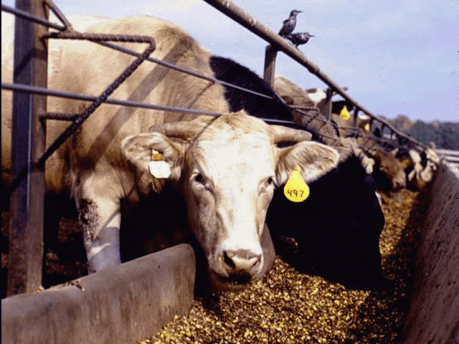
Transmission

Slide 13
BSE Diagnostics
No live animal test
No preclinical test
Need brain tissue
Histology, IHC, WB, ELISA
"Negatives" do not guarantee absence of infectivity

Slide 14
TSE Diagnostics: EU Approved
Histology
Standard IHC and Western Blot
Prionics AG - modified Western Blot (8 hrs)
Enfer Ltd. - High throughput chemiluminescent ELISA (3-4 hrs)
CEA - Sandwich Immunoassay (3-4 hrs)
all require brain/clinical cases

Slide 15
BSE STATISTICS
for GREAT BRITAIN*
(as of February 9, 2001)
Total number of confirmed cases: 177,717
Total number of affected herds: 35,150
Proportion of dairy herds affected: 61.3%
Proportion of beef suckler herds affected: 16.6%
Confirmed total herd incidence: 37.5%
* England, Scotland, Wales

Slide 16
Confirmed cases of BSE in Great Britain by year of restriction (1986 - 1 December 2000)*
*Includes 46 cases not subject to official restriction and
identified by proactive surveillance or at autopsy.

Slide 17
UK MAFF Actions
Mammalian to food animal feed ban
Over thirty month scheme
Selective Cull
Offspring Cull
SRM/SBO bans
Beef on the bone prohibition - No longer in place

Slide 18
First cases of BSE
Total number of cases (3-12-01)
UK >180,000 Belgium - 23
Ireland -653 Spain - 32 Italy - 4
Portugal - 528 Netherlands - 13
Switzerland - 370 Liechtenstein - 2
France - 279 Denmark - 2
Germany - 44 Luxembourg - 1
Portugal
Switzerland
Denmark
Germany
Spain
Netherlands
Belgium
Luxembourg
France
Ireland
Italy
90
00
86
94
97

Slide 19
BSE Incidence Rate (per million cattle > 2 yrs)
98 99
United Kingdom 596 422
Portugal 147 236
Switzerland 16 53
Ireland 22 27
France 2 3
Belgium 4 2
Netherlands 1 1

Slide 20
BSE: Control Measures in EU
SRM bans on sheep, goats, cattle (Oct 2000)
Prohibit feeding of most processed animal proteins (excluded fish meal) to farmed animals (Jan 2001)
test of all cattle >30months at slaughter (if cannot test destroy) (Jan 2001)

Slide 21
EU BSE Surveillance
CNS cases
Fallen stock and emergency slaughter
herdmates of positive cases in some countries
all bovines to slaughter > 30 months of age or older
Negative doesn't guarantee lack of infectivity

Slide 22
BSE: Comparison of surveillance
France
450,000 > 30 mos tested - 10 pos (1-01 to 3-01)
54,000 fallen stock tested - 68 pos (summer 2000 to 3-01)
Switzerland
14,900 normal slaughter - (3 pos 99; 0 pos 00)
22,900 fallen and ES - (22 pos 99; 16 pos 00)

Slide 23
Fallout from BSE (Nov-Feb)
Meat sales drop dramatically
Loss of consumer confidence
Politicians resign or lose jobs
Disposal Problems (carcasses/MBM)
Logistical test problems

Slide 24
EU Geographical BSE Risk
25+ countries evaluated
Member states
Non member states
Examined:
Challenges
Stability of system

Slide 25
EU Geographical BSE Risk
Challenges
External
cattle
MBM
Internal
cattle
MBM

Slide 26
EU Geographical BSE Risk (continued)
Stability
Feed bans
Rendering
Time
Temperature
Pressure
SRM bans

Slide 27
EU Categories of Risk
I - Highly Unlikely
II - Unlikely but Cannot be excluded
III -
Likely but not confirmed
BSE confirmed at a lower level
IV - BSE confirmed at a higher level

Slide 28

Category I
Argentina
Australia
Chile
New Zealand
Norway
Paraguay
Uruguay
Botswana
Namibia
Nicaragua,
Swaziland

Slide 29

Category II
Austria
Finland
Sweden
Canada
United States

Slide 30
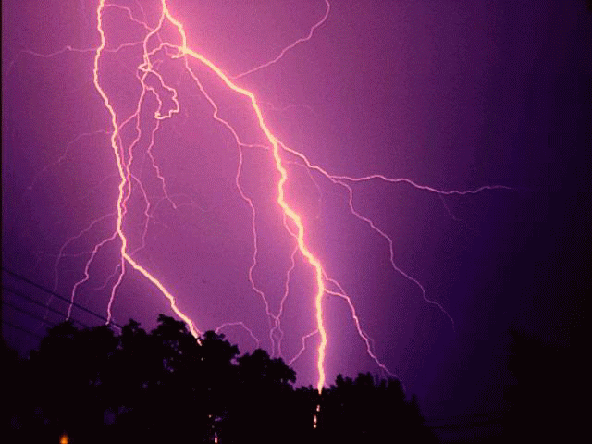
Category III
Germany
Italy
Spain
Lithuania
Belgium
Denmark
France
Ireland
Luxembourg
Netherlands
Switzerland

Slide 31

Category IV
United Kingdom
Portugal

Slide 32
CJD vs. vCJD
sporadic, genetic, iatrogenic
55-75 yrs of age
< 6 mos clinical course
memory loss, myoclonus, dementa
no plaques in brain
food contaminated with BSE infected CNS
28 yrs. median
avg 14 mos clinical course
psychiatric followed by neuro
florid plaques

Slide 33
vCJD Cases
(as of April 2001)
* vCJD cases - 98 definite and
probable
* vCJD cases - 2 definite, 1 probable

Slide 34
vCJD cases by Year

Slide 35
?
vCJD = BSE
epidemiology
macaques
glycoform patterns
strain-typing
transgenetic studies

Slide 36
vCJD: Distribution of Infectivity
Different than classical CJD
Spleen, tonsil, appendix
Retrospective study - 3000 samples - negative results
leucodepletion of blood supply
UK imports plasma and plasma products
US and Canadian deferrals

Slide 37

USDA ACTIONS: Prevention and Surveillance
Import Regulations
Surveillance
Formal Risk Assessments
TSE Working Group
Notes:
These are the broad categories of USDA actions.

Slide 38
BSE - Prevention
Import Restrictions - countries with BSE
July 1989 - live ruminants
November 1989 - ruminant products
1991 - formal regulations
Import Restrictions - Europe
December 1997
January 1998 - interim rule
all live ruminants and most ruminant products
Notes:
Chronology of import regulations because BSE. Most recent actions (all live ruminants and ruminant products banned from the entirety of Europe) were taken as more European countries reported BSE. This in part was due to trading practices and movements within Europe. Countries were given the opportunity to submit information on risks, risk mitigation and surveillance. A rule outlining our assessment of the countries is moving thru channels.

Slide 39
BSE - Prevention
Import Restrictions - Europe
December 6, 2000 - all MBM, etc. regardless of species
Evaluations of other countries
South America underway
Central America
Asia
Notes:
Chronology of import regulations because BSE. Most recent actions (all live ruminants and ruminant products banned from the entirety of Europe) were taken as more European countries reported BSE. This in part was due to trading practices and movements within Europe. Countries were given the opportunity to submit information on risks, risk mitigation and surveillance. A rule outlining our assessment of the countries is moving thru channels.

Slide 40
Import Policies and Regulations
North American Policy

Slide 41
USDA ACTIONS: Surveillance
Field CNS Cases
VDL data
CNS condemns at slaughter
"Downers"
Notes:
These are broad categories of US surveillance.
VDL - State veterinary diagnostic labs

Slide 42
BSE Surveillance: Total Bovine Brain Submission by State May 10, 1990 thru March 31, 2001
71
35
42
213
226
VT-96
63
NH-14
266
217
474
467
MA- 35
117
55
2
89
353
1255
CT- 19
16
187
79
137
NJ-320
1540
186
49
43
156
127
1502
DE-2
221
196
51
157
MD-22
25
65
44
5
2212
13
310
220
143
182
Total = 12,341
17
Source: USDA, APHIS,NVSL
Note: None of the US Brain Submission Have Tested Positive for BSE
Notes:
Self-explanatory

Slide 43
BSE Surveillance
NVSL Bovine Brain Submissions FY 93-99
Total Submissions
855
842
988
982
Tested by IHC
731
729
Downers (fallen stock)
651
495
465
584
412
388
344
112
168
219
223
266
199
Notes:
Bovine brains tested by NVSL. Yellow are number examined histologically and red are number by immunohistochemistry. NVSL attempts to test all submissions using both methods.

Slide 44
NVSL BSE Surveillance
Bovine Brain Submissions FY 00-01 (as of 3-31-01)
2309
2135
Total Submissions
1895
Tested by IHC
"Downers" (fallen stock)
713
643
548
Notes:
Same as previous slide. (couldn't fit it on same graph)

Slide 45
US Surveillance: Current Direction
Regional Goals

Slide 46
US Regions for BSE Surveillance
NW
NC
NE
SW
C
E
SC
SE
Notes:
Surveillance of free ranging cervids.

Slide 47
US Regional Goals for BSE Surveillance - FY 2001
564
606
462
466
766
312
734
644
Notes:
Regional goals based on OIE standards as if each region were a country

Slide 48
US Regional Goals for BSE Surveillance (2001)
REGION
GOAL
2x OIE goals
FY 99
FY 2000
FY 2001*
NW
564
27
134
118
SW
466
256
226
68
C
766
159
120
60
SC
734
281
1094
250
NC
606
135
240
54
NE
462
331
461
122
E
312
26
30
16
SE
644
194
367
51
* as of March 31, 2001

Slide 49
Increase of submissions
Down cattle:
aged; dairy vs. beef
condemns at slaughter
3D/4D
Renderers
Remind VDLs to submit data

Slide 50
Surveillance Reminders
Submissions need:
obex
age of bovine
ID
clinical signs (or down)
10-4 & supplemental
plant number
Questions call NVSL (515-663-7521)

Slide 51
Test Methodology
Histology
Immunohistochemistry
Western Blot
New tests:
Enfer (High throughput chemiluminescent ELISA - 3-4 hrs)
Prionics (modified WB - 8 hrs)
Biorad (Sandwich Immunoassay (3-4 hrs)
All need brain

Slide 52
Status of Cattle Imported into the US from the United Kingdom and Ireland (as of May 2, 2001)
VT-3
Notes:
Cattle remaining in the US from the UK. Total of 496 were imported between 1980 and 1989.

Slide 53
Status of Cattle Imported into the US from other European countries in 1996-97 (as of May 2, 2001)
2
1
3
Notes:
Remaining cattle imported from other European countries not reporting BSE in indigenous cattle. These are all under state quarantine and we have offered to purchase.

Slide 54
www.aphis.usda.gov/oa/bse

Slide 55
BSE Risk Assessment
Harvard School of
Public Health
Tuskegee University
Notes:
USDA has contracted with Harvard School of Public Health to conduct a risk assessment for BSE occurring in the USA. Plans for completion are summer of 2000.

Slide 56
BSE Risk Assessment
Define scope
Describe potential pathways BSE infectivity into national herd or food supply
Characterize and quantify steps in pathways
Identify key steps for research or risk management

Slide 57
BSE Response Plan
First version early 1990's
Slightly revisions early 1996
Major revisions 1996-98

Slide 58
BSE Prevention: Feed Ban
FDA Authority
Prohibited to feed most mammalian proteins to ruminants
Exceptions:
milk
blood
gelatin
plate waste
pure equine/pure porcine

Slide 59
BSE in Sheep: Research (Foster et. al.)
BSE
oral
6 negative
5 positive
negative line
positive line
1 clinical, BSE identified
2 clinical, atypical TSE
Notes:
These are the results of research done by Foster and colleagues in Scotland.

Slide 60
BSE in Sheep: Research
Distribution of Infectivity
brain
spinal cord
blood-1 report
spleen
intestine (PrPsc)

Slide 61
BSE in Sheep: European Situation
Exposure to contaminated MBM
Must differentiate from scrapie - mouse bioassay system (2-3 yrs)
Surveillance for natural cases
None to date - limited number assessed
Public Health Protection - SRM ban on sheep and goat tissues

Slide 62
Imported Sheep in Vermont
Two shipments imported from Belgium and Netherlands
August and November 1996
65 head total
Distribution:
52 - Vermont farm 1
11 - Vermont farm 2
2 rams - New York farm

Slide 63
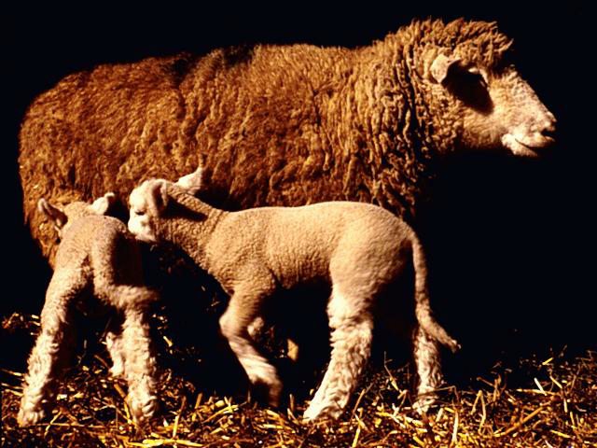
Imported Sheep in Vermont
Monitored since entry
Quarantined since 10-98
9 progeny sold prior to quar.

Slide 64
Imported Sheep in Vermont
USDA bought culls, sicks and picked up deads
Sampled and incinerated
Results:
Histology - vacuolated neurons, astrocytosis, neuronal degeneration
CE - blood positives
Western - 4 brain positives

Slide 65
Imported Sheep in Vermont
Test cannot differentiate "strains" or variants of scrapie from BSE
Mouse bioassay
2-3 years
Named atypical (histology) TSE of foreign origin

Slide 66
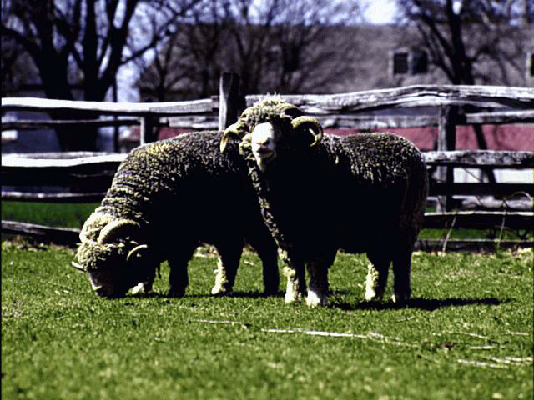
Imported Sheep in Vermont
Owners asked to voluntarily depopulate - one agreed
Declaration of Extraordinary Emergency and Emergency declared on July 14, 2000
Orders issued to seize sheep of 2 flocks

Slide 67
Imported Sheep in Vermont
Two owners went to court for a temporary restraining order (TRO) - July 2000
Judge ruled in USDA's favor and did not grant TRO
Owners did not comply
Motion for order to comply and rule on merits

Slide 68
Imported Sheep in Vermont (continued)
Feb. 6, 2001 - Judge denied plaintiffs motion for summary judgment
Granted defendants motion for judgment and orders for compliance
Plaintiffs ordered to comply with Secretary's Declaration forthwith
Plaintiffs file motion for stay

Slide 69
Imported Sheep in Vermont (continued)
Federal District Court Judge denies motion for stay
Plaintiffs file motion for stay with Second Circuit Court
Motion denied
Sheep removed from farms week of March 19, 2001

Slide 70
Imported Sheep in Vermont (continued)
April 10, 2001 - Arguments in front of second circuit court
April 20, 2001 - Court rules appeal is moot

Slide 71

CONCLUSIONS
No BSE in US to date
Continue conservative approach
Continue and increase surveillance
Adjust as science and policy dictates

