Slide 1

Weather Impacts Briefing April 18th 2011 NWS Nashville *6 To mute your line #6 to unmute your line

Slide 2
Quick Summary
Active week ahead
Storm chances just about every day but today
Severe threat Tuesday Night into Wednesday
Mainly straight line winds and large hail
More locally heavy rain
Another cold front possible Easter Weekend
Flooding potential will increase with each weather system
1

Slide 3
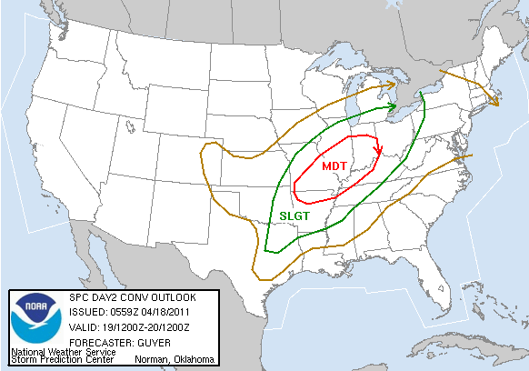
SPC “Day 2” Outlook
2

Slide 4
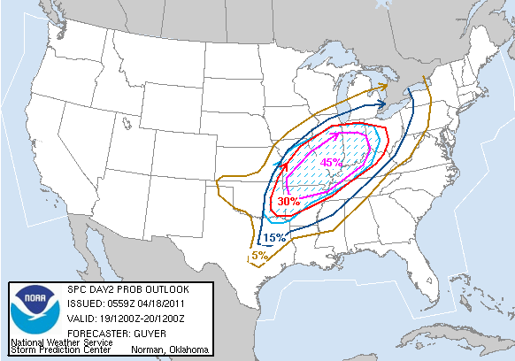

SPC “Day 2” Severe Chances
3

Slide 5
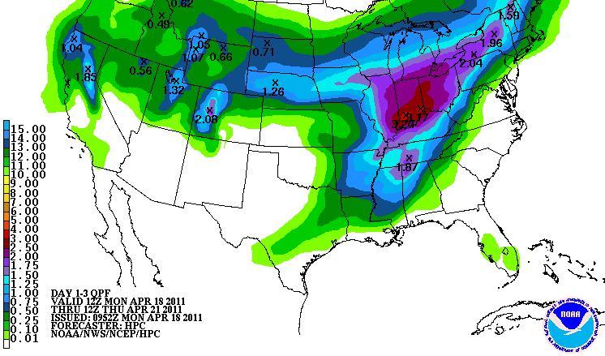
Rainfall Forecast Throught Wednesday Night
4

Slide 6
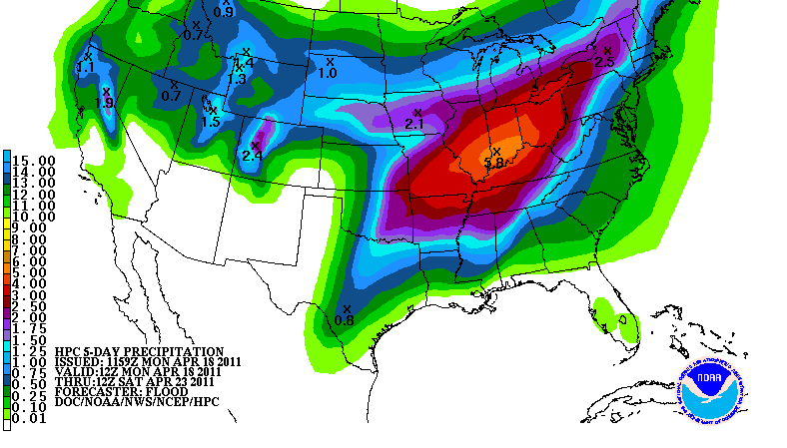
Rainfall Forecast Through Saturday Morning
5

Slide 7
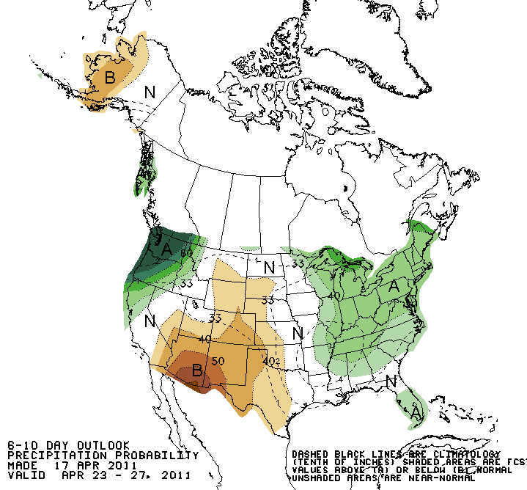
Rainfall Outlook Sat-Tue
6

Slide 8
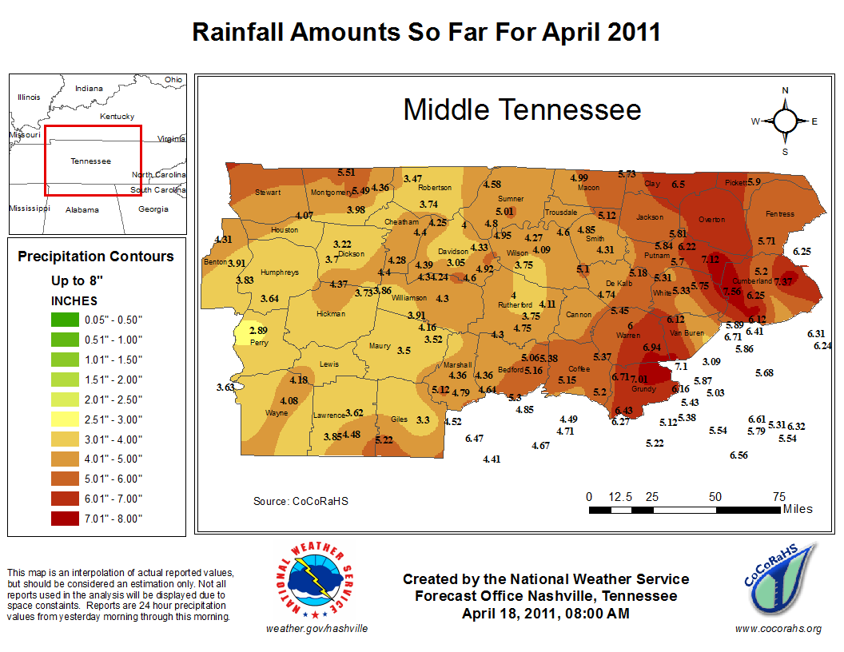
Rainfall Outlook Sat-Tue
6

Slide 9
The Week Ahead - Summary
Main severe weather threat is Tuesday Night into Wednesday
Chance for showers and storms every day but today
Rainfall already well above normal. Additional storms will continue to raise flooding threat
May have a call tomorrow afternoon
Next regularly scheduled briefing 4/25 - 10 am
Will continue each Monday through 5/23
8

Slide 10
QUESTIONS? 615.754.8502 WEATHER.GOV/NASHVILLE

