Slide 1


BASIC ENERGY SCIENCES -- Serving the Present, Shaping the Future
Office of Basic Energy Sciences Office of Science U.S. Department of Energy
Update on the Upcoming COV of the BES
Chemical Sciences, Geosciences, & Biosciences Division
Eric A. Rohlfing
Director, Chemical Sciences, Geosciences, & Biosciences Division
Office of Basic Energy Sciences
Office of Science
U.S. Department of Energy
BESAC Meeting, February 21, 2008
http://www.sc.doe.gov/bes/

Slide 2
Outline
2008 COV (FY2005-2007)
Charge
Organization and membership
2005 COV (FY2002-2004)
Recommendations and actions
Changes in the division
Organizational, staffing, and program changes since last COV
COV preparatory work
November 7, 2007 meeting between chair and division, COV website, etc.
2008 Committee of Visitors Review of the BES Chemical Sciences, Geosciences, and Biosciences Division
April 23-25, 2008
DOE Germantown, MD
All BESAC members are welcome!

Slide 3
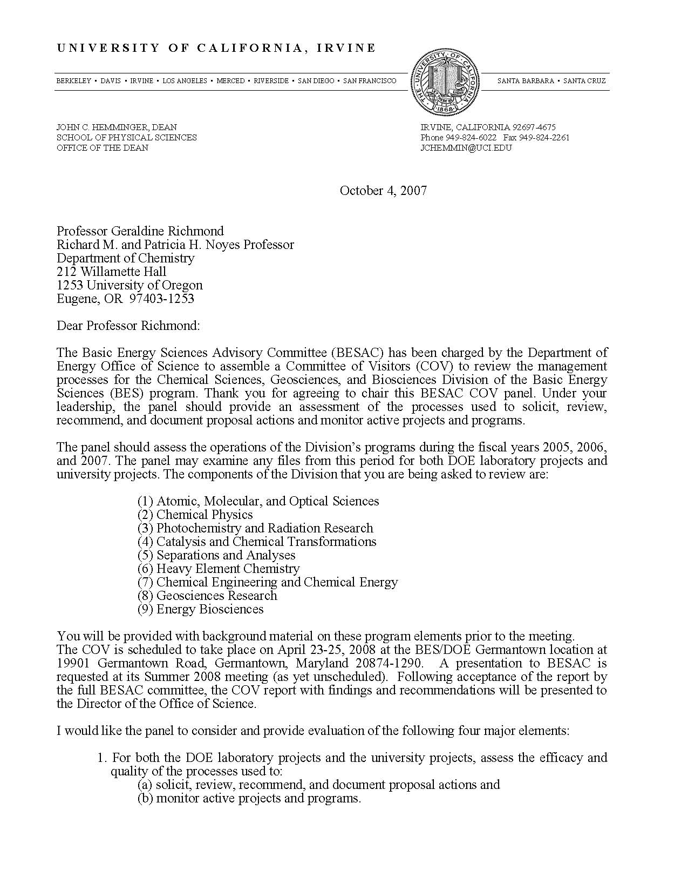
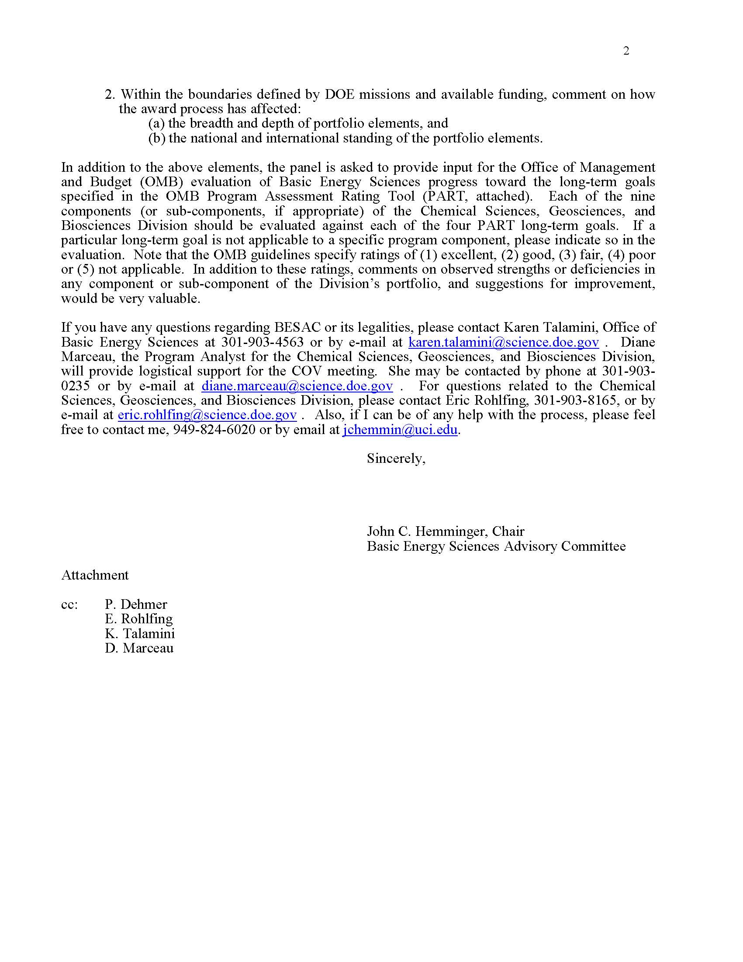
Charge letter
Geri Richmond is COV chair

Slide 4
COV Charge
The panel should assess the operations of the Division’s programs in FY2005, 2006, and 2007 in these areas:
AMO Sciences, Chemical Physics, Photochemistry & Radiation Research, Catalysis & Chemical Transformations, Separations and Analyses, Heavy Element Chemistry, Chemical Engineering and Chemical Energy, Geosciences, and Energy Biosciences
The panel may examine any files during the review period for both DOE lab and university projects (subject to COI constraints).
Two major review criteria:
Assess the efficacy and quality of the processes used to: (a) solicit, review, recommend, and document proposal actions and (b) monitor active projects and programs.
Within the boundaries defined by DOE missions and available funding, comment on how the award process has affected: (a) the breadth and depth of portfolio elements and (b) the national and international standing of the portfolio elements.
The COV panel is asked to provide input on the BES OMB Performance Assessment Rating Tool (PART) long-term goals.

Slide 5
2008 COV Organization and Membership
Chair: Geri Richmond,** University of Oregon
Panel 1: AMO Sciences/Gas-Phase Chemical Physics
Panel Lead: Carl Lineberger,** University of Colorado (2002 COV)
Members: Tom Gallagher, University of Virginia
Anthony Johnson,** University of Maryland
Kate Kirby,* Harvard-Smithsonian CFA
Arthur Suits, Wayne St. University
Sotiris Xantheas, Pacific Northwest National Lab
Panel 2: Photochemistry/Condensed Phase Chemical Physics
Panel Lead: Peter Rossky, University of Texas (2005 COV)
Members: Luis Echegoyen, NSF & Clemson University
Etsuko Fujita, Brookhaven National Laboratory
Devens Gust, Arizona State University
Sharon Hammes-Schiffer,* Pennsylvania State University
Thom Orlando, Georgia Tech
Panel 3: Catalysis
Panel Lead: Bruce Gates,* UC Davis
Members: Cynthia Friend, Harvard University (2005 COV)
Horia Metiu, UC Santa Barbara
Umit Ozkan, Ohio State University
Simon Bare,* UOP LLC
D. Michael Heinekey, University of Washington
Funded by CSGB Division
*Current BESAC member
**Past BESAC member

Slide 6
2008 COV Organization and Membership
Panel 4: Heavy Element Chemistry/Separations & Analyses
Panel Lead: Carol Burns, Los Alamos National Laboratory (2002 COV)
Members: Bruce Chase, Dupont
Sue Clark,* Washington State University (2005 COV)
William Evans, UC Irvine
Michael Heaven, Emory University
Robert Hettich, Oak Ridge National Lab
Panel 5: Geosciences
Panel Lead: Ed Stolper, Cal Tech
Members: Bob Bodnar, Virginia Tech
Randy Cygan, Sandia National Laboratories
Dianne Newman, MIT
Lars Stixrude, University College London
Jim Tyburczy, Arizona St. University
Panel 6: Biosciences
Panel Lead: Elizabetth Gantt, University of Maryland
Members: Robert Blankenship, Washington University
John Richards,* Cal Tech (2005 COV)
John Shanklin, Brookhaven National Laboratory (2005 COV)
Judy St. John, USDA
Funded by CSGB Division
*Current BESAC member
**Past BESAC member

Slide 7
2008 COV Membership Summary
36 total members of the COV:
16 are currently funded by BES/CSGB
20 are not currently funded by BES/CSGB
25 are men
11 are women
27 are from academia
6 are from DOE labs (but 2 academics have previous lab experience)
2 are from industry
1 is from another Federal agency (not counting Luis Echegoyen)
13 are from the East
10 are from the Midwest
13 are from the West
7 have served on CSGB COVs in 2002 or 2005
9 are current or previous BESAC members

Slide 8
2005 COV recommendations and actions
Program management database
Recommendation: Create a BES database for peer review/program management.
Actions: Modest improvements in SC database (IMSC); more effective use of IMSC.
Improved proposal solicitation
Recommendation: Use “Dear Colleague” mailings to community in addition to normal postings on SC website.
Action: Department chair “Dear Colleague” lists developed and used for Chemical Imaging (FY2006) and SEU (FY2007) solicitations.
Long-term support for basic research & young investigator program
Recommendation: Continue “tradition” of long term support, but also consider implementing a young investigator program.
Actions: A significant young investigator program is not feasible under current budget constraints. Award for BES PECASE winners codified ($50k/yr for 5 years) . BES solicitations have allowed more young investigators to be funded.
Diversity
Recommendation: BES should collect demographic data on gender, race, and career-stage and efforts should be made to ensure a diverse work force.
Actions: SC-wide demographic data collection system “in progress;” CSGB co-sponsored gender and URM equity in chemistry workshops with NSF and NIH.

Slide 9
2005 COV recommendations and actions
Re-evaluate and re-focus Energy Biosciences program – integrate it within the Division
Recommendation: New program management should re-evaluate and re-focus program on BES missions; program should be better integrated with division
Action: Under new program leadership (Rich Greene), program has been redefined into two components – Solar Photochemistry and Physical Biosciences. Significant shifts in the portfolio are underway. Team structure changed to foster improved integration (see following).
Program management staff
Recommendation: division be given at least three new program manager positions
Action: BES staffing budget in FY2008 includes 3 new program manager positions in CSGB (see following).
Portfolio prioritization
Recommendation: In light of flat funding, prioritize the portfolio in order to continue supporting areas critical to DOE mission at appropriate level.
Action: significant prioritization accomplished – see following.

Slide 10
Changes in CSGB division
Organizational changes
FY2007: Chemical Physics program split into two parts: Gas-Phase Chemical Physics (combustion related) and Condensed Phase & Interfacial Molecular Science (CPIMS)
FY2008: Created the new Photo- and Biochemistry Team from the Energy Biosciences program plus the Solar Photochemistry program (from Fundamental Interactions); associated modest program name changes
Significant program changes (portfolio optimization)
FY2006 – 2008: Phase out of the Chemical Energy & Chemical Engineering Program
Motivated by budgetary pressure and a lack of coherence in the program
A few research projects moved to Catalysis Science; most funding reprogrammed
FY2005 – 2007: Investment in ultrafast chemical science, principally in AMOS program (UXSL at LBNL; PULSE at SLAC)
FY2006: Investment in chemical imaging across division
Staffing
Significant changes in division staff since the last COV
Significant (but transient!) understaffing during upcoming COV

Slide 11
Chemical Sciences, Geosciences, and
Biosciences Division
February, 2005
Walter Stevens, Director
Diane Marceau, Program Analyst
Vacant FTE, Program Assistant
Fundamental
Interactions
Molecular Processes
and Geosciences
Energy Biosciences Research
Eric Rohlfing
Robin Felder, Program Assistant
John Miller
Sharon Snead, Program Assistant
James Tavares
Vacant FTE, Program Assistant
Atomic, Molecular, and
Optical Science
Catalysis and Chemical
Transformation
Plant Sciences
James Tavares
Michael Casassa
Raul Miranda
John Gordon, LANL
Biochemistry and Biophysics
Sharlene Weatherwax
Chemical Physics
Separations and Analysis
● Frank Tully, SNL
Richard Hilderbrandt
William Millman
◆ Gregory Fiechtner, SNL
Photochemistry &
Radiation Research
Heavy Element Chemistry
Staffing changes
Mary Gress
Mark Spitler, NREL
Lester Morss
■ Norman Edelstein, LBNL
Computational and Theoretical Chemistry
Chemical Energy and
Chemical Engineering
● IPA
◆ Detailee
■ Detailee, 1/4 time, not at HQ
Richard Hilderbrandt
Paul Maupin
Geosciences Research
Nicholas Woodward
● David Lesmes, GWU

Slide 12
Chemical Sciences, Geosciences, and
Biosciences Division
April, 2006
Eric Rohlfing, Acting Director
Diane Marceau, Program Analyst
Michaelena Kyler-King, Program Assistant
Fundamental
Interactions
Molecular Processes
and Geosciences
Energy Biosciences Research
Eric Rohlfing
Robin Felder, Prog. Assist.
John Miller
Vacant, Prog. Assist.
John Miller, acting
Dennis Burmeister, Prog. Assist.
Atomic, Molecular, and
Optical Science
Catalysis and Chemical
Transformation
Plant Sciences
Raul Miranda
Mike Chen, ANL
Biochemistry and Biophysics
Michael Casassa
Richard Greene
COV Panel 1
COV Panel 3
Chemical Physics (Gas Phase)
Chemical Energy and
Chemical Engineering
◆ Michael Kahn, PNNL
◆ Pin-Ching Maness, NREL
● Frank Tully, SNL
Phased out in
COV period
Paul Maupin
Formed during
COV period
COV Panel 6
Chemical Physics (CPIMS)
Separations and Analysis
Gregory Fiechtner
William Millman
COV Panel 2
COV Panel 4
Photochemistry &
Radiation Research
Heavy Element Chemistry
Mary Gress
Mark Spitler, NREL
Lester Morss
■ Norman Edelstein, LBNL
Computational and Theoretical Chemistry
Geosciences Research
● IPA
◆ Detailee
■ Detailee, 1/4 time, not at HQ
Crosscutting
COV Panel 5
Nicholas Woodward
Richard Hilderbrandt

Slide 13
April, 2008?
Chemical Sciences, Geosciences,
and Biosciences Division
Eric Rohlfing, Director
Diane Marceau, Program Analyst
Michaelene Kyler-King, Program Assistant
● IPA
◆ Detailee
■ Detailee, 1/4 time, not at HQ
Fundamental Interactions
Michael Casassa
R. Felder, Prog. Asst.
Photo- and Bio- Chemistry
Richard Greene
S. Watson, Prog. Asst.
Chemical Transformations
John Miller
T. Russ, Prog. Asst.
Atomic, Molecular, and Optical Sciences
Jeffrey Krause
Solar Photochemistry
Mark Spitler
Catalysis Science
Raul Miranda
Paul Maupin
◆ Michael Chen, ANL
Panel 1
Panel 3
Gas-Phase Chem Physics
Vacant
◆ Wade Sisk , BNL
Photosynthetic Systems
Vacant
Heavy Element Chemistry
Lester Morss
■ Noman Edelstein, LBNL
Cond. Phase & Interfacial Molecular Science
Gregory Fiechtner
Panel 2
Panel 4
Physical Biosciences
Vacant
◆ Bob Stack, PNNL
Separations & Analyses
William Millman
◆ Larry Rahn, SNL
Computational & Theoretical Chemistry
Vacant and Posted!
Panel 6
Geosciences
Nicholas Woodward
◆ Patrick Dobson, LBNL
Panel 5
Hiring 4 program managers in FY2008!
<number>

Slide 14
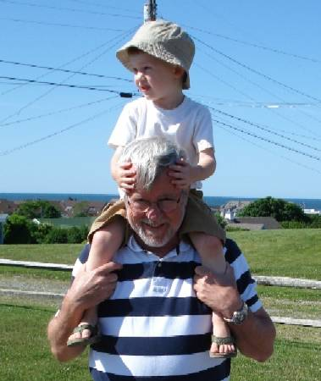
Program manager for computational and theoretical chemistry
Dick Hilderbrandt retired after 21 years of Federal service on December 31, 2007
Job Opportunity: Program Manager for Computational and Theoretical Chemistry
The Office of Basic Energy Sciences (http://www.sc.doe.gov/bes/bes.html ), Office of Science, US Department of Energy, is seeking qualified applicants for a career federal position managing the Computational and Theoretical Chemistry Program, funding mission-oriented basic science at universities and national laboratories. The program encompasses a broad range of computational and theoretical approaches to scientific discovery in areas of interest to DOE. The research includes understanding and predicting the properties and chemical behavior of molecular systems and complexes in the gas phase, in solution, at interfaces, and in biological systems. It emphasizes development of new theories, methods and algorithms for applying theoretical and computational science and simulation to understanding chemical behavior and molecular properties in a wide range of environments, including new opportunities and challenges in complex systems, nanoscale materials, solar energy utilization, and ultrafast science. The program manager also assists in the allocation of computer resources at Office of Science high-performance computing facilities.
The announcement and on-line application instructions can be found via the BES website: http://www.sc.doe.gov/bes/BESjobs.html or directly at USA Jobs: http://jobsearch.usajobs.gov/ftva.asp?seeker=1&JobID=68052643 . Applications must be submitted by 11 pm on April 21, 2008.

Slide 15
CSGB Team Structure
Molecular mechanisms of light capture and its conversion to chemical end electrical energy via chemical and biochemical pathways
Application of physical science tools to biochemical systems
Photo- and Biochemistry
Biomimetic catalytic systems
Structural and dynamical studies of atoms, molecules, and nanostructures; description of their interactions with external stimuli (photons, electrons) at full quantum detail
Characterization, control, and optimization of chemical transformations, from catalysis to geochemistry
Fundamental
Interactions
Chemical
Transformations
Interfacial nanoscale chemistry
Division-wide themes: chemical imaging; ultrafast chemical sciences; nanoscale science; catalysis science; theory, modeling, & simulation; synthesis

Slide 16
CSGB Budget Distribution
FY07 appropriation $221M
Facilities
GPE
SBIR
AMO Sciences
Panel 1
GPP
Gas Phase
Chemical Physics
Energy Biosciences
Panel 6
CPIMS
Panel 2
Photochemistry &
Radiation Research
Geosciences
Panel 5
Chemical Energy
& Chemical Engineering
Heavy Element Chemistry
Catalysis & Chemical
Transformations
Panel 4
Separations
& Analysis
Panel 3

Slide 17
Solicitations with impact during COV period
Notice 04-20, Basic Research for the Hydrogen Fuel Initiative
Published in FY2004; awards made in FY2005
Large, BES wide initiative that provided ~$21M in new funds across BES; supplemented by ~$3M in FY2006
~38 awards assigned to several programs in CSGB; under renewal review in FY2008 as an integrated program across BES
Notice 05-30, Basic Research for Chemical Imaging
Published in FY2005; awards made in FY2006
Modest, CSGB only initiative that reprogrammed ~$3M within CSGB
~17 awards in nearly every program in the division
Notice 06-15, Basic Research for Solar Energy Utilization
Published in FY2006; 27 awards made across BES with modest funding (~$8M) in FY2007
14 awards in CSGB in Solar Photochemistry and Biosciences programs
Notice 06-17, Basic Research for the Hydrogen Fuel Initiative
Published in FY2006; 13 awards made across BES with modest funding (~$4M) in FY2007
6 awards in CSGB in Catalysis Science program

Slide 18
COV preparatory work
November 7 meeting between Geri Richmond and Division
Opportunity for chair to meet with the entire division to understand our structure and programs
Geri used this successfully as chair of the 2007 COV for NSF Chemistry Division
She felt it important to understand the differences between NSF and BES
Full (almost) day visit
Divisional overview presentation
Presentation on COV information
Informal discussions between Geri and program managers/team leads in each program
Next steps for COV
Completion of the membership drive – finished in December, 2007
Plans for COV website – now operational and will be updated with new information
Additional teleconferences with chair and with chair/panel leads before COV

Slide 19
Information for the 2008 COV
Prior to COV – via password-protected website (ORISE)
COV roster (soon to be updated for second read assignments)
Charge letter
Reports from 2002 and 2005 COVs (links to BES website)
Review procedures (links to BES website)
Core research activity descriptions (links to BES website, with updated versions for COV)
Published solicitations during COV period (links to SC Grants website)
Logistical details (agenda, travel, lodging, etc.)
During COV
BES and Division overview presentation
Topical overviews by team leads – topics TBD, but probably solicitations, lab reviews, etc.
Program overview presentations
Spreadsheet for each program showing every project (university and lab) that was active during three-year review period
Spreadsheet showing all CSGB reviewers over review period
Selection of university and lab review files (new awards, renewals, declinations) plus access to all files (constrained by COI)
COV report template (including OMB PART assessments)
Notes:
Really want to use a secure website for COV information and NOT mail out a CD with a ton of stuff. The website will have documents but also a lot of links to other sites (mainly BES website) where COV members can get useful information.
Feel that abstracts for current projects is just too much information. And, we no longer maintain a readily accessible abstract database for BOTH lab and university projects. So, I would like to drop this.
After this, be sure to cut to example spreadsheet from 2005 COV.
Will add a complete (but not terribly user friendly) sheet of CSGB reviewers this time.

Slide 20
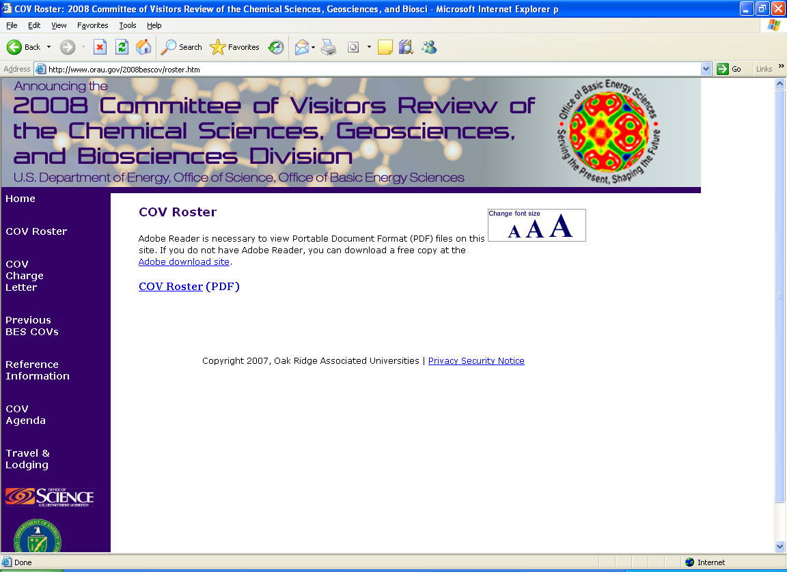
2008 COV website
Charge letter
Reports and responses from 2002 and 2005 CSGB COVs (links to BES website)
Review procedures (links to BES website)
Core research activity descriptions (links to BES website, with updated versions for COV)
Published solicitations during COV period (links to SC Grants website)
Logistical details (agenda, travel, lodging, etc.)

