Slide 1

OMIG COMPLIANCE WEBINAR #1- ADDRESSING EXCLUDED PERSONS IN MEDICAID EMPLOYMENT AND CONTRACTING-NEW YORK JUNE 2010
JIM SHEEHAN
OFFICE OF MEDICAID INSPECTOR GENERAL
JGS05@OMIG.State.ny.us
518 473-3782

Slide 2
OMIG WEBINARS-FULFILLING OMIG’S SECTION 32 DUTY-
“17. to conduct educational programs for medical assistance program providers, vendors, contractors and recipients designed to limit fraud and abuse within the medical assistance program”
These programs will be scheduled as needed by the provider community. Your feedback on this program, and suggestions for new topics are appreciated.
Next program in July on PPACA 6402: Mandatory Disclosure of Overpayments

Slide 3
Program Exclusions
Exclusions
Mandatory
Permissive
Remedial in purpose
protection of federal health care programs and beneficiaries
improper payment
improper/abusive practices
No further program reimbursement (with few exceptions)

Slide 4
Program Exclusions
Statute
Regulation
Federal OIG Guidance
Federal CMS Guidance
State Guidance Mandated by CMS
Condition of NY provider enrollment or NY state contract
Virtually no case law (criminal, civil, or administrative) on extent and effect of exclusion

Slide 5
PROGRAM EXCLUSION
Federal authority and requirement on providers
No claims based on work of excluded persons
Federal authority and mandate on state Medicaid programs
No state Medicaid claims to CMS based on work of excluded persons

Slide 6
PROGRAM EXCLUSION
Why are persons excluded?
Sexual assault
Patient abuse
Failure to repay HEAL loans
Criminal convictions related to program
Criminal convictions related to controlled substances

Slide 7
NEW YORK MEDICAID REMEDIES FOR PROVIDER INAPPROPRIATE PRACTICES
Censure: Persons remain in Medicaid program, but are under intense scrutiny for future efforts
Exclusion: Persons are not allowed to participate in the Medicaid program, due to having committed a crime related to the provision of health care, or having engaged in conduct characterized as “unacceptable practices” in the provision of health care
If the OIG excludes a person from Medicare, State must exclude that person from New York Medicaid
Termination: an end to a provider’s contractual relationship with the Medicaid program-can be for cause or without cause. See NYCRR 504.7 for complete details.
Starting January 1, 2011, under Section 6501 of PPACA, if CMS revokes a provider’s Medicare billing privileges ( of providers and suppliers who are convicted of certain felonies). 42 C.F.R. § 424.535(a)(3), States are required to terminate the individuals or entities from Medicaid programs . The felonies include financial crimes, such as extortion, embezzlement, income tax evasion, insurance fraud and other similar crimes for which the individual was convicted, including guilty pleas and adjudicated pretrial diversions.

Slide 8
PROGRAM EXCLUSION EXAMPLE-Dr. Ioni Sisodia
New York psychiatrist, entered a plea of guilty on 11/20/2007 to petty larceny related to submission of Medicaid claims and paid $75,645.83 in fines and restitution in People of the State of New York v. Ioni Sisodia, Kingston City Court, Dkt. No. 07-56074 (2007)
Dr. Sisodia asked the court at her sentencing for “added protection for [her]self . . . that through institution there will be billing or company billing that it would be allowed.” In response, the court stated, “that’s going to be between you and your employer, they’re going to have to do the best they can.”
OIG notice of exclusion March 31, 2008; upheld by DAB Decision No. 2224 “the plain language of section1128(c)(3)(B) of the Act requires the duration of Petitioner’s exclusion to be no less than five years.”
Excluded 04/20/08 by OMIG, as required by federal law
March 30, 2009-consent censure and reprimand by NY Office of Professional Medical Conduct, permitted to retain her medical license

Slide 9
PROGRAM EXCLUSION EXAMPLE-Nabil Elhadidy, M.D
Medicaid undercover investigator visited asking for prescription pain medication for himself and his fictitious wife. Although Elhadidy had never seen the wife, he supplied prescriptions for the requested drugs (Tylenol 3 and Ambien – schedule III and IV controlled substances), accepting $50 in cash. Petitioner then manufactured a medical record for the bogus wife, which listed vital signs, descriptions of organs, and diagnoses.
pled guilty to one misdemeanor count.(2007) His conviction was “conditionally discharged” upon his completion of community service and payment of $160 in fines and surcharges.
state court decision precluded the OMIG for the State of New York from imposing an exclusion
OIG excluded Dr. Elhadidy- DAB Decision No. CR2000 (2009)
OMIG excluded 3/15/2009 as required based on OIG exclusion
No public OPMC action

Slide 10
PROGRAM EXCLUSION EXAMPLE- Sandra Hernandez/a/k/a Sandra Meza
registered nurse employed as a surveyor for the Texas Department of Aging and Disability Services, the state agency responsible for nursing home inspections. She accepted $2000 from Bill Lofton, the administrator of a nursing home whose facility she was charged with inspecting.
On August 14, 2006, she pled no contest in a Texas State Court to one misdemeanor count of “Gift to Public Servant by Person in his Jurisdiction.” The court entered an order of deferred adjudication. She was sentenced to one year of probation, allowed to complete 32 hours of community service work in lieu of serving four days in jail, and required to pay $2000 in restitution, a $1000 fine, and various court costs and supervision fees.
Excluded from Medicare for five years DAB Decision No. CR1994(2009)
Texas nursing license revoked by state

Slide 11
limiting fraud and abuse within the program
“Abuse means provider practices that are inconsistent with sound fiscal, business, or medical practices, and result in an unnecessary cost to the Medicaid program, or in reimbursement for services that are not medically necessary or that fail to meet professionally recognized standards for health care. It also includes recipient practices that result in unnecessary cost to the Medicaid program.” 42 CFR 455.2-similar provision in state regulations 18 NYCRR 515.1 (b) (1)
“Abuse” does not require intent

Slide 12
Impact of Exclusion on health care employers
Once exclusion occurs, health care providers:
May employ or contract with excluded persons, but may not allow excluded persons to provide or to direct the ordering or delivery of services or supplies, or to undertake certain administrative duties
Whether or not direct care activities are involved
If any part of the task is reimbursed by federal program dollars
Note: Staffing agencies must screen potential candidates to ensure that they have not been excluded prior to being sent to providers for work. Providers must develop and enforce contractual agreements to ensure prescreening occurs.

Slide 13
EXCLUSIONS-FEDERAL LAW-STATE MEDICAID MANAGED CARE PLANS
section 1932(d)(1) of the Social Security Act (42 U.S.C. 1396u-2):
A) In general.—A managed care entity may not knowingly—
(i) have a person described in subparagraph (C) (i.e., an excluded person) as a director, officer, partner, or person with beneficial ownership of more than 5 percent of the entity's equity, or
(ii) have an employment, consulting, or other agreement with a person described in such subparagraph for the provision of items and services that are significant and material to the entity's obligations under its contract with the state.
Thus, a managed care plan may not knowingly contract with excluded persons to provide services to Medicaid managed care enrollees.
Compare with fee-for-service: “ knew or had reason to know of the exclusion.” 42 CFR 1001.1901 (b)

Slide 14
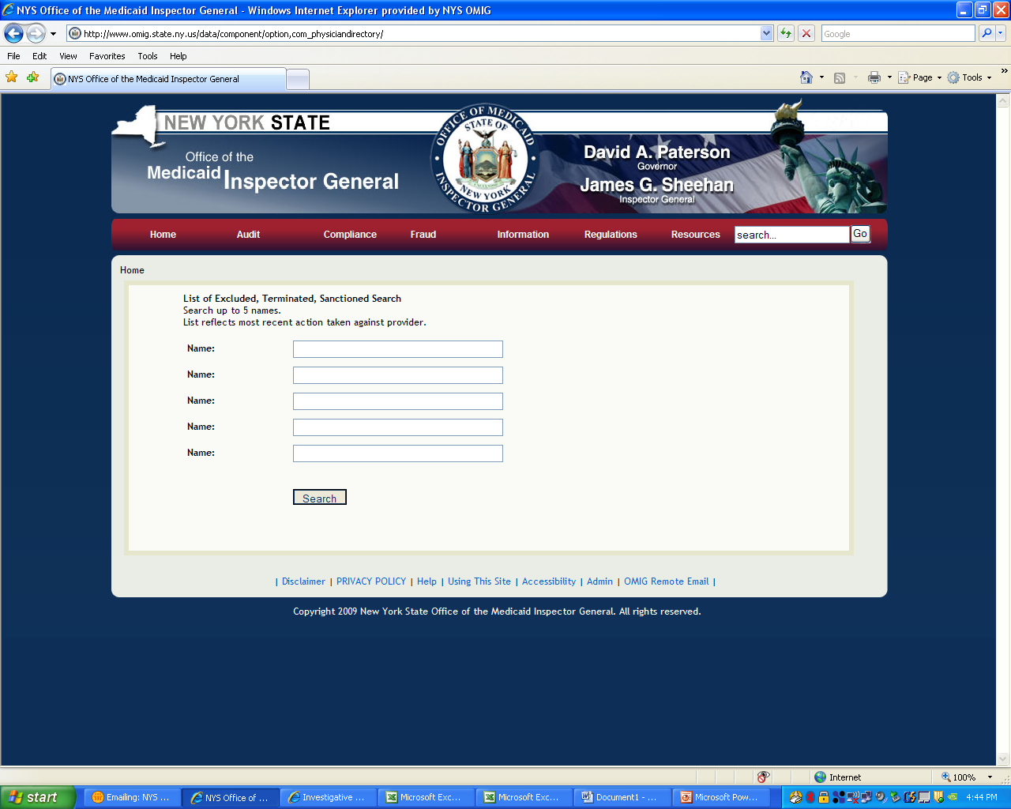
Searching the OMIG Web Site

Slide 15
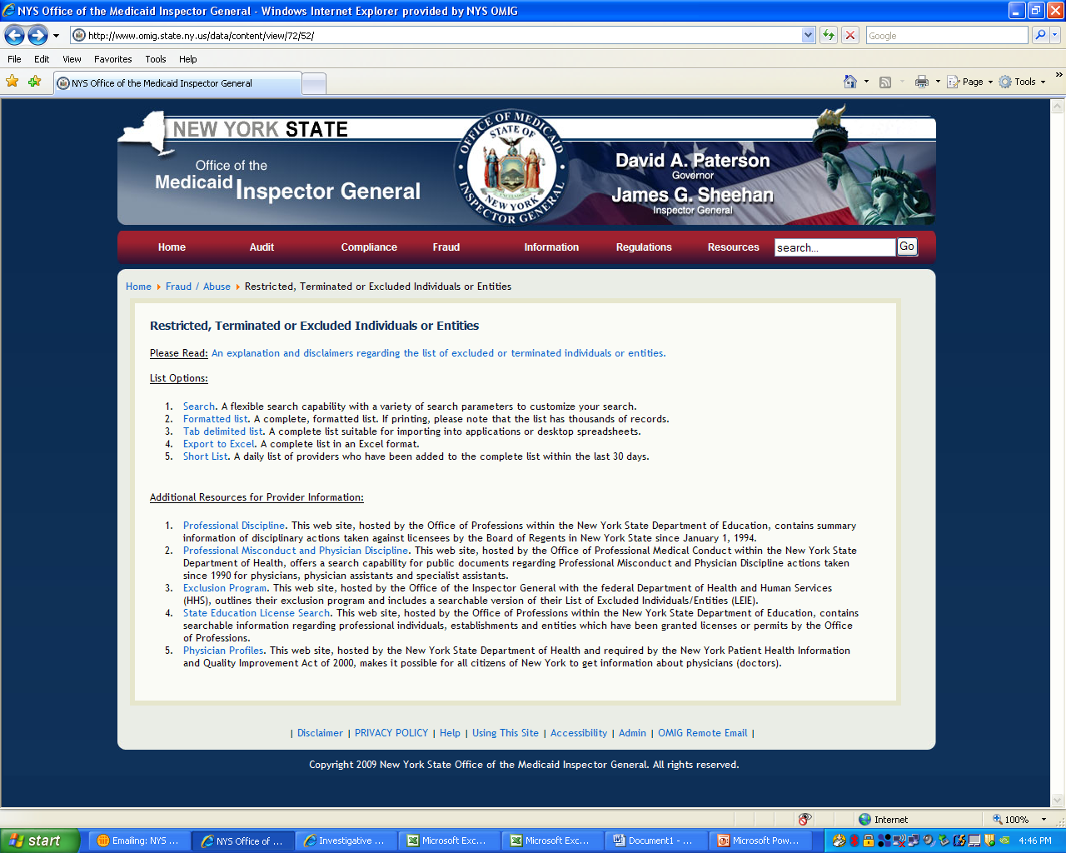

Slide 16
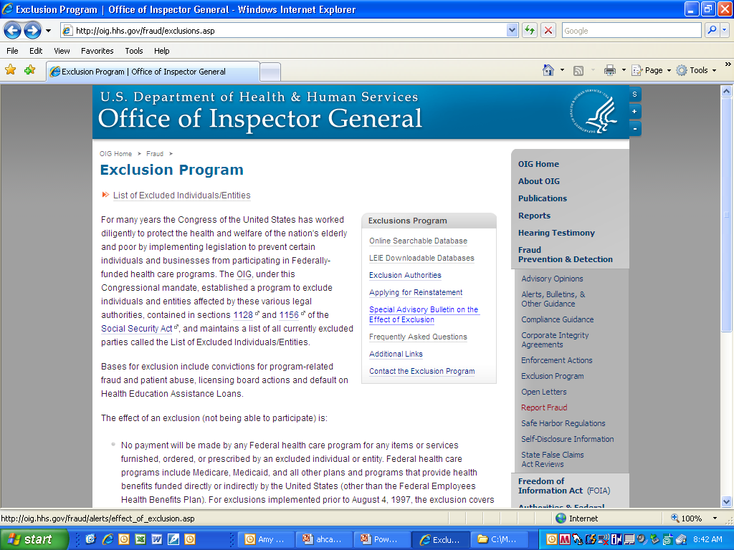
31

Slide 17
The Federal Acquisition Streamlining Act of 1994 requires that exclusion from any federal program is exclusion from all
mandates and expands the government-wide effect of all debarments, suspensions, and other exclusionary actions to federal procurement, as well as non-procurement programs.
Section 2455: “No agency shall allow a party to participate in any procurement or nonprocurement activity if any agency has debarred, suspended, or otherwise excluded (to the extent specified in the exclusion agreement) that party from participation in a procurement or nonprocurement activity.”
THE GSA AND OIG LISTS ARE NOT INTEGRATED-EACH MUST BE CHECKED
List of parties excluded from federal procurement and nonprocurement programs https://www.epls.gov
No public discussion of this provision by CMS or OIG that OMIG could find
NOTE THAT EXCLUSION FROM ONE STATE’S MEDICAID PROGRAM DOES NOT RESULT IN EXCLUSION FROM ALL STATE MEDICAID PROGRAMS, AND THAT INDIVIDUAL STATE EXCLUSIONS ARE NOT REPORTED ON ANY FEDERAL DATABASE
After January 1, 2011, any state’s “termination” of a person will require that all states “terminate” that person (PPACA Section 6501).

Slide 18
THE CMS EXCLUSION REGULATION
“No payment will be made by Medicare, Medicaid or any of the other federal health care programs for any item or service furnished by an excluded individual or entity, or at the medical direction or on the prescription of a physician or other authorized individual who is excluded when the person furnishing such item or service knew or had reason to know of the exclusion.” 42 CFR 1001.1901 (b)
Focus is not on the relationship but on the payment.

Slide 19
THE FEDERAL GUIDANCE
Special Advisory Bulletin on the Effect of Exclusion (OIG-September, 1999)
Frequently Asked Questions (OIG)
STATE MEDICAID DIRECTOR LETTERS(CMS)
SMDL #09-001 January 16, 2009
SMDL #08-003 June 12, 2008

Slide 20
THE NEW YORK STATE EXCLUSION REGULATION
18 NYCRR 515.5 Sanctions effect: (a) No payments will be made to or on behalf of any person for the medical care, services or supplies furnished by or under the supervision of the person during a period of exclusion or in violation of any condition of participation in the program.

Slide 21
THE NEW YORK STATE EXCLUSION REGULATION
18 NYCRR 515.5 Sanctions effect (continued):
(b) No payment will be made for medical care, services or supplies ordered or prescribed by any person while that person is excluded, nor for any medical care, services or supplies ordered or prescribed in violation of any condition of participation in the program.
(c) A person who is excluded from the program cannot be involved in any activity relating to furnishing medical care, services or supplies to recipients of medical assistance for which claims are submitted to the program, or relating to claiming or receiving payment for medical care, services or supplies during the period. (d) Providers reimbursed on a cost-related basis may not claim as allowable costs any amounts paid or credited to any person who is excluded from the program or who is in violation of any condition of participation in the program. (e) Providers reimbursed on a fee-for-services basis may not submit any claim and cannot be reimbursed for any medical care, services or supplies furnished by any person who is excluded from the program or which are furnished in violation of any condition of participation in the program.

Slide 22
THE NEW YORK GUIDANCE DOH Medicaid Update June 2005 Vol. 20, No. 7
DOH Medicaid Update June 2005 Vol. 20, No. 7
CREDENTIALING
Medicaid providers need to ensure that they do not employ, or are affiliated with, any individual who has been excluded from either the Medicare or the Medicaid program.
Pursuant to federal regulations and department regulations at 18 NYCRR 515.5, an excluded person cannot be involved in any activity relating to the furnishing of medical care, services or supplies to recipients of medical assistance for which claims are submitted to Medicaid.
The same prohibition applies to activities related to the Medicare program. Activities include both furnishing and ordering (i.e., prescribing) medical care, services or supplies.
This prohibition extends to group affiliations and to employers (hospitals, nursing homes, pharmacies, etc.) who cannot be associated with, or employ, an excluded individual.
Eligible Medicaid providers are prohibited from submitting claims or ordering services for excluded individuals

Slide 23
THE NEW YORK GUIDANCE DOH Medicaid Update June 2007 Vol. 23, No. 6
Disqualified Provider List Do Not Hire! It is important for all employers and individuals conducting business with the New York State Medicaid program to examine the list of providers not allowed to order before hiring an individual.
The New York State Department of Health's providers not allowed to order list includes:
previously enrolled Medicaid providers who have been disqualified from the Medicaid program for various reasons; and
individual providers who have never been enrolled in the Medicaid program, but have been disqualified from the Medicare program and therefore are not allowed to enroll in the New York State Medicaid program, or disqualified from the New York State Medicaid program and not allowed to enroll.

Slide 24
THE NEW YORK GUIDANCE DOH Medicaid Update April 2010 Vol. 26, No. 6
“The Office of the Medicaid Inspector General (OMIG) reminds providers that they have an obligation to screen employees, prospective employees, and contractors, both individuals and entities, to determine if they have been excluded or terminated from participation in federal health care programs or New York Medicaid.”

Slide 25
THE NEW YORK GUIDANCE DOH Medicaid Update April 2010 Vol. 26, No. 6
“Web searches should be performed for each individual upon hire and all employees, vendors, and referral sources should be rescreened on a monthly basis, at a minimum.”
“Providers must use the OMIG Web site at www.omig.state.ny.us to perform this process. Direct access to the disqualified individuals list is available on the home page.

Slide 26
THE LISTS
List of Excluded Individuals/Entities (LEIE) (OIG) http://www.oig.hhs.gov/fraud/ exclusions/exclusions/about.asp
List of Parties Excluded From Federal Procurement and Nonprocurement Programs http://www.epls.gov
Restricted, Terminated or Excluded Individuals or Entities www.OMIG.state.ny.us (Note explanation and disclaimer for restricted, terminated or excluded individuals or entities)

Slide 27
DATA MINING: CREDENTIALING AND EXCLUSION
WHERE ARE THEY NOW? PROBLEM DOCTORS , NURSES, PHARMACISTS, THERAPISTS, AND PROVIDERS-STRAIGHTFORWARD FALSE CLAIM ACTION-CMS, OIG CITE 1999 STANDARD
KEEPING BAD AND EXCLUDED PROVIDERS OUT OF HEALTH CARE--USING AUTOMATED BACKGROUND CHECKS, PRIOR LICENSE ACTIONS, PRIOR EXCLUSIONS (state and federal)
NEW JERSEY PROJECT X

Slide 28
CMS-State Medicaid Directors Letter 09-001
Providers have an obligation to screen all employees and contractors to determine whether any of them have been excluded.
States should explicitly require providers to agree to comply with this obligation as a condition of enrollment. (One reason for Medicaid Updates and this Webinar)
Providers can search the HHS-OIG Web site by the names of any individual or entity.
(http://www.epls.gov)
Providers should search the HHS-OIG Web site monthly to capture exclusions and reinstatements that have occurred since the last search
Providers should immediately report to OMIG any employee or contractor who is on the excluded list

Slide 29
EXCLUSIONS-SMDL 09-001-PRECLUDES ALL MEDICAID PAYMENTS FOR EXCLUDED PERSONS
all methods of reimbursement, whether payment results from itemized claims, cost reports, fee schedules, or a prospective payment system;
payment for administrative and management services not directly related to patient care, but that are a necessary component of providing items and services to Medicaid recipients, when those payments are reported on a cost report or are otherwise payable by the Medicaid program; and
payment to cover an excluded individual's salary, expenses or fringe benefits, regardless of whether they provide direct patient care, when those payments are reported on a cost report or are otherwise payable by the Medicaid program.
no Medicaid payments can be made for any items or services directed or prescribed by an excluded physician or other authorized person when the individual or entity furnishing the services either knew or should have known of the exclusion

Slide 30
Effect of Exclusion From Participation in Medicaid (SMDL 09-001) No payment for:
Services performed by excluded nurses, technicians, or other excluded individuals who work for a hospital, nursing home, home health agency or physician practice, where such services are related to administrative duties, preparation of surgical trays or review of treatment plans if such services are reimbursed directly or indirectly (such as through a pay-per-service or a bundled payment) by a Medicaid program, even if the individuals do not furnish direct care to Medicaid recipients;
Services performed by excluded pharmacists or other excluded individuals who input prescription information for pharmacy billing or who are involved in any way in filling prescriptions for drugs reimbursed, directly or indirectly, by a Medicaid program;
Services performed by excluded ambulance drivers, dispatchers and other employees involved in providing transportation reimbursed by a Medicaid program, to hospital patients or nursing home residents;

Slide 31
Effect of Exclusion From Participation in Medicaid (SMDL 09-001)
Services performed for program recipients by excluded individuals who sell, deliver or refill orders for medical devices or equipment being reimbursed by a Medicaid program;
Services performed by excluded social workers who are employed by health care entities to provide services to Medicaid recipients, and whose services are reimbursed, directly or indirectly, by a Medicaid program; and
Services performed by an excluded administrator, billing agent, accountant, claims processor or utilization reviewer that are related to and reimbursed, directly or indirectly, by a Medicaid program.

Slide 32
OIG POLICY GUIDANCE
“For all new employees who have discretionary authority to make decisions that may involve compliance with the law or compliance oversight, billing companies should conduct a reasonable and prudent background investigation, including a reference check, as part of every such employment application. The application should specifically require the applicant to disclose any criminal conviction, as defined by 42 U.S.C. 1320a-7(i), or exclusion action. Pursuant to the compliance program, billing company policies should prohibit the employment of individuals who have been recently convicted of a criminal offense related to health care or who are listed as debarred, excluded or otherwise ineligible for participation in Federal health care programs.
Similarly, with regard to current employees or independent contractors, if resolution of the matter results in conviction,debarment or exclusion, then the billing company should remove the individual from company.”
OIG Billing Compliance Guidance for Third-Party Billers
oig.hhs.gov/fraud/docs/complianceguidance/thirdparty.pdf (1998)

Slide 33
Notable Exceptions
Pharmacy claims will pay as long as the prescription date by the excluded/terminated individual (previously enrolled or unenrolled) precedes the exclusion or termination date, for service dates up to and including 180 days from the date of the prescription.
Medicare co-insurance and deductible amounts will be paid to the previously enrolled individual on dates of service after the exclusion/termination date as long as the individual remains eligible for Medicare; and
Claims with dates of service prior to the exclusion date will be paid directly to the excluded provider or to other providers where the excluded practitioner is listed as the order source, even when the claim is processed after the exclusion date.

Slide 34
Impact on Employers
Potential Liability for Employing or Contracting with Excluded Individuals/Entities
For the excluded individual/entity submitting claims:
$10,000 fine for each item/service claimed or “caused to be” claimed (i.e., by another entity)
Plus treble damages = amount claimed for each item/service
Extension of existing exclusion period
Reinstatement is not automatic after exclusion
Provider must apply for reinstatement
Also potentially amounts to a false claim under Federal False Claims Act
Separate basis for administrative sanctions or exclusion

Slide 35
Exclusions under Section 1128(b)(4)
1128(b)(4) – License Revocation, Suspension or Surrender
Any individual or entity whose license has been revoked, suspended, otherwise lost or voluntarily surrendered for reasons bearing on professional competence or professional performance or financial integrity.

Slide 36
Exclusions under Section 1128(b)(8)
1128(b)(8) – Entities Owned or Controlled by Sanctioned Person
Associated with an individual
Convicted under 1128(a) or 1128(b)
Had CMP or assessment imposed under 1128A
Excluded
Direct or indirect ownership or control interest of 5 percent or more in the entity, etc.

Slide 37
Exclusions under Section 1128(b)(15)
1128(b)(15) – Individuals Owning or Controlling Excluded Entity
Any individual who has a direct or indirect ownership/control interest in an excluded entity AND who knows or should know of action constituting the basis for exclusion or conviction
Notes:
BREAK

Slide 38
Waivers continued
Written request from the individual administering the federal or state health care program
Limited geographical area
Exclusion remains in effect elsewhere
Program that requested waiver must contact OIG immediately if basis for waiver no longer exists

Slide 39
Waivers
Waiver may be granted under sections 1128(a)(1), (a)(3) and (a) (4) if the subject is the:
Sole community physician
Sole source of essential specialized services in the community
No waiver under section 1128(a) (2)
Waiver may be granted under section 1128(b) if:
The OIG determines that imposition of exclusion is not in the public’s interest

Slide 40
STATE EXCLUSIONS
Defined by state statute and regulation
Not reciprocal
Require specific action by a state to follow up on exclusion by another state

Slide 41
SAMPLE OIG EXCLUSION CASES-CIVIL MONEY PENALTIES
04-29-2010
After it self-disclosed conduct to the OIG, LRG Healthcare d/b/a Lakes Region General Hospital (LRGH), New Hampshire, agreed to pay $42,900 for allegedly violating the Civil Monetary Penalties Law. The OIG alleged that LRGH employed an individual that it knew or should have known was excluded from participation in federal health care programs.

Slide 42
SAMPLE OIG EXCLUSION CASES-CIVIL MONEY PENALTIES
07-17-2009
After it self-disclosed conduct to the OIG, a cardiac catheterization provider agreed to pay $15,133 for allegedly violating the Civil Monetary Penalties Law. The OIG alleged that the provider employed an individual that it knew or should have known was excluded from participation in federal health care programs.

Slide 43
SAMPLE OIG EXCLUSION CASES-CIVIL MONEY PENALTIES
03-11-2009
After it self-disclosed conduct to the OIG, Walgreen Louisiana Co. (Walgreen), Louisiana, agreed to pay $1,053,775 for allegedly violating the Civil Monetary Penalties Law. The OIG alleged that Walgreen employed an individual that Walgreen knew or should have known was excluded from participation in federal health care programs.

Slide 44
SAMPLE OIG EXCLUSION CASES-CIVIL MONEY PENALTIES
03-25-2009
After it self-disclosed conduct to the OIG, St. Mary Medical Center (SMMC), Pennsylvania, agreed to pay $172,617 for allegedly violating the Civil Monetary Penalties Law. The OIG alleged that SMMC employed an individual that SMMC knew or should have known was excluded from participation in federal health care programs

Slide 45
SAMPLE OIG EXCLUSION CASES-CIVIL MONEY PENALTIES
12-29-2008
Haven Nursing Home, Inc. (Haven), Maryland, agreed to pay $90,921 for allegedly violating the Civil Monetary Penalties Law. The OIG alleged that Haven employed an individual that Haven knew or should have known was excluded from participation in federal health care programs.

Slide 46
Connecticut Excluded Provider Project-(DOJ/HHS)
July 2009, RELIANCE HOUSE, a behavioral healthcare provider, agreed to pay $5,723.
August 2009, GREENTREE MANOR, a skilled nursing and rehabilitation center, agreed to pay $14,979.
September 2009, STONINGTON INSTITUTE, a behavioral healthcare provider, agreed to pay $21,430.
January 2010, GROTON REGENCY, a skilled nursing and rehabilitation center agreed to pay $42,363.
March, 2010, THE MAY INSTITUTE, a behavioral health care provider, agreed to pay $109,689 for services performed by two individuals who had been excluded from Medicare and Medicaid.
“In each of these cases, the facility agreed to resolve allegations that it violated the False Claims Act by submitting or causing to be submitted claims to federal health care programs for services performed by an individual who had been previously excluded from Medicare and Medicaid.”

Slide 47
CMS ON EXCLUSION DUTIES OF STATE PROGRAM INTEGRITY AGENCIES SMDL-09-001
Because it is prohibited by federal law from doing so, CMS shall make no payments to states for any amount expended for items or services (other than an emergency item or service not provided in a hospital emergency room) furnished under the plan by an individual or entity while being excluded from participation (unless the claim for payment meets an exception listed in 42 CFR section 1001.1901(c)). Any such payments actually claimed for federal financial participation constitute an overpayment under sections 1903(d)(2)(A) and 1903(i)(2) of the Act, and are therefore subject to recoupment.

Slide 48
HOW ?
Should providers check exclusion lists?
Often should they check?
Should providers confirm name match?
Disclose services provided or ordered by excluded person?
Should states notify CMS and OIG?
What about state and other governmental entities? School boards?

Slide 49
PROVIDER COMPLIANCE EXPECTATIONS (knew or should have known)
Check 3 exclusion lists for each new hire.
Check 3 exclusion lists for contractors.
Check 3 exclusion lists for referral sources.
Check 3 exclusion lists once each month for updates.
Require contractors to conduct similar checks on their employees and contractors.
Report each verified hit on current employees and current contractors from any of three exclusion lists to OMIG through disclosure protocol.
Be prepared to review process as 1/1/11 approaches.

Slide 50
FREE STUFF FROM New York- OMIG Web site-WWW.OMIG.State.ny.us
Model compliance programs-hospitals, managed care (coming soon)
Nearly 2,000 provider audit reports, detailing findings in specific industry
Work plan issued 4/24/09-shared with other states and CMS, OIG (2010-11 work plan forthcomng)
Listserv (sign up via Web site: www.omig.state.ny.us)
New York excluded provider list
Disclosure protocol

Slide 51
THANKS TO OMIG STAFF WHO MADE THIS WEBINAR POSSIBLE
700+ participating sites
Wanda Fischer
Bill Scialdo
Steve Chartier
Jason Moreland

Slide 52
QUESTION TIME
Basis for Q/A
Answers to be posted on OMIG Web site (www.omig.state.ny.us)
Next Webinar: July 14, 2010

