Slide 1
Maryland Transportation Operations Summit Regional Coordination & Communication
Richard W Steeg, PE
Regional Operations Director
Northern Region
May 1, 2008
<number>

Slide 2
MATOC Program
Metropolitan Area Transportation Operations Coordination
Regional Function that facilitates: interagency real-time transportation information and data sharing, enabling coordinated management of transportation systems, incidents, emergency response, and public information needs
Objectives:
Provide timely & accurate transportation information to the public especially during incidents
Improve technological systems for information and data sharing
Enhance standard operating procedures & notification practices
Facilitate and maintain regional situational awareness of transportation operations for the NCR
Drill, exercise, assess regional incident preparedness
Assess performance and outcomes
Notes:
Meese

Slide 3
MATOC Focus
People who will be responsible to ensure regional coordination and communication for transportation operations
Process for developing and maintaining operational policies, procedures, and protocols to enable effective coordination and information sharing
Technology through RITIS and other means to share timely, accurate transportation systems condition across the region
Notes:
Meese

Slide 4
MATOC Program Background and Status
2005 TPB support, SAFETEA-LU funding through Congressman Moran
MATOC documents developed and signed spring / summer 2007
MOU, bylaws, funding agreement
Independent entity of its “owners” DDOT, MDOT, VDOT, WMATA
Appointment and Funding logistics finalized spring 2008
Contract for consultant support completed winter 2008
Award to Telvent Faradyne
Official entity with Board and By-laws – March 27, 2008
Development process underway – Concept Strawman by the Volpe Center, USDOT
Notes:
Meese

Slide 5
Proposed MATOC Business Functions Adapted from 2006 Volpe Study
MATOC
Regional Ops
Planning
Regional Ops
Regional
MATOC Finance
Coordination
Information
& Administration
Systems
Establish MOUs
Compile Data
Interface Agency and Regional
Systems
Plan SOPs
Identify Regional Incident
Build and Operate Regional
Advise Pre-Planning of Responses
Monitor Secondary Impacts
Information System
Planned Event
Collaborate with
Provide Traveler Information
Emergency/1st Response
Transportation Agencies
Compile Weather Information
Day-to-day Incident
Communicate with 3rd Parties
Manage GIS Information
Construction
Document Lessons Learned
Distribute Data
Archive Data
Train & Exercise
Maintain Repository of Transportation
and Communication Systems
Act as Regional Liaison
Coordinate with Regional ITS
Forecast Incident Effects
Architecture
Examine Regional Incident Performance
Notes:
Meese
Listing of anticipated functions for MATOC
Note categories
Activities listed also coordinated or shared as necessary with individual agencies, with RESF-1, or other parties

Slide 6
MATOC in Regional and State/National Incidents
Public
Coordination Complexity
Preparedness
State & Federal Involvement
Classifications
NATIONAL
STATE
REGIONAL
LOCAL
•
Minor Traffic
•
Train Derailment
•
Train Crashes
•
Port/Airport
•
Terrorist Attack/WMD
Incidents
•
Major Bus/Rail
•
Airplane Crashes
Incidents
•
Floods, blizzards
EXAMPLES
•
Traffic Crashes
Transit Accidents
•
Hazmat Incidents
•
Large Building
•
Transportation
•
Minor Load Spills
•
Major Truck
•
Multi
-
vehicle
Fire or
Infrastructure Collapses
•
Vehicle Fires
Accidents
Accidents
Explosion
•
Extended power/water
•
Minor Train/Bus
•
Multi
-
vehicle
•
Tunnel Fires
•
Industrial
outage
Accidents
Crashes
•
Major Casualties
Incidents
•
Large Riots
•
Accidents w/
•
Hazmat Spills
& Fatalities
•
Major Tunnel
•
Mass Casualties
Injuries
•
Some Casualties &
•
Tornadoes
or Bridge
Fatalities
Closure
EXPECTED
0
-
2 HOURS
DAYS
DAYS
WEEKS
EVENT
2
-
24 HOURS
DURATION
Notes:
Meese or Contestabile
This and the next slide show MATOC in the continuum of emergencies, from least to most severe.
As severity increases, so does complexity
More institutions are involved
The bottom section shows how local agencies will be involved in all incidents including local. The MATOC Program will come into play when an incident becomes regional in nature.
The RESF/Emergency Management Structure comes into play for the most major incidents, particularly when it is a declared emergency, but locals and MATOC still have roles to play.

Slide 7
RITIS
The Regional Integrated Transportation Information System
A data fusion system to support MATOC activities by compiling real-time traffic and transit data from agencies around the region, putting it together in a common format, and enabling it to be shared with agencies, the media, and the public
A prototype is now in operation, with many of the envisioned functions, sharing information with several agencies
Notes:
Pack

Slide 8
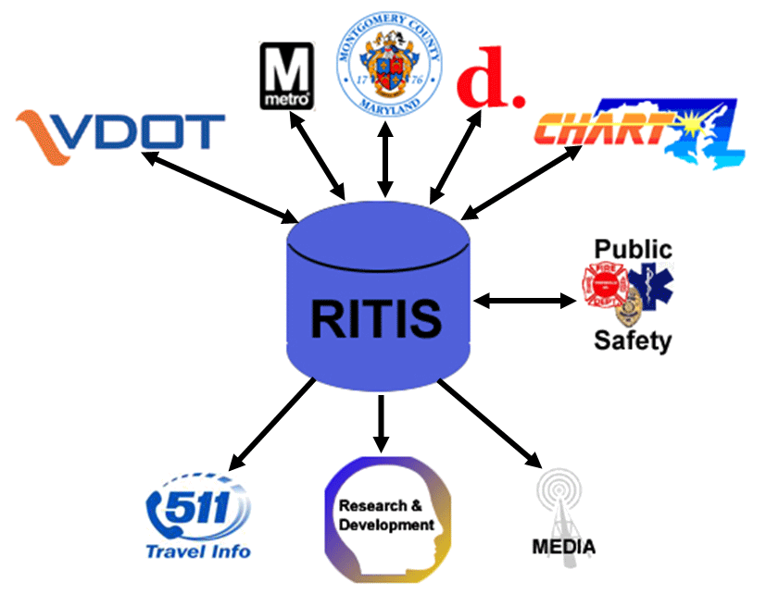

RITIS Functions to Support MATOC
Transportation data acquisition from transportation, public safety, and weather agencies
Incidents, Events, Construction, and Related Information
Real-time information dissemination for:
Incident/traffic mgt.
Traveler information
Archived data for
R&D
Planning
Performance Measures
Traveler Info
Traveler Information
Notes:
Pack

Slide 9
How Will RITIS/MATOC Help?
Agency Needs | Pre-RITIS/MATOC | With RITIS/MATOC
Cross agency incident notification | Ad hoc – stovepiped agency by agency | Automated, real-time
Situational awareness | Ad hoc – via phone (time permitting) | Automated, real-time
Information dissemination to media/public | Agency by agency | Cross-informed regional information available
Tracking regional impacts | Ad hoc | Cross-informed regional information available
Performance Measures | Per agency | Region-wide performance measures
After Action Reviews | Ad hoc | Via RITIS data archive and visualization tools
Notes:
Pack

Slide 10
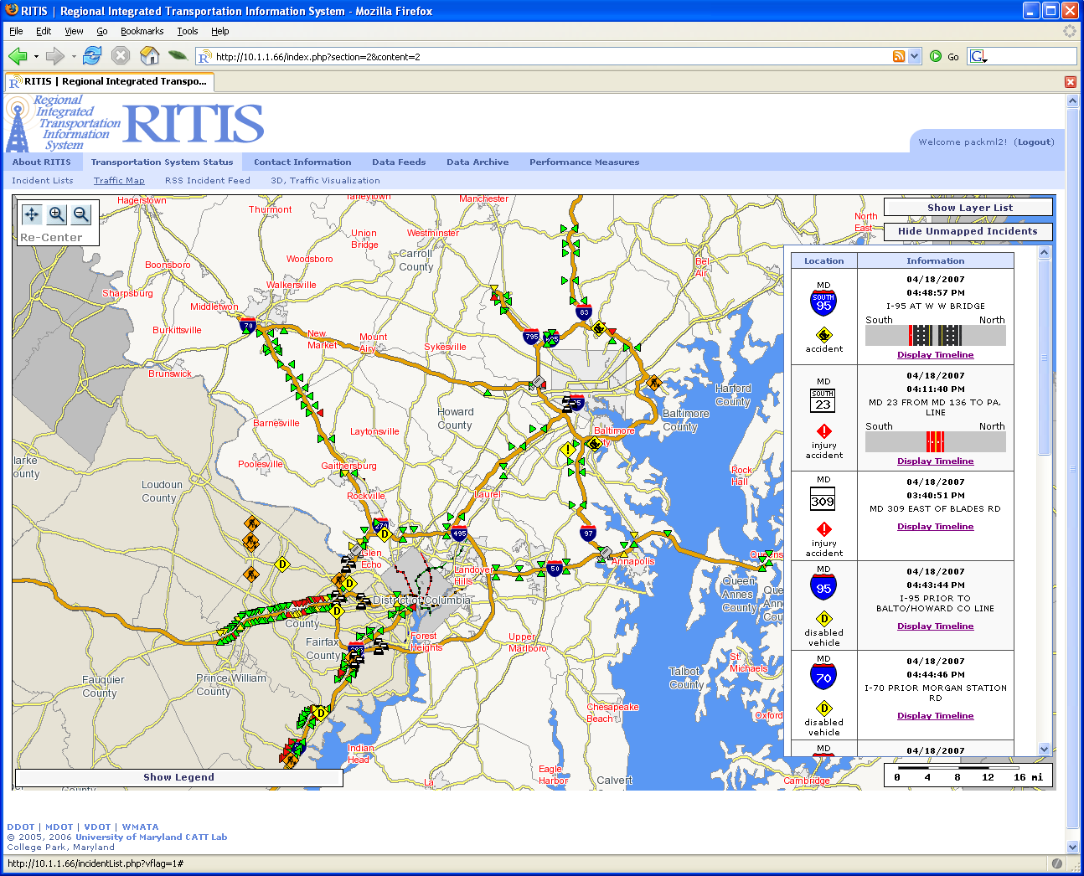
Notes:
Pack

