Slide 1

Hands on Using the OSG client Abhishek Singh Rana and David Meyers
OSG Consortium Mtg March 2007
Quick Start Guide to the OSG

Slide 2
OSG 0.6.0 Infrastructure
VORS – Virtual Organization Resource Selector
MonALISA – MONitoring Agents using a Large Integrated Service Architecture
Gratia – Grid accounting facility
Virtual Organization (VO) issues
GOC – Grid Operations Center
OSG Consortium Mtg March 2007
Quick Start Guide to the OSG

Slide 3
Virtual Organization Resource Selector - VORS
Custom web interface to a grid scanner that checks services and resources on:
Each Compute Element
Each Storage Element
Very handy for checking:
Paths of installed tools on Worker Nodes.
Location & amount of disk space for planning a workflow.
Troubleshooting when an error occurs.
OSG Consortium Mtg March 2007
Quick Start Guide to the OSG

Slide 4
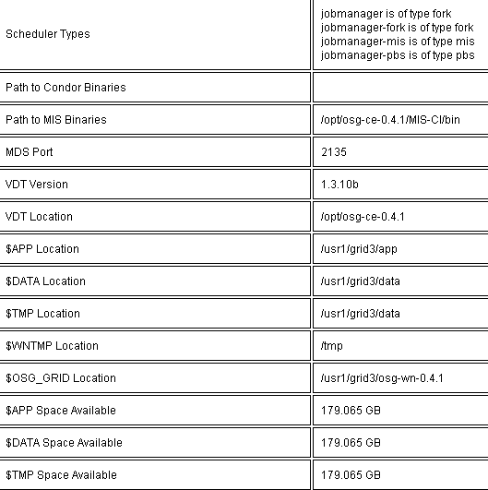
VORS entry for OSG_LIGO_PSU
Gatekeeper: grid3.aset.psu.edu
OSG Consortium Mtg March 2007
Quick Start Guide to the OSG

Slide 5
VORS is developing a grid-scanner for Storage Elements (coming soon) for OSG 0.6.0
Testing for SE SRM control protocol : YES control type = srm_v1 end point = srm://fndca1.fnal.gov:8443/ full path = /pnfs/fnal.gov/usr/fermigrid/volatile/mis executing srmls -retry_num=0 srm://fndca1.fnal.gov:8443//pnfs/fnal.gov/usr/fermigrid/volatile/mis 2>&1 ….
Testing srmls : PASS - read 12 lines 512 srm://fndca1.fnal.gov:8443//pnfs/fnal.gov/usr/fermigrid/volatile/mis 1715 srm://fndca1.fnal.gov:8443//pnfs/fnal.gov/usr/fermigrid/volatile/mis/file1 1715 srm://fndca1.fnal.gov:8443//pnfs/fnal.gov/usr/fermigrid/volatile/mis/file2 41767
….
Testing srmcp (from SE) : FAIL - returns error code 256
OSG Consortium Mtg March 2007
Quick Start Guide to the OSG

Slide 6
MonALISA
Mature OSG-wide real-time monitoring of jobs
Provides templates for charting job and workflow progress on a site or per a collection of sites used by a Virtual Organization.
Provides historical database records on past usage.
OSG Consortium Mtg March 2007
Quick Start Guide to the OSG

Slide 7
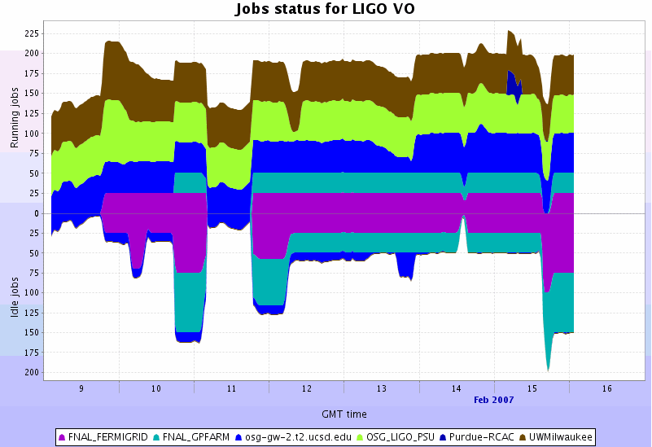
MonALISA Graph capability – Run-time performance of a LIGO App at 6 OSG sites
OSG Consortium Mtg March 2007
Quick Start Guide to the OSG

Slide 8
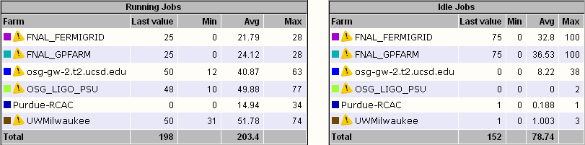
MonALISA stats – 7 day performance of a LIGO App at 6 OSG sites
OSG Consortium Mtg March 2007
Quick Start Guide to the OSG

Slide 9
Gratia – Grid Accounting Package
Goal: Accurate set of views of Grid resource usage.
Uniform accounting records independent of batch scheduler and operating system.
Gratia Probe installed as part of the OSG 0.60 Compute Element installation.
Gratia Reporting Facility at FNAL.
SQL retrieval of records from FNAL DB.
OSG Consortium Mtg March 2007
Quick Start Guide to the OSG

Slide 10
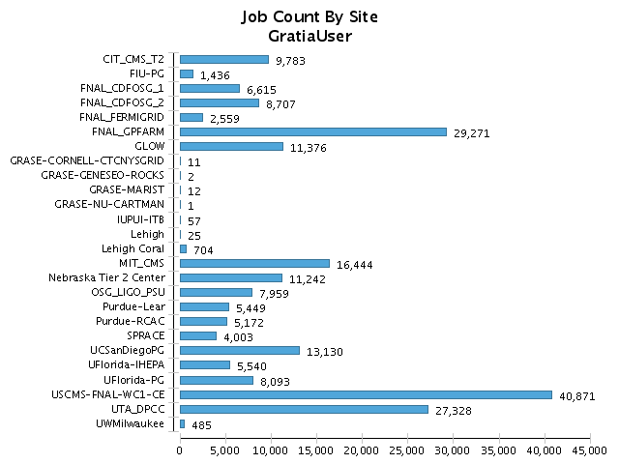
Date range: 2007-02-26 00:00:00 GMT - 2007-03-05 23:59:59 GMT
OSG Consortium Mtg March 2007
Quick Start Guide to the OSG

Slide 11
Virtual Organization(VO) Issues
Your Grid Certificate is tied to a specific VO.
Each VO has a VO administrator. The VO admin manages a VOMS server.
VOMS – Virtual Organization Membership Service is a DB which collects all the membership information for the organization.
The Globus gatekeeper authentication process references your identity information from VOMS to determine if you are to be authenticated when you attempt to run a Globus job or GSIFTP a file.
OSG Consortium Mtg March 2007
Quick Start Guide to the OSG

Slide 12
Virtual Organization(VO) Issues
Why can’t I run a job at site X?
The site X may not support your VO. A Production site on the OSG is not required to support all VOs. (check with your VO admin)
The site X may require additional configuration to support your VO (missing VO home directory, wrong permissions, no VO grid mapping) Your VO admin may need the GOC to fix this.
OSG Consortium Mtg March 2007
Quick Start Guide to the OSG

Slide 13
Grid Operations Center
Based at Indiana University and provides a central repository of staff and monitoring systems for:
Real time grid monitoring.
Problem tracking via a trouble ticket system.
Support for developers and sys admins.
Maintains infrastructure – VORS, MonALISA and registration DB.
Maintains OSG software repositories.
OSG Consortium Mtg March 2007
Quick Start Guide to the OSG

Slide 14
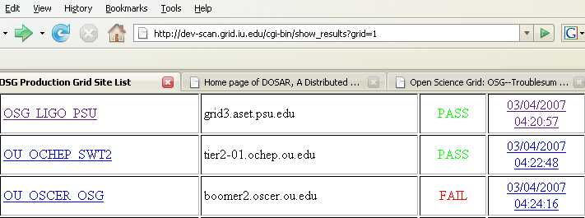
Running jobs on the OSG
Command line tools –common idioms
Check the VORS page
We need to specify the gatekeeper (second column above) for a site:
globus-job-run grid3.aset.psu.edu /bin/date
Sun Mar 4 00:30:02 EST 2007
Can we authenticate on OU_OCHEP_SW2 ?
globusrun -a -r tier2-01.ochep.ou.edu
GRAM Authentication test successful
OSG Consortium Mtg March 2007
Quick Start Guide to the OSG

Slide 15
Running jobs on the OSG
globusrun and globus-job-run can be used for complex job specifications:
Batch schedulers supported include:
Condor, LSF, PBS and SGE
To access many nodes on a remote resource specify the proper batch scheduler used at that site:
globus-job-run grid3.aset.psu.edu/jobmanager-pbs /bin/date
Command is queued on the batch scheduler and will run when the job reaches the front of the queue. The job may wait in the queue for minutes to hours depending on your priority and how busy the resource is.
OSG Consortium Mtg March 2007
Quick Start Guide to the OSG

Slide 16
Running jobs on the Grid
Globus is built on a Resource Specification Language (RSL) which can control batch schedulers that manage clusters.
An RSL example:
&(executable=“/bin/ls”) (directory=“/tmp”) (arguments=“-l”)
Place the RSL string in a file: myjob.rsl
Try: globusrun -s -r osg-itb.ligo.caltech.edu -f myjob.rsl
Try globusrun –s –r osg-itb.ligo.caltech.edu/jobmanager-condor –f myjob.rsl
But for more robust job management use Condor-G!
OSG Consortium Mtg March 2007
Quick Start Guide to the OSG

Slide 17
GridFTP: File transfer and staging
GridFTP is the globus protocol for transferring files between:
Grid clients (submit hosts) and grid Compute Elements.
Support multiple simultaneously streams for high performance.
Supports third-party copy: Host A requests Host B transfer files to Host C.
globus-url-copy is a wrapper on GridFTP with a convenient syntax.
OSG Consortium Mtg March 2007
Quick Start Guide to the OSG

Slide 18
globus-url-copy
Syntax: globus-url-copy source-url destination-url
Example:
globus-url-copy gsiftp://osg-itb.ligo.caltech.edu/archive/frames/H-H1_RDS-1024.gwf
gsiftp://testwulf.hpcc.ttu.edu/mnt/hep/osg/workdir/H-H1_RDS-1024.gwf
Many options exist. Please see the globus-url-copy of the GridIFTP User’s Guide:
http://www.globus.org/toolkit/docs/3.2/gridftp/user/globusurlcopy.html#commandlineoptions
for details.
OSG Consortium Mtg March 2007
Quick Start Guide to the OSG

Slide 19
Condor-G/DAGman
Globus virtualized the interface to high performance computing resources and file transfers.
However, run-time event management in distributed systems is needed:
Gatekeeper may be down.
GridFTP server may be down.
Operating system may become unresponsive.
Batch scheduler may become unresponsive.
Submit host may not be able to stage-out results of a job due to a full disk.
Condor-G/DAGman provides a means to monitor and manage end-to-end events during a Grid application execution.
OSG Consortium Mtg March 2007
Quick Start Guide to the OSG

Slide 20
Condor-G/DAGman
Condor folks created the globus universe. Condor scripts submitted to the globus universe are submitted to a Globus gatekeeper or GridFTP server and use all of the resources of Globus jobs.
Condor scripts are submitted by the user running a Condor client and having a local condor queue. So Grid job management is simplified for the user due to Condor toolset:
condor_submit: submit a condor script.
condor_q: check the status of a condor job.
condor_rm: remove a condor job from the queue.
OSG Consortium Mtg March 2007
Quick Start Guide to the OSG

Slide 21
A simple Condor-G script
universe = globus
executable = /bin/ls
notification = NEVER
globusrsl = (jobtype=single) globusscheduler = osg-itb.ligo.caltech.edu/jobmanager-condor copy_to_spool = false error = /home/dmeyers/osg-itb.err log = /home/dmeyers/osg-itb.log output = /home/dmeyers/osg-itb.out transfer_executable = false transfer_error = true transfer_output = true periodic_release = (NumSystemHolds <= 3) periodic_remove = (NumSystemHolds > 3) remote_initialdir = /home/dmeyers queue
OSG Consortium Mtg March 2007
Quick Start Guide to the OSG

Slide 22
DAGman
DAG manager (DAGman) is an extension to the Condor system that adds a Directed Acyclic Graph(DAG) abstraction.
Many scientific and engineering workflows can be modeled as a collection of DAG nodes.
Each DAG node is tracked and its status determined by the DAG manager. Errors are handled by auto-restarting a failed node to increase reliability. Condor has the notion of a rescue DAG which represents the place in the Graph where a workflow can be restarted from, to resume a workflow.
OSG Consortium Mtg March 2007
Quick Start Guide to the OSG

Slide 23

DAGman
Diamond DAG
An example input file for DAGMan is
# Filename: diamond.dag
Job A A.condor
Job B B.condor
Job C C.condor
Job D D.condor
Script PRE A top_pre.csh
Script PRE B mid_pre.perl $JOB
Script POST B mid_post.perl $JOB $RETURN
Script PRE C mid_pre.perl $JOB
Script POST C mid_post.perl $JOB $RETURN
Script PRE D bot_pre.csh
PARENT A CHILD B C
PARENT B C CHILD D
Retry C 3
OSG Consortium Mtg March 2007
Quick Start Guide to the OSG

Slide 24
DAGMan
For more information on DAGMan see the DAGMan section of the Condor manual:
http://www.cs.wisc.edu/condor/manual/v6.4/2_11DAGMan_Applications.html#fig:dagman-diamond
Automatic Tools exist to convert DAGs into Condor-G submit scripts that can be run with the Condor command: condor-submit-dag.
One of these tools is the Pegasus Workflow Planner described at: http://pegasus.isi.edu/
OSG Consortium Mtg March 2007
Quick Start Guide to the OSG

Slide 25
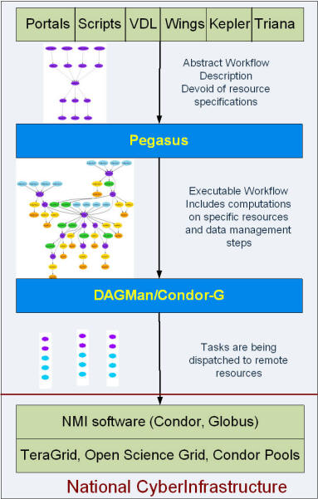
For More information on these topics see the references and URLs on the next page.
OSG Consortium Mtg March 2007
Quick Start Guide to the OSG

Slide 26
Trouble Shooting Info
OSG Troubleshooting guide:
http://grow.uiowa.edu/dokuwiki/doku.php/projects/troubleshooting/troubleshooting_guide
Includes Condor-G and Globus Error Codes and
Email addresses for:
The OSG Grid Operations Center
The OSG Troubleshooting Working Group
If you have a problem that you can not resolve, contact your VO support center first.
Your VO support center contact can be found at:
http://www.grid.iu.edu/osg-includes/sc.php
OSG Consortium Mtg March 2007
Quick Start Guide to the OSG

