Slide 1
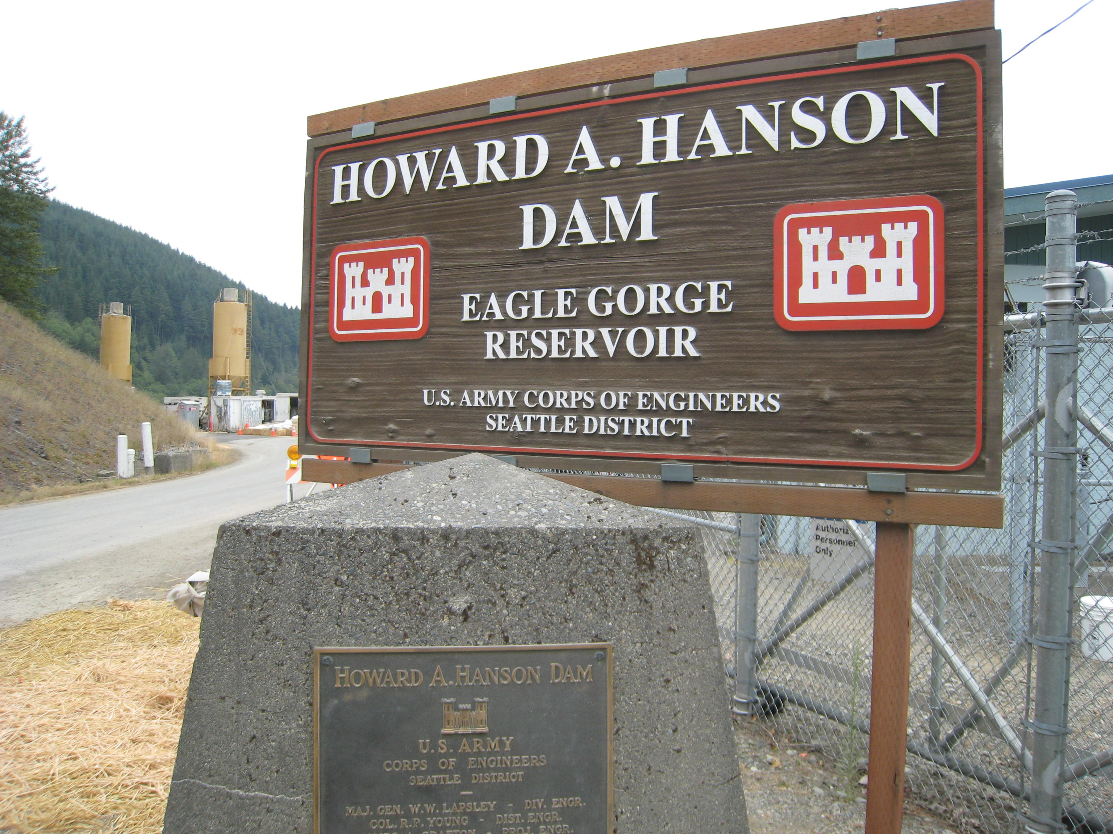
U.S. ARMY COPS OF ENGINEERS
Howard Hanson Dam Update

Slide 2
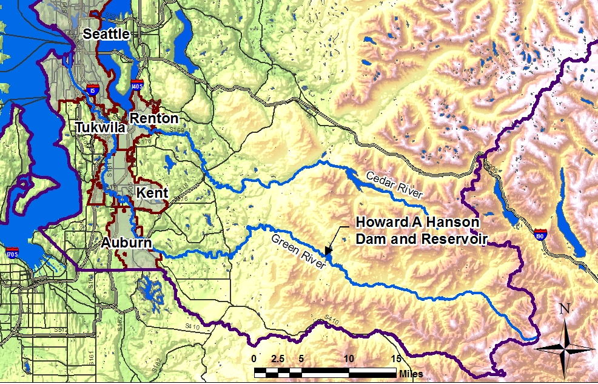
Green River Watershed

Slide 3

Normal Project Operations
NOV
MAR
JUN
NOV
1206 ft
Potential flood pools of short duration
Spring ramp-up for augmentation
Summer and fall flow augmentation
1167 ft
1075 ft
Pool elevation in feet above sea level

Slide 4
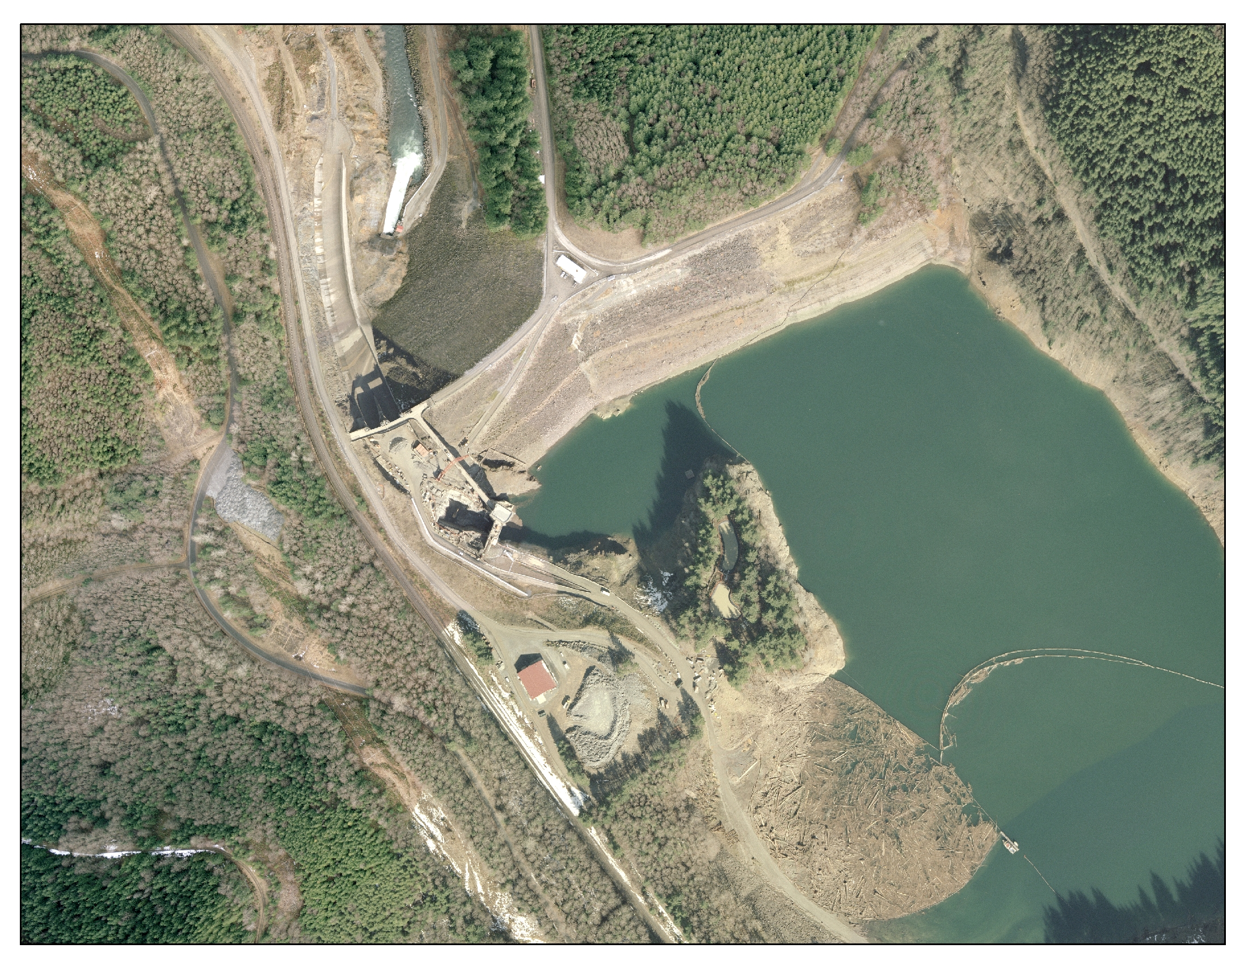
Landslide Debris
Green River
Underground Drainage
Tunnel
Grout Curtain
Spillway
Right Abutment
Dam Embankment
Eagle Gorge Reservoir

Slide 5
