Slide 1

Release 3 User Interface Presentation, including Reports Functionality: Broker and Vendor Session
January 28, 2004
Presenters:
Dale Wilson, CBP
Ray Portu, eCP
Paul Nugent, eCP
Kevin Smith, eCP
Notes:
<number>
<footer>
<header>
<date/time>

Slide 2
Agenda
Introduction – Ray Portu
Account Management – Ray Portu
Account Revenue – Paul Nugent
Reports – Kevin Smith

Slide 3
Release 3 User Interface Presentation, including Reports Functionality: Broker and Vendor Session
INTRODUCTION Ray Portu, eCP
Notes:
<number>
<footer>
<header>
<date/time>

Slide 4
Introduction
“Release 3 User Interface Presentation Sector Breakout Sessions”
Demonstrates ACE Release 3 account management, account revenue, and reporting graphical user interface views
Describes a transition for functionality established in ACE Release 2 and functionality added in ACE Release 3.
Presented in three sessions:
ACE Portal Importer (exporter and surety)
ACE Portal Broker (vendor)
ACE Portal Carrier
Notes:
Statements and Reporting Presented in the “Release 3 User Interface Presentation” Importer and Brokers Sessions
Periodic Payment Scenario and Q&A in “R3 Informational Session with TSN Accounts and TSN Revenue Committees”

Slide 5
Introduction (continued)
All screens shown in this session are
“For Conceptual Purposes Only”
Morris Brokerage Account Scenario
Secure Data Portal Importer View of the following tabs:
Home
Accounts
Reports
SAL (Significant Activity Log)
Action Plan
Statements
Sample Preliminary Periodic Monthly
Notes:
Statements and Reporting Presented in the “Release 3 User Interface Presentation” Importer and Brokers Sessions
Periodic Payment Scenario and Q&A in “R3 Informational Session with TSN Accounts and TSN Revenue Committees”

Slide 6
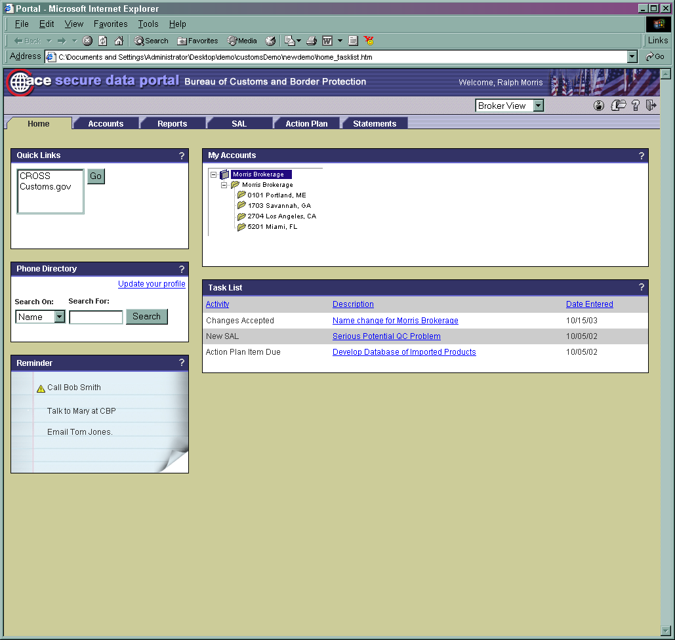

Slide 7
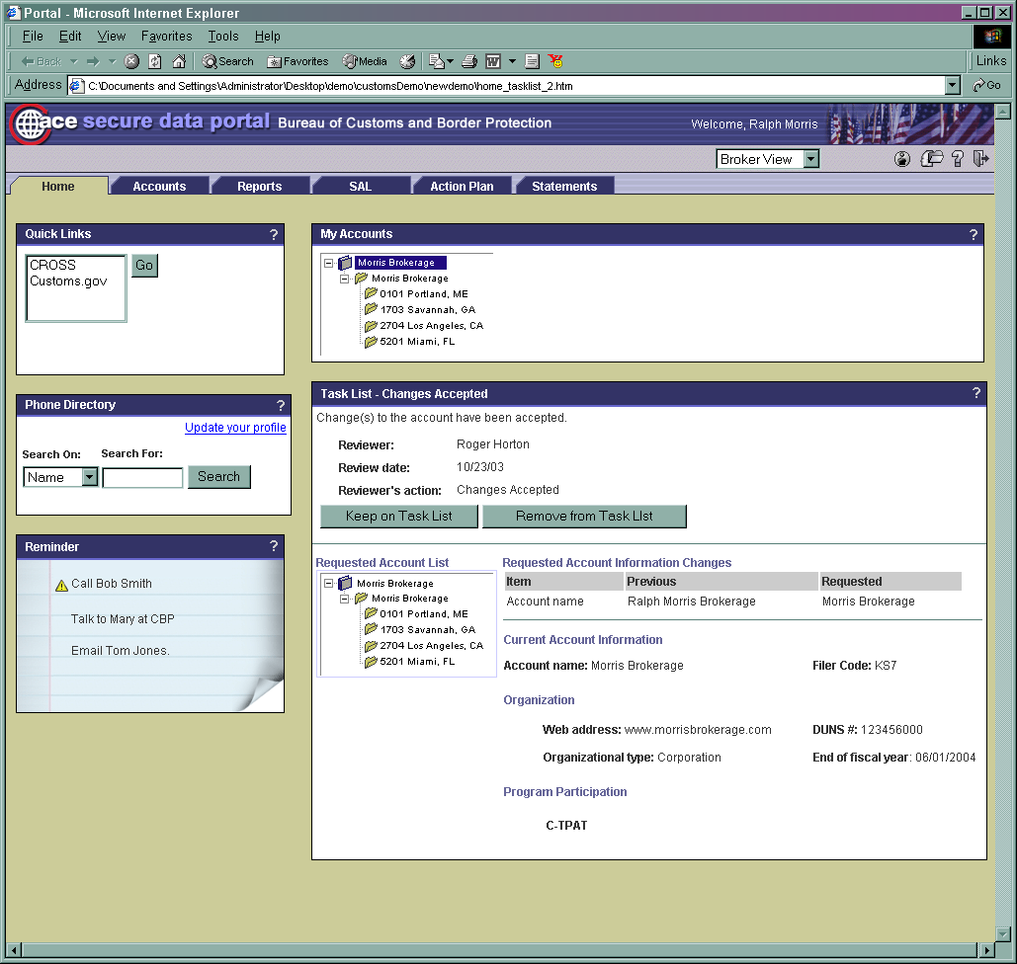

Slide 8
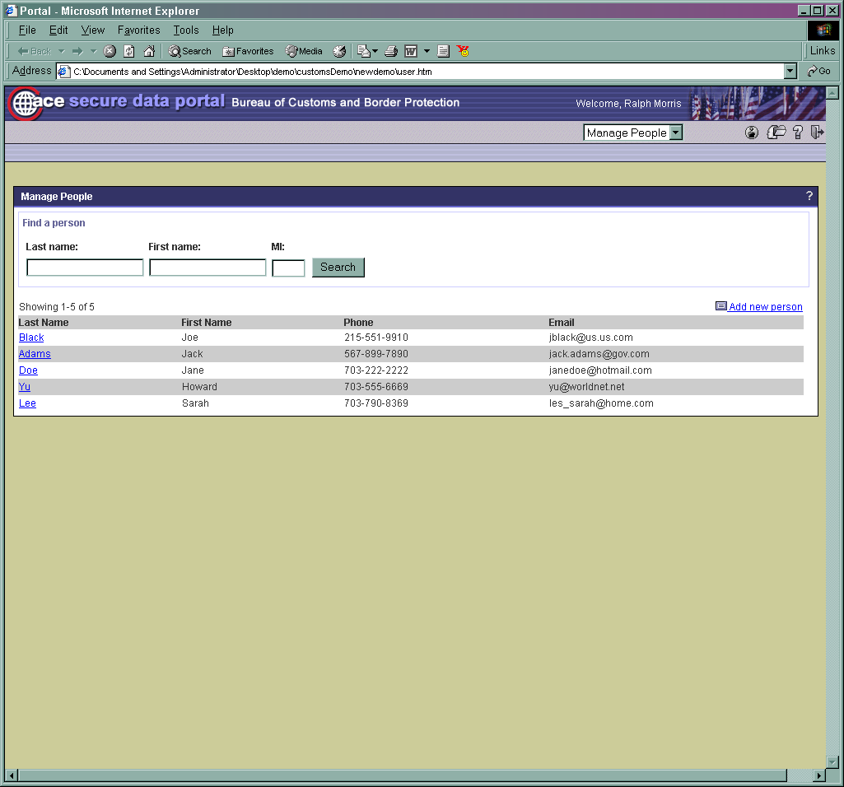

Slide 9
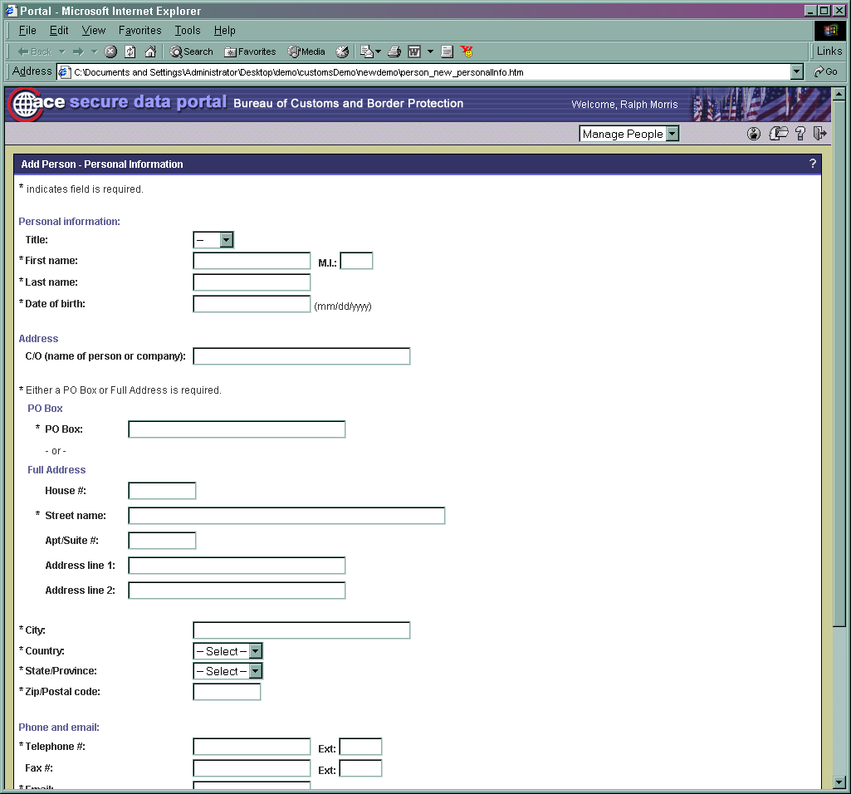

Slide 10
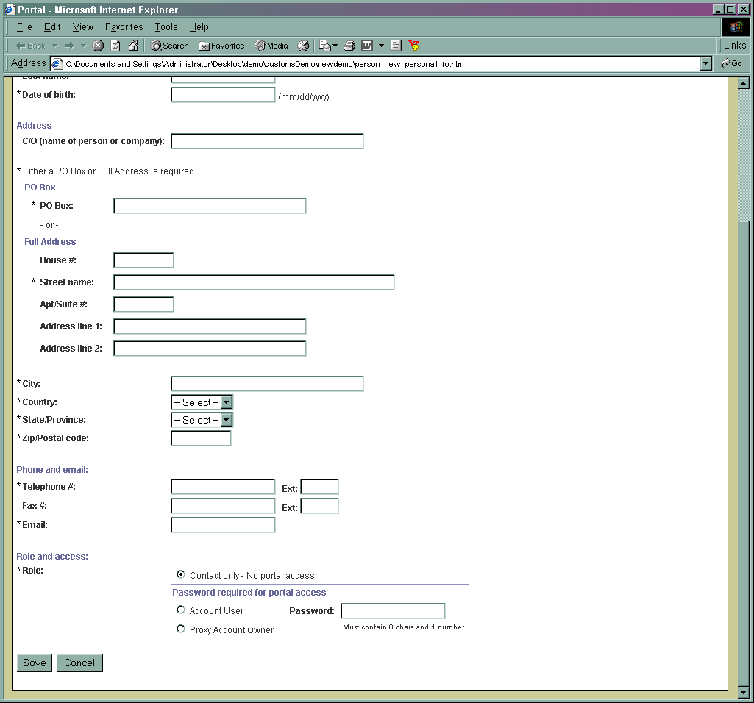

Slide 12
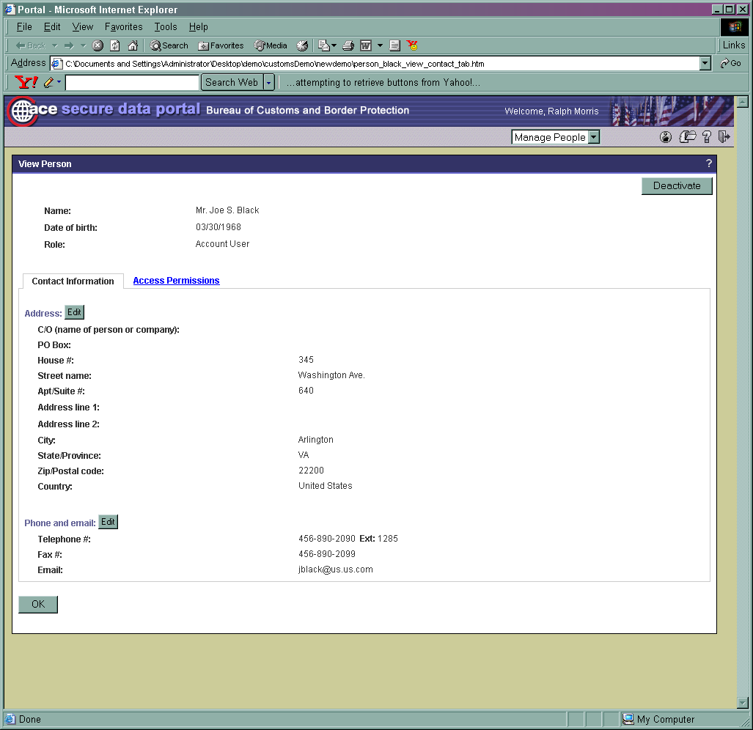

Slide 13
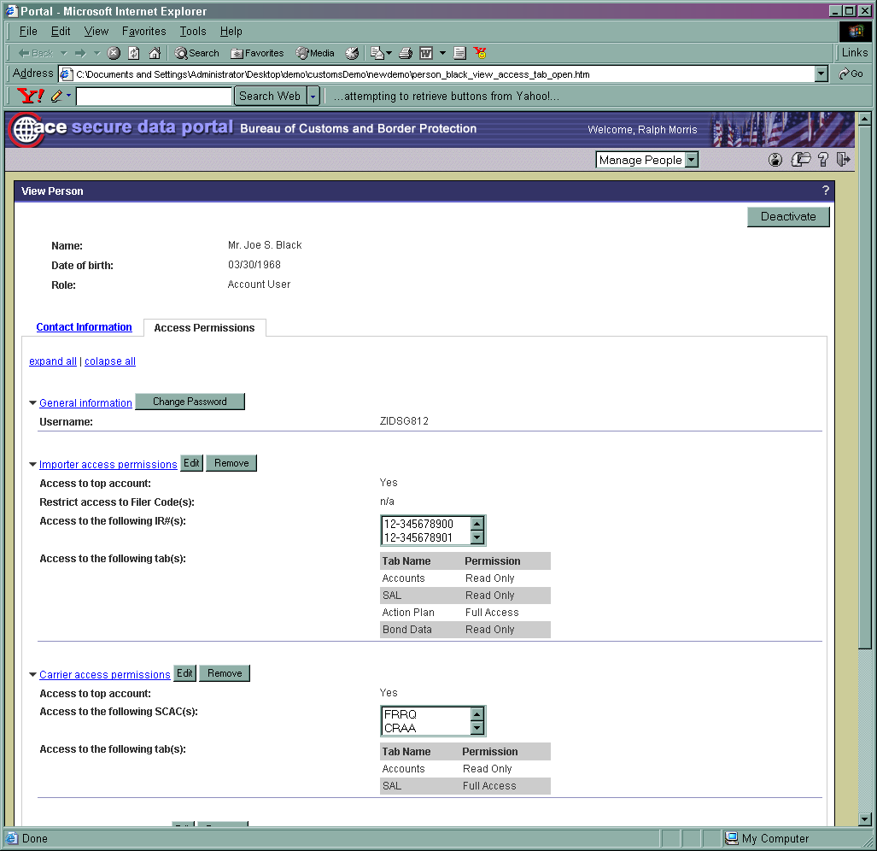

Slide 14
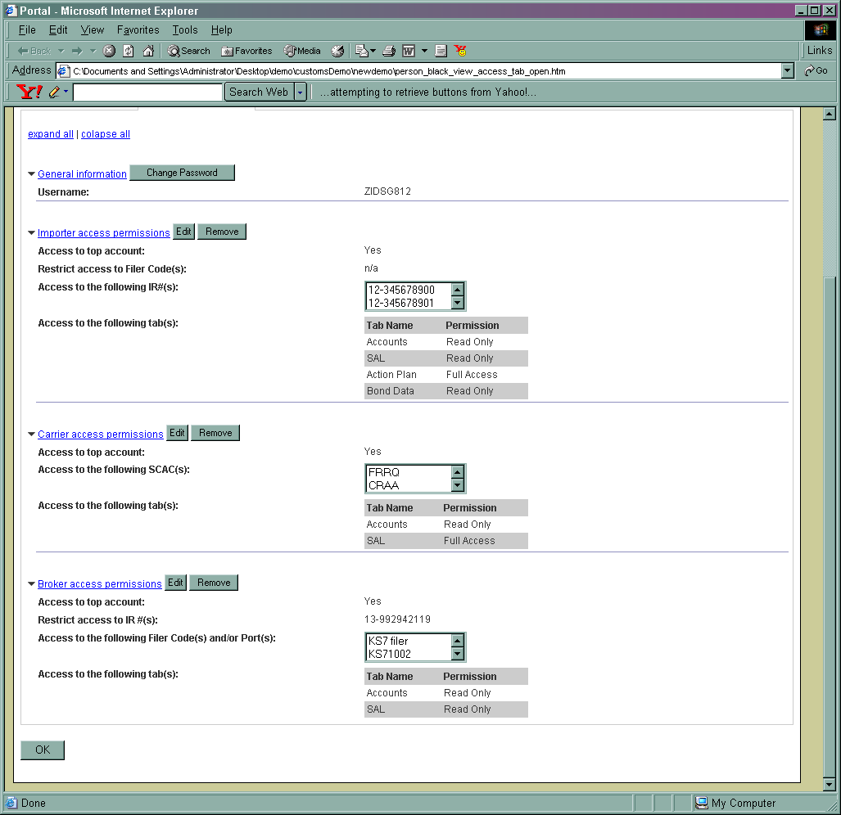

Slide 15
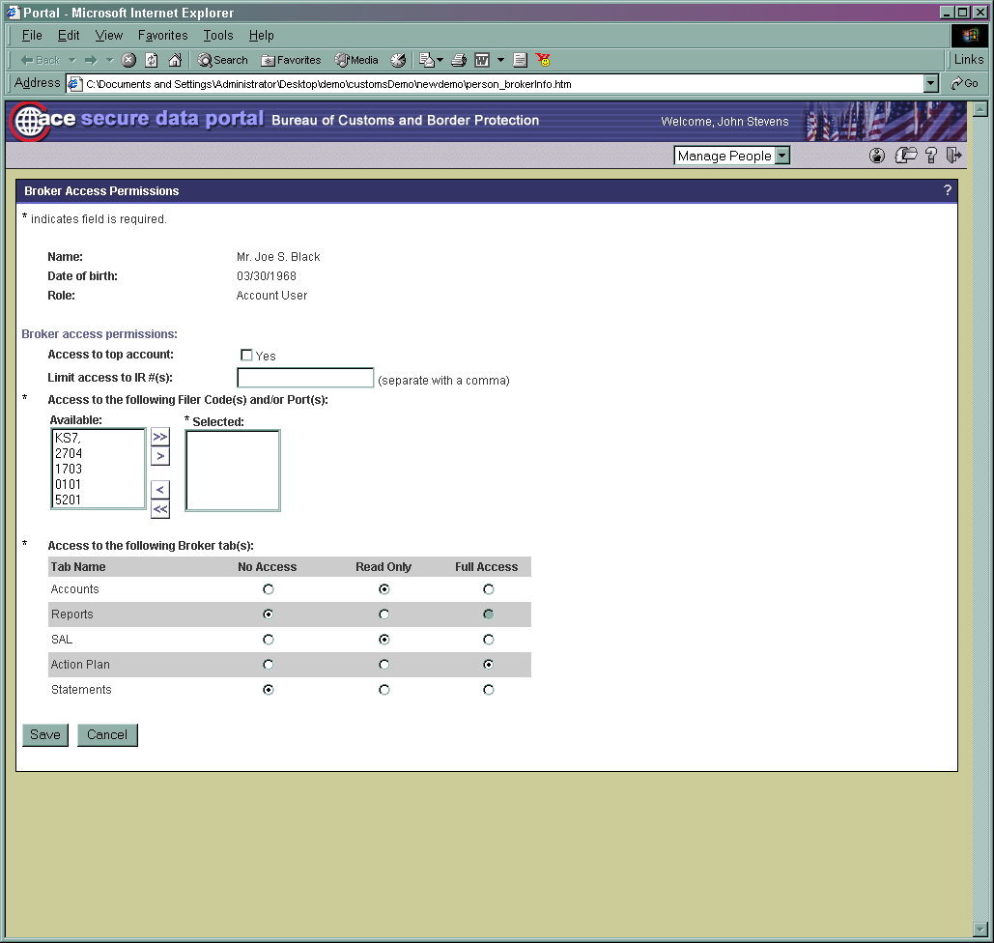

Slide 16
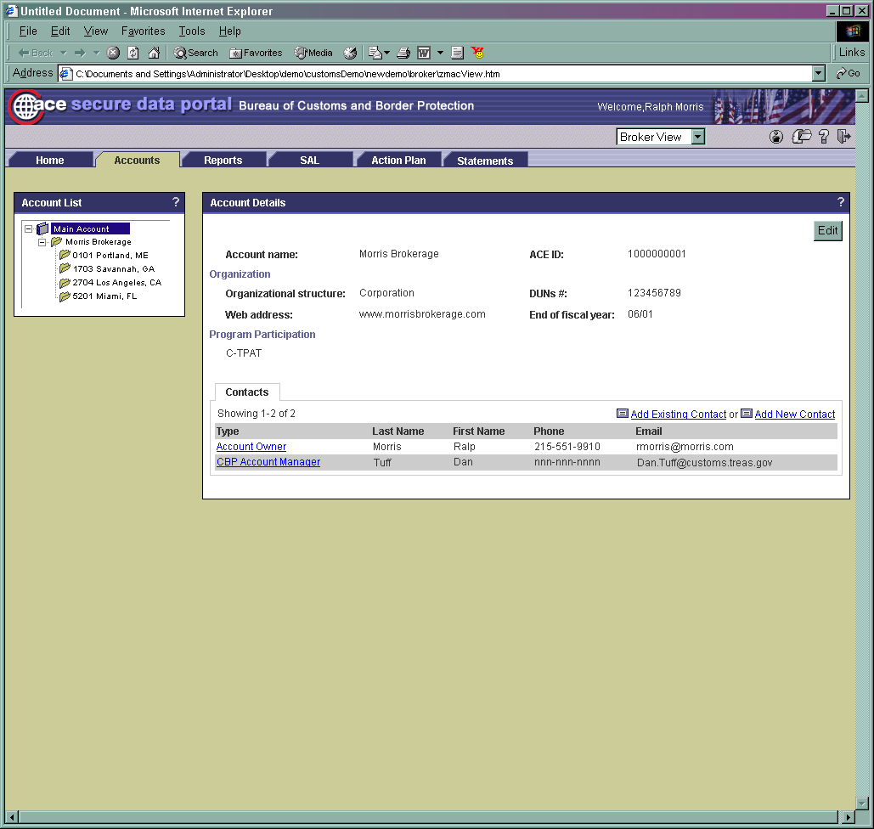

Slide 17
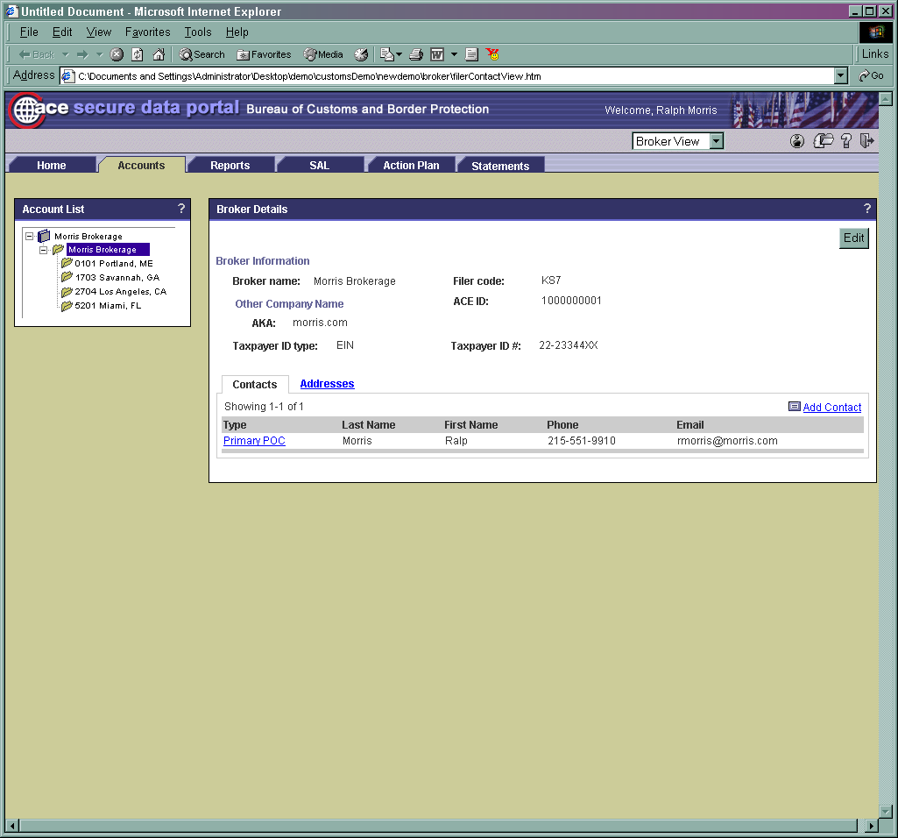

Slide 18
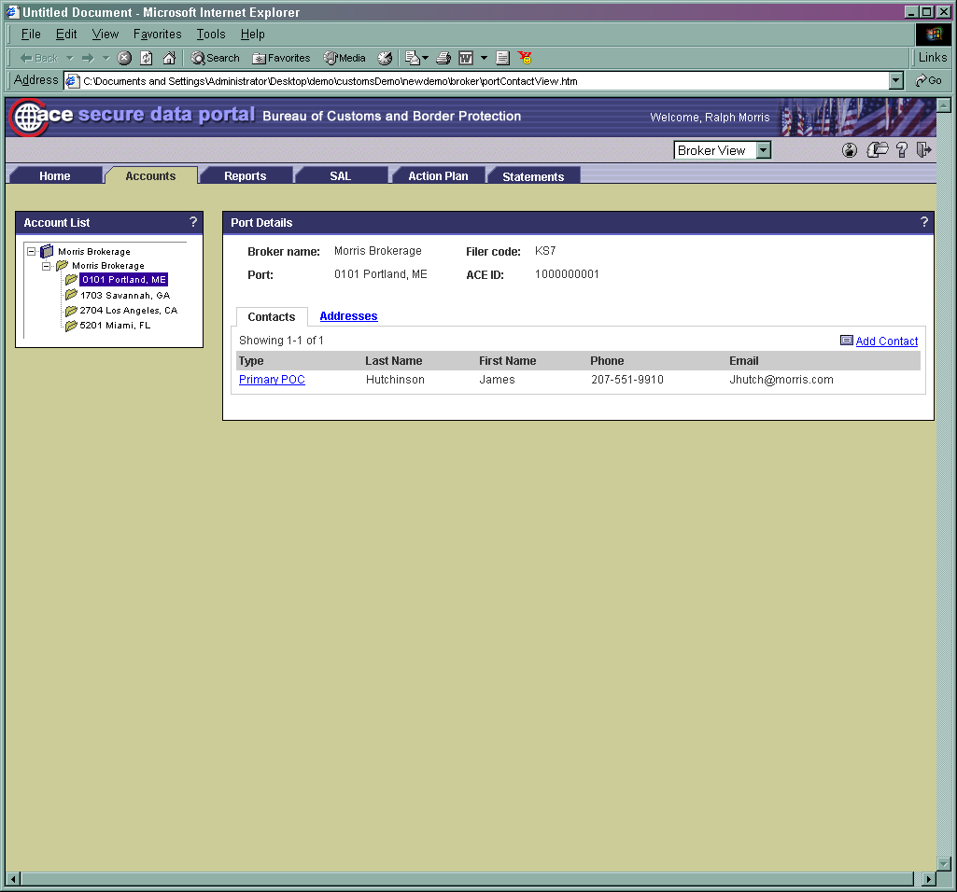

Slide 19
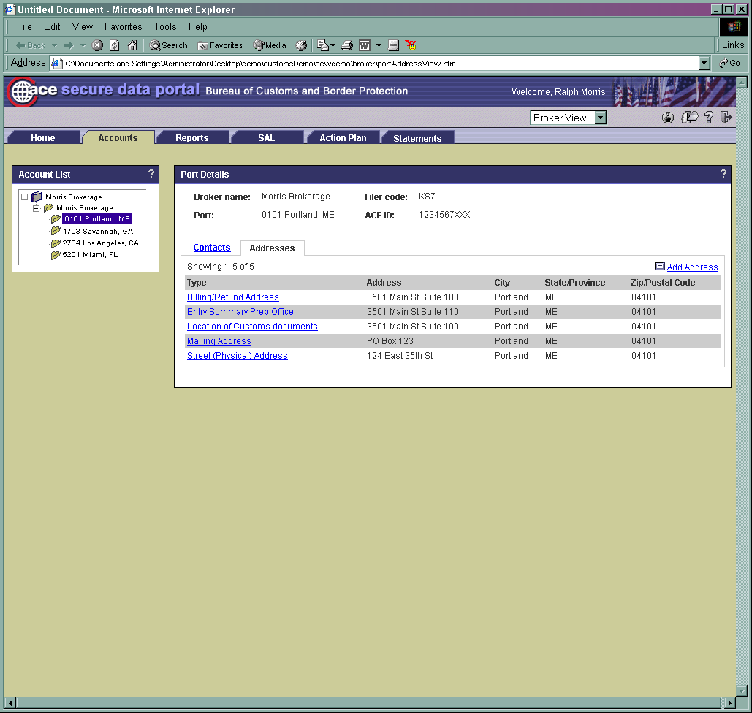

Slide 20
Release 2 - Reports
More than 40 reports regarding:
Entry Summary Line Items
Cargo Exam Discrepancy Details Report
Entry Summary Discrepancy Details Report
Aggregate Importer Reports
Aggregate Cargo Exam Compliance Reports
Aggregate Entry Summary Compliance Reports
Importer Quick Views
Portal interface to select report and enter queries

Slide 21

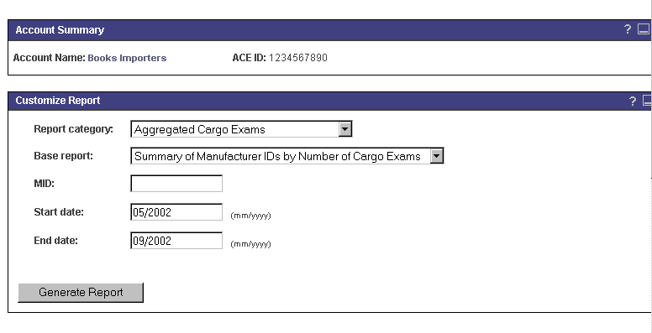
Release 2 – Reporting Interface

Slide 22
Release 3 – AM Reports
Account Mgmt – 67 reports
New User Interface
Updated Release 2 reports
New Data Type (Cargo Entry)
New Reports
Advanced queries (Entry Summary, Cargo Entry, Cargo Exams and Team Reviews)
Filer by Port
New Compliance Quick View and Reports
Broker/Filer Quick Views
New Functionality

Slide 23
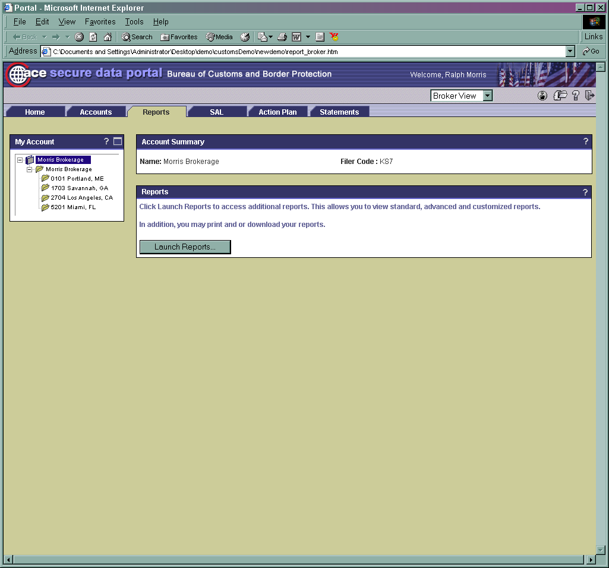
Select the “Launch Reports” button to open the reporting tool

Slide 24
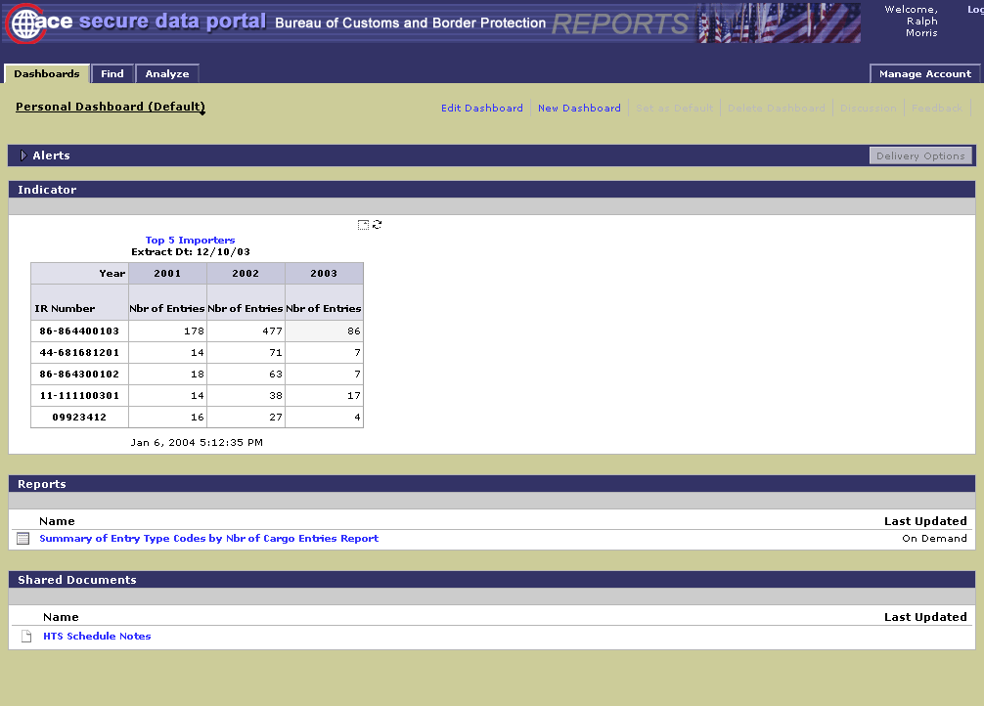
The “Dashboard” is the default tab when opening the reporting application

Slide 25
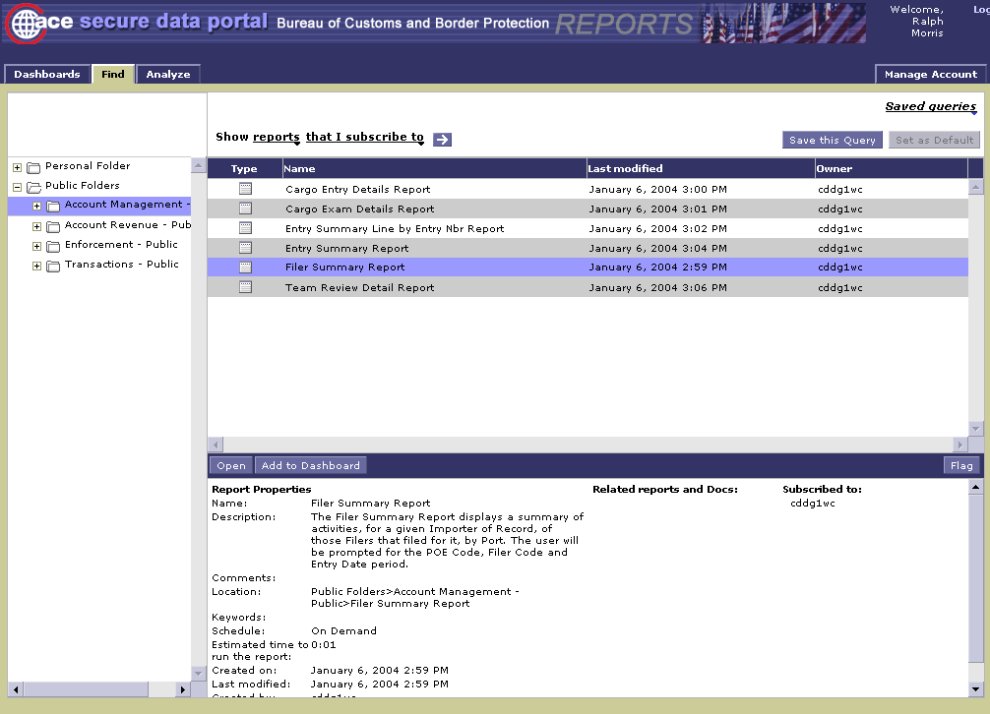
To locate an existing report, choose the “Find” tab
1
2
3
4

Slide 26
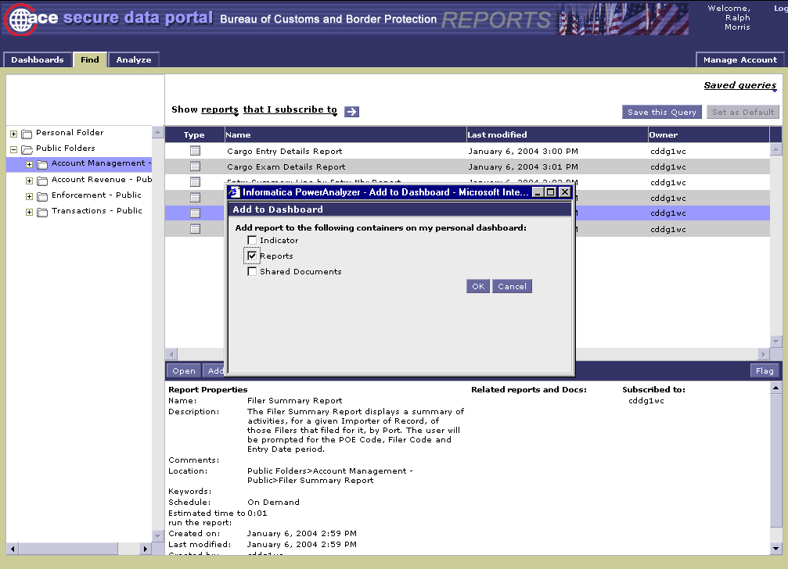
Select the container in your dashboard where you want to store the canned report

Slide 27
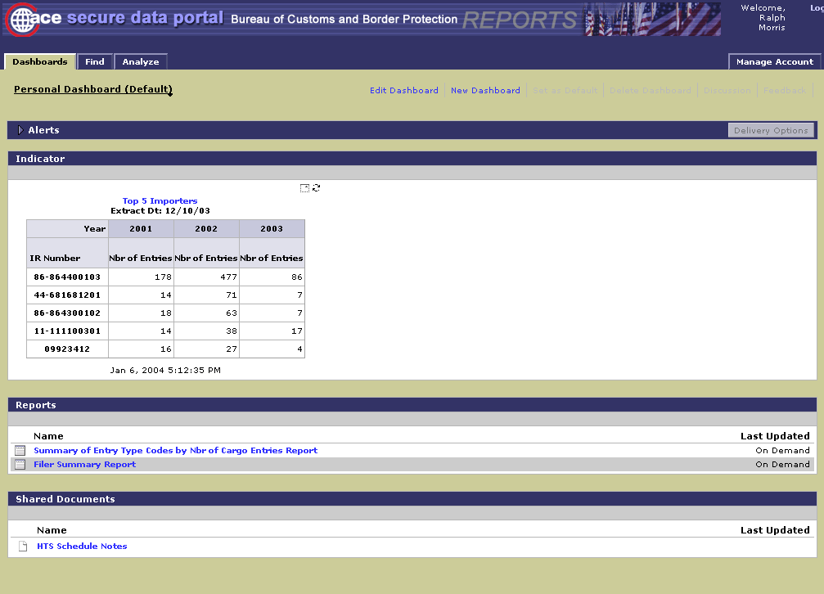
Note the “Filer Summary Report” has been added to the “Reports” container

Slide 28
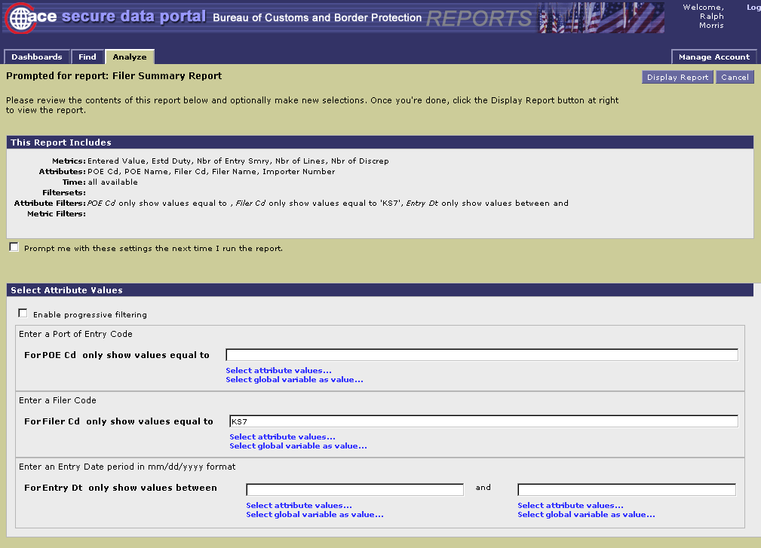
Fill in the filter criteria and select “Display Report” to view the results

Slide 29
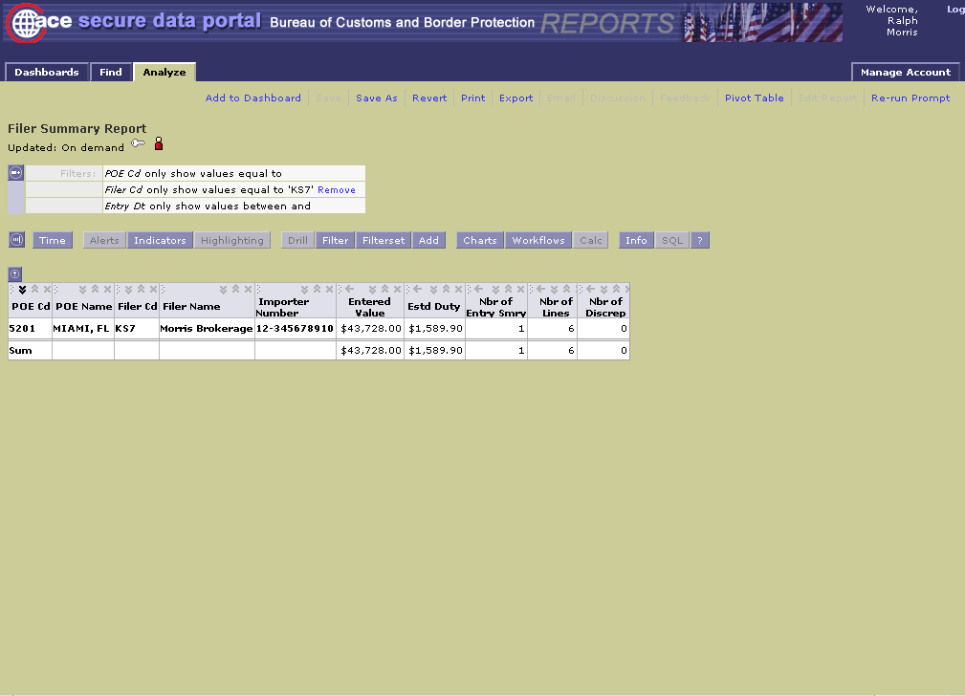
The query results are now displayed

Slide 30
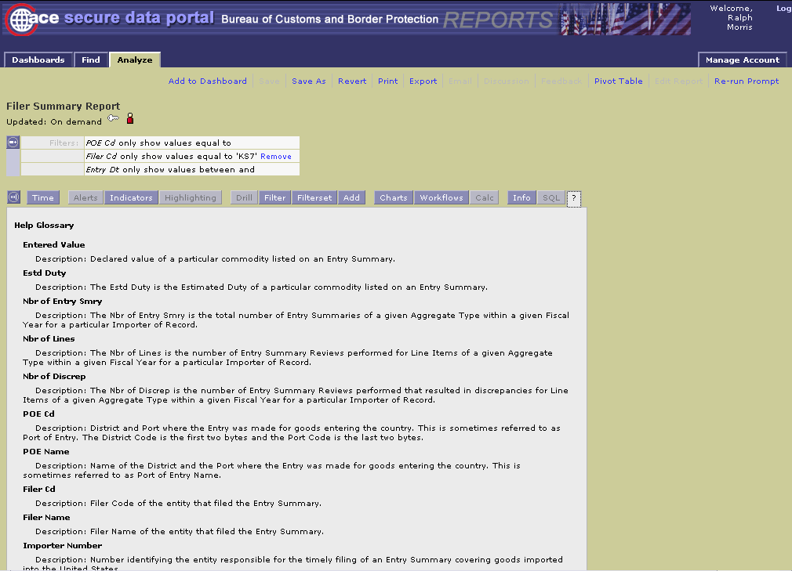
Selecting ? will display a description of the data fields

Slide 31
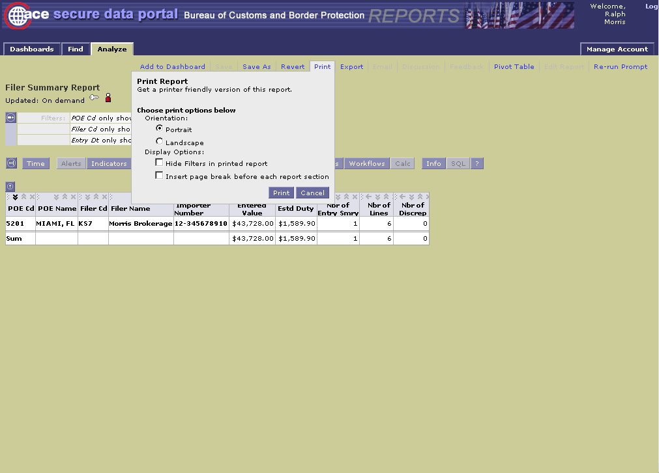
Select the “Print” function to obtain a hard copy of the report

Slide 32
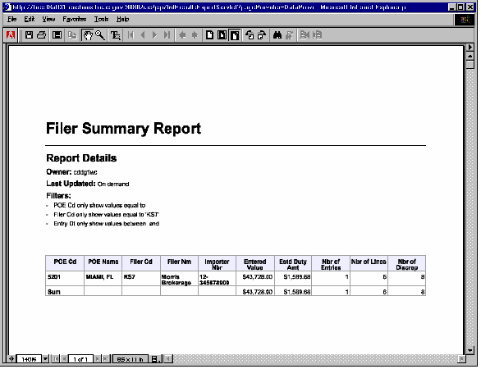
The report is formatted in PDF and can be printed on a local printer

Slide 33
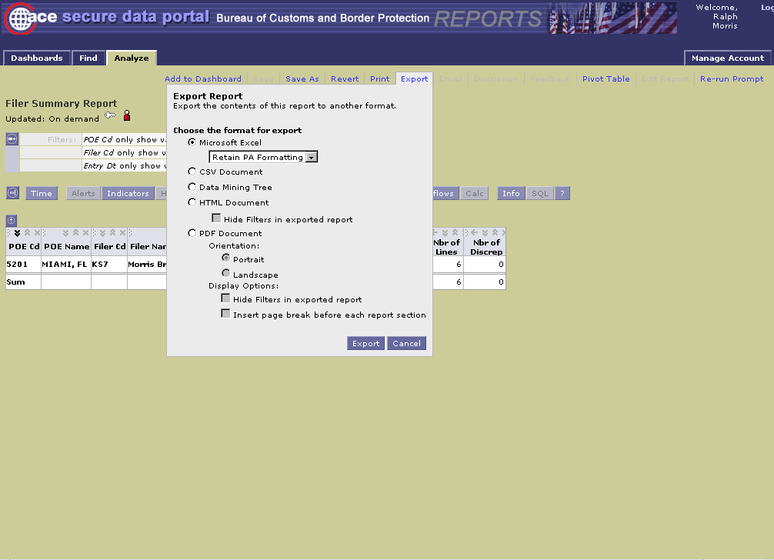
Select the “Export” function to obtain an electronic copy of the report

Slide 34
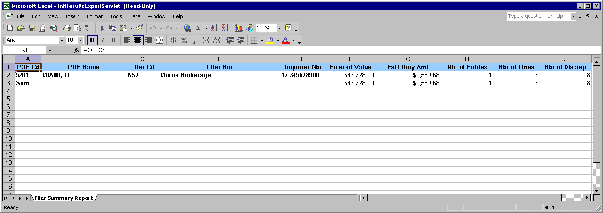
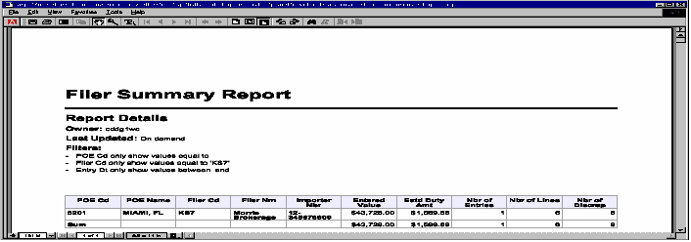
Example of “Exported” Excel version of report
Example of “Exported” PDF version of report

Slide 35
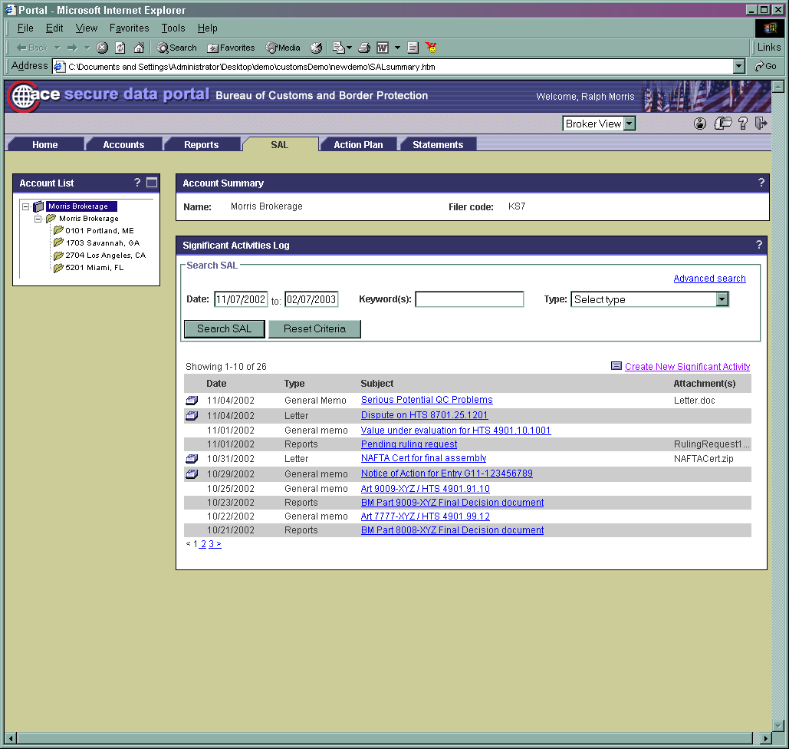

Slide 36
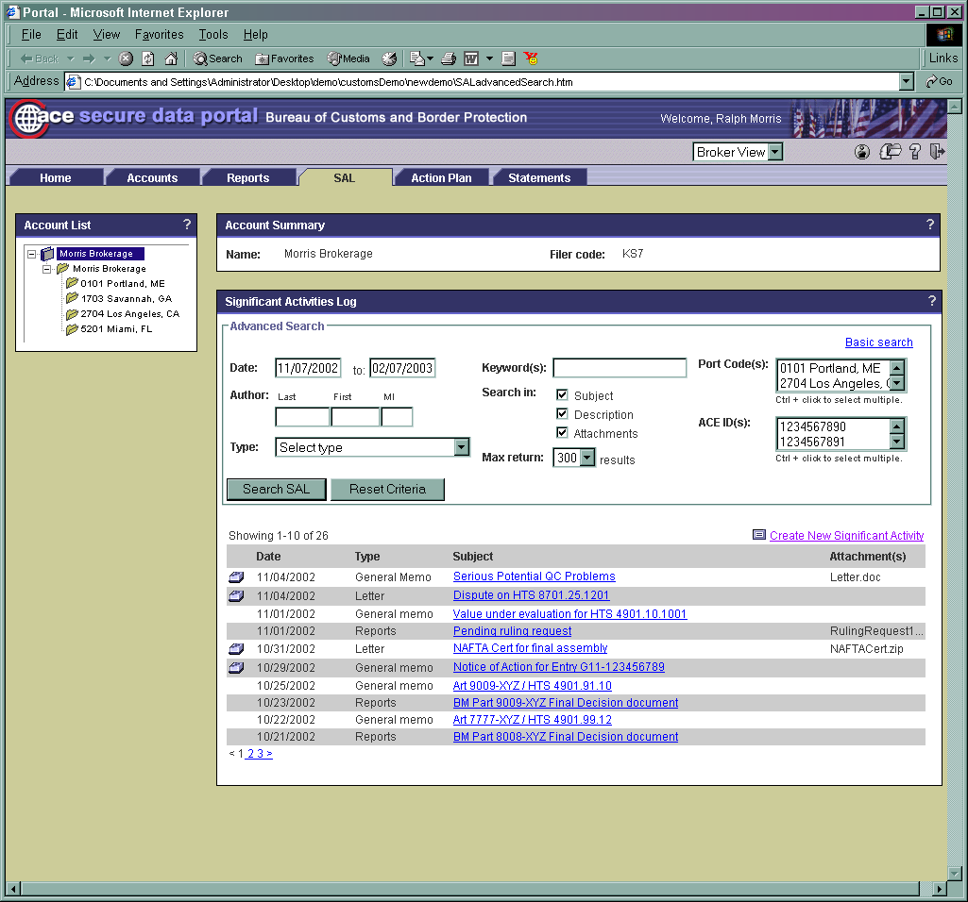

Slide 37
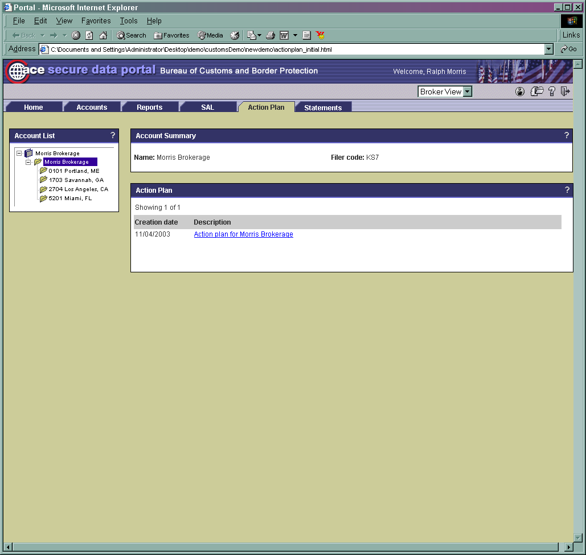

Slide 38
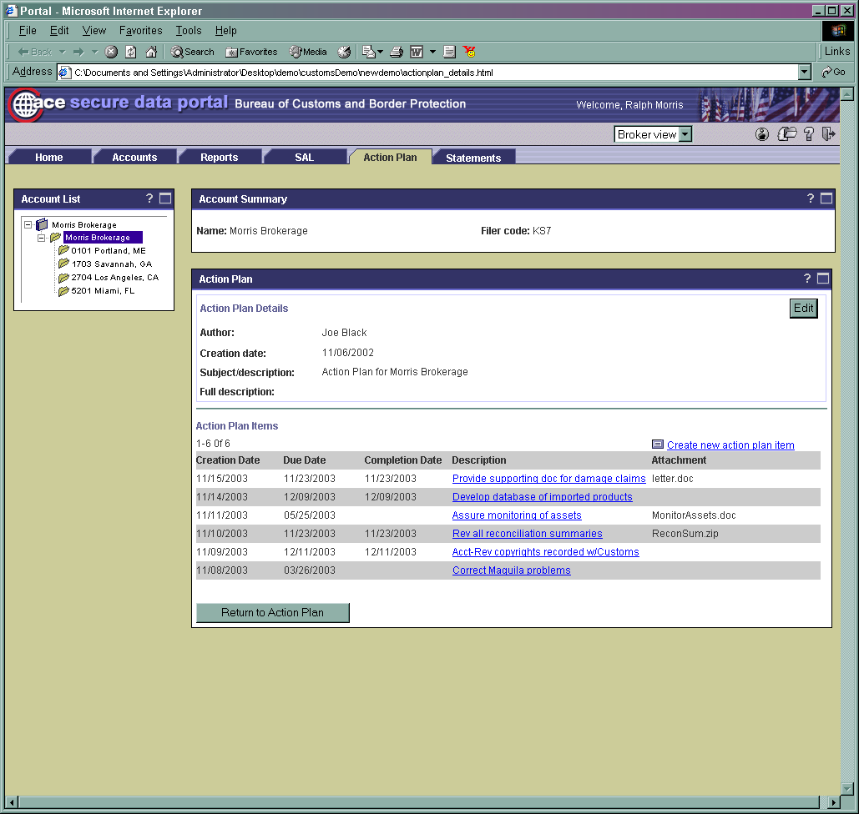

Slide 39
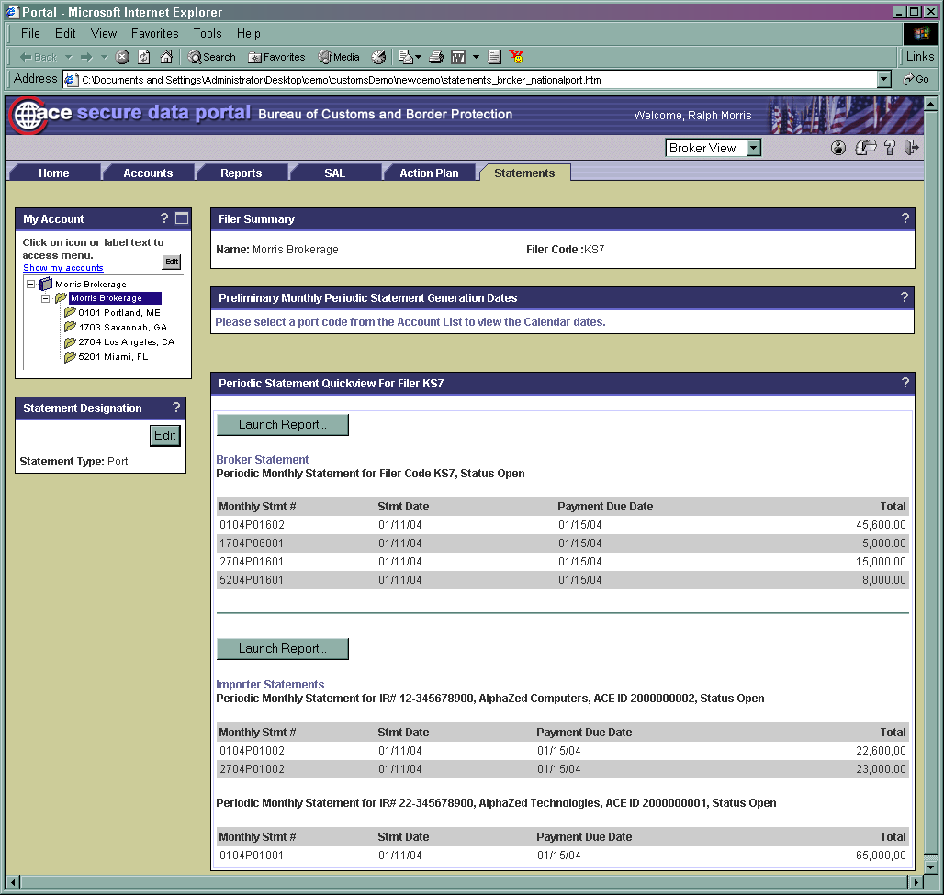

Slide 40
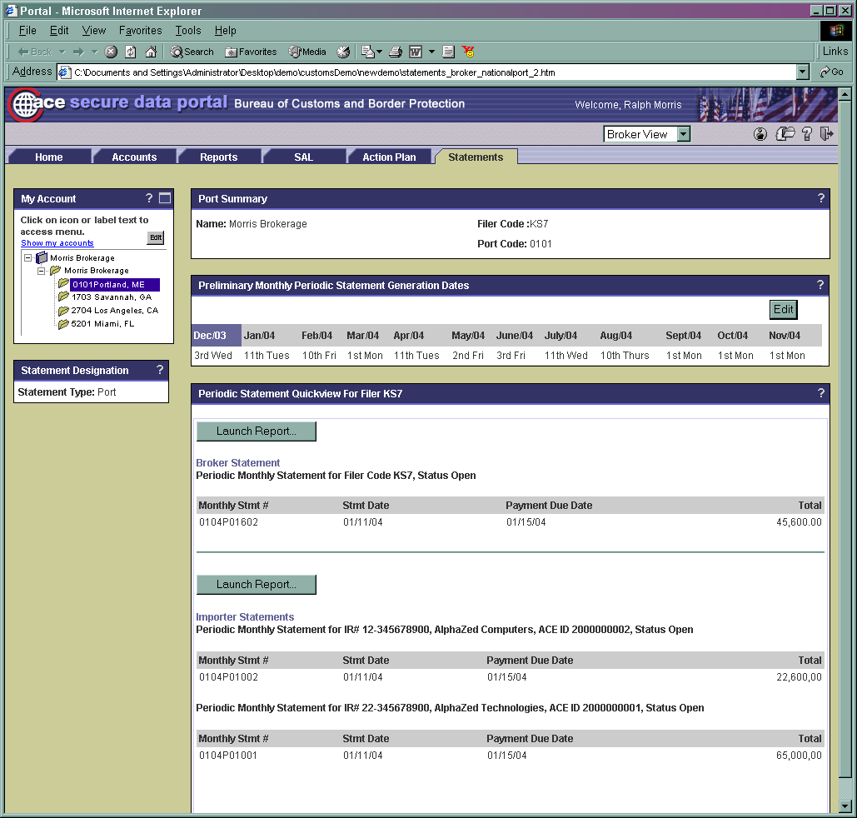

Slide 41
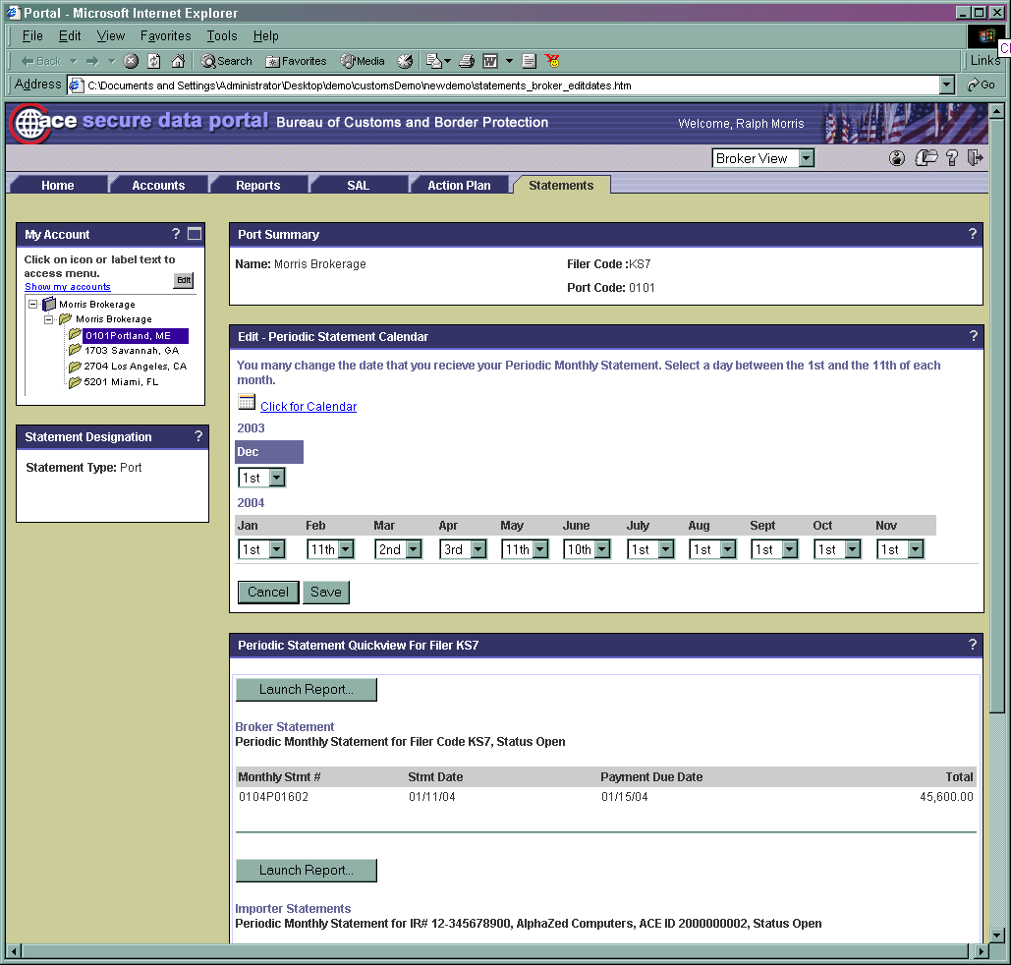

Slide 43
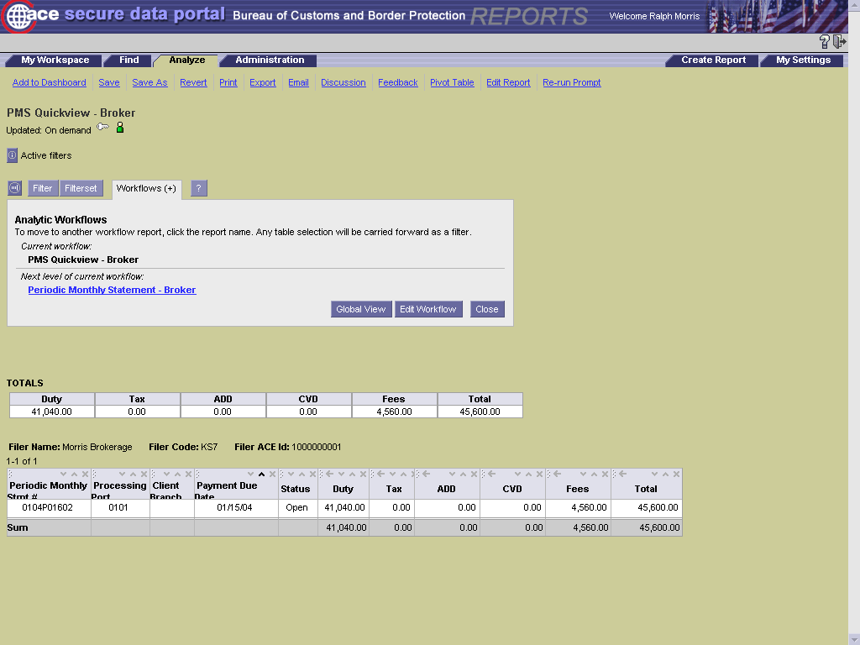

Slide 44
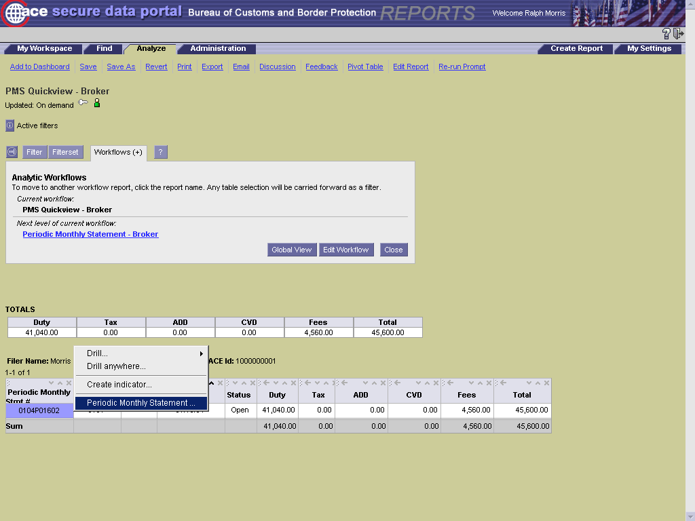

Slide 45
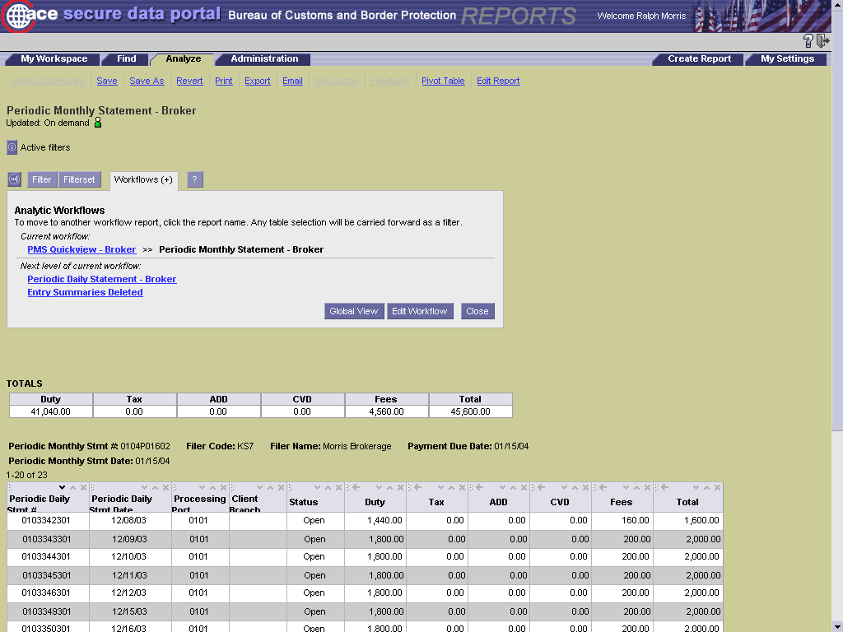

Slide 46
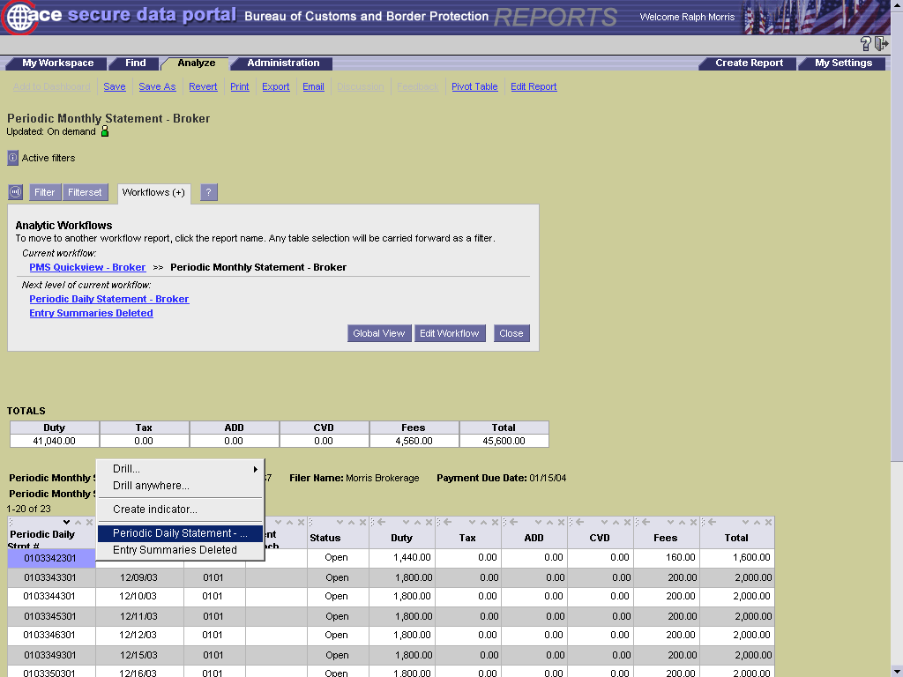

Slide 47
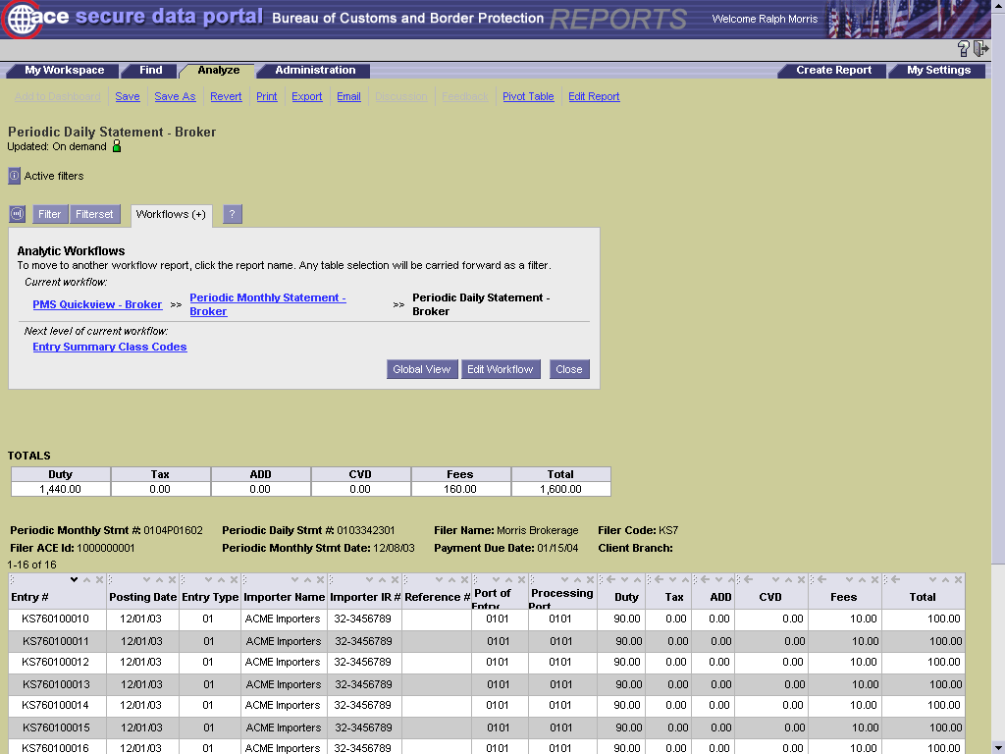

Slide 48
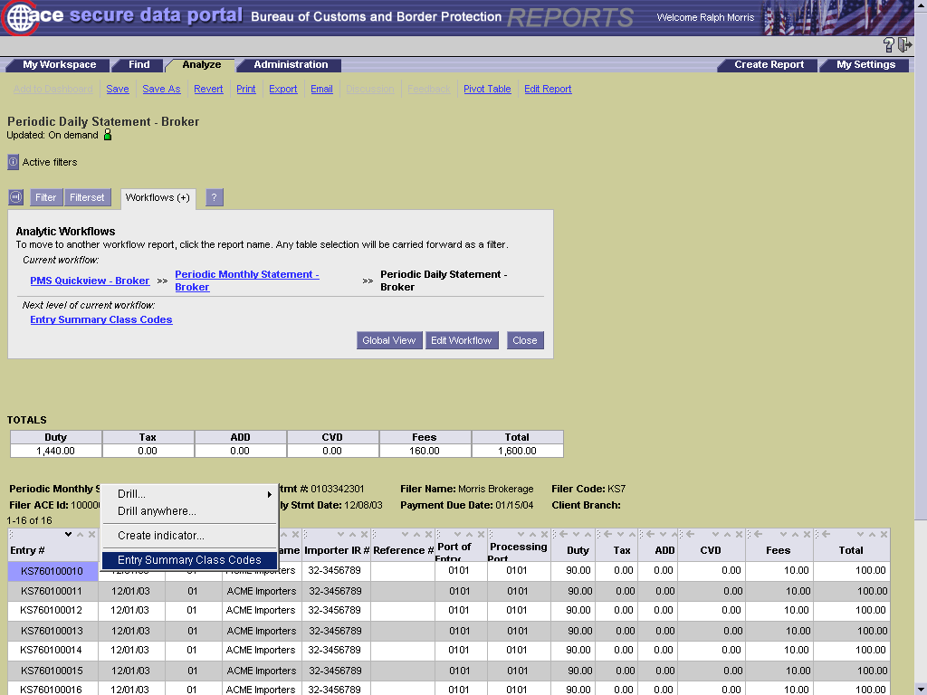

Slide 49
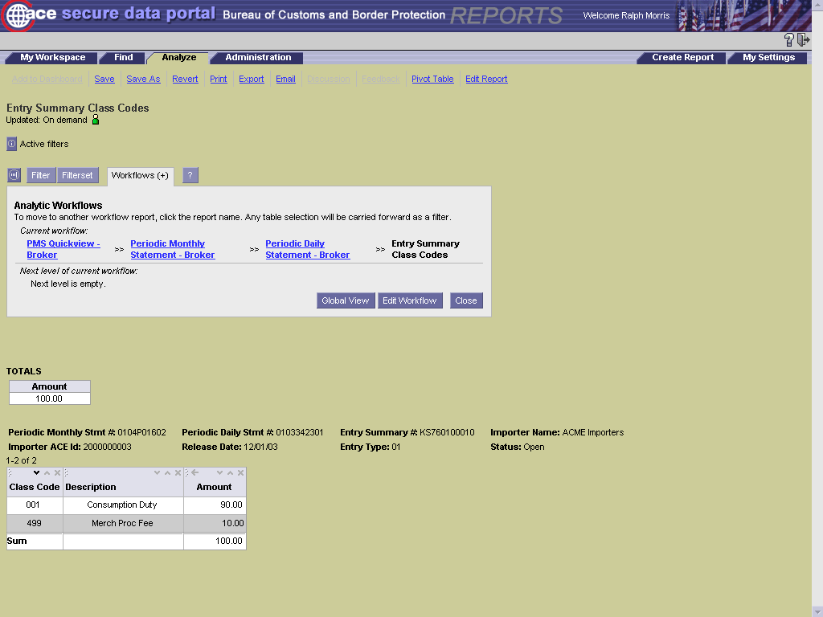

Slide 51
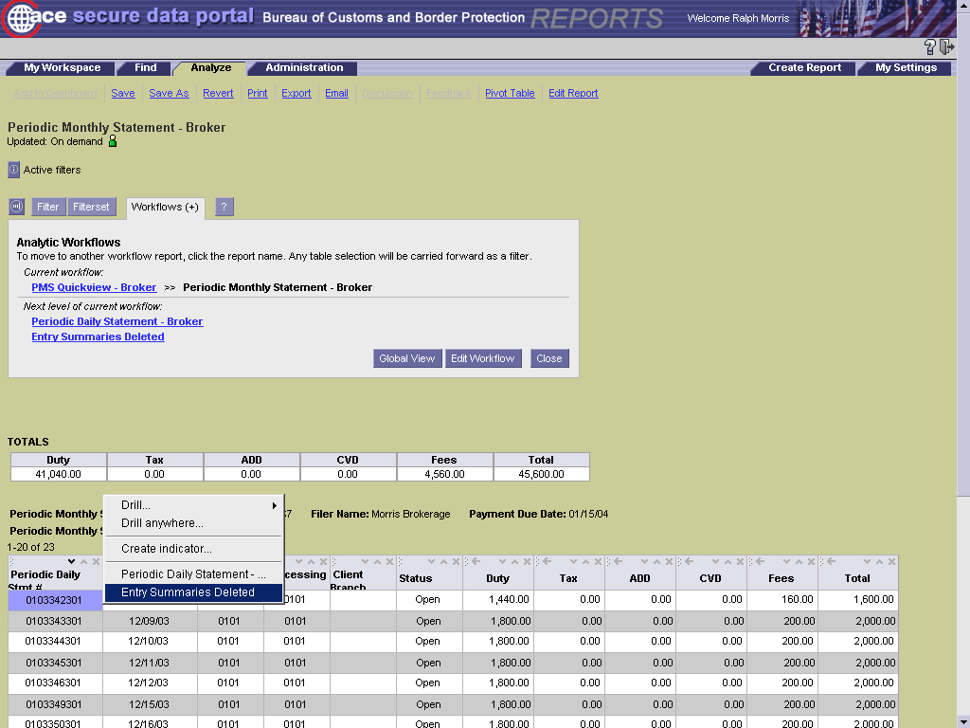

Slide 52
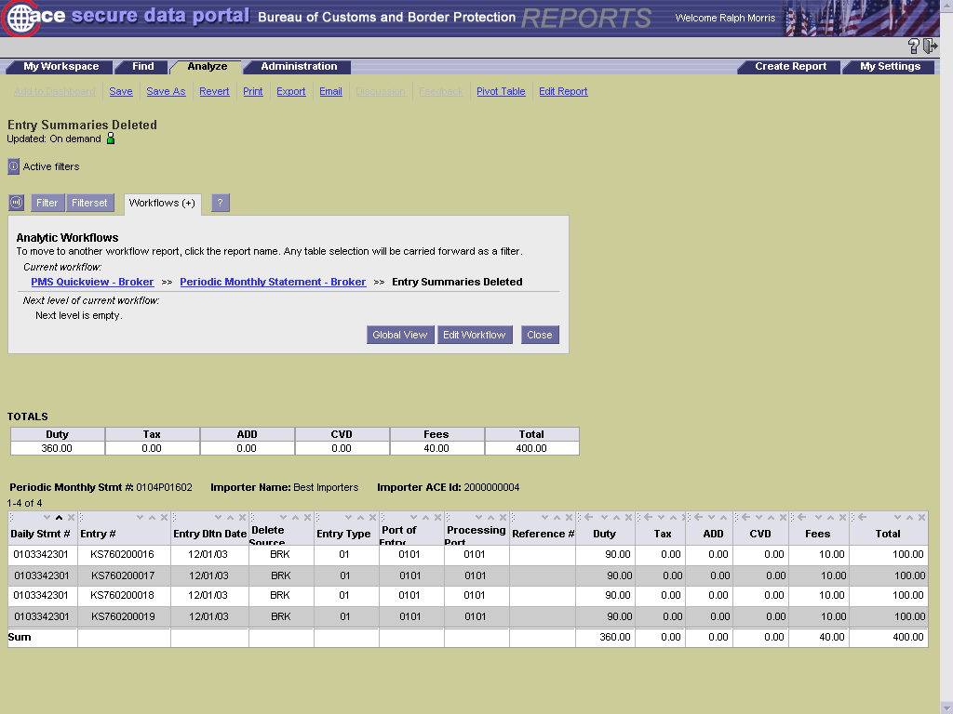

Slide 53
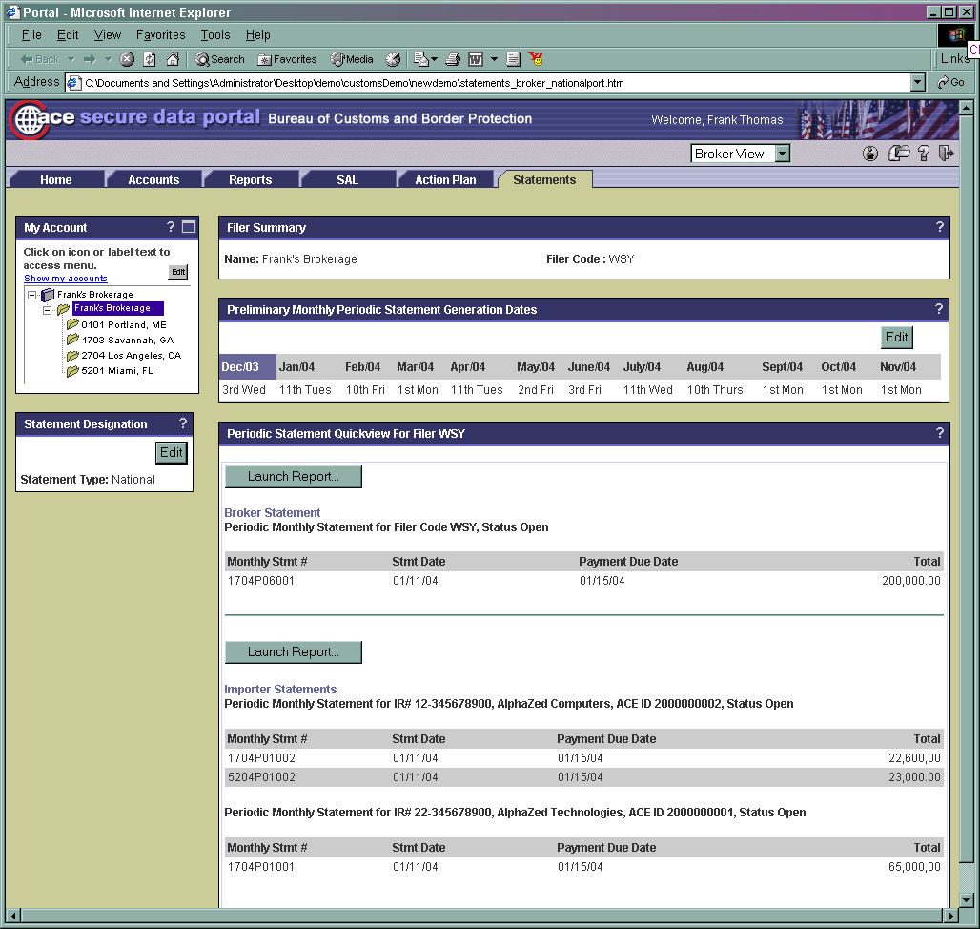

Slide 54
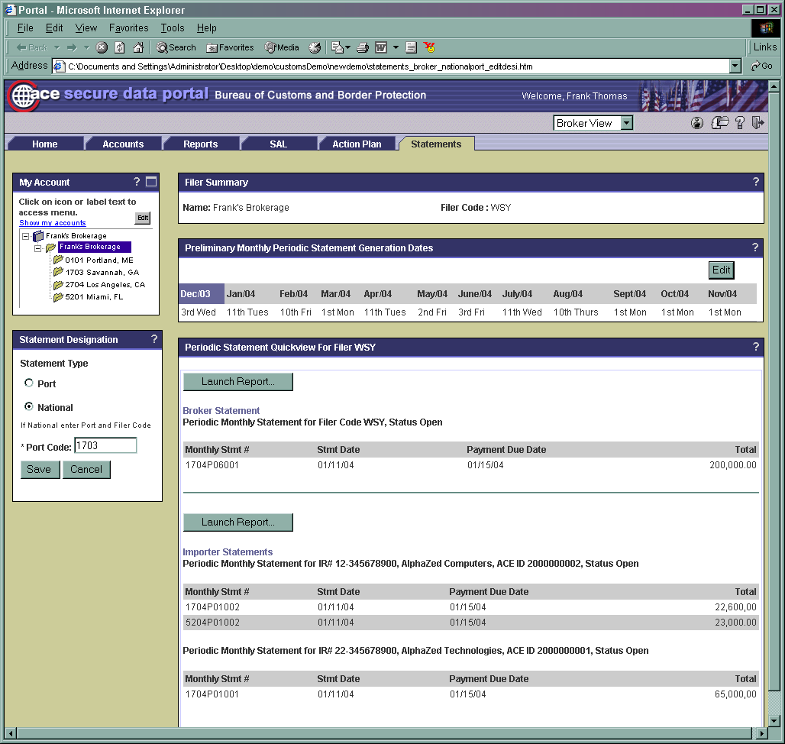

Slide 56
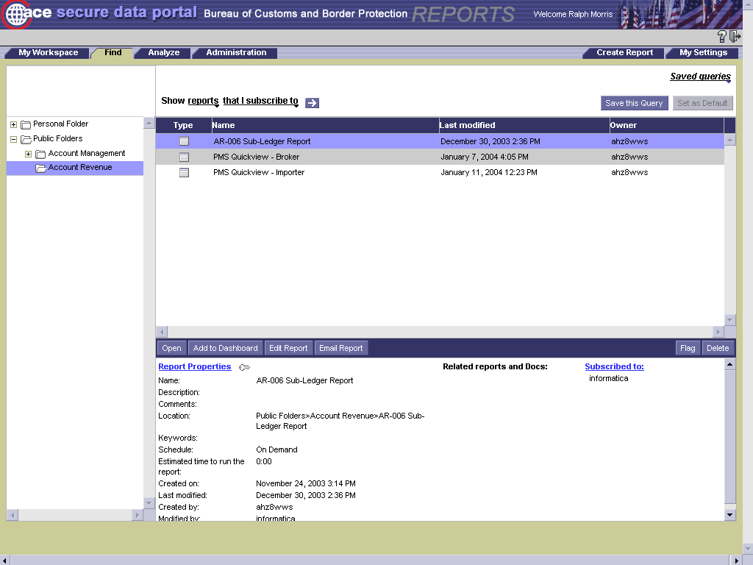

Slide 57
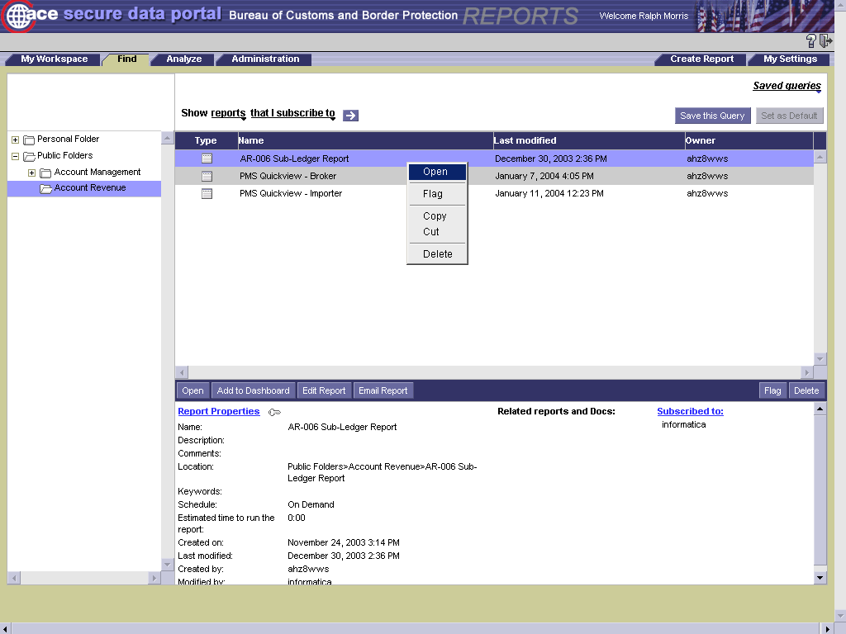

Slide 58
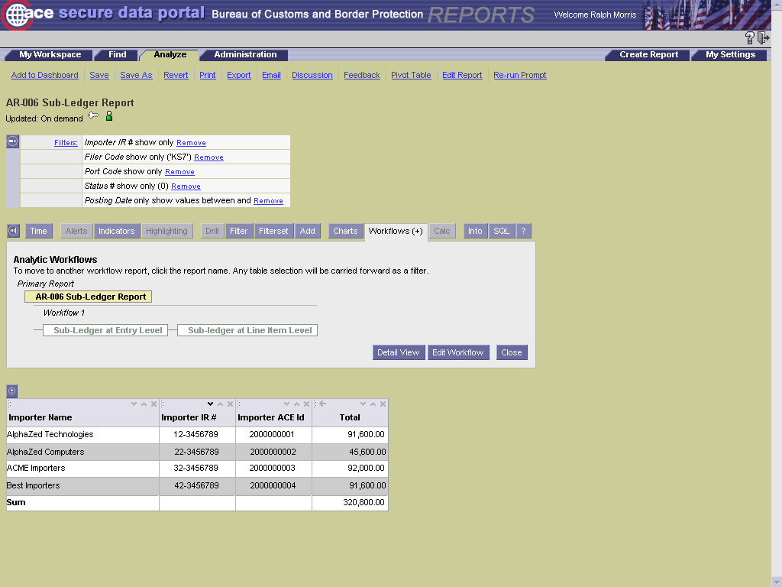

Slide 59
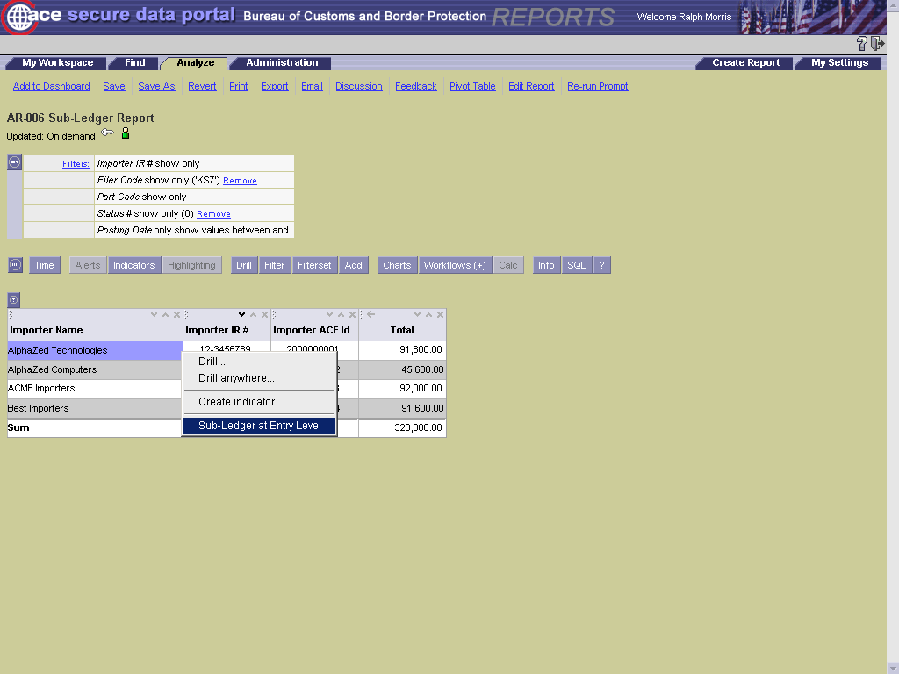

Slide 60
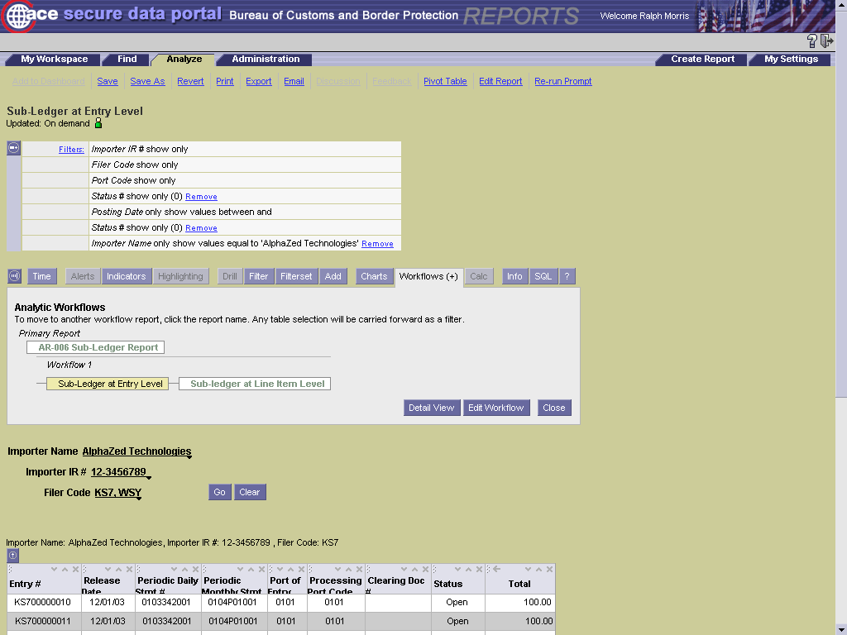

Slide 61


Slide 62


Slide 63
Sample Periodic Monthly Statement (Preliminary)
STATEMENT NUMBER: 0103P12001 BUREAU OF CUSTOMS AND BORDER PROTECTION PAGE: 1
AUTOMATED COMMERCIAL ENVIRONMENT STATEMENT PRINT DATE: MM/DD/YY
PERIODIC MONTHLY STATEMENT REPORT (PRELIMINARY) CLIENT BRANCH DESIGNATION:
PROCESS DATE: MM/DD/YY
STATEMENT FOR: TEST BROKER
IMPRT OF REC#:
BROKER/FILER#: XXX
PROCESS DIST/PORT: DDPP
PERIODIC DAILY STATEMENT PRES
STATEMENT DATE DATE ESTIMATED DUTY ESTIMATED TAX ESTIMATED CVD ESTIMATED ADD USER FEES TOTAL AMOUNT
0103307001 11/03/03 11/04/03 1,000.00 0.00 100.00 100.00 100.00 1,300.00
0103308001 11/04/03 11/05/03 1,000.00 0.00 100.00 100.00 100.00 1,300.00
0103309001 11/05/03 11/06/03 1,000.00 0.00 100.00 100.00 100.00 1,300.00
0103310001 11/06/03 11/07/03 1,000.00 0.00 100.00 100.00 100.00 1,300.00
0103311001 11/07/03 11/08/03 1,000.00 0.00 100.00 100.00 100.00 1,300.00
0103314001 11/10/03 11/11/03 1,000.00 0.00 100.00 100.00 100.00 1,300.00
0103316001 11/12/03 11/13/03 1,000.00 0.00 100.00 100.00 100.00 1,300.00
0103317001 11/13/03 11/14/03 1,000.00 0.00 100.00 100.00 100.00 1,300.00
0103318001 11/14/03 11/15/03 1,000.00 0.00 100.00 100.00 100.00 1,300.00
0103321001 11/17/03 11/18/03 1,000.00 0.00 100.00 100.00 100.00 1,300.00
0103322001 11/18/03 11/19/03 1,000.00 0.00 100.00 100.00 100.00 1,300.00
0103323001 11/19/03 11/20/03 1,000.00 0.00 100.00 100.00 100.00 1,300.00
0103324001 11/20/03 11/21/03 1,000.00 0.00 100.00 100.00 100.00 1,300.00
0103325001 11/21/03 11/22/03 1,000.00 0.00 100.00 100.00 100.00 1,300.00
0103328001 11/24/03 11/25/03 1,000.00 0.00 100.00 100.00 100.00 1,300.00
0103329001 11/25/03 11/26/03 1,000.00 0.00 100.00 100.00 100.00 1,300.00
0103330001 11/26/03 11/27/03 1,000.00 0.00 100.00 100.00 100.00 1,300.00
0103332001 11/28/03 11/29/03 1,000.00 0.00 100.00 100.00 100.00 1,300.00
0103335001 12/01/03 12/04/03 1,000.00 0.00 100.00 100.00 100.00 1,300.00
0103336001 12/02/03 12/03/03 1,000.00 0.00 100.00 100.00 100.00 1,300.00
0103337001 12/03/03 12/04/03 1,000.00 0.00 100.00 100.00 100.00 1,300.00
0103338001 12/04/03 12/05/03 1,000.00 0.00 100.00 100.00 100.00 1,300.00
0103339001 12/05/03 12/06/03 1,000.00 0.00 100.00 100.00 100.00 1,300.00
0103342001 12/08/03 12/09/03 1,000.00 0.00 100.00 100.00 100.00 1,300.00
0103343001 12/09/03 12/10/03 1,000.00 0.00 100.00 100.00 100.00 1,300.00

Slide 64
Sample Periodic Monthly Statement (Preliminary)
STATEMENT NUM: 0103P12001 BUREAU OF CUSTOMS AND BORDER PROTECTION PAGE: 2
AUTOMATED COMMERCIAL ENVIRONMENT STATEMENT PRINT DATE: MM/DD/YY
PERIODIC MONTHLY STATEMENT REPORT (PRELIMINARY) CLIENT BRANCH DESIGNATION:
PROCESS DATE: MM/DD/YY
STATEMENT FOR: TEST BROKER
IMPRT OF REC#:
BROKER/FILER#: XXX
PROCESS DIST/PORT: DDPP
STATEMENT TOTALS
PRELIMINARY TOTALS
ESTIMATED DUTY 25,000.00
ESTIMATED TAXES 0.00
ESTIMATED ADD 2,500.00
ESTIMATED CVD 2,500.00
COTTON FEE 100.00
SUGAR FEE 100.00
MAIL FEE 100.00
PORK FEE 100.00
BEEF FEE 100.00
MERCHANDISE FEE 900.00
MERC INFORMAL FEE 100.00
MERC SURCHARGE FEE 100.00
HONEY FEE 100.00
WATERWAYS FEE 100.00
PECAN FEE 100.00
POTATO FEE 100.00
LIME FEE 100.00
MUSHROOM FEE 100.00
WATERMELON FEE 100.00
SHEEP FEE 100.00
BLUEBERRY FEE 100.00
TOTAL AMOUNT-DUE 32,500.00

Slide 65
Sample Periodic Monthly Statement (Preliminary)
STATEMENT NUMBER: 0103P12001 BUREAU OF CUSTOMS AND BORDER PROTECTION PAGE: 3
AUTOMATED COMMERCIAL ENVIRONMENT STATEMENT PRINT DATE: MM/DD/YY
PERIODIC MONTHLY STATEMENT REPORT (PRELIMINARY) CLIENT BRANCH DESIGNATION:
PROCESS DATE: MM/DD/YY
STATEMENT FOR: TEST BROKER
IMPRT OF REC#:
BROKER/FILER#: XXX
PROCESS DIST/PORT: DDPP
ENTRY SUMMARIES DELETED AFTER PERIODIC DAILY STATEMENTS ACCEPTANCE
PERIODIC DAILY
STATEMENT ENTRIES DELETED DELETE SOURCE
0103312001 XXX-1000001-1 ABI

Slide 66


