Slide 1


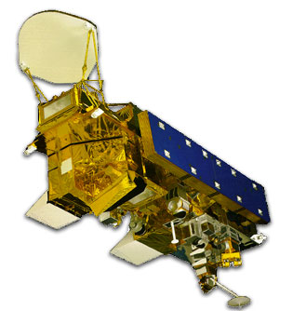
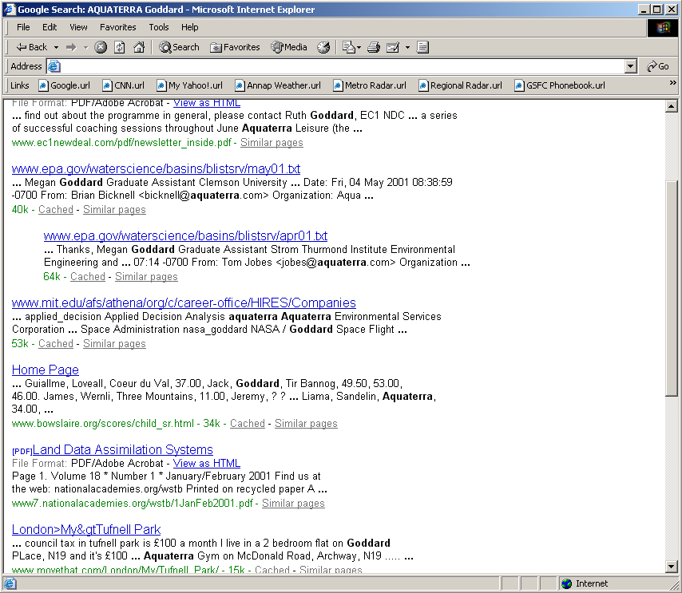
Scientists
Terra
Aqua
SGM Web Monitor
goal input
EO1
image data
MODIS data
status and updates
image request
goals
web service
EO1 Ops
Center
EOS DAAC /
RapidFire
System
SGM
lat/lon
next flyover
image request
RapidFire data
request ack
sched time
image taken
image url
subset of status messages, via by email
Email alerts to interest parties

Slide 2
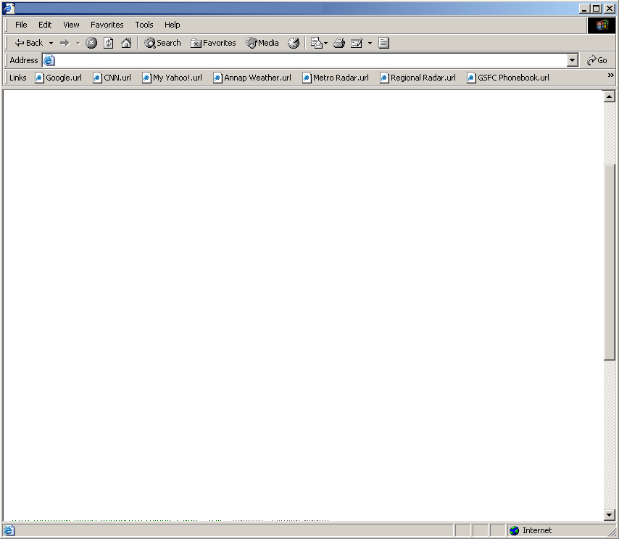
SAMPLE!!! Mock up of web-based SGM monitor/detail status page
Area of Interest: Lat/Lon _______ Radius _____ Density _____
Other thumbnails:
possibly weather forecast, cloud cover, etc
Last MODIS image:
MODIS Thumb nail
(click for details
Current SGM Density ____
Goal Status:
xx:xx Goal triggered at ___ by density of ___
xx:xx Next flyover _____
xx:xx Image requested
xx:xx Image scheduled for _______
xx:xx Image taken
xx:xx Data available at http://url
EO1 thumbnail (click for details

