Slide 1
Pilot study to develop telehealth tinnitus management for persons with and without traumatic brain injury
James A. Henry, PhD; Tara L. Zaugg, AuD; Paula J. Myers, PhD; Caroline J. Schmidt, PhD; Susan Griest, MPH; Marcia W. Legro, PhD; Christine Kaelin, MBA; Emily J. Thielman, MS; Daniel M. Storzbach, PhD; Garnett P. McMillan, PhD; Kathleen F. Carlson, PhD

Slide 2
Aim
Pilot study to evaluate feasibility and potential efficacy of telehealth Progressive Tinnitus Management (PTM) for veterans with and without traumatic brain injury (TBI).
Relevance
Tinnitus affects 10%–15% of adults; it can be problematic and require lifelong management.
Many people with TBI also have tinnitus.

Slide 3
Methods
PTM
Education and counseling to help patients self-manage their reactions to tinnitus.
For pilot, we adapted PTM by delivering it via telephone and adding cognitive-behavioral therapy.
Participants
Veterans with clinically significant tinnitus and:
Probable symptomatic mild TBI (n = 15).
Moderate to severe TBI (n = 9).
No symptomatic TBI (n = 12).
Received 6 mo of telephone counseling (6 sessions total).
Completed questionnaires at baseline, 12 wk, and 24 wk.

Slide 4
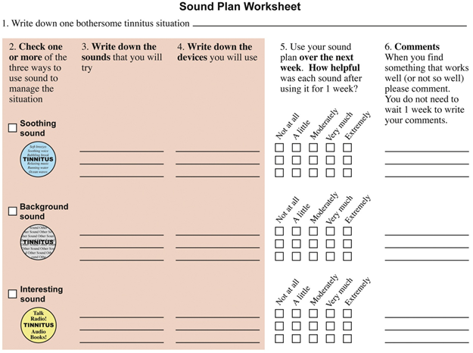
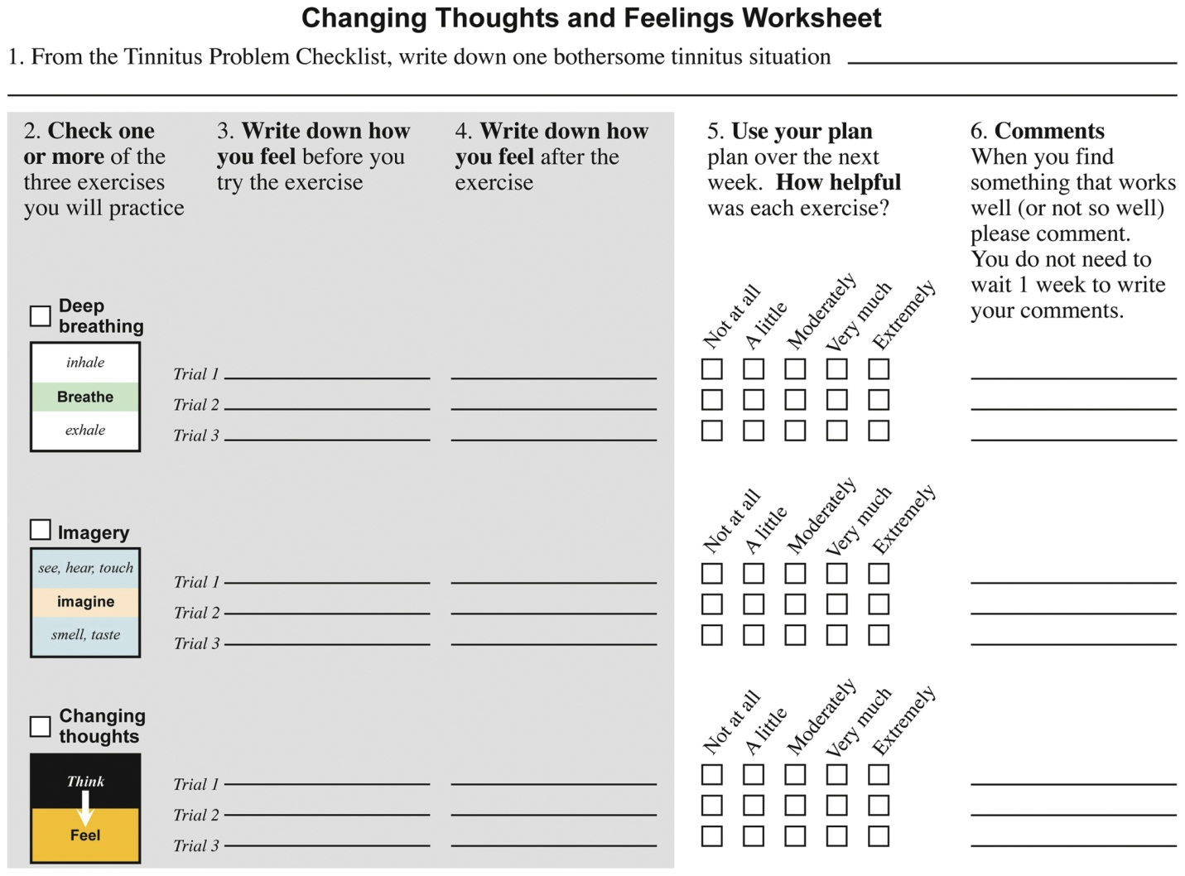
Example of PTM counseling by audiologist. “Sound Plan Worksheet” helps veteran develop individualized plan to manage reactions to tinnitus.
Example of PTM counseling by psychologist. “Changing Thoughts and Feelings Worksheet” incorporates cognitive and behavioral coping skills.

Slide 5
Results
All groups showed trends reflecting improvement in self-perceived functional limitations due to tinnitus.
These data, and experiences gained from conducting the study, have been used to design randomized clinical trial to more definitively evaluate efficacy of this telehealth methodology.

Slide 6
Conclusion
Our pilot study showed positive results of conducting PTM via telephone.
PTM as home-based telehealth service has potential to provide tinnitus services to Veterans with and without TBI for relatively small cost and with minimal effect on individual VA hospitals.
After follow-up clinical trial, we will fully develop the tinnitus telehealth program and document organizational requirements and patient outcomes.

