Slide 1
Testimony of Trent L. Clark
Monsanto Public and Government Affairs
before the
Natural Resources Legislative Interim Committee - Bear River Working Group
April 27, 2004

Slide 2
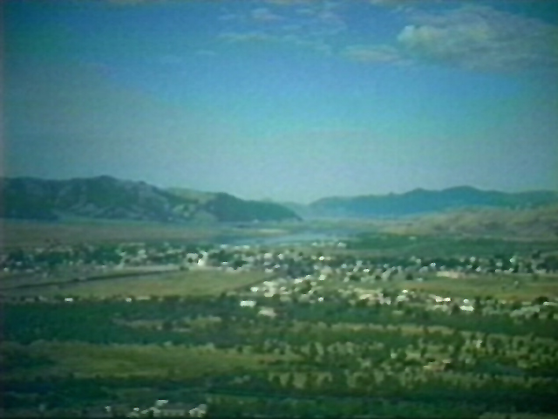
Soda Springs

Slide 3
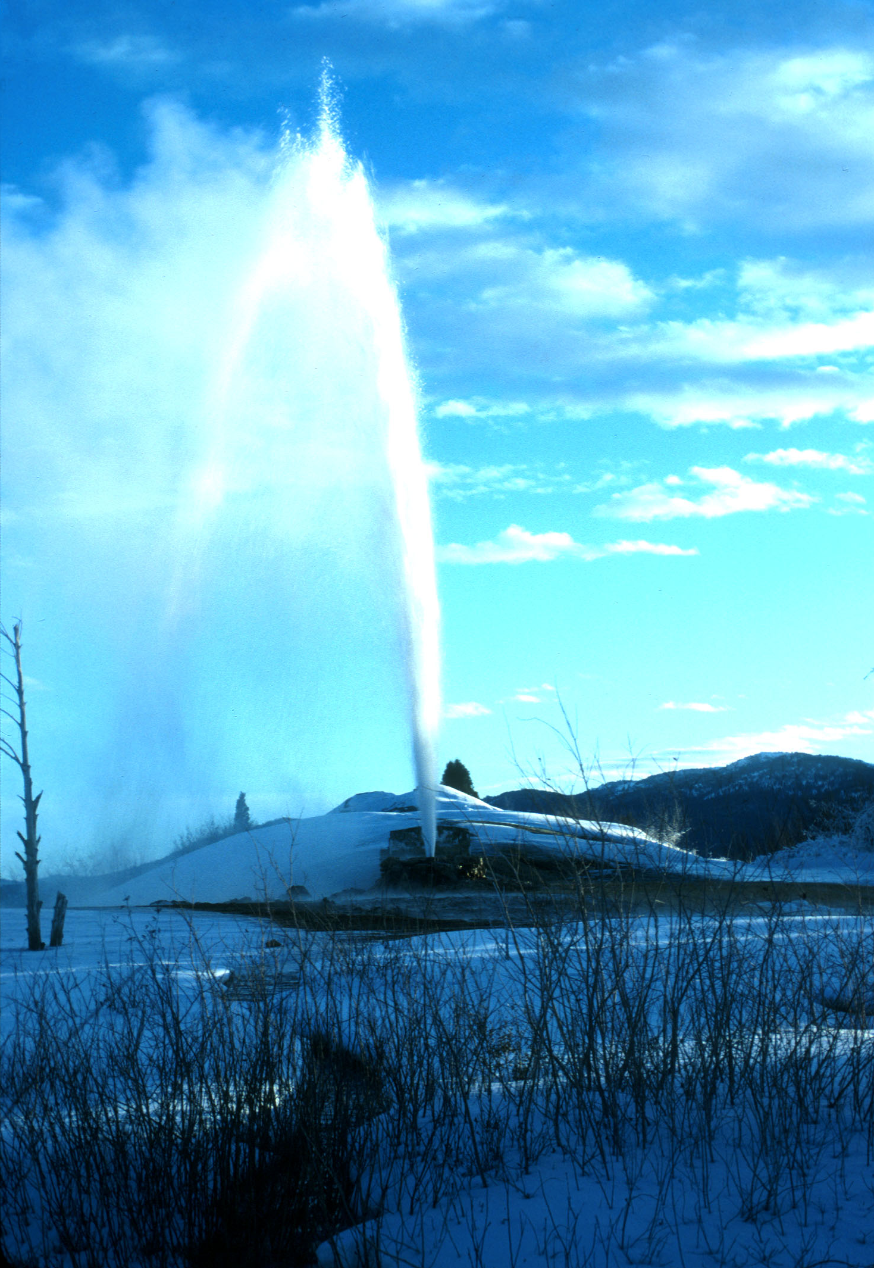
“Tosoiba” –
Land of sparkling
waters

Slide 4
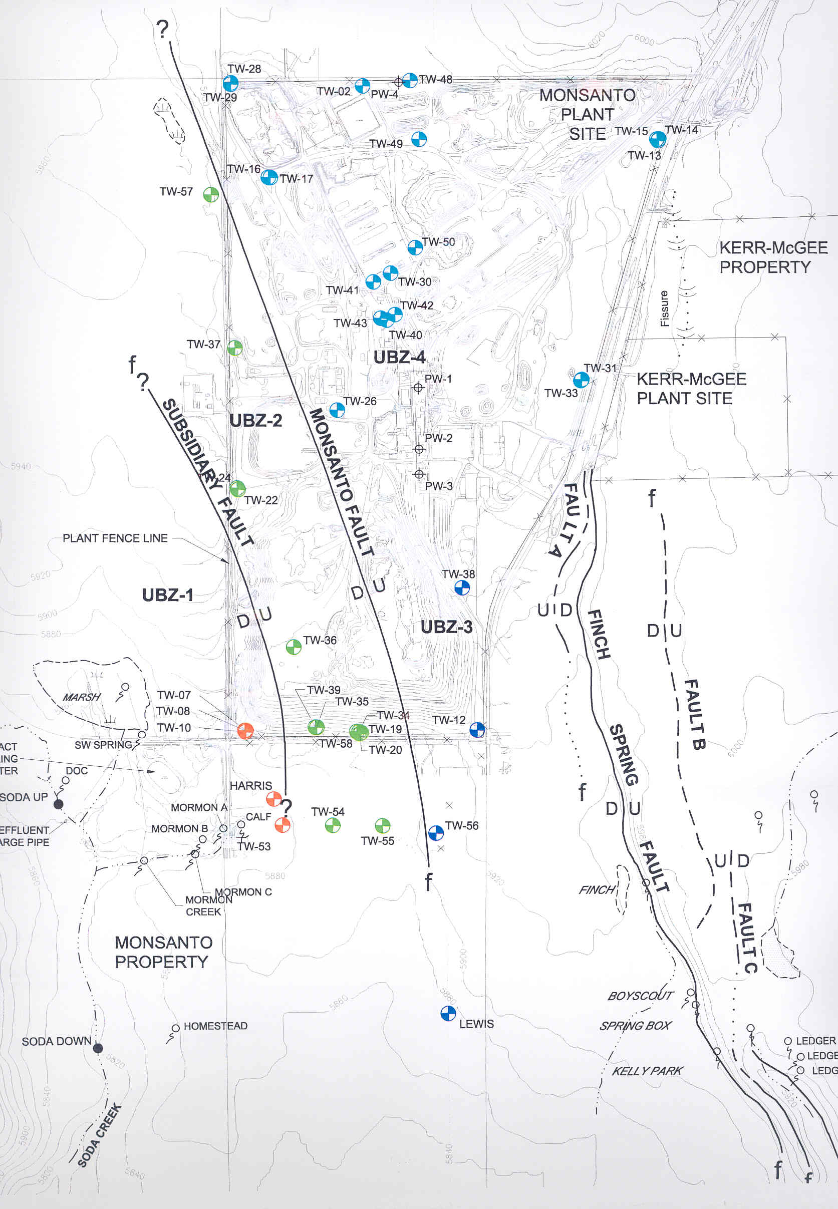
Monsanto has spent millions of $ characterizing and monitoring the aquifer(s) in and around our operations, including the installation of nearly 60 monitoring wells.

Slide 5
Understanding the hydro-geology in and around
Monsanto’s operations has been a key component
of our business for decades now.

Slide 7
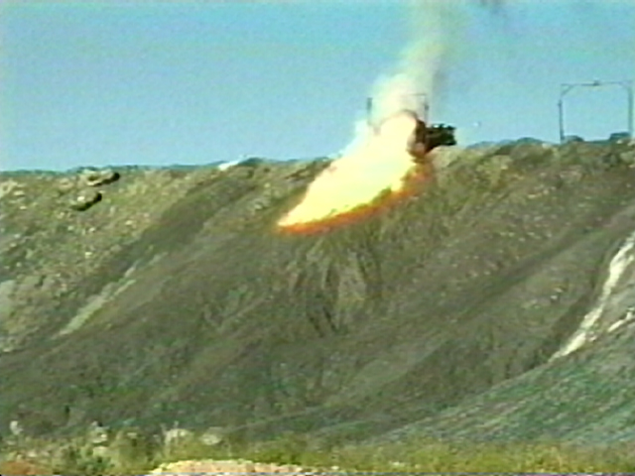
Cooling water – The electrodes in Monsanto’s electric arc furnaces burn at temperatures as high as 14,000 degrees F., hot enough to melt rock into liquid.

Slide 8
Some Guiding Principles (Water 2025)
Recognize and respect state, tribal, and federal water rights, contracts, and interstate compacts or decrees of the United States Supreme Court that allocate the right to use water.
Maintain and modernize existing water facilities so they will continue to provide water and power.
Enhance water conservation, use efficiency, and resource monitoring to allow existing water supplies to be used more effectively.

Slide 9
Some Guiding Principles (Water 2025)
Use collaborative approaches and market based transfers to minimize conflicts.
Improve water treatment technology, such as desalination, to help increase water supply.
Existing water supply infrastructure can provide additional benefits for existing and emerging needs for water.

