Slide 1
Chromatic Correction Sextupole status update
Feb 16, 2007
Jerry Annala

Slide 2
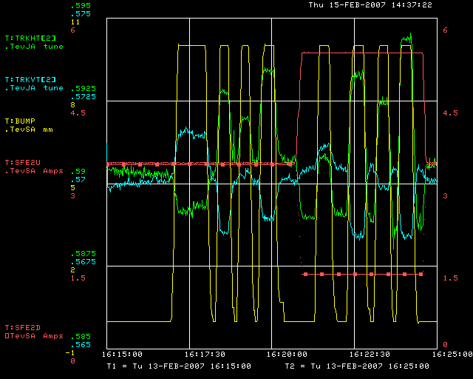

Slide 3
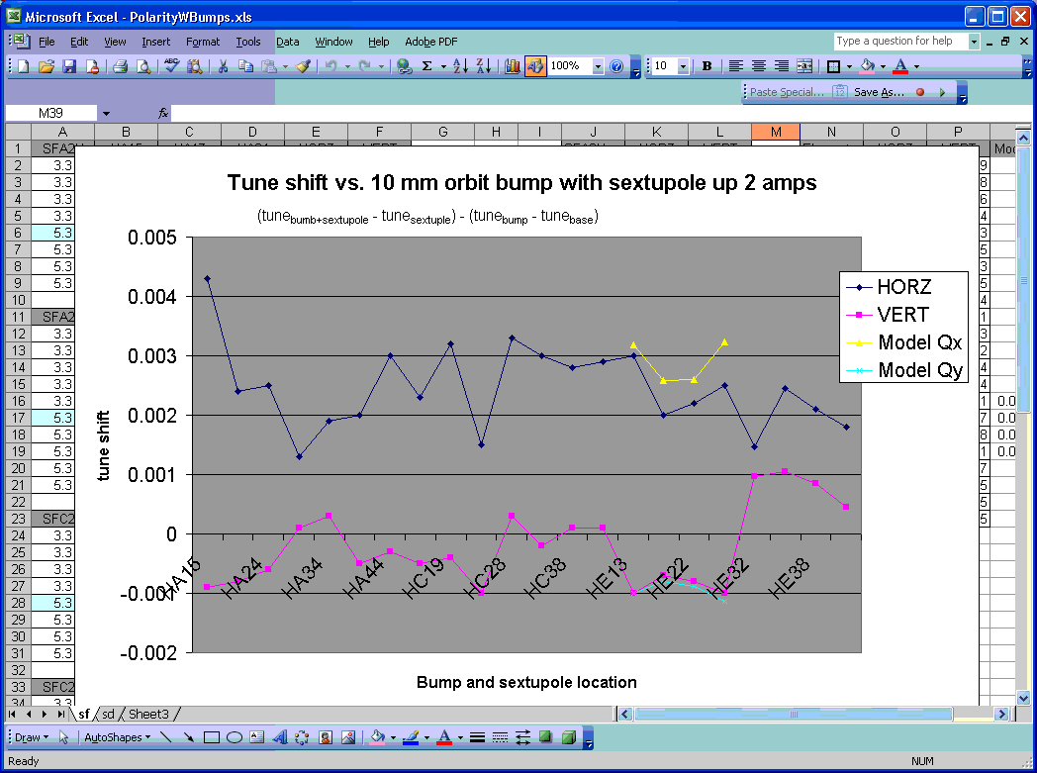

Slide 4
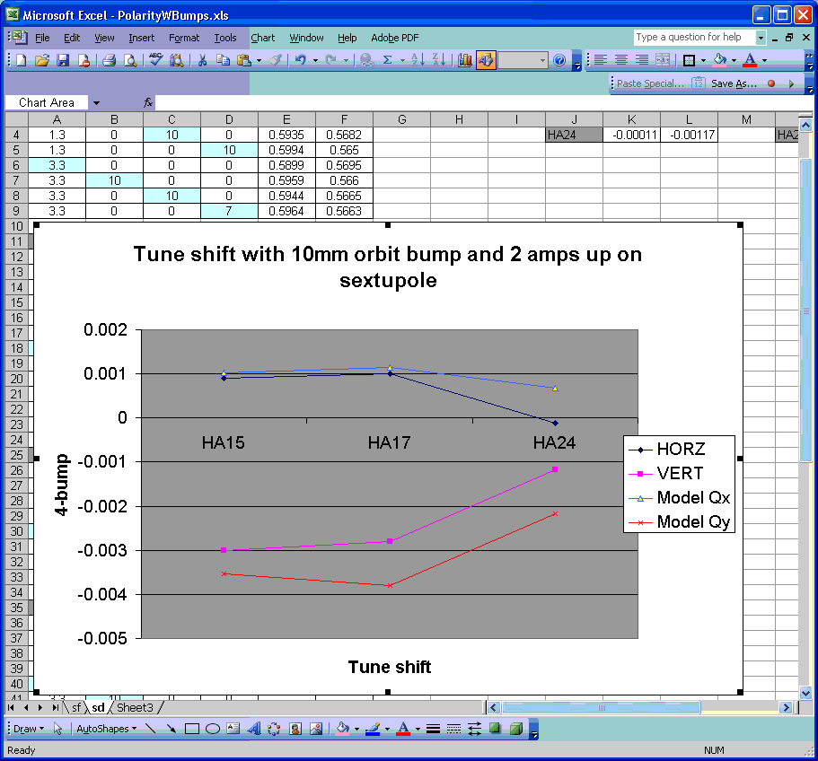

Slide 5
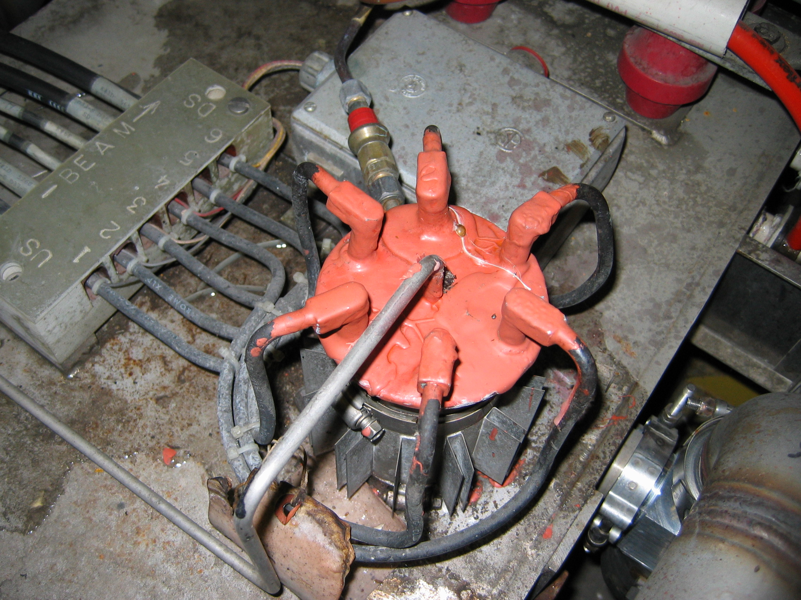

Slide 6
Evidence of Problem at A25
G-10 cover plate indicates wiring error
Very little response to polarity test
Alex’s lattice measurements shows problems at A25

