Slide 1
Acceleration Schemes for MC
Alex Bogacz
in collaboration with
Kevin Beard, Vasiliy Morozov
and
Yves Roblin
<number>
Muon Collider 2011, Telluride, June 30, 2011

Slide 2
Overview
High/Medium/Low Emittance MC Schemes (1.5 TeV)
Components, Layout, Transmission Efficiencies
Cooling Performance ⇨ Accelerator acceptance
Acceleration Schemes (appropriate in various energy ranges)
Linac and RLA
FFAG Ring
Fast Ramping Synchrotrons
High Transmission Acceleration scheme – initial beam dynamic choices
Linac (0.4 – 1.5 GeV)
RLAs (1.5 – 12.5 GeV) and (12.5 – 100 GeV)
RCS Rings
Emerging Acceleration Scheme…
<number>
Muon Collider 2011, Telluride, June 30, 2011

Slide 3
Parameters of various MC options
 | Low ε (Johnson) | Med ε (Alexahin) | High ε (Palmer)
CM Energy | 1.5 | 1.5 | 1.5 | TeV
Luminosity | 2.7 | 1 | 1 | 10³⁴cm²/s
Muons/bunch | 0.1 *10 | 1 | 2 | 10¹²
Ring circumference | 2.3 | 3 | 8.1 | km
β* = σ_{z} | 5 | 10 | 10 | mm
Δp/p (rms) | 1.0 | 0.1 | 0.1 | %
Ring depth | 35 | 13 | 135 | m
Muon survival | 30 | 4 | 7 | %
ε_{T} | 2.1 | 12 | 25 | π mm mrad
ε_{L} | 370,000 | 72,000 | 72,000 | π mm mrad
Bob Palmer circa 2009
6/30/08
NuFact08, Valencia
<number>
Muon Collider 2011, Telluride, June 30, 2011

Slide 4
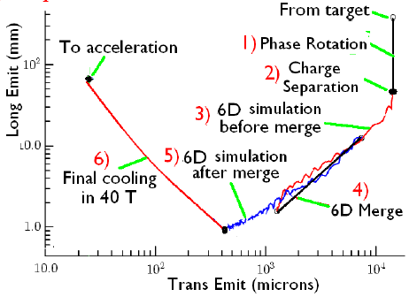
HEMC – Phase space after cooling
ε_{T} | 25 | π mm mrad
ε_{L} | 72,000 | π mm mrad
Bob Palmer
<number>
Muon Collider 2011, Telluride, June 30, 2011

Slide 5
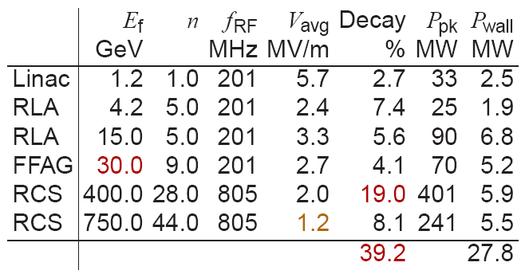
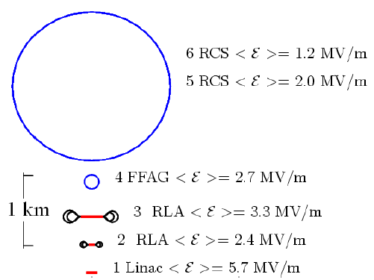
HEMC Scenario I (NF centric)
ε_{T} | 25 | π mm mrad
ε_{L} | 72,000 | π mm mrad
4.5
4.5
Berg/Palmer
<number>
Muon Collider 2011, Telluride, June 30, 2011
Notes:
<number>

Slide 6
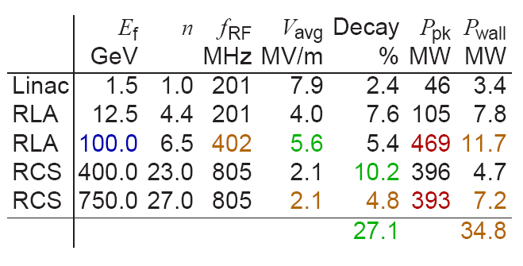
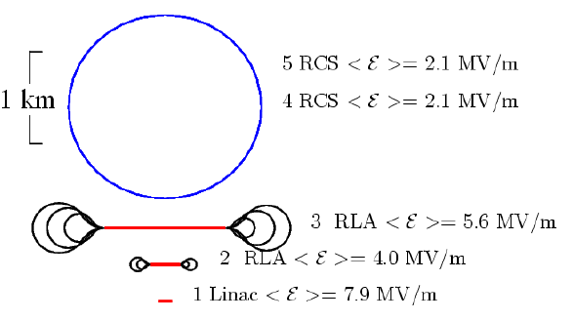
HEMC Scenario II (Low Decay)
ε_{T} | 25 | π mm mrad
ε_{L} | 72,000 | π mm mrad
4.5
Berg/Palmer
<number>
Muon Collider 2011, Telluride, June 30, 2011
Notes:
<number>

Slide 7
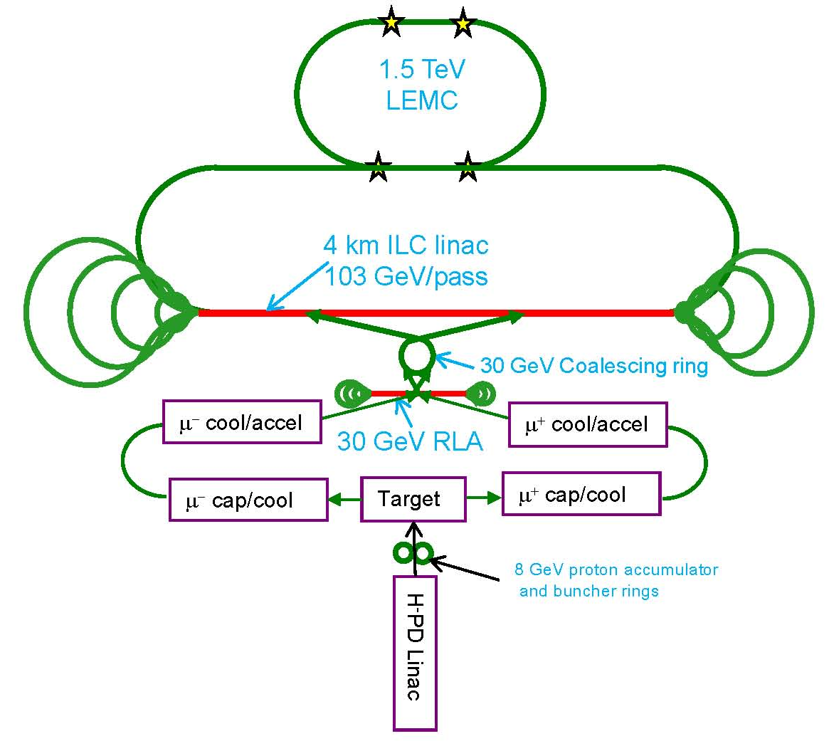
Low Emittance MC Scenario
ε_{T} | 2.1 | π mm mrad
ε_{L} | 370,000 | π mm mrad
Rol Johnson
<number>
Muon Collider 2011, Telluride, June 30, 2011
Notes:
<number>

Slide 8
Linac + RLA
Moderate re-use of the linac (a few passes)
Switchyard (single bend, horizontal)
Individual energy return Arcs for recirculation
Increasing number of passes:
Ramped linac quads
Reducing number of return Arcs:
Use multi-pass(2) arcs based on combined function magnets
Arcs now have larger aperture
Simplifying switchyard
<number>
Muon Collider 2011, Telluride, June 30, 2011

Slide 9
FFAG Rings
More passes through RF cavities (10+) – higher efficiency
No switchyard (RLA) − single arc with large energy acceptance
Linear magnets to get large energy acceptance
Linear non-scaling FFAG
Challenges
Injection and extraction difficult (kickers: 15 cm radius, 0.1 T field)
No synchrotron oscillations
Amplitude dependent time of flight
<number>
Muon Collider 2011, Telluride, June 30, 2011

Slide 10
Fast Ramping Synchrotron
Allows arbitrary number of passes (high efficiency)
Maintain beam synchronization with RF
Magnets ramped extremely fast
Expensive power supplies (Eddy currents)
Small apertures help to keep power down
Beam not centered in magnets
High average bend field
Ramping magnets have low field limit
Hybrid lattice/magnets ⇨ SC magnets fixed field + warm magnets ramped
<number>
Muon Collider 2011, Telluride, June 30, 2011

Slide 11
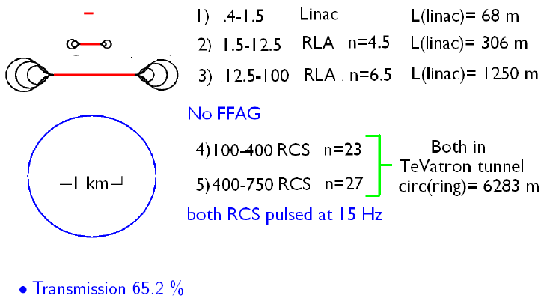
Acceleration with Improved Transmission
ε_{T} | 25 | π mm mrad
ε_{L} | 72,000 | π mm mrad
×192 =
ε_{T} | 4,800 | π mm mrad
ε_{L} | 24,000 | π mm mrad
MC
NF
Berg/Palmer
<number>
Muon Collider 2011, Telluride, June 30, 2011

Slide 12
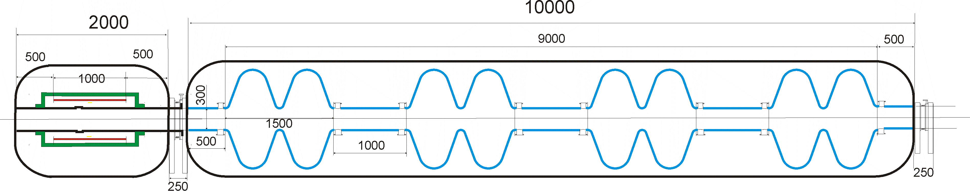
Linac Cryo-module
ε_{T} | 25 | π mm mrad
17 MV/m 201 MHz SRF
0.9-2.5 Tesla solenoid
× 2
Linac cell (solenoid + 2×8 2-cell cavities), length: 22.75 meter
<number>
Muon Collider 2011, Telluride, June 30, 2011

Slide 13
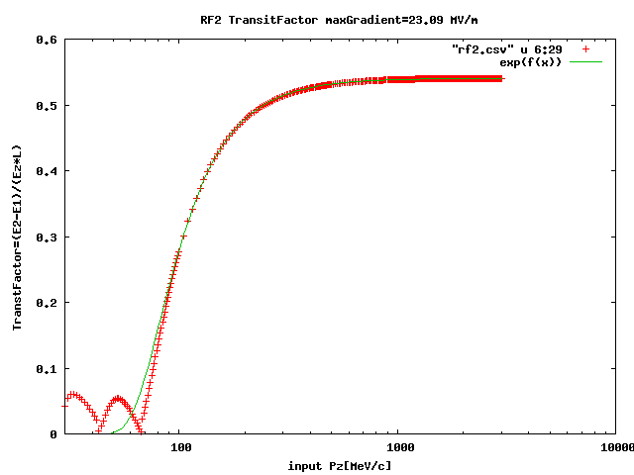
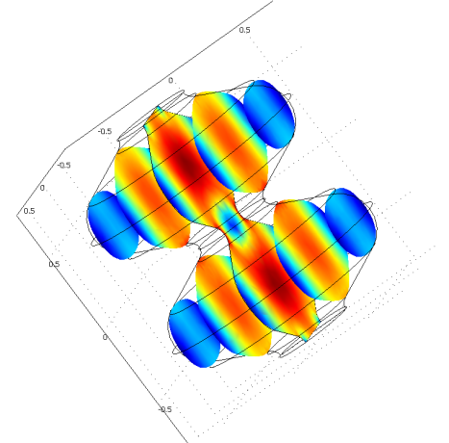
Transit time effect – G4BL
E = 400 MeV
= 3.7858
Kevin Beard
<number>
Muon Collider 2011, Telluride, June 30, 2011

Slide 14
0.4-1.5 GeV Linac – Transverse Dynamics
5
2.5 σ beam envelope
5
ε_{Ν} = 25 mm mrad
Size_X[cm]
Size_Y[cm]
0
0
0
Ax_bet
Ay_bet
Ax_disp
Ay_disp
227.5
10 × cells
Transmission: 0.986
<number>
Muon Collider 2011, Telluride, June 30, 2011

Slide 15
Solenoid vs Quad focusing
60
5
BETA_X&Y[m]
DISP_X&Y[m]
0
0
BETA_X
BETA_Y
DISP_X
DISP_Y
22.75
0
60
5
BETA_X&Y[m]
DISP_X&Y[m]
0
0
BETA_X
BETA_Y
DISP_X
DISP_Y
22.76
0
<number>
Muon Collider 2011, Telluride, June 30, 2011

Slide 16
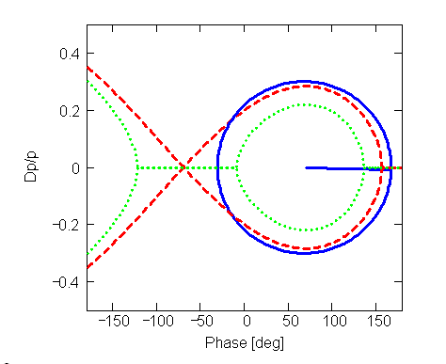
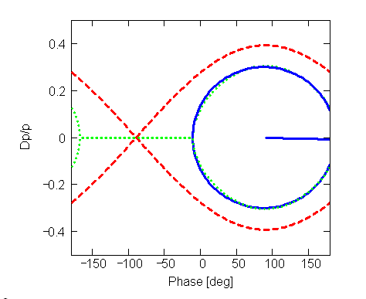
Longitudinal Matching
longitudinal emittance: ε_{l} (ε_{l} = σ_{Δp} σ_{z}/m_{μ}c) momentum spread: σ_{Δp/p} bunch length: σ_{z} | mm mm | 72 0.12 164
201 MHz, 17 MeV/m
E = 400 MeV
= 3.7858
70 deg. off-crest
90 deg. off-crest
<number>
Muon Collider 2011, Telluride, June 30, 2011

Slide 17
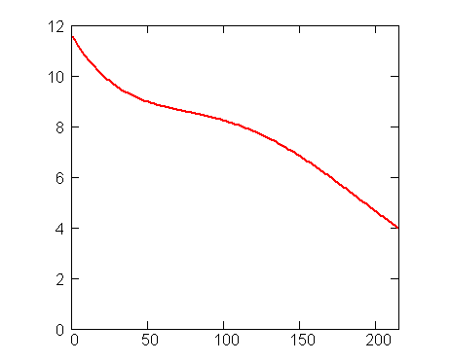
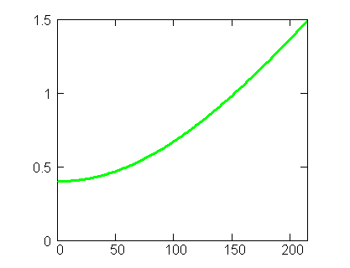
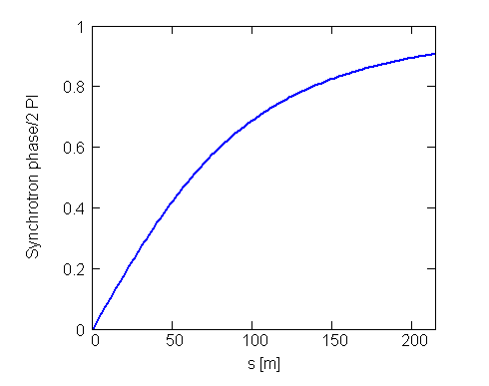
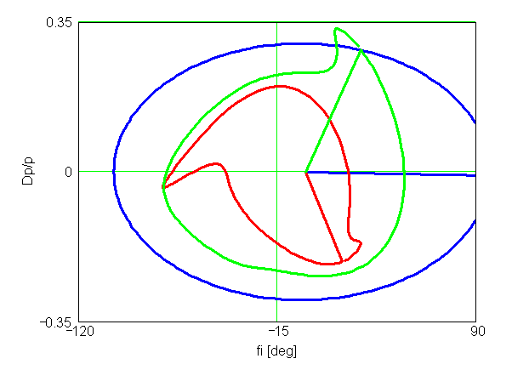
Longitudinal Dynamics
initial stationary bucket gradually brought to 25 deg. off-crest
bucket area
Energy [GeV]
Synchrotron phase
/γ₀ = 3.7
γ₀ = 3.79
γ = 14.29
<number>
Muon Collider 2011, Telluride, June 30, 2011

Slide 18
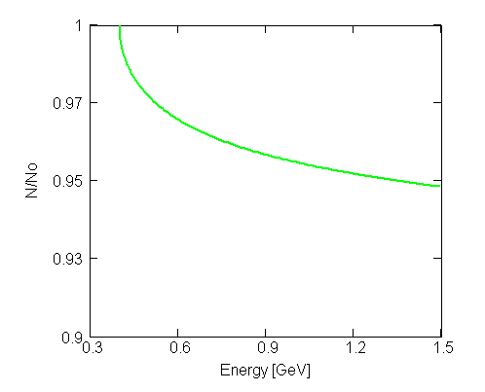
0.4-1.5 GeV Linac – Transmission
Transmission: 1.4% loss
Muon decay: 5% loss
Total loss: 6.4%
MODELING A 0.4-1.5 GeV MUON LINAC, Beard at al
<number>
Muon Collider 2011, Telluride, June 30, 2011

Slide 19
‘Dogbone’ RLA
3 GeV
allows both charges to traverse the Linac in the same direction (more uniform focusing profile)
better orbit separation at linac’s end ~ energy difference between consecutive passes (2ΔE)
the droplets can be reduced in size according to the required energy
both charge signs can be made to follow a Figure-8 path (suppression of depolarization effects)
<number>
Muon Collider 2011, Telluride, June 30, 2011

Slide 20
Multi-pass ‘bisected’ linac Optics
4-pass, 17-21 GeV
100
5
quad gradient
BETA_X&Y[m]
DISP_X&Y[m]
0
0
0
BETA_X
BETA_Y
DISP_X
DISP_Y
254.651
7-pass, 29-33 GeV
120
5
BETA_X&Y[m]
DISP_X&Y[m]
quad gradient
0
0
0
BETA_X
BETA_Y
DISP_X
DISP_Y
254.651
<number>
Muon Collider 2011, Telluride, June 30, 2011

Slide 21
‘Fixed’ vs ‘Pulsed’ linac Optics (8-pass)
100
5
Fixed
BETA_X&Y[m]
DISP_X&Y[m]
0
0
0
BETA_X
BETA_Y
DISP_X
DISP_Y
254.651
100
5
Pulsed
BETA_X&Y[m]
DISP_X&Y[m]
0
0
0
BETA_X
BETA_Y
DISP_X
DISP_Y
254.651
<number>
Muon Collider 2011, Telluride, June 30, 2011

Slide 22
Mirror-symmetric ‘Droplet’ Arc – Optics
15
(β_{out} = β_{in} and α_{out} = -α_{in} , matched to the linacs)
3
E =5 GeV
BETA_X&Y[m]
DISP_X&Y[m]
0
-3
0
BETA_X
BETA_Y
DISP_X
DISP_Y
130
2 cells out
transition
10 cells in
transition
2 cells out
<number>
Muon Collider 2011, Telluride, June 30, 2011

Slide 23
‘Dogbone’ RLA with 2-pass Arcs
<number>
Muon Collider 2011, Telluride, June 30, 2011

Slide 24
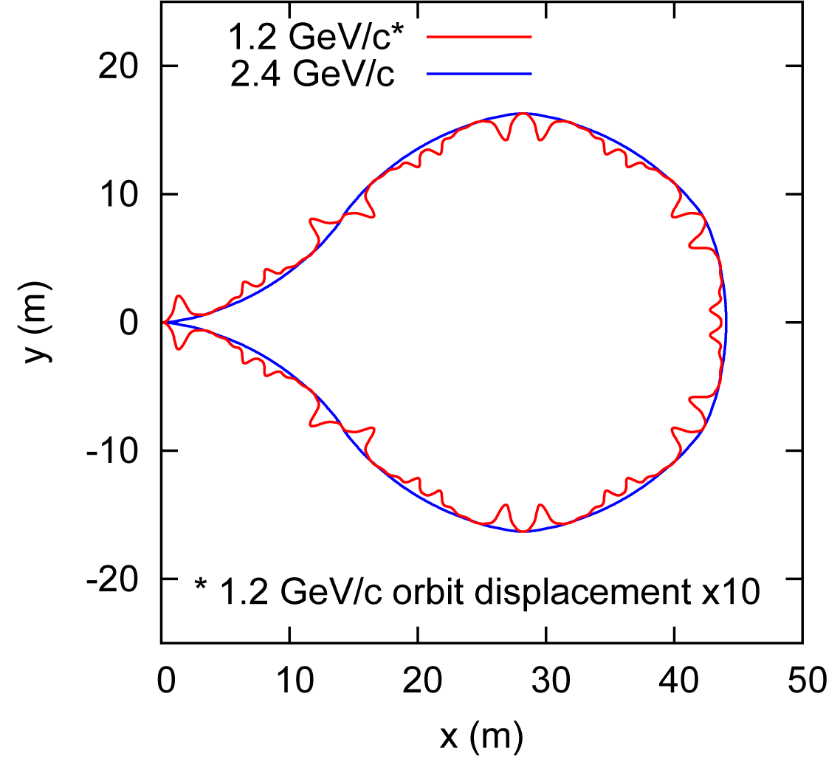
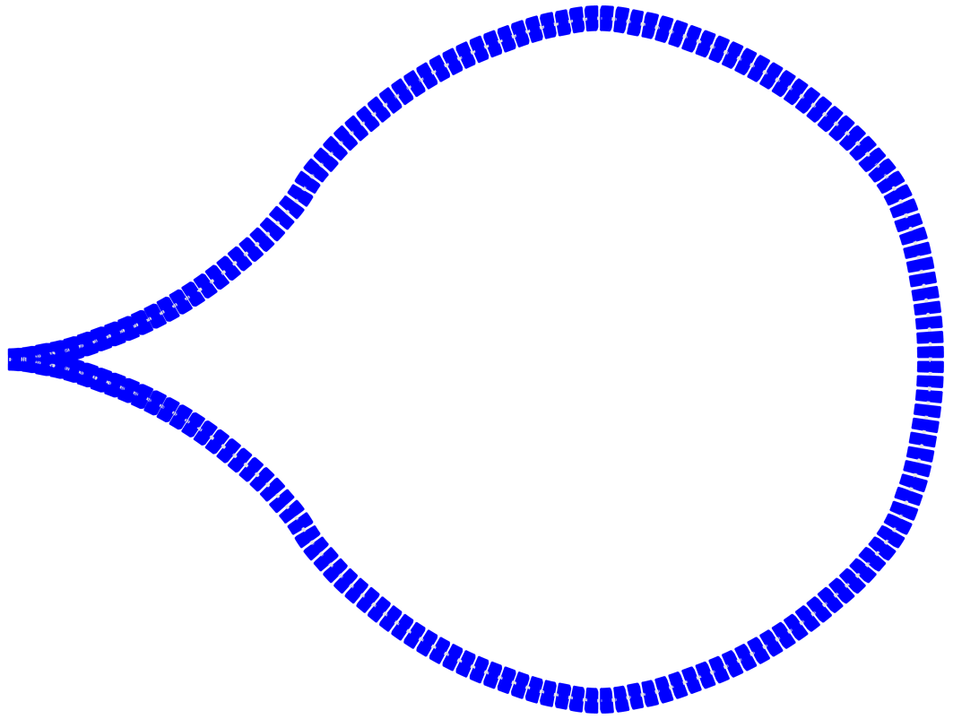
Two-pass Arc Layout
Simple closing of arc geometry when using similar super cells
1.2 / 2.4 GeV/c arc design used as an illustration can be scaled/optimized for higher energies preserving the factor of 2 momentum ratio of the two passes
Droplet arc:
60° outward bend
300° inward bend
60° outward bend
300°
60°
C = 117.6 m
Vasiliy Morozov
<number>
Muon Collider 2011, Telluride, June 30, 2011

Slide 25
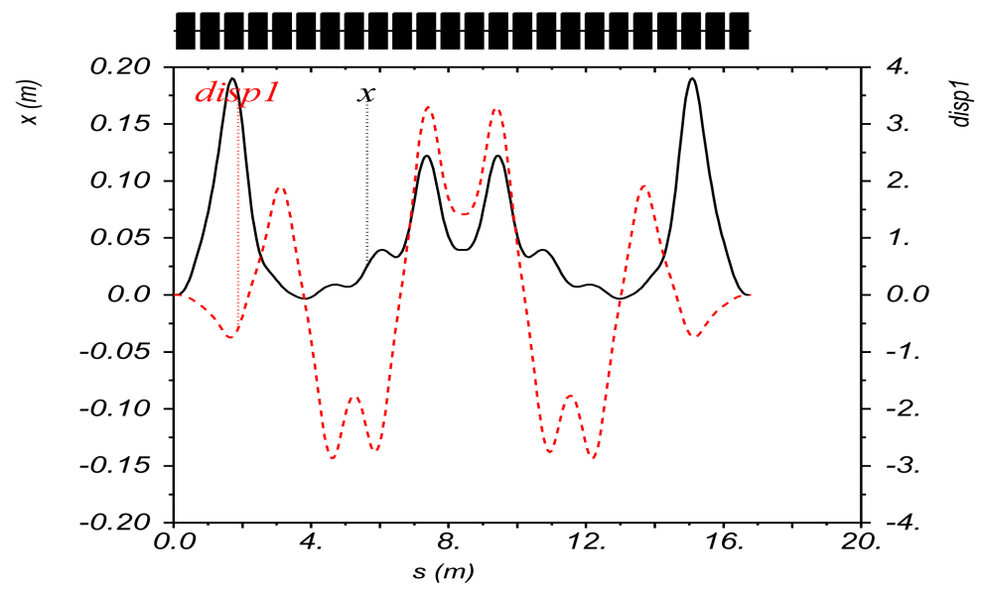
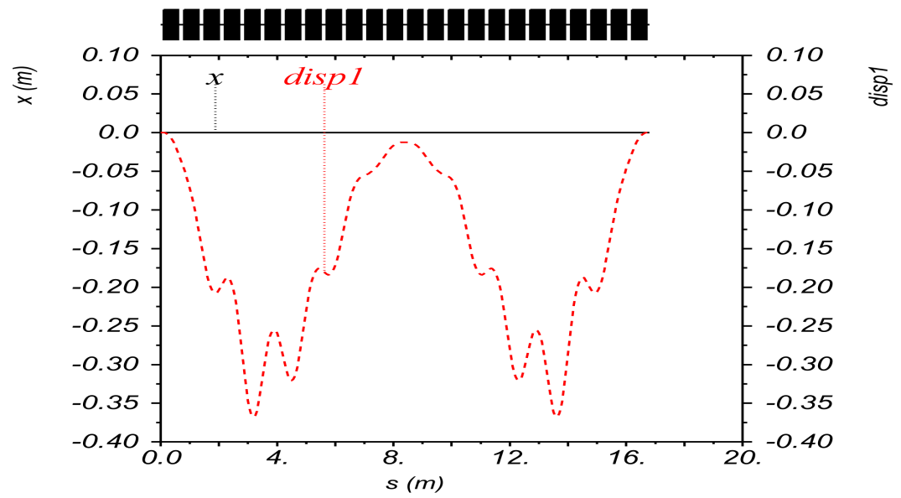
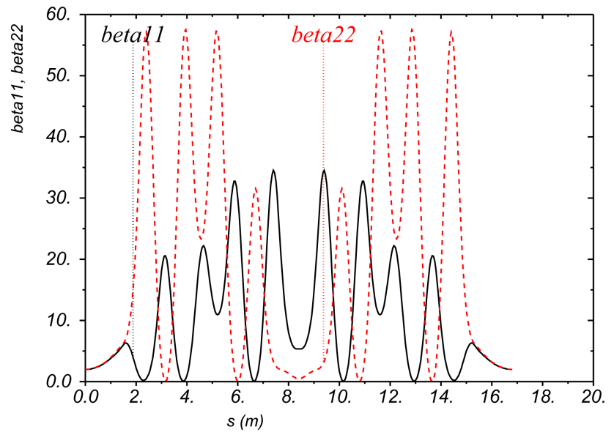
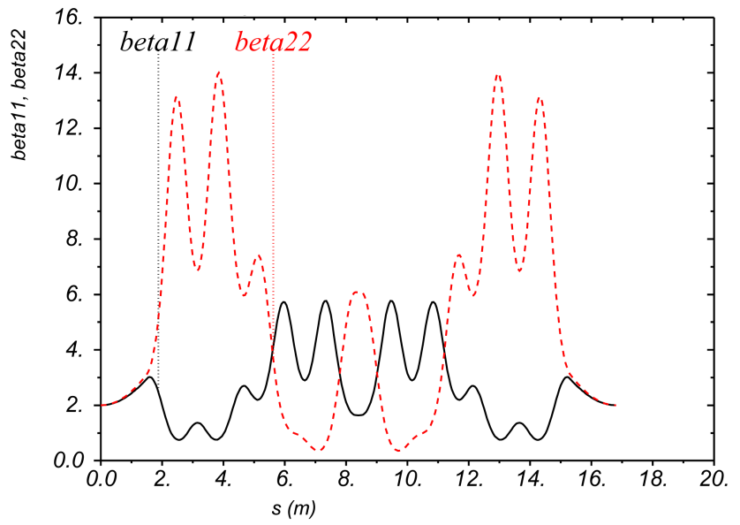
Super-Cell Optics for P₂/P₁ = 2
Each arc is composed of symmetric super cells consisting of linear combined-function magnets (each bend: 2.5⁰)
Vasiliy Morozov
P
2xP
θ = 60⁰
<number>
Muon Collider 2011, Telluride, June 30, 2011

Slide 26
‘Droplet’ Arc − Spreader/Recombiner
First few magnets of the super cell have dipole field component only, serving as Spreader/Recombiner
* Trajectories are shown to scale
B | 1 .7 Tesla
G | 28 Tesla/m
Vasiliy Morozov
<number>
Muon Collider 2011, Telluride, June 30, 2011

Slide 27
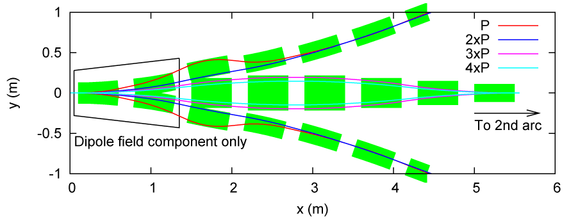
A pair of 2-pass Arcs − Switchyard
Lower momentum arc is the most challenging because of the highest momentum ratio; have a solution but still plenty of room for optimization
* Trajectories are shown to scale
Vasiliy Morozov
<number>
Muon Collider 2011, Telluride, June 30, 2011

Slide 28
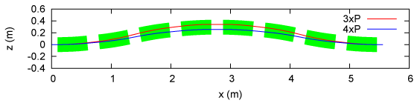
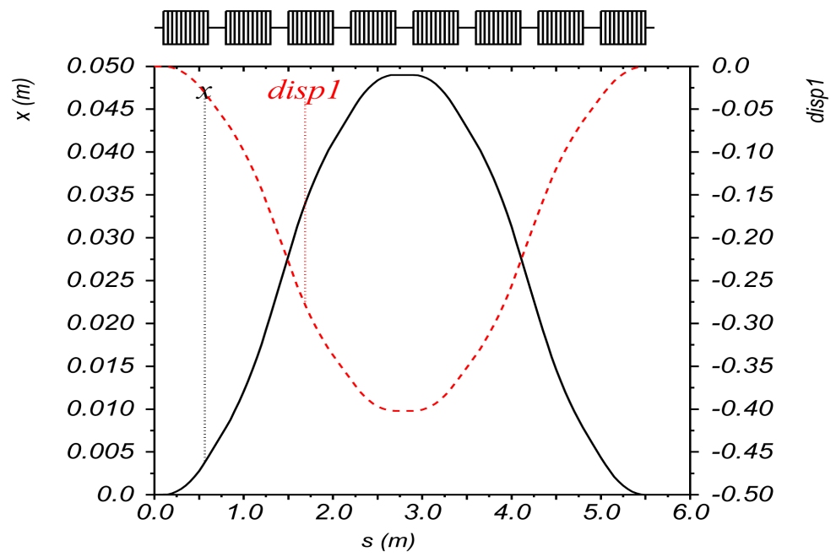
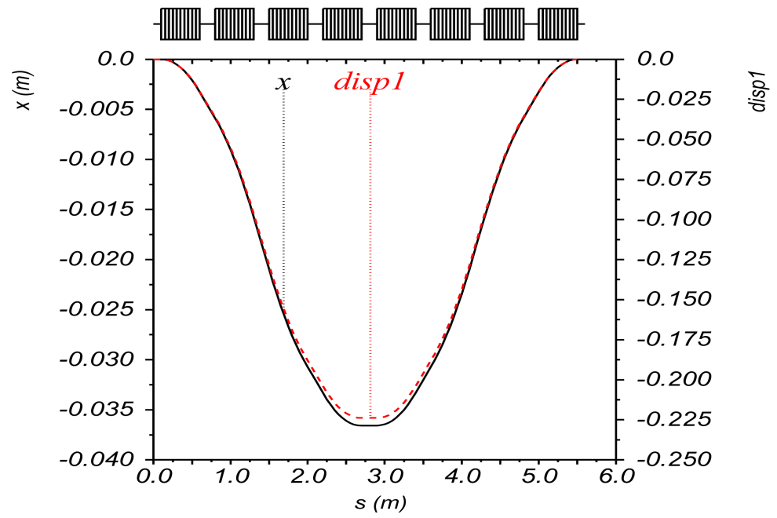
Vertical Bypass Concept
3xP
4xP
Vasiliy Morozov
<number>
Muon Collider 2011, Telluride, June 30, 2011

Slide 29
Advantages of New Arc Design
No need for a dedicated switchyard with spreader/recombiner incorporated into the arc design
Optimization of magnet bending angles in addition to quadrupole components allows for greater compactness and minimal orbit excursion (equal same-direction bends used as initial condition in the optimization)
Greater dynamic aperture and momentum acceptance expected with linear-field lattice
Simpler linear combined-function magnet design
Fully scalable Optics
MULTIPASS MUON RLA RETURN ARCS BASED ON LINEAR COMBINED-FUNCTION MAGNETS, Morozov et al
<number>
Muon Collider 2011, Telluride, June 30, 2011

Slide 30
RLA s with multi-pass Arcs
1.5-12.5 GeV RLA (4.5-pass)
1.5 GeV
2.44 GeV/pass
310 m linac (201 MHz)
12.5-100 GeV RLA (8.5-pass)
12.5 GeV
10.3 GeV/pass
960 m linac (402 MHz)
<number>
Muon Collider 2011, Telluride, June 30, 2011

Slide 31
Summary
MC Acceleration Schemes (1.5 TeV)
High//Low Emittance
Cooling Performance ⇨ Accelerator acceptance
Transmission Efficiencies
Longitudinal matching into a single pass Linac
‘High Transmission’ Acceleration scheme – initial beam dynamic choices
Linac (0.4 – 1.5 GeV)
RLAs (1.5 – 12.5 GeV) and (12.5 – 100 GeV)
RCS Rings
Emerging Acceleration Scheme…
<number>
Muon Collider 2011, Telluride, June 30, 2011

Slide 32
Injection/Extraction Chicane
$Lc = 60 cm
$angH = 9 deg.
$BH = 10.2 kGauss
$Lc = 60 cm
$angV = 5 deg.
$BV = 4.7 kGauss
μ⁺
μ⁺ μ⁻
50 cm
1.7 m
2.1 GeV
0.9 GeV
μ⁺
μ⁻
1.5 GeV
μ⁻
30
1
Double achromat Optics
FODO lattice:
90⁰/120⁰ (h/v) betatron phase adv. per cell
BETA_X&Y[m]
DISP_X&Y[m]
0
-1
0
BETA_X
BETA_Y
DISP_X
DISP_Y
30
H
-H
V
3 cells
-V
-H
H
4 cells
<number>
Muon Collider 2011, Telluride, June 30, 2011

