Slide 1

The Data Reference Model and Intellectual Property 2 November 2006
Federal Data Architecture Subcommittee Co-chairs:
Bryan Aucoin Suzanne Acar
DNI CIO Chief Architect Department of the Interior
703.874.8501 Senior Information Arhictect
bryanja@dni.gov suzanne_acar@ios.doi.gov

Slide 2
Agenda
Basic Data Sharing Concepts
What’s a Document according to the FEA DRM?
FEA DRM Guidance on Privacy and Security
The Way Ahead

Slide 3
FEA DRM Concept
Data Sharing
How do I exchange the data?
Query Points and Exchange Packages
How do I find the data and access it?
What does the data mean?
Data Description
Data Context
Data
Taxonomies
Based on FEA DRM Version 2.0
Notes:
<number>
<footer>
<header>
<date/time>

Slide 4
The DRM Data Strategy Framework
The Rule: All 3
pillars are required
for an effective
data strategy.
Business &
Data Goals
drive
Governance
Data Strategy
Information Sharing/Exchange
(Services)
Data Architecture
(Structure)
Goals drive; governance controls; structure defines; and services enable data strategy.
Special thanks to Laila Moretto and Forrest Snyder, MITRE Corp.
Notes:
<number>
<footer>
<header>
<date/time>
This slide illustrates the Data Strategy Framework. As shown, it consists of Goals, and a data strategy of three components, that is of governance, structure, and services.
Data strategy starts with goals. These goals are business goals and are normally well outside the bounds of the data strategy itself. Business goals include things like “increase market share” and “decrease cycle time”. Business goals drive the data strategy and there are comprehensive methods of translating them into data management goals that support attainment of the business goals. Goals drive the data strategy.
Within the data strategy, we find ourselves dealing with the Structure of our data (which is where a lot of us live and never come up for air). We find ourselves dealing with Services that make the data available and with Governance which establishes procedures, sets standards, and generally specifies how everything fits and works together to meet the corporate goals, so maybe the arrow from Goals to Data Strategy needs to be two ended.

Slide 5
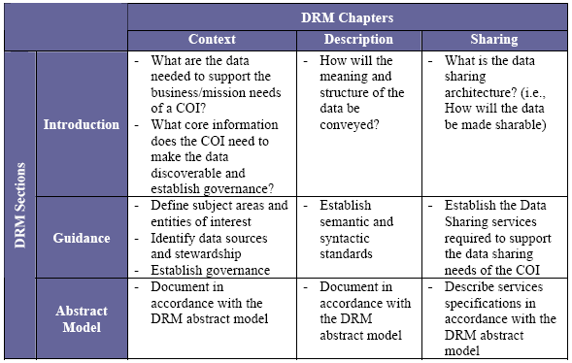
COI and LOB Implementation
Business &
Data Goals
drive
Governance
Data Architecture
(Structure)
Data Strategy
Information Sharing/Exchange
(Services)
Each COI or LOB will implement the
three pillar framework strategy and will
focus on business requirements.

Slide 6
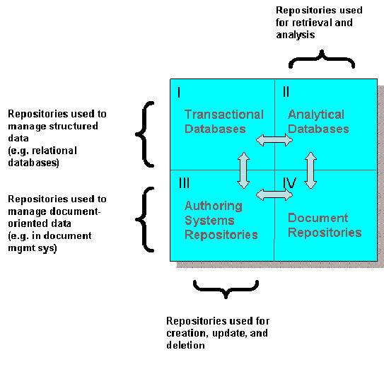
Basic Data Sharing Concepts in the FEA DRM:
Services provisioned depends on the type of data being exchanged.
Data Sharing Services Types:
Data Exchange
Data Access

Slide 7
Basic Data Sharing Concepts: Provision Services for Data
Types of Data Exchange Services:
Extract/Transform/Load (ETL)
Publication
Entity/Relationship Extraction
Document Translation
Types of Data Access Services
Context Awareness
Structural Awareness
Transactional Services
Data Query
Content Search and Discovery
Retrieval, Subscription and Notification

Slide 8
The DRM Definition of a Document
A file containing Unstructured and/or Semi-Structured Data Resources. A discrete and unique electronic aggregation of data produced with the intent of conveying information.
All data within a document may be in the same format (e.g., text), or a document may be a composite that consists of sets of data in a variety of formats (e.g., MS Word files containing embedded graphics).
The term “discrete” implies that a document requires no linkage to other data to convey its meaning.
The term “unique” implies that each instance or version of a document can be distinguished from all others (i.e., it can be assigned a unique identifying number).

Slide 9
The DRM Definition of a Document
Documents may be unstructured
The document follows no rigid, machine interpretable structural convention or it may contain self describing metadata that is machine interpretable.
For example: An ASCII text document
Documents may be semi-structured
The documents conforms to a machine interpretable structural convention or contains embedded self-describing metadata that is machine interpretable.
A Microsoft Word document with headings and sub-headings is considered semi-structured, as is a XHTML document.

Slide 10
Relevant DRM Document Related Data Services
Publication
(Structured data or documents to aggregate documents): Publication is the process of assembling a document from its component pieces, putting into a desired format and disseminating it to target databases. The payload of this type of service is a document.
Document Translation (Document to document)
Document translation is the process of transforming a document from its original format to a format required to support a target application. The transformations may be structural (e.g., transforming MS Word to PDF format), language-oriented (e.g., changing English to French), or special purpose (e.g., the development of abstracts from longer documents.) The payload of this type of service is a document.

Slide 11
DRM Guidance on Quality, Security, Privacy, and Confidentiality
Within A Community of Interest (COI):
Establish Data Stewardship
Define the Policies. Use the following “policy buckets”:
Data is available for open, unrestricted access
Data is accessible only to a group
Data access is a function of the person (his or her identity), data about that person (e.g., current position), and data about the environment (e.g., physical location)
Data is self protecting through digital rights management or similar technologies
Implement the policies within the Data Sharing Services

Slide 12
So…What’s the Way Ahead for Copyrighting and Marking US Government Works?
A FEA Profile that builds on the DRM Constructs:
Notional Components:
Stewards in a COI identify material that needs copyright protection.
Focus on Publication and Translation Services
Tag the documents at publication (e.g. source referencing)
If non-repudiation is needed, sign the documents
(Also what to think about records and records management here.)
If the documents are very sensitive, wrap them in a Digital Rights Management capable package.
Need to agree on voluntary consensus standards for document tagging for copyright.
The Data Architecture Subcommittee can help.

Slide 13
Summary
FEA DRM provides an overarching construct.
While copyright and intellectual property is not specifically addressed, the model can be extended.
Federal level guidance could be addressed in a profile.
The Federal Data Architecture Subcommittee (DAS) is ready to help.

Slide 14

Questions
Notes:
<number>
<footer>
<header>
<date/time>

