Slide 1
RDA Special Topics: Relationship Designators in RDA Name Authority Records (NARs)
Ana Lupe Cristán Policy and Standards Division
Library of Congress
March 2012
Notes:
<number>
<number>

Slide 2
RDA – Appendix K Chapter 29 Guidelines on recording relationships … Related persons – Chapter 30 Related families – Chapter 31 Related corporate bodies – Chapter 32 RDA- Appendix J Chapter 25 – Related works Chapter 26 – Related expressions
Relationship Designators – MARC 21
Notes:
<number>
This section concentrates on the MARC coding not so much the RDA attributes and FRAD/FRBR tasks. That information is in Module F of November’s refresher workshop by Judy Kuhagen as well as Documents R-5 and R-6.
This covers the FRAD task: Relate. In RDA you’ll find the guidelines in Chapter 29 on recording the relationships between Persons, Families and Corporate bodies with more details, description, purpose and scope in Chapters, 30, 31, and 32 respectively for each of these entities.
Generally these are used with terms from Appendix K. Appendix J is used to describe relationships that are described in Chapters 25 and 26, note that these are the same relationship designators used for bibliographic records. Another appendix that has relationship designators is Appendix I – but that contains the list of relationship designators that you use to relate persons, families, and corporate bodies to particular manifestations (bibliographic records) such as: author, contributor, editor, illustrator, etc. Let’s look at this another way [CLICK]

Slide 3
Relationship Designators – Overview
Appendix I
Relates Persons, Families, and Corporate bodies to Works, Expressions, and Manifestations
Used in only bibliographic records
Appendix J
Relates Works, Expressions, and Manifestations to Works, Expressions, and Manifestations
Used in both bibliographic and authority records (formerly known as “see-alsos”)
Appendix K
Relates Persons, Families, and Corporate bodies to Persons, Families, and Corporate bodies
Used only in authority records (formerly known as “see-alsos”)
Notes:
[INSTRUCTOR: read slide and reinforce that these relationships are what used to be called “see- also references” especially when talking about the use on authority records. The point of this slide is to reinforce that Appendix I is only used for bibliographic records (and that this session will not talk about those designators). We will touch on J as that appendix is used for both and we will look more at K as that is ONLY used for authority records]

Slide 4
Appendix I – Reminder: Relationship Designators for Bibliographic Records – Quiz
RDA Bibliographic Record:
100 1# $a Mishima, Yukio, $d 1925-1970, $e author.
240 10 $a Shiosai. $l English
245 14 $a The Sound of waves / $c Yukio Mishima; translated by Meredith Weatherby.
700 1# $a Weatherby, Meredith, $e translator.
Authority Records:
100 1#
___ __ $a Mishima, Yukio, $_ 1925-1970. $_ Shiosai. $_ English
d
t
l
100 1#
___ __ $a Weatherby, Meredith
Notes:
<number>
<number>
And just so that you remember how you use (or that we don’t use Appendix I in NARs).
Let’s start off with a quick quiz. Based on the information in this snippet of a bibliographic record create a Name/Title NAR for this bibliographic record and create an NAR for the translator.
[Instructor - Students should supply MARC tags for the NAR – the point of the exercise is to point out that
we did not carry over the relationship designator from the bibliographic record to either one of the NARs. The answers show up by clicking thru each one]
<number>

Slide 5
Relationship designators (29.5) - Appendix K
K.2.1 Persons to other persons
Alternate identity
Real identity
K.2.2 Persons to families
Family member
Progenitor
K.2.3 Persons to corporate bodies
Employee
Founder
Group member
Incumbent
Sponsor
K.3.1 Families to Persons
Descendants
K.3.2 Families to Families
Descendant family
K.3.3 Families to corporate bodies
Founding family
Sponsoring family
K.4.1 Corporate bodies to persons
Employer
K.4.2 Corporate bodies to family
Founded organization
Sponsored organization
K.4.3 Corporate bodies to corporate bodies
Hierarchical subordinate
Hierarchical superior
Mergee
Predecessor
Product of a merger
Product of split
Successor
Notes:
So as I mentioned earlier the Relationship designators between persons, families, and corporate bodies (formerly known as see-alsos) are found in RDA in Appendix K.
This slide shows you all the available terms to relate these entities one to another.
Note that Appendix K covers other relationships especially for families to persons such as “progenitor” and for corporate entities relationship to persons such as “founder” “employer”, etc. but notice that the terms that we use “earlier/later” are not used to show those relationships – they are now called Predecessor/Successor.
Another reminder that RDA’s Appendix J is used to relate works, expressions, and manifestations and we’ll talk about those later.

Slide 6
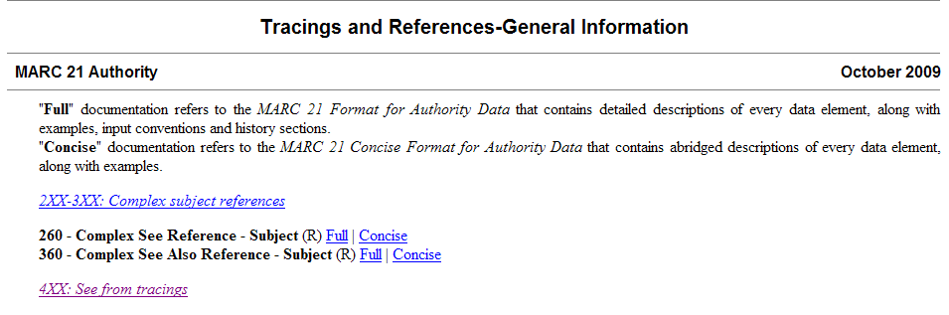
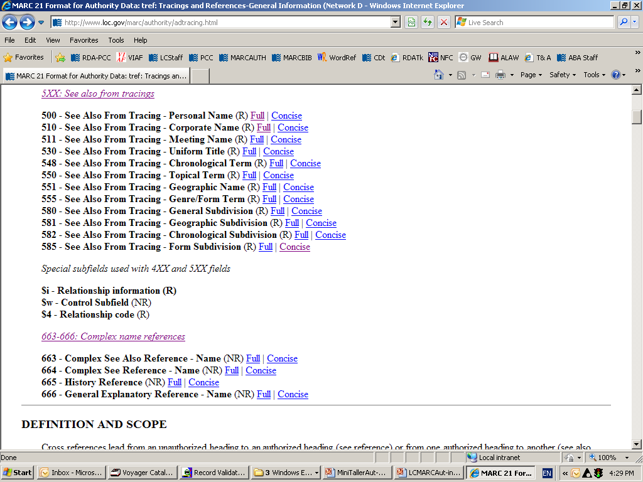
MARC 21 Format for Authority Data
Notes:
In the MARC format on the Tracings and References- General Information section you’ll need to go to the Special subfields used with 4XX and 5XX fields to read the definitions and guidelines for use. That is highlighted here with other information snipped out so that it would all fit on the slide.

Slide 7
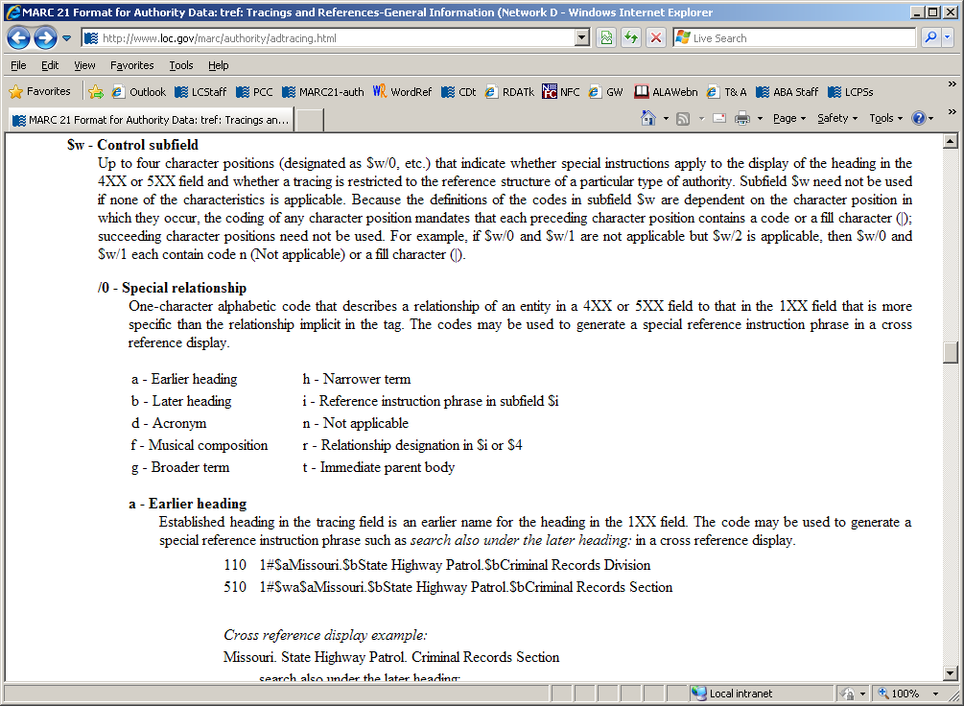
MARC 21 Format for Authority Data
Notes:
This slide show a the MARC 21 page for subfield $w and shows the possible positions for use. Notice position 0 (zero) of the subfield $w. Here are the codes used and their definitions.
The only ones that we currently use in the LC/NAF are code “a”-earlier heading and “b”-later heading; but now we have a new code and the definition: “r” -relationship designation in $i or $4 – LC and NACO catalogers will only supply $i and not use $4 so we are not going to talk about $4.

Slide 8
LC Policy: code “r” and subfield $i
Use of subfield $w/0 “r” and subfield $i is optional
Subfield $w/0 coded “r” must be used in conjunction with subfield $i (code “r” announces the presence of $i)
When using subfield $i capitalize the first letter of the term and add a colon before subfield $a
Do not use $w/0 “r” and subfield $i in 4XXs
Use $w/0 “r” and subfield $i only in 5XXs
Notes:
[INSTRUCTOR: $w/0 should be stated as “Subfield w position zero” - Here are the LC policies for the use of code “r” and subfield $i.
After going over the bullet 2 say] REMEMBER: Terms from Appendix K and J must be used in subfield $i but only if subfield $w contains value “r”. In other words code “r” in position zero of the subfield $w announces that there will be a subfield $i with information on a relationship.

Slide 9
LC Policy: code “r” and subfield $i –Family names
Family names
Use code “r” in subfield $w/0 and add subfield $i with the appropriate term from Appendix K to show family relationships
RDA NAR Example:
100 3# $a Weir (Family : $g Weir, Robert Walter, 1803-1889)
500 1# $w r $i Progenitor: ‡a Weir, Robert Walter, $d 1803-1889
Notes:
If you are creating a Family name and want to add the 5XX to show the relationship to the Progenitor (remember this is an optional addition) you may add a subfield $w/0 coded “r” plus the subfield $i with the Appendix K relationship designator

Slide 10
Example - code “r” and subfield $i –Family names
Subfield $w/0 coded “r” and subfield $i were not intended for use with AACR2 NARs but in order to code a reciprocal NAR they had to be allowed.
AACR2 NAR:
100 1# $a Weir, Robert Walter, $d 1803-1889
RDA NAR :
100 3# $a Weir (Family : $g Weir, Robert Walter, 1803-1889)
500 1# $w r $i Progenitor: ‡a Weir, Robert Walter, ‡d 1803-1889
Reciprocity is not required - but if you want to add this reciprocal information OK – and to an AACR2 NAR!
For family names remember that you must use the authorized form of name of the progenitor
500 3# $w r $i Descendents: ‡a Weir (Family : $g Weir, Robert Walter, 1803-1889)
Notes:
As the slide states subfield $i was only meant to be used with RDA (AACR2 did not have rules for the creation of family names); but because catalogers wanted to link to a person’s name that had been established under AACR2 LC has authorized the use of indicator 3 and of subfield $w/0 coded “r” and the subfield $i with the reciprocal relationship designator. [CLICK to bring in reciprocal 5XX] – The authorized access point for the progenitor means there must be an NAR for the personal name.
[Instructor: IF anyone asks if the date in the 100 for the progenitor should have a subfield $d – remind them that: Subfield d in Family Names is defined for use as the date of the family NOT of the progenitor – therefore not needed]

Slide 11
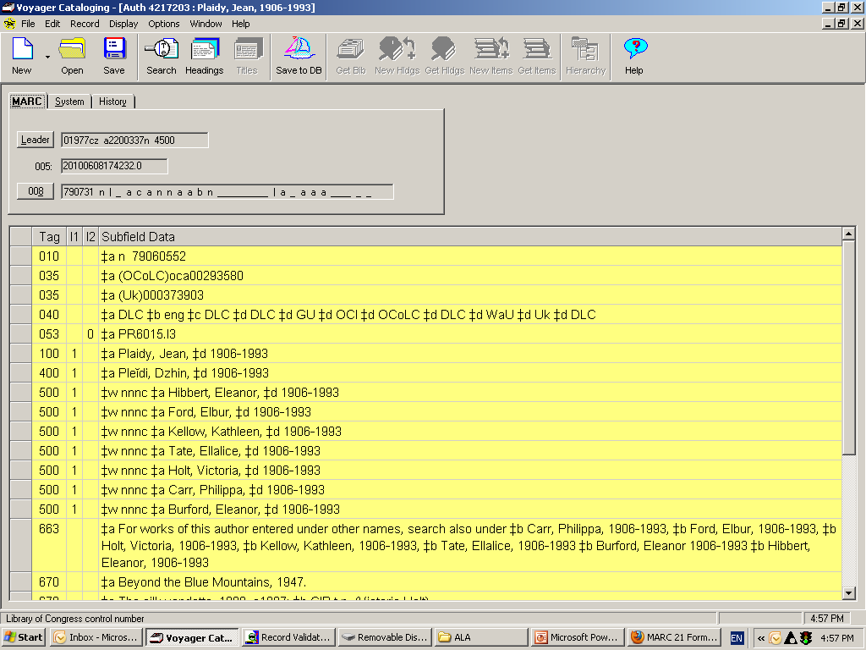
LC Policy for use of code “r” and subfield $i
Personal names – pseudonyms
Do not use $w/0 “r” and subfield $i for multiple pseudonyms.
Use $w nnnc in combination with a 663 note (see FAQ at: http://www.loc.gov/catdir/cpso/pseud.pdf)
Example: n 79060552
92
Notes:
For pseudonyms under AACR2 we use a combination of subfield $w/ position 3 “c” and a 663 note to tie together multiple pseudonyms and we will continue to do that under RDA until we have had the time to discuss with our subject colleagues the impact of undoing the “Basic name” approach to authors with multiple pseudonyms.
Currently under LCSH we need to identify one name for use in biographies, etc. Stay tuned for development on this issue.

Slide 12
LC Policy: code “r” and subfield $i- Pseudonyms
Optionally, for a single pseudonym $w/0 “r” and subfield $i may be used.
Example:
100 1 $a King, Stephen
500 1 $w r $i Alternate identity: $a Bachman, Richard
100 1 $a Bachman, Richard
500 1 $w r $i Real identity: $a King, Stephen
Or, continue to use the simple 500 without subfield $w
For pseudonyms reciprocity is required
both for only one pseudonym and for multiple pseudonyms
this means each name must have its own NAR
Notes:
But for a single pseudonym we now have the option of using subfield $w/0 in conjunction with subfield $i and the terms from Appendix K. Currently we would only use a simple 500 to connect the two names. As you see this is more user friendly and it may be something catalogers will want to use, but again this is still an option.

Slide 13
LC Policy code “r” and subfield $i – Corporate bodies
Corporate bodies (per LCPS 32.1.1.3)
Do not use code “r” and subfield $i in RDA NARs for earlier/later relationships
– Continue to use subfield $w/0 coded “a” (earlier) and/or code “b” (later) in 5XXs to relate corporate bodies
In this case a reciprocal NAR is required for each NAR
Note that PCC libraries are not bound by the LC policy to use earlier/later and starting with the US RDA Test have been creating NARs with relationship designators using Appendix K terms when relating corporate bodies
Notes:
Remind LC catalogers that PCC libraries have been adding Appendix J and especially Appendix K terms in NARs.
While Appendix J terms are easily absorbed into the LC/NAF without notice but, the Appendix K terms are more intrusive as we’ll see in the next few slides.

Slide 14
Subfield $w – Earlier/Later – Corporate bodies
NAR 1
1XX _# $a Body A
5XX _# $w b $a Body B
NAR 2
1XX _# $a Body B
5XX _# $w a $a Body A
5XX _# $w b $a Body C
NAR 3
1XX _# $a Body C
5XX _# $w a $a Body B
Notes:
This slide shows the current example of what we do when Body A changes its name to Body B – We add the “b” in $w/0 of the NAR for Body A and to the NAR for Body B and subsequently we add the $w/0 “a” when Body B changes it’s name to Body C you add another 5XX with $w/0 for the later name and create the a new NAR for Body C with the $w/0.
Just as we have been doing – we are continuing our practice under RDA per LCPS 32.1.1.3.

Slide 15
LC Policy code “r” and subfield $i –Corporate bodies
But, what happens if a later form of a corporate name is needed and the earlier form is in a PCC created RDA NAR with subfield $i and the relationship designators from Appendix K?
Use cataloger judgment
create a new RDA NAR for the latest form of name with subfield $w/0 coded “r” and add subfield $i
or you could go ahead and add the $w/0 a (earlier) and b (later)
Hybrid NARs are OK in this case – this means a mix of MARC content designations is OK not that the headings are hybrid
Notes:
Remember that earlier I said that LC started out saying that code “r” and subfield $i had been created specifically for RDA but we quickly found that these had to be used in AACR2 NARs because there was no other way to make the reciprocal link when connecting to an existing AACR2 NAR – and I showed you the example of a cataloger that wanted to link a person to an RDA family name and the name was already established as AACR2 so we had to allow code “r” and subfield $i not just for RDA NARs.
The same is true for corporate names LC will continue to code for earlier/later relationships but supposing you have a situation where you need a new NAR and there are NARs created by a PCC library using RDA Appendix K and these relationships are not called earlier/later but called “predecessor/successor” – well, as with the family name we have what might be termed a hybrid situation – LC catalogers will have to pull out the old Cataloger Judgment charm and decide on one of 2 choices. Let’s look at the example on the next page.

Slide 16
LC policy subfield $w r and $i – Relationship designator – Corporate body
RDA NAR 1 created by PCC cataloger
1XX _# $a Body A
5XX _# $w r $i Successor: $a Body B
RDA NAR 2 created by PCC cataloger
1XX _# $a Body B
5XX _# $w r $i Predecessor: $a Body A
5XX _# $w r $i Successor: $a Body C
5XX _# $w b $a Body C
NAR 3 created by LC cataloger
1XX _# $a Body C
5XX _# $w r $i Predecessor: $a Body B
5XX _# $w a $a Body B
Notes:
In this case here we see 2 reciprocal NARs created by a PCC cataloger and now the LC cataloger has the need to create a NAR for a later change of name then the cataloger must choose to decide is to follow the pattern used or to make the new NAR with the earlier/later usage – up to you – use your judgment and common sense. In this case hybrid NARs are OK – the hybridness is really just in the mixing of MARC subfielding so we can live with this.

Slide 17
LC Policy code “r” and subfield $i – Corporate bodies
Corporate bodies
Optionally, code “r and subfield $i may be used to relate persons to corporate bodies
Reciprocity is not required
All names used in 5XXs must be established
NOTE: The requirement for the name of the person to be in the name of the group is not in RDA – there is no LCPS
Example of current person to corporate body relationship
110 2# Art Tatum Trio
500 1# Tatum, Art, $d 1909-1956
100 1# Tatum, Art, $d 1909-1956
510 2# Art Tatum Trio
Notes:
This example shows the NAR for the Art Tatum Trio - under the previous LCRI – LC restricted making links between the group and the person unless the person’s name appear as part of the name of the corporate entity and we encouraged reciprocity.
Under RDA there is no LCPS limiting the addition of these relationships – but just as before if you do make those links the names in the 5xx must be established; however reciprocity is not required.

Slide 18
LC Policy: code “r” and subfield $i
Example:
110 2# $a R.E.M (Musical group)
500 1# $w r $i Group member: $a Stipe, Michael, $d 1960-
500 1# $w r $i Group member: $a Buck, Peter, $d 1956-
500 1# $w r $i Group member: $a Mills, Mike, $d 1958 December 17-
500 1# $w r $i Group member: $a Berry, Bill, $d 1958-
670 ## $a Rock on, c1985: ‡b v. 3 (R.E.M. formed 1980; Michael Stipe, vocals; Pete Buck, guitar; Mike Mills, bass, vocals; Bill Berry, drums, vocals; hometown, Athens, Ga.)
Notes:
Example for R.E.M.
In this case making all the relationships to the band members means that you will also have to create authority records for the names of the persons. Continue to rely on 670 information to show that a member has been added, etc.

Slide 19
LC Policy: code “r” and subfield $i – Relationship designators missing from Appendix K
Some relationship designators are one-way – some terms not yet defined in Appendix K
In example below there is no appropriate reciprocal term for group member
100 1# $a Stipe, Michael, $d 1960-
510 2# $a R.E.M. (Musical group)
100 1# $a Buck, Peter, $d 1956-
510 2# $a R.E.M. (Musical group)
Notes:
Here’s a lacuna in RDA; because currently there is no term available to in Appendix K to convey the relationship between corporate body and the person (other than employer) then on the personal name NAR we’d simply have a 5XX without the subfield $i – in other words what we call a “simple” see also.

Slide 20
LC Policy: code “r” and subfield $i
Use relationship designators for persons to corporate bodies with caution
Use relationship designators to relate the corporate body to the person but be wary of the reciprocal relationship.
In the case of a NAR for LC or Disney, etc. it would be thousands of names if you added the relationship designator “Employee” for each person that works there.
Example:
100 1# $a Billington, James H.
510 2# $w r $i Employer: $a Library of Congress
Notes:
Relate the corporate body to the person but be wary of the reciprocal relationship for example in the case of the NAR for the Library of Congress or Disney, or any large institution it would be thousands of names to be added to the NAR if you added the relationship “Employee” for each person.

Slide 21
LC Policy for use of code “r” and subfield $i
All names used in 5XXs should be established
5XXs used on one NAR do not need to be reciprocal 5XXs on the related NAR
110 2# $a Library of Congress
500 1# $w r $i Employee: $a Guiles, Kay D.
500 1# $w r $i Employee: $a Reser, David
500 1# $w r $i Employee: $a Phong, Tran
500 1# $w r $i Employee: $a Sinclair, Linda + a zillion others
Best practice: prefer to use the MARC field 373 to show those affiliated group relationships instead
Example: 100 1# $a Guiles, Kay D.
373 ## $a Library of Congress $s 1958
Notes:
In RDA making the reciprocal 5XX on the opposite NAR is not required – especially in the case of Employer/Employee relationships. A best practice would be to add the 373 to NAR instead of a 510 to the personal name NAR to show the relationship– this is cataloger judgment.
Consider that in the case of a musical group, architectural firm or other corporate body that has 6 or 7 prominent members showing a reciprocal relationship to those persons may be acceptable, but for a large institution that has hundreds/thousands of employees it would be best practice to not make those relationships in the NAR.

Slide 22
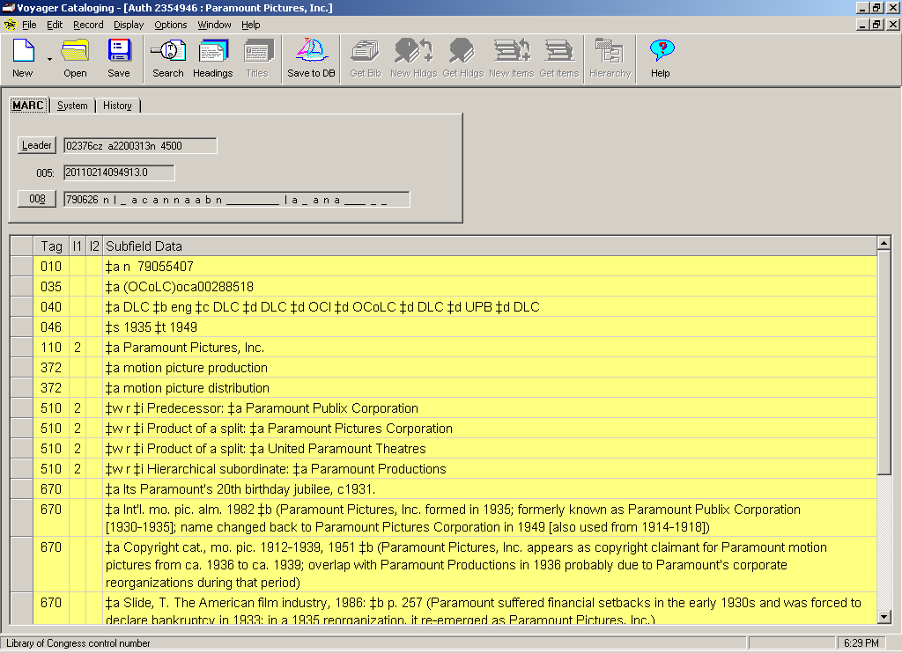
EXAMPLE
M
M
Notes:
So now your saying – I ain’t scared of no relationship designator - but look at this NAR and at the corporate body relationships to other corporate bodies shown here and note the complexity. Me, I prefer the simple earlier/later, but if an institution has the need and time for catalogers to show all these relationships, the use of Appendix K facilitates this – so just be aware of the possibilities.

Slide 23
Appendix J: Relationship designators in NARs
Example:
046 ## $k 1933
130 ## $a Devil’s brother (Motion picture)
380 ## $a Motion picture
500 1# $w r $i Motion picture adaptation of (work): ‡a Auber, D. F. E. $q (Daniel François Esprit), $d 1782-1871. $t Fra Diavolo
670 ## $a The devil's brother, 1933.
670 ## $a IMDB.com, Dec. 27, 2010 ‡b (Devil's brother; motion picture adaptation of Auber's Fra Diavolo produced by Metro-Goldwyn-Mayer and released in 1933)
Notes:
Before we wrap up - I want to quickly show you an example of using terms from Appendix J in NARs for works and expressions – Here is an example of using a relationship designator for Related Works (Work to Work relationship) – The Motion picture is a work and the term used shows its relationship to the opera by Auber. Notice also the 046 subfield $k the date of the creation of the work and the 380 added to show Form of the work.

Slide 24
Appendix J: Relationship designators in NARs
Example:
046 ## $k 1830
100 1# $a Auber, D. F. E. $q (Daniel François Esprit), $d 1782-1871. $t Fra Diavolo
380 ## $a Opera
530 ## $w r $i Adapted as a motion picture (work): ‡a Devil's brother (Motion picture)
670 ## $a Wikipedia, Dec. 27, 2010 ‡b (Fra Diavolo; L'hôtellerie de Terracine; Inn of Terracina; opéra comique by Daniel Auber; based loosely on the life of Michele Pezza; first performed on Jan. 28, 1830 in Paris)
Notes:
This is of course reciprocal on the Name/Title NAR for the work and in this case the term is Adapted as a motion picture (work): and again notice the 046 this time for the creation of the opera based on when it was first performed. These are the same relationships you might make in the bibliographic record but they can also be made in NARs.

Slide 25
Appendix J: Relationship designators in NARs Bonus quiz:
100 1# $a Mishima, Yukio, $d 1925-1970. $t Shiosai. $l English
400 1# $a Mishima, Yukio, $d 1925-1970. $t Sound of waves
670 ## $a Sound of waves, 1994.
336 ## $a text $2 rdacontent
500 1# $w r $i Translation of: $a Mishima, Yukio, $d 1925-1970. $t Shiosai
Reciprocal NAR not very helpful:
100 1# $a Mishima, Yukio, $d 1925-1970. $t Shiosai
500 1# $w r $i Translated as: $a Mishima, Yukio, $d 1925-1970. $t Shiosai. $l English
Notes:
<number>
<number>
One last example for Appendix J in the form of a quiz. So here is the NAR for the name/title – authorized access point for the preferred title. What could we add to this NAR? It’s an expression so we add 1) a 336 for the type of content (field used only for expressions which this is) and 2) a 500 with the relationship designator from Appendix J for Related Expressions – Derivative Expression Relationships: Translation of – NOTICE here that you do not need to add (work) in this case because that is all it could ever be – a translation of a work so no need to repeat.
Note also that in this case the reciprocal NAR is not very helpful (at least in the current scenario) but perhaps in the future… – the point is that some PCC institutions are making these relationships in NARs now so you will see these in the LC/NAF.
<number>

Slide 26
QUESTIONS? LChelpforRDA@loc.gov

