Slide 1
Building Your
Bag of
Tricks
Presented by:
Rhonda K. Hedges
Principal

Slide 2
5% - 7%
FBA
Agency Support
Judicial System
Intensive Strategies
Mental Health
15% - 20%
SST
FRC
Targeted Strategies
Social Skills
Guidance
70 %– 75 %
Universal Strategies
CHAMPs
First Days of School
Discipline with Dignity

Slide 3
What happens when we do not have a plan for misbehavior?

Slide 4
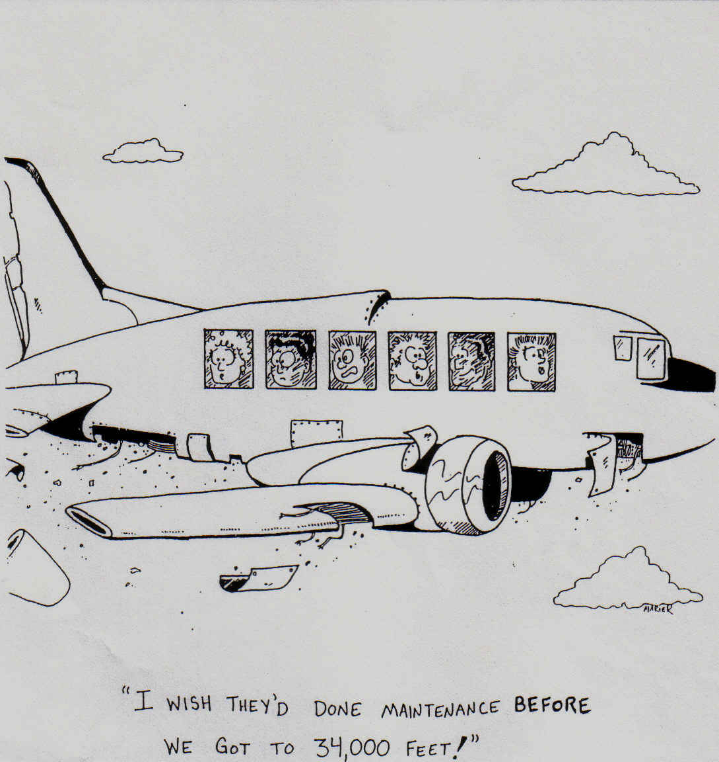
Airplane cartoon

Slide 5
OUTCOMES
Be prepared to categorize misbehaviors as mild/early, moderate, or severe stage
Begin to analyze if the misbehavior is due to: awareness, ability, attention-seeking, or purposeful/habitual issues
Be prepared to name a basic correction strategy (approach) for each category.
Notes:
When we become frustrated, it’s human nature to say to students, “I’ve done everything I can to help you. Why are you doing this? Why are you doing this to me?
Do not take student misbehavior personally. If we do, we cannot be objective enough to help our students.
The better prepared we are to deal with misbehavior, the less frustrated we will be.
The first step in analyzing behavior is to look at the behavior.
Most of the time we make a guesstimate at what the problem behavior is and what’s causing it. Don’t worry, if we get it wrong, he will be back tomorrow. We get to do it all over again.
Read slide.
This is important because it will help you plan the type of corrective procedure based on your “guestimate” and/or the function of the behavior. Refer to handout (function)
Most classroom misbehaviors are not pathological. Meaning- there are not deep-rooted emotional problems. How many of you have said, “He’s doing that just to get attention?” There is nothing wrong with some amount of attention-seeking behavior.(I.e.all eyes on me).
Kids want attention and do just about anything to get it. Even it that means they have to misbehave to get it.
If you’re having difficulty with the whole class or a few and if students are just beginning to misbehave (to get attention) or have been driving you crazy for a while, check:
Classroom rules. Are kids beginning to break the classroom rules. If so, start there and analyze your own rules. Are they clear? kids understand them? Have you modeled and practiced? Do you have consequences both punitive and positive that are enforceable and are you being consistent?
Do this before you decide, “That’s it, this kid is driving me crazy. There’s something seriously wrong with him (Show cartoon)..

Slide 6
Mild/Early
Stage Problems
Habitual/Long Standing Problems
Middle Stage Problems
Awareness/ or ability
Attention Seeking
Power/ Revenge
Develop & Implement an Intervention

Slide 7
Severe-Habitual/Long-Standing Problems
When chronic misbehavior does not stem from a student’s lack of awareness or ability, and is not being exhibited because the student wants attention, then you need to assume that the behavior is now habitual/long standing and is serving some other purpose for the student.
Student loses control/ others may be physically threatened
Teacher doesn’t feel he/she can teach when the student has the problem
Long history of having the problem
Notes:
Have participants call out misbehaviors to compare with moderate and early stage misbehaviors.
Use playing cards or another strategy to call on participants.

Slide 8
Habitual/Long-Standing Problems
Establish a structured system for reinforcing appropriate behavior and providing a consequence for inappropriate behavior
With student create a list of reinforcers
Set up a procedure for monitoring behavior
Create a reinforcement menu
Establish appropriate consequences for misbehavior
Give student increased praise and attention for managing himself/herself well.
GET ENTHUSISTIC !!!

Slide 9
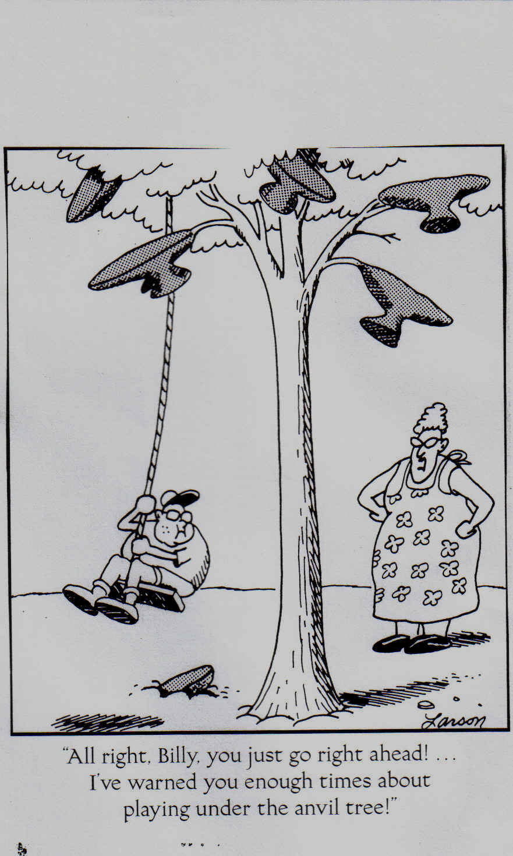

Slide 10
Moderate Misbehaviors
Gone on for several weeks or for longer intervals of time
Teacher feeling frustrated
Student is always “pushing the boundaries”
Notes:
Despite discussions and mild verbal reprimands the problem persists: talking, out of seat, whining tattling

Slide 11
Early-Stage Misbehavior
For “Early-Stage” misbehaviors, be prepared to respond with one of a variety of correction strategies that are designed to provide information.
Student is irritating or annoying
Behavior doesn’t interfere with teaching
Student isn’t motivated
Notes:
One of the basic premises of this module is that preplanning how you will respond to misbehavior will make your corrections more effective, will cut down on being reactive and will give you more confidence.
Rule one for early stage misbehaviors: Always try the most simple correction first with consistency for at least two weeks. For most behaviors-especially- early stage it is the consistency that makes the difference, not the severity of the consequence. (Barbara Colaroso- Say what you mean, mean what you say and do what you said you would do.) Be the broken record.
The problem is that we are not consistent and the kid catches us on a bad day, when we’ve had enough and bam! We use a chainsaw when a simple screwdriver would have worked. (show the cartoon)

Slide 12
Early Stage /Mild Problems
Student should be made aware of the problem
Set a goal with student to change the behavior
Respond consistently to the inappropriate behavior
Signals
Verbal Reprimands
Consequence
Use reinforcement to encourage appropriate behavior
Frequent non-contingent attention

Slide 13
Menu of Early-Stage Corrections
Proximity
Gentle verbal reprimand
Discussion
Family Contact
Humor
Praise someone behaving responsibly
Restitution
An emotional reaction
Use planned Ignoring
If behavior is severe and/or affects other students, implement consequences
If other students give the target student attention, gently correct them.
Use reinforcement to encourage appropriate behavior
Use frequent praise and attention
Use intermittent reinforcement
Ensure a 3 to 1 Ratio of positive to negative

Slide 14
Awareness Type Misbehaviors
For ongoing misbehavior that stem from students’ lack of awareness of when/how much they are misbehaving, be prepared to develop and implement an intervention plan that includes increasing their awareness of their behavior.
Notes:
Have the participants brainstorm various Habitual/Long standing problems and call them out – Put on poster paper and flip so they cannot see – to later be displayed.
When the student isn’t aware of when or how he is engaging in irresponsible behavior then our job is to increase the student’s level of awareness of the behavior.
Using corrective procedures or punishers is not appropriate.
Give example of an awareness behavior (grunting or groaning, being out of seat a lot, blurting out)
Often students are unaware of misbehaviors due to our inconsistency. (with one teacher it is OK to get out of seat, sharpen pencil, talk etc. With another it is not)
If we are serious about helping students learn new behaviors due to awareness problems we must adopt the instructive attitude. Teach social skills, model the expected behavior, practice the new behavior and give feedback on correctiveness of the behavior. (Show the cartoon) This is not the instructive attitude.

Slide 15
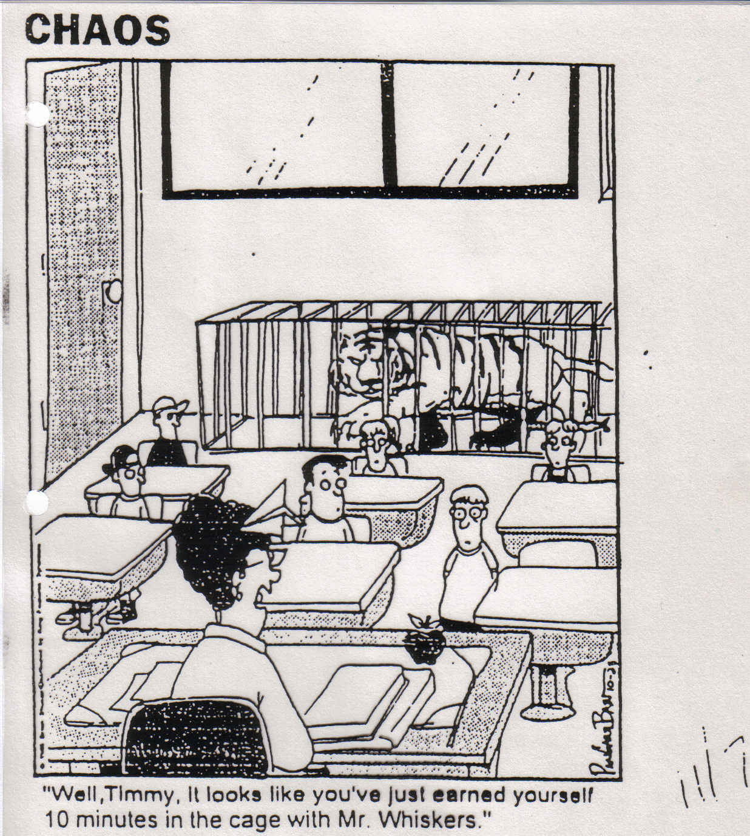
Awareness Type Misbehaviors

Slide 16
Problems of Ability or Awareness
Conduct Lessons to help the student learn and how to exhibit the appropriate behavior
Make accommodations
Change structure
Develop Goal Contract
Overt Expectations (“No Talking” or “Talking)
Create a limit (tickets, points, etc…)
Teach Self Talk
Create Self Monitoring or Self Evaluation system
Create Prompts
Prompt by using precorrection

Slide 17
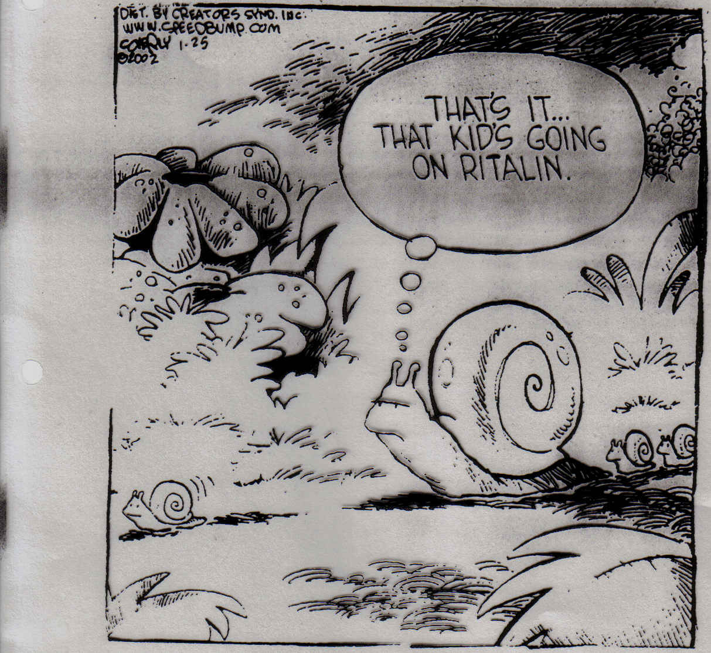

Slide 18
Power/Revenge Problems
Respond Consistently
Clarify difference between positive and negative behavior
Determine a consequence to implement every time the student engages in the negative behavior.
Calmly implement a consequence every time
Don’t show your frustration when the student exhibits the negative behavior – simply invoke the consequence
Identify a positive trait for describing the positive behavior (even the absence of the negative behavior) e.g., “positive leadership”
Praise the student for participating in positive ways
Use the word powerful when describing the plan to the student
Move the student into a position of Positive POWER

Slide 19
Attention –Seeking Problems
Respond Consistently to the inappropriate behavior
Use planned Ignoring
If behavior is severe and/or affects other students, implement consequences
If other students give the target student attention, gently correct them.
Use reinforcement to encourage appropriate behavior
Use frequent praise and attention
Use intermittent reinforcement
Ensure a 3 to 1 Ratio of positive to negative

Slide 20
PLANNED IGNORING
I’ve Decided To Use Planned Ignoring
What behaviors will I ignore?
What behaviors will I give a corrective consequence?
What behaviors will I encourage?
Notes:
Blurting out, hitting others, raising hand

Slide 21
What do you notice about…
Mild/Early Stage Problems
Middle Stage Problems
Habitual/Long Standing Problems
Notes:
Many/all of the problems are the same regardless if they are longstanding, moderate or early stage. If we do not analyze all problems will be treated the same and the interventions that we choose will not be effective.

Slide 22
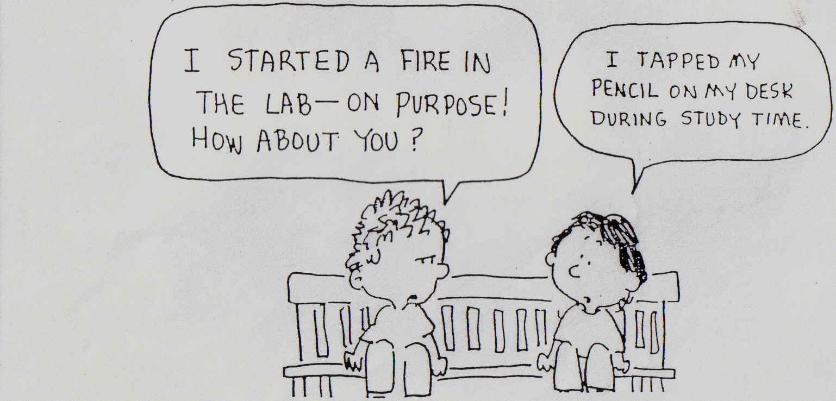
Make the punishment fit the crime

Slide 23
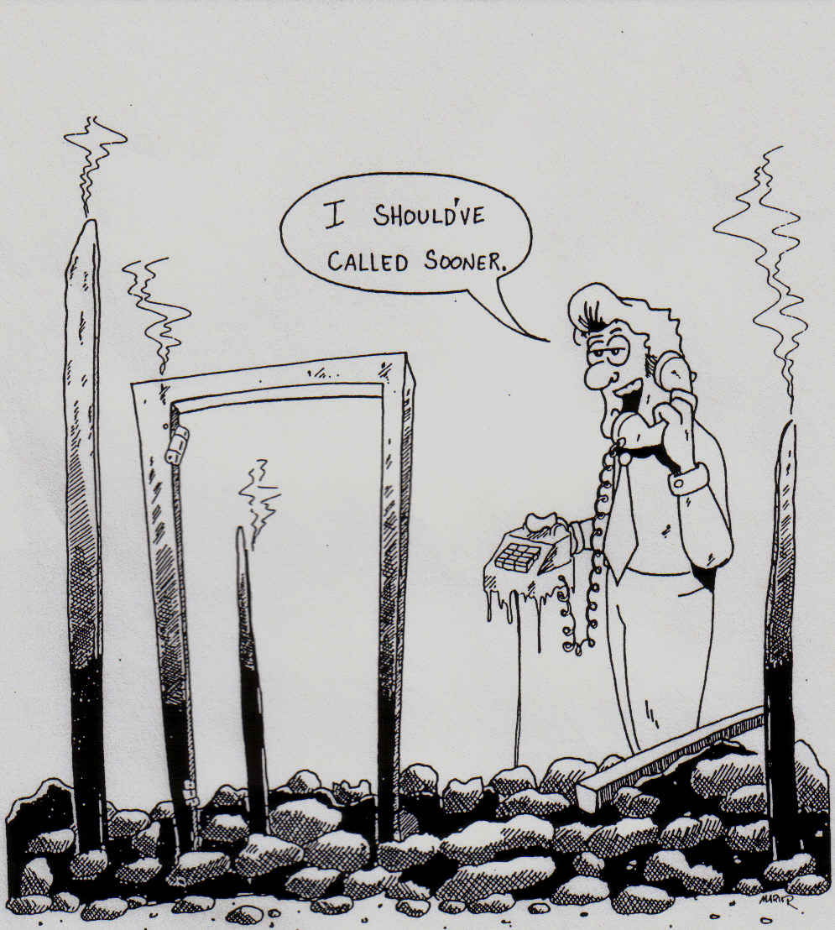
Begin interventions at the early stages of misbehavior
Notes:
Use the simplest intervention you can, be consistent and continue for a good long period of time.

Slide 24
Have you attended meetings on students and left feeling like nothing was accomplished?
Was the meeting…
Unfocused with no clear agenda
A gripe session about students and/or their parents
Participants spend time trying to find a consequence that will “make” the student behave responsibly

Slide 25
?
?
?
?
?
?
?

Slide 26
How do you sell the idea of team planning to frustrated staff members?
TIME

Slide 27
25 Minutes
=
a Plan

Slide 28
Team Members
Leader
Recorder
Time Keeper or Timer
Parent Optional

Slide 29
Background
STEP 1:
(Six Minutes)
Describe the problem (when, where, how often, how long, etc… the problem occurs.
Identify student STRENGTHS
Identify strategies already tried

Slide 30
Problem and Goal
STEP 2:
(Two Minutes)
Narrow the scope of the problem and identify a goal.

Slide 31
Corrective Consequences
STEP 3:
(Two Minutes)
Determine whether irresponsible or inappropriate behavior will be corrected, ignored, or whether a consequence will be implemented.

Slide 32
Responsible and Irresponsible Behavior
STEP 4:
(Four Minutes)
Provide examples of responsible and or student strengths to encourage. Provide examples of irresponsible behavior to discourage. (T-Chart)

Slide 33
Proactive Strategies
STEP 5:
(Four Minutes)
Brainstorm strategies to encourage responsible behavior (Don’t evaluate).

Slide 34
Proactive Plan
STEP 6:
(Three Minutes)
Select a manageable set of proactive strategies to implement.

Slide 35
Final Details
STEP 7:
(Four Minutes)
Evaluate: Identify at least two ways to determine if the plan is working.
Support: Identify things other adults can do to assist the student and teacher.
Plan Summary: Identify each person’s responsibilities and when actions will be taken. Identify who will discuss the plan with the student.

Slide 36
Teamwork = 25 Minutes
Assign roles to members of the group
Leader
Recorder
Time Keeper or Timer
Parent Optional
Read your Background information in your packet (Have one person read orally).
Complete the 25-minute Intervention Plan for your student
Please put Step 6 & 7 on the Poster-paper under the heading for your student.

Slide 37
Items to put on Your Poster
Steps from the 25-Minute Intervention Plan
Step 6: Proactive Plan
Select a manageable set of proactive strategies to implement
Step 7: Final Details
Identify at least two ways to determine if the plan is working
Support ( Identify things other adults can do to assist the student and teacher – be specific who, what, where, when).
Plan Summary– Identify who is responsible and when the actions will be taken
Who Responsibilities Dates

Slide 38
Gallery Walk
Take Note of the following:
Do plans differ from team to team.
Look for plans that are new to you.
Make notes on particular question you have about a particular plan.
Be able to identify problem behavior.

